Slide 1




ADManager Plus
Access Certification Campaign
Preventing privilege creep and meeting compliance requirements

Slide 2

Imagine a world where managing user access is streamlined and efficient. With today's digital security demands, wouldn't it be amazing to have a structured process that guarantees the right access for every user?
ADManager Plus' access certification campaigns offer a structured process to ensure the rights and privileges assigned to users are accurate and up-to-date

Slide 3
Why do organizations need access certification campaigns?
Mitigate access-related risks
Ensure compliance
By regularly reviewing and certifying access rights, organizations can demonstrate compliance with regulatory requirements and industry standards, avoiding penalties and legal consequences
Access certification campaigns ensure that access rights align with organizational policies, reducing the risk of unauthorized access and potential security breaches

Slide 4

ADManager Plus' Access Certification Campaign
An access certification campaign is a process that involves reviewing and validating users' access rights and privileges
Access certification campaigns can be utilized to recertify and revoke users' access rights and implement the principle of least privilege and role-based access control
With the access certification campaigns in ADManager Plus, user access rights can be validated in bulk, resulting in improved operational efficiency

Slide 5




Components of
access certification campaign
Certification campaigns
Certifier
Audit campaigns that can be scheduled and prioritized according to the entitlements to be assessed
A key stakeholder in the procedure responsible for reviewing and managing users' access permissions. The role of a certifier may be fulfilled by an administrator, help desk technician, a user's manager, or tailored according to the organization’s requirements
Entitlements
Users' group memberships and access permissions that will be validated by the certifier
Certifier assigning rules
Rules that can be configured to dynamically assign certifiers for the audit campaigns

Slide 6
Campaign creation
The campaign creation process in ADManager Plus involves defining the campaign details, selecting the entitlements and objects for review, choosing certifiers and scheduling the campaign, configuring settings, and reviewing the summary of the campaign settings
STEP 1
STEP 2
STEP 3
STEP 4
STEP 5
Describe the campaign details
Specify the entitlements and objects to be reviewed
Assign certifiers and schedule the campaign
Configure custom settings for the campaign
View the summary of the campaign

Slide 7
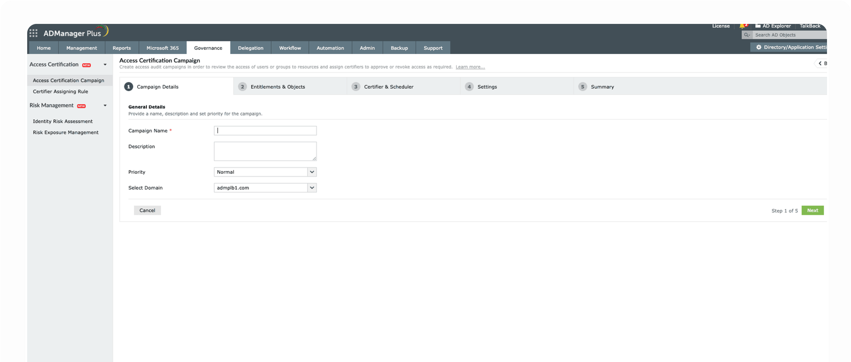
Campaign details
Set the name, purpose, and priority for the campaign

Slide 8
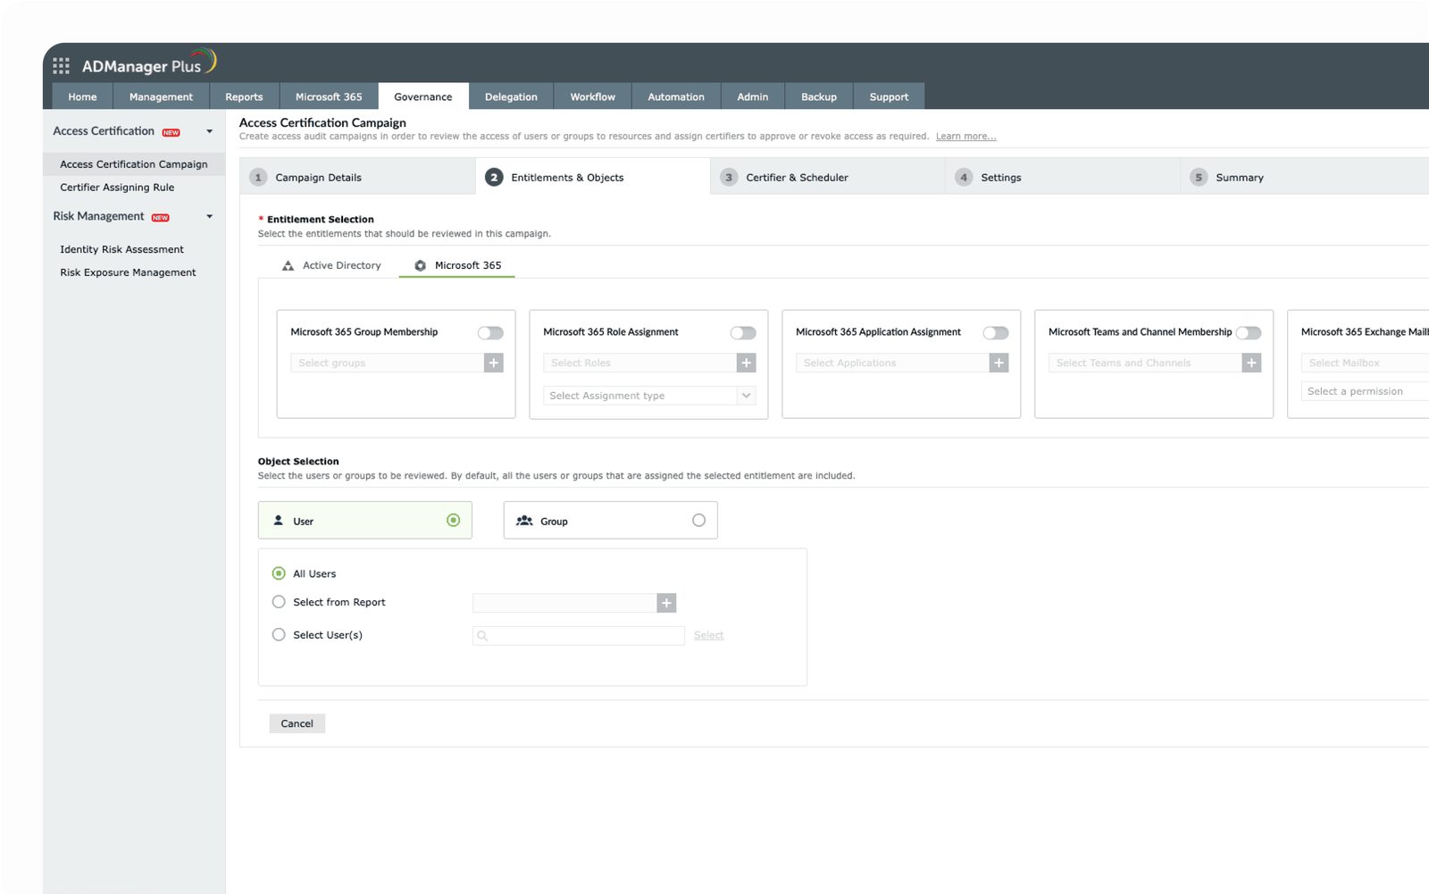
Entitlements supported
ADManager Plus allows you to review the following entitlements:
AD entitlements
Group memberships
NTFS permissions
Microsoft 365 entitlements
Group memberships
Role assignments
Application assignments
Microsoft Teams channel memberships

Slide 9
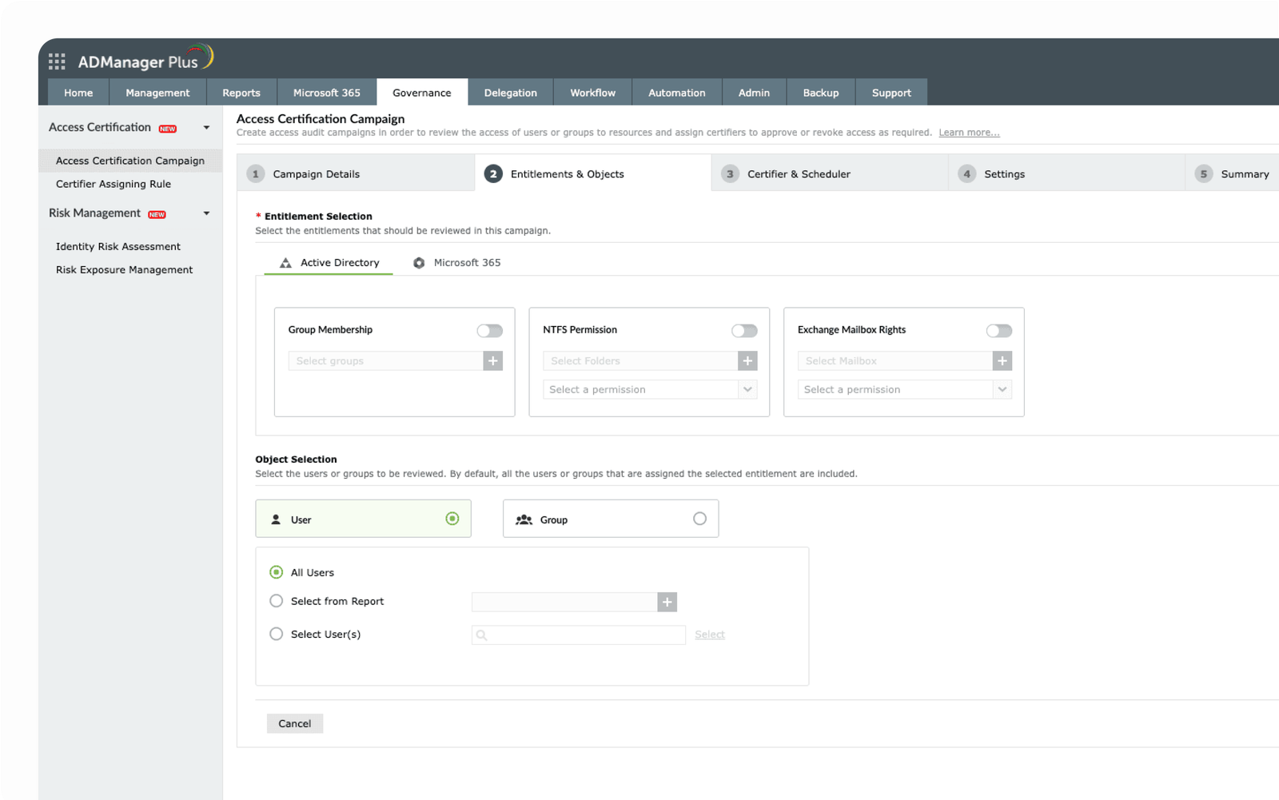
Entitlements supported
ADManager Plus allows you to review the following entitlements:
Exchange entitlements
Exchange mailbox rights (both on-premise and cloud)

Slide 10
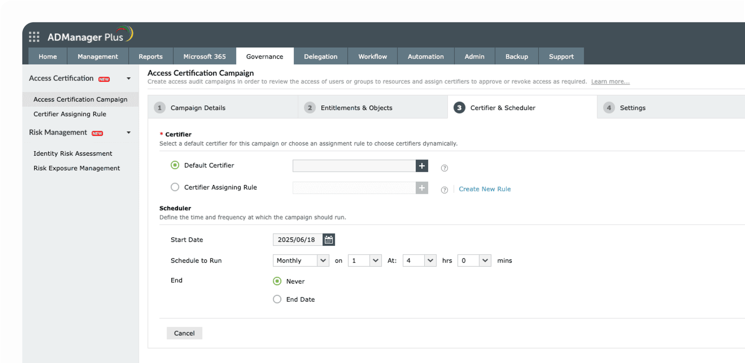
Assigning a certifier
Select a certifier for the campaign and schedule the process to run automatically
You can select any one of the technicians as certifiers to review the access request and they will be assigned by default once the task is created
You can schedule the campaign to run automatically at preferred intervals (i.e., weekly, monthly, quarterly, semi-annually, annually)

Slide 11
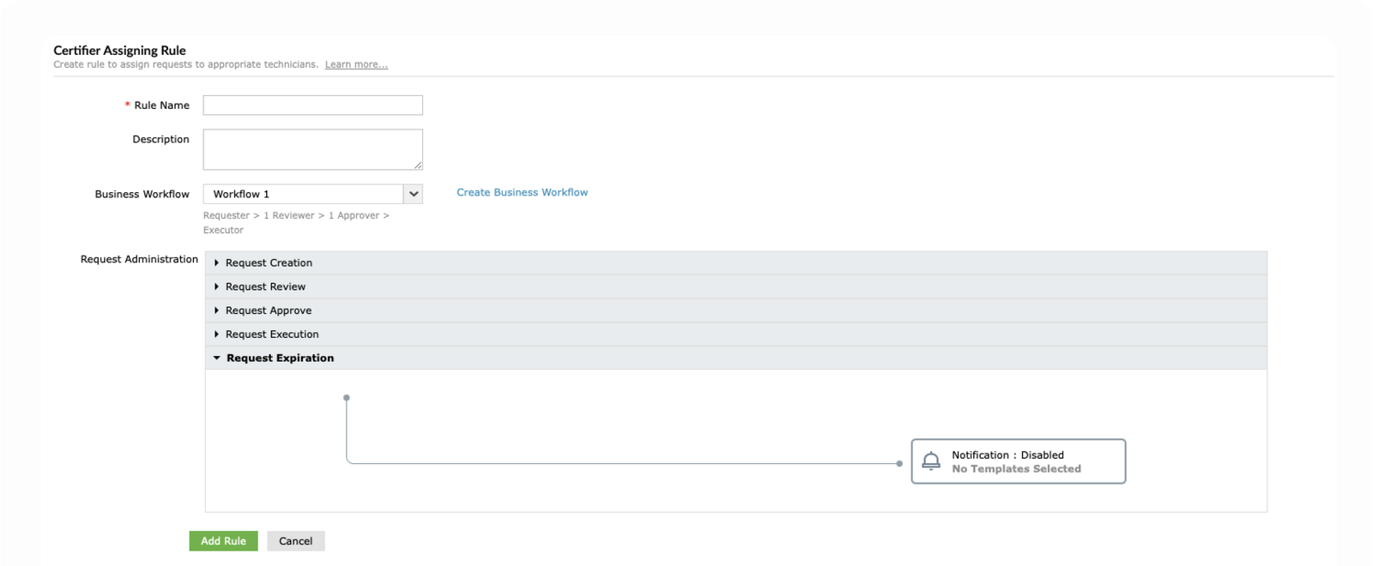
Certifier Assigning Rule
The Certifier Assigning Rule will dynamically assign technicians as certifiers for access review campaigns based on the conditions specified
Admins can also configure a workflow with reviewers, approvers, and executors through which the requests need to be reviewed

Slide 12
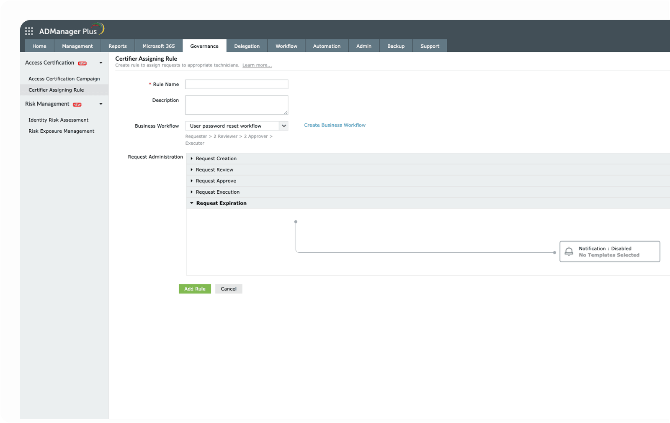
Customize your campaign
Configuration
Customize the access certification process by mandating comments for approval and revoke operations, preventing self-certification, and enabling bulk certifications for efficient management of access permissions
Campaign settings
Configure actions for certification requests that have not been reviewed upon campaign completion, including setting request expiration time, sending reminders to certifiers. Define default actions for approved or unapproved requests, such as taking no action, approving all, or revoking all

Slide 13
Benefits of ADManager Plus' Access Certification Campaign
Compliance readiness
Elevated security
Prevent privilege creep
Adhere to regulatory requirements and organizational policies by maintaining a verifiable record of access reviews and modifications
Mitigate the potential for unauthorized access by identifying and revoking users' unnecessary access rights
Review access permissions regularly to prevent the accumulation of privileges, leading to a more efficient and manageable access control system
Mitigated insider threats
Efficient resource management
Improved efficiency
Regularly review users' access rights to identify and revoke unnecessary privileges, thus deterring malicious insider activities
Streamline access management processes by running automated campaigns to identify and revoke access for over-privileged accounts
By reviewing and revoking users' access to enterprise resources and group memberships, organizations can effectively lower license and subscription expenses

Slide 14











Streamlined identity life cycle management
Multi-level business workflows
Secure data backups and recovery
200+ pre-packaged reports
Why
ADManagerPlus?
ADManager Plus: Your go-to IGA tool
Template-based, event-driven automations
Integration with popular SIEM, HCM, ITSM and help desk tools
Periodic access certification campaigns
iOS and Android mobile apps for on-the-go management
Explore ADManager Plus' full potential! Sign up now for a free product demo to explore additional features and functionalities
Register here

Slide 15



GOT
QUESTIONS?
Reach out to us
support@admanagerplus.com
manageengine.com/products/ad-manager/

