Slide 1


Improve productivity,
assess identity threats, and achieve compliance
with ADManager Plus' reports

Slide 2

What's inside?
ADManager Plus' report library
The custom report builder
How to run custom reports
Risk assessment reports
How does it work?
Compliance and ADManager Plus
How ADManager Plus' reports helped Essentia Health
Additional capabilities
01

Slide 3

ADManager Plus' report library
Access over 150 built-in reports with different categories covering AD, Microsoft 365, and Google Workspace
Manage objects right from within the reports
Avoid missing out on critical insights by scheduling reports to run automatically at specified time intervals
02

Slide 4
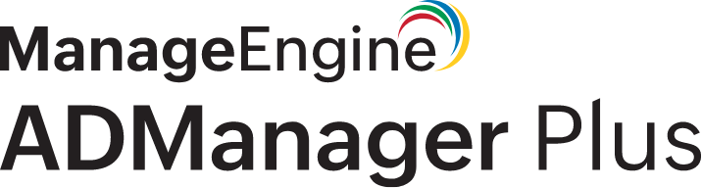



ADManager Plus' report library
Active Directory reports on
Microsoft 365 reports on
Google Workspace reports on
Users
Passwords
NTFS permissions
And more!
Users
Security
And more!
Active users
Suspended users
03

Slide 5
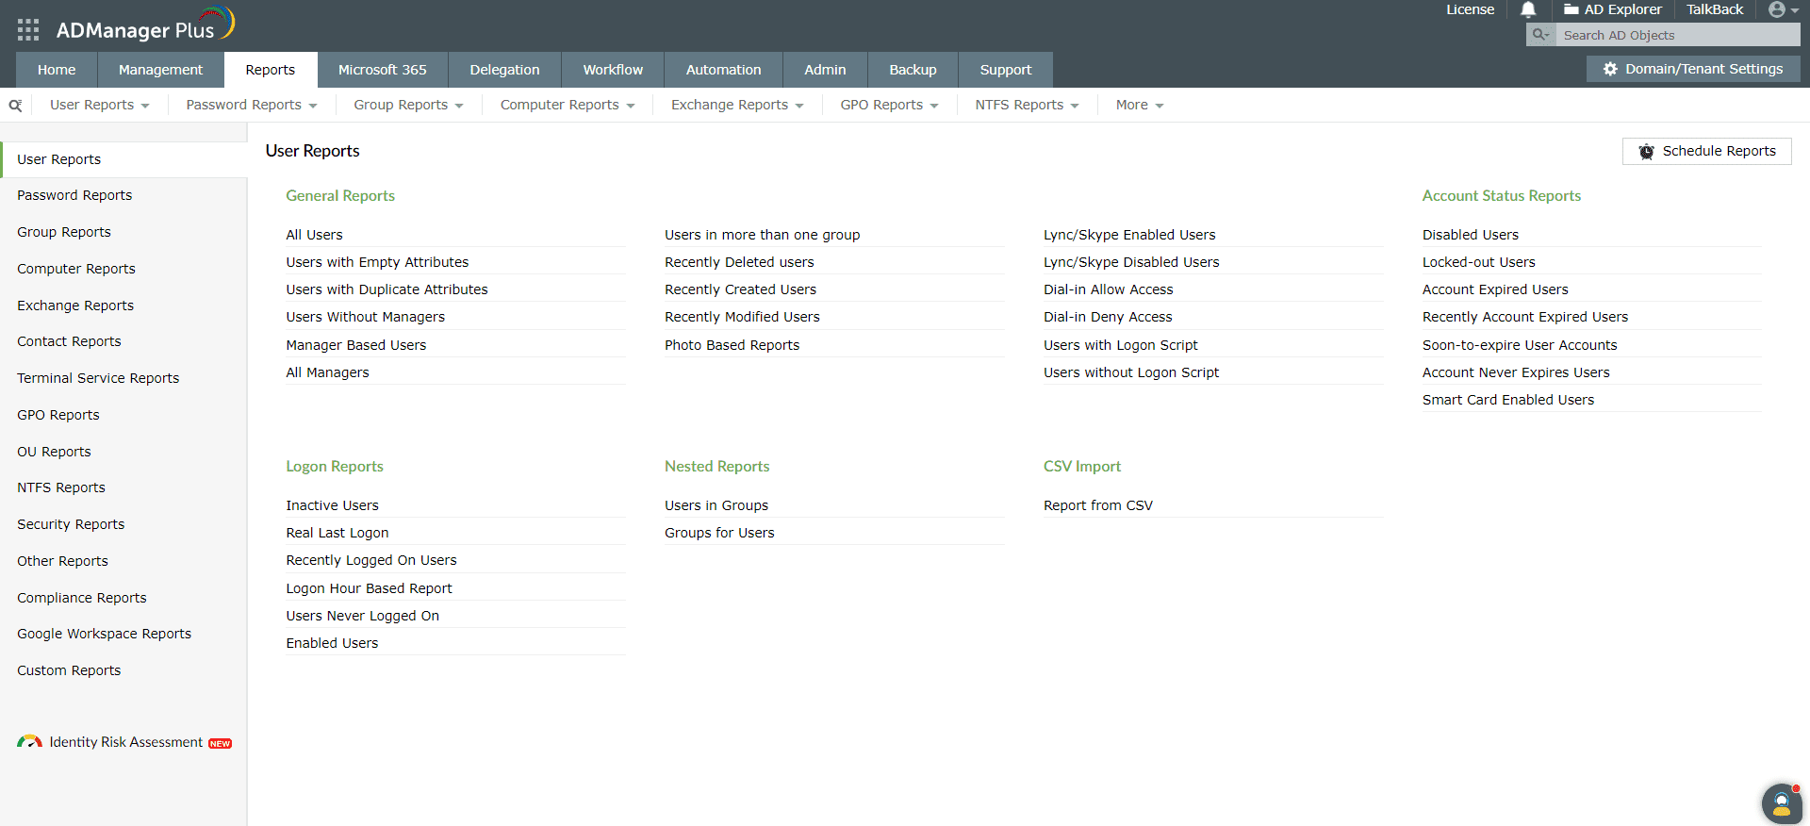
Get a glimpse of the different types of reports
Schedule reports to be sent via email
04

Slide 6
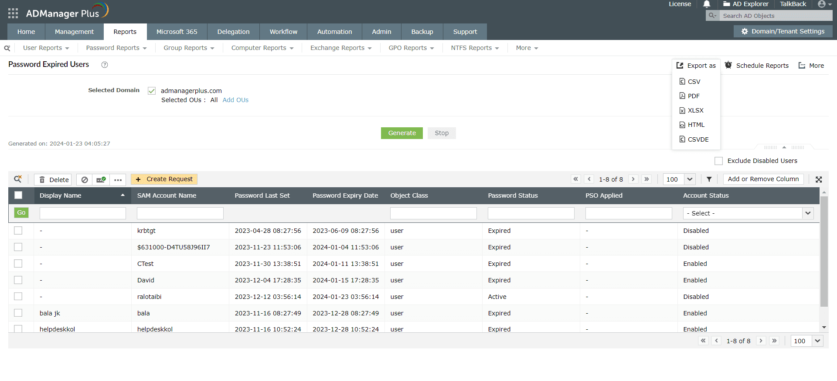
Export the reports in convenient formats
Implement a business workflow from the report itself
05

Slide 7
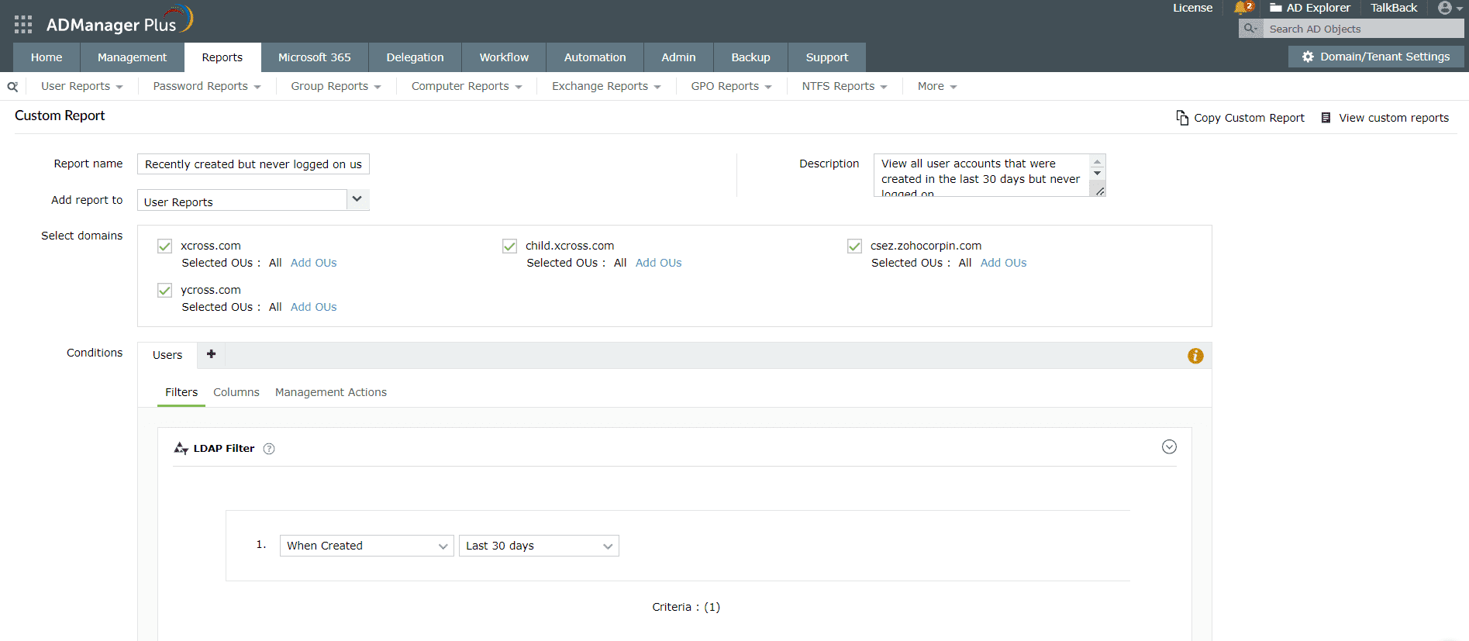
The custom report builder
Build custom reports from scratch with criteria-based LDAP queries and advanced filters for unique scenarios
Refine the results of a report with specific conditions to get a curated list of the objects you want
06

Slide 8
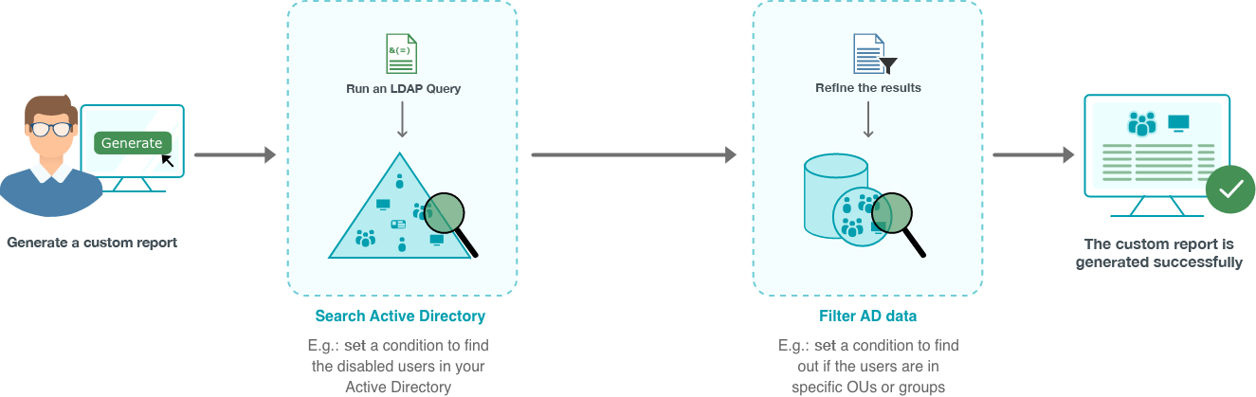
How to run custom reports
07

Slide 9
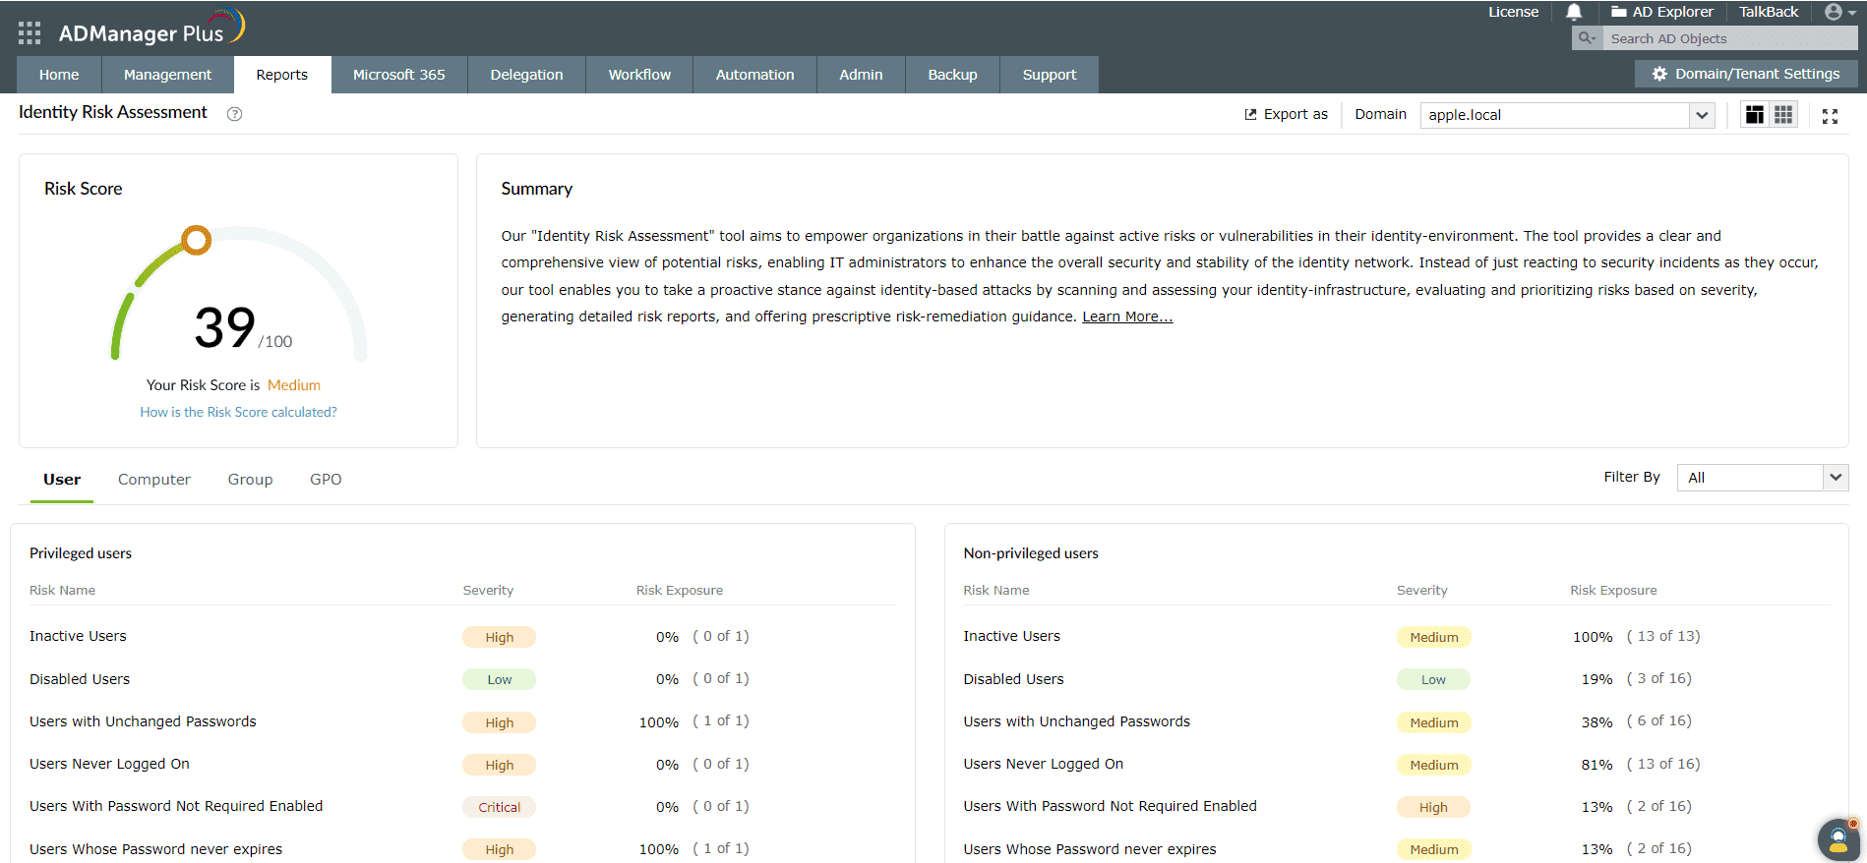
Risk assessment reports
Understand your AD and Microsoft 365 risk posture through risk scores
Access one-click reports on the threat indicators to find out your potential security gaps and fix them
The risk score and the severity of the risks
08

Slide 10
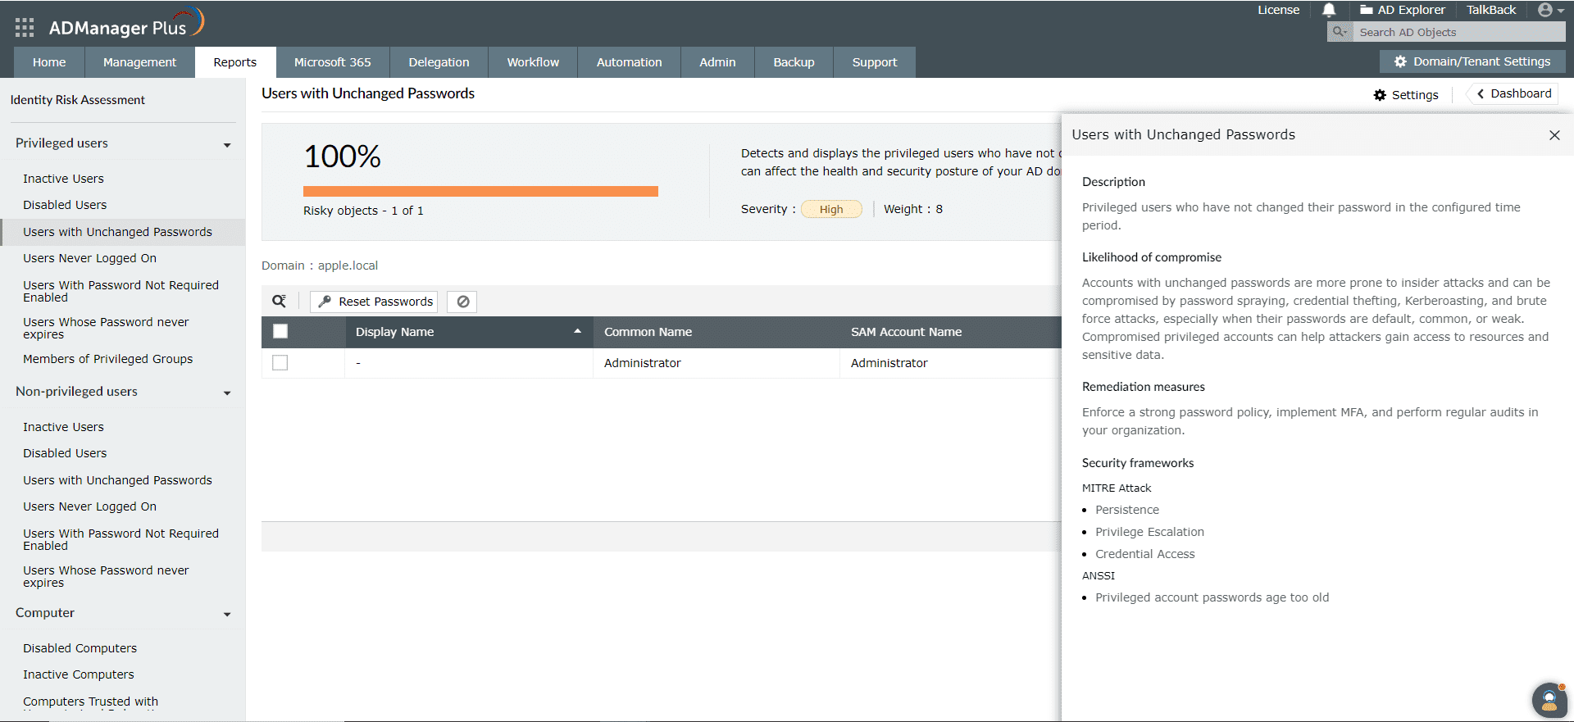
Learn what to do after identifying risks
09

Slide 11
How does it work?
Risk score
ADManager Plus analyzes identity risks in your AD and
Microsoft 365 landscapes through three phases of computation
Phase 1: Determines the severity of risks
Phase 2:
Gives risk indicators weightage on a scale from 1 to 10 to calculate the risk exposure of each
Step 1:
Likelihood determination
Calculates the opportunities for possible threat incidents and the degree of harm if the threats materialize
Step 2:
Impact analysis
Analyzes potential consequences of the risk based on the confidentiality, integrity, and availability (CIA) triad
Potential consequences include damage to business operations, financial loss, and reputational harm
Step 3:
Severity level assignment
Categorizes the risk as low, medium, high or critical from the results of Step 1 and Step 2
Phase 3:
Gives the overall risk score based on the values obtained from Phase 1 and 2
Risk indicators include:
Privileged users
Non-privileged users
Computers Groups and GPOs
10

Slide 12




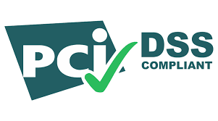

Compliance and ADManager Plus
Satisfy compliance mandates using reports
We offer compliance reports for
SOX
HIPAA
PCI DSS
FISMA
GLBA
GDPR
11

Slide 13
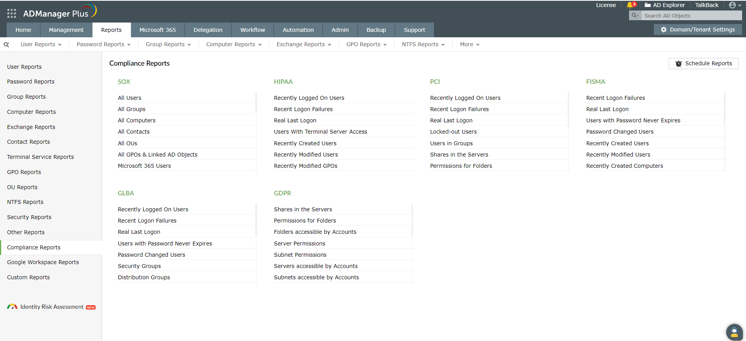
Compliance and ADManager Plus
12

Slide 14





How ADManager Plus' reports helped Essentia Health
Text
Had stale and expired user accounts in AD
Could not pull up information from AD
ADManager Plus provided fine-grain reports and the option to create custom reports from scratch, which turned out to be such a relief for Essentia Health's IT admins
Business
challenges
Needed
advanced reporting capabilities
Had numerous legacy items in the organization
13

Slide 15







360° identity governance in AD,Microsoft 365, and Google Workspace
Template-based, event-driven automations
Periodic access certification campaigns
Frictionless integrations with enterprise applications.
Additional
capabilities
AD, Azure AD, and Google Workspace backup and recovery.
Approval-based business workflows
14

Slide 16
Explore more about
ADManager Plus
right away!

