Slide 1





Workflows and Delegation

Slide 2

Outline
ADManager Plus overview
Business challenges
Delegation
How to delegate
Key features
Use cases
Workflows
Ticketing using workflows
SLAs in workflows
Key features
Use cases
License requirements

Slide 3
ADManager Plus overview
ADManager Plus is an identity governance and administration (IGA) solution with features for securely managing and governing the identities in an organization
‌Streamlined identity life cycle management
Compliance-oriented reporting
Multi-level business workflows
Granular access controls and delegation
Automated access certification campaigns
Inter-forest and intra-forest migration of AD objects
Secure data backups and recovery
Integrations with popular SIEM, HCM, ITSM, and help desk tools

Slide 4
Business challenges
Business challenges that necessitate the implementation of workflows and delegation include
01
Complex task management
04
Cross-functional collaboration
Managing a variety of tasks across different departments can become cumbersome without efficient workflow processes
Workflows and delegation facilitate collaboration among different departments by providing clear roles and responsibilities
02
Compliance with regulations
Organizations must ensure that tasks are executed in accordance with internal policies and external regulations, requiring clear workflows and delegated responsibilities
05
SLAs
Meeting SLAs requires efficient task assignment, tracking, and completion, which can be achieved through workflow and delegation mechanisms
03
Resource optimization
Efficiently allocating tasks among the available resources is essential for maximizing productivity and minimizing delays

Slide 5
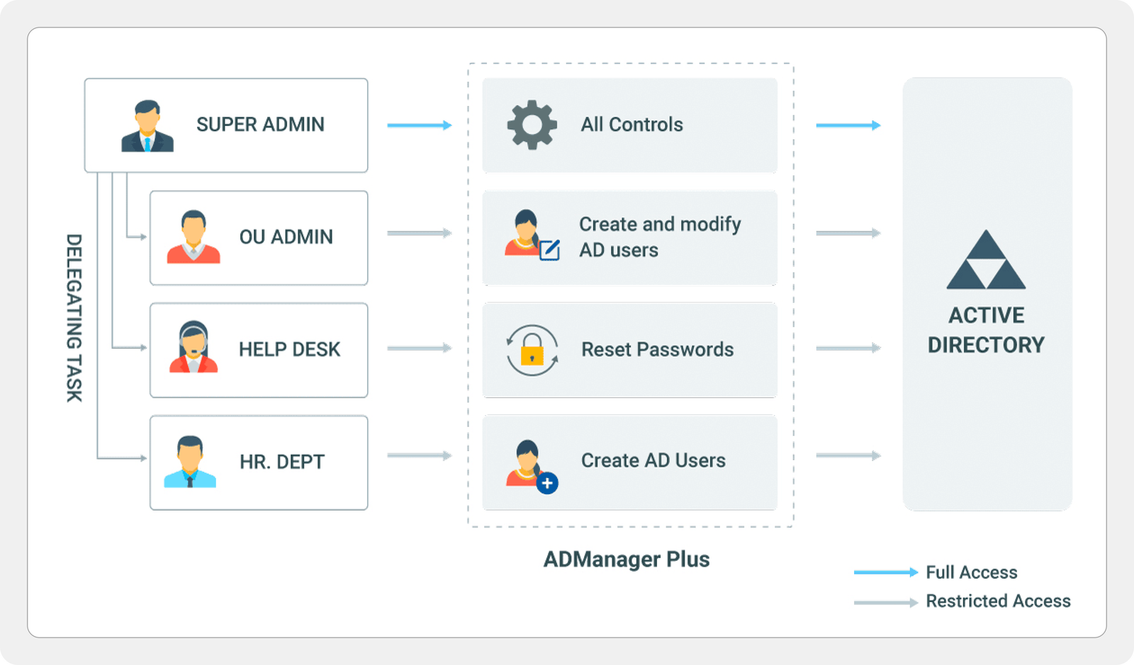
Delegation
Delegation involves granting help desk technicians restricted access and privileges to efficiently handle assigned tasks, such as password resets, user creation, and data migration

Slide 6
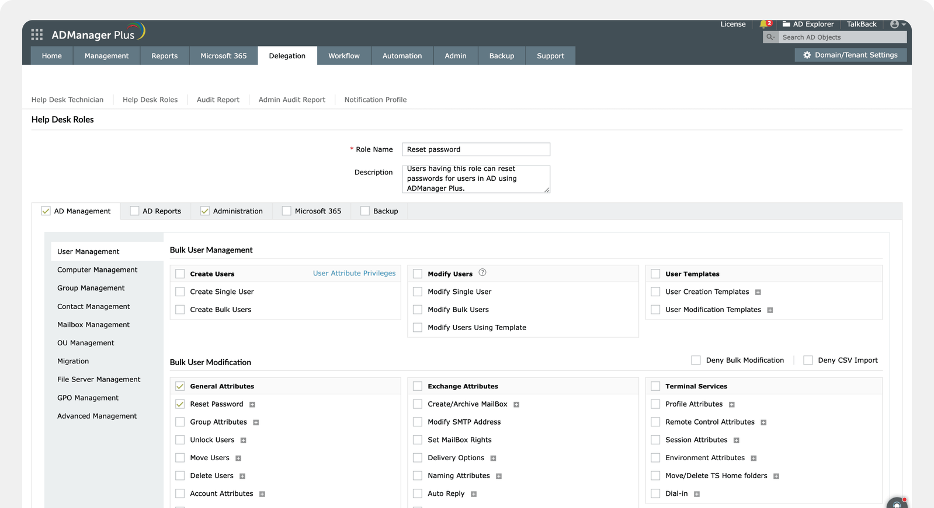
How to delegate
Step 1:
Create a role with the desired permissions
Create a role for help desk technicians, specifying the tasks they are authorized to perform

Slide 7
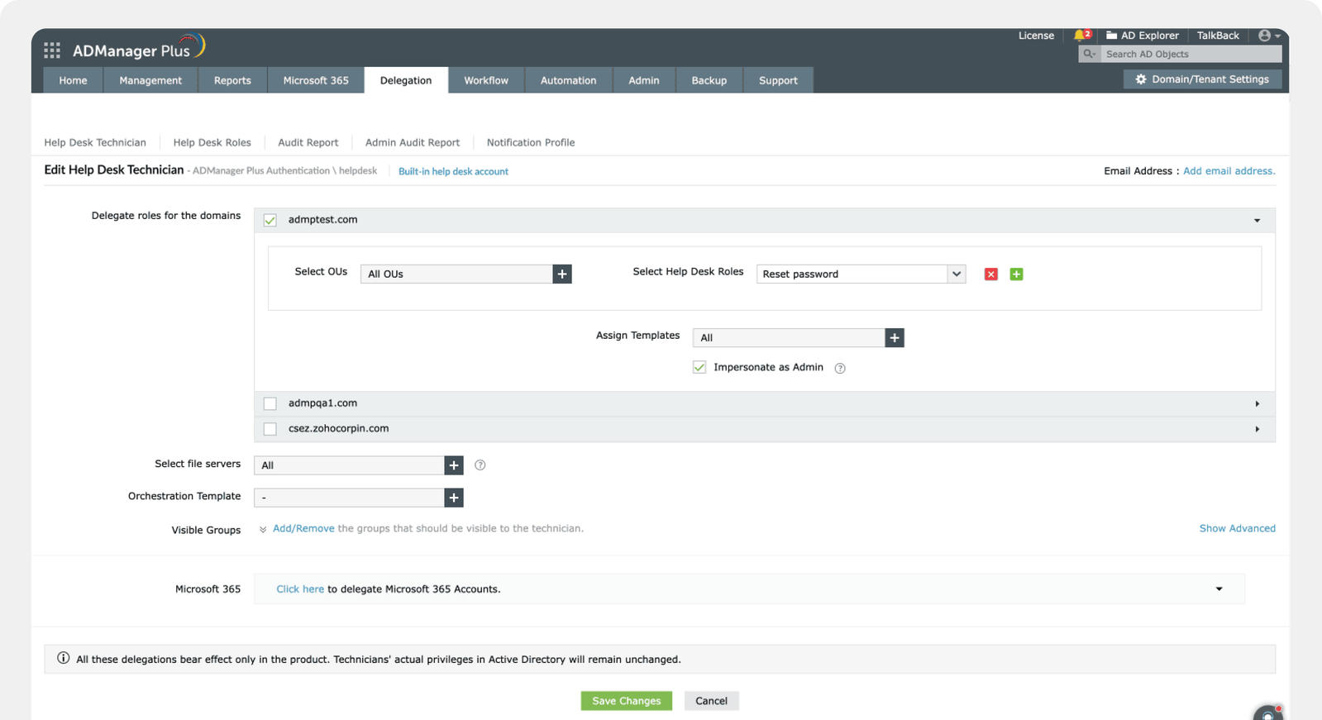
How to delegate
Step 2:
Assign the role to a technician
Designate a technician or select an existing technician and assign the role to delegate the required actions to them

Slide 8
Key features
Non-invasive delegation
Audit trails
‌Distribute administrative tasks effectively while maintaining security, compliance, and control over identity management tasks
Log and track all delegated actions performed by administrators
Role-based access controls (RBACs)
Anomaly detection
Implement RBAC principles to define roles with specific permissions
Detect anomalies in help desk technician activity by identifying deviations from typical behavior to flag unusual actions.
Granular controls
Ensure users have the appropriate permissions to perform tasks without unnecessary access

Slide 9

Use cases
Help desk ticket management
Delegating tasks to help desk technicians by giving them permissions to reset passwords, unlock user accounts, and modify user attributes helps you streamline ticket resolution processes without granting full administrative access
Access management
Allowing managers to review user access and permissions within their teams by running access certification campaigns promotes efficient access management and enhanced data security

Slide 10
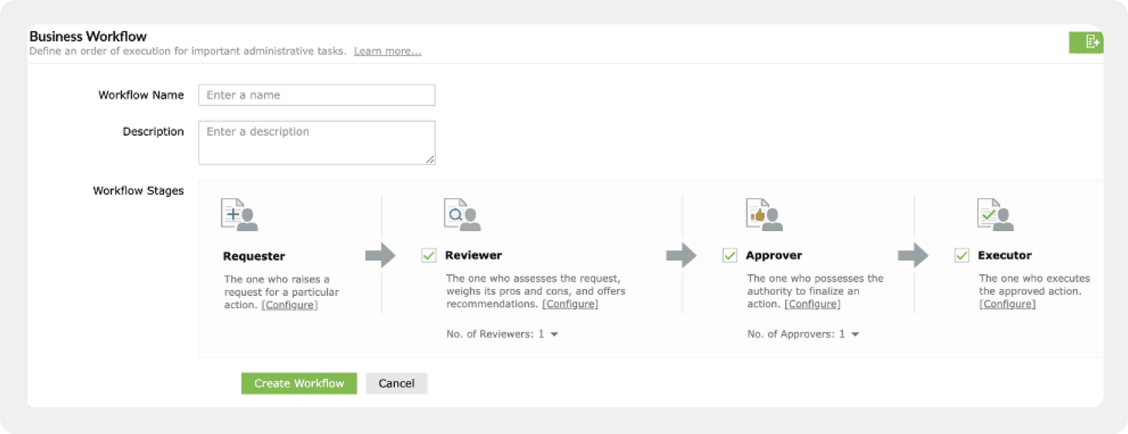
Workflows
‌You can exercise control over automated tasks by setting up multi-level workflows to validate and prioritize user requests with efficient SLA management

Slide 11
Ticketing using workflows
Workflows support a pool of requests that are submitted, routed, reviewed, and executed, with statuses tracked and notifications sent at each stage
This streamlines request management, improves response times, and enhances collaboration among teams
Step 1
Step 2
Step 3
Step 4
A requester raises a request
A customized workflow is triggered
Stakeholders review and approve the request
An executor executes the task

Slide 12
SLAs in workflows
SLA features allow organizations to define and enforce expected response times, resolution targets, and service quality standards for tasks
With ADManager Plus' SLA features, users can configure the following:
SLA rules
Response times
Escalations
You can configure attributes as the basis on which workflow requests must be filtered and SLAs must be applied
You can set the expected response times in terms of days, hours, or minutes, according to organizational requirements
If a request isn't completed within the specified time, you can choose to notify admins, reassign it, change the priority, or change the status; you can also set multiple escalations to occur at specific intervals

Slide 13

Key features
Customizable workflow stages
Define multiple workflow stages, such as request initiation, review, approval, and execution, tailored to your organizational needs
The automation of routine tasks
Automate repetitive tasks, reducing manual effort and improving efficiency in Active Directory management
Audit trails and compliance monitoring
Maintain comprehensive audit trails of all actions performed, ensuring accountability and compliance with organizational policies
Audit trails and compliance monitoring
Maintain comprehensive audit trails of all actions performed, ensuring accountability and compliance with organizational policies

Slide 14
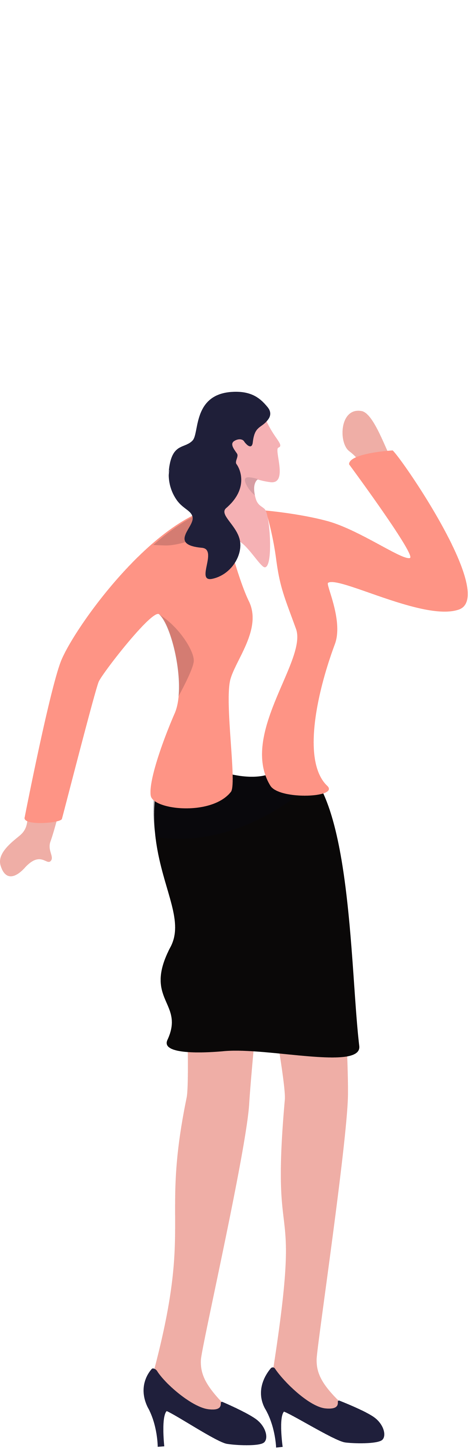
Use case: Disabling inactive users
Say a sysadmin wants to disable the accounts of employees who have been absent for a prolonged time
To do this, the sysadmin has to identify users who have not logged in for a long time and then raise a request to disable their accounts, which will be reviewed by the respective employees' managers and executed by the HR manager
This process can be eased by using a standardized workflow

Slide 15

Use case: Temporary group memberships
‌Picture a marketing team tackling a time-sensitive campaign that requires additional resources and permissions not typical for the members' roles
Instead of making permanent changes to group memberships and permissions, which could pose security threats or increase complexity, ADManager Plus provides just-in-time access, which limits privileges to a particular time frame that can be specified when granting access

Slide 16
License requirements
Customizable workflow stages
Workflows
Based on the number of domains and the number of help desk technicians, the licensing will vary
‌Workflows are available in the Professional edition
Any user can be added as a workflow requestor or reviewer
Delegation is available in the Standard edition with limited functionality
An approver or executor for the workflow must be a help desk technician, which requires a license
OU-based, group-based, cross-domain, and multiple-domain AD delegation; Microsoft 365 and Google Workspace delegation; and technician-specific templates are only available in the Professional edition
For more details, visit manageengine.com/products/ad-manager/pricing-details.html

Slide 17

Thank you!
For more information, contact support@admanagerplus.com or visit manageengine.com/products/ad-manager/

