Slide 1



Simplify your Active Directory migrations

Slide 2




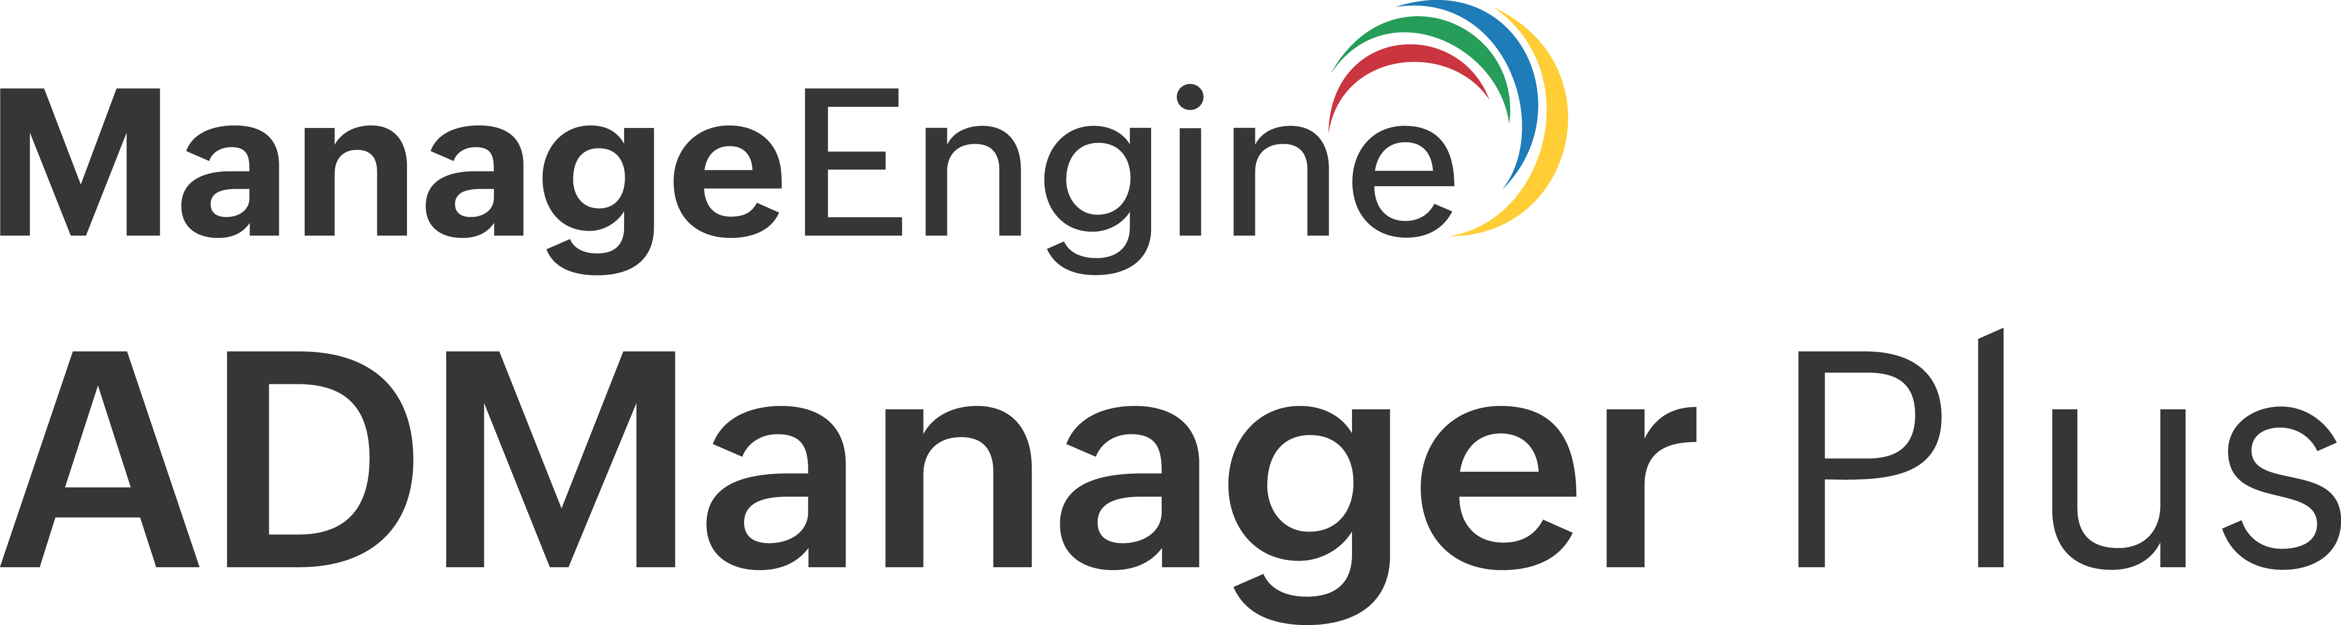
Outline
  5
  1
  6
Use case
Empowering enterprises:
ADManager Plus
in action
Additional
capabilities
  2
  4
Why
Migration matters
Why use
ADManager Plus for migration?
  3
A closer look at the ADManager Plus
migration tool

Slide 3




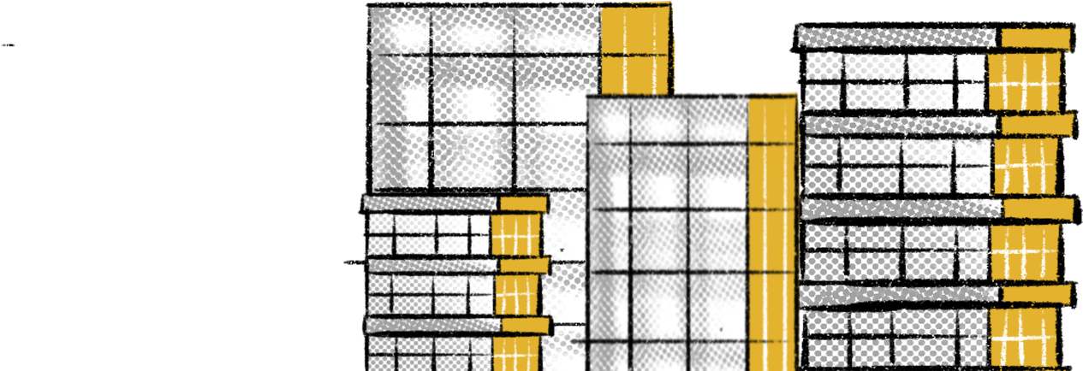
  Empowering
  enterprises
  ADManager Plus
  in action
ADManager Plus is an identity governance and administration (IGA) tool designed for securely managing and governing identities in Active Directory (AD), Microsoft 365, and other enterprise applications.
ADManager Plus also functions as an AD migration tool, assisting in the secure migration of AD objects.

Slide 4






  Why migration matters
Seamless
operational continuity
Effective AD migrations are crucial for organizations during changes like mergers or acquisitions, ensuring a seamless transfer of data and infrastructure for operational continuity.
Adaptability
and efficiency
They enable businesses to adapt to evolving technology, improve efficiency, and stay competitive.
Streamlined migration strategy
A well-executed migration strategy, supported by tools like the Active Directory Migration Tool (ADMT) and ADManager Plus, streamlines the process, reduces risks, and helps achieve strategic objectives efficiently.

Slide 5






  A closer look at the ADManager Plus migration tool
User migration
Migrate users, including their access rights, group memberships, and SID history.
As an AD migration tool,
ADManager Plus lets you perform
Group migration
Migrate groups, including their members.
Contact migration
Migrate AD contacts, along with their OU details.
GPO migration
Migrate GPOs with or without ACL, or a migration table.

Slide 6

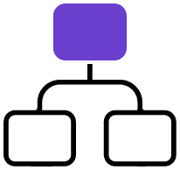



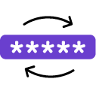
  Why use ADManager Plus for migration?
Conflict resolution
Automatically resolve naming conflicts using predefined formats.
OU hierarchy migration
Migrate objects with their OU details across domains and forests.
Permission management
Transfer users and groups along with their access rights.
Password migration
Securely migrate user passwords with preconfigured settings.

Slide 7




  Why use ADManager Plus for migration?
Data integrity assurance
Preserve object attributes to prevent data loss during migration.
Efficiency enhancement
Migrate large object volumes without AD performance degradation.
Administrative relief
Delegate tasks to technicians, reducing the burden on administrators.
Data loss prevention
Backup and recover data instantly in case of migration failures, minimizing data loss.

Slide 8

  Use case
Scenario
Solution
ABC Corp recently acquired XYZ Corp, and as part of the integration process, they need to migrate users and groups from the XYZ Corp's AD forest to their own AD forest. ABC Corp wants to ensure a seamless migration process without disrupting user access and maintaining security permissions.
By leveraging ADManager Plus, ABC Corp can efficiently migrate users and groups from XYZ Corp's AD forest to their own, ensuring a seamless integration process while maintaining security and compliance.

Slide 9
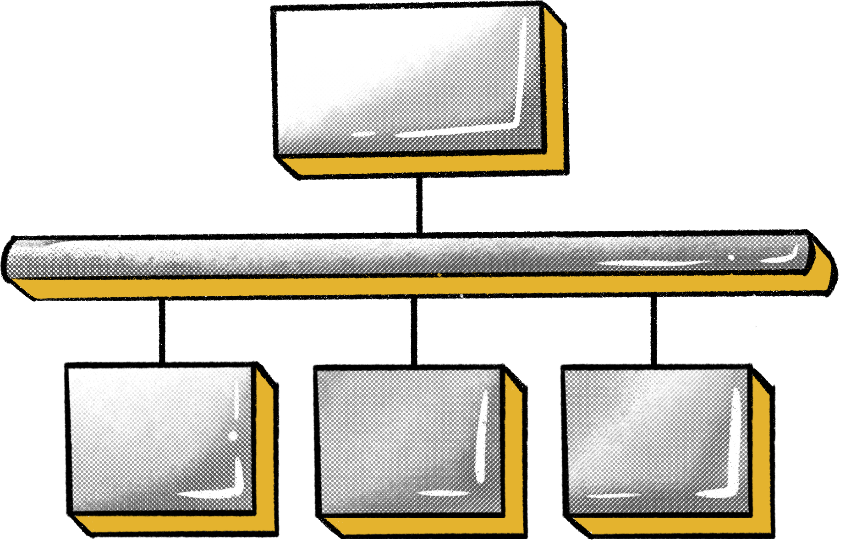

  Use case
Simplify AD forest migration with thorough pre-planning, accurate execution, and detailed post-migration tasks.
Migration execution
3
1
Schedule migration during off-peak hours.
Ensure accurate migration of user accounts, group memberships, and permissions.
Post-migration tasks
Pre-migration planning
Update DNS records to point to new AD forest.
Verify migration success using reporting capabilities.
Analyze existing AD infrastructures of both forests.
Map users and groups from source to destination AD forest.
2

Slide 10





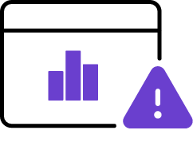





360° identity governance across AD, Microsoft 365, and Google Workspace.
Enjoy frictionless integrations with enterprise applications.
Conduct periodic access certification campaigns.
  Additional capabilities
Backup and recover AD, Azure AD, and Google Workspace.
Explore the comprehensive features of ADManager Plus, including:
Implement approval-based business workflows.
Monitor AD and Microsoft 365 health and mitigate risks.
Utilize template-based, event-driven automations.
Over 200 actionable reports.
Explore further details about ADManager Plus!
For a comprehensive product walk-through, simply
Register here

Slide 11

  Thank you!

