Slide 1





Streamline identity management using ADManager Plus' application integrations

Slide 2
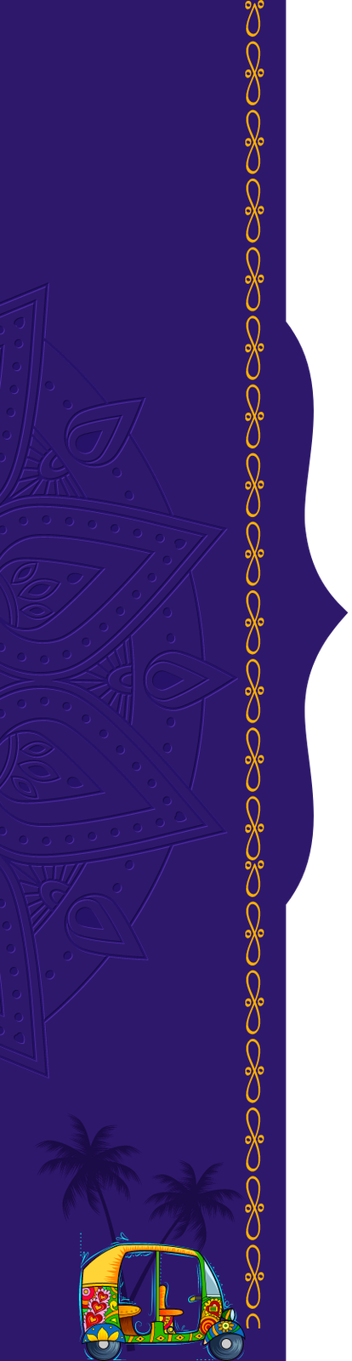


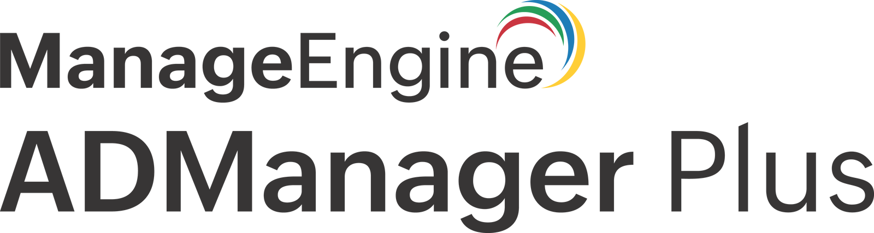
Outline
ADManager Plus: Your go-to hybrid AD IGA tool
ADManager Plus' application integrations
List of applications
How application integrations work in ADManager Plus
How ADManager Plus helped ImmunoTek
Benefits of ADManager Plus' application integrations

Slide 3
ADManager Plus:
Your go-to hybrid AD IGA tool
ADManager Plus is an identity governance and administration (IGA) tool built to securely manage and govern the identities in Active Directory (AD), Microsoft 365, Exchange, and Google Workspace environments
With capabilities like management, reporting, risk assessment, access certification, event-driven automation, and more, ADManager Plus simplifies IGA for enterprises
ADManager Plus can be integrated with enterprise applications to manage identities synergistically

Slide 4
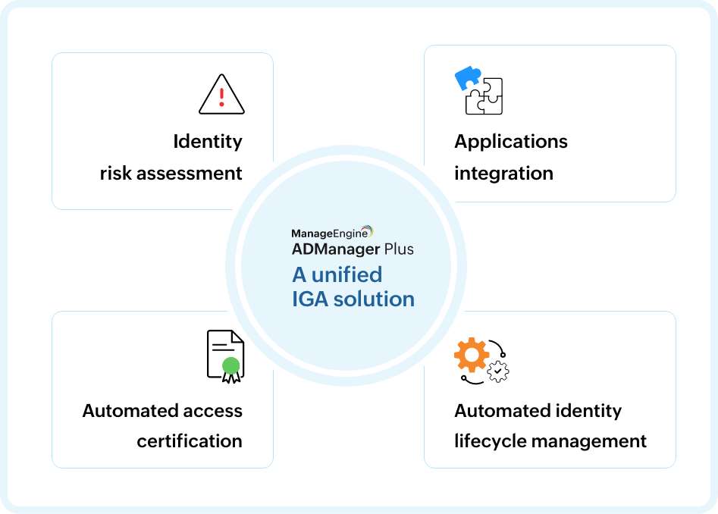
ADManager Plus:
Your go-to hybrid AD IGA tool

Slide 5
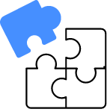

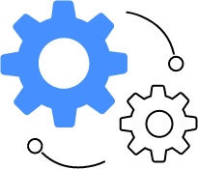
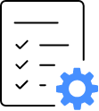
ADManager Plus'
application integrations
ADManager Plus offers pre-built integrations that can be configured instantly
A wide range of applications that support REST API can be integrated, including HCM, ITSM, SIEM, and any custom application
Integration enables automated identity management across applications
User onboarding and offboarding can be streamlined from integrated applications

Slide 6






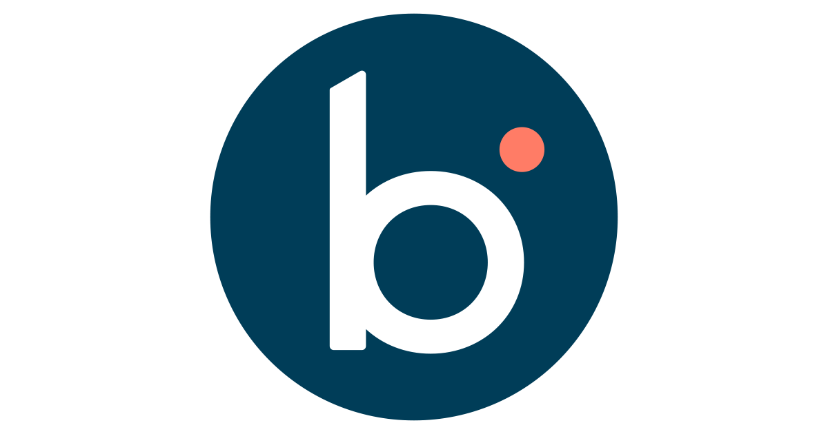








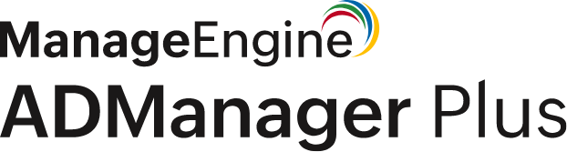






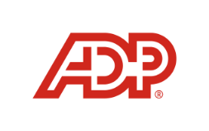

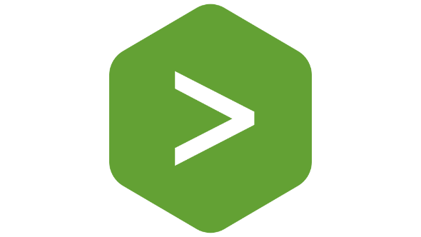




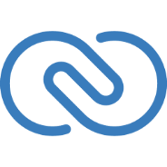

List of applications
ITSM/help desk
HCM
SIEM
Databases
CRM software
This list is not exhaustive and any application that supports REST API can be
integrated with ADManager Plus. To learn how, click here.

Slide 7
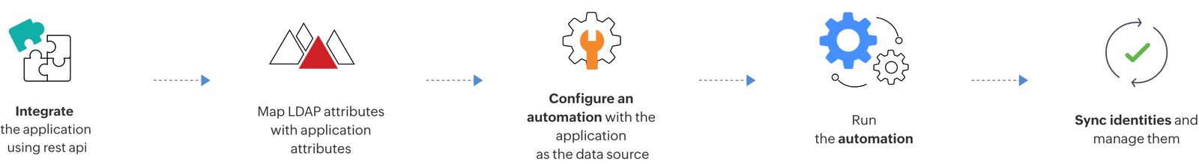
How application integrations
work in ADManager Plus
Integration with an HCM solution

Slide 8
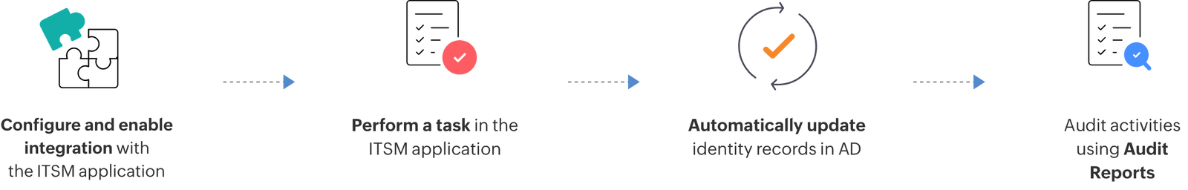
How application integrations
work in ADManager Plus
Integration with an ITSM/help desk solution

Slide 9
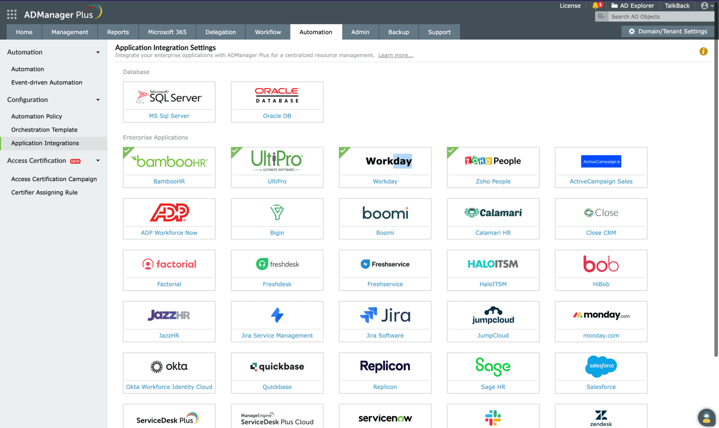
A glimpse into the application
integrations offered by ADManager Plus

Slide 10


How ADManager Plus helped ImmunoTek
Business challenge
The IT team at ImmunoTek was dependent on conventional AD methods to provision user accounts. They were also behind on receiving notifications from HR for new employees, role changes, and terminations.
Solution
ImmunoTek chose ADManager Plus to address this business challenge. By integrating the company's HCM solution with ADManager Plus, the IT team was able to automatically create corresponding new user accounts in AD as soon as they were added to the HCM solution, instantly modify and delete users, and also notify the stakeholders involved.

Slide 11



How ADManager Plus helped ImmunoTek
This is how ImmunoTek has benefitted:
Real-time notification
Improved productivity
Automated user management
Stakeholders are notified instantly about a techncian's task status, automation status, and more as and when a task is executed
ImmunoTek's IT team no longer provisions and deprovisions users manually and has automated the entire process, resulting in improved business efficiency
Integrating with its HCM application, ImmunoTek has now cut down the HR waiting period and automated the user life cycle management process

Slide 12

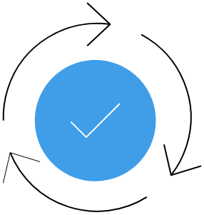




Benefits of integrating
ADManager Plus with enterprise applications
Integrating ADManager Plus
with external applications
enables:
Automated identity life cycle management
Bi-directional sync
Allows automatic provisioning and deprovisioning of users as and when they are updated in the integrated applications
Allows automatic provisioning and deprovisioning of users as and when they are updated in the integrated applications
Centralized identity management
Enhanced
productivity
Minimized data
entry errors
Provides a unified view into identities and helps manage them efficiently
Accelerates IT teams' productivity by reducing the time to switch between applications
Reduces manual data entry errors by automating management processes

Slide 13




  Thank you!
For more information,
Contact: support@admanagerplus.com Visit: manageengine.com/products/ad-manager/

