Slide 1

IT Management, Simplified
Real-time IT management solutions for the new speed of business

Slide 2
Envisioning the service desk as
the control center of IT
Streamlining the new employee onboarding process.

Slide 3






Functions of a centralized IT service desk
Device
management
IT operations
management
IT security
IT service
management
Active Directory management
IT analytics
The problem: They all work in silos
Notes:
2 way representation-with out details

Slide 4



The implications
Lack of streamlined IT service desk processes and reduced productivity.
Lack of control and visibility over the IT environment.
Inability to gain insights from the IT help desk data to support decisions.
Notes:
2 way representation-with out details

Slide 5
How centralized IT service desks should work
IT analytics
Active Directory management
IT security
IT service
management
Device
management
IT operations
management
Notes:
2 way representation-with out details

Slide 6
Story time
The tale of Zylker and its IT team.

Slide 7








Say hello to Zylker
Business users
IT folks
MARCUS
CIO
WENDY
HR
CATRIN
IT SERVICE DESK MANAGER
DAVE
HIRING MANAGER
JOHN
END USER
JASON
IT TECHNICIAN
SCOTT
IT TECHNICIAN
ADAM
IT TECHNICIAN

Slide 8


New employee onboarding
New employee onboarding request #1
JASON
IT TECHNICIAN
Task 1 : Provide a workstation and install requested software.
SCOTT
IT TECHNICIAN
Task 2 : Create an Active
Directory entry.
WENDY
HR
CATRIN
IT SERVICE DESK MANAGER
ADAM
IT TECHNICIAN
Task 3 : Create an email account and provide ID card with requested access permissions.

Slide 9
More employees
New employee onboarding request #2
JASON
IT TECHNICIAN
Task 1: Provide a work station and install requested software.
SCOTT
IT TECHNICIAN
Task 2: Create an Active
Directory entry.
WENDY
HR
CATRIN
IT SERVICE DESK MANAGER
ADAM
IT TECHNICIAN
Task 3: Create an email account and provide ID card with requested access permissions.

Slide 10





More. . .
New employee onboarding request #n
JASON
IT TECHNICIAN
Task 1: Provide a work station and install requested software.
SCOTT
IT TECHNICIAN
Task 2: Create an Active
Directory entry.
WENDY
HR
CATRIN
IT SERVICE DESK MANAGER
ADAM
IT TECHNICIAN
Task 3: Create an email account and provide ID card with requested access permissions.

Slide 11
. . .is not merrier!
There are too many software installations to handle. Manual installations are eating my time!
I have 10 open onboarding requests. And we expect 20 more people to join us next week. Can this get any worse???
What's happening here? We shouldn't be taking
this long!
Configuring user details
and properties manually for
every request takes time and
effort, and is error-prone!
I need more
time to do it right.
JASON
WENDY
HR
CATRIN
IT SERVICE DESK MANAGER
SCOTT
Doing the same mundane password resets is killing my productivity! I have other requests and tickets to take care of.
ADAM

Slide 12

When the boss calls
The CEO called.
Why are we slow?
IT needs to speed up. Identify bottlenecks and get me an action plan to better handle the onboarding process ASAP.
???????
MARCUS
CIO
CATRIN
IT SERVICE DESK MANAGER

Slide 13




New employee onboarding – The smart way.
Task 1 :
Create an Active
Directory entry.
Active Directory management
SCOTT
IT TECHNICIAN
Task 2 :
Provide email id and email access
Task 3 :
Provide requested workstation
Centralized
IT service
management
Device
management
Task 4 :
Deploy OS,
if necessary
JASON
IT TECHNICIAN
WENDY
HR
CATRIN
IT SERVICE DESK MANAGER
Multiple technicians. Multiple software.
One window.
Task 5 :
Install requested software
One service request with 6 tasks, and automatic delegation of tasks to respective technicians.
Task 6 :
Provide id with requested access permissions
ADAM
IT TECHNICIAN

Slide 14
Streamlined new employee onboarding process
with
ServiceDesk Plus

Slide 15
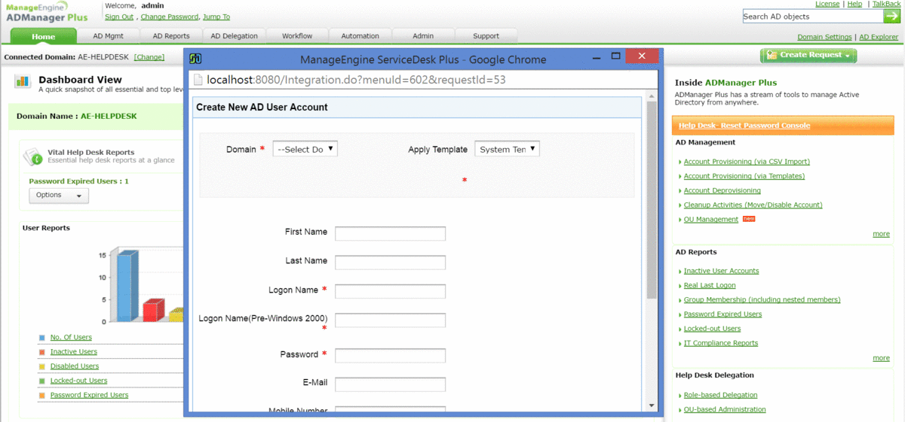
Catrin integrates ServiceDesk Plus with
ADManager Plus
ADSelfService Plus
Desktop Central

Slide 16
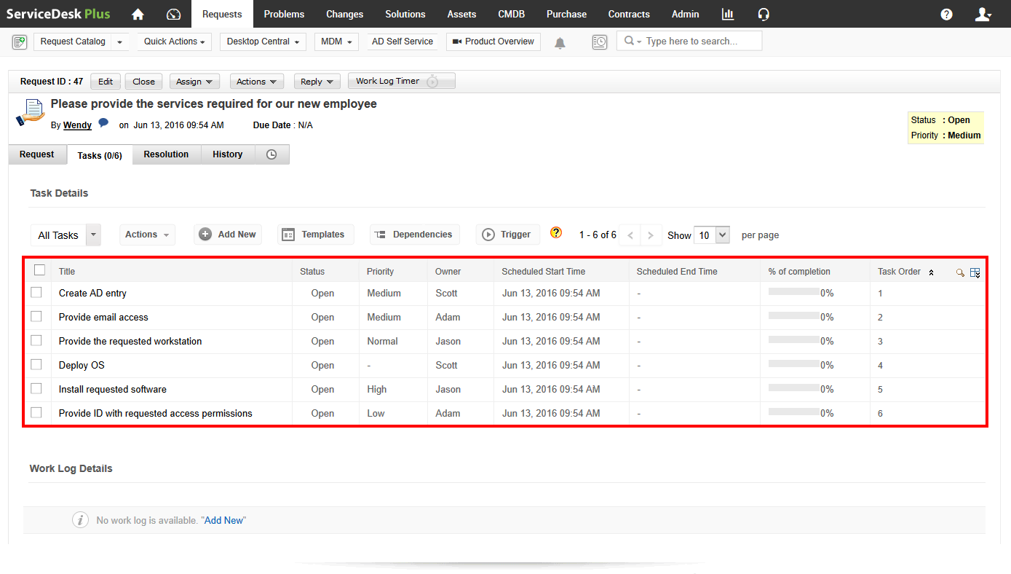
Catrin creates a service request template in ServiceDesk Plus with associated tasks that need to be completed to successfully onboard new employees.

Slide 17
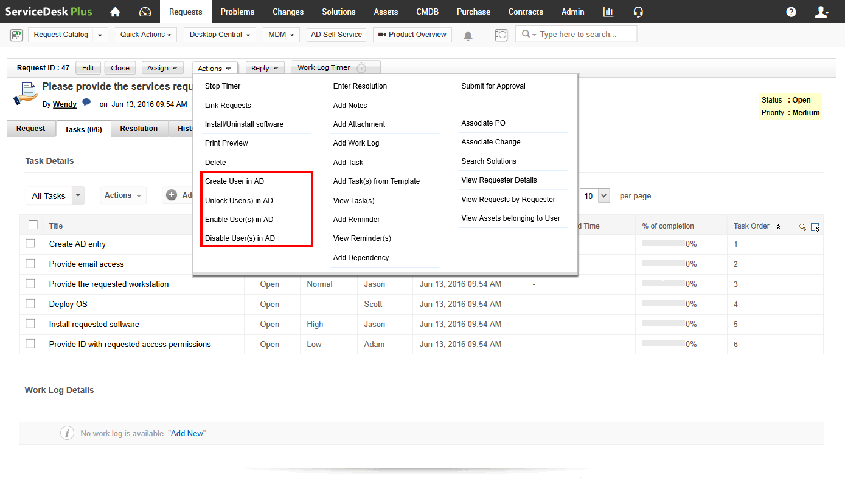
The ADManager Plus integration lets Scott to create, enable, and disable Active Directory entries from within the help desk.

Slide 18
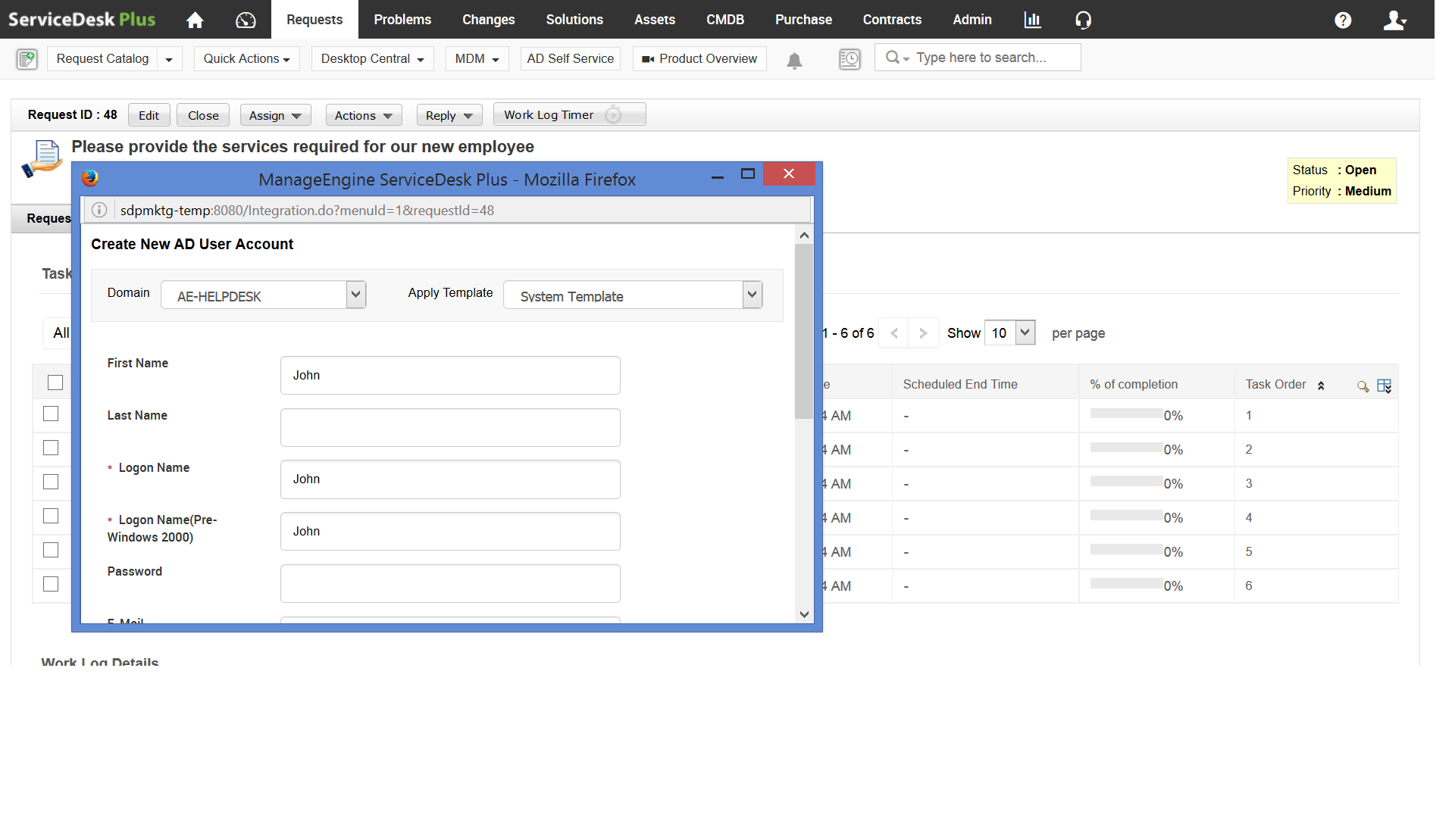
Scott also creates an Active Directory entry for the new employee from within the request. When an entry is created on Active Directory, an email ID is automatically generated for the new employee based on the Zylker’s email policy.

Slide 19
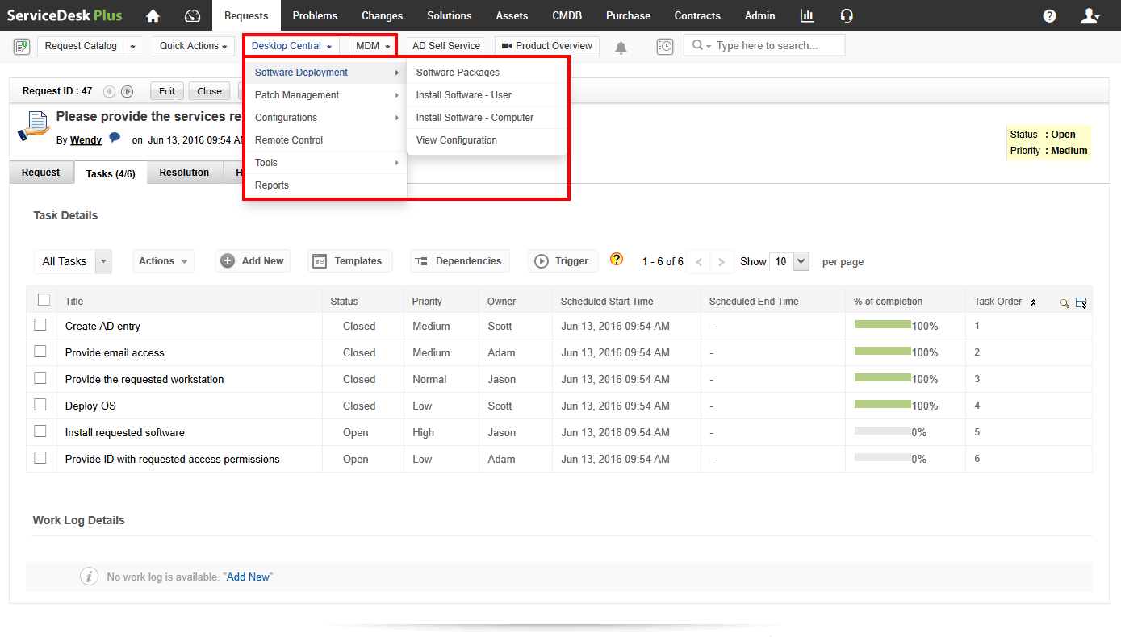
The Desktop Central integration lets Jason trigger software installations, and uninstallations, manage patches, take remote control, chat, make announcements, and remote shut down end user workstations right from the service desk console.

Slide 20
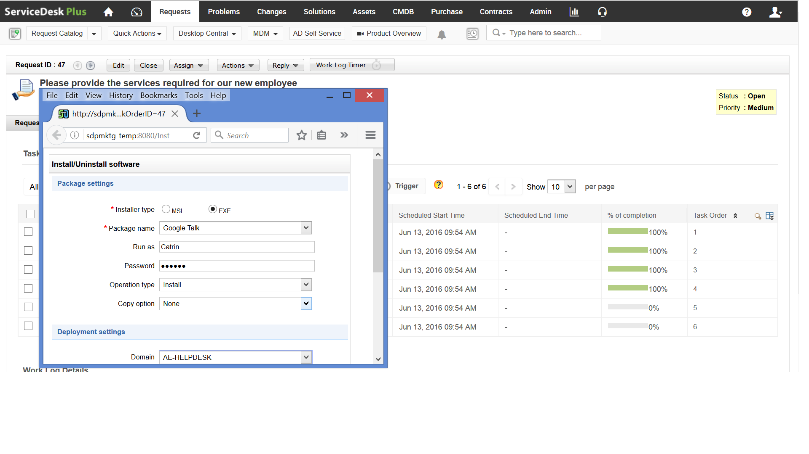
Jason triggers the installation of all the requested software for the new employee from within the service request.

Slide 21
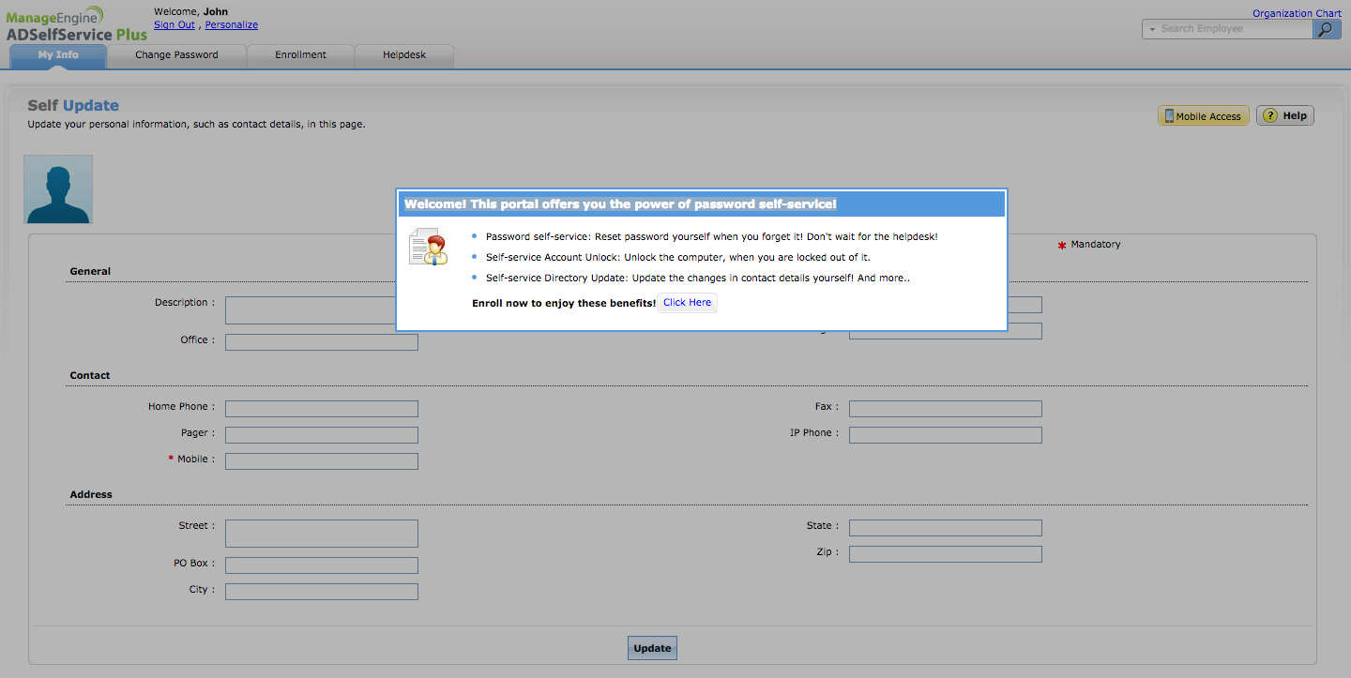
The ADSelf Service Plus integration lets John, the new employee, reset his AD password, unlock his AD account, and update his AD profile all on his own without raising a help desk ticket.

Slide 22
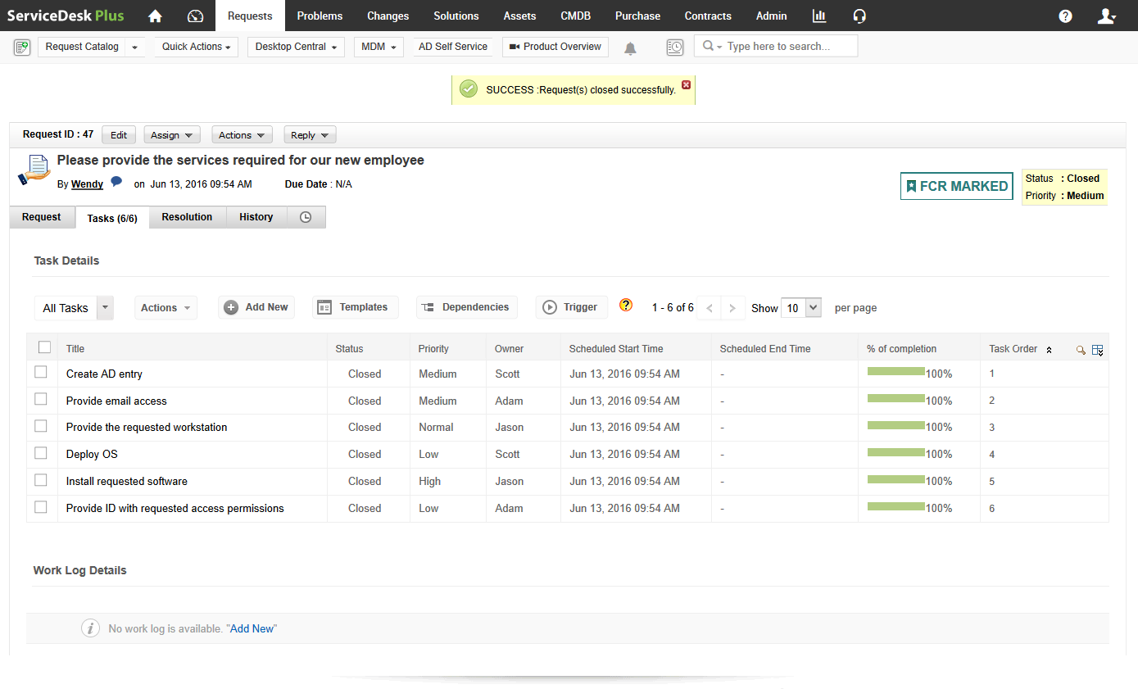
Finally, Catrin closes the request with all the associated tasks completed in minutes.

Slide 23
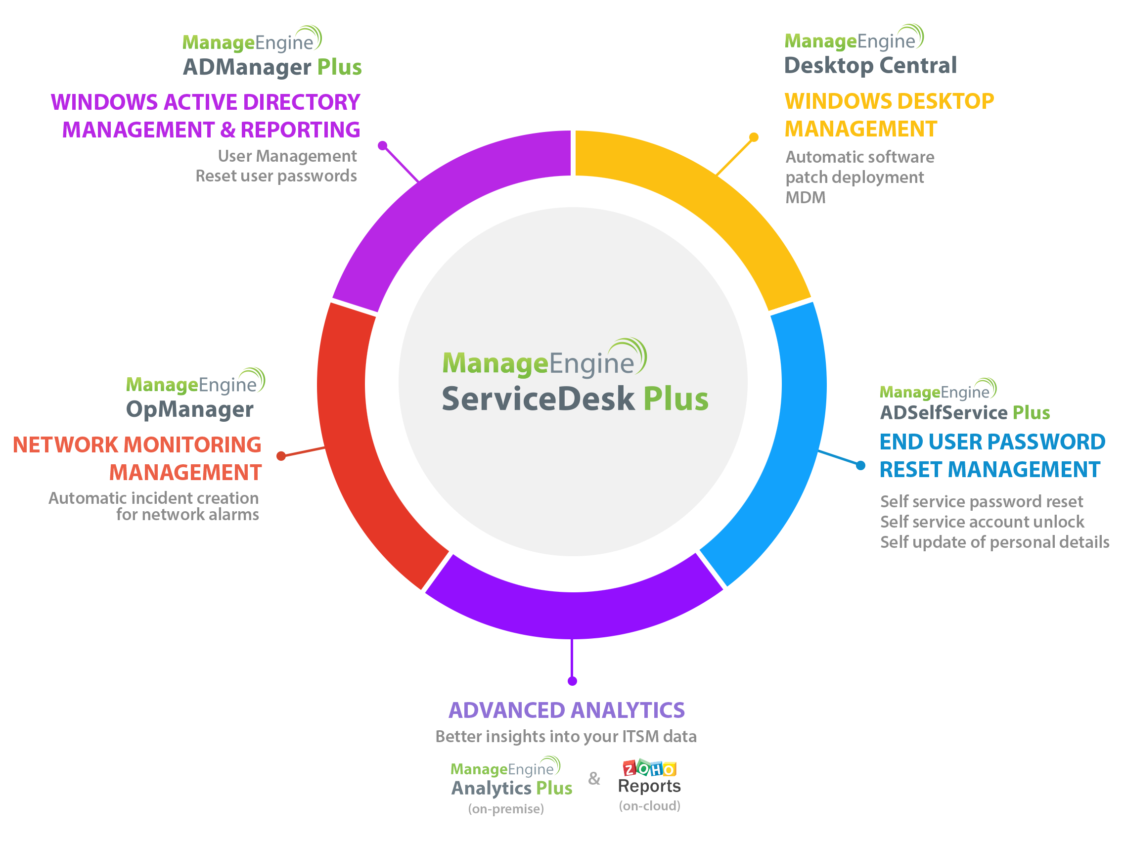
Building a
centralized
IT service desk
with
ServiceDesk Plus

Slide 24


“ ”
ServiceDesk Plus has been a great decision both functionally and financially.
James Arnold service desk manager Manhattan Associates
Join the
100,000+
happy IT service desks worldwide
Sign up for a 30-day free trial now.

Slide 25

Thank you!
hello@servicedeskplus.com

