Slide 1


An incident management
architecture that keeps your
business resilient

Slide 2
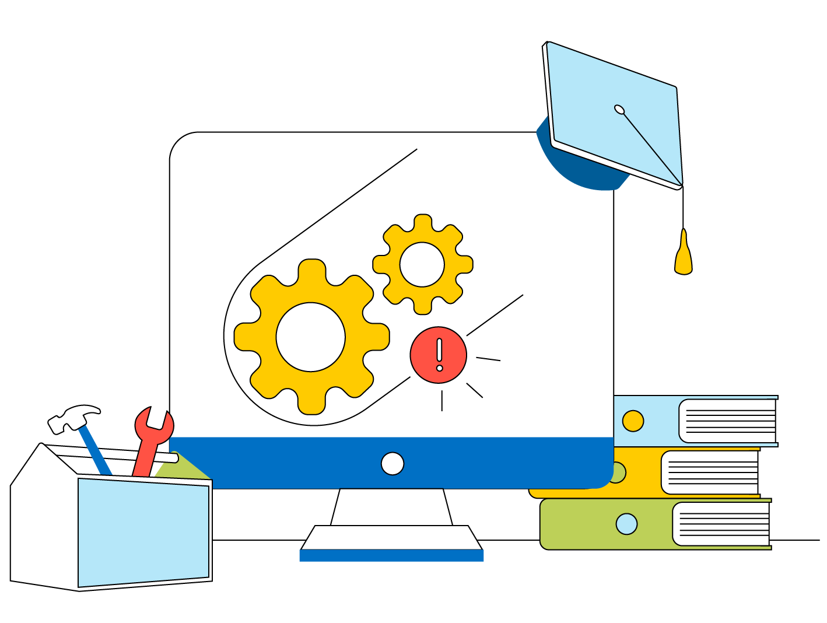
From routine maintenance to a major mishap
A global educational technology vendor helps universities solve remote and hybrid learning challenges with its SaaS-based LMS
The LMS is hosted across data centres owned by the vendor, while a backbone network links all these data centres together
During a routine maintenance job to assess the backbone's capacity, the wrong command is issued, which takes down all the connections in the backbone network

Slide 3



Errors of their own making
The audit tool used by the company doesn't detect the erroneus command, while the IT team fails to realise the extent of the outage—which is everything
As they scramble to respond, there are internal communication pitfalls as all the teams are working remote
The outage also takes down some internal tools, leading to employees badgering the help desk with tickets and calls

Slide 4
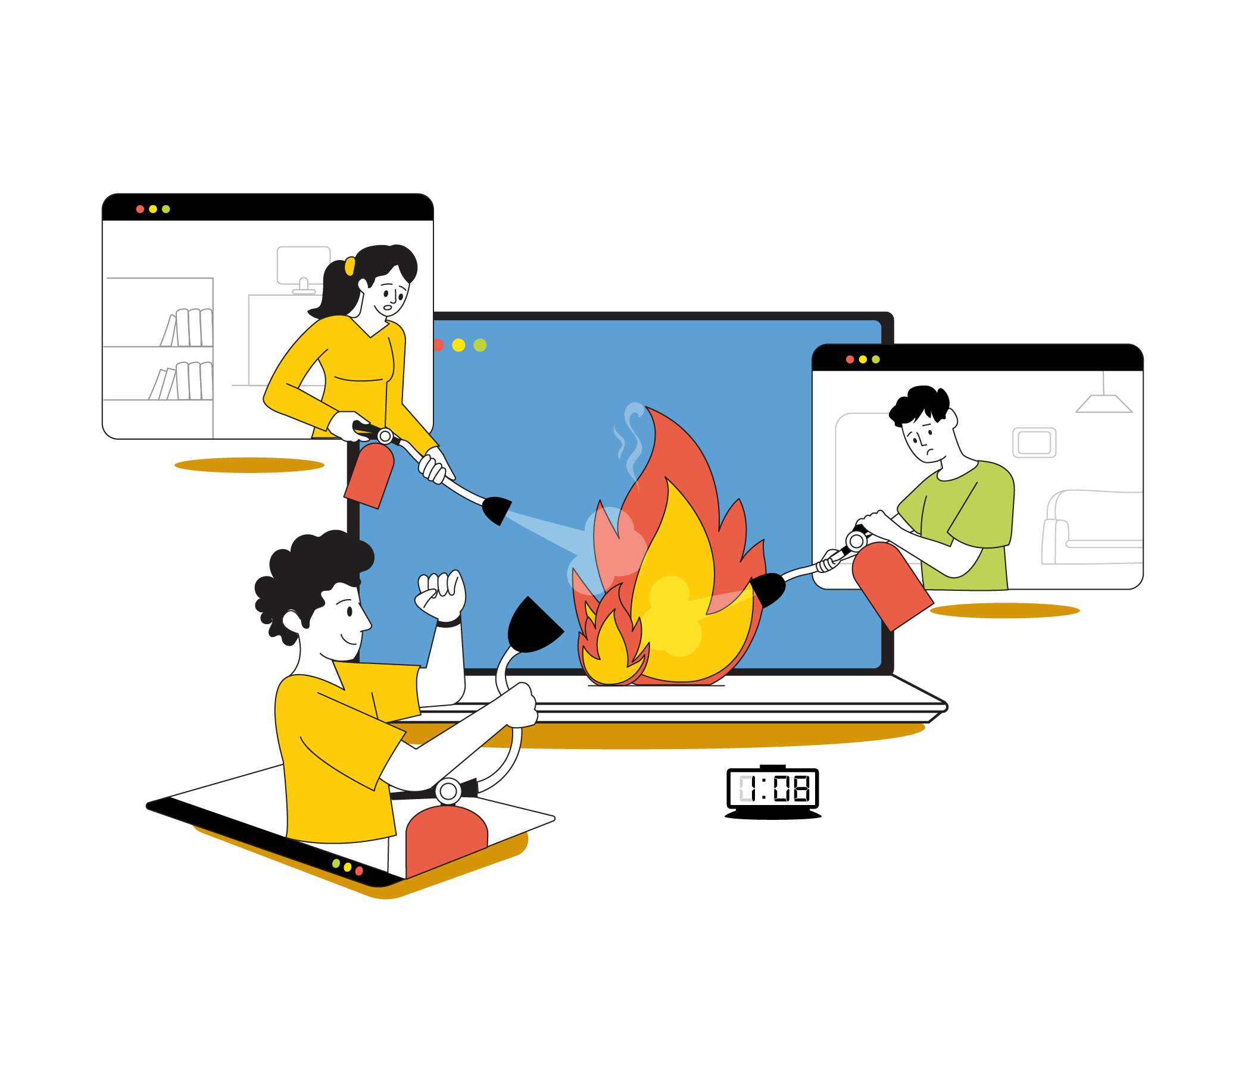
Move fast to manage major outages—with your best minds on board no matter where they are

Slide 5
Smooth sailing with ServiceDesk Plus
The challenge
The toolset
The ServiceDesk Plus platform
ManageEngine integrations
Site24x7
OpManager
Integrated change management
The IT team fails to realise the extent of the outage—which is everything
A diagnostic tool to alert teams about the outage and its extent
Bidirectional integrations with collaboration tools:
Microsoft tools
Slack
Jira
Request life cycle
Announcements
OLAs
Collaboration channels to bring together teams (SRE, NOC, Data Center Ops, Customer Support, etc.) distributed across the globe
Internal communication pitfalls
Employees badger the help desk with tickets
Effective automations to manage the inflow of tickets, and an integrated CMDB to map the affected services
Link and merge tickets
CMDB

Slide 6
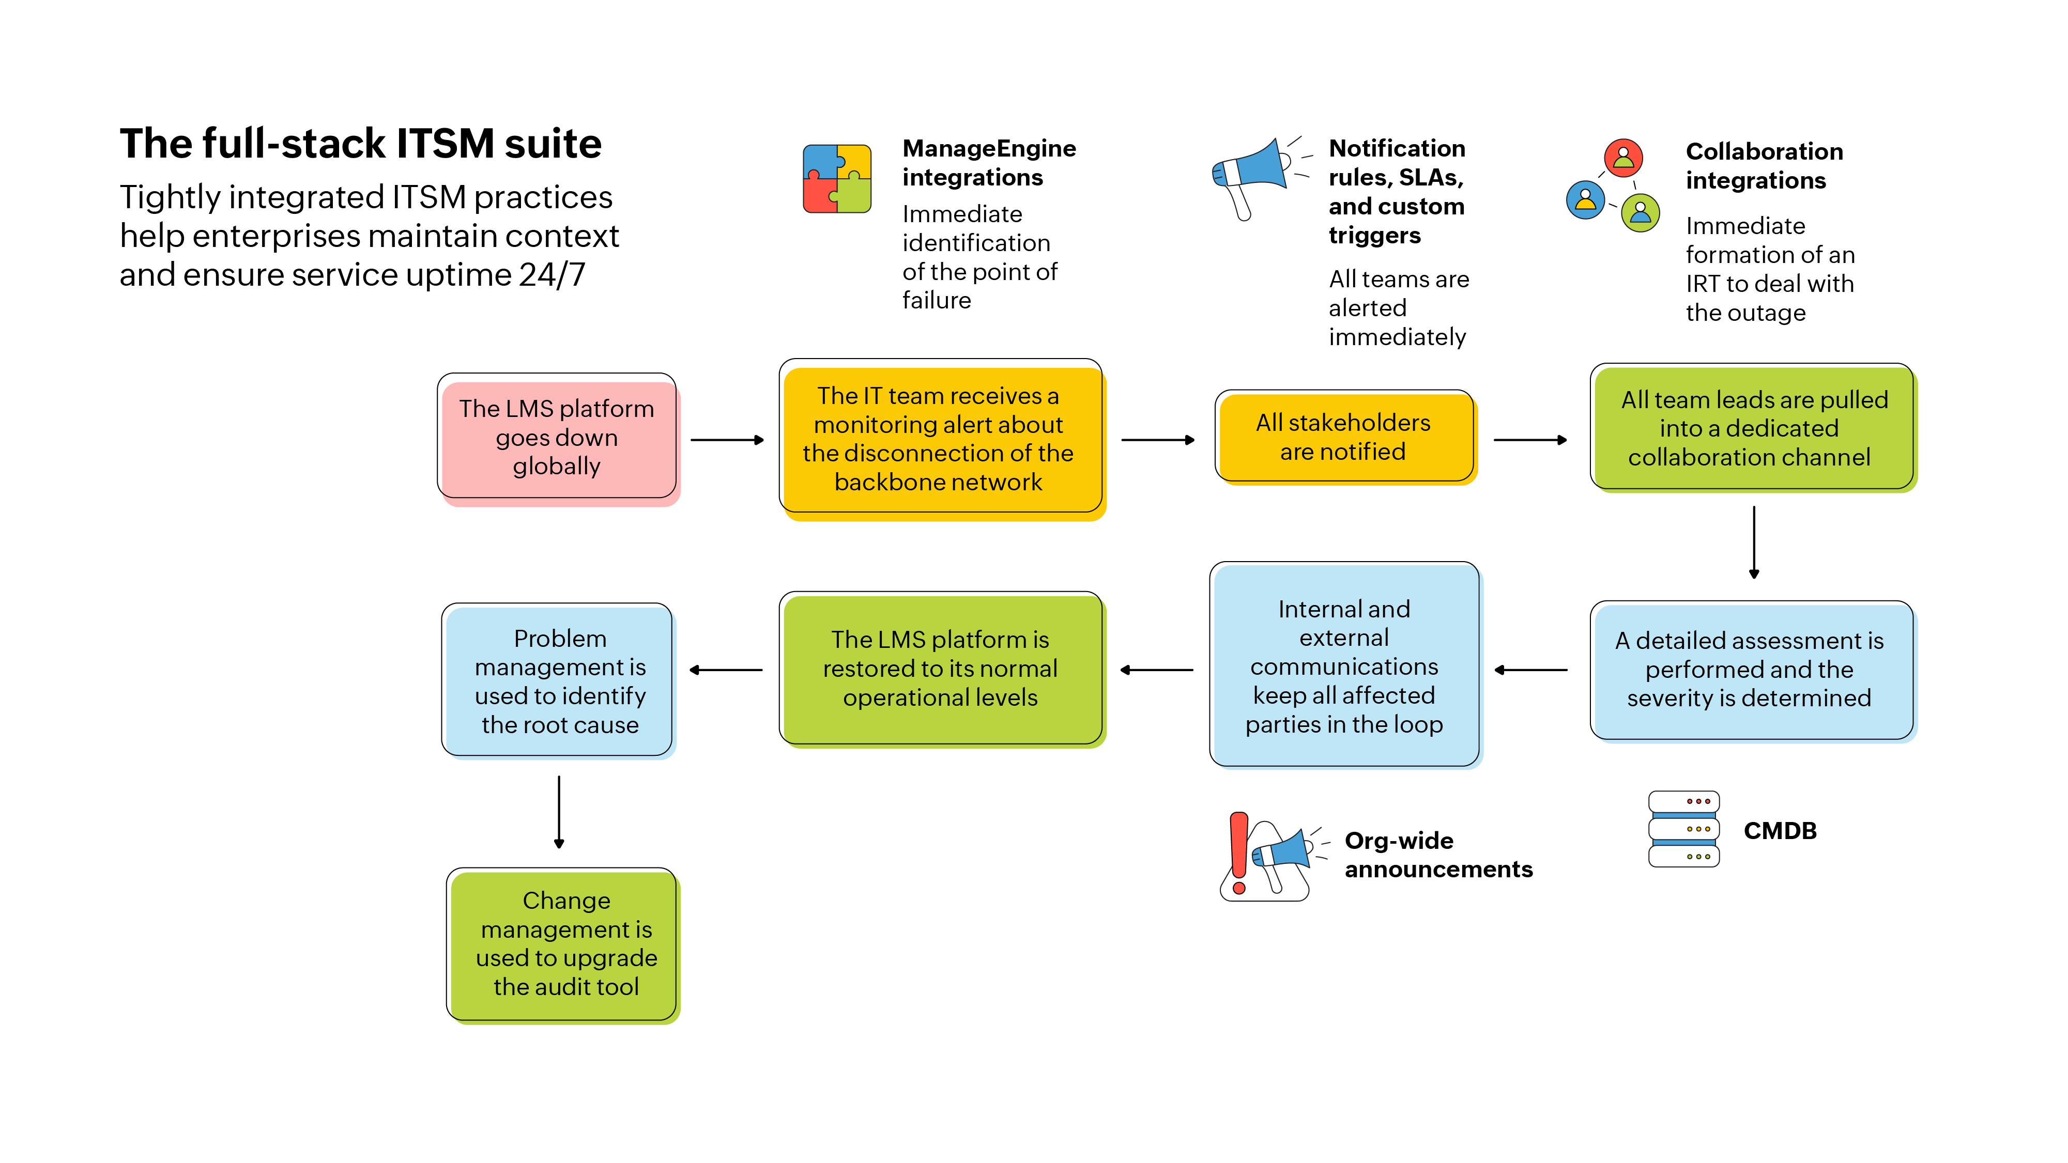

Slide 7
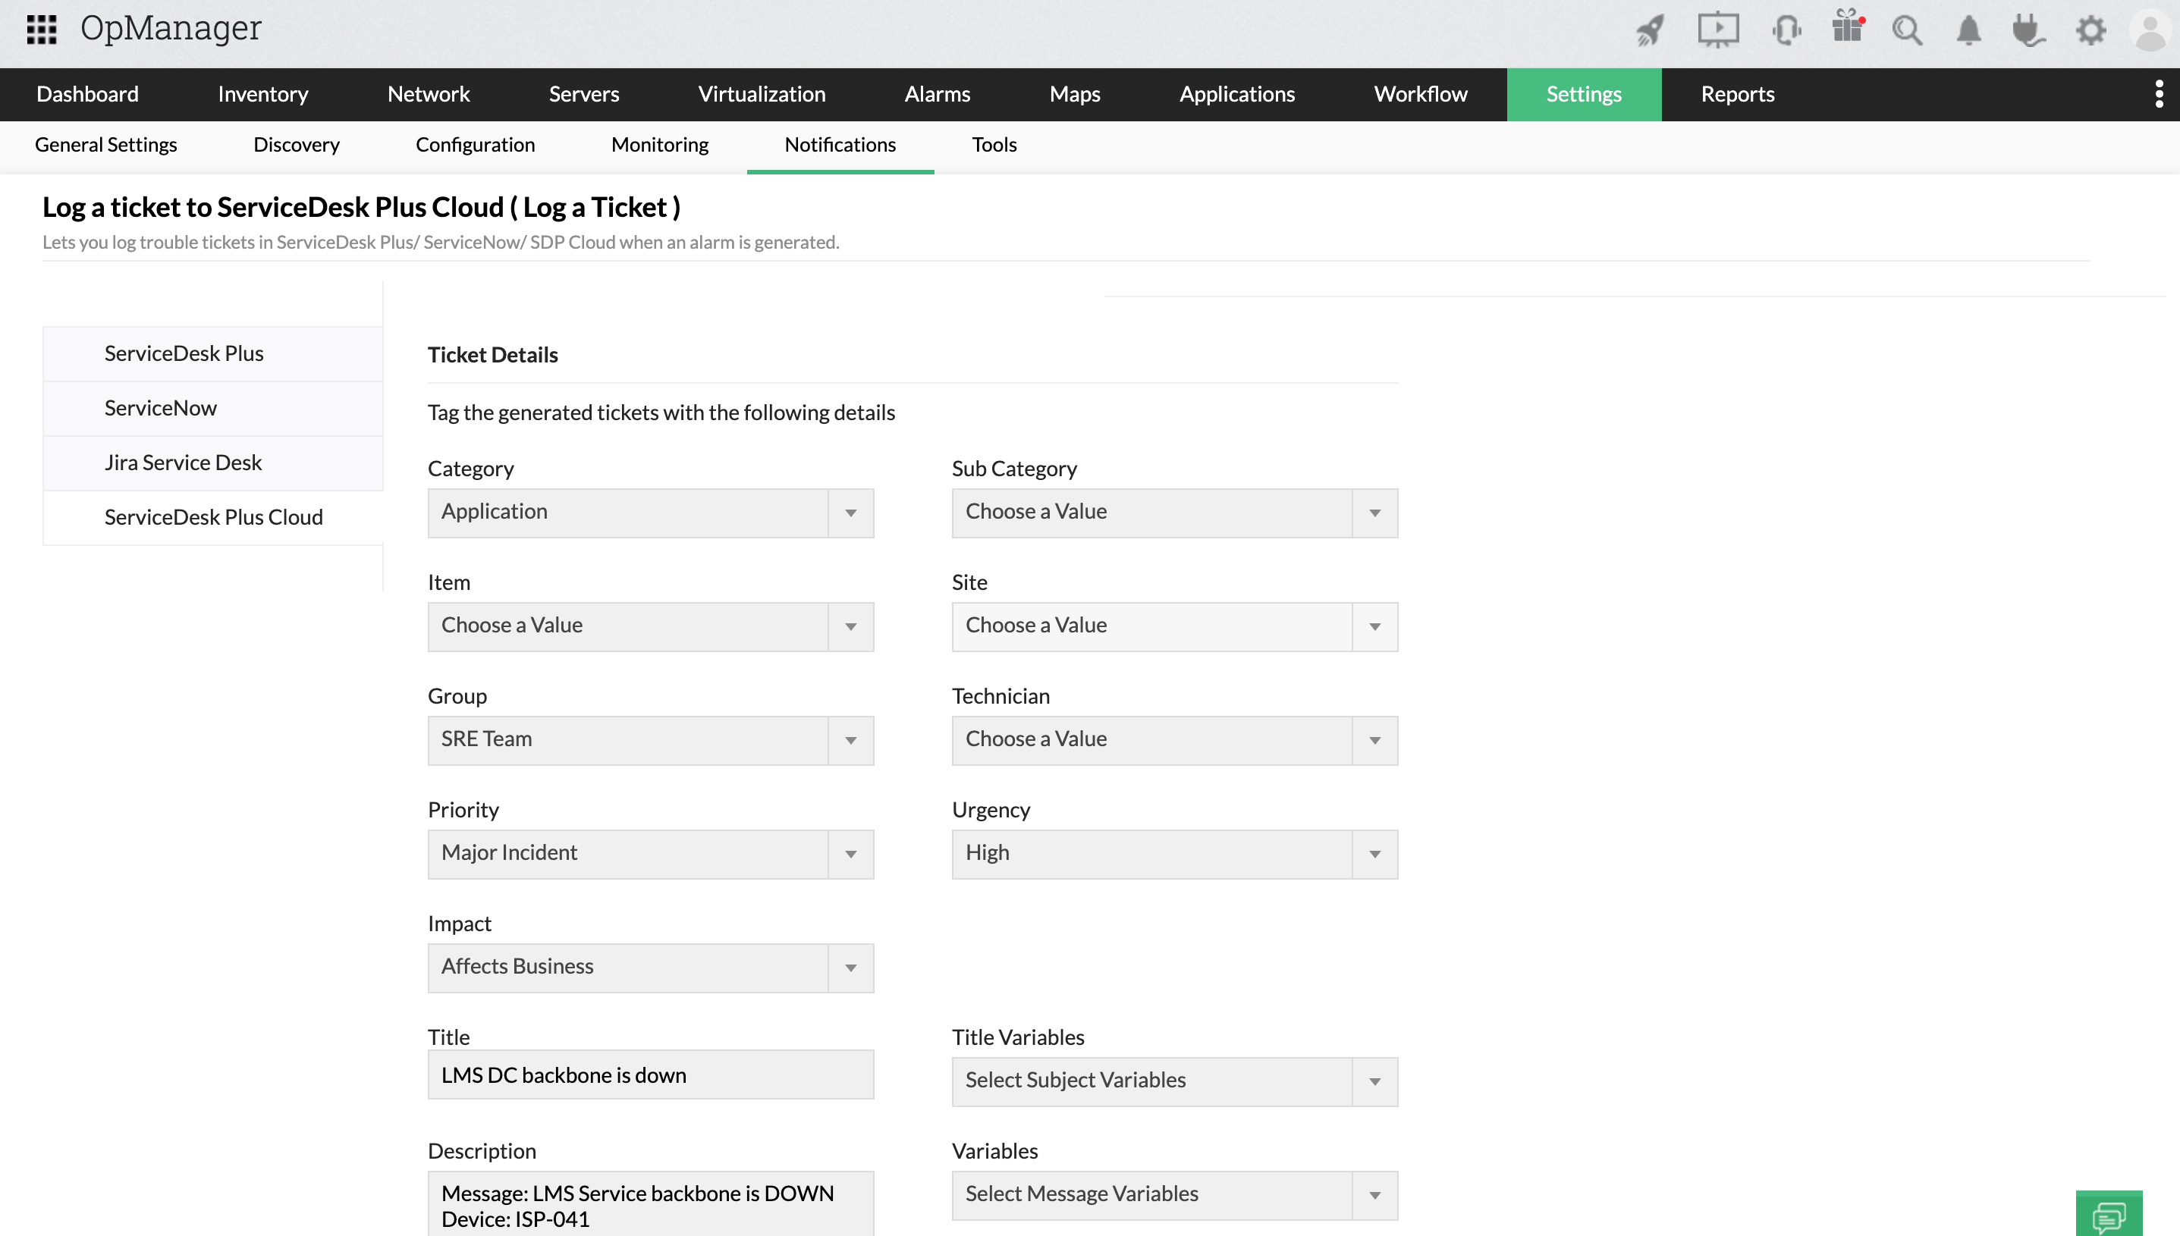
A network issue is detected by OpManager and a ticket is logged into ServiceDesk Plus

Slide 8
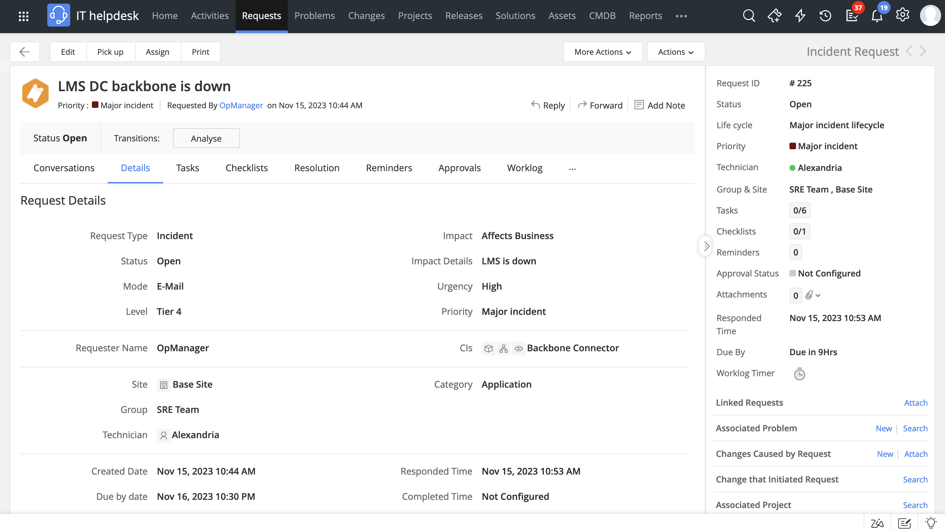
An incident ticket is created in ServiceDesk Plus

Slide 9
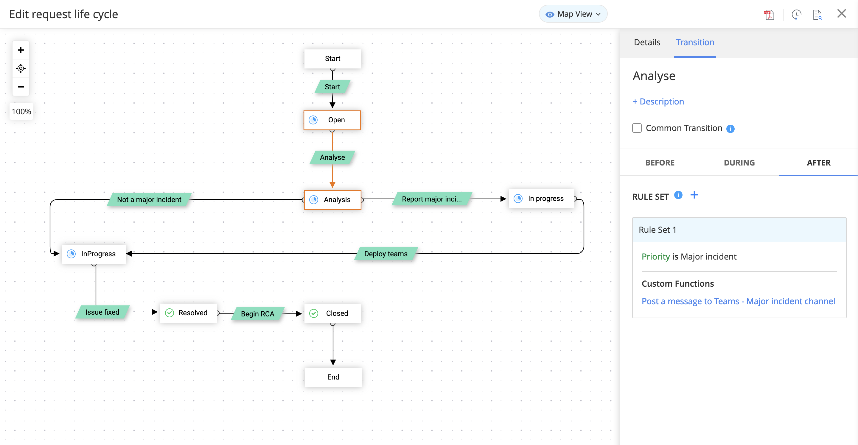
A custom function is triggered from within the assigned RLC to notify all the Team leads in a dedicated collaboration channel

Slide 10
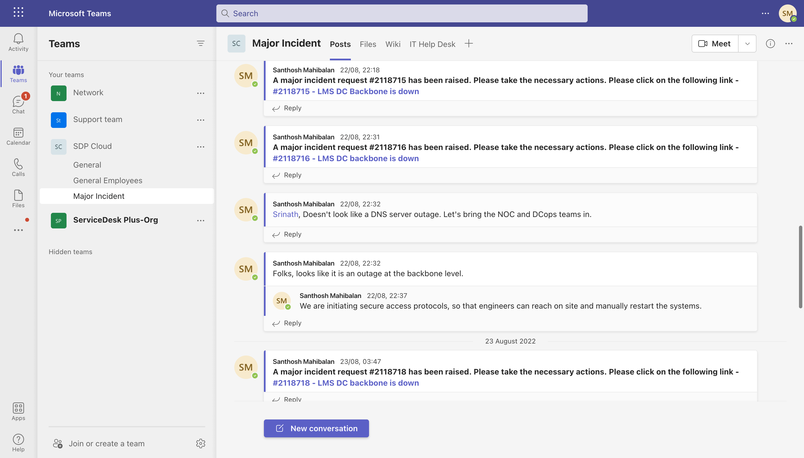
All stakeholders including the SRE, Customer Support, NOC, DC Ops and Facilities teams are notified

Slide 11
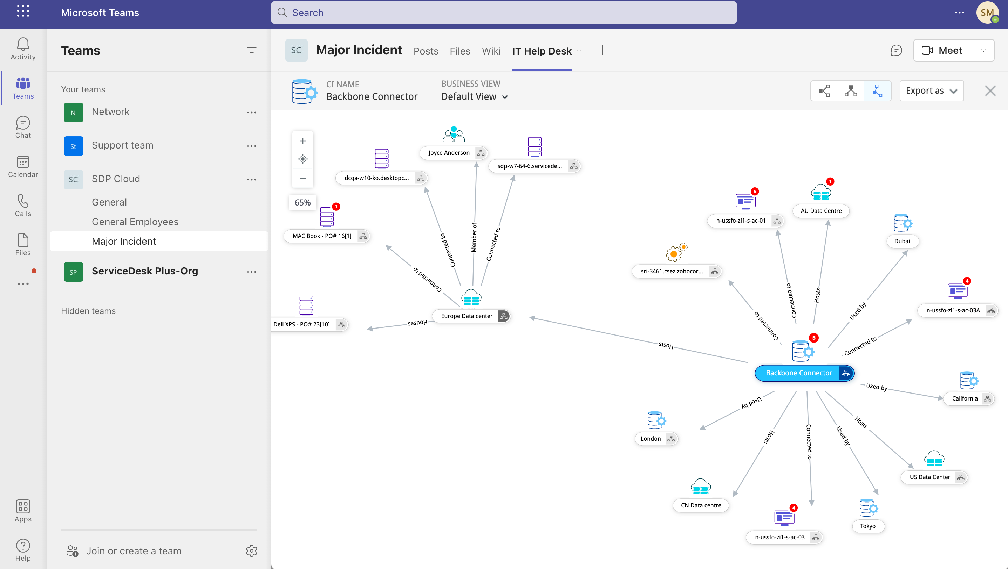
A detailed assessment is performed and the severity is determined

Slide 12
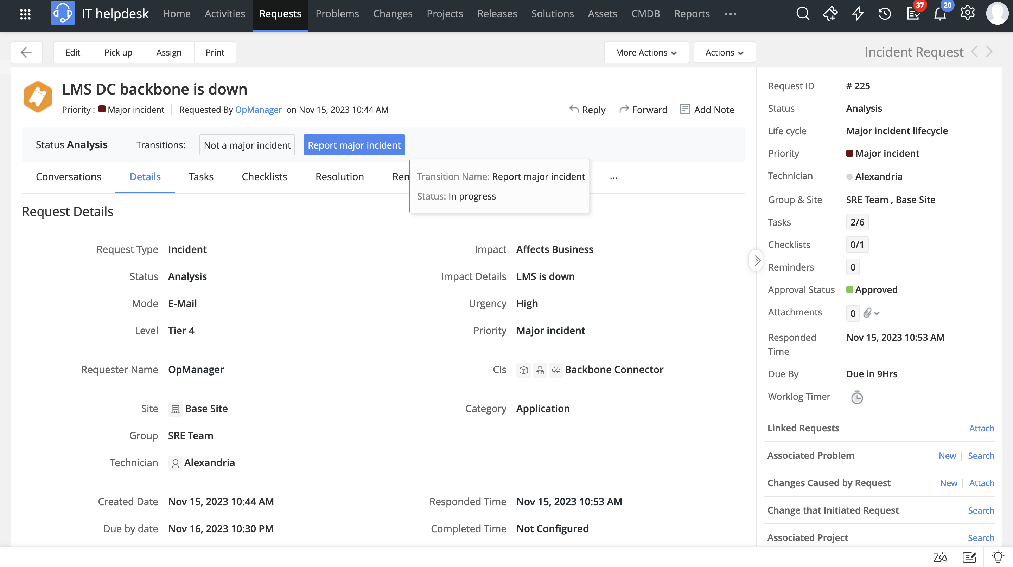
Upon determining the severity, it is reported as a major incident

Slide 13
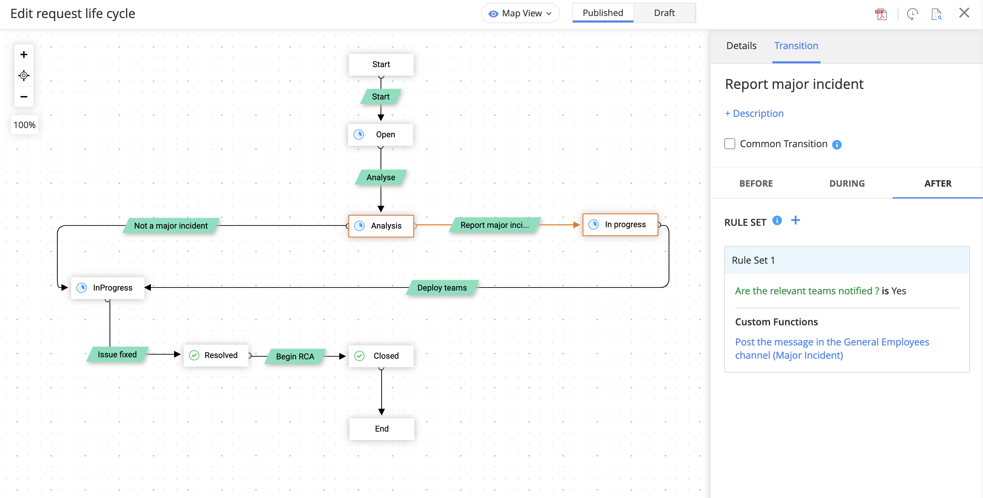
A custom function is triggered to post a message in the employees channel

Slide 14
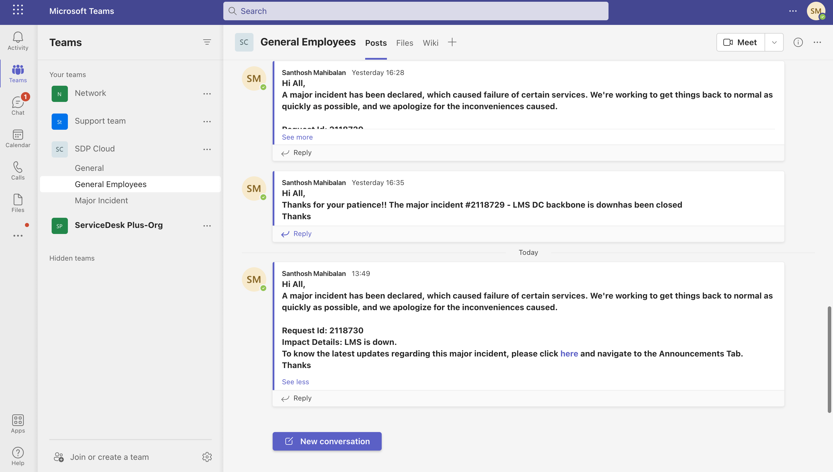
The relevant stakeholders are alerted and are kept in the loop

Slide 15
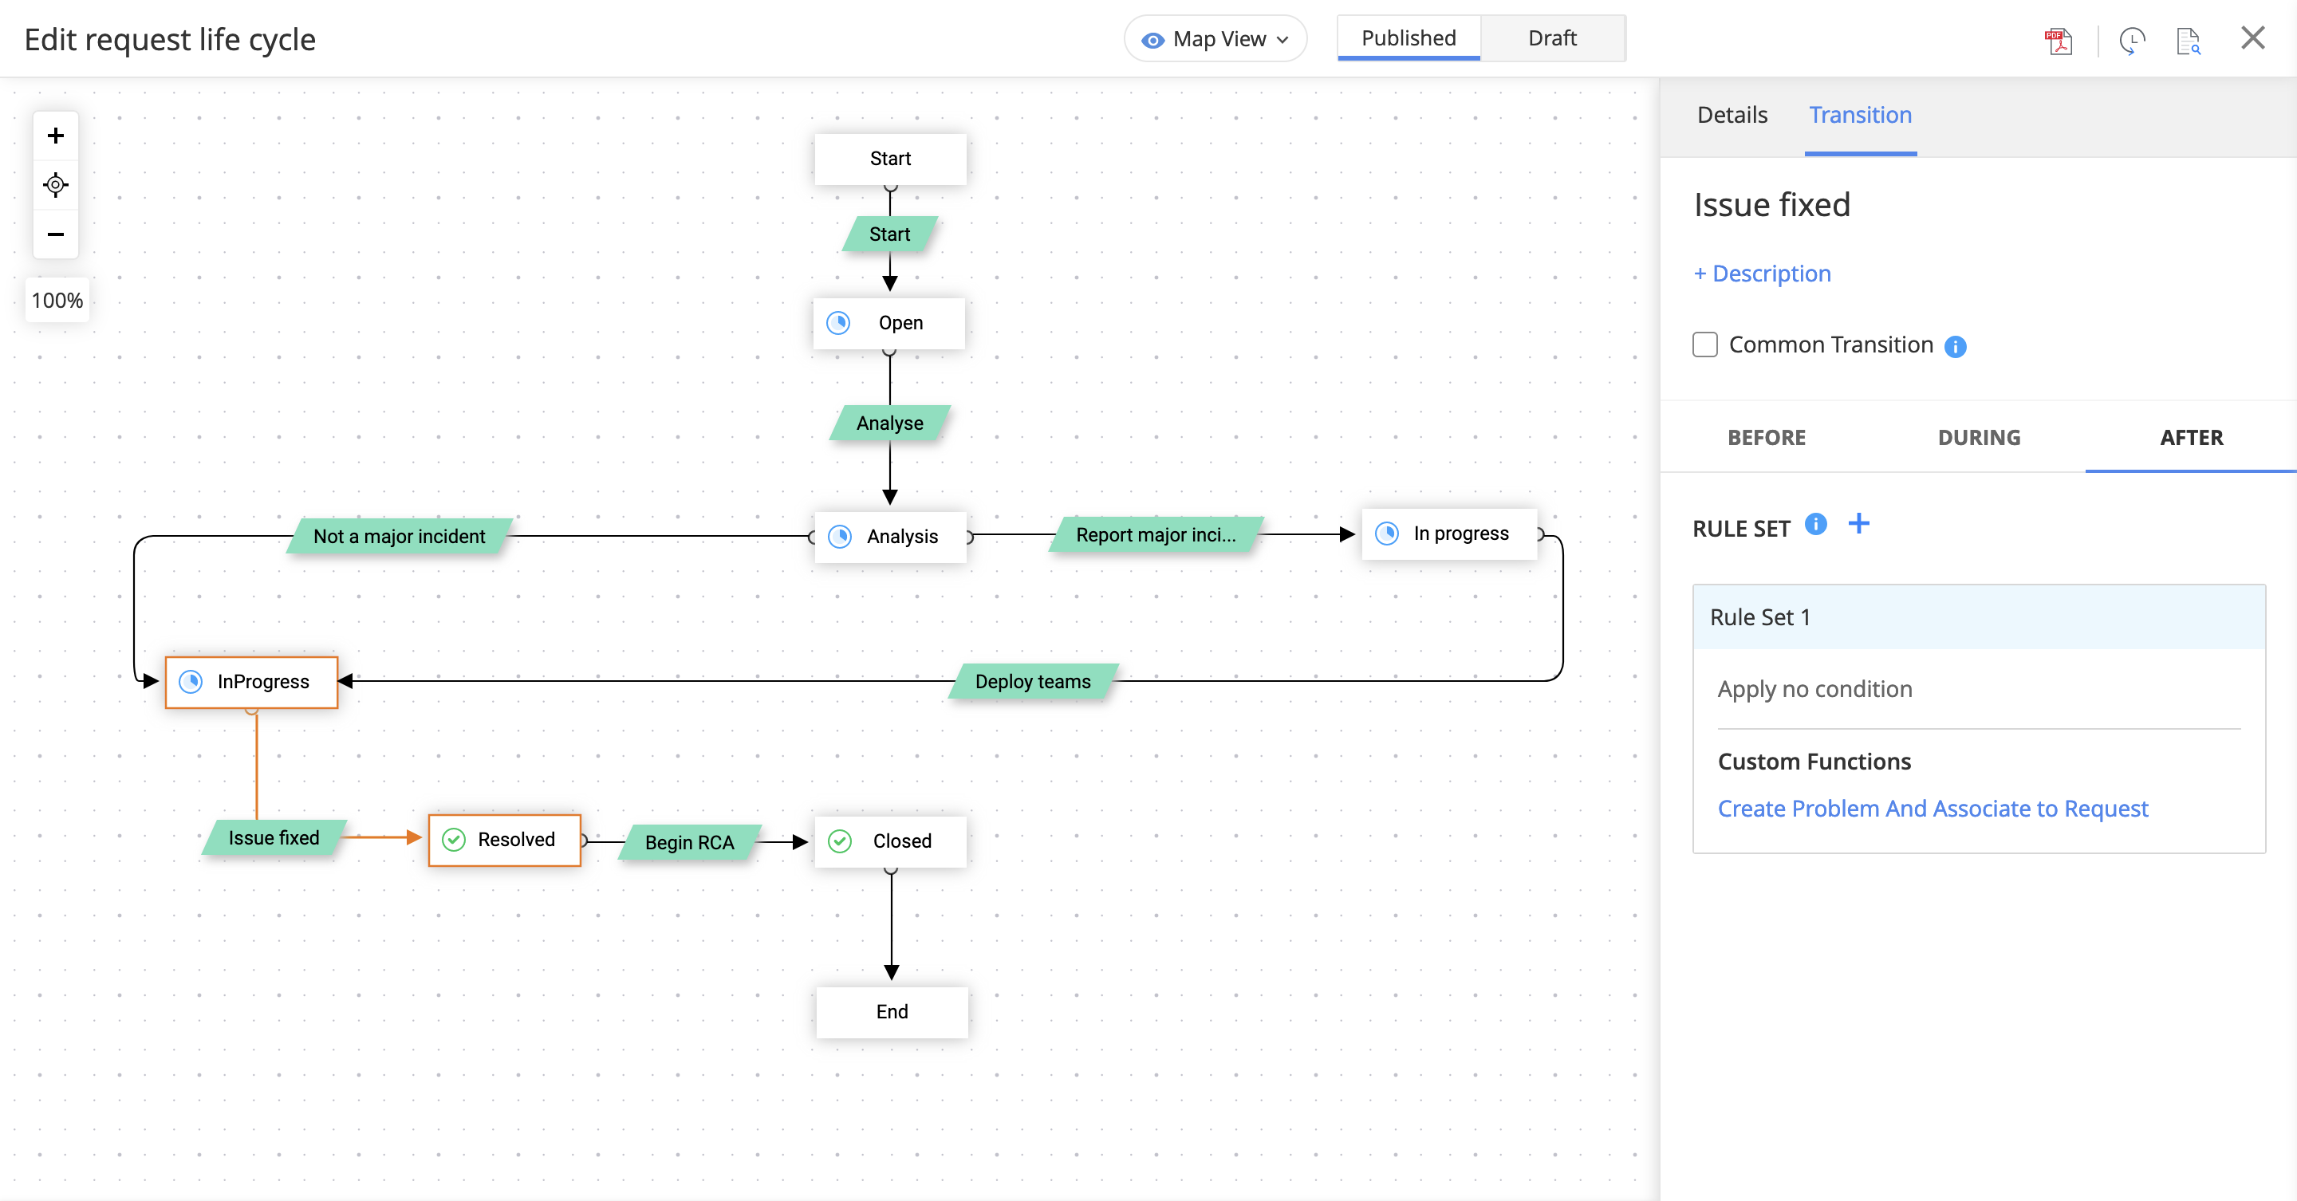
A custom function is triggered and a problem ticket is created to initiate a Root Cause analysis

Slide 16
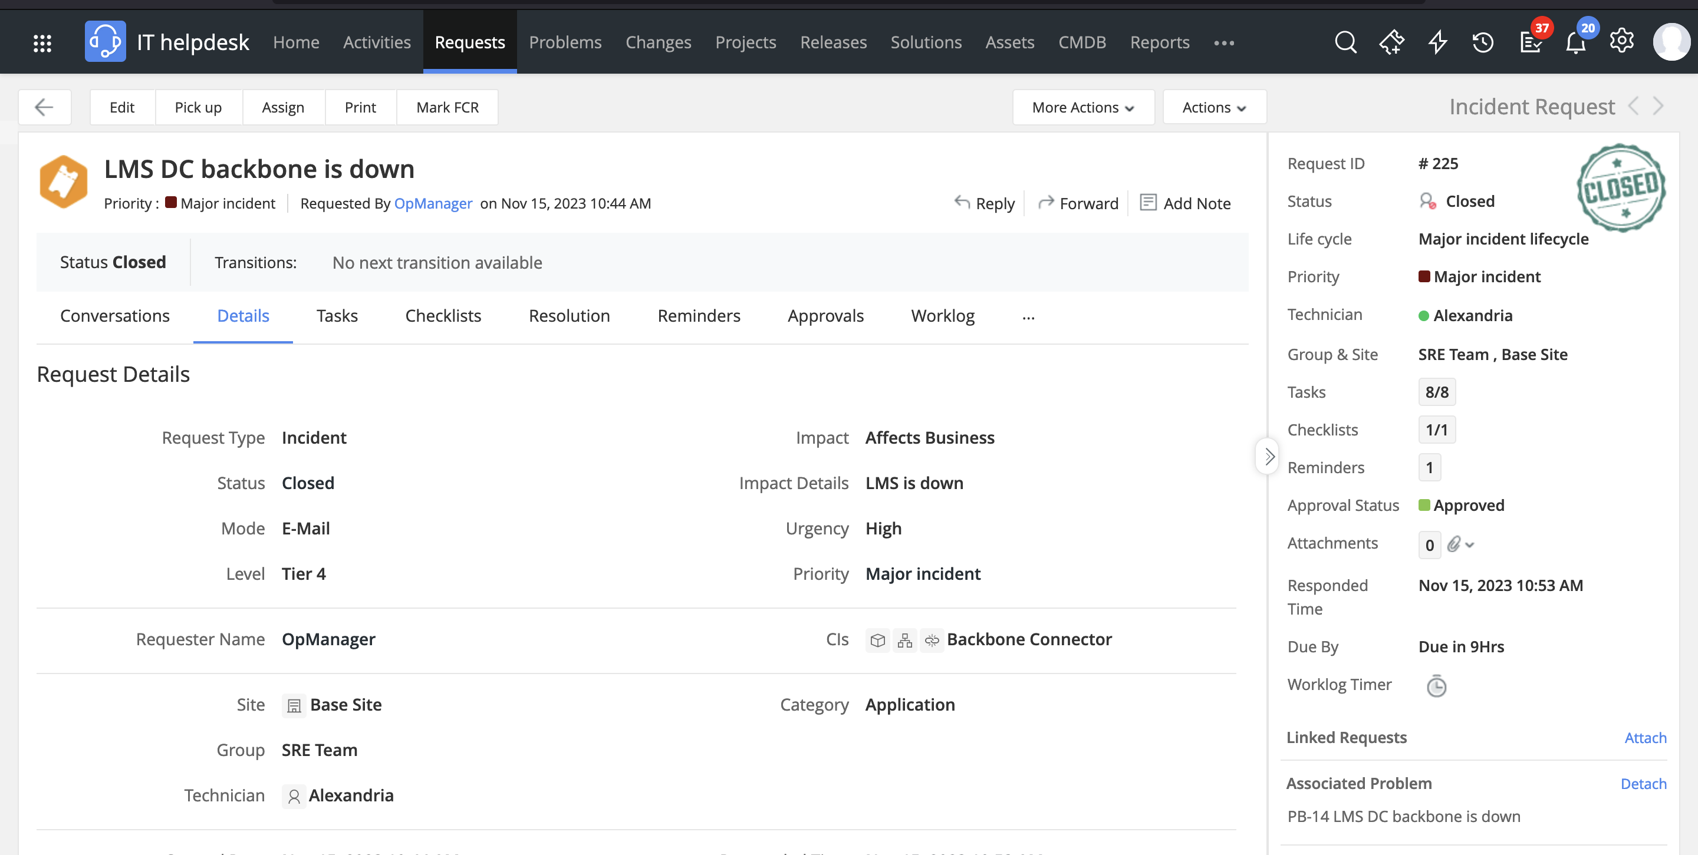
Once the LMS platform is restored to its normal operational levels, a problem ticket is automatically created and associated to the incident ticket

Slide 17
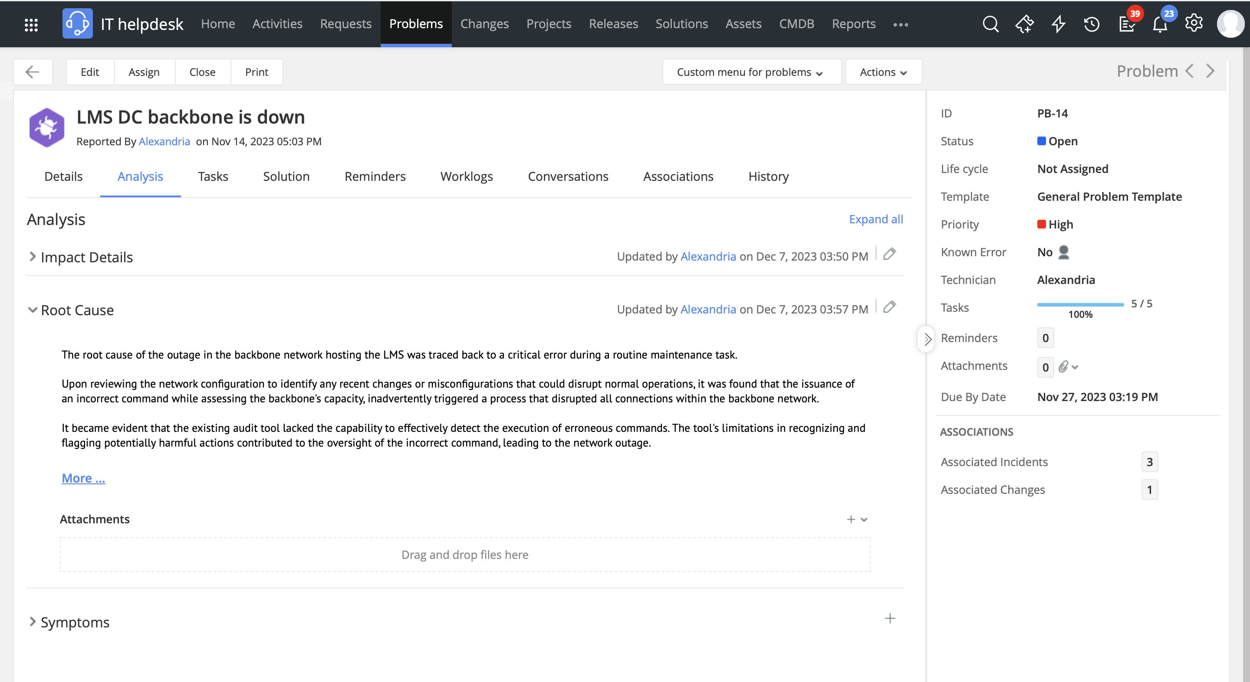
The root cause is identified and is attributed to inefficiencies with the existing auditing tool

Slide 18
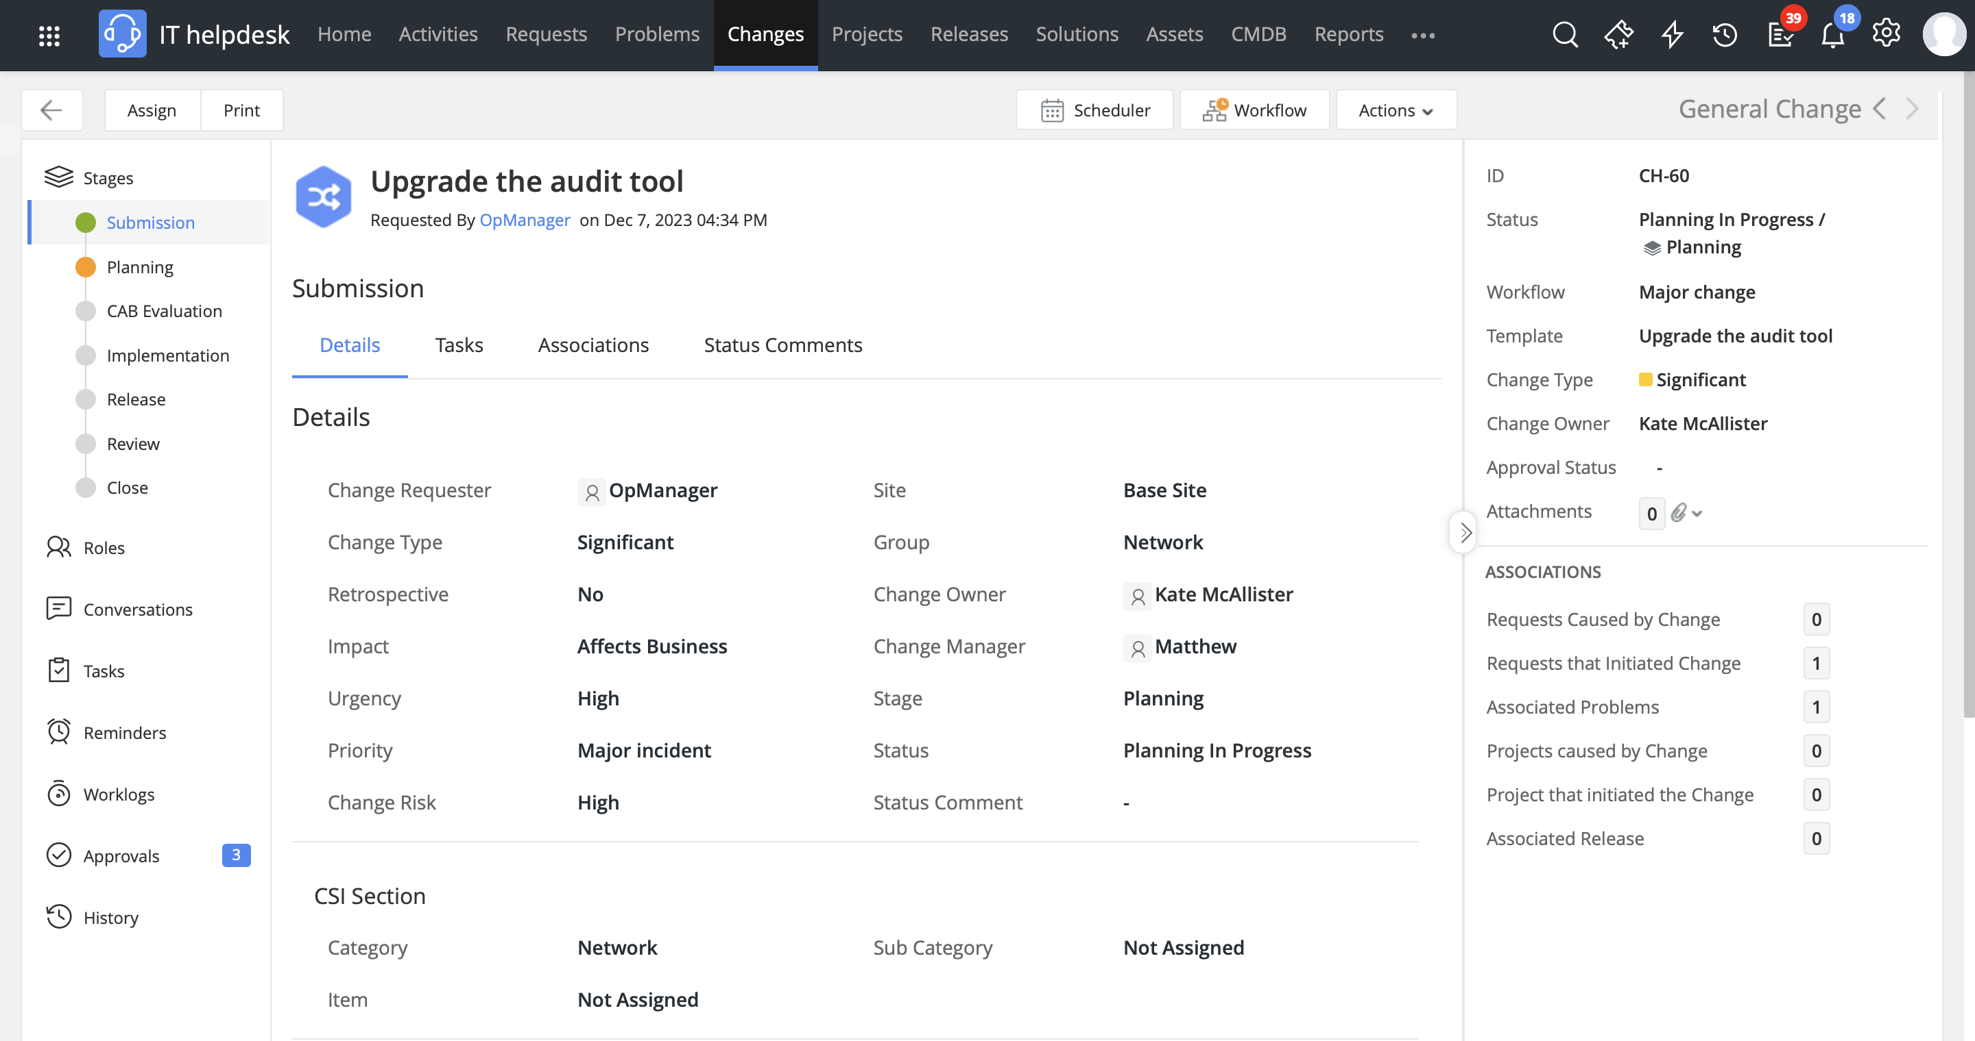
A change is initiated to upgrade the audit tool

Slide 19



An ITSM solution for all exigencies
Helps reduce the time taken to restore services to normal operating levels
Brings central visibility by integrating the CMDB, incident management, problem management, and change management on a single console
Connects teams in far-flung locations by using collaboration tools they are comfortable working with

Slide 20


