Slide 1
Project Management and IT – Workflow or Traffic Wreck ?
Dennis Drogseth
Vice President - Application and Business Services
Enterprise Management Associates

Slide 2
Agenda
How IT is expected to perform in 2013 and the foreseeable future, and how this represents a rupture with the past
How IT project management must change in response
How PPM solutions will eventually evolve into uniquely optimized workflows coupled with automation and analytics
How to begin to unravel the mess

Slide 3
Key Changes in IT in 2013 and Beyond
No longer about just being “stable and precise”
IT ecosystems (partners, suppliers, service providers, cloud, etc.) = “ITIL version 7.0”
Consumerization of IT
Front-office governance supersedes back-office governance
Where to optimize on costs, and where to optimize on value?

Slide 4
The “ Ecosystem Project”
Partner Sprawl
Service Provider Sprawl
Supplier Sprawl
Geographic Sprawl
Cultural Sprawl
WHO OWN’S WHAT????

Slide 5
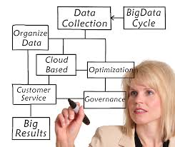
Front Office Governance
Front Office Governance = externalized metrics on service plus behavioral/business optimization informed by User Experience-enriched dialog, business objectives and a clear and defined relationship between IT activity and business outcomes.
VALUE as well as COST
Extroverted trumps Introverted
Persona-driven trumps
Systems-driven

Slide 6
How Project Management Must Change in Response

Slide 7
What is a “Project?”
Disasters and Severe Incidents – Multi-Stakeholder Triage
Routine incidents and requests
Asset Management inventories, license management, etc.
Asset lifecycle management and optimization
Process enhancements across IT – IT transformation
IT- business front-office alignment (user experience, etc.)
Portfolio planning
Data center consolidation
Complex infrastructure provisioning
New application releases
Patch management and routine releases
Governance, Risk, Compliance
Etc

Slide 8
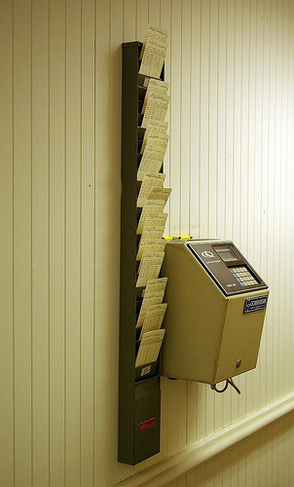
Time Tracking
What a mess
80% of spend is people?
What are you tracking it against?
Multiple options
Project portfolio system
Service desk
ERP system (HR module)
Professional Services Automation (PSA) system
Stopwatch functionality
Custom built
Nothing – allocation only

Slide 9
Service Desk Integration with Non-IT Call Centers is Expanding the Scope of IT Project Management
Service Desk Integration with non-IT Call Centers or Customer Support
Sample Size = 326

Slide 10
Overburdened IT Professionals Get Pressured from all Fronts
Ongoing improvement
Bigger than a ticket, smaller than a project.
Capacity/security/risk availability/architecture/etc etc etc
Project work
Deliverables
Stories
Issues/risks/action items
Releases
Service support
Incidents
Changes
Service Requests
Overburden
Multitasking
Poor execution

Slide 11
The Old Way
Waterfall thinking
Good for one version of one system
Moment of truth
Plan
IT Service
Build
Run

Slide 12
But IT Services Are Evolving With Accelerating Speed
Moment of truth
Moment of truth
Moment of truth
Moment of truth
Moment of truth
Moment of truth
Moment of truth
Moment of truth
Moment of truth
Moment of truth
Service Lifecycle
IT Service
IT Service
IT Service
IT Service
IT Service
IT Service
IT Service
IT Service
IT Service
IT Service

Slide 13
The Impact of Cloud Makes this Only Worse
Faster, faster, faster!
Greater choice, greater diversity
“Service” versus “domain-centricity”
Ecosystem-centricity
Multiple Options
Dynamic Assets

Slide 14
How PPM Solutions Will Evolve

Slide 15
Project Management Today– Some Key Data Points – a Snapshot in Time
Those who strongly favor Project Management are more likely to:
be executives
be itSMF members
view ITIL as becoming “more important”
favor integrations with runbook or IT Process automation capabilities
favor integrated support for performance analytics
prioritize “financial optimization” for a CMDB use case
view CMDB deployments as “very successful”
enjoy more extensive service catalog deployments
already have integrated release management in the service desk with more progressive support for application reviews and SLAs
enjoy Integrated support for mobility for ITSM professionals

Slide 16
Project and Portfolio Management is Second to the Top for Next-Generation ITSM Tools
What is the main point of interest for the next generation of ITSM tools?
Sample Size = 326

Slide 17
Visibility into Work in Progress is Second to the Top for Top Functional Priorities for Service Desk
Which of the following functional capabilities are most important to your organization’s help/service desk solution?
Sample Size = 326

Slide 18
But Service-Desk Integrated Project Management Solutions are at only 32% Deployed
Integrated with project management solutions integrated with Service Desk
Sample Size = 326

Slide 19
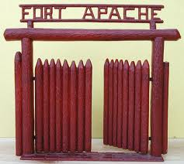
Service Desk as Communications Center or Fort Apache ?
“We view integration with the Service Desk as critical. It isn’t until we can work in and through the Service Desk that our analytics solutions can fully take flight and support all the critical processes, projects and workflows within IT.” (Large Managed Services Provider based in North America)
“We don’t own the Help Desk which is pretty much a bastion of last resort. All it’s good for is reacting to disasters once they happen. So we’re not interested integrating our analytics data with it.” (Another Large Managed Service Provider based in North America)

Slide 20
Demand/Supply/Execute: Transforming to a New more Dynamic Model for Project Management
Demand
What is required.
The Business Problem
Moment of truth
Moment of truth
Moment of truth
Moment of truth
Moment of truth
Moment of truth
Moment of truth
Moment of truth
Moment of truth
Moment of truth
Execute
IT Value Realization
Service Lifecycle
IT VALUE
IT Service
IT Service
IT Service
IT Service
IT Service
IT Service
IT Service
IT Service
IT Service
IT Service
Supply
Ingredients. Systems. Solutions. Services.

Slide 21
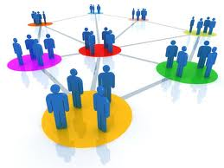
Another look at the New Project Management Model
Project Management must evolve beyond a static mapping system to a more dynamic, self-informing set of options
These will include higher levels of automation, analytics, and service modeling-related insights as well as other technologies such as social networking and self-service

Slide 22
Integrated Workflow-Process Automation is Becoming A Must
Integrated workflow-process automation with Service Desk
Sample Size = 326

Slide 23
Integration with End-User Self-Service Portals is a Help, but not a Panacea
Integrated with end-user self-service portal with Service Desk
Sample Size = 326

Slide 24
Other Integrations Key to Next-Generation Project Management
Integrated Portfolio Management System at 33% with 32% planning to deploy
Integrated SLM at 38% deployed with 37% planning to deploy
Integrated Change Management at 43% with 35% planning to deploy
Integrated Lifecycle Management System at 27% with 34% planning to deploy
45% offer MOBILITY in support of Service Desk and Integrated PPM Professionals

Slide 25
On Average, Fewer Than One-Third of Trouble Tickets are Generated through Alerts
What percentage of tickets are generated through monitoring alerts?
Sample Size = 239

Slide 26
Three Views from the Trenches
Enforceable Execution: “We had an opportunity to reinvent change management in our organization and go from a traditional PPM approach that was very ambivalent when it came to execution, to a much more enforceable approach that supported clear ownership and could lead to increased levels of automation.”
Function as a Team “We were looking for a solution that would allow us to function more effectively as a team.”
Holistic Vision “We have a complete approach to application lifecycle management. We leverage the system both for small adjustments in application requirements, and for full-bore application deployments. By having both pre-production and production in the system, we can easily prioritize issues so we know when the impact is. “

Slide 27
The Growing Impact of Social Networking
Project Management will Require Increasing Levels of Dialog –
Adjust to changing business and consumer requirements
Better understand relevant stakeholder roles and opinions
Address the “nuances” of status beyond “multiple choice”
Promote better teamwork and team awareness
Enable more accurate assessments of what’s working and what’s not
Promote “relevance” as an ongoing question/ condition

Slide 28
How to Begin to Unravel the Mess

Slide 29
Unraveling the Mess!
Disasters and Severe Incidents – Multi-Stakeholder Triage
Routine incidents and requests
Asset Management inventories, license management, etc.
Asset lifecycle management and optimization
Process enhancements across IT – IT transformation
IT- business front-office alignment (user experience, etc.)
Portfolio planning
Data center consolidation
Complex infrastructure provisioning
New application releases
Patch management and routine releases
Governance, Risk, Compliance
Etc

Slide 30
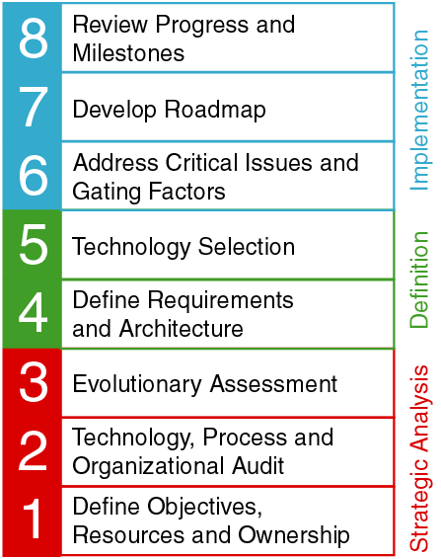
EMA’s 8-Step Methodology Strategic Project Management
Based on years of practical experience by EMA staff
Proven successful at large companies with challenging infrastructures
Can’t skip any steps – each builds on previous efforts
Focuses on tools, process, and people

Slide 31
Project Management is more than TWICE as likely to be a part of “Completely Satisfied” Service Desk Deployments
SIGNIFICANTLY more likely to have more service-desk functionality deployed – but more than 2 to 1:
Project management
Integrated workflow/process automation
Integrated with Operations for SLM and performance
Financial planning
IT portfolio management
CMDB/CMS
Application lifecycle management
Service catalog
Integrated release management

Slide 32
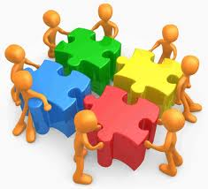
Conclusion
IT is become more dynamic and front-office driven.
To meet this need, Project Management should no longer be viewed as a manual overlay unique in itself, but an integrated part of diverse Service Desk and Operations functionality.
In parallel, projects range in scope, urgency and complexity and need to be managed with unique strategies, owners and packages.
To do this will require strong levels of support from associated technologies such as automation, analytics, service modeling and service awareness, mobility, self-service and social networking.

Slide 33
Project Management in ServiceDeskPlus (Overview) Task Management Made Easy
Online Demo
http://projects.servicedeskplus.com/

Slide 34
Project Management in ServiceDesk Plus
What is a Project?
A large scale change implementation
Which organizes Tasks effectively and
Is useful when Task count becomes impossible to handle
What does it do?
Bundles Tasks into one big Project which goes through many phases before reaching completion.

Slide 35
Phases of a Project
Milestone – Phase where you decide what should be done and also take the necessary steps
Task – Phase where a specific action is carried out
Phases have a Flexible Structure
Milestones & Tasks are given equal importance
A Task, although considered a sub-unit of Milestone, can be declared independently

Slide 36
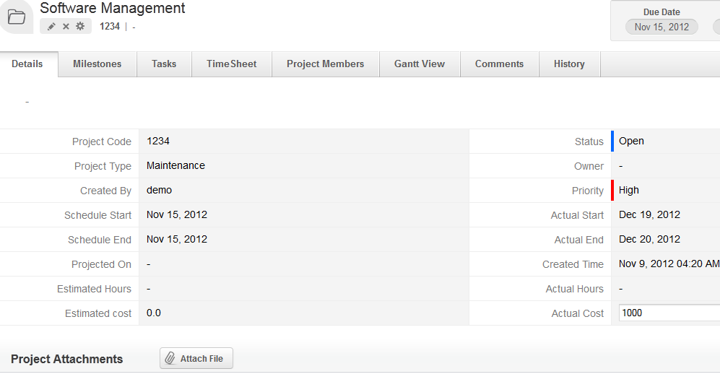
Inside a Project

Slide 37
Project Attributes
Project Code, Project Title, Project Description
Project Owner, Project Member
Project Member can be a Requester or a Technician
Project Type (Software, Infrastructure, etc.,)
Project Duration (Start, End time)
Project Hours (hours spent by members)
Project Cost (estimated & actual cost)

Slide 38
Project Structure
Project
Milestone
Sub-Unit Task 1
Sub-Unit Task 2
Independent Tasks
Task Dependency: Project(s) allows for task dependency configuration; that is, lets you decide the sequence in which the tasks should be executed. This is accomplished with the following features: Mark-Parent Task Mark-Child Task

Slide 39
Task Dependency Map
Mark-Parent Task: Appears while hovering over a Task in the Task Dependency Map - allows you to configure Parent to the highlighted task.
Mark-Child Task: Appears while hovering over a Task in the Task Dependency Map - allows you to configure Child to the highlighted Task.

Slide 40
Gantt Charts
Graphical representation of Project(s), its members, Milestones and Tasks
Presents a clear picture of Task distribution
Based on Project’s progress lets you change/ reassign Milestones, Tasks and everything related to the Project
Provides filters to generate Milestone-based, Task-based or Member-based charts
In short, a quick access to managing/editing Project(s)

Slide 41
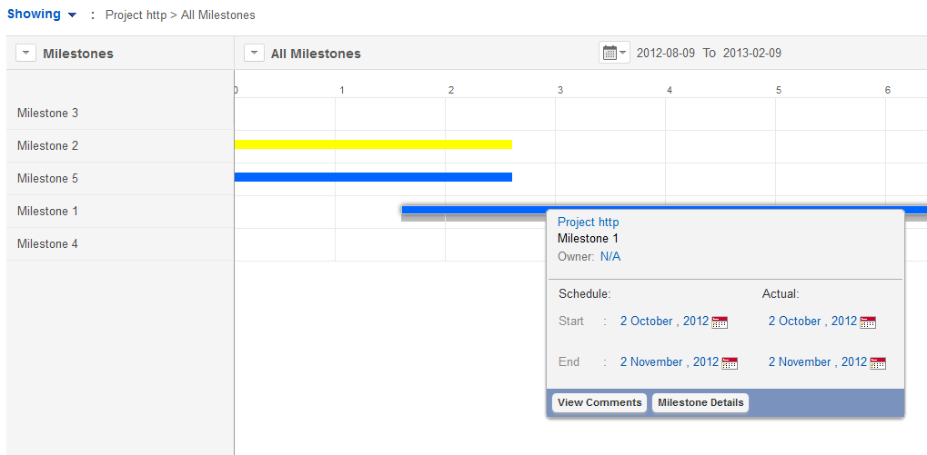
Gantt Chart View
Resource management Vs. Time management (based on Tasks listed)
Gantt chart is not merely a peek into project(s) management but an entity that lets you decide the course of actions concerning project(s) depending on: the resources available, time available/elapsed, task’s progress at the time the chart gets generated.

Slide 42
Project Overview Map
Present in the left extreme represented by a spiked wheel is the ‘Project Overview Map’ which displays the structure of the Project along with its Milestones & Tasks
In the above diag., Final Stage I & II are Tasks while Choosing the Software is a Milestone with Running Tests & Scanning as its tasks

Slide 43
Project Management Highlights
Effective Resource Management (via Gantt Chart)
Efficient Time Management (via Worklogs & Timesheet)
Minimal Cost Expenditure (by comparing the Project’s budget with Estimated Cost)
Uncomplicated design that streamlines project creation & tracking
Task Dependency Map for efficient handling of Tasks

Slide 44
Questions?

