Slide 1










IT management, simplified.
Real-time IT management solutions for the new speed of business

Slide 2


Underpinning of a successful IT help desk
Major incident management in
ServiceDesk Plus

Slide 3
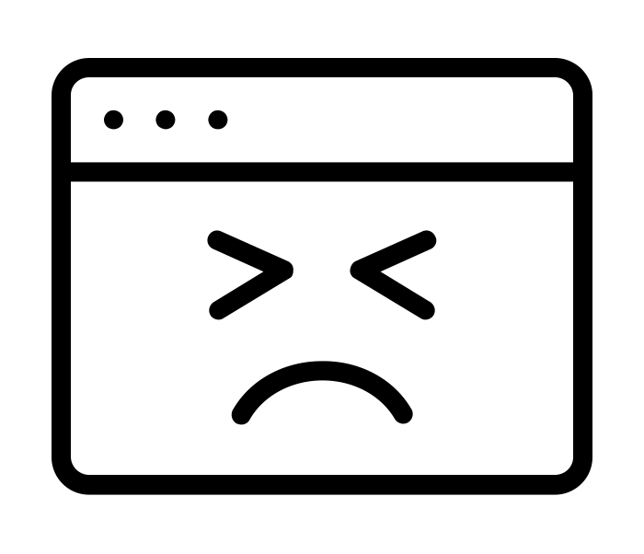
How Zylker handles major incidents
EzeeBill, the billing software of Zylker, crashes and what happens thereon!

Slide 4








Say hello to Zylker
BUSINESS USERS
IT FOLKS
SCOTT
IT TECHNICIAN
DAVE
HIRING MANAGER
JASON
IT TECHNICIAN
CIO
MARCUS
CATRIN
IT SERVICE MANAGER
ADAM
IT TECHNICIAN
WENDY
HR
JOHN
END USER

Slide 5


How things should work
STEP 1
Scott receives a notification of the incident.
Keeps users informed of the progress.
Escalates to service manager.
SCOTT
IT TECHNICIAN
END USERS
STEP 2
Catrin forms an incident investigation team.
Keeps the CIO informed of the status.
CATRIN
IT SERVICE MANAGER
MARCUS, CIO
STEP 3
Incident investigation team analyze.
Find a resolution quickly. Service is restored.
ADAM
IT TECHNICIAN
JASON
IT TECHNICIAN

Slide 6






How things work at Zylker!
For the nth time, any update?
NO. There isn’t any update!
What’s happening? The chairman is on the line!
Who handled the call today?!
Let me take this call first.
I know this has happened before. We can solve this in minutes if I can dig through all my emails!

Slide 7




The impact
What went wrong?
END USERS NOT NOTIFIED
COMPLEXITY IN TRACKING
End users were not notified on the outage and the status of their tickets which gave rise to high volume of calls and walk-ins
No proper mechanism to track IT tickets. Lack of ownership.
SLA BREACH
LACK OF AUTOMATION
Lack of automation to prioritize and assign tickets to the right technicians speed up the resolution process
Lack of automation to prioritize and assign tickets to the right technicians speed up the resolution process

Slide 8
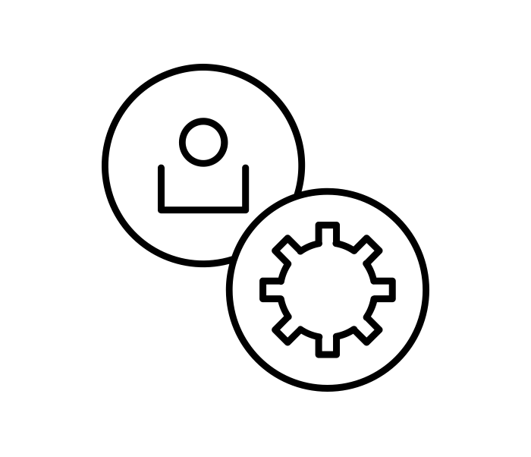
Major incident management with
ServiceDesk Plus
How Zylker handles major incidents the ServiceDesk Plus way!

Slide 9
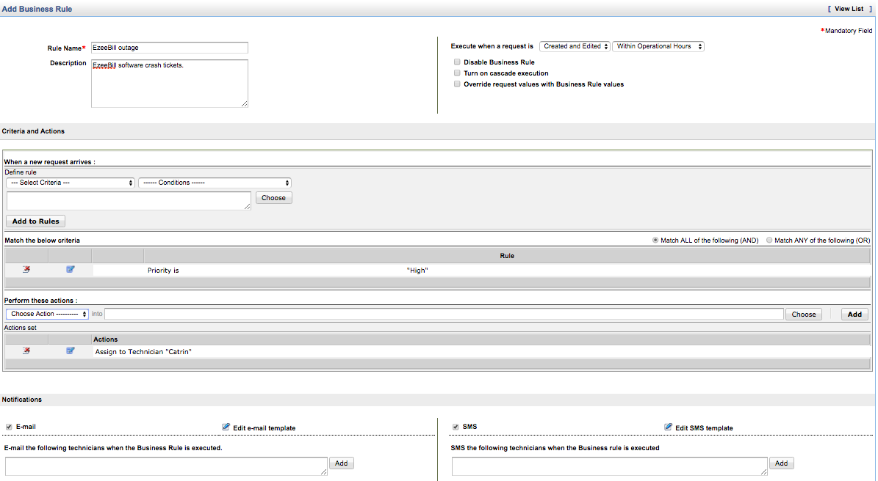
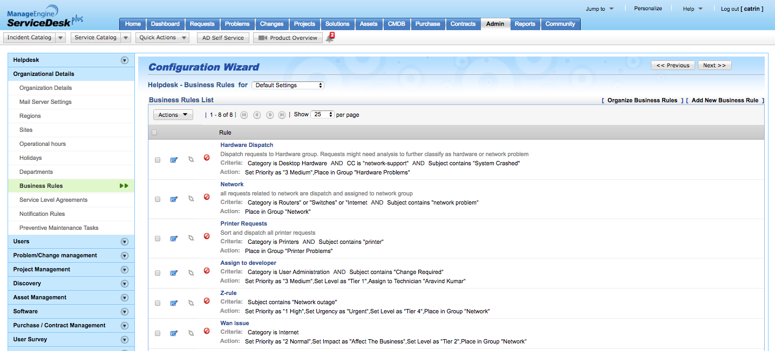
AUTOMATED TICKET CREATION AND NOTIFICATION
FEATURE: BUSINESS RULES
Since EzeeBill is a business critical application, as the IT service desk manager and admin, Catrin adds business rules in ServiceDesk Plus to handle tickets related to the EzeeBill outage. She gives the rule name, description, sets the priority to high, places the tickets in the application management group, and self assigns the tickets. Further, she configures notifications to get notified whenever there is an incoming EzeeBill ticket.
Catrin defines the rule name as EzeeBill outage and gives a description
Sets priority as high.
Places the EzeeBill tickets to application management group and self assigns the tickets.
Configures mail and SMS notifications.

Slide 10
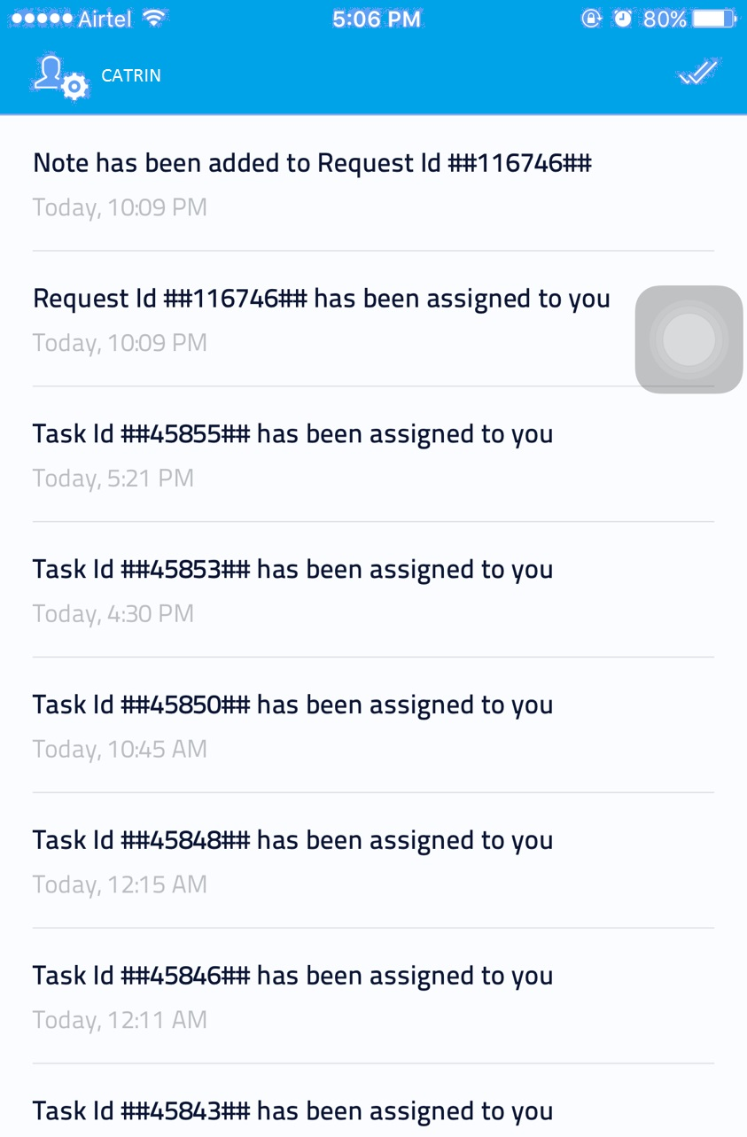
NOTIFIYING IT TECHNICIANS ON TICKET CREATION
FEATURE:: PUSH NOTIFICATIONS
Catrin receives push notifications on her mobile whenever an EzeeBIll ticket is created and assigned to her.

Slide 11
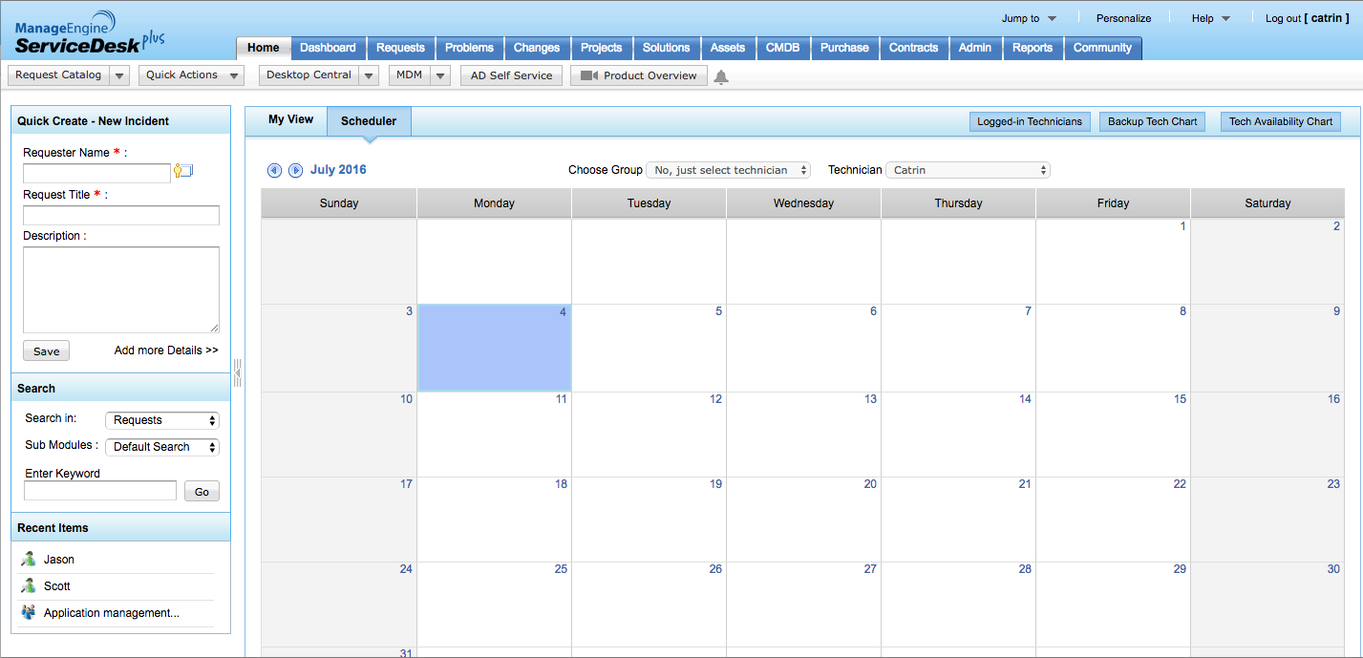
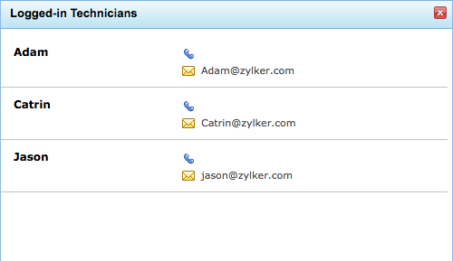
CHECKING TECHNICIAN AVAILABILITY BEFORE ASSIGNING TICKETS
FEATURE: SCHEDULER – LOGGED IN TECHNICIANS/TECH AVAILABILITY CHART
Once Catrin is notified of incoming tickets, she needs to assemble a team. Catrin uses the scheduler in ServiceDesk Plus to check the list of logged in technicians. She is in particular looking for Scott, but he’s not available on that particular day.
Catrin views the logged in technicians and finds Scott missing

Slide 12
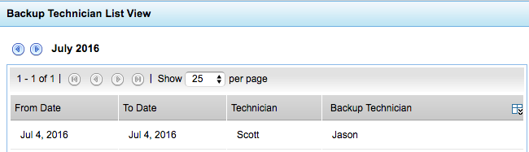
CHECKING FOR BACKUP TECHNICIANS BEFORE ASSIGNING TICKETS
FEATURE: SCHEDULER – BACKUP TECHNICIAN CHART
Catrin uses the backup technician view and figures out that Jason is the backup technician for Scott. Catrin forms an incident investigation team that includes Jason and Adam.
Catrin figures out the backup technicians is Scott and assigns the task to him.

Slide 13
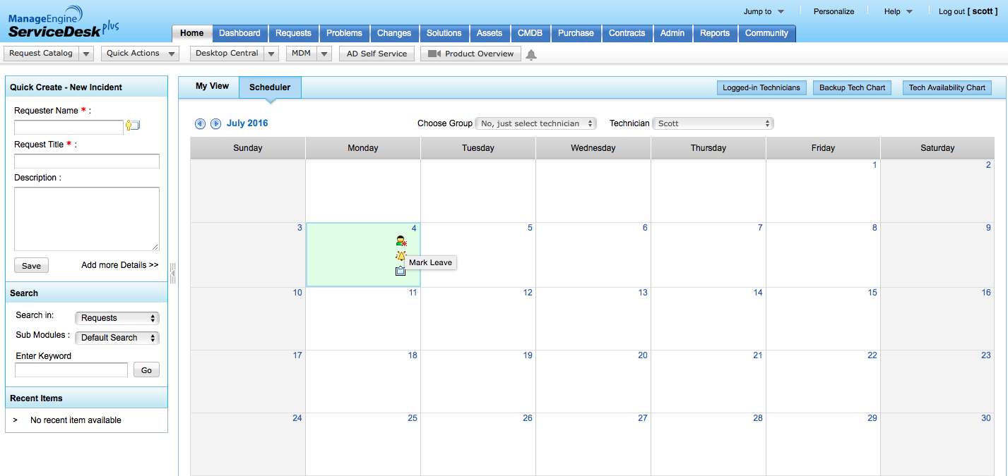
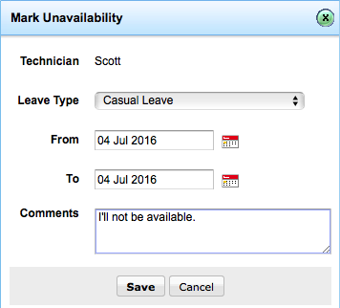
MARKING LEAVE OF ABSENCE
FEATURE: SCHEDULER – MARKING UNAVAILABILITY
Before the EzeeBill crash, Scott uses the scheduler to mark leave of absence.
Clicks on the icon to mark leave of absence.

Slide 14
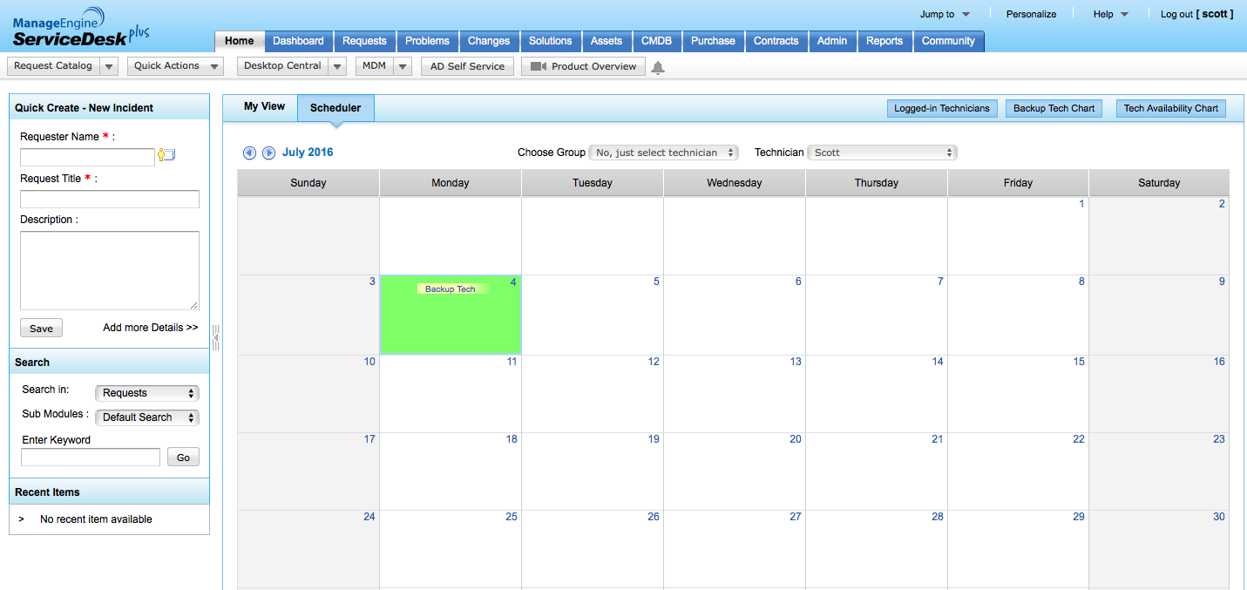
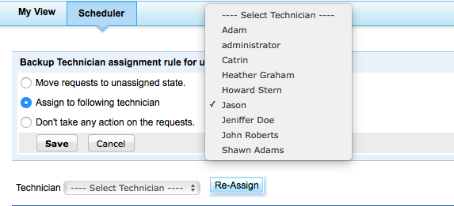
CONFIGURING A BACKUP TECHNICIAN TO HANDLE INCIDENTS IN A TECHNCIAN’s ABSENCE
FEATURE: BACK UP TECHNICIAN
Scott configures the backup technician as Jason to handle all tickets while he is away.
Clicks on the link to configure the backup technician.
3 things a technician can do when he/she is on leave.

Slide 15
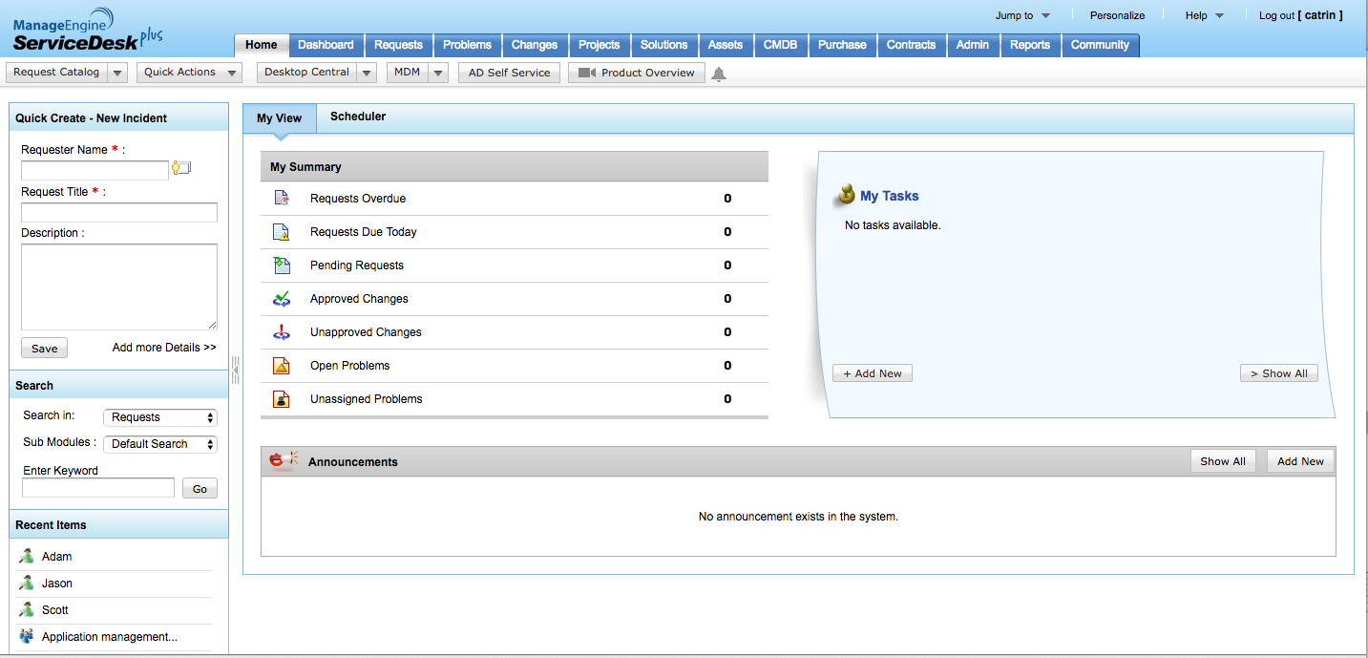
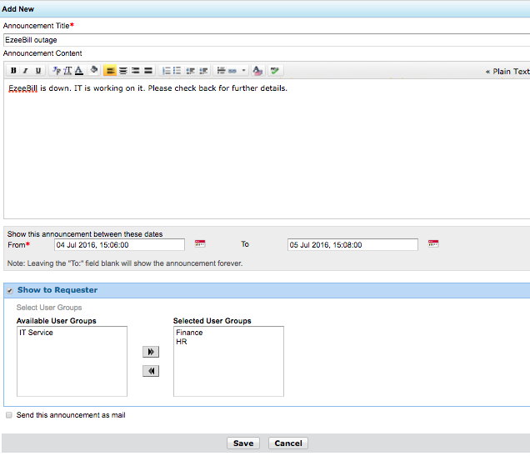
NOTIFYING END USERS AT EVERY STEP
FEATURE: ANNOUNCEMENTS and USER GROUPS
Catrin uses announcements in ServiceDesk Plus to notify the end users. She uses user groups to display the announcement to those end users using EzeeBill.
Announcements sent to relevant user groups.

Slide 16
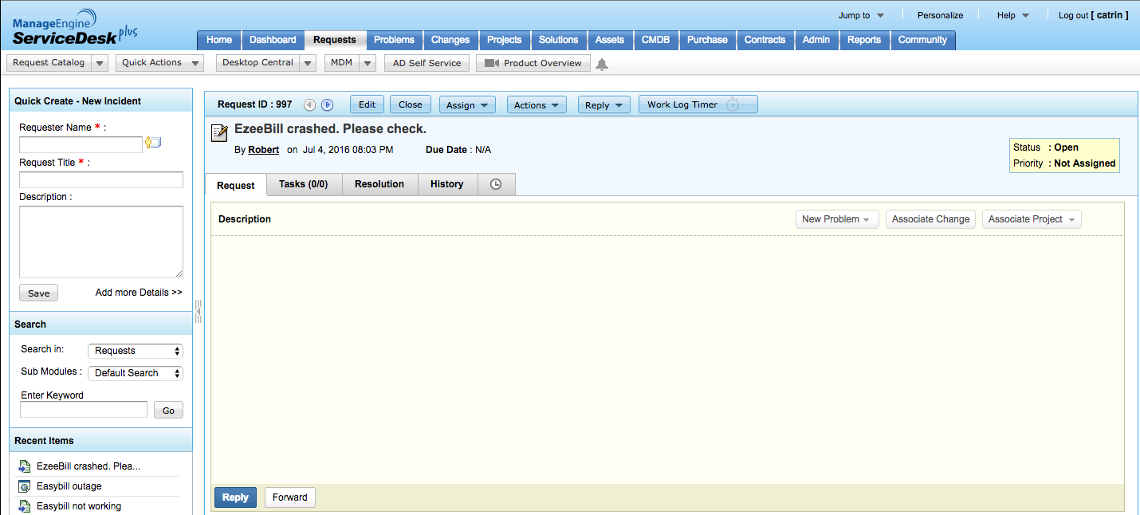
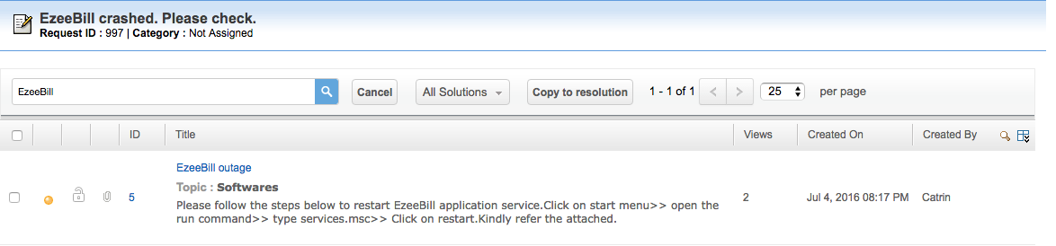
KEYWORD SEARCH TO ADD A RESOLUTION
FEATURE: KNOWLEDGE BASE
Jason and Adam use the keyword search quickly pull out a solution from the knowledge base and resolve the incident.
Catrin selects the solution and copies it to the ticket.¸

Slide 17
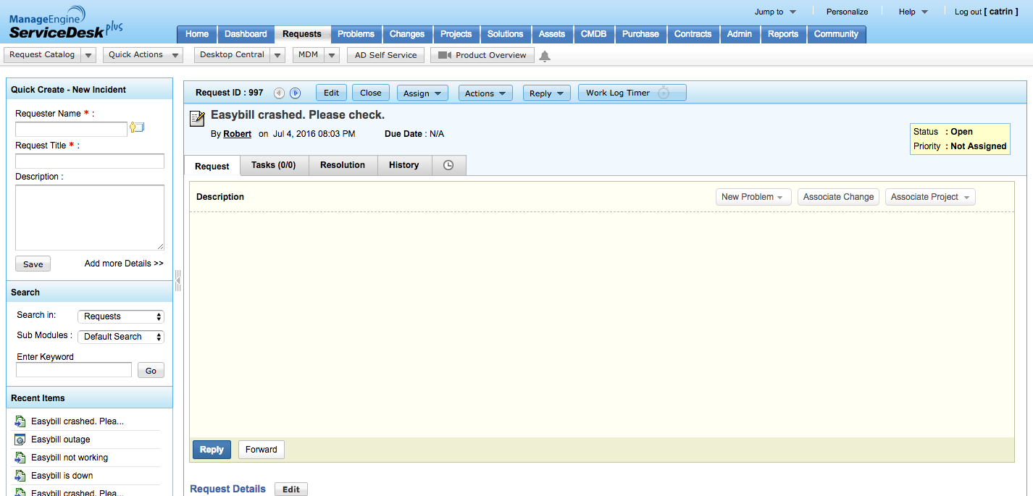
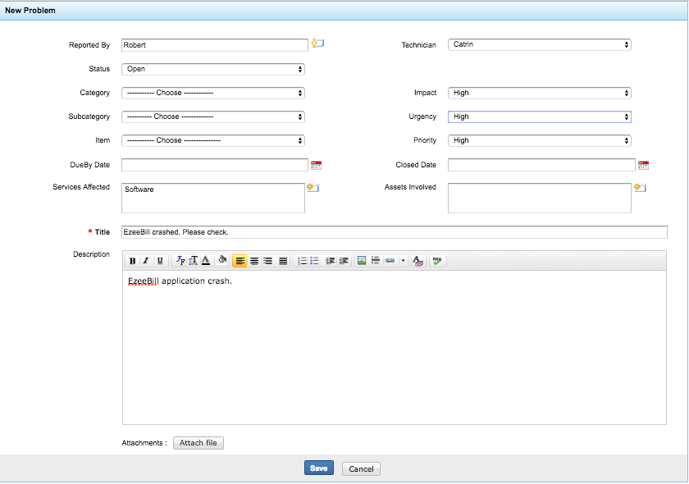
UNDERLYING THE ROOT CAUSE OF AN INCIDENT
FEATURE: CREATING A PROBLEM
Catrin doesn’t wish to stop with providing a workaround. She wants to resolve the incident and creates a problem from within an incident to find the underlying root cause.
Catrin creates a problem from within an incident.

Slide 18
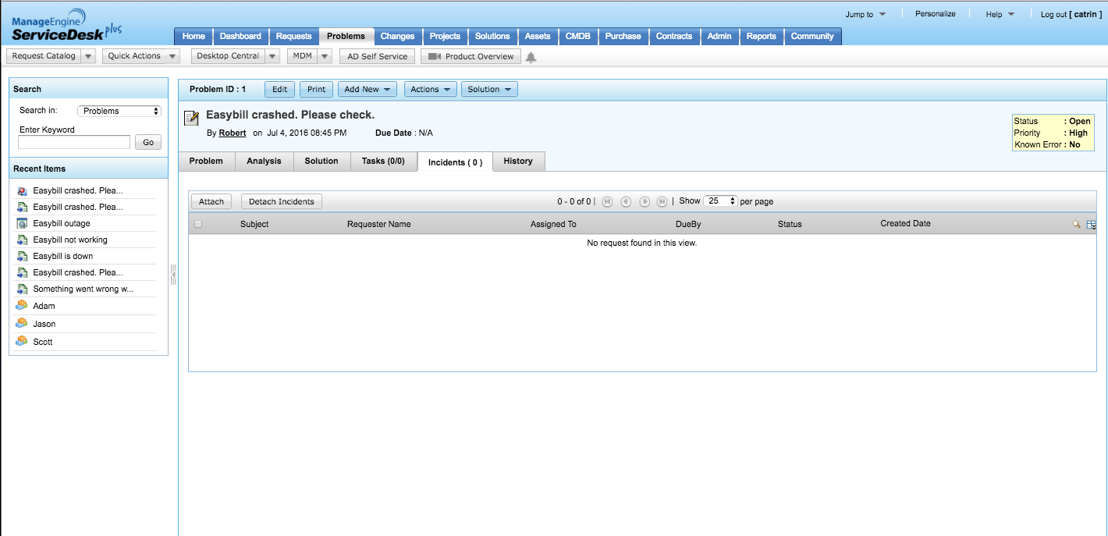
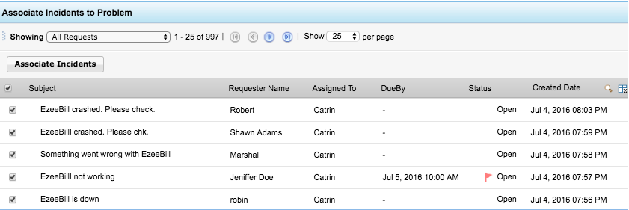
ASSOCIATING INCIDENTS
FEATURE: ASSOCIATING RELATED INCIDENTS TO A PROBLEM
Catrin associates all related incidents to the problem she just created.
Associates all related incidents to the problem.

Slide 19
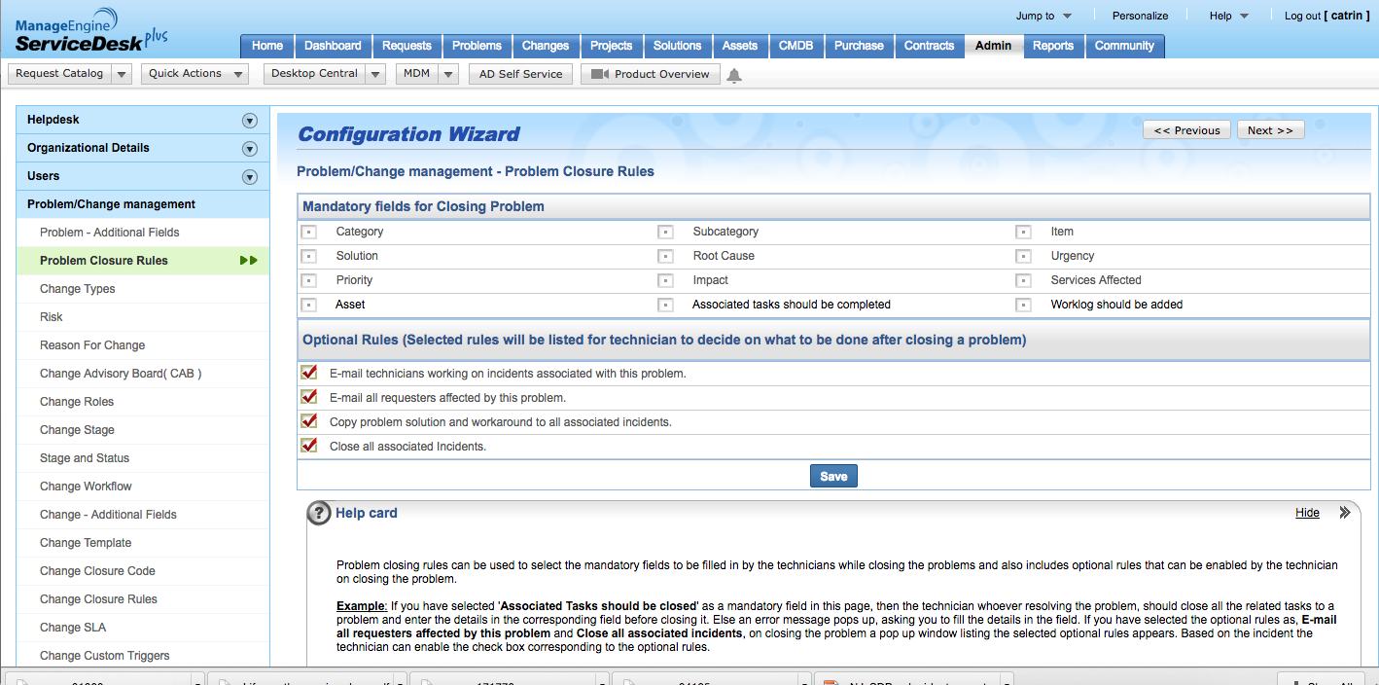
CLOSING ALL RELATED INCIDENTS IN ONE SHOT
FEATURE: PROBLEM CLOSURE RULES
As a final step, Catrin configures problem closure rules to close all associated incidents when a problem is closed!
Configures problem closure rules to close all associated incidents when a problem is closed.

Slide 20
A happy ending with ServiceDesk Plus!
ENSURE
Technician availability chart and backup technician ensure help desk accountability
PUBLISH
3
Knowledge base allows the technicians to pull out a published solution from the knowledge base (KB) using a keyword search.
COMMUNICATE
CLOSURE
Announcements are displayed to end users to keep them informed of the status.
Problem closure rules allows technicians to associate all related incidents to a problem and close all those incidents when the problem is resolved
2
4
AUTOMATE
1
Based on preconfigured business rules the tickets are prioritized and assigned to relevant technicians. SLAs ensure response times and escalation paths
NOTIFY
Push/SMS notifications keep the IT team informed of the incoming tickets.
5
7
6
CREATE
Ticket creation is done via the self-service portal, email, or phone

Slide 21
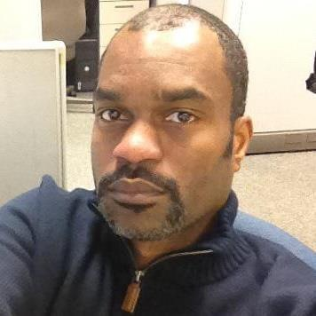
What customers say
ServiceDesk Plus has been a great decision both functionally and financially.
James Arnold
Service desk manager
Manhattan Associates

Slide 22
100,000+
IT service desks
700,000
IT technicians
185
Countries worldwide

Slide 23

Get ServiceDesk Plus
Join the 100,000+ IT help desks worldwide.
Sign up for a 30-day free trial.
Have questions? Drop us a line at hello@servicedeskplus.com

Slide 25


