Slide 1



Deliver a secure, exceptional employee experience to a distributed workforce with ServiceDesk Plus

Slide 2



Remote:
Employees work from home permanently
A cautious return to the office and business expansion
Resident: Employees work from the office permanently
‌As the pandemic showed signs of subsiding and economies opened up, Zylker resumed its hiring program
While a number of employees returned to the office, a large part of the workforce still preferred to work remotely, leading the bank to create three different work models
Hybrid:
Each week, employees work from office for three days and from home for two

Slide 3



Glitches in the onboarding machine
Incomplete information about new employees leads to confusion, and personal information is not encrypted by the current ITSM solution
‌Inability to standardise the onboarding process leads to operational inefficiencies and delayed service fulfilment
‌
Lack of communication between different teams and departments hampers service delivery

Slide 4
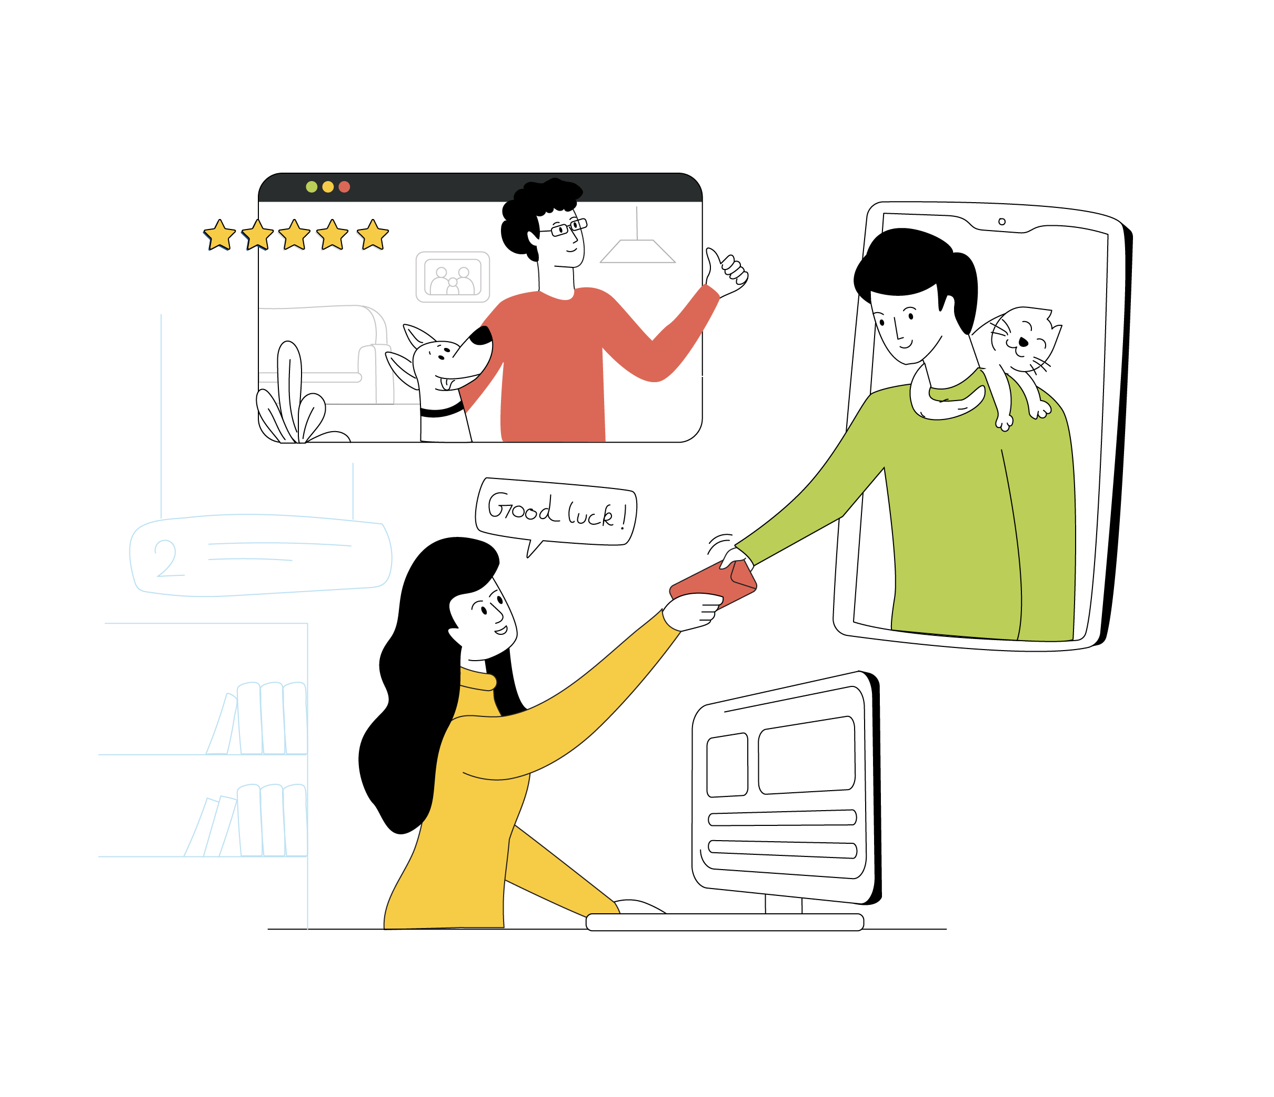
Crafting an exceptional
employee onboarding experience across different work models

Slide 5
Helping the onboarding machine bring out its A game
The challenge
The toolset
The ServiceDesk Plus platform
Service request templates
Dynamic resource sections
PII and encryption
Custom functions
‌Incomplete information collection
‌A coherent mechanism to collect information about the new joiners and map their unique requirements
SLAs and OLAs
Request life cycles
Business rules
Notification rules
Space management
Integrations
Inability to standardise the onboarding process
A visual workflow builder to handle different onboarding processes with automated notifications
A set of capabilities that help ensure seamless coordination between the numerous teams involved in service fulfilment
Roles
Approvals
Task dependencies
Technician groups
Cross-functional workflows
Lack of communication between different teams and departments

Slide 6
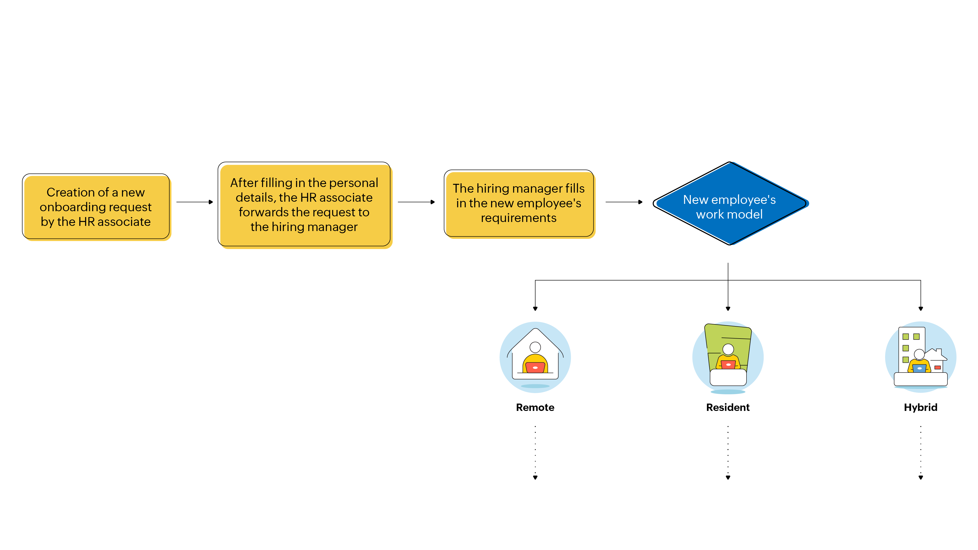

Slide 7
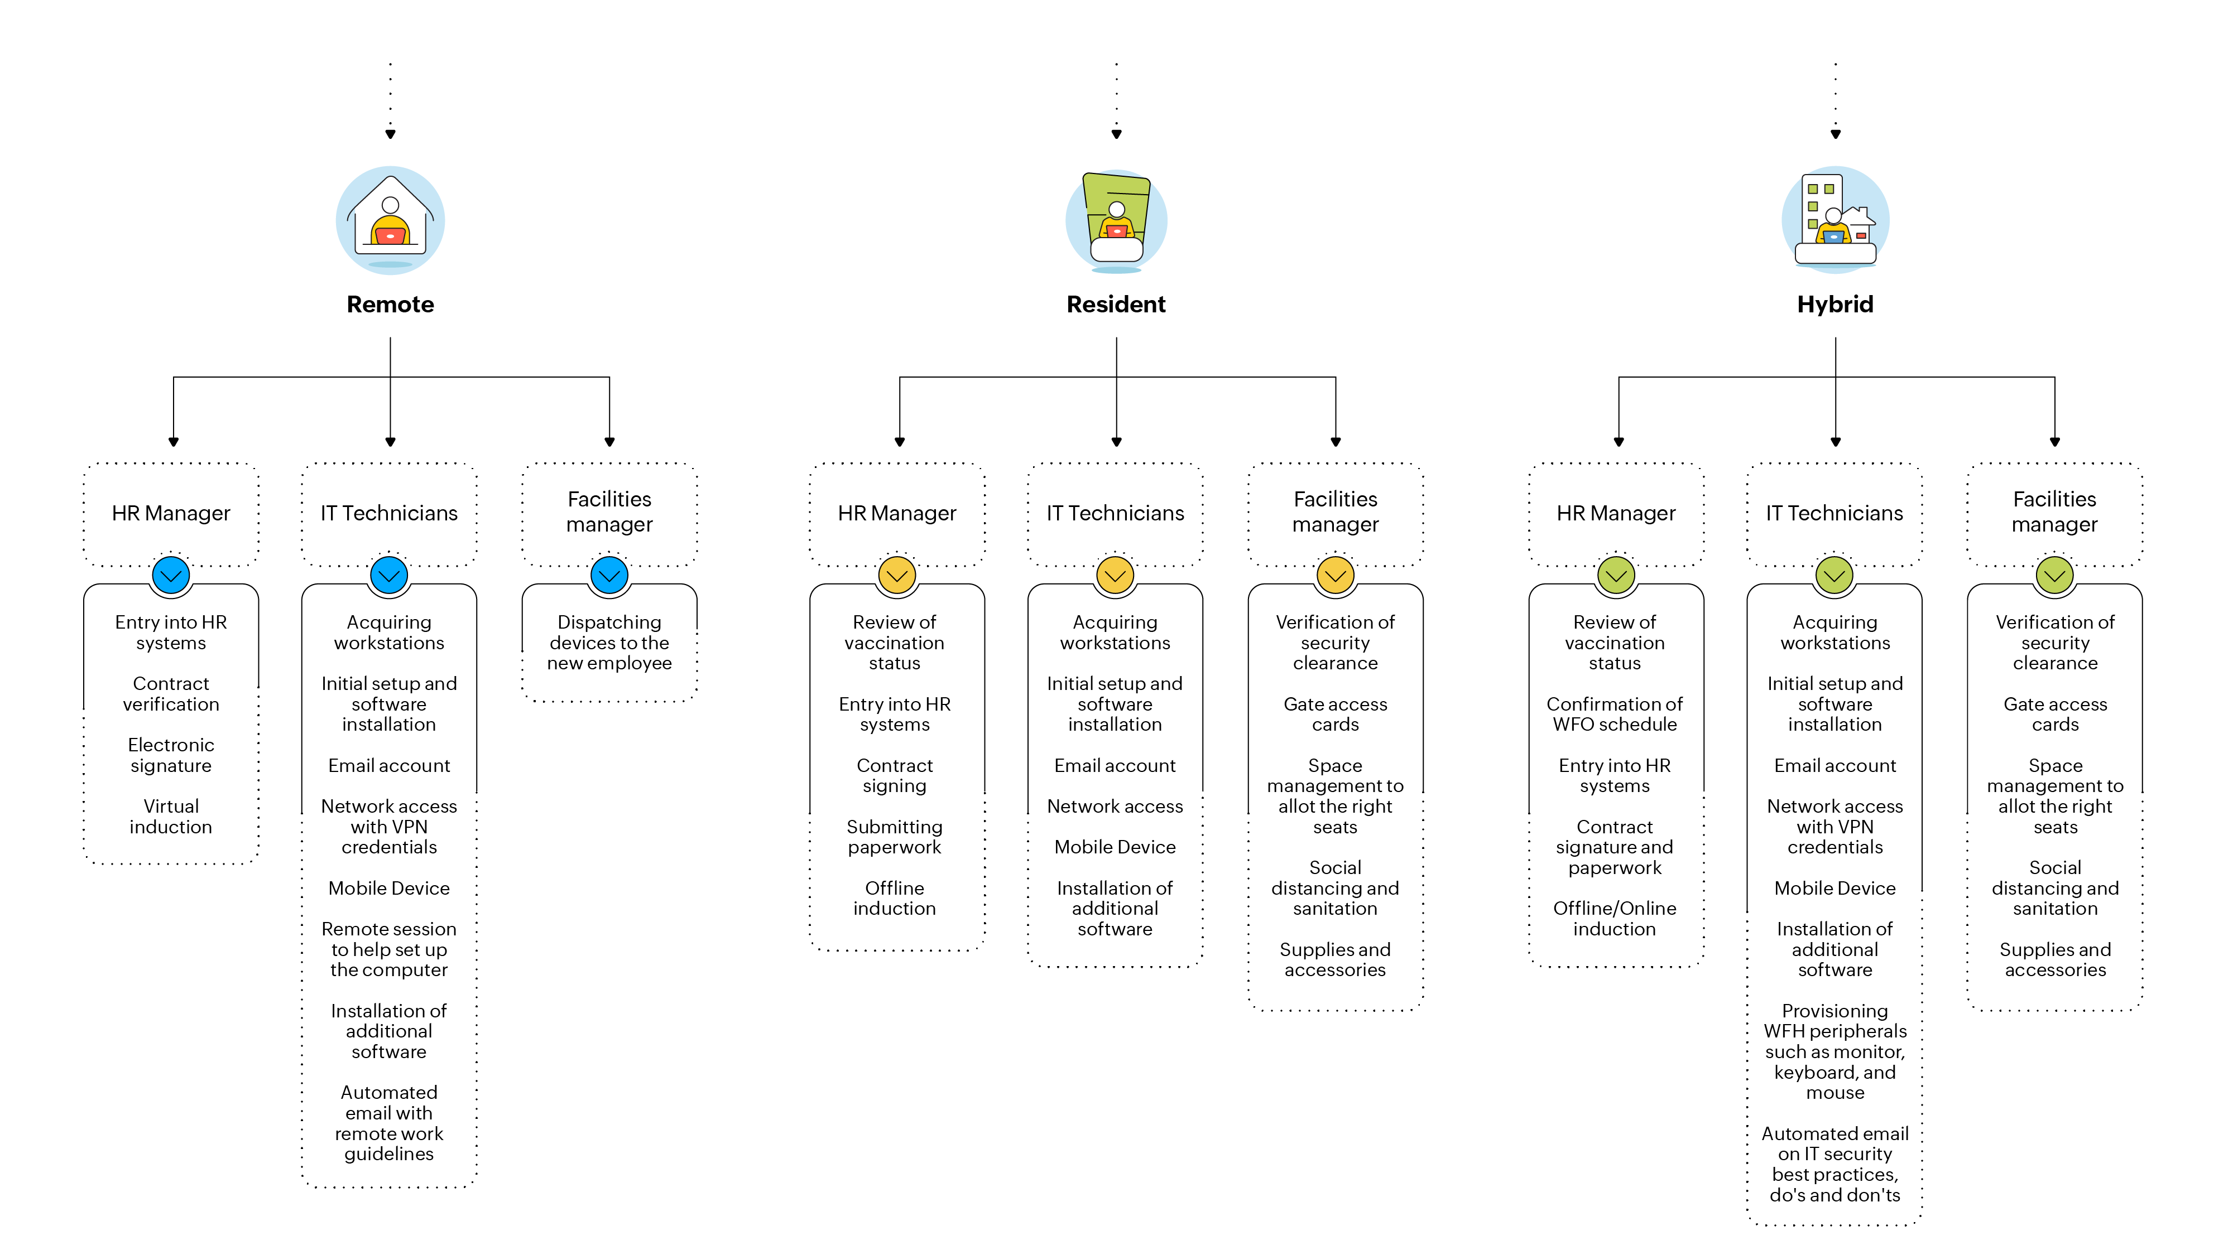

Slide 8
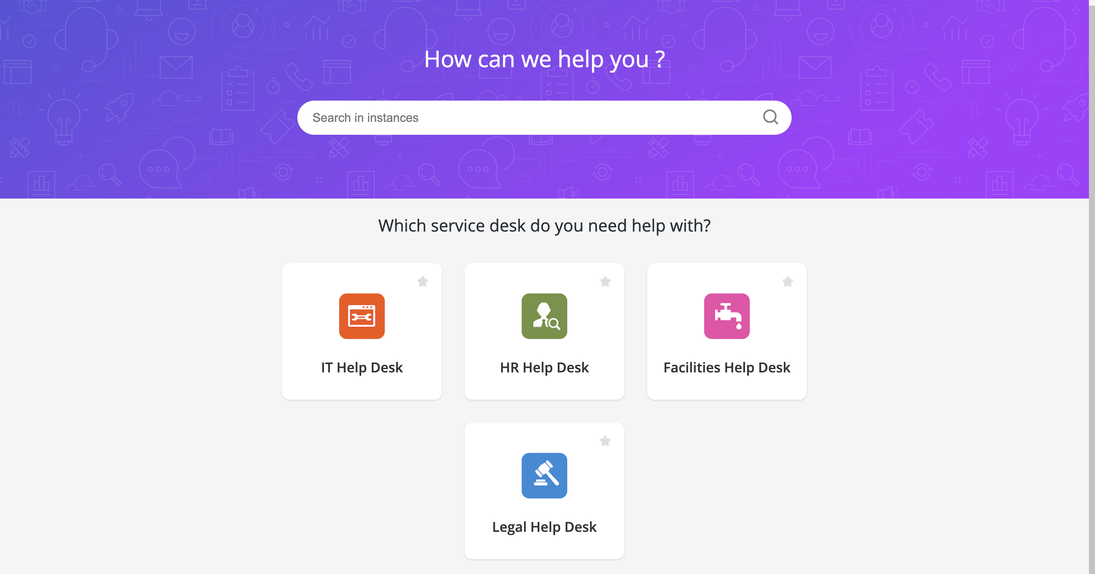
The relevant help desk is selected from the self-service portal to raise the employee onboarding request

Slide 9
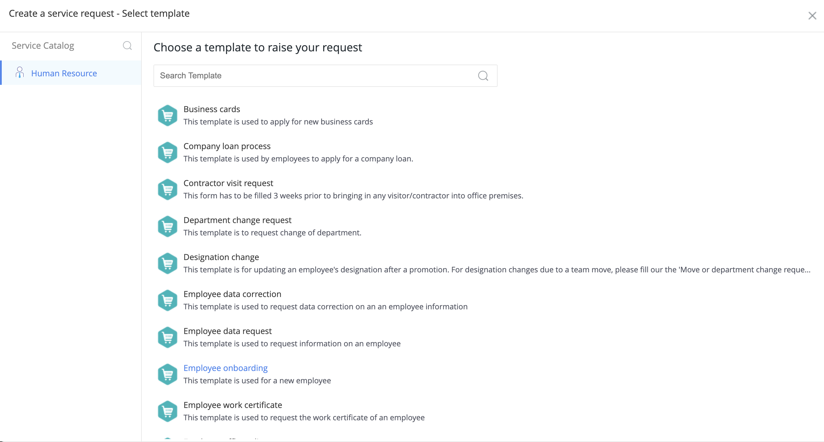
The employee onboarding request template is selected from the service catalog

Slide 10
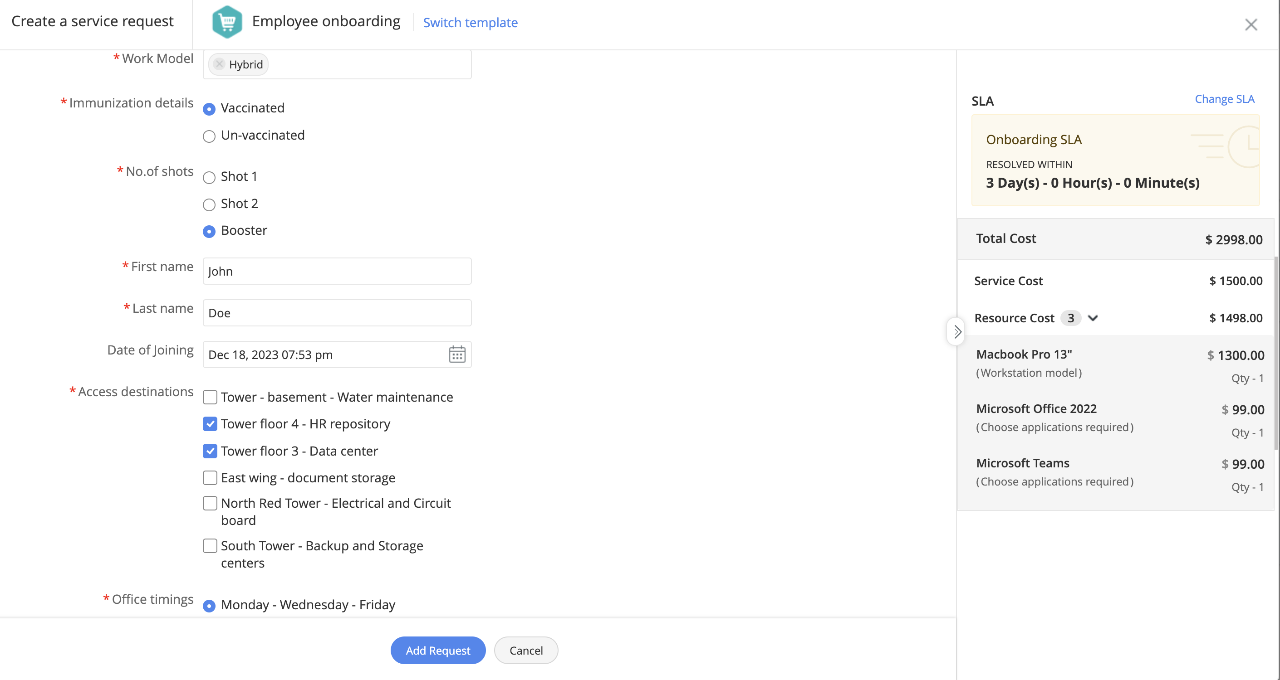
The HR associate fills in the necessary details and raises the request

Slide 11
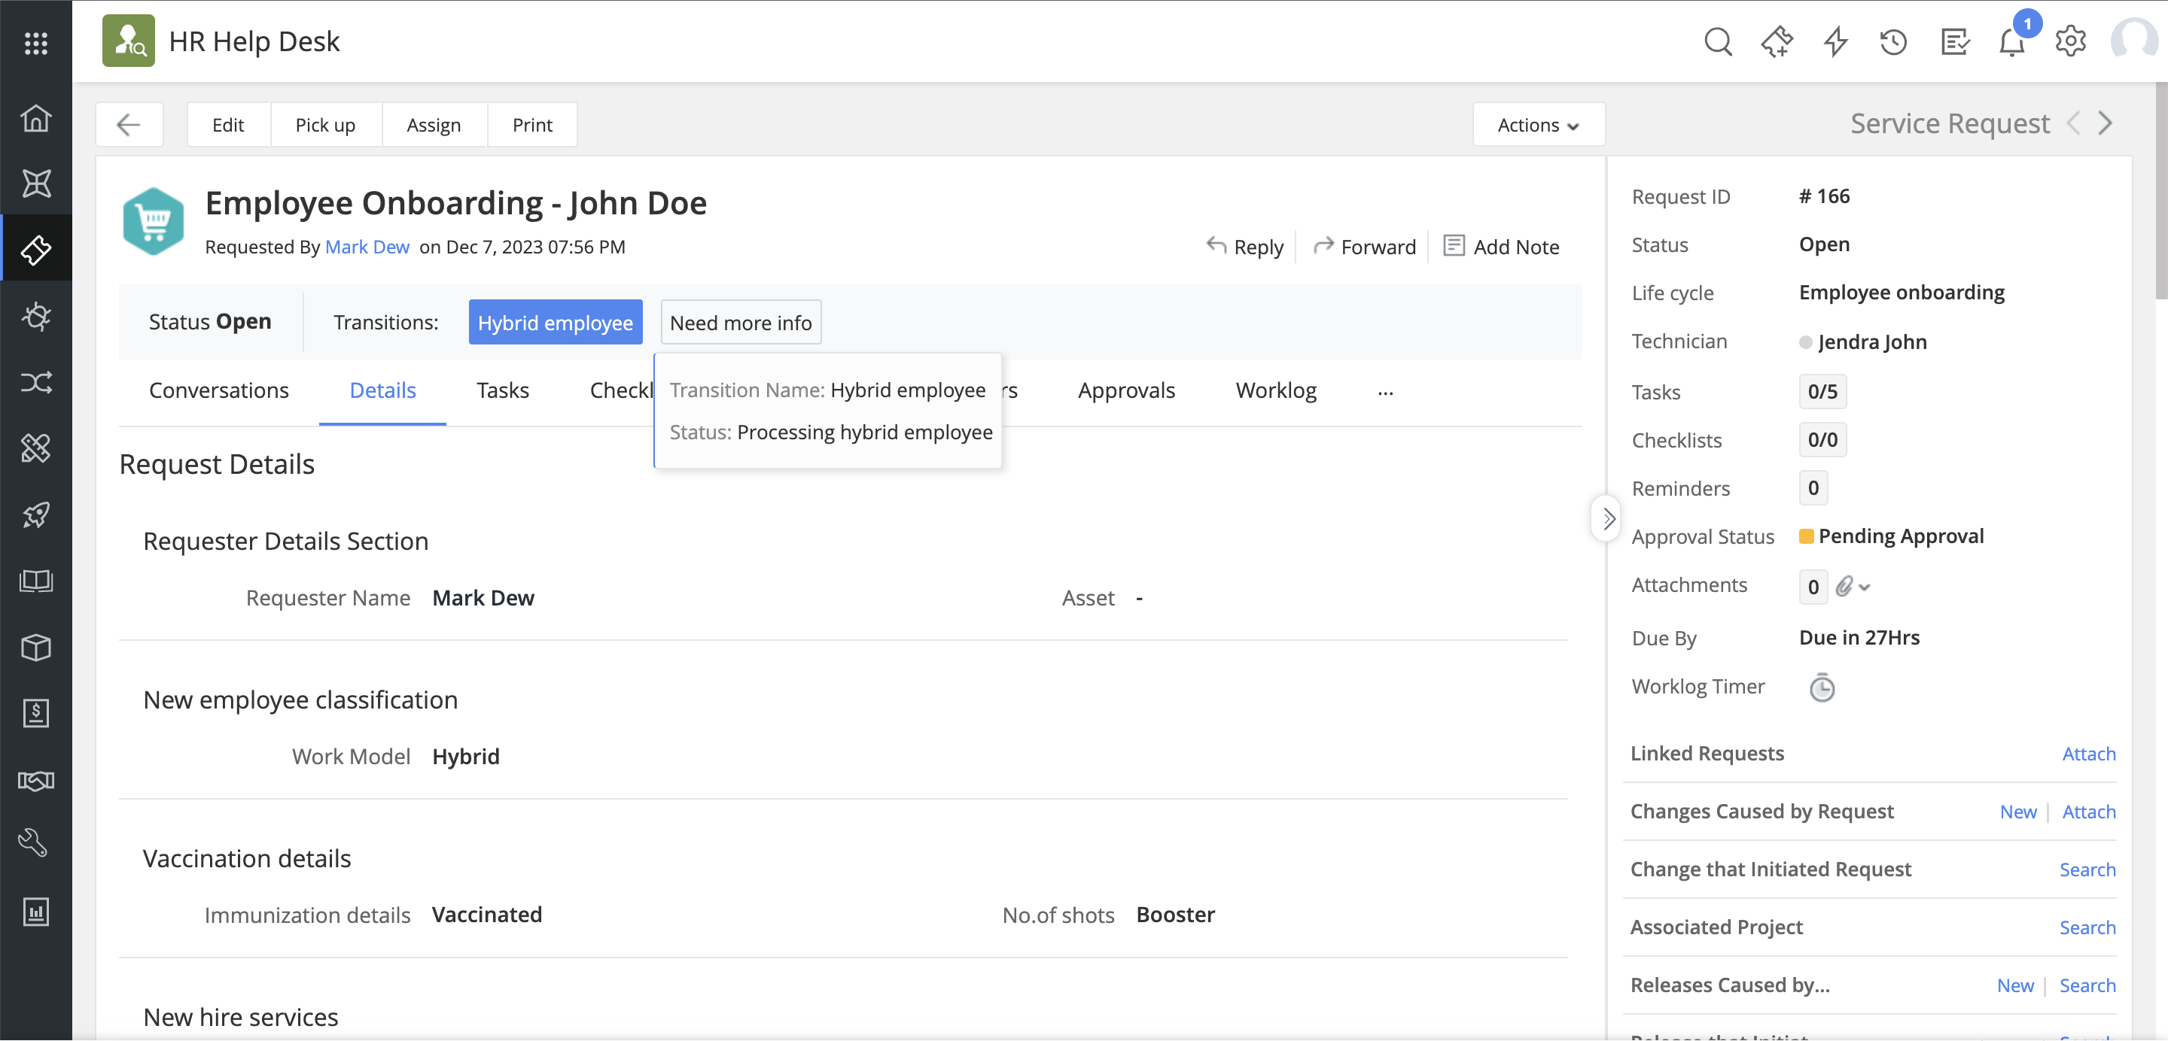
A service request is created in the HR help desk

Slide 12
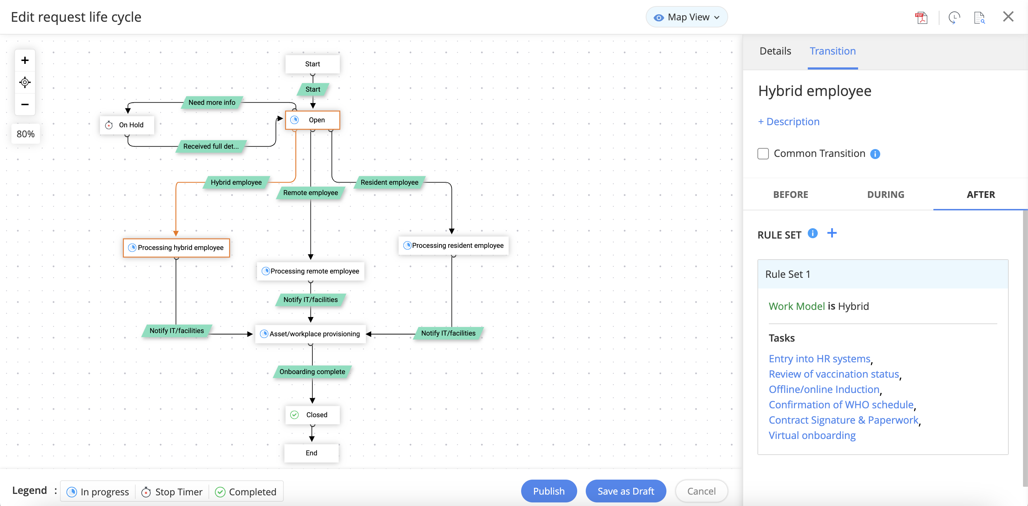
The request follows the hybrid work model path in the assigned RLC

Slide 13
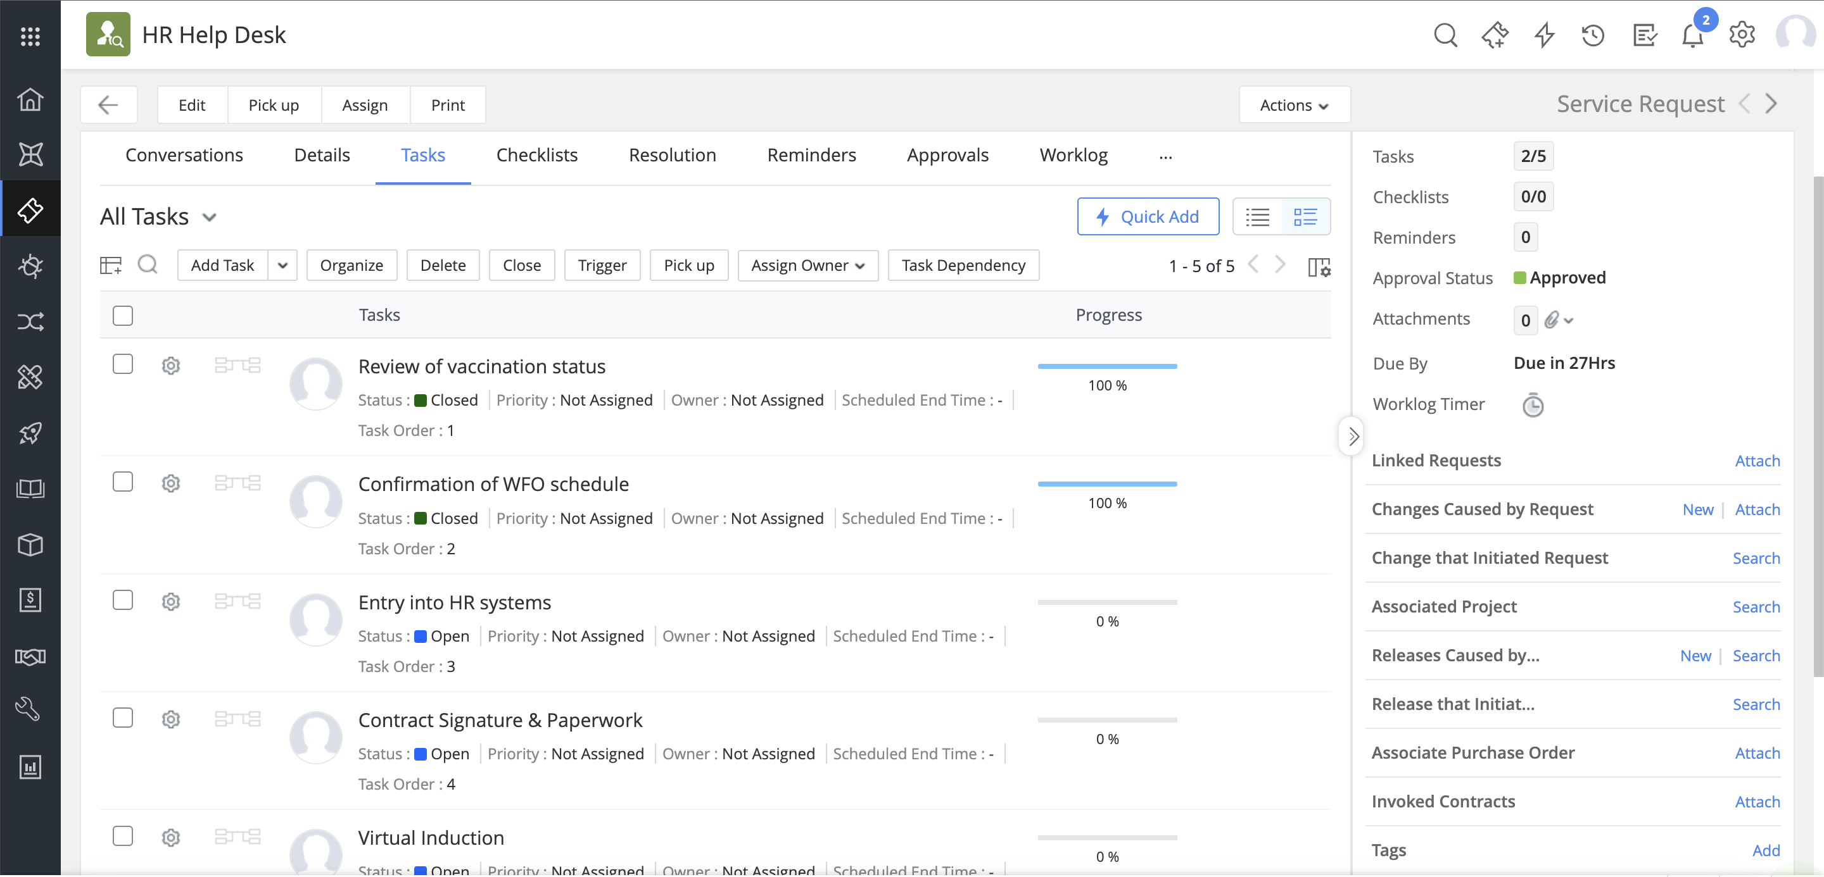
The relevant tasks to process the hybrid employee are automatically created within the ticket

Slide 14
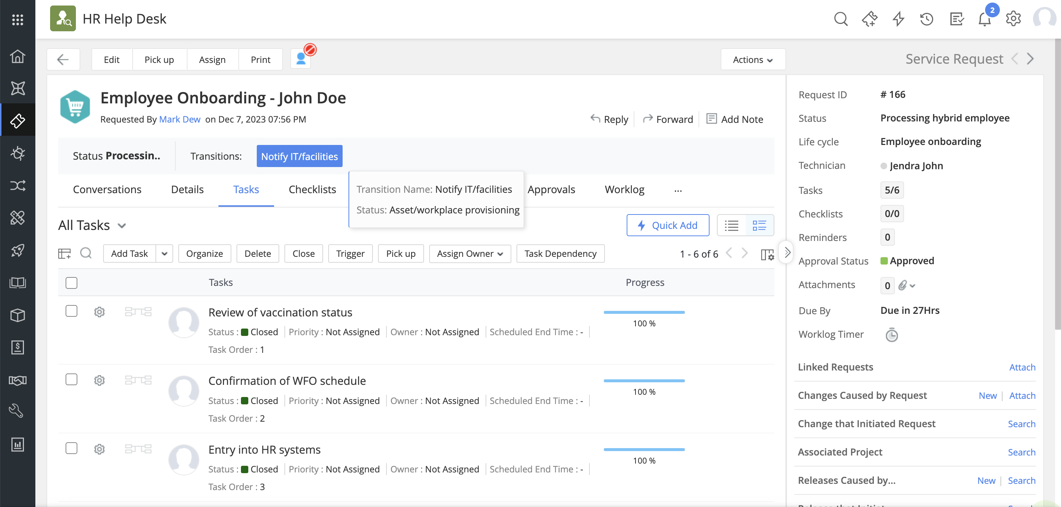
The IT and facilities teams are looped in to carry out the respective tasks for the employee to be onboarded

Slide 15
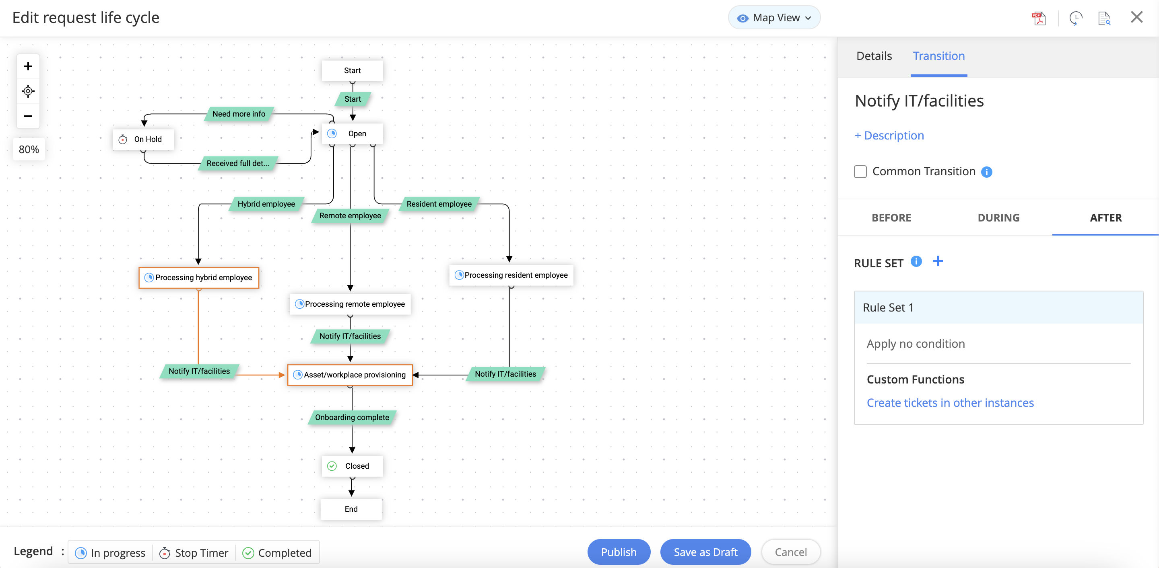
A custom function is triggered from within the RLC to create tickets in other instances

Slide 16
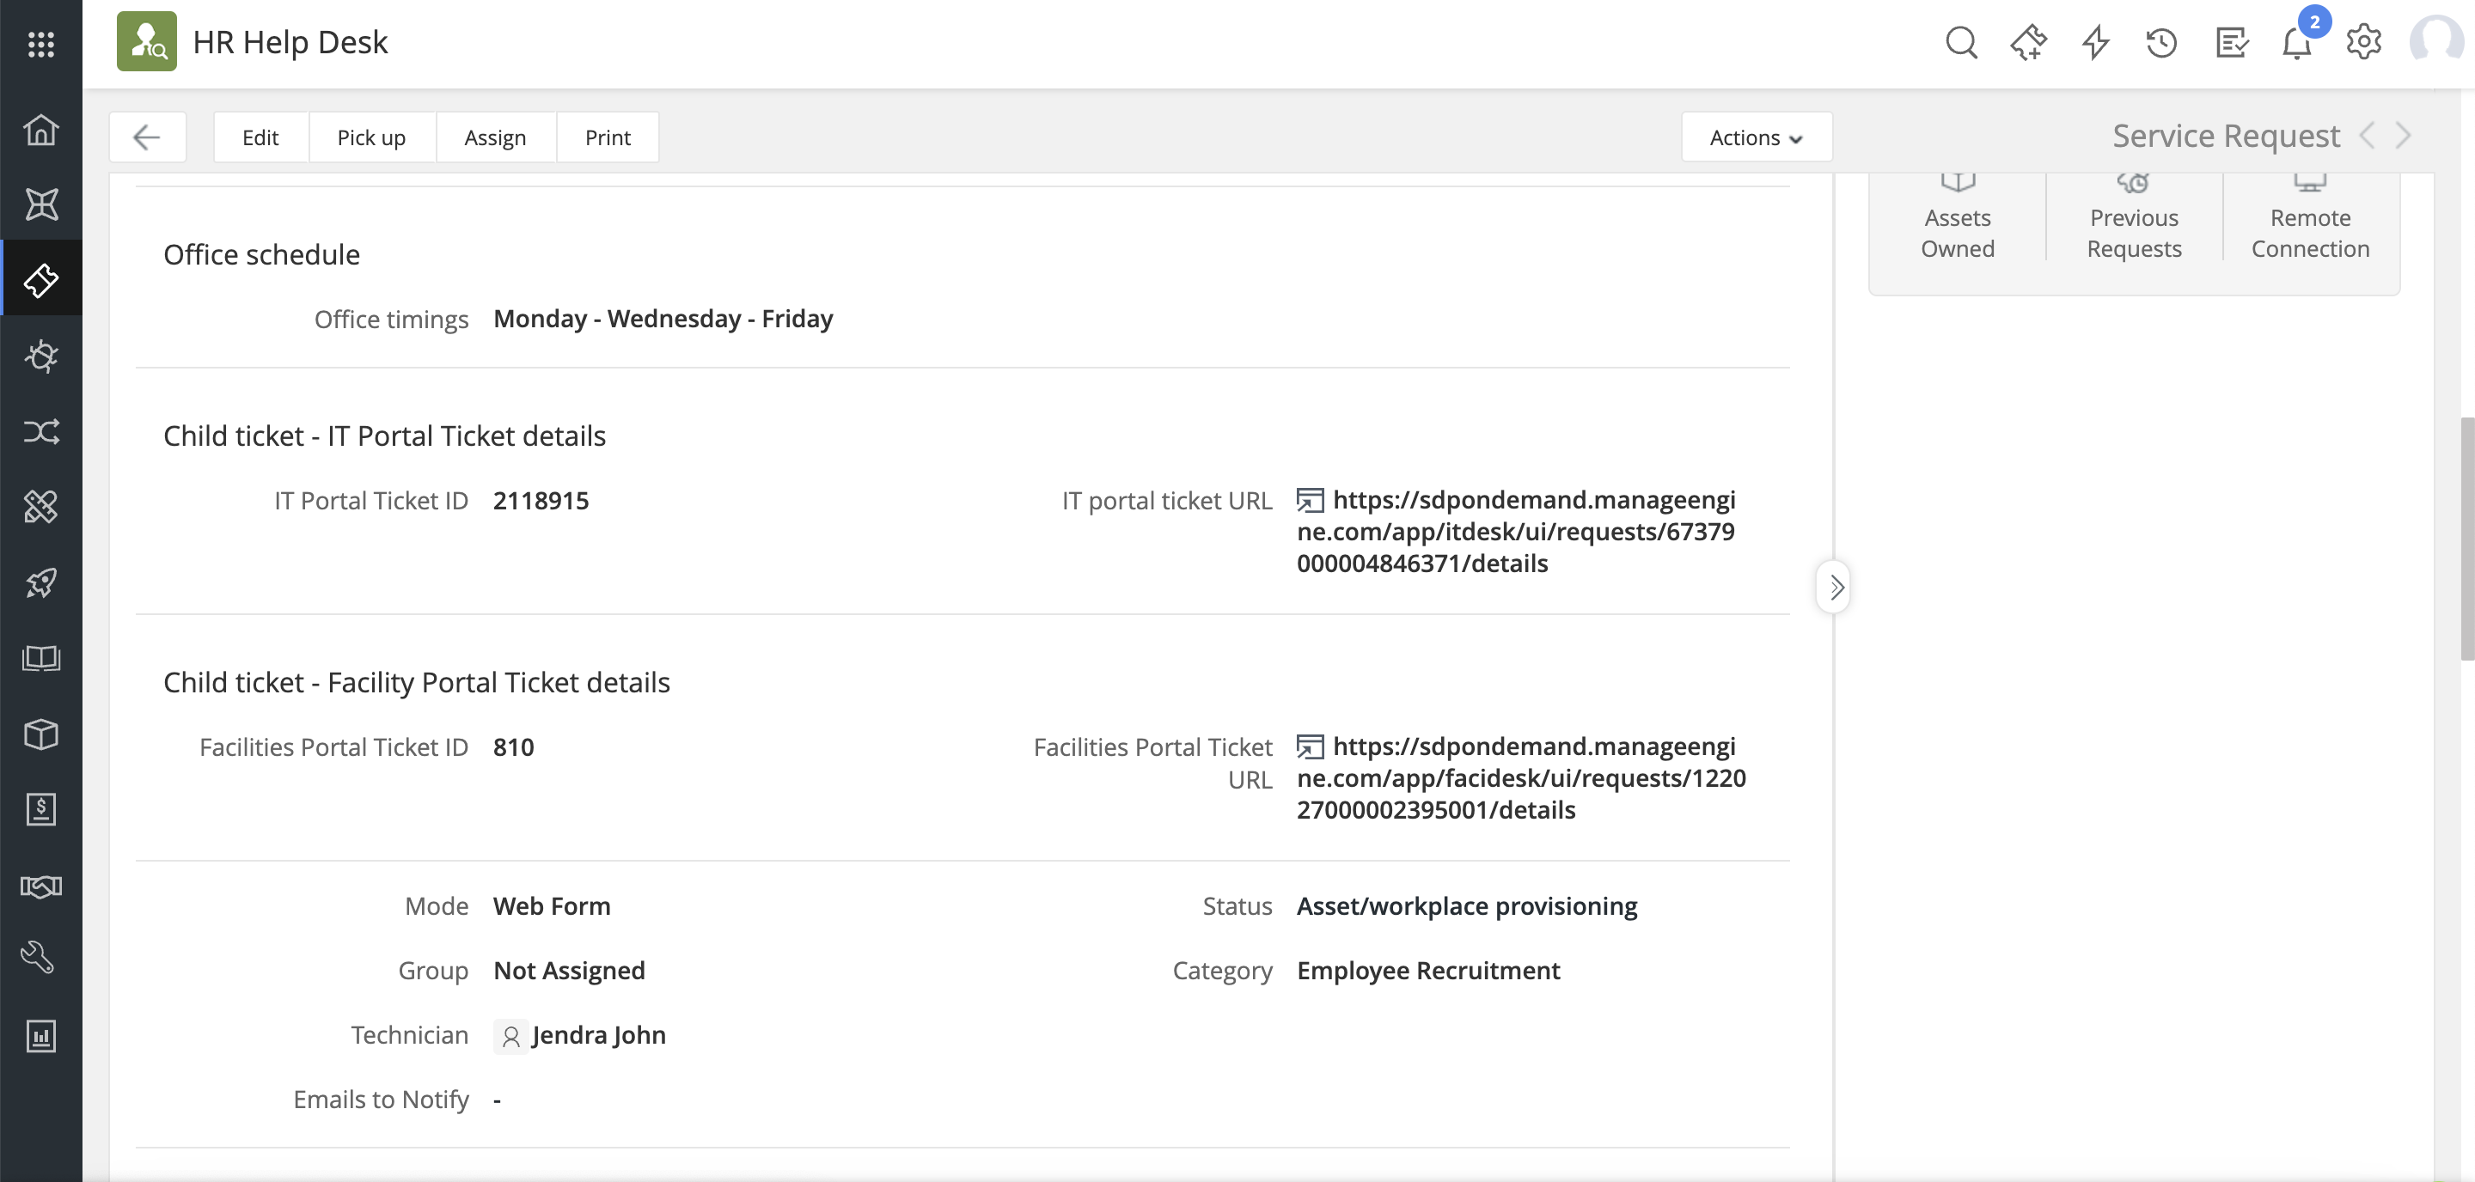
Child tickets are automatically created in the IT and Facilities instances

Slide 17
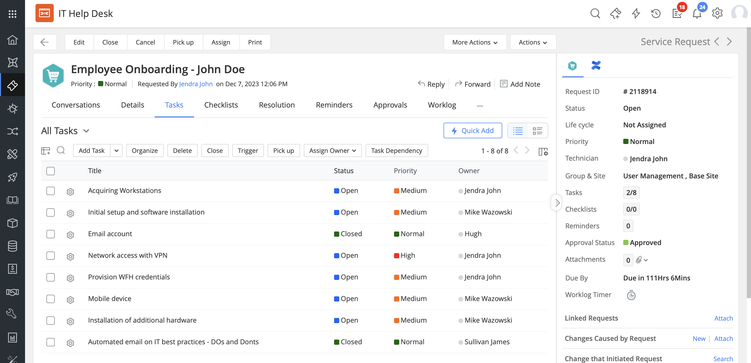
The IT team gets assigned a set of tasks that they start working on

Slide 18
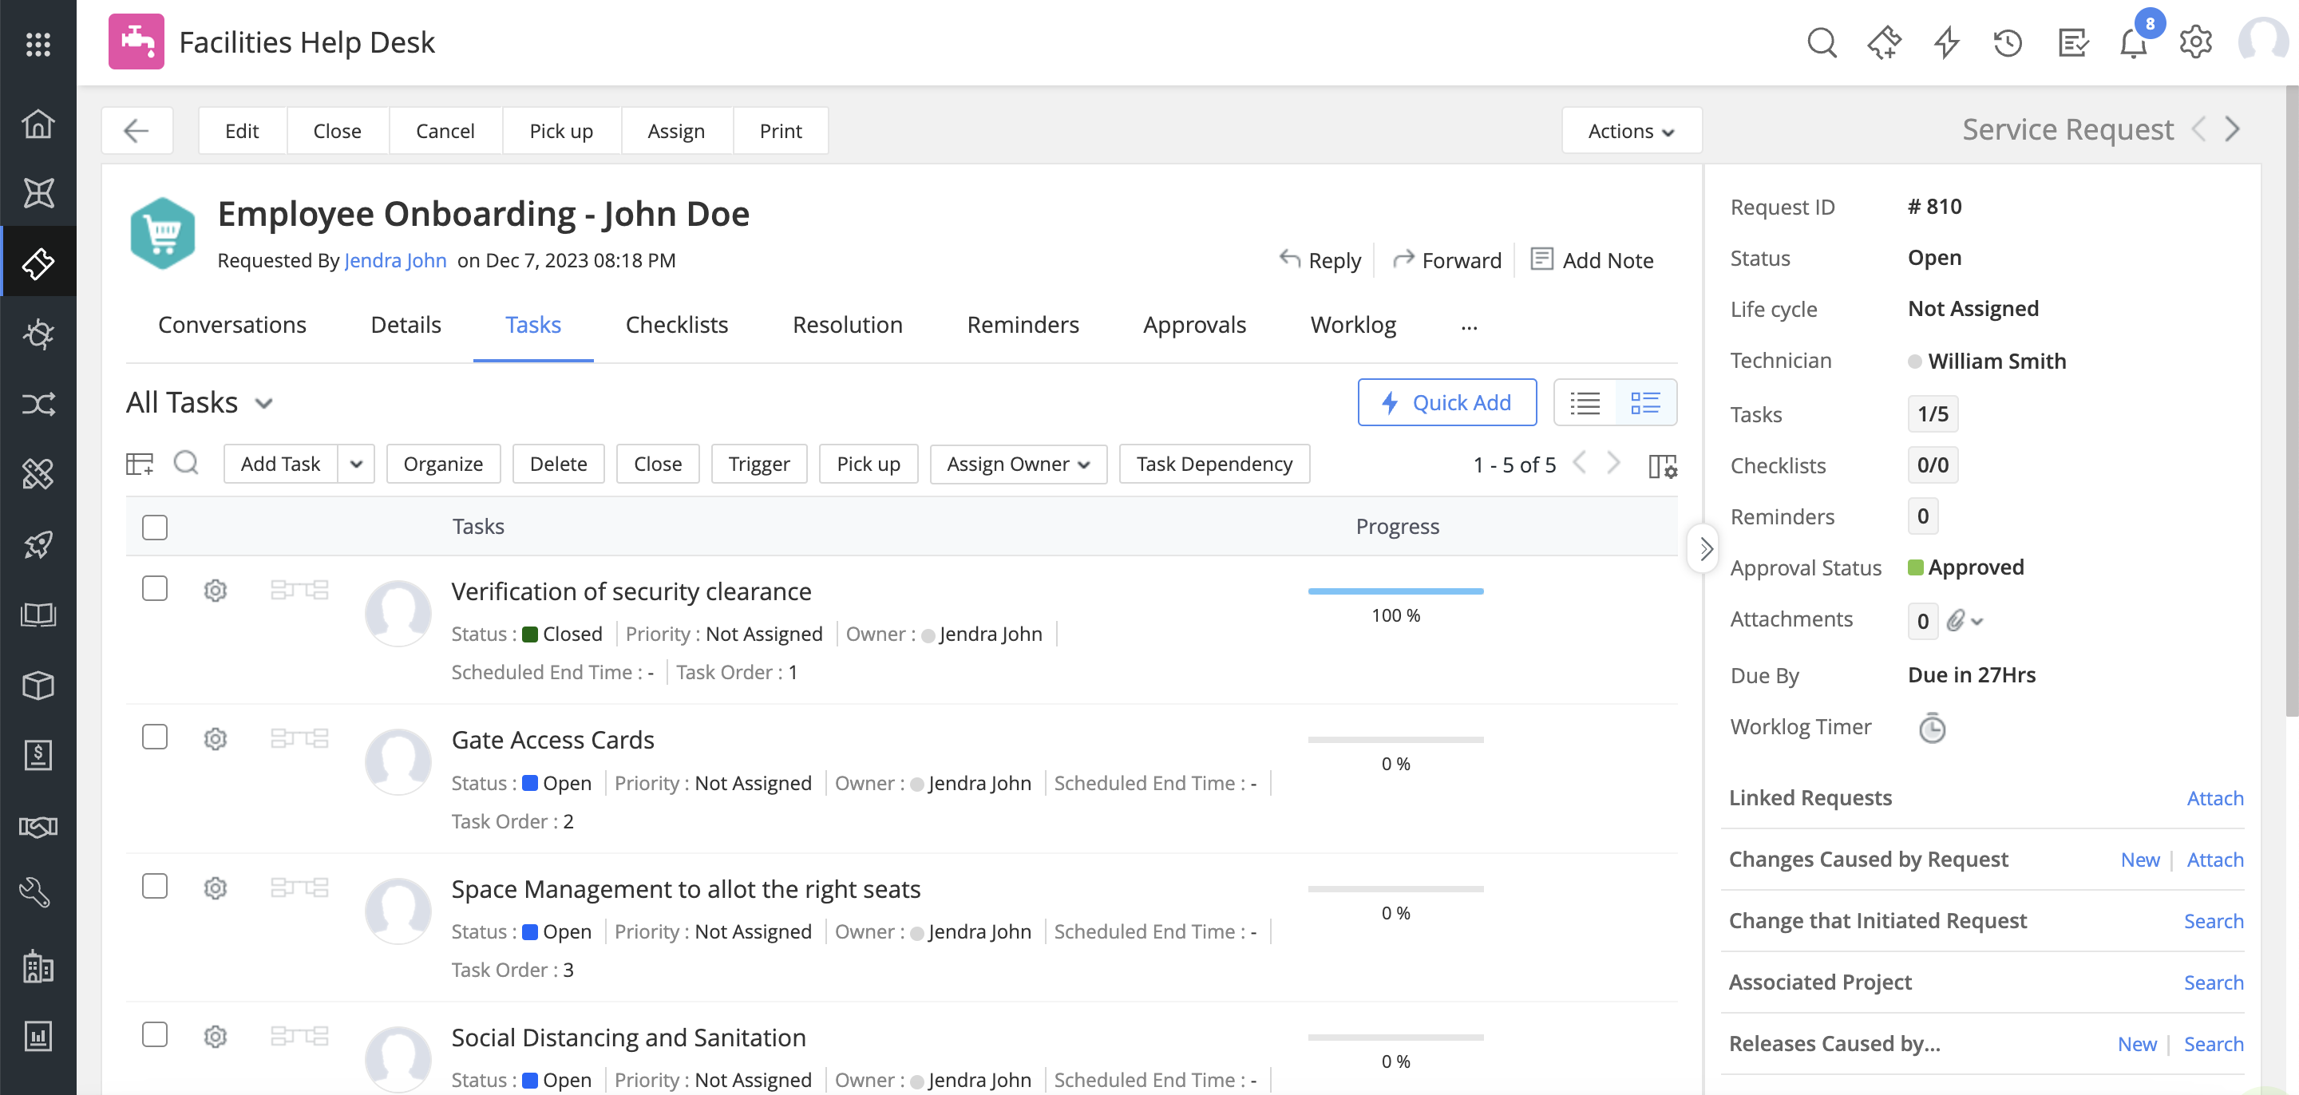
In parallel, the Facilities team also gets assigned a set of tasks that they start working on

Slide 19
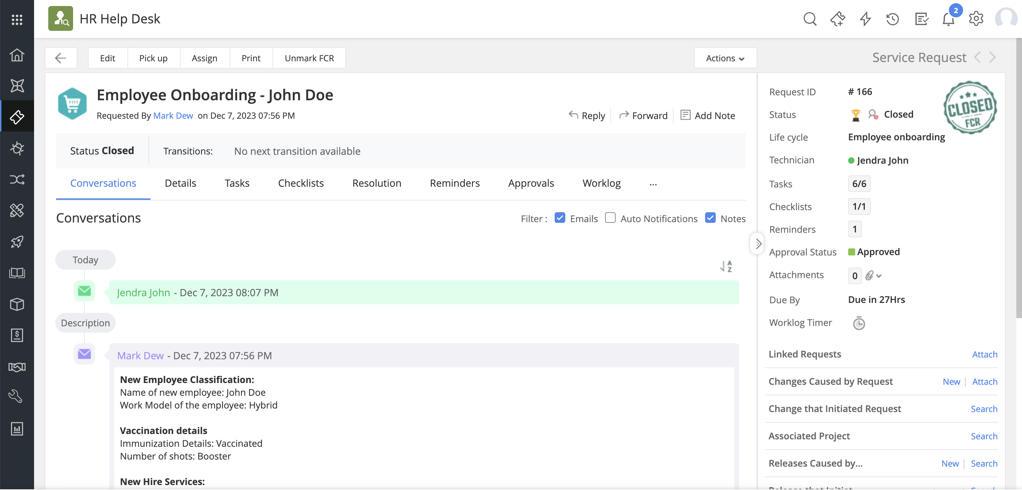
Once all the teams complete the required tasks, the employee gets successfully onboarded and the request is closed

Slide 20

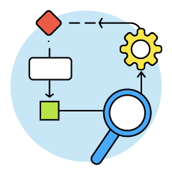

A streamlined onboarding experience powered by ServiceDesk Plus
Accurate information collection ensures nothing falls through the cracks, helping employees work from anywhere
‌Digitised workflows automate the mundane out of the way, helping technicians focus on mission-critical tasks
Consistent communication and task delegation bring diverse teams together even while working apart

Slide 21


