Slide 1
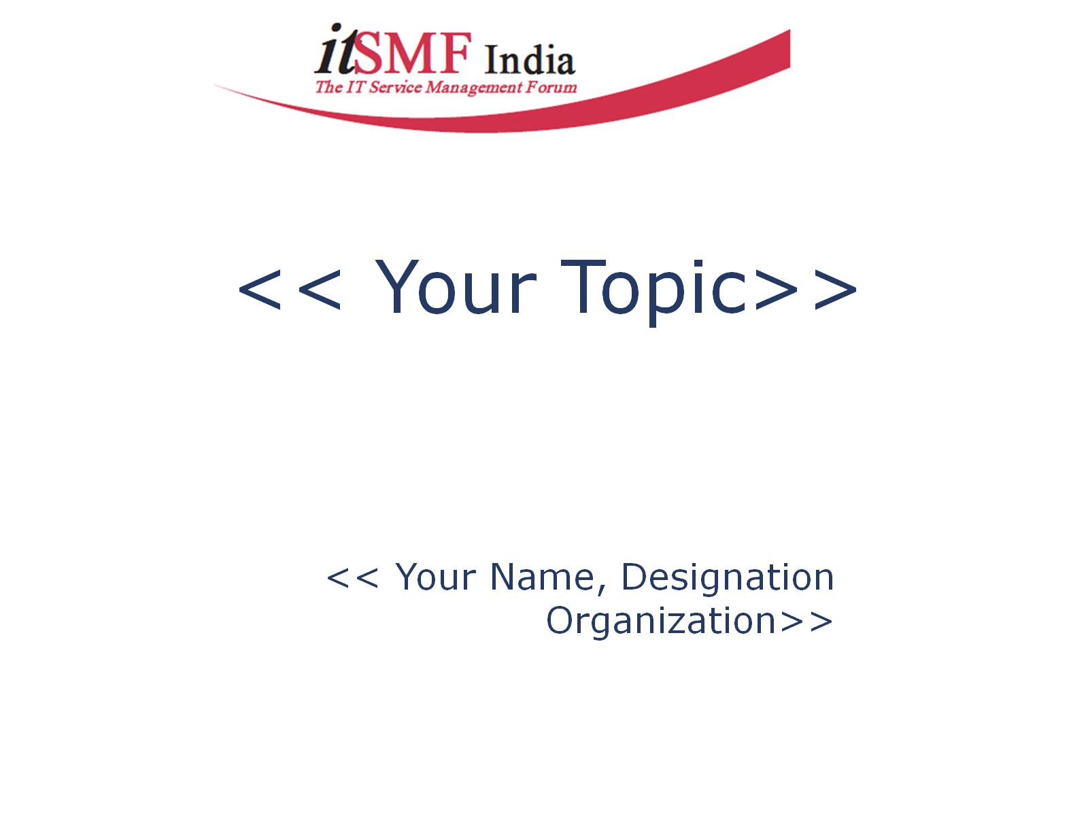
Six Steps to Implementing
Change Management that Works
Arvind Parthiban

Slide 2


Agenda
Identify why you want the change
Sell the Value of Change Management
Define what a Change is
Assign Roles & Responsibilities
Define a process for handling changes
Define key performance indicators

Slide 3


A “Failed Change”
Are You A Victim?

Slide 4
What are businesses doing
without proper change management in place?

Slide 5

The Maverick

Slide 6

One Man Show

Slide 7

Half baked

Slide 8
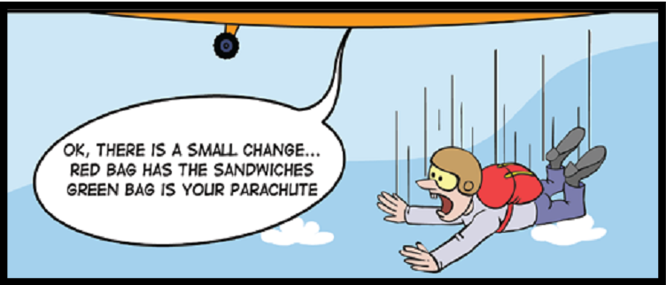
Gut Feel Vs Actual Risk
Change is simple
Doesn‘t require any major planning
Slippages when you underestimate the time required
Never expects any failure – ignoring the dependencies.
Most of all “the people problem”

Slide 9
End Result ~ Failure

Slide 10

Change Management is Never Easy…
Notes:
Change Management is never easy

Slide 11

The right questions
Why: The reason for the change. What is the business benefit you hope to
achieve with the change?
What: Is it hardware, software, system architecture, a process,
documentation, or a combination of these that will be subjected to change?
Impact: What are the possible negative consequences of the change ?
What is the cost of making the change?
Does the benefit outweigh the cost?
What is the business priority of the change?
How do we implement the change?
Who will implement the change?
When should we implement the change?
What do we do if the change goes wrong? Do we have a backup plan in place?

Slide 12
Six Steps to Implement Change Management that Works
Notes:
6 steps to implement change management that works

Slide 13

1.Identify what you want to change ?

Slide 14

Get executive buy-in for your change management implementation by selling the benefits and the objectives at a high level.
Stakeholders On-board

Slide 15
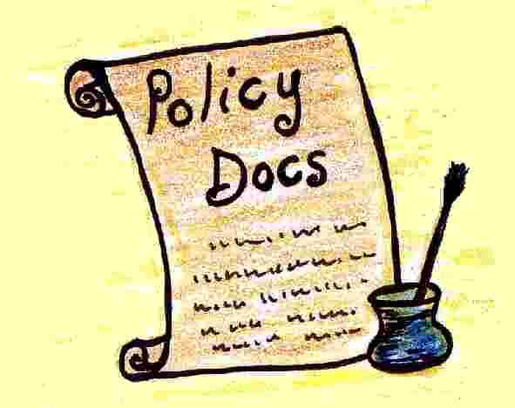
Agree to a high-level change policy that prohibits unauthorized changes and gives the change management function the authority to make decisions and handle resistance
Agree to a Change Policy

Slide 16
2.Sell the value of Change Management

Slide 17

Communicate the “why” before you communicate the “what.”

Slide 18

• Answer the question, “what’s in it for me?” for each stakeholder group.

Slide 19
3.Define what a change is?

Slide 20
Change Types
Standard – (Low Risk )Approval not required changes
Major – (High Risk) Higher Change Authority for approval
Emergency – (Disrupting Business Impact) Quick practical approach
Minor – (Low Risk with limited potential Impact) CAB usually not necessary
Normal – (Moderate Risk ) CAB is a Must

Slide 21
4.Assign Roles & Responsibilities
Change Advisory Board
CAB is a group of experts/advisors who can recommend on the change proceedings, both requesters & technicians can be part of CAB.
Change Manager
He is the key decision maker of the change request, who has the authority to approve or reject a change.
Change Authority
Every change requires a formal authorization before it can be implemented. Depending on size, cost, and risk, an appropriate change authority is
required to provide this approval. The change authority may be a director, c-level manager, or indeed, the board of directors
ECAB
The ECAB is a smaller, core group of CAB members that is available on short notice to respond to emergency changes that must be made on a short notice to remedy an urgent issue.

Slide 22
5.Define a process for handling changes

Slide 23
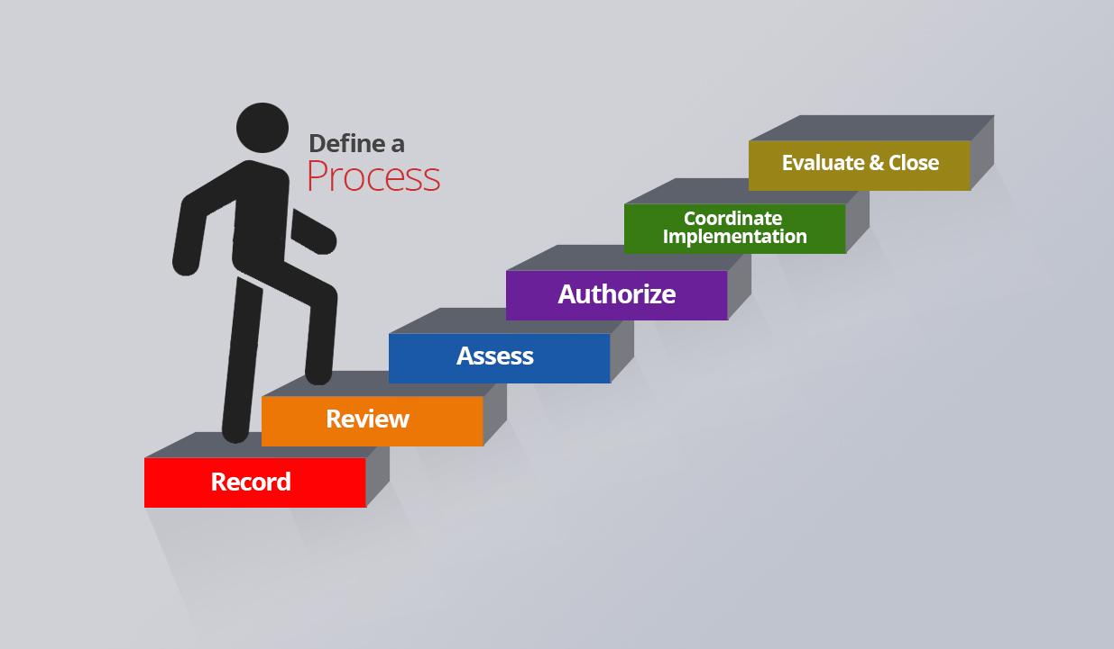

Slide 24
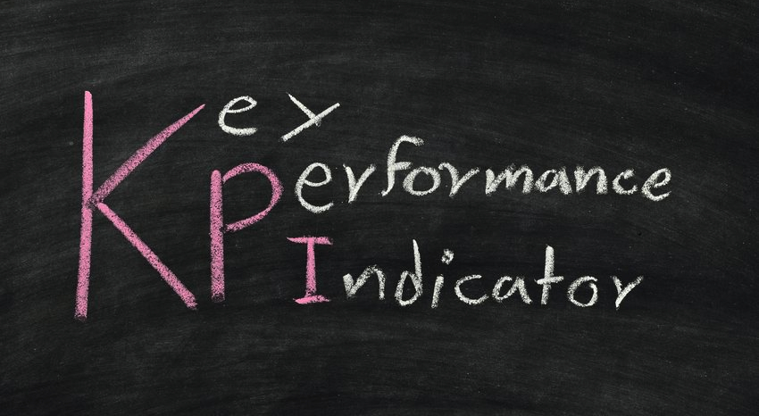
6.Define Key Performance Indicators
Key performance indicators refer to:
Number of successful changes
Number of failed changes that were rolled back
Number of changes in the backlog
Number of incidents caused by change
Number of emergency/out-of-hours changes
Number of unauthorized changes identified
Resources used and funds spent on changes
Percentage of changes that happened as per the FSC
Critical Success Factors:
Define a set of KPIs that are relevant to your organization.
Use KPIs to communicate the value of change management to the business and specific IT groups on a regular basis.

Slide 25
Tips for a Successful Change
AVOID being bureaucratic
PROCEDURES for Minor, Major & Emergency Changes
Well COMMUNICATED & UNDERSTOOD process
AUTOMATED process for ‘standard’ changes
DELEGATED authority to Change Manager
EASY to raise and track a change
Clear REASONS for decisions taken
Clear COMMUNICATION to requestors and to affected users
AUTHORITY must reside with CAB & Change Manager to avoid ‘independent’ action

Slide 26

Thank you
arvind@manageengine.com
Twitter : @arvindparthiban

