Slide 1






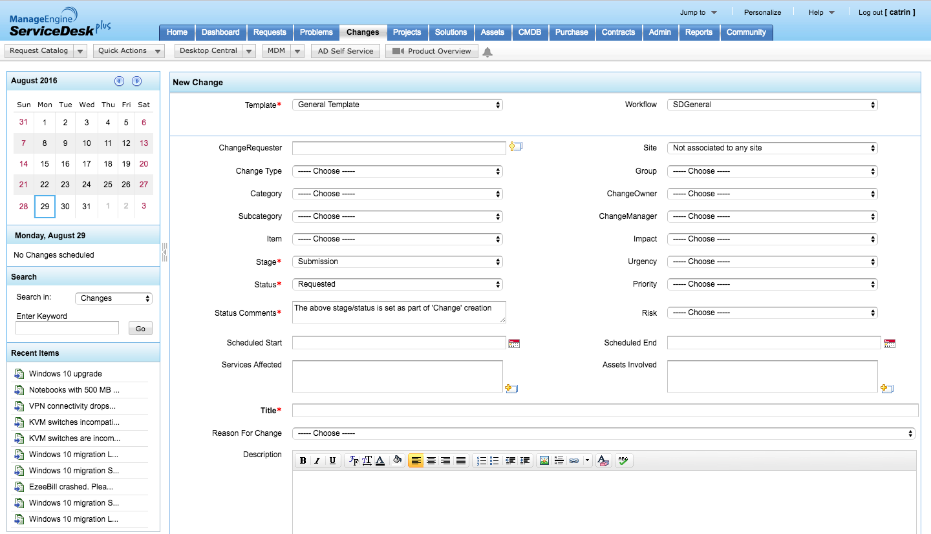



IT management,
simplified.
Real-time IT management solutions for the new speed of business

Slide 2

Seamless transitions for successful changes
Change management in
ServiceDesk Plus

Slide 3









Welcome to Zylkerville!
BUSINESS USERS
IT FOLKS
SCOTT
IT TECHNICIAN
DAVE
HIRING MANAGER
JASON
IT TECHNICIAN
MARCUS
CIO
CATRIN
IT SERVICE MANAGER
ADAM
IT TECHNICIAN
WENDY
HR
JOHN
END USER

Slide 4



Two stories of change from Zylker
Zylker works out two different changes. Let’s see how the stories unfold.
Replacing the printers at Zylker.
ROOTKIT at Zylker.

Slide 5
Zylker IT replaces their printers
Change management with ServiceDesk Plus

Slide 6



The Zylker printers are ageing
The paper always gets jammed!
The print quality is getting worse everyday.
This printer’s giving me trouble every single day!
We can’t send invoices to our customers.
The images lack clarity.
Wendy, HR
Dave, Hiring Manager
John, End User

Slide 7
Zylker decides to take an easy way out
STEP 1
Catrin informs Marcus about the need to replace
the old laser printers with LED
ones.
STEP 2
Marcus confirms that the team can go ahead
with the change, provided the finances
involved are taken care of.
CATRIN
IT SERVICE MANAGER
MARCUS
CIO
STEP 3
The technicians replace the old laser printers with
the new LED ones.

Slide 8


It’s a nice, sunny day at Zylker until…
The tornado strikes.
I get an “Access is denied” error every time I try to print.
Wendy, from the 1st floor
I don’t know the IP address of the printer. It has changed!
END USERS
John from the 2nd floor
WI-FI printing takes too long!
Dave from the 3rd floor

Slide 9





Zylkerville in trouble!
Who changed the IP address?
I thought you had this under control.
Did you not know you weren’t supposed to change the static IP address?
What’s going wrong here, Catrin?
Geez! I didn’t know the IP configuration procedure.
I’m trying to fix the WI-FI issue! Doesn’t seem to be working though!
The “Access denied error” is because of the changed IP address.

Slide 10
The snowball effect takes a toll on Zylker
How a minor change blew up to a major issue, thereby affecting productivity
NO FORETHOUGHT OF RISKS
There was a lack of proper planning and the risks weren’t identified.
LACK OF EXPERIENCE
The technicians lacked expertise and were not familiar with the process.
LACK OF IMPACT ANALYSIS AND BACK OUT PLAN
The impact of the change wasn’t analyzed due to lack of planning and a back out plan wasn’t laid out.
POOR TRACKING SYSTEM
No tracking system to keep tabs on the progress or the status of the change.
LACK OF AN APPROVAL SYSTEM
Lack of approval caught people unawares and the right expertise was not pinned to the change.

Slide 11

Change management with ServiceDesk Plus
For hassle free changes

Slide 12
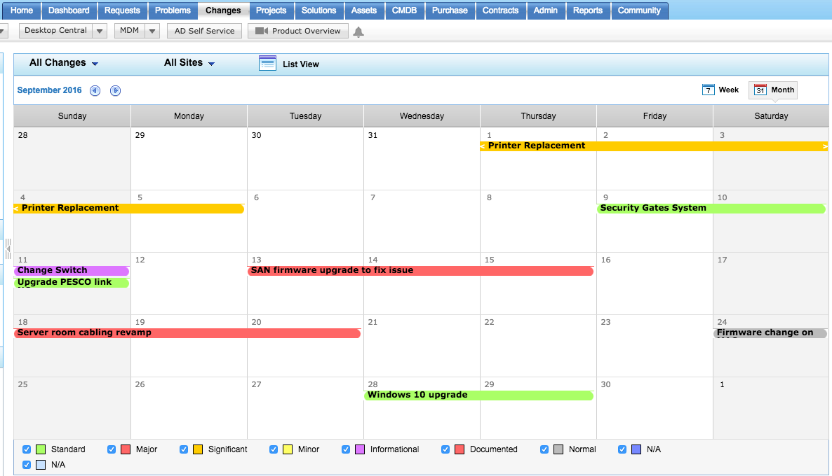
PLANNING CHANGES
FEATURE: CALENDAR VIEW.
Catrin checks the calendar view of changes and plans the printer replacement change, accordingly. She schedules the change using the scheduled start and scheduled end options during change submission.
Catrin schedules the change making sure it doesn’t interfere with other changes.

Slide 13
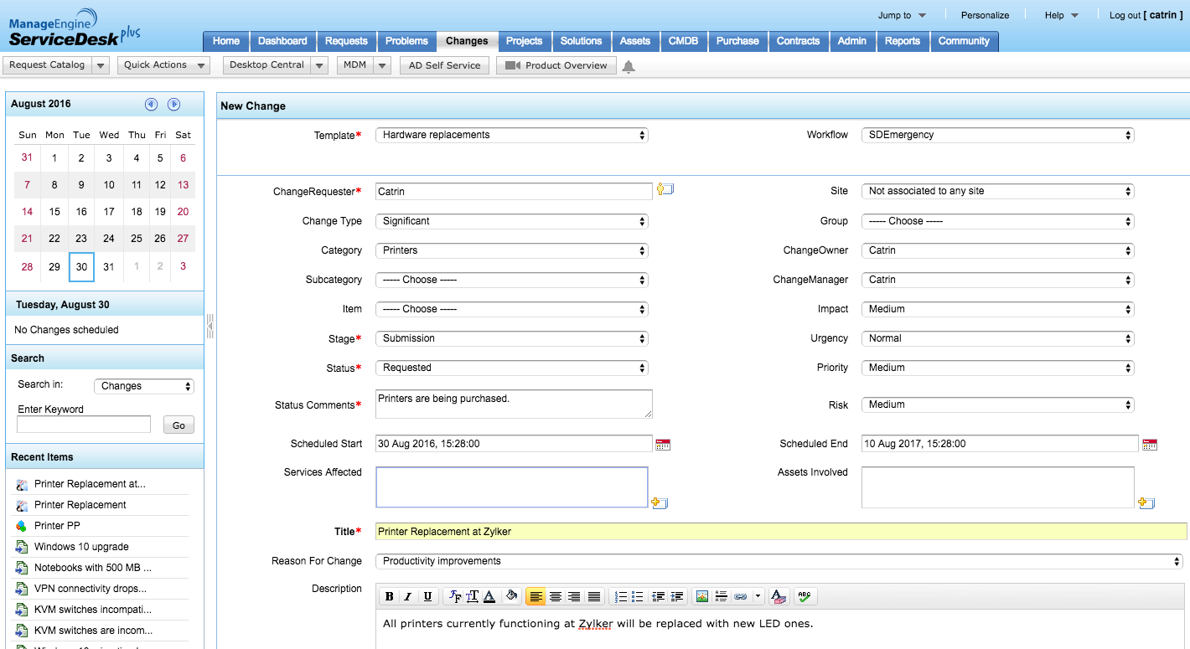
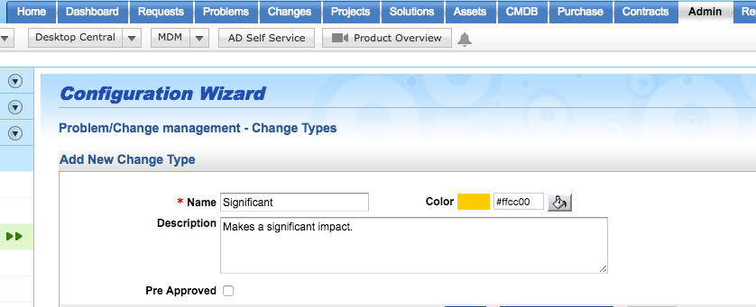
CHANGE SUBMISSION
FEATURE: CHANGES.
Zylker is a fairly big organization that has a number of printers installed in the company. To manage the overall process of replacing the existing printers with new LED ones, Catrin creates a new change in the “Changes” module of ServiceDesk Plus.
Catrin creates a new change type in the admin module.
Chooses the newly configured change type for the change.
Selects the time frame of the change.
Creates a new change in the “Changes” tab.

Slide 14
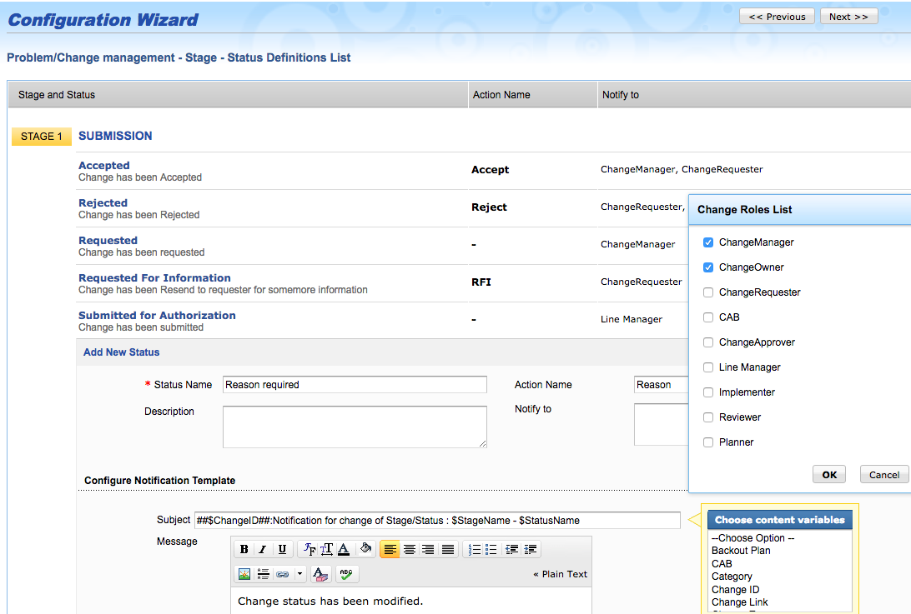
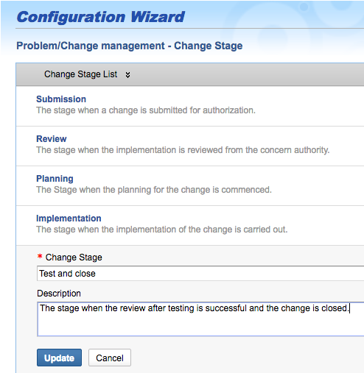
CHANGE CONFIGURATION
FEATURE: CHANGE STAGE AND STATUS.
Catrin updates the change stages to match the requirements and creates statuses for each stage.
Catrin adds new statuses for each stage of the change.
Edits the change stage.

Slide 15
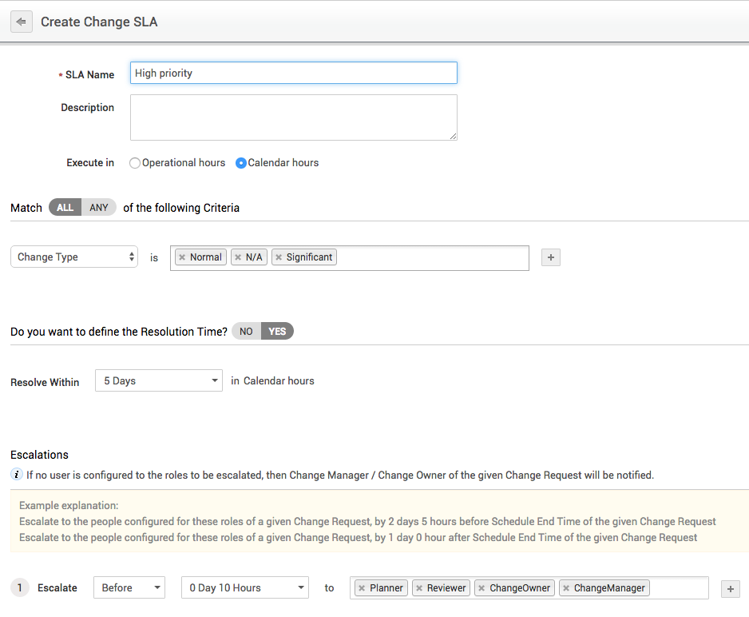
CHANGE CONFIGURATION
FEATURE: CHANGE SLA.
Catrin sets the resolution SLA and defines escalation levels. This helps to notify change roles on the progress of the change and maintain the desired pace of the process.
Catrin adds new statuses for each stage of the change using the configuration wizard.
Adds new statuses for each stage of planning.
Sets escalation rules to notify the specified roles should the SLA be violated.

Slide 16
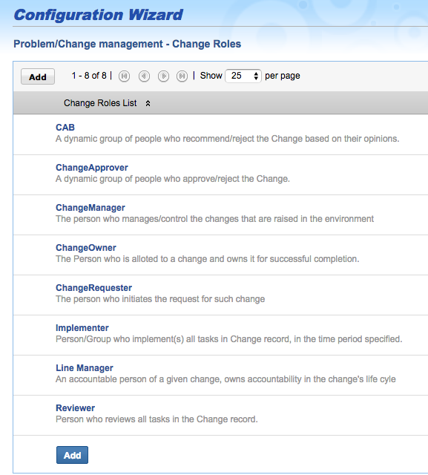
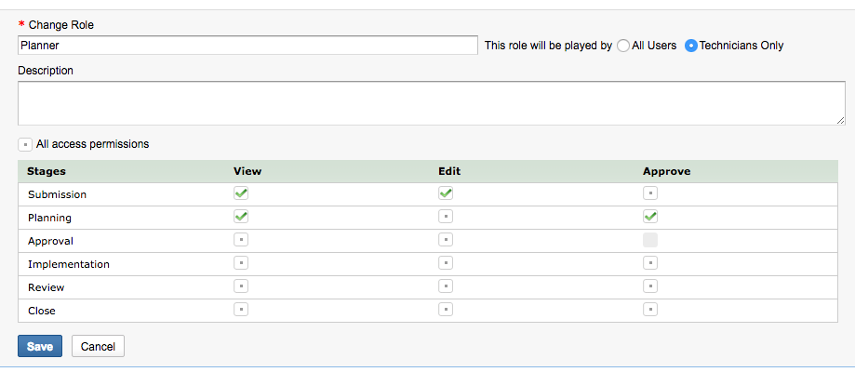
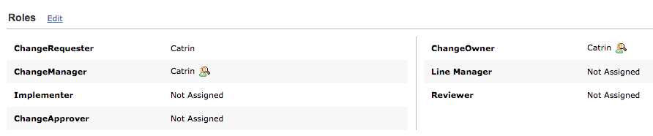
CHANGE CONFIGURATION
FEATURE: CHANGE ROLES.
Catrin creates roles pertaining to the change in the admin module and provides the required access permissions. This helps to assign change specific roles to technicians or end users.
Restricts the role to technicians.
Catrin adds the change roles required.
Gives relevant access permissions.
Assigns the right technicians for each role.

Slide 17
CHANGE CONFIGURATION
FEATURE: NOTIFICATION TEMPLATE.
Catrin defines the notification template that will be automatically triggered when the status changes.
Defines the change roles that need to be notified of change in status.
Configures the notification template.

Slide 18
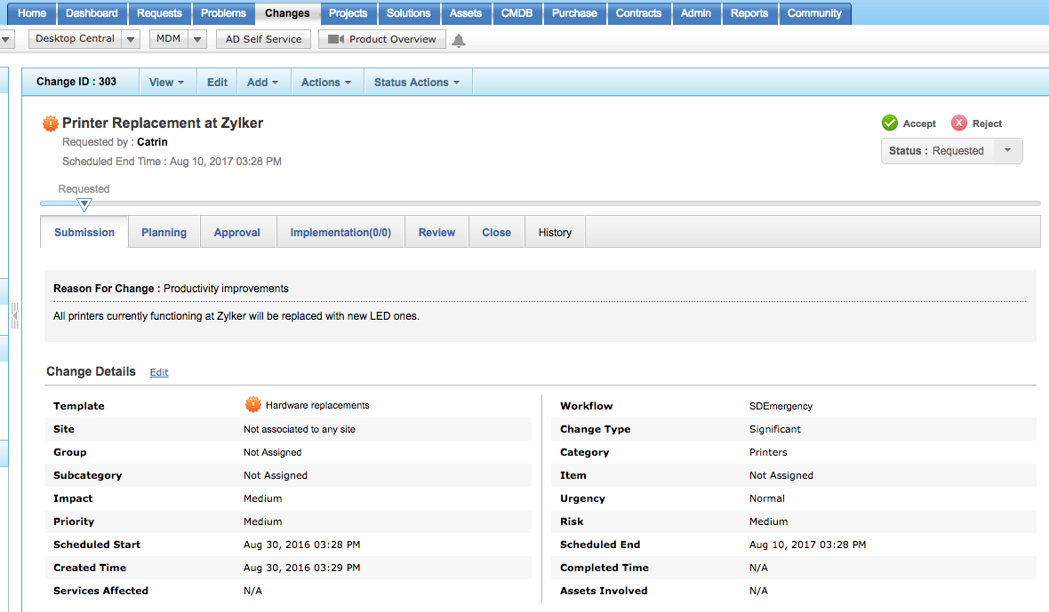
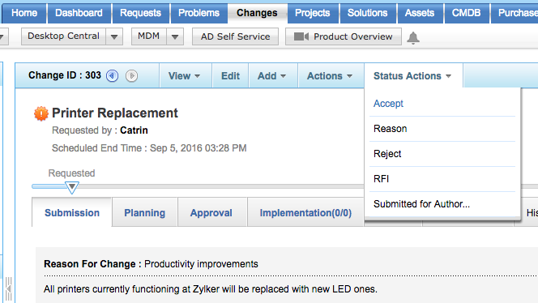
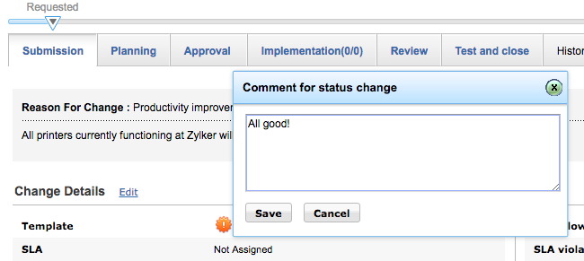
CHANGE STATUS TRANSITION:
FEATURE: STATUS ACTIONS.
To move the change to the next stage, Catrin uses the ‘Status Action’ option. She chooses ‘Accept’ from the ‘status actions’ dropdown and adds a comment. The status of the change automatically moves to the next stage.
Catrin chooses ‘Accept’ in the status actions.
Catrin moves to the planning phase after submitting the change.
Adds a comment on the status change and saves it.

Slide 19
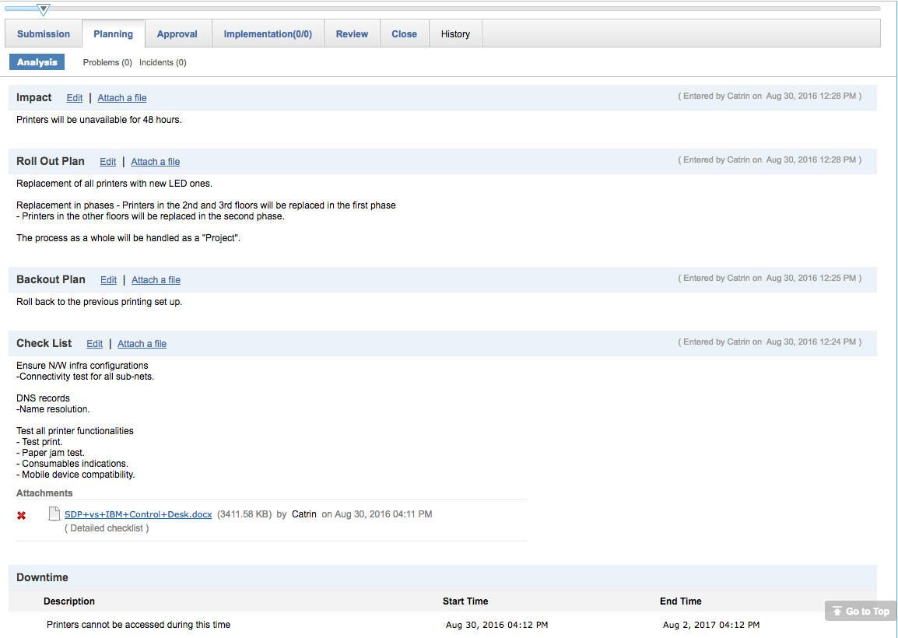
CHANGE PLANNING
FEATURE: PLANNING (Roll Out Plan, Back Out Plan, Check List, Downtime).
Catrin adds the roll out and back out plans for the change to make sure nothing falls through the cracks. She adds a checklist for technicians to easily carry out the process of replacing the printers. She also sets the time period for which printers will be inaccessible.
Creates a roll out plan and back out plan.
Sets a checklist of things to do.
She adds the detailed checklist as an attachment.
Sets the time for which printers are going to be inaccessible.

Slide 20
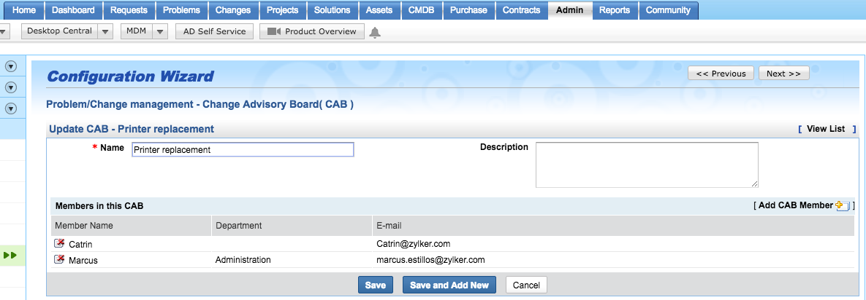
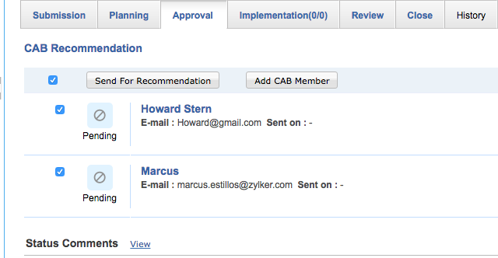
CHANGE APPROVAL
FEATURE: APPROVAL, ADDING CAB, SEND FOR RECOMMENDATION.
Catrin forms a Change Advisory Board (CAB) in the admin module, selects the CAB members in the “approval” tab and sends a pre-defined notification template to them asking for their approval.
Associates the CAB with the change and sends it for approval.
Catrin creates a CAB for the printer replacement change.

Slide 21
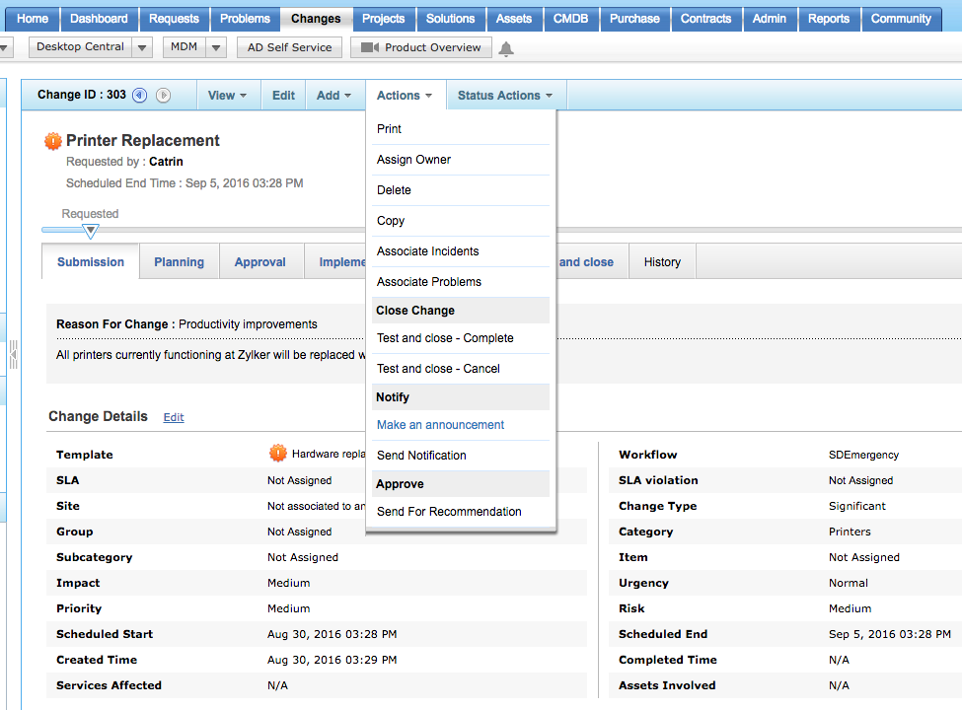
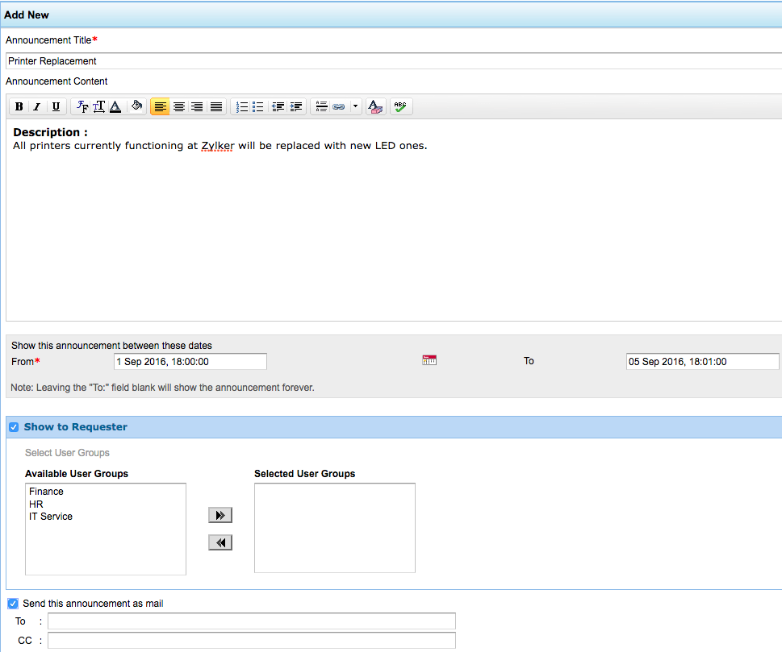
NOTIFYING END USERS AND TECHNICIANS ABOUT THE CHANGE
FEATURE: ANNOUNCEMENTS.
Catrin creates an announcement using the ‘Actions’ drop down box for the end users and technicians. This will ensure that everyone is updated and are on the same page when the change is being implemented. The auto-suggest feature also makes sure that end users who have missed the announcement don’t log in tickets on issues pertaining to the change.
Catrin creates a new announcement that will be available for end users and technicians to view.
Chooses to send the announcement as email to selected users.

Slide 22
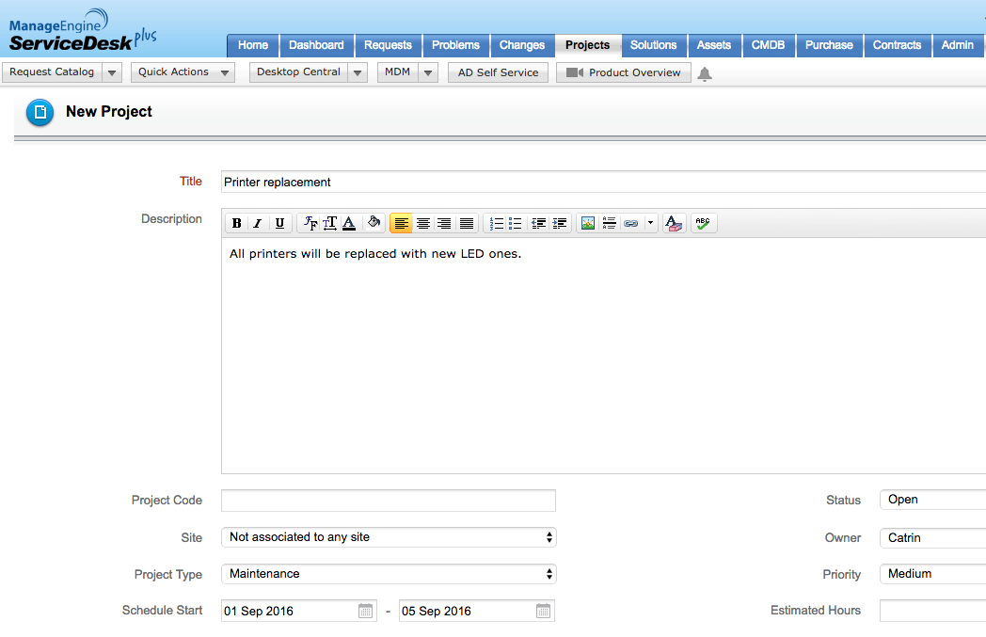
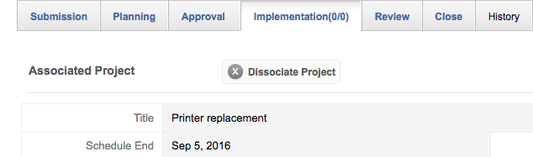
IMPLEMENTATION OF CHANGE:
FEATURE: PROJECT MANAGEMENT.
Since Zylker has a big number of printers, Catrin turns the change into a project instead of breaking it down to tasks. She creates a new project titled, “Printer replacement” and associates it with the change.
Catrin creates a new project for the printer replacement.
Associates the project with the change in the implementation phase.

Slide 23
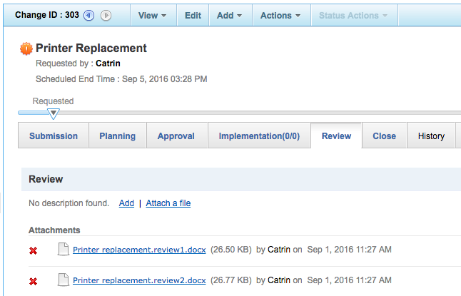
CHANGE REVIEW:
FEATURE: REVIEW.
Catrin collects reviews from the CAB, the associated technicians, and the end users and attaches them as files to the change in the ‘review’ tab. This helps ensure a successful change and also serves as references for similar changes in the future.
Catrin attaches the reviews to the change.

Slide 24
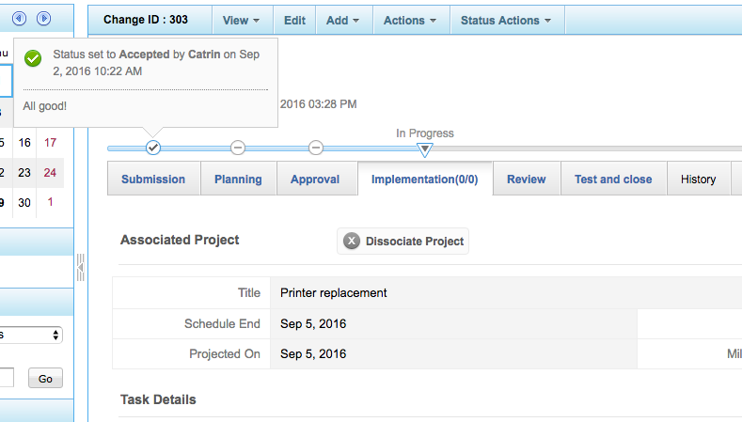
CHANGE TIMELINE:
FEATURE: TIMELINE.
At each stage, Catrin checks the status details of the change easily by hovering the cursor over the timeline.
Catrin views the status comments at each stage easily by hovering over the timeline.

Slide 25
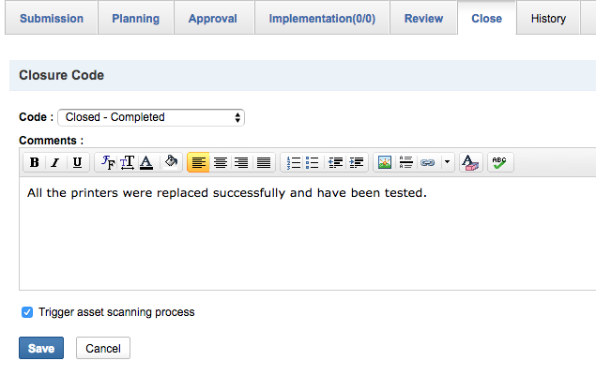
CHANGE CHANGE CLOSURE:
FEATURE: CLOSE TAB.
Based on the reviews, Catrin decides to close the change. This registers the complete closure of the change. She also triggers an asset scan to record the new printers in the asset directory.
Catrin selects the closure code and closes the change.
Triggers the scanning of the newly installed printers.

Slide 26



Driving a successful change with ServiceDesk Plus.
IMPLEMENT
The change is associated with a newly created project and implemented.
REVIEW
CLOSE
The implemented change is reviewed and recorded.
The change is closed after analyzing the review.
4
2
3
4
PLAN
1
The change is planned with the 6 stages of planning.
ANNOUNCE
5
The technicians and end users are notified of the change by making an announcement.
6
SUBMIT
The change is created.

Slide 27
ROOTKIT at Zylker
Firefighting using emergency change management in ServiceDesk Plus

Slide 28



Zylker under attack!
5:00 a.m.: Scott is a happy guy, kicking off his day listening to cool music!
SCOTT
IT TECHNICIAN
5:10 a.m.: Scott notices something strange in his dashboard. There were entries showing multiple failed login attempts.
5:20 a.m.: Scott is not so happy! Finds out it’s a ROOTKIT!

Slide 29


How Scott handles the issue.
I know how to handle this!
Oh wait! Catrin has made it very clear that I shouldn’t process anything without an approval!
1
Scott creates a change and sends it for approval
from Catrin and the CAB. Waits for the approval.
2
None of the members of the CAB were working at those
early hours and by the time they responded, it was too late.

Slide 30
Emergency changes
Handling emergency changes using ServiceDesk Plus

Slide 31
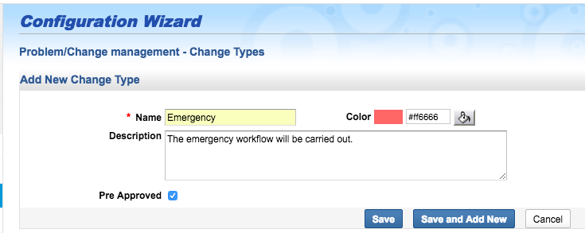
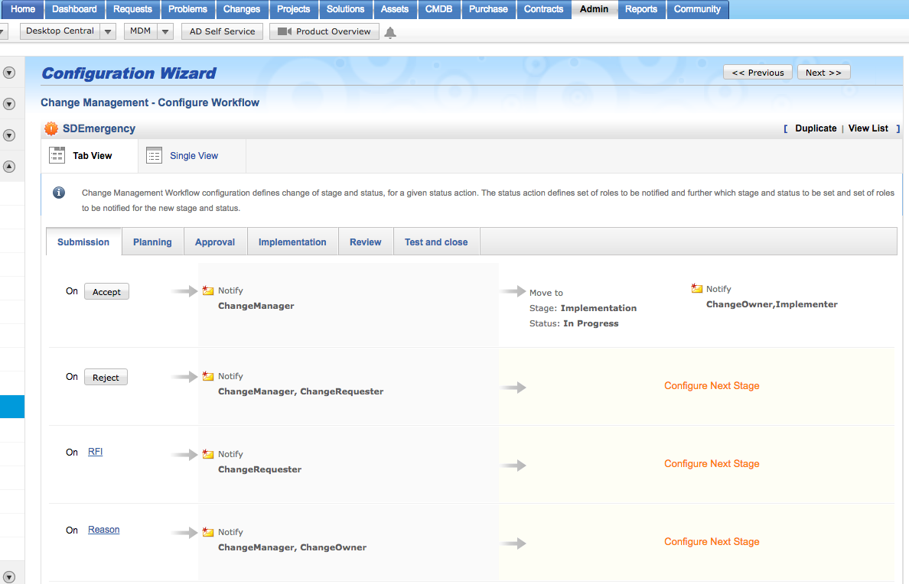
EMERGENCY CHANGE:
FEATURE: CHANGE TYPES; CHANGE WORKFLOW.
Scott creates a new change type for the emergency type and marks it as a pre-approved change. This will allow him to skip the approval stage. Scott doesn’t have the time for an elaborate change workflow. He modifies the Emergency workflow and sets it to skip a few stages.
Scott creates a new change type for the emergency change and marks it ‘pre-approved’.
Defines a quick processing change workflow for the emergency change.

Slide 32
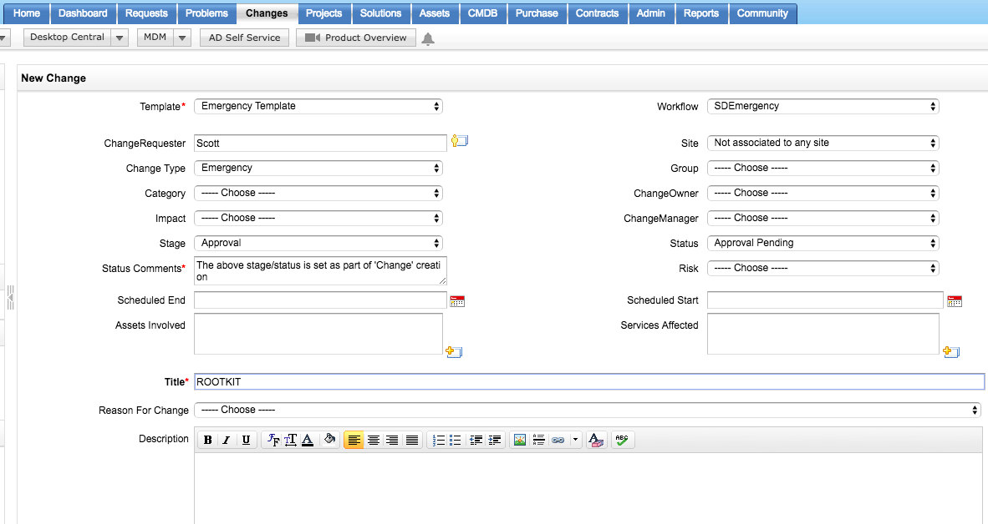
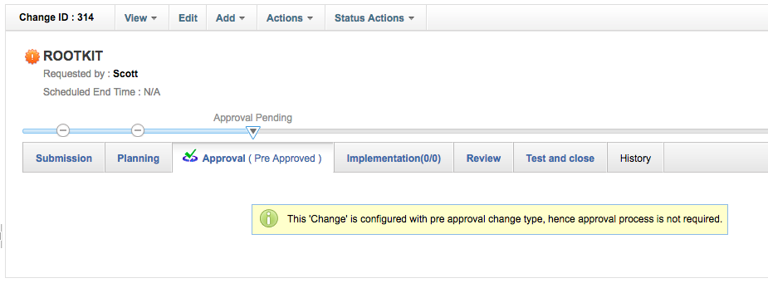
EMERGENCY CHANGE SUBMISSION:
FEATURE:. CHANGE MODULE
Scott creates a new change with the emergency change template and workflow, which will allow him to skip a few stages for faster closure of the change. The pre-approved emergency change workflow automatically by-passes the approval stage.
Scott creates a new change using the emergency template and workflow.
The workflow automatically skips the approval step.

Slide 33
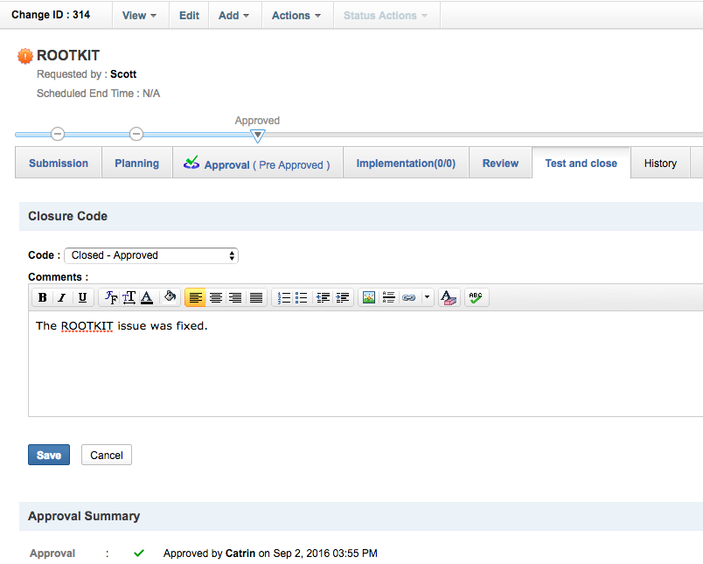
EMERGENCY CHANGE CLOSURE:
FEATURE:. CLOSE.
Scott implements the change and closes it quickly and the issue is solved.
Scott selects the closure code, adds a comment and closes the change.

Slide 34






ROOTKIT busted With ServiceDesk Plus!
SOLVE
CLOSE
SKIP
PRE-
APPROVE
CREATE
DEFINE
The emergency change workflow is defined.
The change is created.
The pre-approved workflow skips the approval stage.
The emergency workflow moves the change directly to implementation.
The change is completed and closed.
The issue is fixed in no time.

Slide 35

What customers say
ServiceDesk Plus has been a great decision both functionally and financially.
James Arnold
Service desk manager
Manhattan Associates

Slide 36
100,000+
IT service desks
700,000
IT technicians
185
Countries worldwide

Slide 37

Get ServiceDesk Plus
Join the 100,000+ IT help desks worldwide.
Sign up for a 30-day free trial.
Have questions? Drop us a line at hello@servicedeskplus.com

