Slide 1
Product Overview

Slide 2
Introduction
Analytics Plus is a self-service Business Intelligence and advanced analytics software.
On-premises analytics solution.
Helps analyze IT data with powerful visualizations.
Offers key insights to help make business-critical decisions.
Analytics Plus

Slide 3
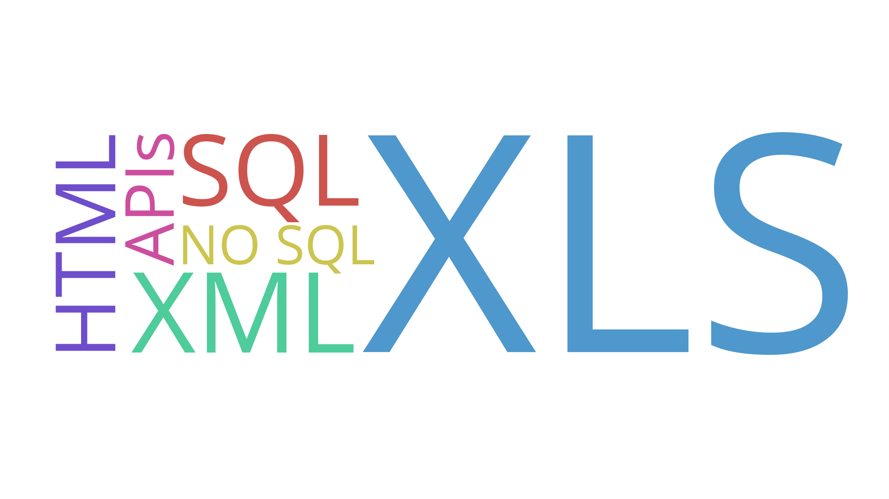
Import Data from Different Sources
Connect to data from files and feeds.
Synchronize data from SQL and No SQL databases.
Pull in table data from websites.
Displays table data in an easy-to-view Excel format.
Analytics Plus

Slide 4
Integration with ServiceDesk Plus and ServiceDesk Plus MSP
Integration and auto analysis in less than 5 minutes!
Over 100+ reports and dashboards built on 80+ KPIs.
Build custom reports without having to write complex SQL queries.
Populate charts from various ServiceDesk Plus modules, all combined in a single dashboard.
Drill down to key metrics from live dashboards.
Periodic data synchronization.
Analytics Plus

Slide 5
Integration with Opmanager and Applications Manager
Offers out of the box integration with OpManager and Applications Manager.
100+ Prebuilt reports on 400+ KPIs.
Analytics on inventory, monitor groups, performance metrics, alarm history and current alarm status.
Unified ITOM dashboards with data from both OpManager and Applications Manager.
Periodic data synchronization.
Analytics Plus

Slide 6
Integration with SupportCenter Plus
Out of the box integration with SupportCenter Plus.
60+ pre-built reports generated on various helpdesk KPIs.
Role based dashboards to match different roles in the organization.
Analytics on accounts, business units, request trends, technician performance and much more.
Periodic data synchronization.
Analytics Plus

Slide 7
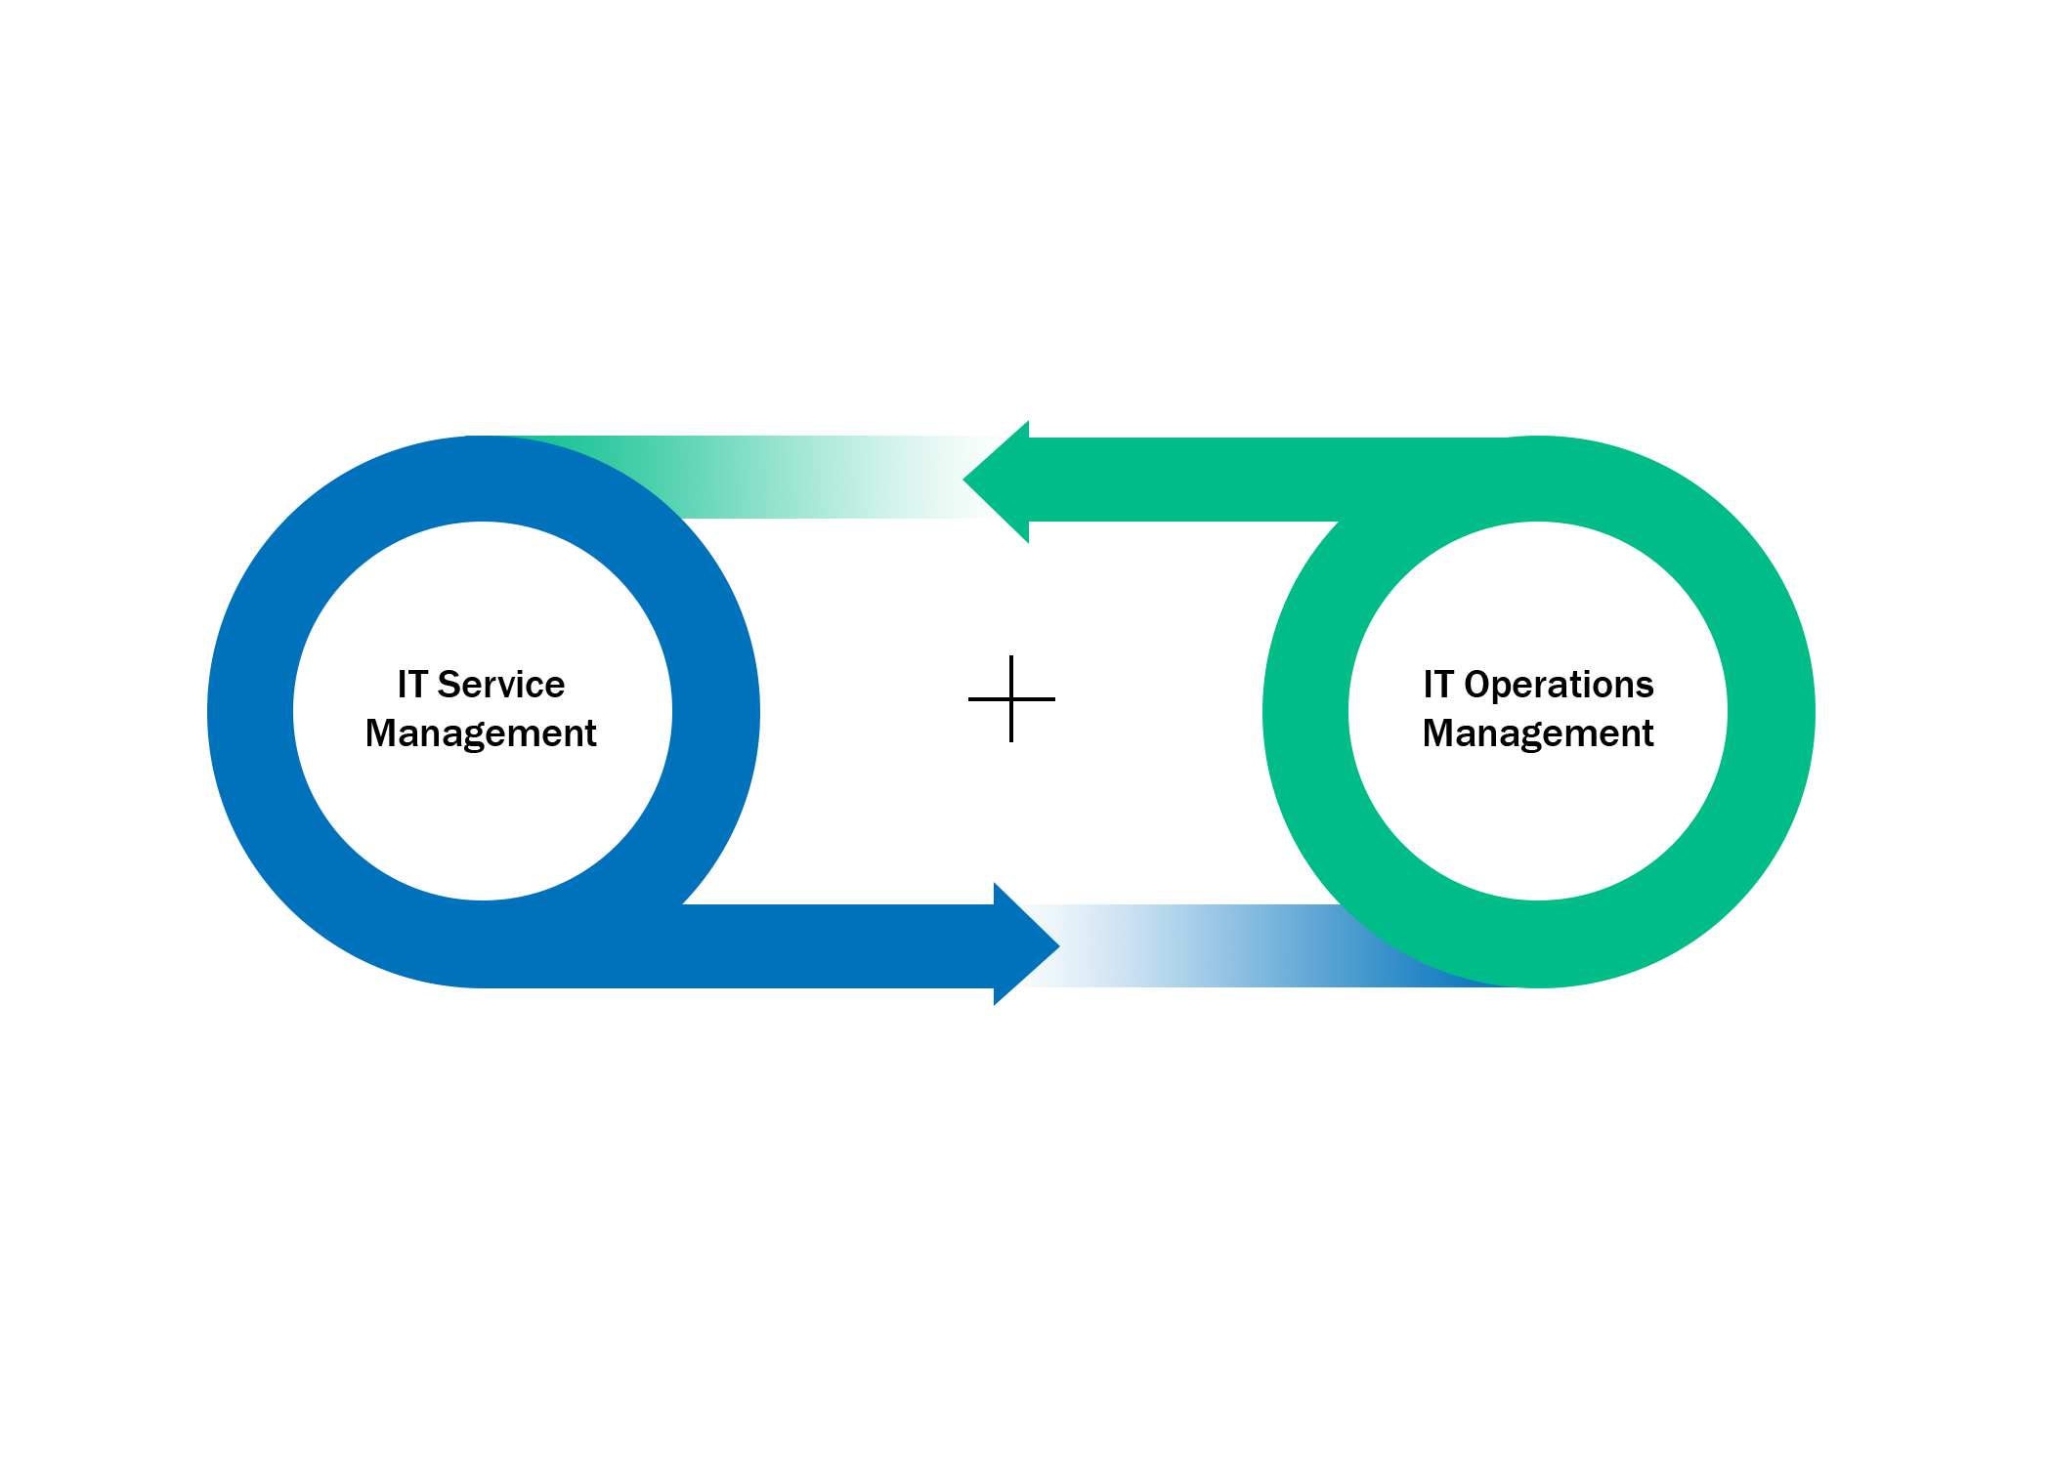
Unified Dashboards
Create unified dashboards by including visualizations from different databases.
Compare performance KPIs across databases.
Choose between HTML embed or complete data blending.
Analytics Plus

Slide 8
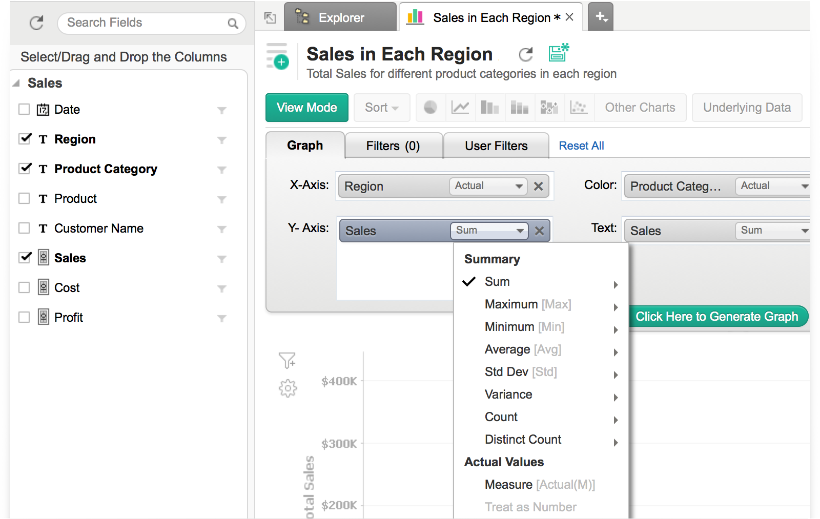
Ease of Use
Drag and drop report building capability.
Little or no technical expertise needed.
Auto analysis feature builds charts and dashboards for any type of data.
User-friendly interface.
Analytics Plus

Slide 9
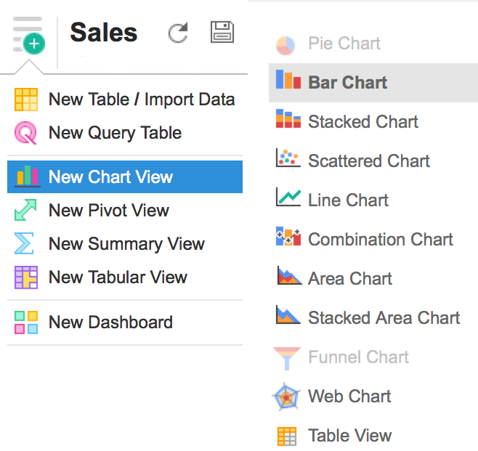
Powerful Visualizations
Turns your table data into visualizations.
Auto-selects the right type of chart based on data type.
More than 30 types of charts to represent your data.

Slide 10
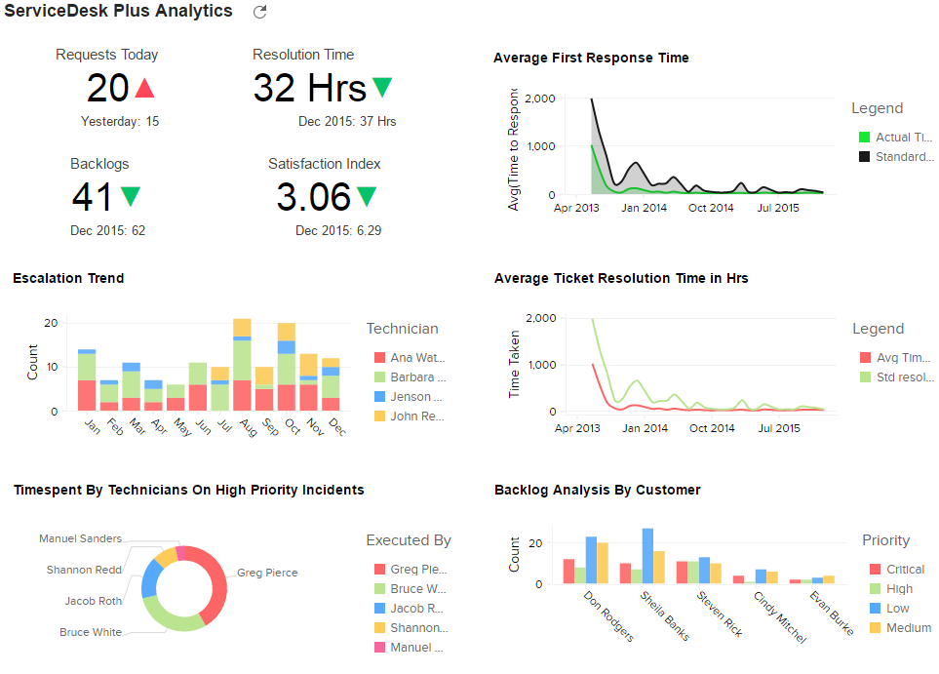
Intuitive Dashboards
Populate dashboards with charts, widgets and text.
Set drill down path and change chart type, right from within the dashboard.
Build slideshows with multiple dashboards.
Flexible layout to organize multiple reports.

Slide 11
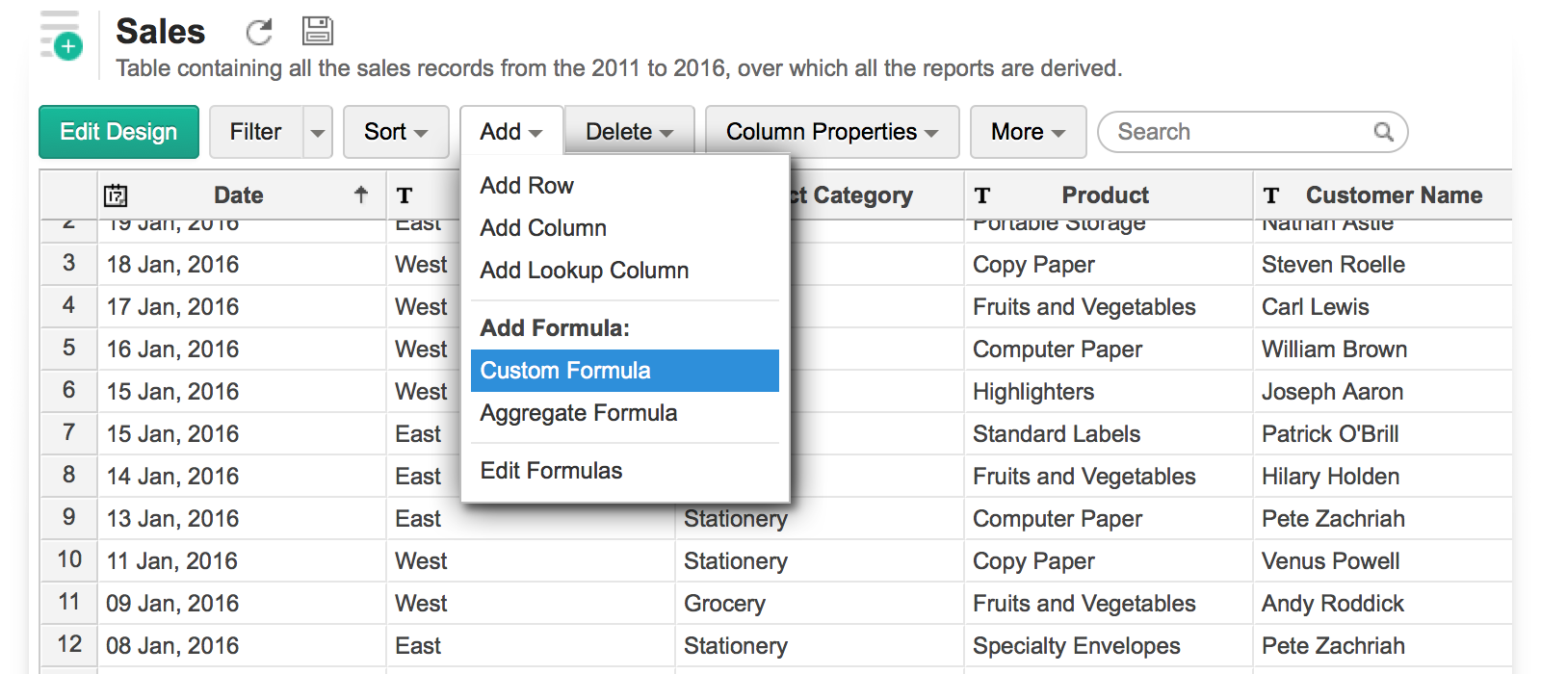
Custom Functions
Built in formula engine.
Choose from a wide range of mathematical and statistical functions.
Use custom or aggregate formulas to derive new columns.

Slide 12
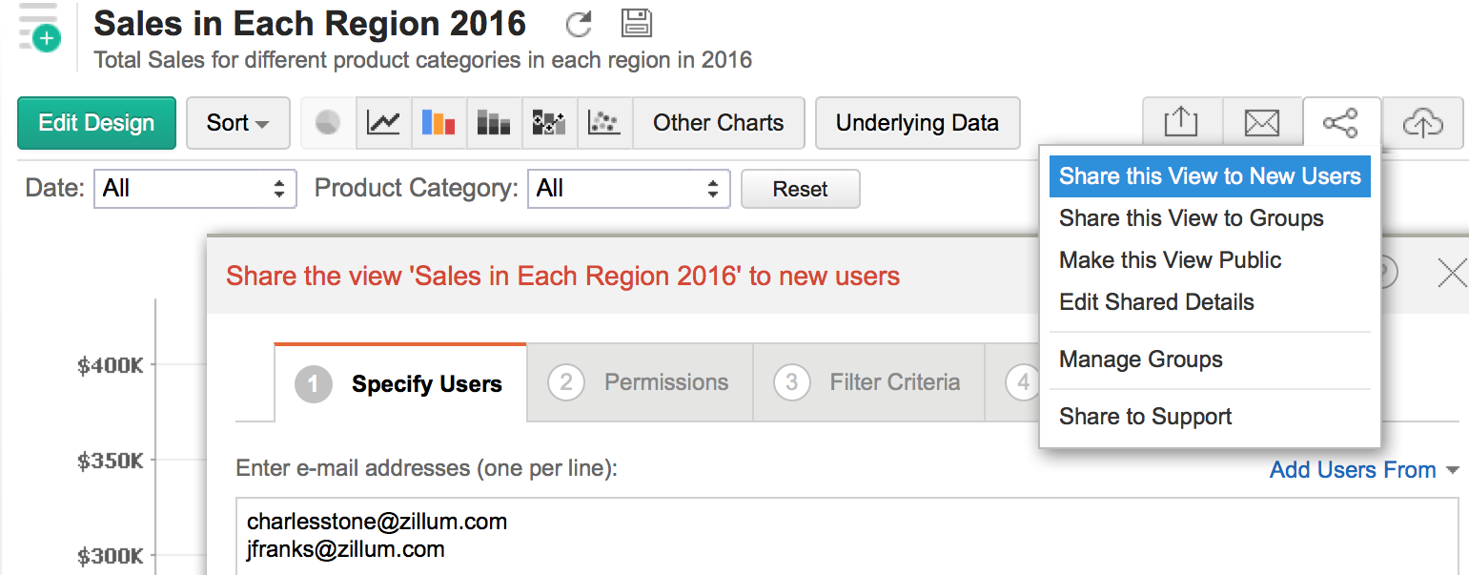
Sharing and Collaboration
Collaborate with your colleagues seamlessly.
Share reports and dashboards across the organization.
Define fine grained permissions.
Filter data based on specific criteria.

Slide 13
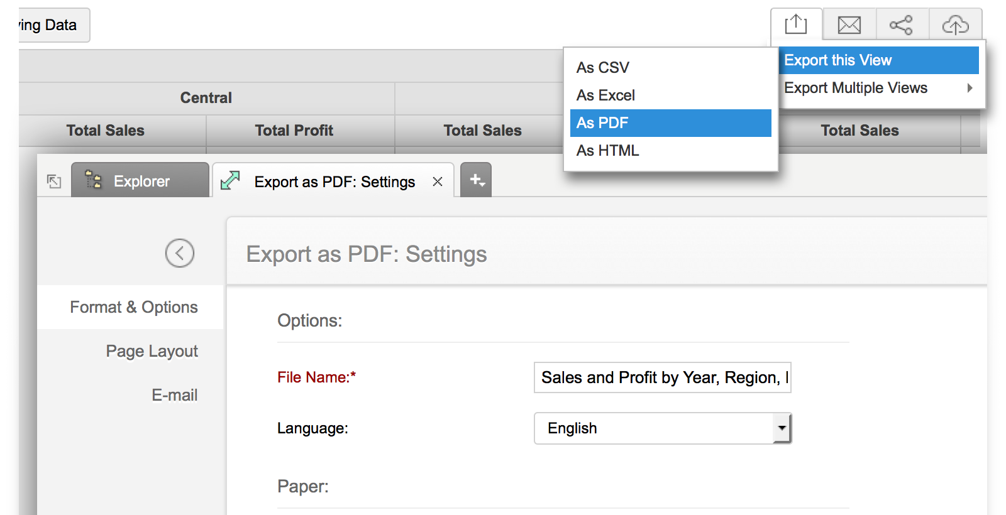
Exporting Data
Export reports and dashboards as CSV, XLS, PDF or HTML files.
Flexible schedules to send reports right to your inbox.
Embed or publish dashboards and reports.

Slide 14
Thank You

