Slide 1
Thomas cook redefines Active Directory management with ADManager Plus
Case study Thomas cook

Slide 2
Customer for case study
Case study Thomas cook
A 130 years old company
Offers services in Tours & Travels, Travel insurance & Foreign exchange segments
The Group operates under six geographical segments in 22 countries
Stands number one or two in all its core markets.
Serves more than 23 million customers

Slide 3
Case study Thomas cook
Fetching reports from AD took our IT people a lot of time
Having to fetch it from the complex AD environment made the process more tiresome
The absence of a AD management tool made technical expertise in AD a must for the IT staff

Slide 4
How did ADManager Plus address the challenge..
Case study Thomas cook
Awe-striking reporting feature – a report for every need in just a few minutes
The template-based bulk user creation and modification is another feature that added more cream to the pie
Simply easy deployment
& definitely Cost effective

Slide 5
Testimonial…
Case study Thomas cook
“It has competitive features & is a easy as well as user friendly application & the other important factor is our experience with ManageEngine ‘s incredible technical support team who were prompt on support pre & post trial of the product”
-Mr. Swapnil Patkar, Manager-IT Thomas Cook (India) Ltd.

Slide 6
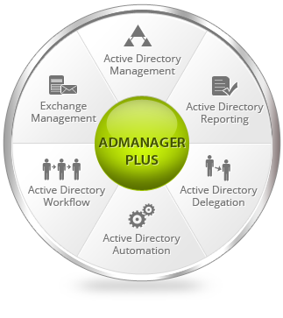
ADManager Plus highlights
Case study Thomas cook

Slide 7
More Information: www.admanagerplus.com Download Free Trial: www.manageengine.com/products/ad-manager/download.html For any further help: E-mail support@admanagerplus.com Phone : +1888-720-9500
Case study Thomas cook

