Slide 1

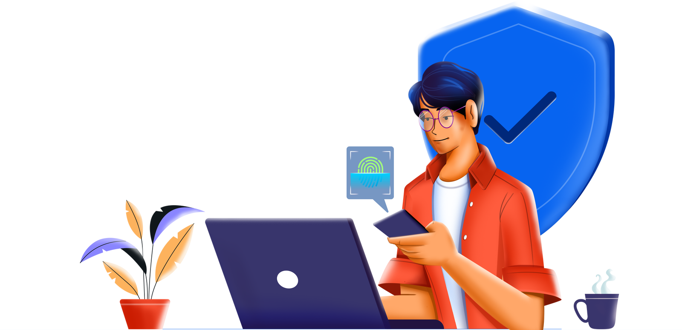

ADSelfService Plus
ManageEngine
An identity security solution with adaptive MFA, single sign-on, and password management capabilities.

Slide 2







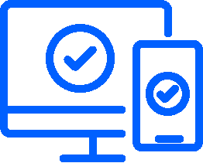






Critical identity security challenges
Workforce self-service
Overview of ADSelfService Plus
Benefits of ADSelfService Plus
O
u
t
l
in
e
Solutions offered by ADSelfService Plus
Our customers
Adaptive MFA
Case study
Single sign-on
Licensing, pricing and feature support
Self-service password management
and security
Add-ons
Remote work enablement
Contact us

Slide 3



Critical identity security challenges in enterprises
Password reset tickets
Upholding user productivity using MFA
Influx of passwords
Forgotten passwords and account lockouts remain the major source of help desk tickets.
A password reset ticket could take approximately 20 minutes and $30 to solve. This drastically affects employee productivity; even more so if you have a remote workforce. expiration
As organizations adopt cloud applications in droves, users have to enter more passwords throughout the day just to access these applications and complete their work.
Credentials remain the top cause of all data breaches. While MFA is a well-known approach today, organizations struggle to implement an effective MFA strategy that fortifies local and remote access security while simultaneously upholding user productivity

Slide 4

ManageEngine ADSelfService Plus is an identity security solution with multi-factor authentication, single sign-on, and self-service password management capabilities
An all-encompassing identity security solution

Slide 5

Solutions offered by ADSelfService Plus
Adaptive MFA
SSO for applications
Self-service password management and security
Secure local and remote access to endpoints and applications
Establish secure, one-click access to all enterprise applications
Enable self-service password management and fortify passwords
Remote work enablement
Workforce self-service
Streamline and secure remote access to enterprise resources
Provide a self-service portal for group management and AD attributes update

Slide 6
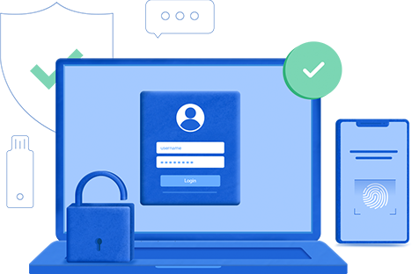
Implement adaptive MFA and evade credential misuse–the main culprit for data breaches
Adaptive MFA

Slide 7
Why is generic MFA not enough?
IT compliance laws now mandate or recommend the use of context-based MFA
Regulations like NIST mandate additional rules on privileged account protection
With multiple endpoints to protect, using different solutions for different endpoints becomes tiring
Connection to the MFA server can sometimes be severed, taking the user offline. In such cases, bypassing MFA or blocking access are both unwise options
Enabling MFA using the native options in applications and systems can create friction, since different systems support different ways and modes of authentication.

Slide 8



Adaptive MFA
Endpoint MFA
Conditional access
Passwordless MFA for applications
Secure access to the enterprise network with advanced MFA for access to machines (Windows, Linux, macOS); VPN and other network endpoints using RADIUS; and OWA and other IIS web applications
Automate access control decisions for the enterprise network and its resources based on risk factors like IP address, business hours, device used, and geolocation
Allow access to enterprise applications via SSO solely using advanced authentication methods such as biometrics, YubiKey, Google Authenticator, and more
Offline MFA
Passwordless MFA for applications
Protect user identities and machines by implementing MFA for Windows machines even when there is no internet connectivity or the ADSelfService Plus server is unreachable.
‌Enable passwordless access to enterprise applications using advanced authentication methods such as biometrics, smart card authentication, YubiKey, Google Authenticator, passkeys, and more—for secure, one-click access.

Slide 9



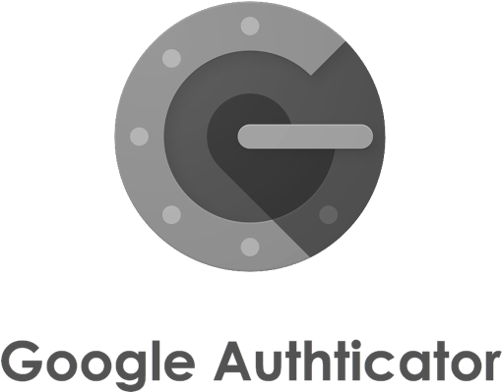


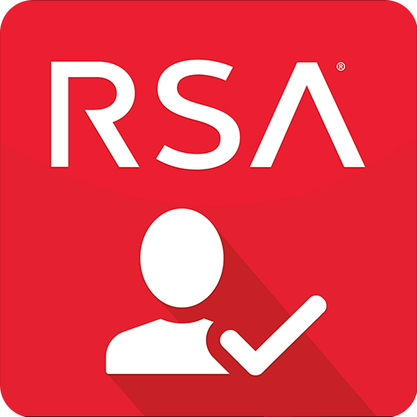


Supported Authenticators for MFA
FIDO Passkeys
QR Code-Based Authentication
Biometric Authentication
Duo Security
Smart Card Authentication
RSA SecurID
YubiKey Authentication
Azure AD MFA
Zoho OneAuth TOTP Authentication
RADIUS Authentication
Google Authenticator
SAML Authentication
Microsoft Authenticato
Email Verification
Custom TOTP Authenticator
SMS Verification
Security Questions and Answers
TOTP Authentication
AD Security Questions
Push Notification Authentication
SAML Authentication

Slide 10

Endpoint security via MFA
The MFA feature helps secure the following endpoints into the enterprise network.
Logins into the machine
Microsoft RDP logins
Windows machine unlock
This features works in two ways:
Both RDP client authentication and RDP server authentication is secured by MFA
MFA will be applied when the user unlocks their Windows machine
User-based MFA:
Here MFA is applied during logins into any configured machine by a specific user
Machine-based MFA:
Here MFA is enforced for all logins into a specific machine, irrespective of user
Windows User Account Control (UAC) prompts
MFA will be required for authentication during all elevated UAC prompts or Run As Administrator prompts

Slide 11


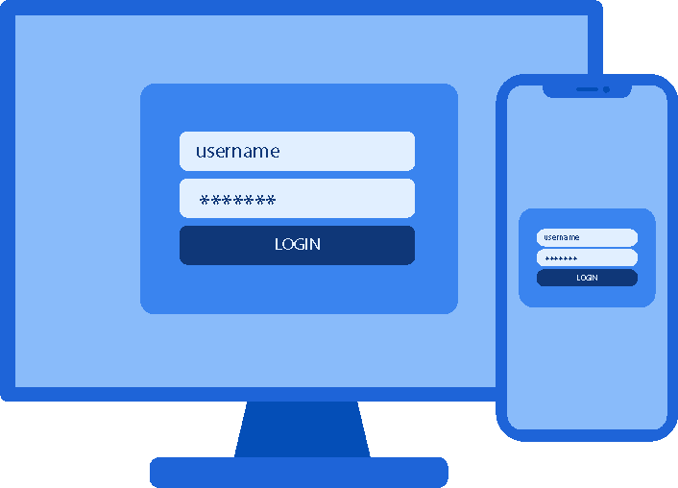
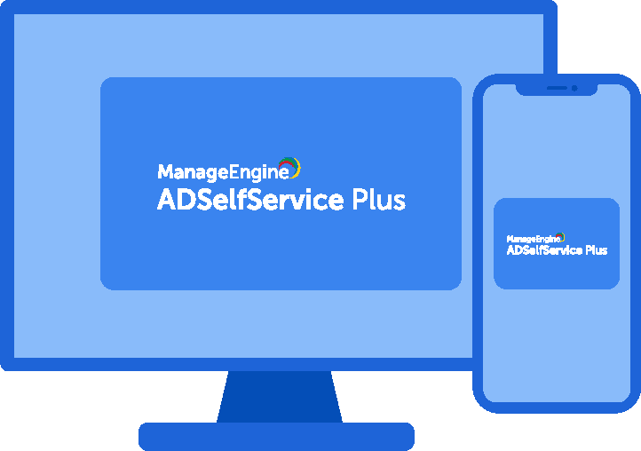

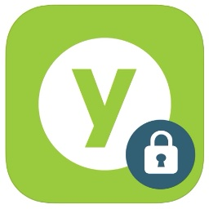
How does MFA work?
Step 1
Step 2
Step 3
The user enters their domain credentials as the first level of authentication into an endpoint or an enterprise application
The user completes further authentication using any of the supported methods such as biometrics, time-based verification codes, or through a third-party authenticator like YubiKey Authenticator
After successful authentication, the user is allowed access

Slide 12
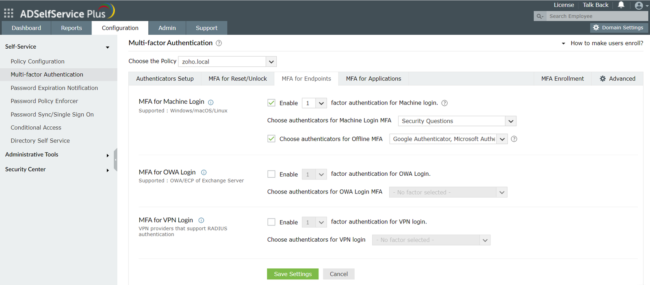
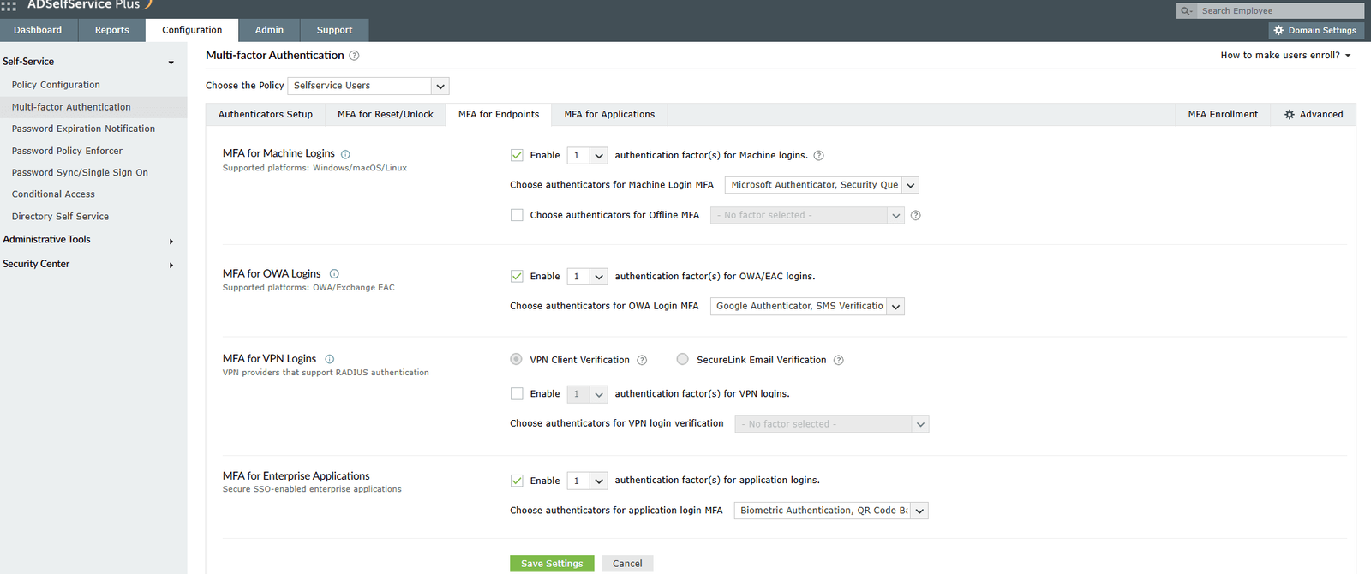
Endpoint MFA configuration

Slide 13

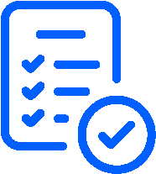

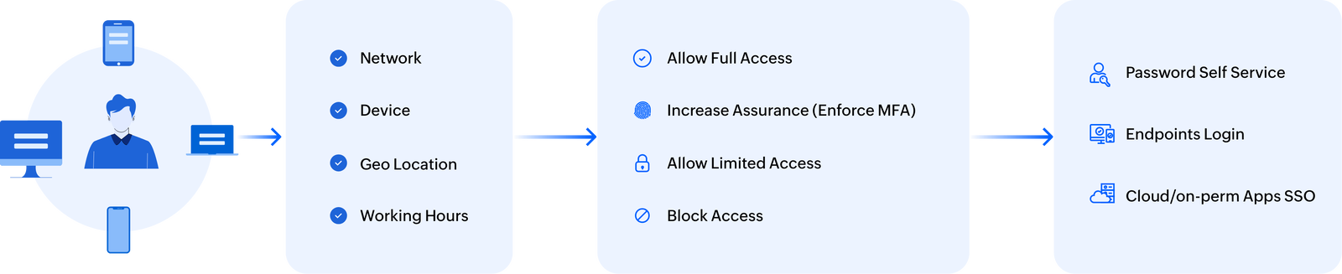
How do conditional access policies work?
A user attempts to log into their machine or access any other integrated application
Based on pre-configured conditions and the risk factor data, the solution enables one of the following:
Complete access to the machine or application
Secure access to the machine or application using MFA
Limited access to certain ADSelfService Plus features
Restricted access to ADSelfService Plus features
Risk factors such as the user's IP address, time of access, and geolocation are analyzed
Client Access
Conditions
Actions
Features

Slide 14
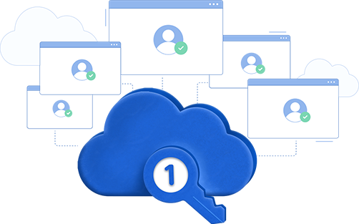
End login fatigue and simplify application onboarding with SSO
Single sign-on

Slide 15
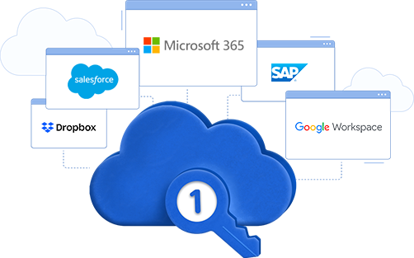
Single sign-on
SSO for established cloud applications
Secure and streamline application access by allowing users to authenticate once and access any of the supported applications without requiring further authentication
..... as well as custom enterprise applications
Enable SSO for custom on-premises and cloud applications via SAML, OAuth, and OpenID Connect protocols
Seamless access to applications that don't support standard SSO protocols like SAML, OAuth, or OIDC with the Bookmark functionality.

Slide 16
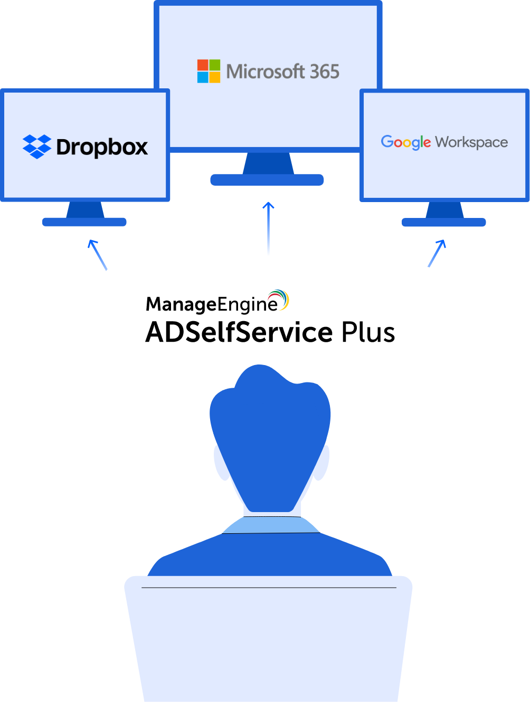
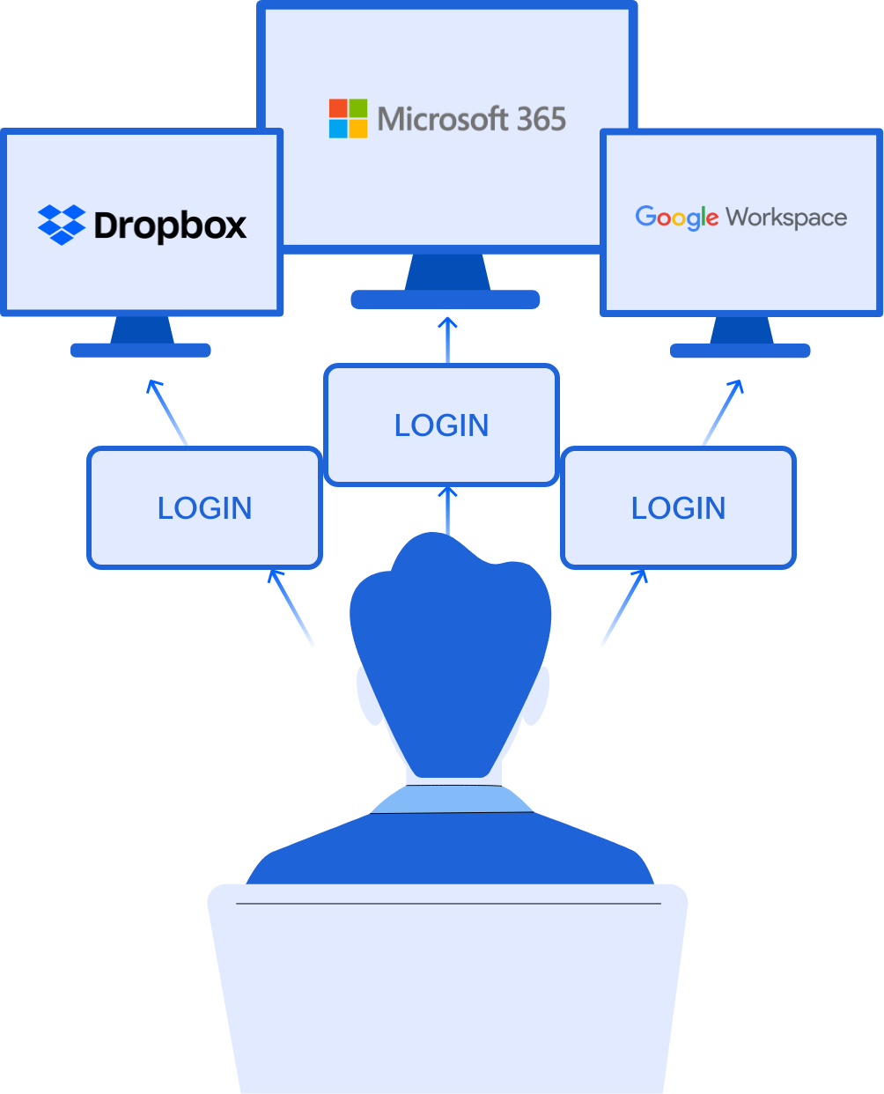
How SSO streamlines access to enterprise applications for users
Before implementing SSO
After implementing SSO
The user opens and logs in to each enterprise application individually with a separate set of credentials
The user opens the ADSelfService Plus portal (for IdP-initiated SSO) or the enterprise application (for SP-initiated SSO)
The user completes authentication using ADSelfService Plus (in case of SP-initiated SSO, users will be redirected to the ADSelfService Plus portal)
The user obtains access to multiple applications

Slide 17
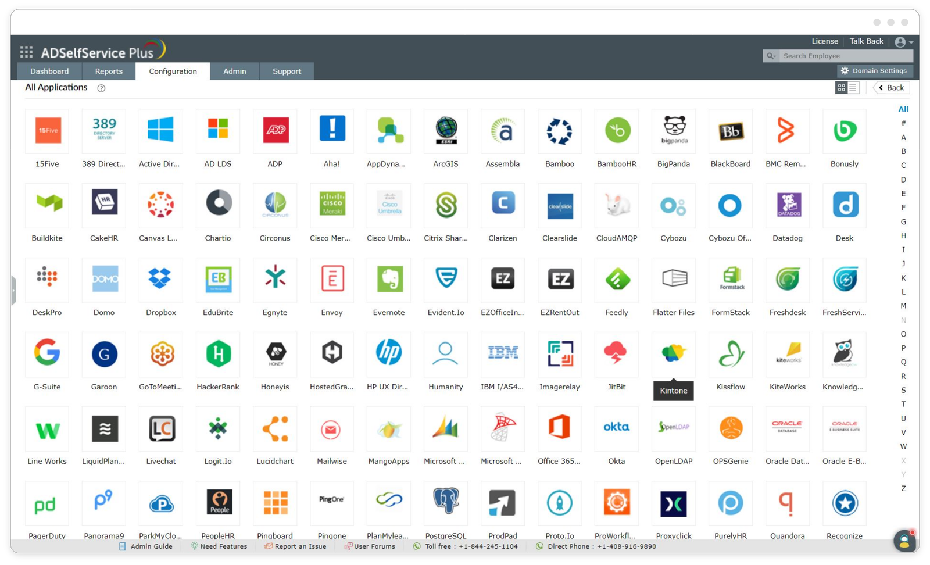
Applications supported out-of-the-box for SSO

Slide 18
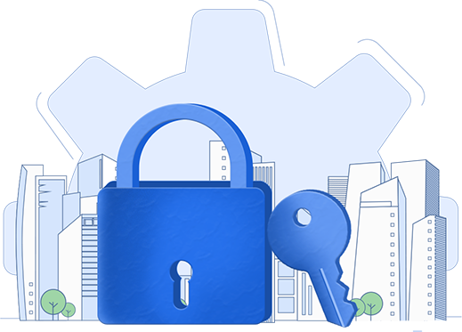
Eliminate password reset tickets and uphold password security
Self-service password management and security

Slide 19




Self -service password management and security
Self-service password reset and account unlock
Password synchronization
Enable users to reset passwords and unlock accounts in office, at home, or on the move, all without help desk aid
Sync AD password resets and changes with the connected enterprise applications, in real time
Password and account expiration alerts
Password policy enforcer
Automate password and account expiration reminders to users via email, push, and SMS alerts
Mandate creation of complex passwords by implementing advanced password requirements during password changes and resets

Slide 20
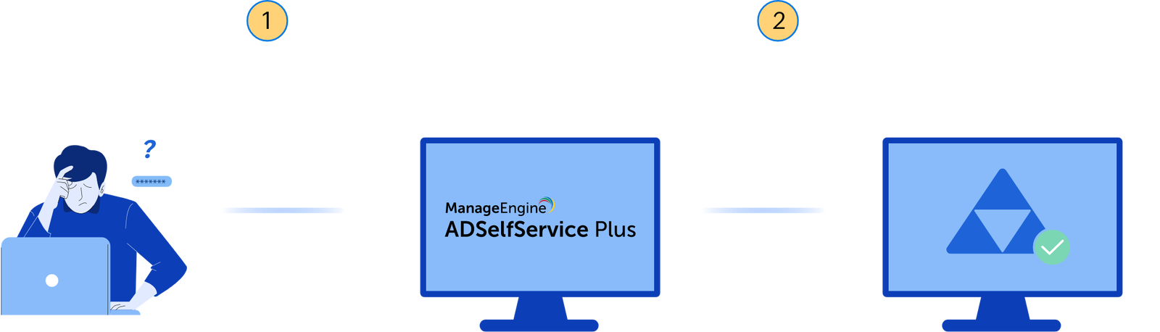
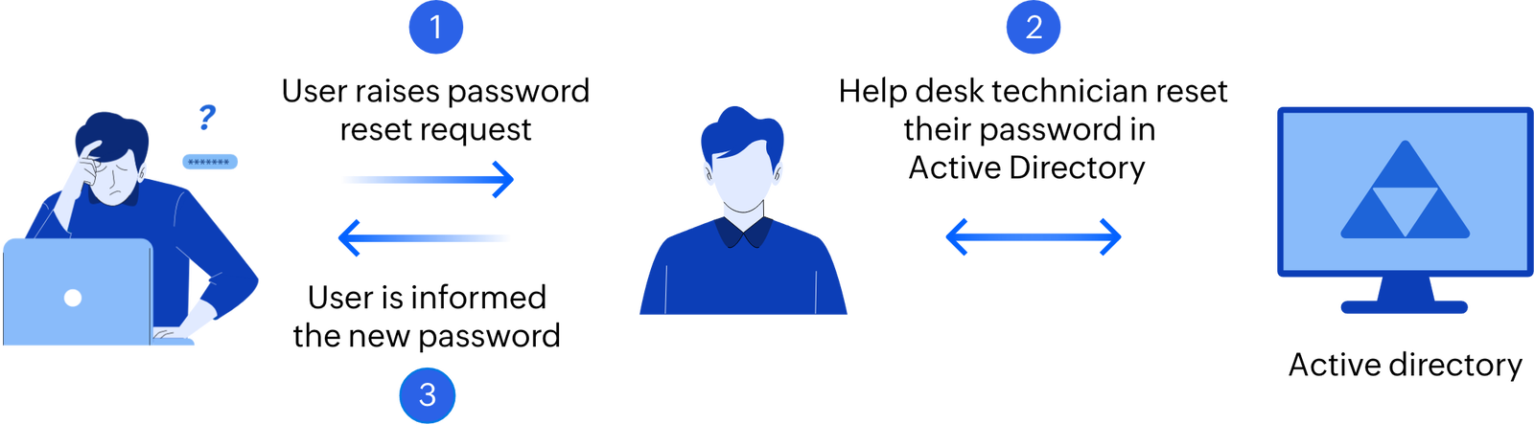
How admins free themselves from redundant password reset tickets
Before ADSelfService Plus
After ADSelfService Plus
A user who has forgotten their AD domain password, contacts the IT help desk.
The IT help-desk verifies their identity and resets their password.
A user who has forgotten their AD domain password opens the ADSelfService Plus password reset portal via a web-browser, their login screen, or mobile device
User authenticates using MFA and resets their password

Slide 21
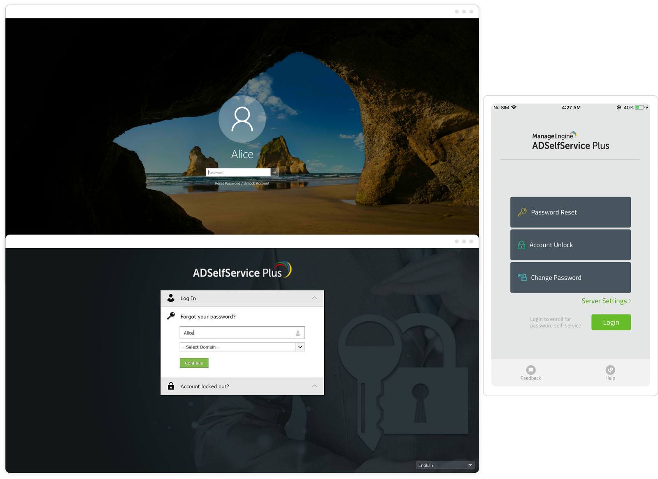
Self -service password management and security

Slide 22
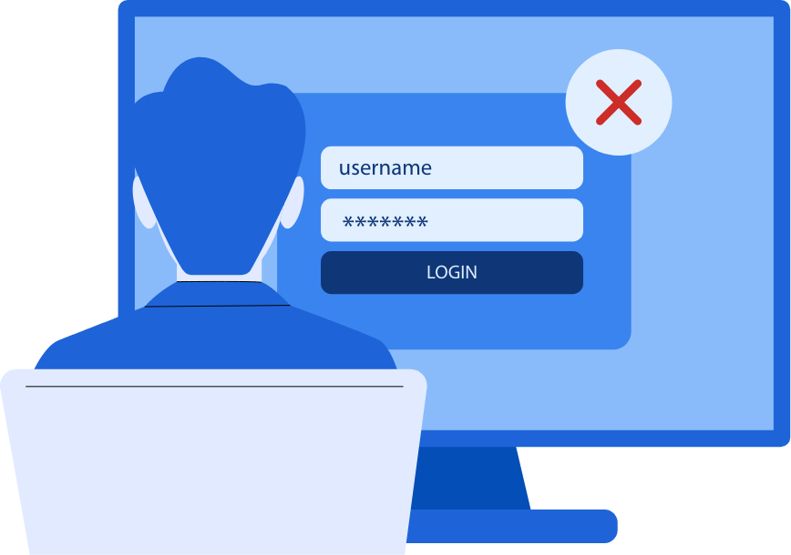
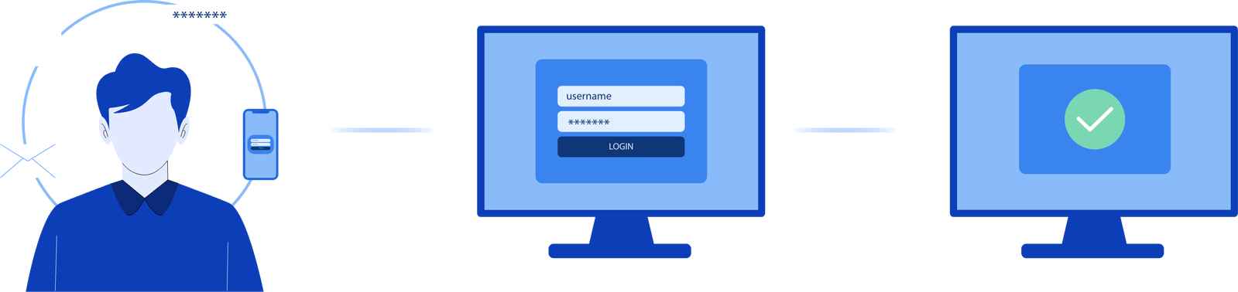
How remote users stay on top of AD password and account expiration
Before ADSelfService Plus
After ADSelfService Plus
Remote users, especially VPN and OWA users, have no way of being notified about their expiring passwords and accounts. Users often lose access to their accounts and the help desk are rendered unable to assist the users remotely
Users with passwords or accounts that are nearing expiration receive regular reminders via SMS, email, and push notifications
Users can change their passwords before expiration and contact the help desk to deal with their AD account expiration

Slide 23

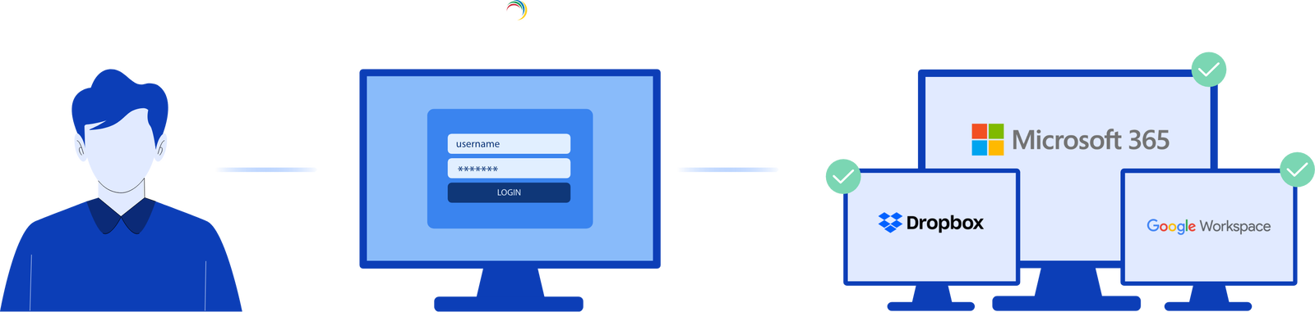
Rescue users from password fatigue
Before ADSelfService Plus
After ADSelfService Plus
A user has to create and maintain a separate set of credentials for each of their enterprise application accounts. This may lead to forgotten passwords or poor password hygiene
The user's AD password is synchronized across integrated applications
Any password change or reset is replicated across the applications. They can also choose to change or reset the password of particular applications, if required

Slide 24



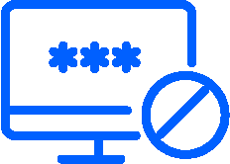

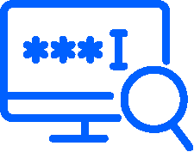
Advanced custom password policies
Create multiple password policies and enable them for users belonging to specific domains, OUs, and groups. Impose the password policy during password changes via the Ctrl+Alt+Del portal and password resets from the Active Directory Users and Computers console.
Restrict characters
Restrict patterns
Use passphrases
Restrict the number of special characters, numbers, and Unicode characters that users can use
‌Restrict keyboard sequences, dictionary words, and palindromes, and configure a custom regex pattern to enforce your organization's password policy by specifying the desired criteria.
Option to use passphrases that does not conform to the complexity requirements when the password length exceeds a predefined limit (say, 20 characters)
Restrict repetition
Restrict length
Password strength checker
Enforce a password history check during password reset, and restrict the repetition of specific character(s) or username as the password.(e.g. “aaaaa” or “user01”)
Specify the minimum and maximum password lengths
Display the password policy requirement on the reset and change password pages

Slide 25
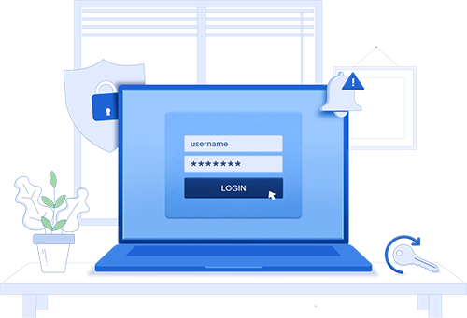
Secure and streamline remote work
Remote work enablement

Slide 26
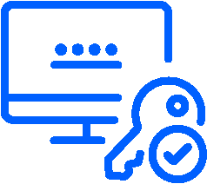



Remote work enablement
MFA for remote endpoints
Cached credentials update
Implement MFA for remote endpoints such as RDP and VPN logins to secure remote access
Automatically update users' remote password resets in the local cache of their machines for smooth authentication, with or without a VPN connection.
Web-based domain password change
Mobile-based password management
Offer a secure web-based portal for remote employees to change their domain and enterprise application passwords
Empower users on the go with self-service password reset and account unlock, password change, and enrollment capabilities right from their mobile devices

Slide 27
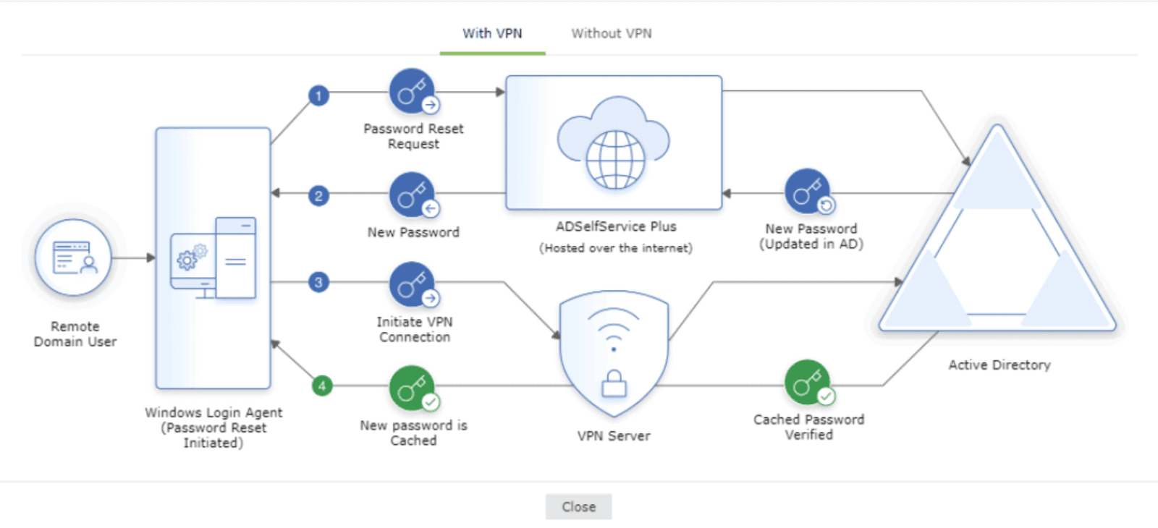
How cached credentials update work
Through a VPN client
The user's identity is verified through MFA, and the reset password request is sent to ADSelfService Plus, which updates the new password in AD.
The new password is sent to the Windows Login Agent on the user's machine.
The login agent automatically establishes a secure connection with AD through the VPN connection commands configured and initiates a request for updating the local cached credentials.
The request is successfully approved by AD, and the cached credentials are automatically updated in the local cache on the user's Windows machine.

Slide 28
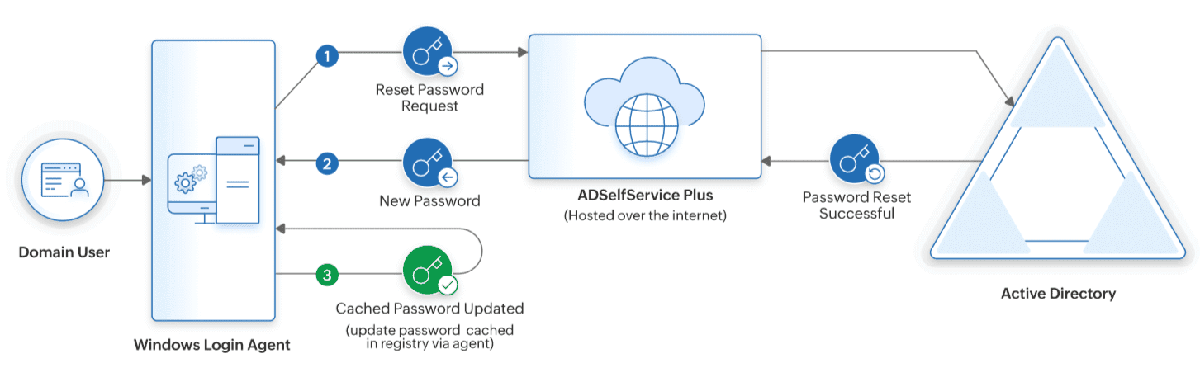
How cached credentials update work
Without a VPN Client
The user's identity is verified through MFA and the Reset Password request is sent to ADSelfService Plus, which updates the new password in AD.
After the new password is updated in AD, the local cache on users' machines is automatically updated with the new password.

Slide 29

Maintain an up-to-date user profile directory without overburdening the help desk
Workforce self-service

Slide 30
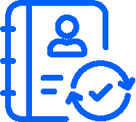




Workforce self-service
Directory self-update
Self-service group management
Organization chart
Allow users to self-update their AD profile information using a secure portal
Let users subscribe and unsubscribe from AD groups appropriate to them
Display the position of users in the organizational hierarchy and allow them to look up employee relations and IDs
Employee search
Approval-based workflow for self-service
Allow users to search for information on their colleagues via a filter-based corporate directory search tool
Give help desk technicians the ability to review and approve users' self-service actions

Slide 31
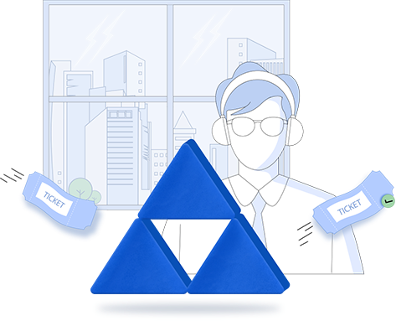

How does self-update of employee profile information work?
Before ADSelfService Plus
After ADSelfService Plus
User has to contact the help desk each time any of their AD profile information needs updating
User securely logs in to the ADSelfService Plus web portal
User updates their AD profile information using the console provided
The information provided is updated in AD in real time

Slide 32
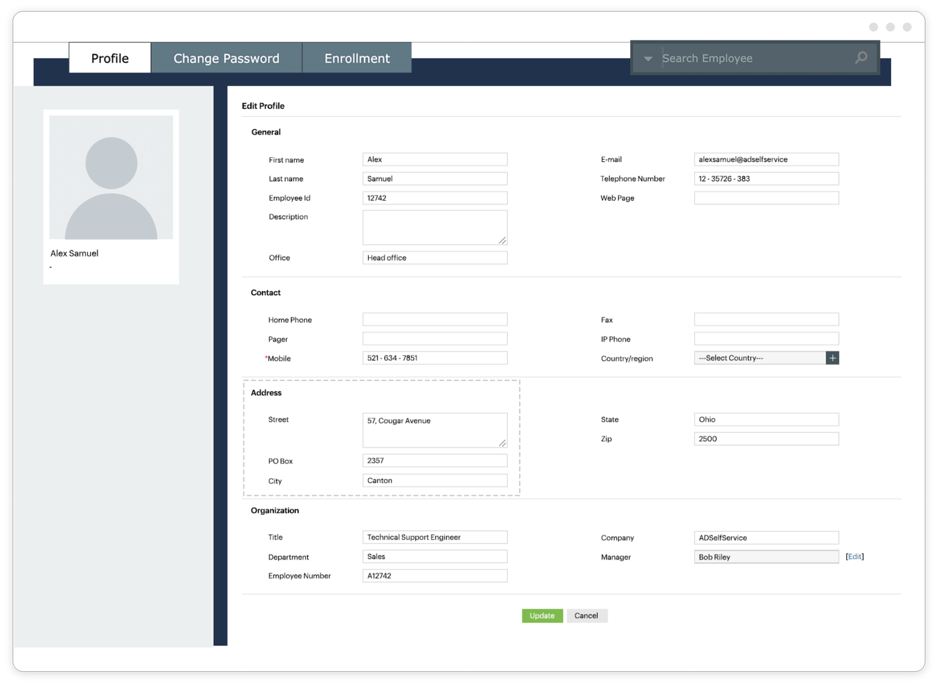
Directory self-update portal

Slide 33
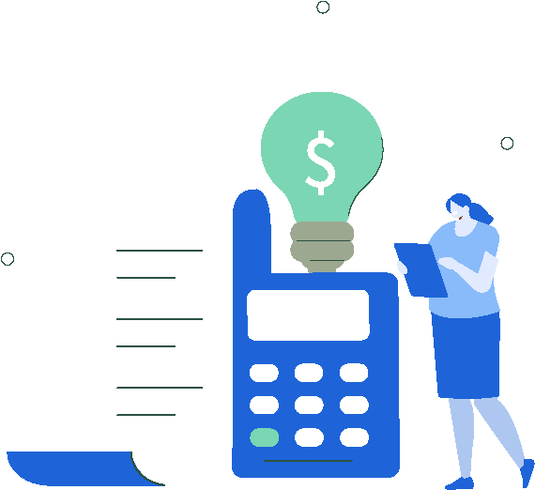

Benefits of ADSelfService Plus
Cost savings
Improves IT security
Improves user experience
Eliminates password resets–a major source of help desk calls
Allows IT admins to focus on critical tasks
Protects enterprises from data breach recovery costs
Secures critical enterprise endpoints with MFA
Provides risk-based access control for enterprise resources and self-service actions
Enforces strong password policies
Reduces dependency on help desk
Provides access to self-service features from anywhere
Enables seamless login for enterprise applications
Puts an end to password fatigue

Slide 34

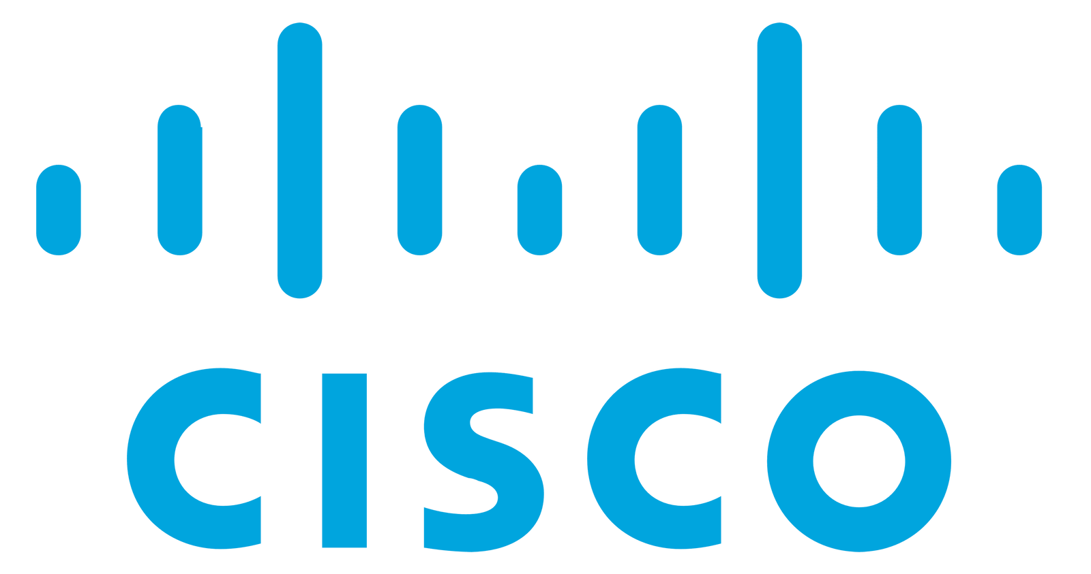









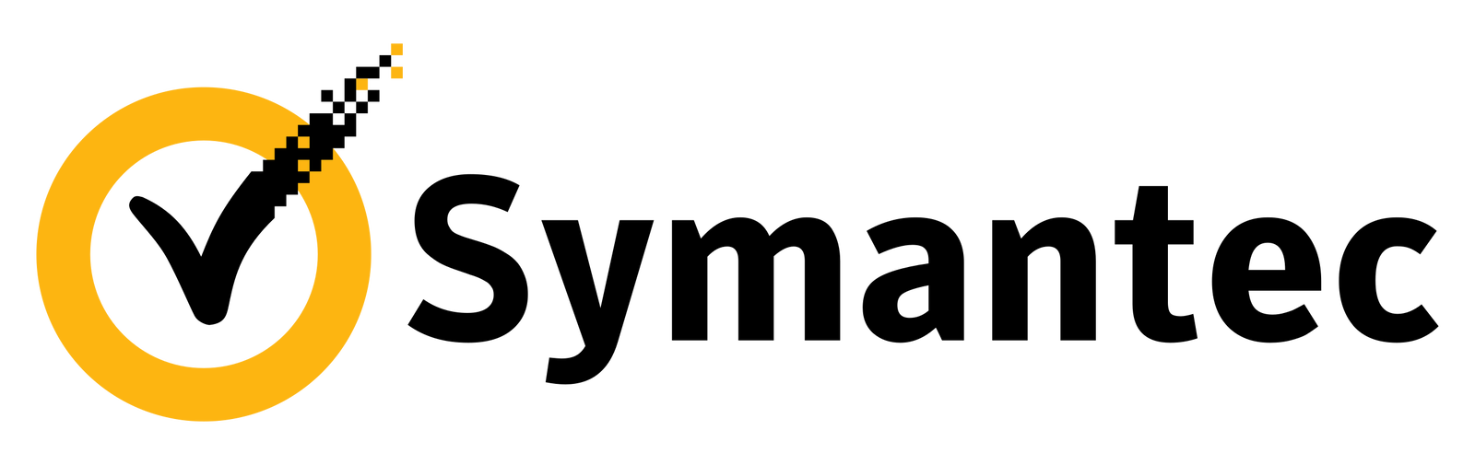


Trusted By

Slide 35
How ADSelfService can help organizations across sectors
Government sector
Education sector
Healthcare sector
Comply with the requirements of regulations like FISMA and the NIST Cybersecurity Framework
Prevent credential-based attacks on the domain network using adaptive MFA and advanced password policies
Comply with the requirements and guidelines of regulations like the Family Educational Rights and Privacy Act (FERPA), and the NIST Cybersecurity Framework
Empower students and staff to reset their passwords and unlock their accounts from anywhere and access multiple applications from a single console
Comply with the requirements and guidelines of HIPAA and the NIST Cybersecurity Framework
Secure and streamline access to ePHI using SSO, MFA, and conditional access
Allow healthcare professionals to perform password self-service and ensure up-to-date employee profiles
IT sector
Finance sector
Comply with the requirements and guidelines of the GDPR and NIS Directive
Implement SSO for enterprise applications secured by passwordless authentication based on robust authenticators like biometrics
Enable users to reset their domain passwords and unlock their domain accounts without depending on their IT help desk
Comply with the requirements and guidelines of SOX, GLBA, PCI DSS, and the NIST Cybersecurity Framework
Provide seamless access to sensitive data using MFA, conditional access, and SSO
Enable employees to perform password resets while upholding stringent password policies

Slide 36

TriMark deploys ADSelfService Plus to tackle password problems
Industry: Food industry Location: USA
“When our employees needed a password reset while they were outside the organization, ADSelfService Plus helped us by allowing them to reset their passwords remotely. It was beneficial for us,”
Roger DeVivo,
senior system administrator at TriMark
Business needs
Allow users to self-update their AD profile information using a secure portal
No trust was established between AD domains leading to password fatigue.They needed a solution that could sync passwords across all of users' account

Slide 37
How ADSelfService Plus helps Trimark?
ADSelfService Plus helps remote employees reset their passwords, and then it locally updates the credentials in users' machines
ADSelfService Plus' Password Sync feature allowed TriMark to automatically sync all password changes between multiple Active Directory domains
ADSelfService Plus helped admins to schedule password expiration alerts via SMS, email, and push notifications so users change their soon-to-expire passwords, well in advance
"The support team helped me pretty quickly every time I called in, and I’d say I’m happy with the support!"

Slide 38
Licensing, pricing, and feature support
Detail | Evaluation edition | Free edition | Standard edition | Professional edition
Expiration | Expires in 30 days | No expiration | As per license terms | As per license terms
Number of domains | Unlimited domains | Unlimited domains | As per license terms | As per license terms
Number of domain users | Unlimited domains | 50 users | As per license terms | As per license terms
24-5 support | Available | Available | Available | Available
Pricing | Free | Free | Starts at $595 for 500 users Endpoint MFA starts at $195 for 100 users (Free for up to 10 users with the ADSelfService Plus Standard and Professional editions) | Starts at $1195 for 500 users Endpoint MFA starts at $295 for 100 users
Features | Fully-functional Professional Edition, along with Endpoint MFA. Converts to Free Edition after evaluation period. | All features offered in Professional edition. | ‌Web-based self-service password reset and account unlock MFA for self-service password resets/account unlocks and cloud application logins Password expiry notifier Password policy enforcer Real-time password synchronizer Password reset using ADSelfService Plus' iOS or Android app, or via mobile browser Self-service directory update, employee search, organization chart, and self-service group management Passwordless authentication for cloud applications | All features supported Standard edition and: Password reset from Windows, macOS, and Linux logon screens Conditional access Cached credentials update for remote password reset Password policy enforcement in Windows Change Password page and ADUC

Slide 39
Licensing, pricing, and feature support
Detail | Evaluation edition | Free edition | Standard edition | Professional edition
Endpoint MFA Features | Fully-functional Professional Edition, along with Endpoint MFA. Converts to Free Edition after evaluation period. | Supports all features of the Standard Edition for 50 users. (Includes the Standard Edition of Endpoint MFA for 10 users) | Endpoint MFA's Standard edition offers: SSO for applications JIT provisioning MFA for Applications MFA for Windows, macOS, and Linux machines Security Question & Answer, SMS and email verification, Google Authenticator, Microsoft Authenticator, AD Security Questions, Zoho OneAuth, and custom software token-based TOTP provider | Endpoint MFA's Professional edition offers all features supported by the Standard edition and: MFA for Windows server machines MFA for RDP Device-based MFA for Windows MFA for UAC sessions MFA for VPN & other RADIUS servers MFA for OWA & other IIS servers Passwordless logins for applications Adaptive SSO Adaptive MFA Offline MFA for Windows and macOS Custom hardware token-based TOTP provider for authentication, FIDO Passkeys, Smart card Authentication, SAML Authentication, YubiKey Authenticator, Duo Security, Radius Authentication, Push Notification, QR Code Based Authentication, biometric authentication, ADSelfService Plus mobile app TOTP, Azure AD MFA, and RSA SecurID

Slide 40
Add-ons
Add-on name | Description | Pricing
Failover and Secure Gateway Services add-on | Includes high availability, load balancing, and reverse proxy. | $395
SMS add-on | Includes the SMS Gateway and credits required to send SMS notifications from ADSelfService Plus - As per the number of SMS credits required | Starts at $395 for 2000 SMS credits

Slide 41





Contact us
Contact Number
Support Email
+1-408-916-9890
support@adselfserviceplus.com
Live chat
Visit our website
For instant responses.
www.adselfserviceplus.com/
DOWNLOAD NOW

