Slide 1




Password policy enhancement
with ADSelfService Plus
Fortify user passwords with strong password policy controls

Slide 2
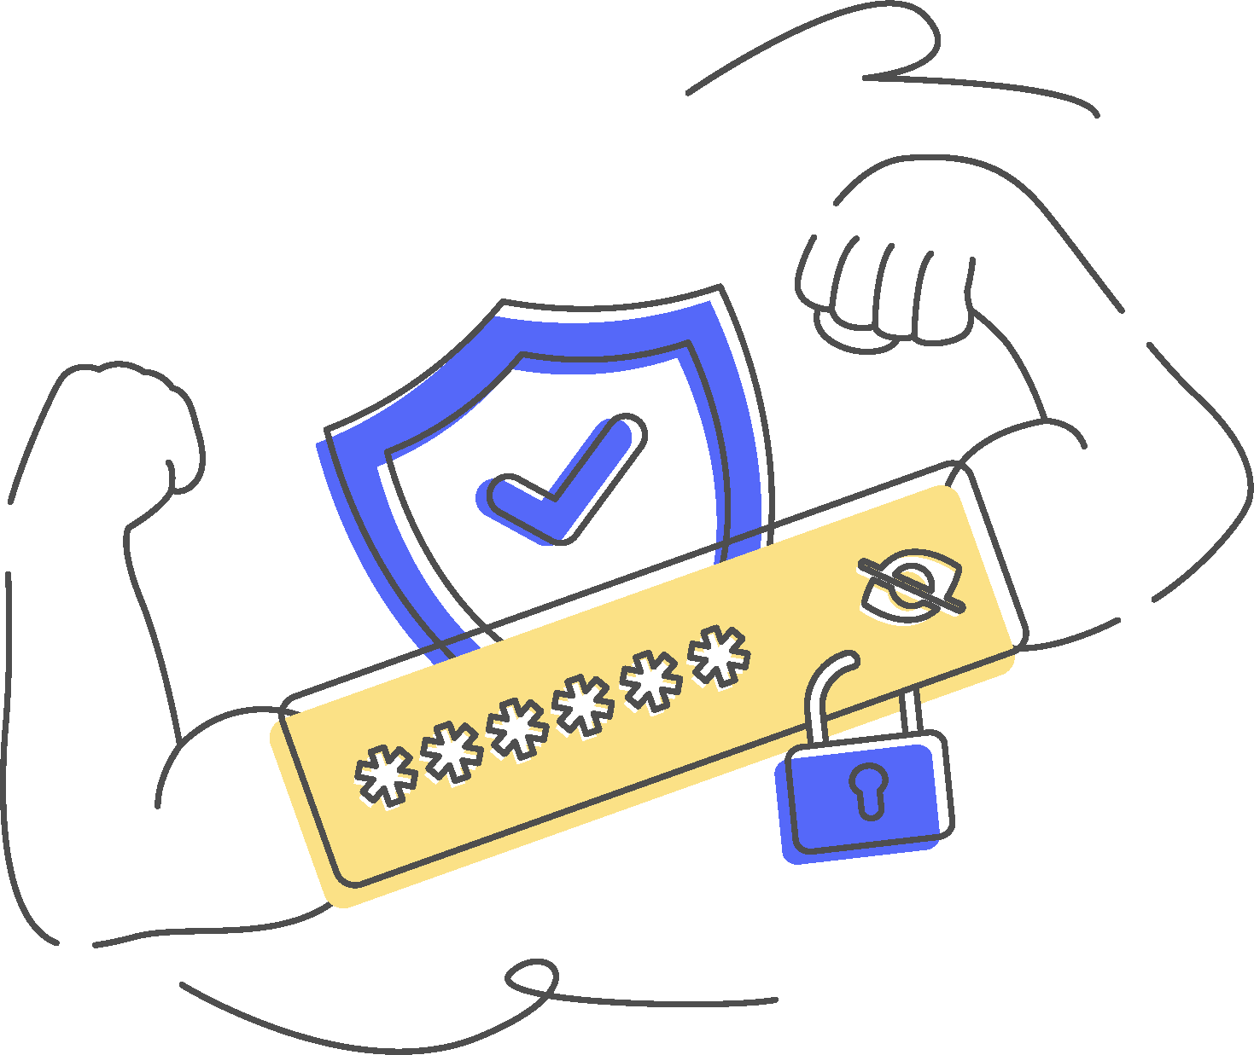
Are your users constantly creating weak passwords
and putting your company at risk?
Strong passwords can only be achieved with
strong password policies!
Are Active Directory password policies strong enough?
- Be tailored for specific OUs
- Restrict character repetition, dictionary words, and patterns
- Defend against today's sophisticated password attacks
- Make passwords comply with regulatory standards
Active Directory password policies cannot:

Slide 3


ADSelfService Plus
is the answer!
Implement strong and sophisticated password policies with ADSelfService Plus' Password Policy Enhancer.

Slide 4
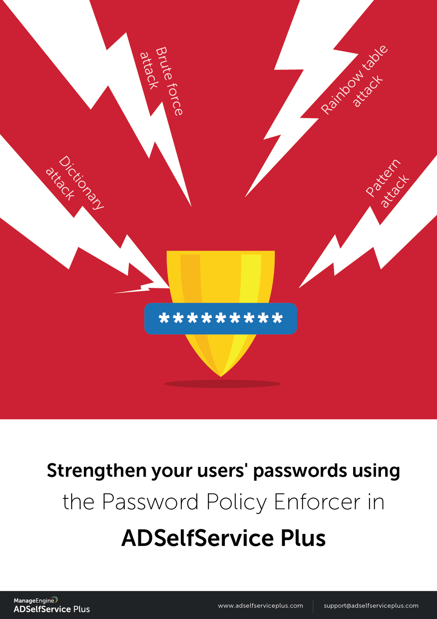
With ADSelfService Plus' Password policy enhancer, you can:
Enforce custom, fine-grained, and strong password policies
Specify character types to include
Restrict consecutive characters from usernames and previous passwords
Restrict custom dictionary words, patterns, and palindromes
Enforce passwords to match the regex pattern
Specify the minimum and maximum length of passwords
Restrict compromised passwords
Overcome drawbacks of AD password policies
Create passwords that comply with regulatory standards

Slide 5
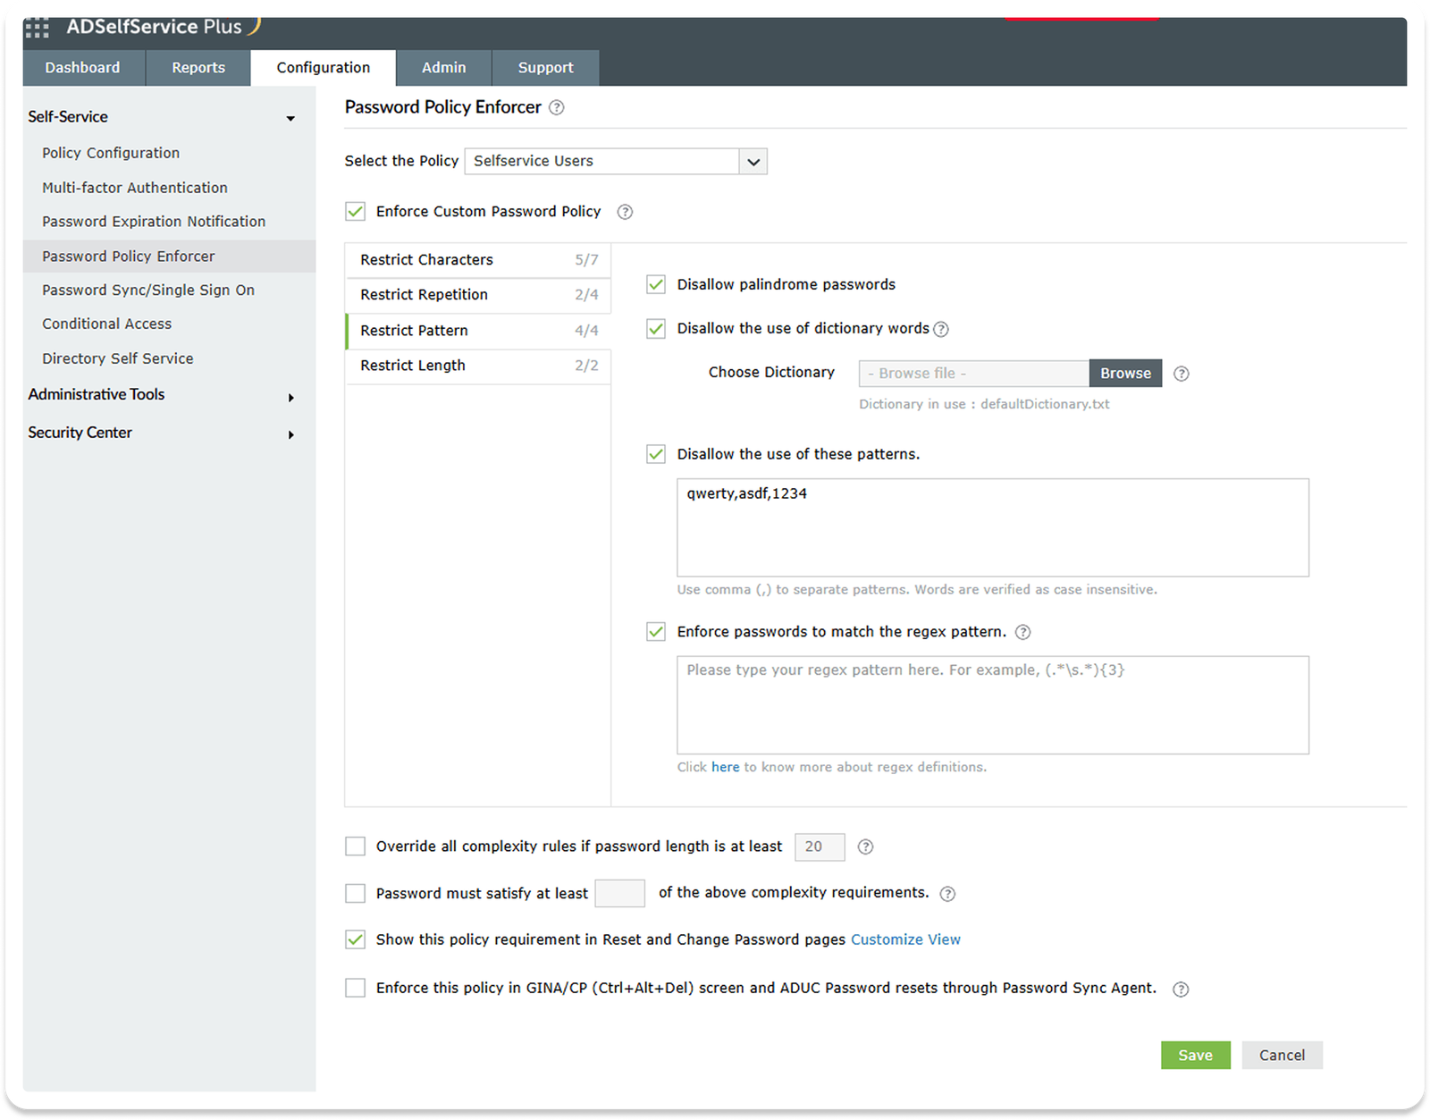
Restrict
characters

Slide 6
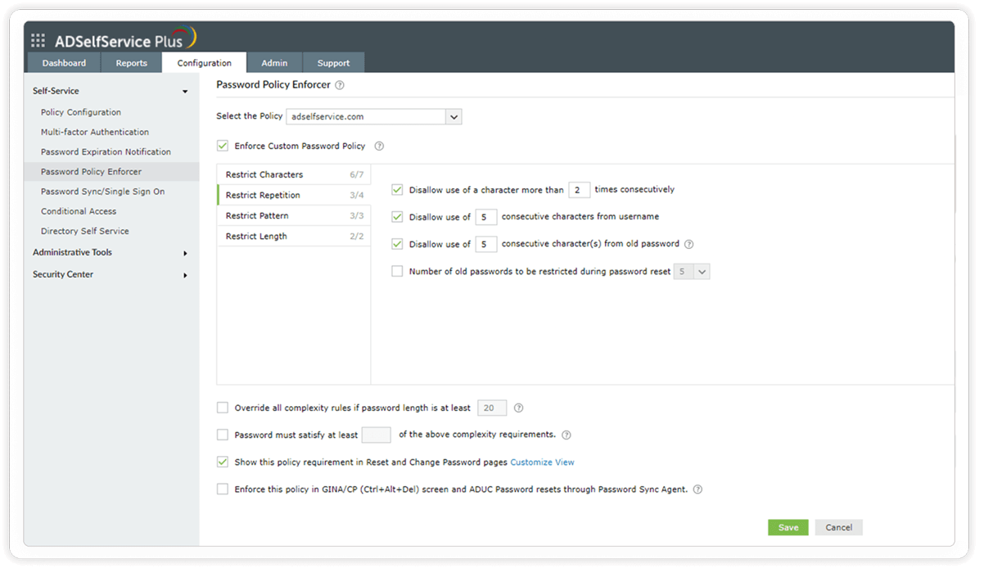
Restrict repetition

Slide 7
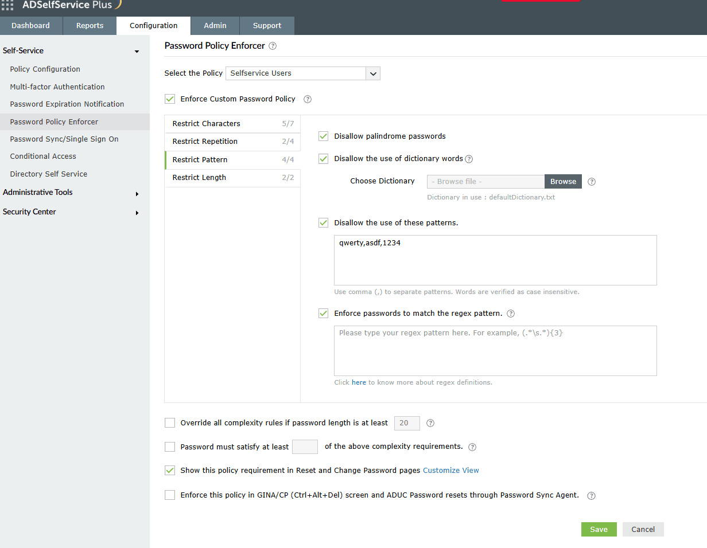
Restrict pattern

Slide 8
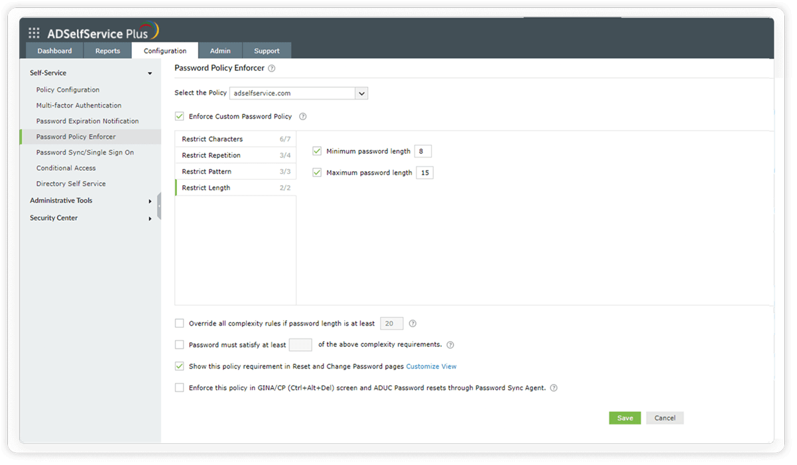
Restrict length

Slide 9
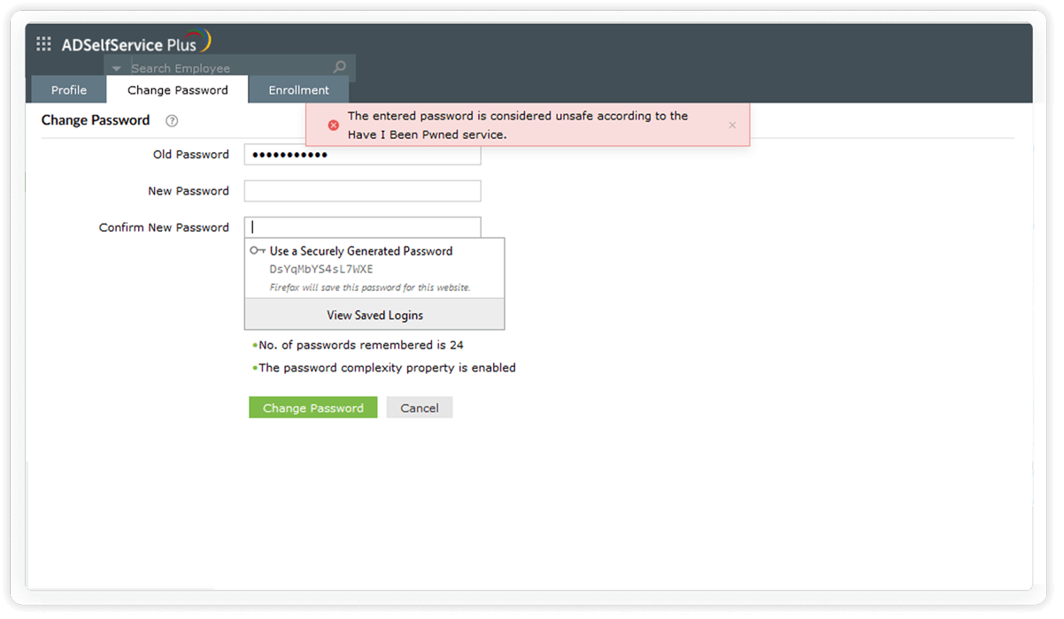
Restrict compromised passwords

Slide 10



Switch to
ADSelfService Plus today
and enjoy enhanced identity security for your organization!
Guaranteed ROI
ADSelfService Plus gives you an immediate ROI by nearly eliminating password-related tickets.
Calculate ROI

Slide 11



For technical support:
Contact us
+1-408-916-9890
support@adselfserviceplus.com
www.adselfserviceplus.com
Chat live with our support team
Personalized web demo
Download ADSelfService Plus now

