Slide 1


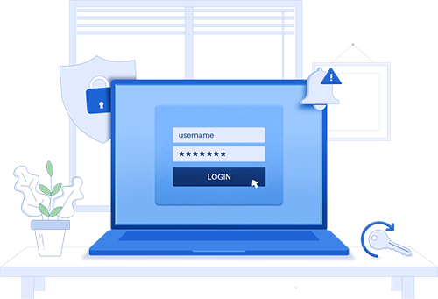

Remote work enablement
with ADSelfService Plus
Secure and streamline remote work for your enterprise

Slide 2
Is hybrid work your company's new normal?
Did you know?
Did you know that 20% of IT enterprises experienced a breach due to a remote
worker during the pandemic?
Remote work demands extra security!
Both admins and users may experience challenges in remote work
In the hunt for security in remote work, user
experience is often overlooked.
There are also increased help desk requests and remote password management issues.

Slide 3


Worry no more!
ADSelfService Plus provides efficient remote work capabilities—like MFA for VPN logins and mobile password management—ensuring a smooth ride for admins and end users.

Slide 4
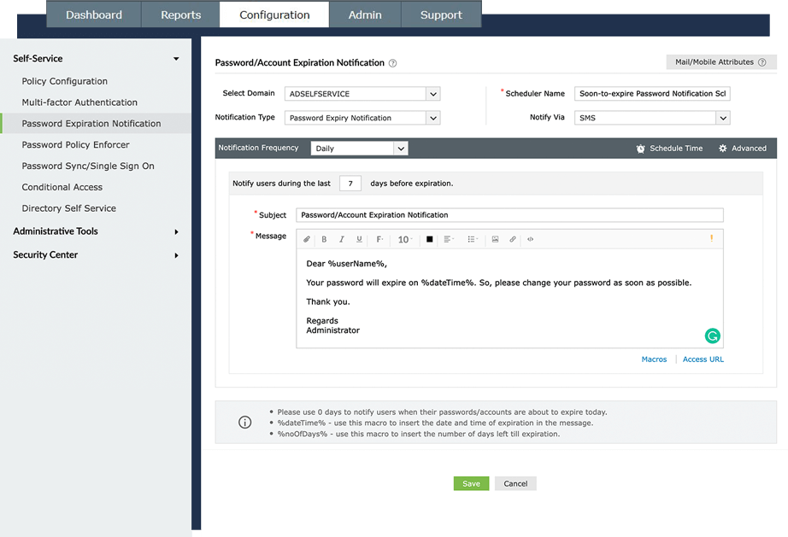
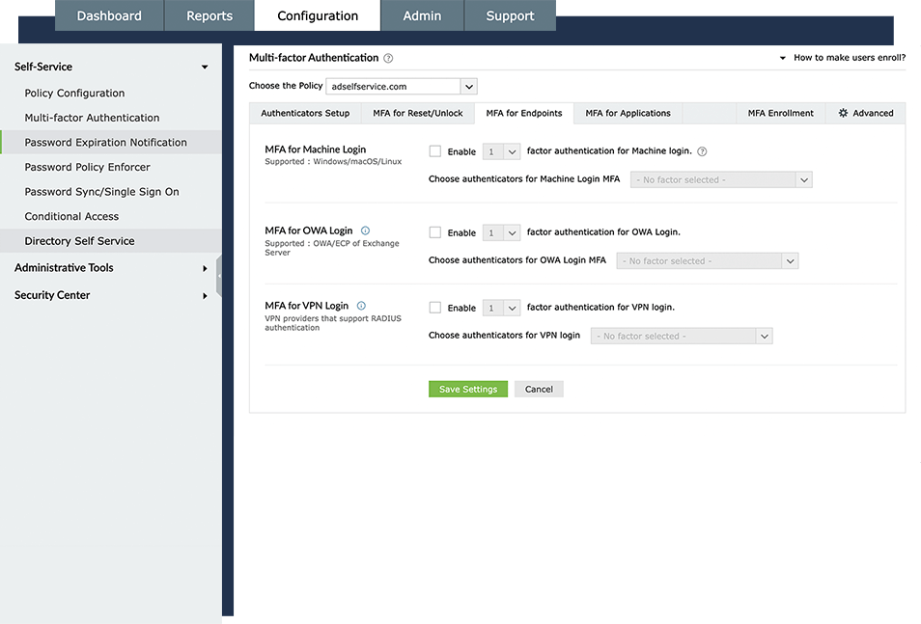
ADSelfService Plus secures and eases remote work with capabilities like
MFA for VPN, OWA, and RDP logins
Cached credential updates
Password expiry notifications
Mobile password management
Web-based password changes

Slide 5
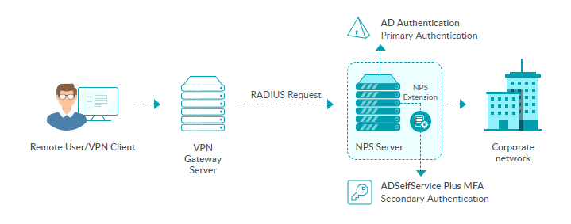
Here's how MFA for VPN logins works in ADSelfService Plus

Slide 6
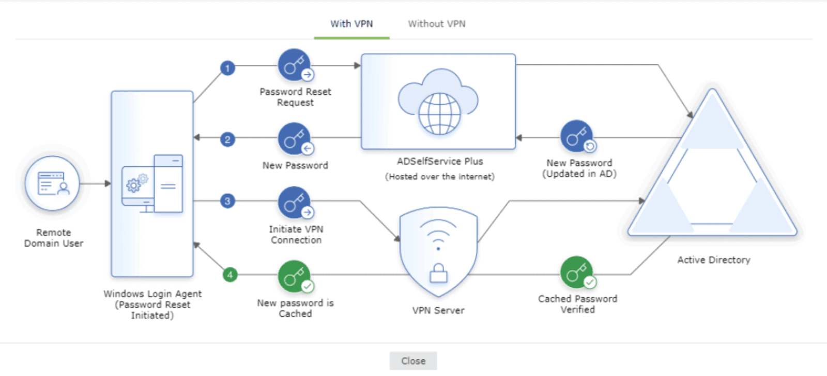
Here's how cached credential updates happen in ADSelfService Plus
Through a VPN client:

Slide 7
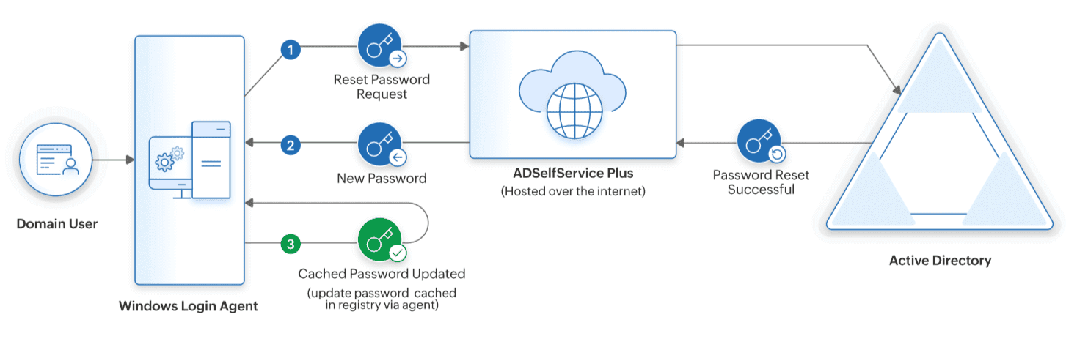
Here's how cached credential updates happen in ADSelfService Plus
Without a VPN client:

Slide 8
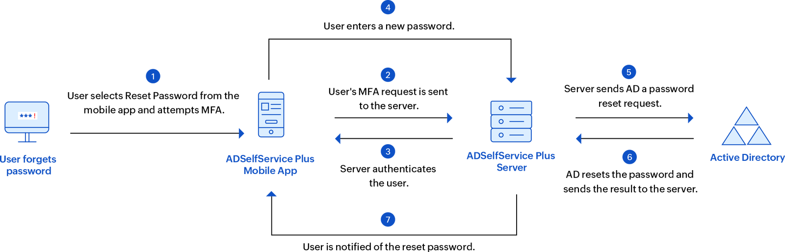
Here's how mobile password reset works in ADSelfService plus

Slide 9



Switch to
ADSelfService Plus today
and enjoy enhanced identity security for your organization!
Guaranteed ROI
ADSelfService Plus gives you an immediate ROI by nearly eliminating password-related tickets.
Calculate ROI

Slide 10



For technical support:
Contact us
+1-408-916-9890
support@adselfserviceplus.com
www.adselfserviceplus.com
Chat live with our support team
Personalized web demo
Download ADSelfService Plus now

