Slide 1


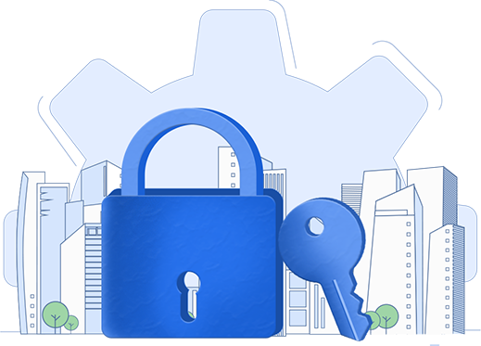

Self-service password management
with ADSelfService Plus
Reduce help desk tickets and improve employee productivity

Slide 2


Password management:
Unwarranted overhead cost and security risk
According to the Gartner Group, around
Forrester Research states that resolving each password reset request costs companies
20% to 50%
around $70
on an average!
of all help desk calls are due to password resets.
Help desk tickets primarily forgotten passwords and locked out accounts?
Users struggling to remember different passwords for multiple enterprise apps?
Users constantly creating weak passwords and putting your company at risk?
Users forgetting to change their Active Directory passwords on time?
Are your...

Slide 3


ADSelfService Plus
is the right solution for you!
ADSelfService Plus, an identity security solution, provides secure self-service password management to reduce help desk tickets and improve password security.

Slide 4
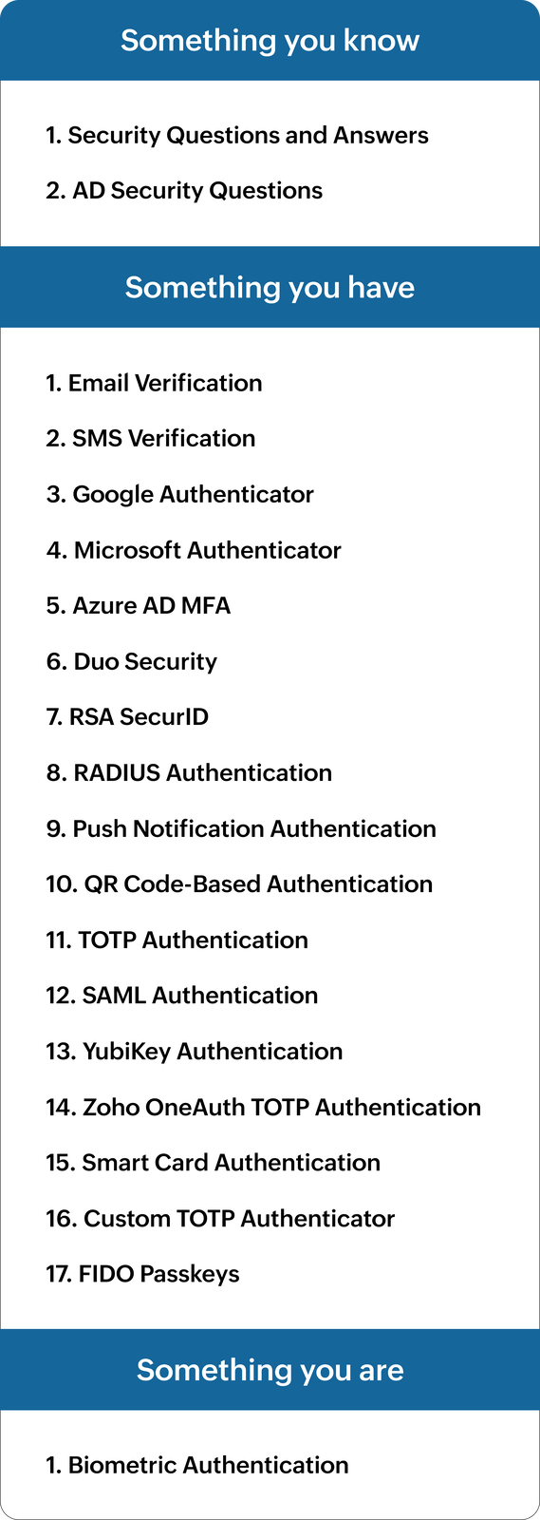
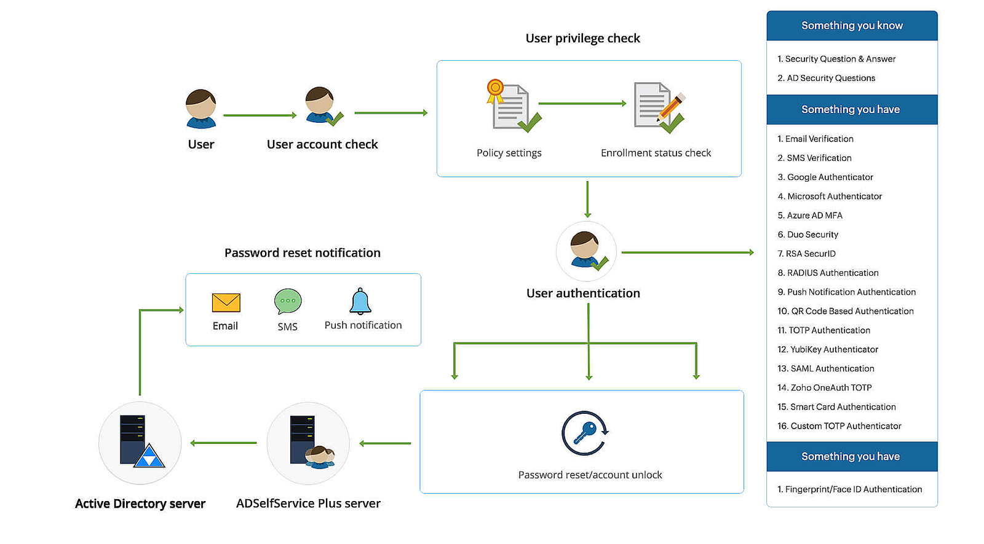
Password self-service
ADSelfService Plus empowers end users with web- and mobile-app-based self-service password reset, password change, and account unlock
All end user self-service actions are secured with modern MFA methods
A user can reset their password and unlock their account right from their logon screen

Slide 5
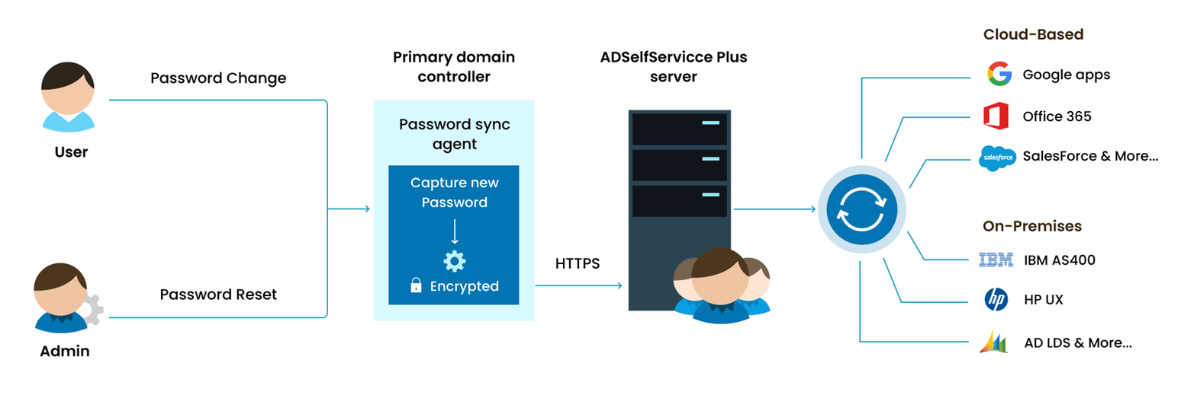
Password sync
ADSelfService Plus offers password synchronization that seamlessly replicates Windows AD password and account changes across a wide range of cloud and on-premises applications.
The password synchronization process is real time and customizable.

Slide 6
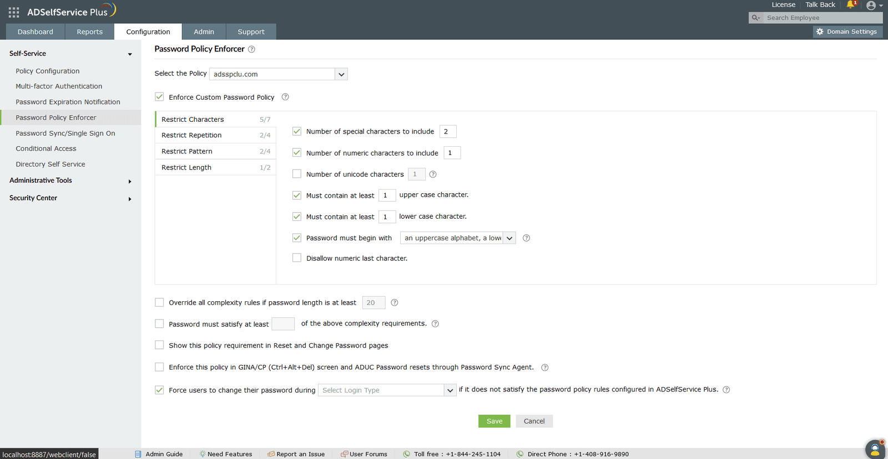
Password policy enhancer
ADSelfService Plus helps enforce strong, compliant user passwords.
Supports granular settings:
Restrict number of special characters, numbers, and Unicode characters
Limit repetitions and sequences
Block dictionary words, palindromes, and enforce regex patterns
Set password length rules and complexity bypass options
You can restrict breached passwords via HaveIBeenPwned integration.

Slide 7
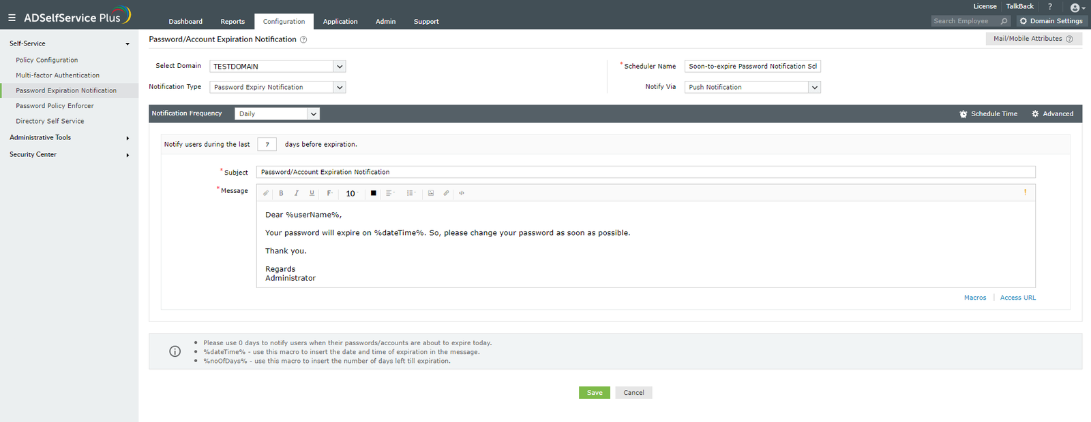
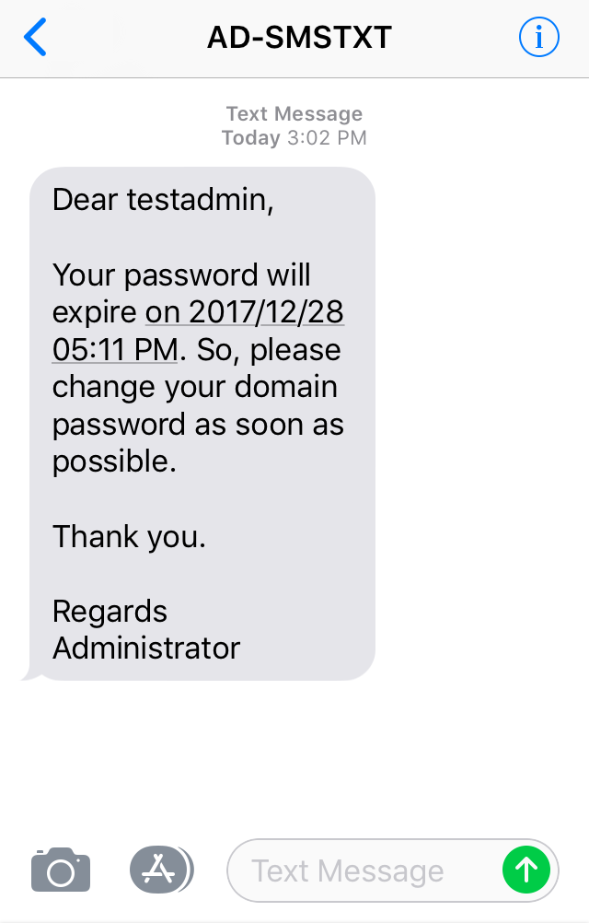
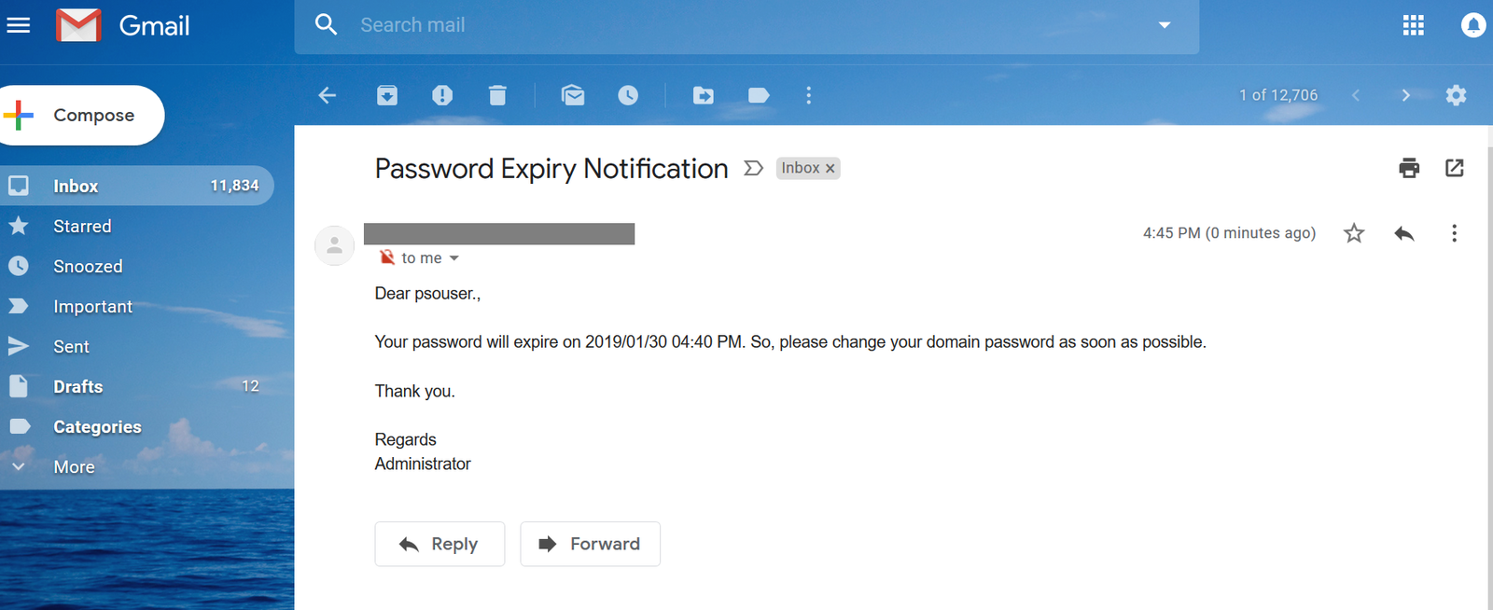
Password expiration notifications
ADSelfService Plus provides password expiry SMS and email notifications for your users to promptly change their AD passwords
The notifications are phased and can be
customized to suit your organizational needs
You can also notify users and their managers
about account expiration

Slide 8



Switch to
ADSelfService Plus today
and enjoy enhanced identity security for your organization!
Guaranteed ROI
ADSelfService Plus gives you an immediate ROI by nearly eliminating password-related tickets.
Calculate ROI

Slide 9



For technical support:
Contact us
+1-408-916-9890
support@adselfserviceplus.com
www.adselfserviceplus.com
Chat live with our support team
Personalized web demo
Download ADSelfService Plus now

