Slide 1
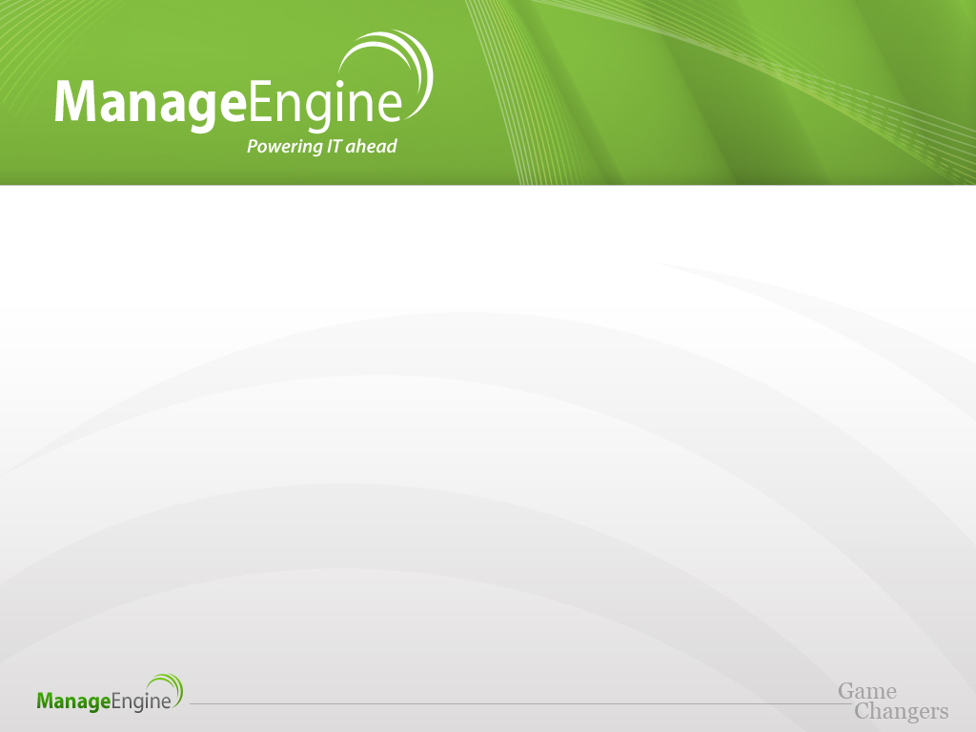
The Road to ServiceDesk Plus
Christopher Burg
American Transmission Co

Slide 2
Introduction
Team Leader – IT System Management
Accountable for:
Service Desk
Data Centers
Server and storage infrastructure
Client hardware, desktop support
Began working in IT support in 1995

Slide 3
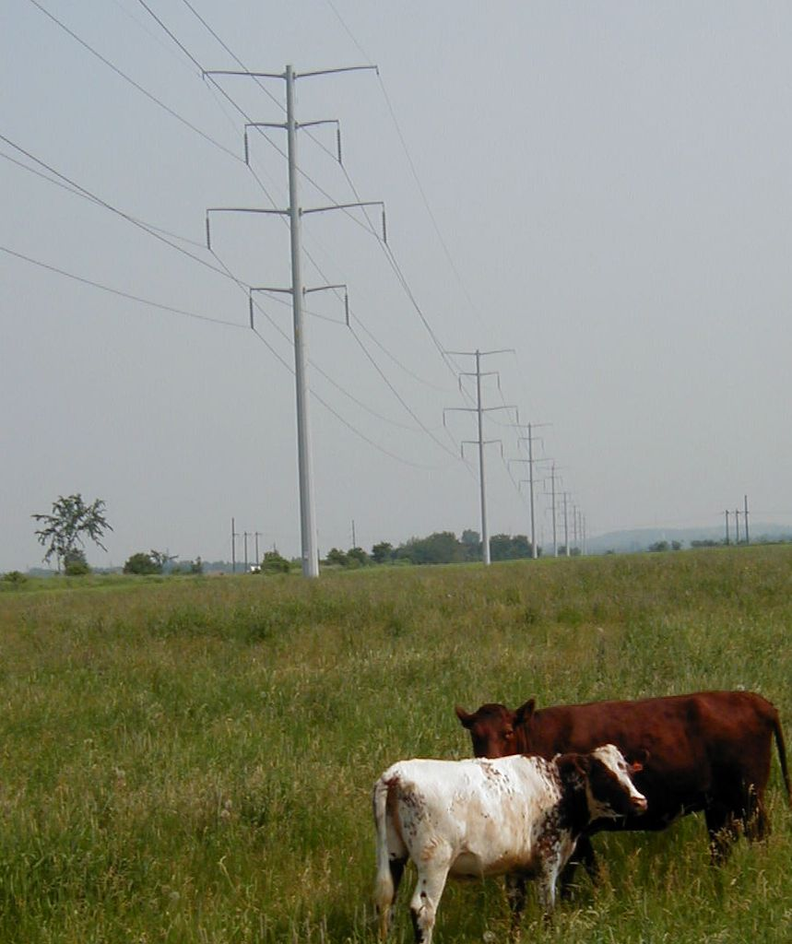
About American Transmission Co
Founded in 2001
First multi-state electric transmission-only utility
Service area includes portions of Wisconsin, Michigan, Minnesota and Illinois
9,400 circuit miles of transmission line
$2.75 billion in total assets

Slide 4
Primary Challenges with Remedy
Significant Resource Overhead
Specialized skills needed to maintain system
2. Application Performance
Lack of proper maintenance impacted usability
Lack of email capture reduced ticket volume
Most emails were not re-entered into Remedy
User interface was not intuitive
No one likes to use ugly software
Information gathering challenging
Highly normalized database and inelegant reporting engine made simple queries anything but
Expensive!

Slide 5
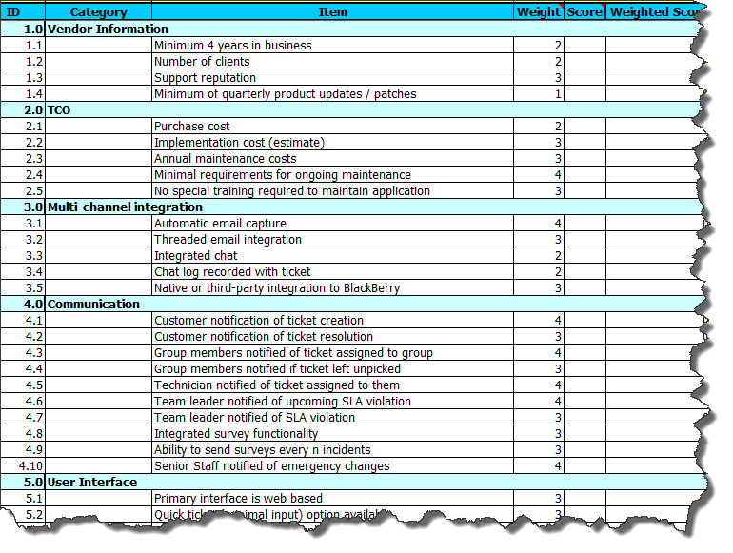
Assessment Methodology
Create master list of requirements
Assign subjective weight based on business objectives
Score each product 1-10
Compare total scores
WARNING

Slide 6
Key Requirements
Minimal administrative burden
Robust feature set
Good application performance that doesn’t degrade
Reasonable cost
Alignment with ITIL

Slide 7
Technology Constraints
Less Customizable
More Customizable
Picking from the Gartner Magic Quadrant can be dangerous for small and mid-sized organizations with strong capitalization
The airport metaphor:
Build me an airport, but don’t worry – we’ll only have three flights a day
In other words, support resource cost of entry for complex systems is high and not proportionate to usage patterns
Administrative Overhead

Slide 8


Flexibility of ManageEngine
Less Customizable
More Customizable
Multiple versions of Service Desk Plus helped us decide what was right for our organization
Administrative Overhead
Standard
Professional
Enterprise

Slide 9
Results with ManageEngine
Greatly improved incident capture
Ticket volume increased over 100% in the first month
Email volume now 52% of total ticket volume
Enhanced technician experience
Performance bottlenecks have been eliminated
Visually appealing, intuitive interface
Training focuses on process, not the tool

Slide 10
Results with ManageEngine
Improved customer experience
Ticket creation notifications reassure customers
“Snapshot” surveys help improve service
Reminders drive better compliance with service levels
Improved efficiency
Administrative overhead reduced from 1.0 FTE to 0.25 FTE
Greatly reduced annual cost

Slide 11
Results with ManageEngine
Significantly enhanced Change Management
Online collaboration improves flexibility
Elimination of change approval meeting saves time
Record of approval creates regulatory audit trail
CAB integration improves business awareness

Slide 12
Why ATC Loves ManageEngine
ManageEngine is a company that listens. We feel like we have an open dialogue that allows us to offer suggestions that improve the product, which helps us.

Slide 13
Thank you!

