Slide 1
Boost your organization's
security and centralize management with
Identity360
A cloud-native identity platform for workforce IAM

Slide 2
IAM challenges
Some challenges noted in Gartner's research and industry observations include:
Complex IAM environments
User experience versus security
Cloud adoption
Large enterprises often utilize multiple directories and numerous applications
Balancing security and access, plus providing strong authentication and authorization is vital
Integrating IAM solutions with cloud services and ensuring consistent security policies is challenging
Scalability and performance
Cybersecurity threats
Synergy in integrations
IAM solutions should scale to handle increased user loads
IAM systems are often targeted in cyberattacks, and frequently through identity-related breaches
Ensuring that IAM solutions work seamlessly with other systems and applications in an organization's IT infrastructure.

Slide 3
Universal Directory
Integrations
Leverage Universal Directory to consolidate identities
Integrate directories and apps for unified management
Why
Identity360?
Multi-factor authentication
Identity life cycle management
Unify identity silos, streamline identity management, and secure resources with centralized access management.
Automate identity life cycle management with orchestration
Validate your identities with multiple secondary authentication factors
Delegation
Dashboard and reports
Delegate routine tasks and focus on critical IT issues
Gain visibility and insights via a dashboard and reports
SSO
Implement SSO for any apps that support
SAML, OAuth, and OIDC

Slide 4
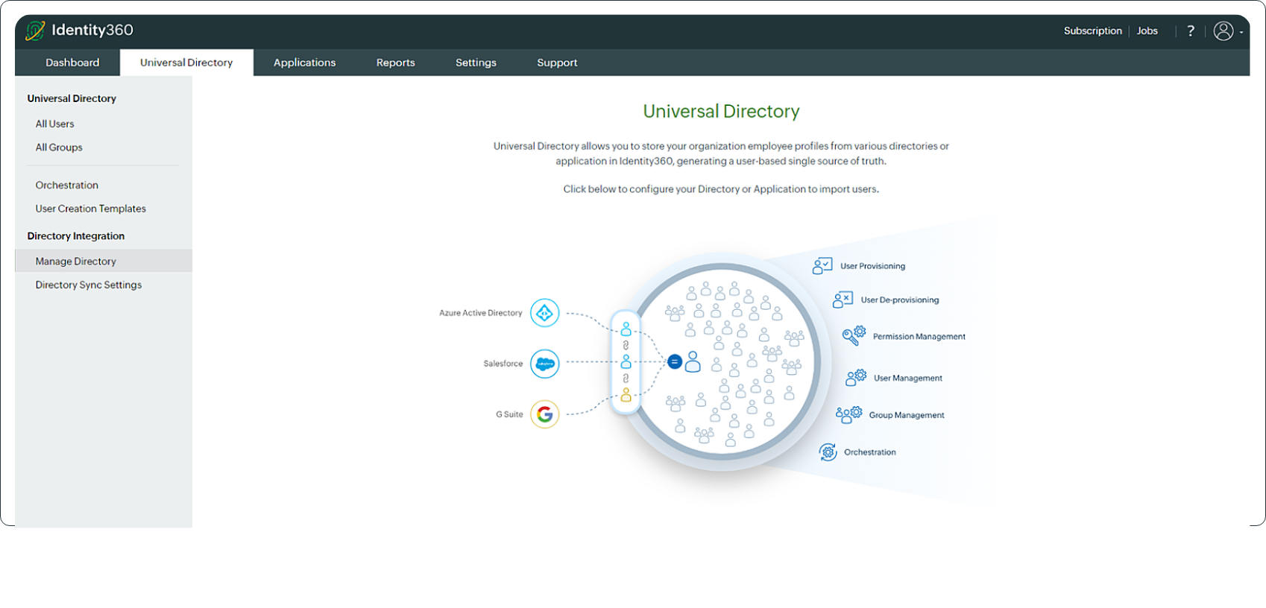
Universal Directory
Leverage Universal Directory to consolidate identities from multiple platforms
Gain a unified view of user identities and attributes for streamlined access control
Generate detailed reports for identifying security risks, like unauthorized access attempts and suspicious user activities

Slide 5
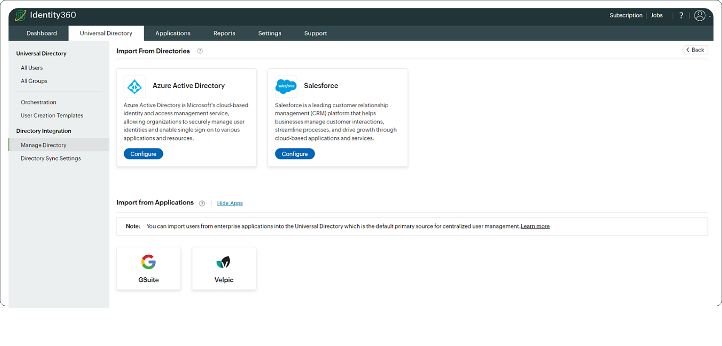
Integrations
Integrate directories and turn them into an identity provider for accessing your organization's applications with secure SSO
Integrate and secure access to a plethora of apps like Slack, Zendesk, Google Workspace, Jira, Zoho People, and more

Slide 6
Identity life cycle management
Orchestrate automation-driven user provisioning and deprovisioning, access modification across apps, license management, and more
Utilize predefined templates with intuitive creation rules for quick and easy onboarding
Simplify user creation with a user-friendly interface that facilitates template customization and attribute copying for ease of use

Slide 7
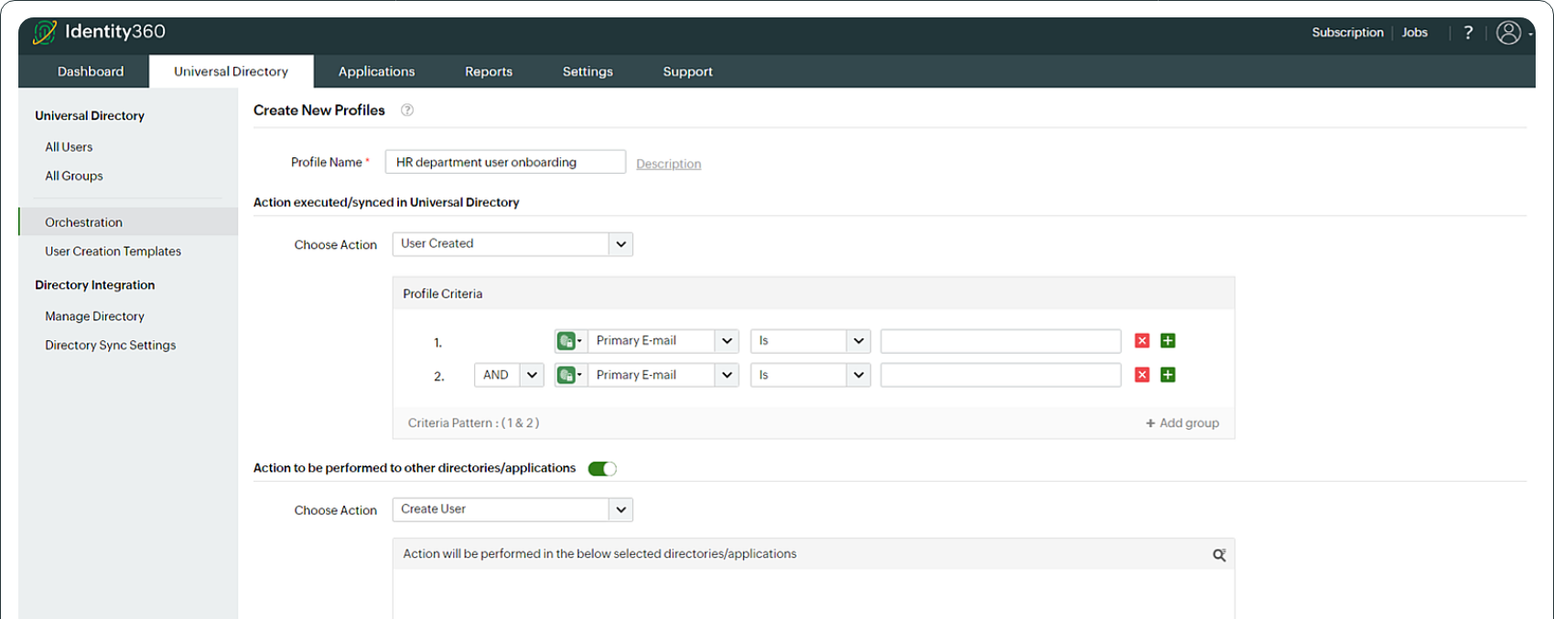
Orchestration
Take control of IAM processes, reducing redundant, manual tasks by using custom orchestration profiles
Automate user management across your organization's directories and applications using orchestration profiles
Orchestrate role-based access control, user modification, and access management with notifications for critical updates

Slide 8
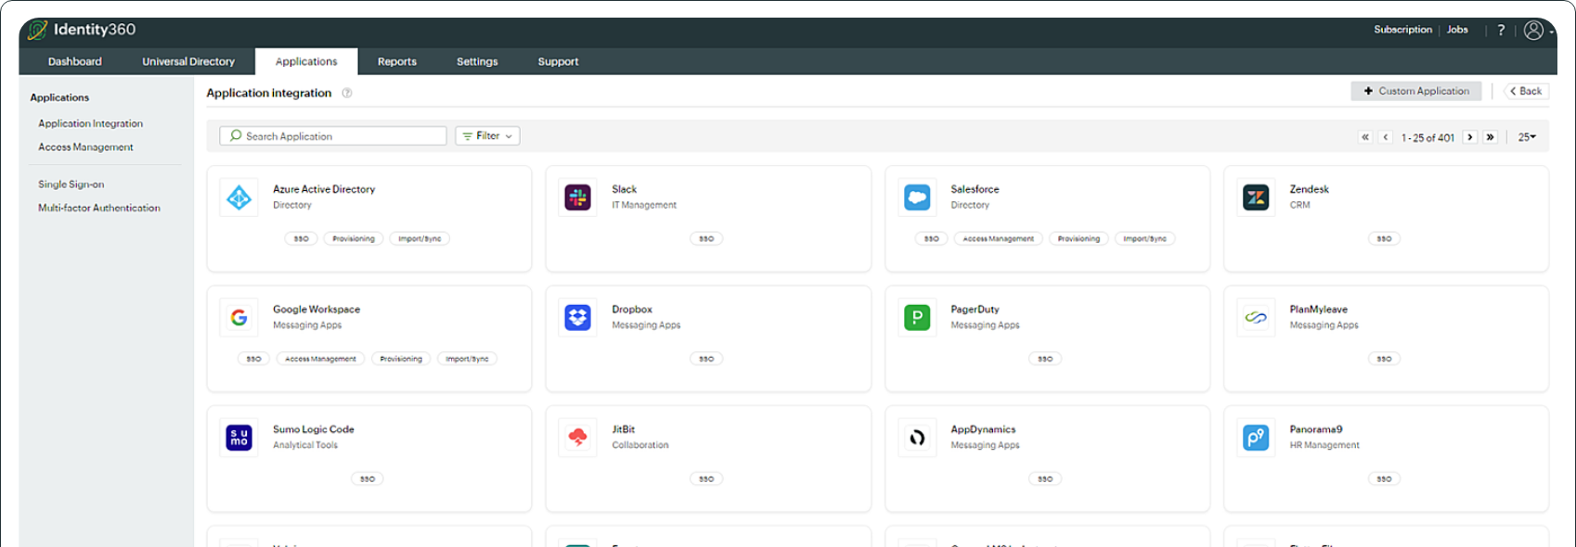
Single sign-on
Track SSO activity with prebuilt reports, including users assigned to each app, logon counts, and last logon times
Enable secure SSO with strong MFA, including custom TOTP and detailed reports
Simplify activation for pre-integrated and custom applications with a user-friendly UI, enhancing the SSO experience for admins and end users

Slide 9
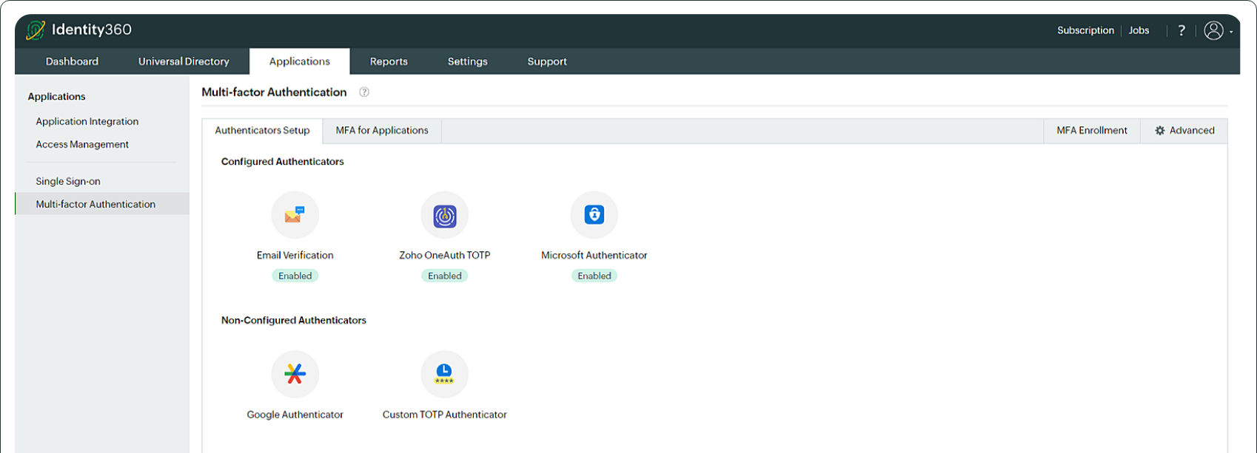
Multi-factor authentication
Verify identities with a diverse set of MFA options like email verification, Google Authenticator, and custom TOTP authenticators
Enable granular MFA customization for your organization with time-limited browser trust, MFA session time limits, CAPTCHA enforcement, and more
Generate detailed MFA reports for tracking user MFA status and attempts

Slide 10
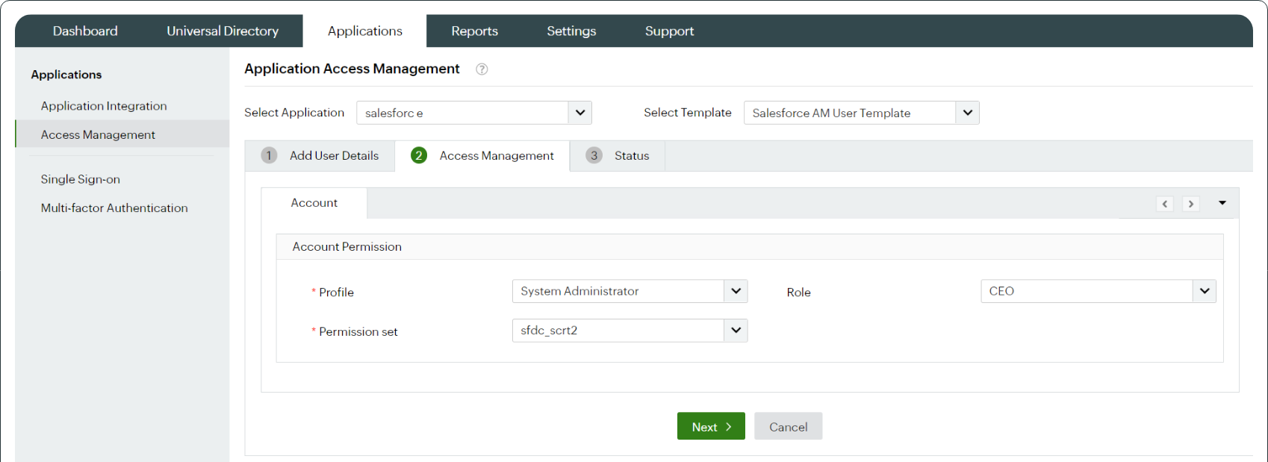
Access management
Utilize seamless SCIM-based access provisioning for end users, and automate access management actions across platforms based on predefined conditions
Manage roles and permissions on different platforms for example, someone's job title changes to ensure they have the right access and are informed about it
Effortlessly grant or revoke application access and adjust user roles or permissions within each application

Slide 11
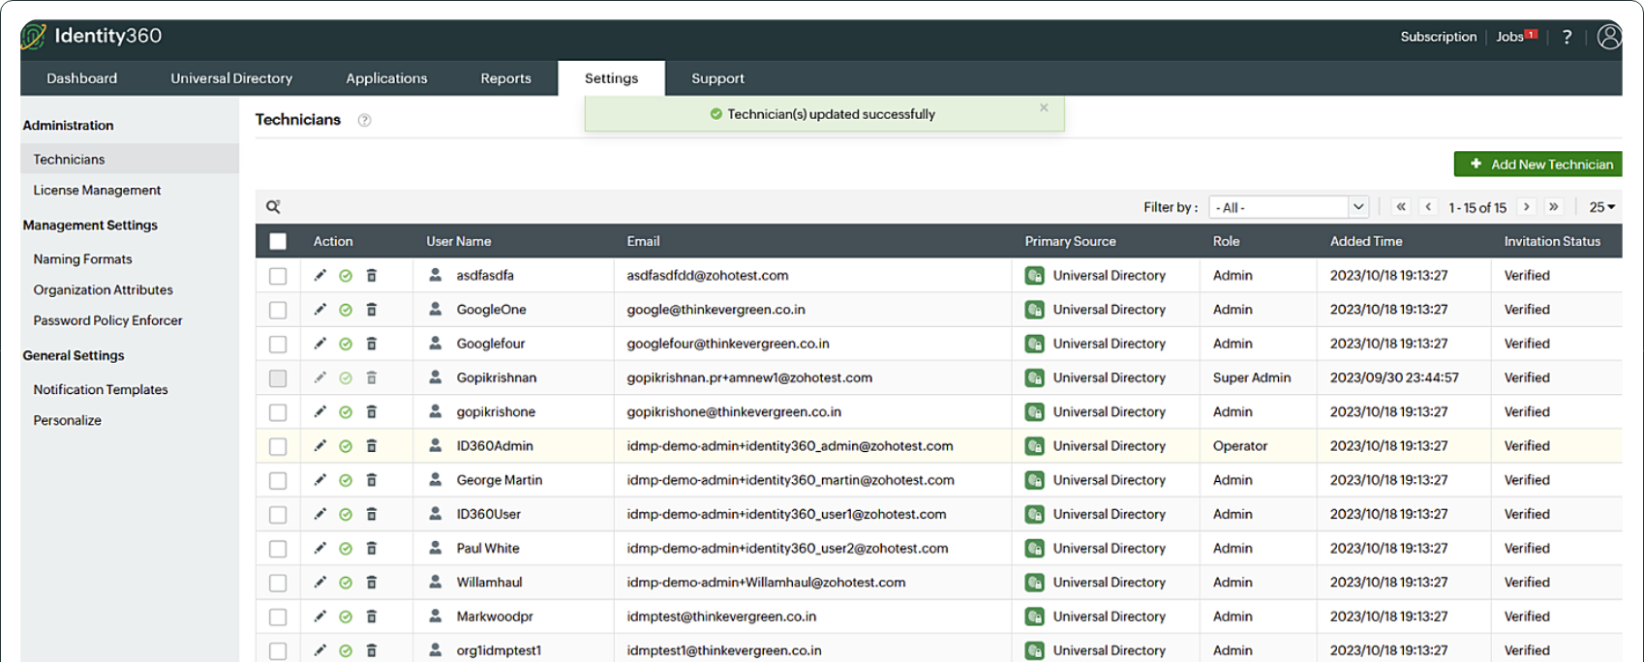
Delegation
Delegate identity management, access control, and reporting tasks to help desk technicians, reducing the admin's workload
These tasks include user management, orchestration, report generation, application assignment, and security functions like MFA and SSO
Leverage predefined roles such Super Admin, Admin, and Operator to delegate tasks to technicians

Slide 12
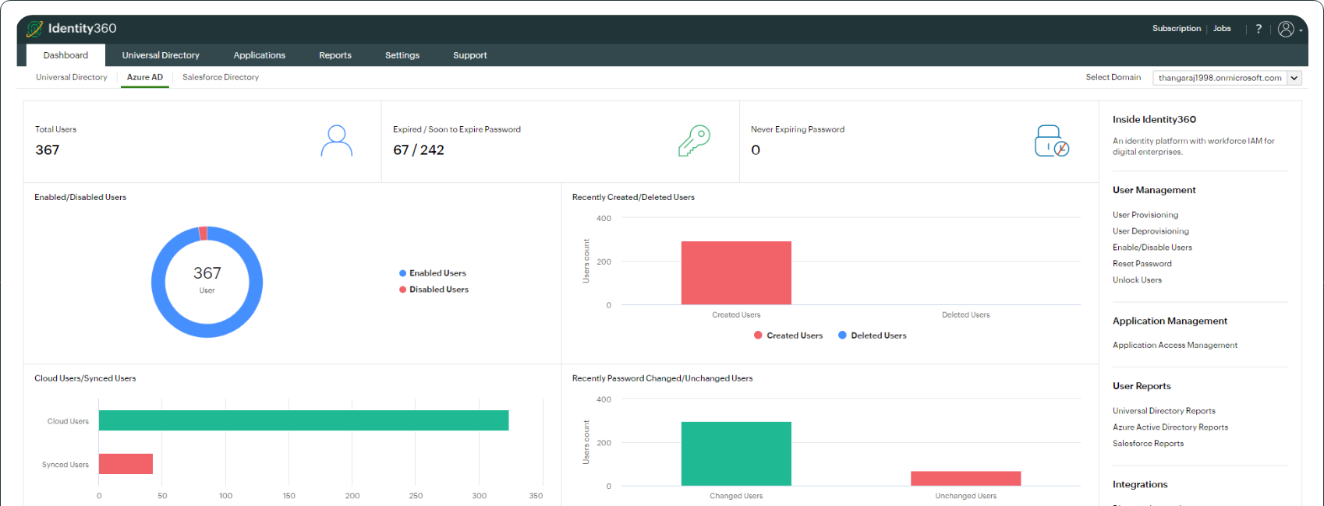
Access insights
Visualize key insights from integrated identity stores, summarizing essential metrics like total users, logon activity, and application access through a straightforward GUI
Generate comprehensive reports that provide insights into user and admin activities, application access, MFA attempts, license usage, and more
Customize and export these detailed reports in various formats such as PDF, CSV, XLS, and HTML

Slide 13
End user experience
Identity360 makes it easy for end users to access all the applications they need from a single place
SSO helps end users access their apps quickly, preventing password sprawl and multiple login prompts
MFA protects users' identities from credential-based attacks

Slide 14
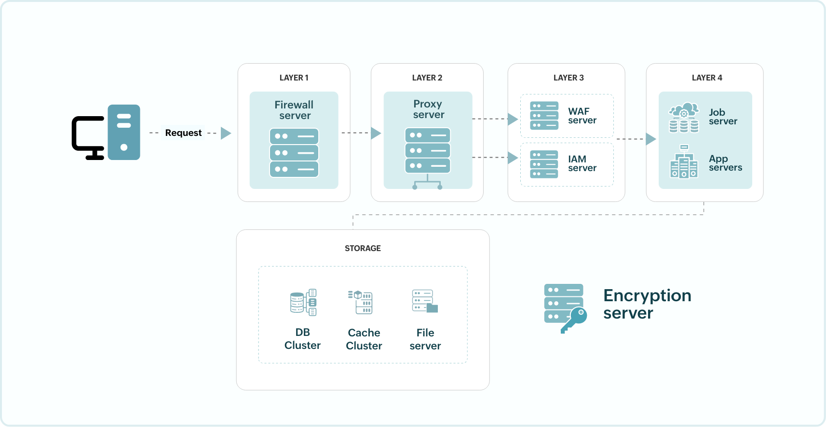
Architecture

Slide 15
Architecture
As a request enters the system, it first encounters the Firewall server for initial security checks
The request then passes through the Proxy server, which handles load balancing and routing
Next, the IAM server takes over to authenticate and authorize the request
Concurrently, the request is checked by the WAF (web application firewall) servers for web application security
If the request is authorized, it proceeds to the App servers, which process the request
Some requests may involve heavy back-end tasks, which are managed by the Job servers
The request is cached in Cache clusters for quick retrieval of commonly accessed data
The File server handles file storage and retrieval, if needed
Data is also be stored in DB clusters for long-term storage and retrieval
The Encryption server handles encryption for security when necessary

Slide 16
Benefits
Improved security
Enhanced visibility
Efficient management
Boost security by ensuring only authorized users can access certain resources and reduce the risk of data breaches
Achieve regulatory compliance standards by consistently monitoring user actions with detailed reports
Simplify user onboarding and offboarding with seamless provisioning, orchestration, and smart templates. Utilize a centralized console for managing user identities and access permissions across various systems
Increased productivity
Greater cost savings
Improved scalability
Automate user onboarding and access management with SCIM-based provisioning to ensure users have access to necessary resources from day one
Automate routine tasks, reduce labor costs, and eliminate maintenance costs with a cloud-powered architecture to realize long-term cost savings
Cloud-powered and scalable, Identity360 accommodates the growing needs of organizations worldwide
Text

Slide 17
Identity360 licensing
Components
Pricing
v
Life cycle management
Starts at
$295
per 100 users per year
MFA and SSO
Starts at
$195
per 100 users per year
Starts at
$395
All-inclusive
(Life cycle management with MFA and SSO)
per 100 users per year

Slide 18
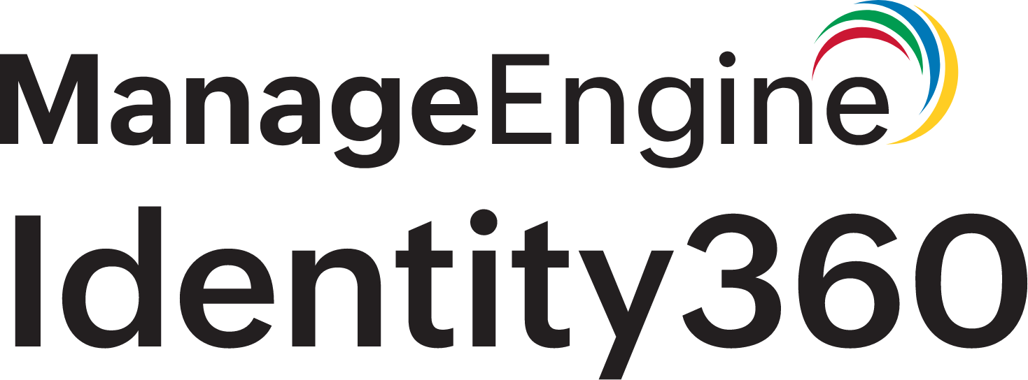
Thank you!

