Slide 1
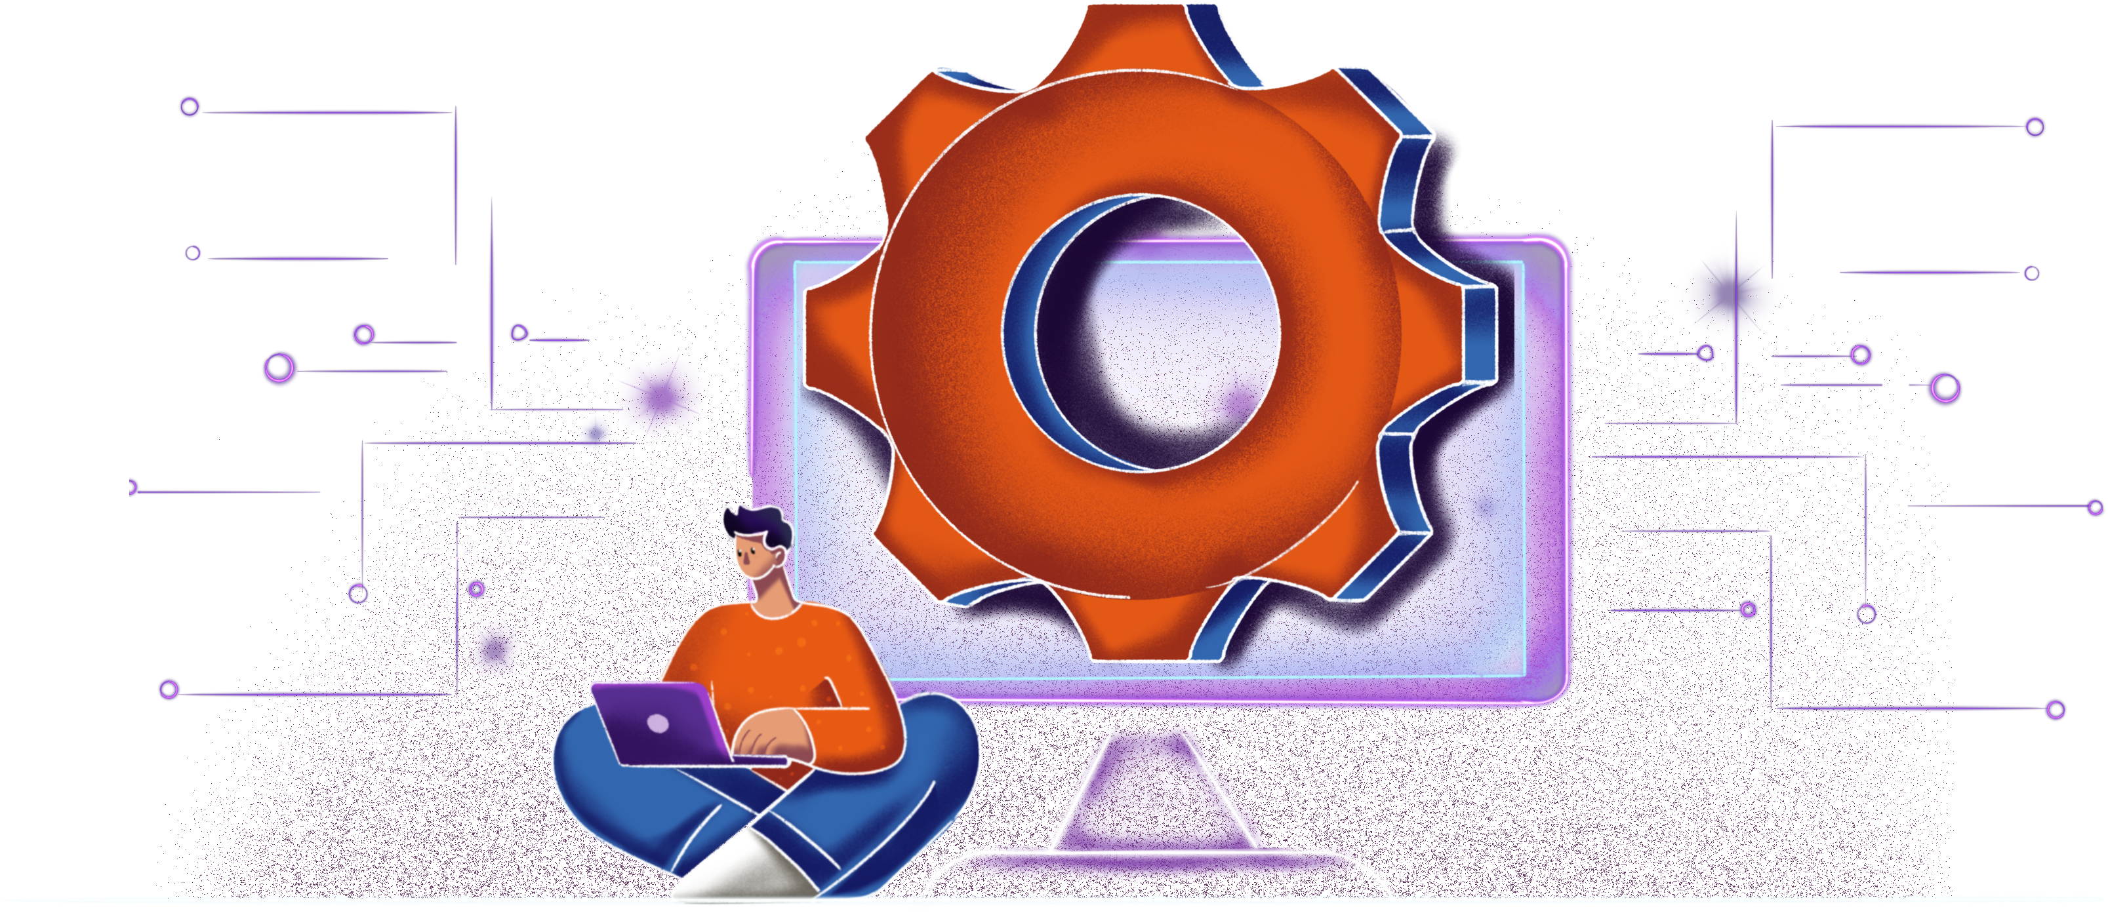
Automate and simplify identity management with ADManager Plus

Slide 2
Outline
What is ADManager Plus?
Business challenges
Automating identity management with ADManager Plus
Automation components
Scheduled automations
How do scheduled automations work?
Event-driven automations
How do event-driven automations work?
Use case: Onboarding users from UKG Pro
Use case: User deprovisioning
Benefits of automating identity management using ADManager Plus

Slide 3
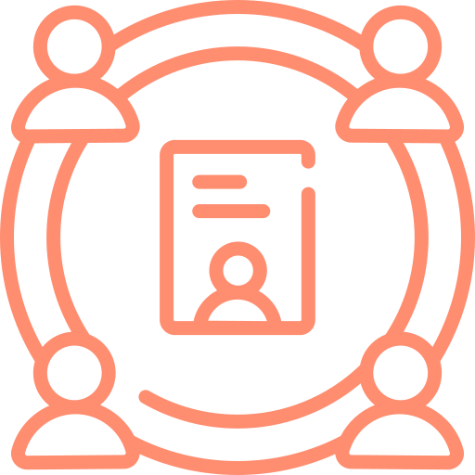


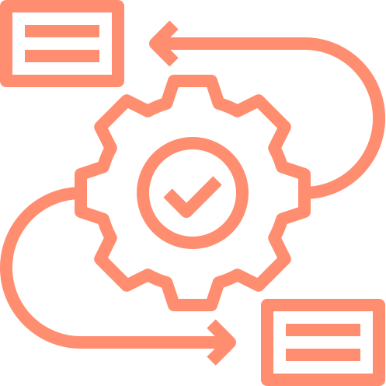
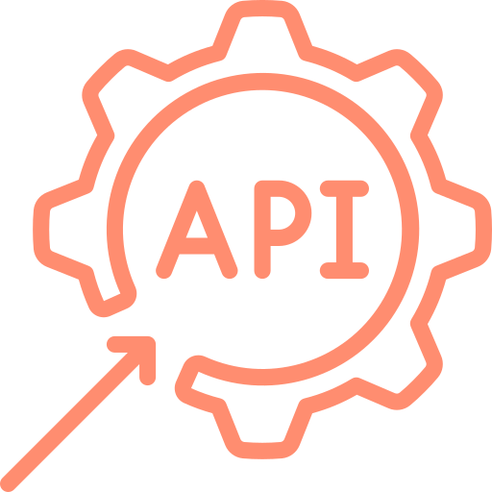

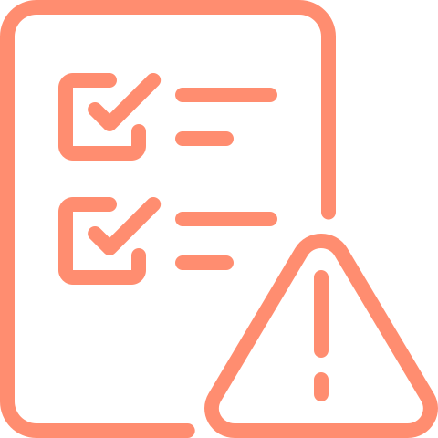


What is ADManager Plus?
360-degree user provisioning across AD, Microsoft 365, Google Workspace, and any enterprise applications
Over 200 predefined, scheduled, exportable reports
Automated, orchestrated identity management
ADManager Plus is an identity governance and administration (IGA) solution with features to securely manage and govern the identities in an organization
Multi-level workflows with SLAs
Integrations with enterprise applications
Automated access certification campaigns
Comprehensive risk assessment reports
Non-invasive, secure help desk delegation
AD, Entra ID, and Google Workspace backup and recovery

Slide 4
01
02
Business challenges
Labor-intensive identity management
Manual data entry requires significant resources and effort, thus causing high administrative overhead
Error-prone processes
Conventional identity management methods are error-prone, which can have significant consequences
Manual identity management is monotonous, time-consuming, and error-prone, and it has to be streamlined for improved business efficiency
03
04
Repetitive and mundane tasks
Identity management involves repetitive and time-consuming tasks like user creation and password resets
Compliance management
Not automating certain management tasks can lead to noncompliance with several IT mandates like SOX and HIPAA

Slide 5


Automating identity management with ADManager Plus
Automate routine IT admin tasks, like user creation, password resets, AD cleanup, and user account enabling and disabling, with automation policies, reports, and orchestration templates
Configure automations to manage identities in bulk, implement just-in-time (JIT) access, meet compliance requirements with detailed audit histories, and bid farewell to data entry errors
Automate tasks in ADManager Plus using:
Scheduled automations
Event-driven automations
Schedule and automate crucial tasks at defined time intervals across enterprise applications
Trigger and execute a sequence of tasks when an event occurs in ADManager Plus

Slide 6

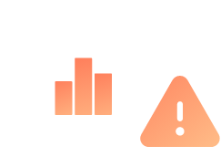

Automation components
Automation policies containing sequential tasks with defined time intervals; these are useful when cleaning up AD, providing JIT access to groups, and doing even more
Notification templates with customizable notification content about the automation execution status, which can be sent to the desired stakeholders
Multi-level workflows to control and oversee automation execution
Webhooks that enable task execution to and from enterprise applications using REST APIs
Orchestration templates with a sequence of AD, Microsoft 365, and Google Workspace tasks; logic blocks; notifications; and webhooks constructed using REST APIs

Slide 7


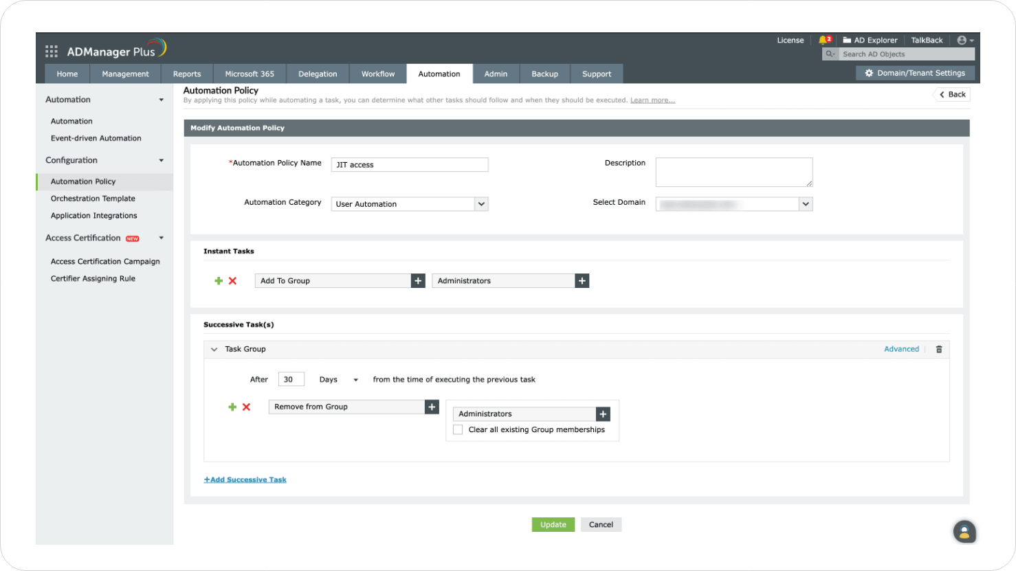

Automation
policies
An automation policy for implementing JIT access

Slide 8

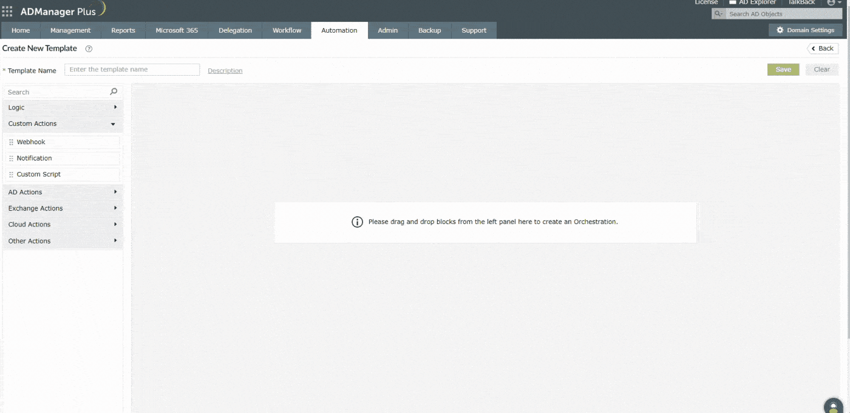
Orchestration templates
Constructing an orchestration template using just drag-and-drop actions

Slide 9
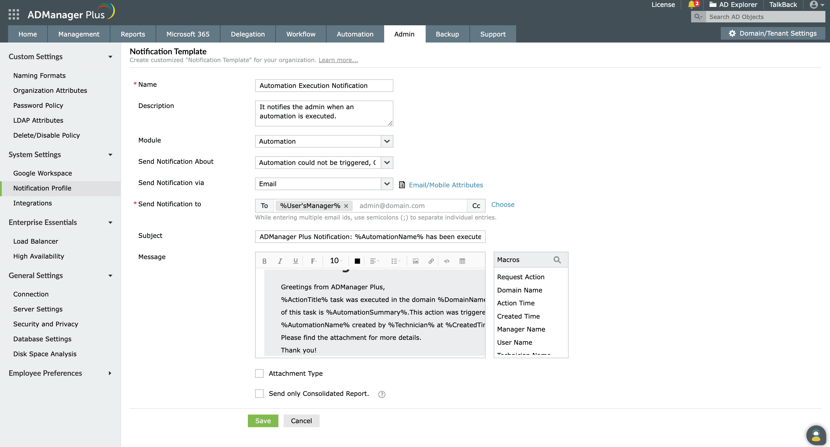
Notification templates
A notification template to notify users' managers about automation execution statuses

Slide 10
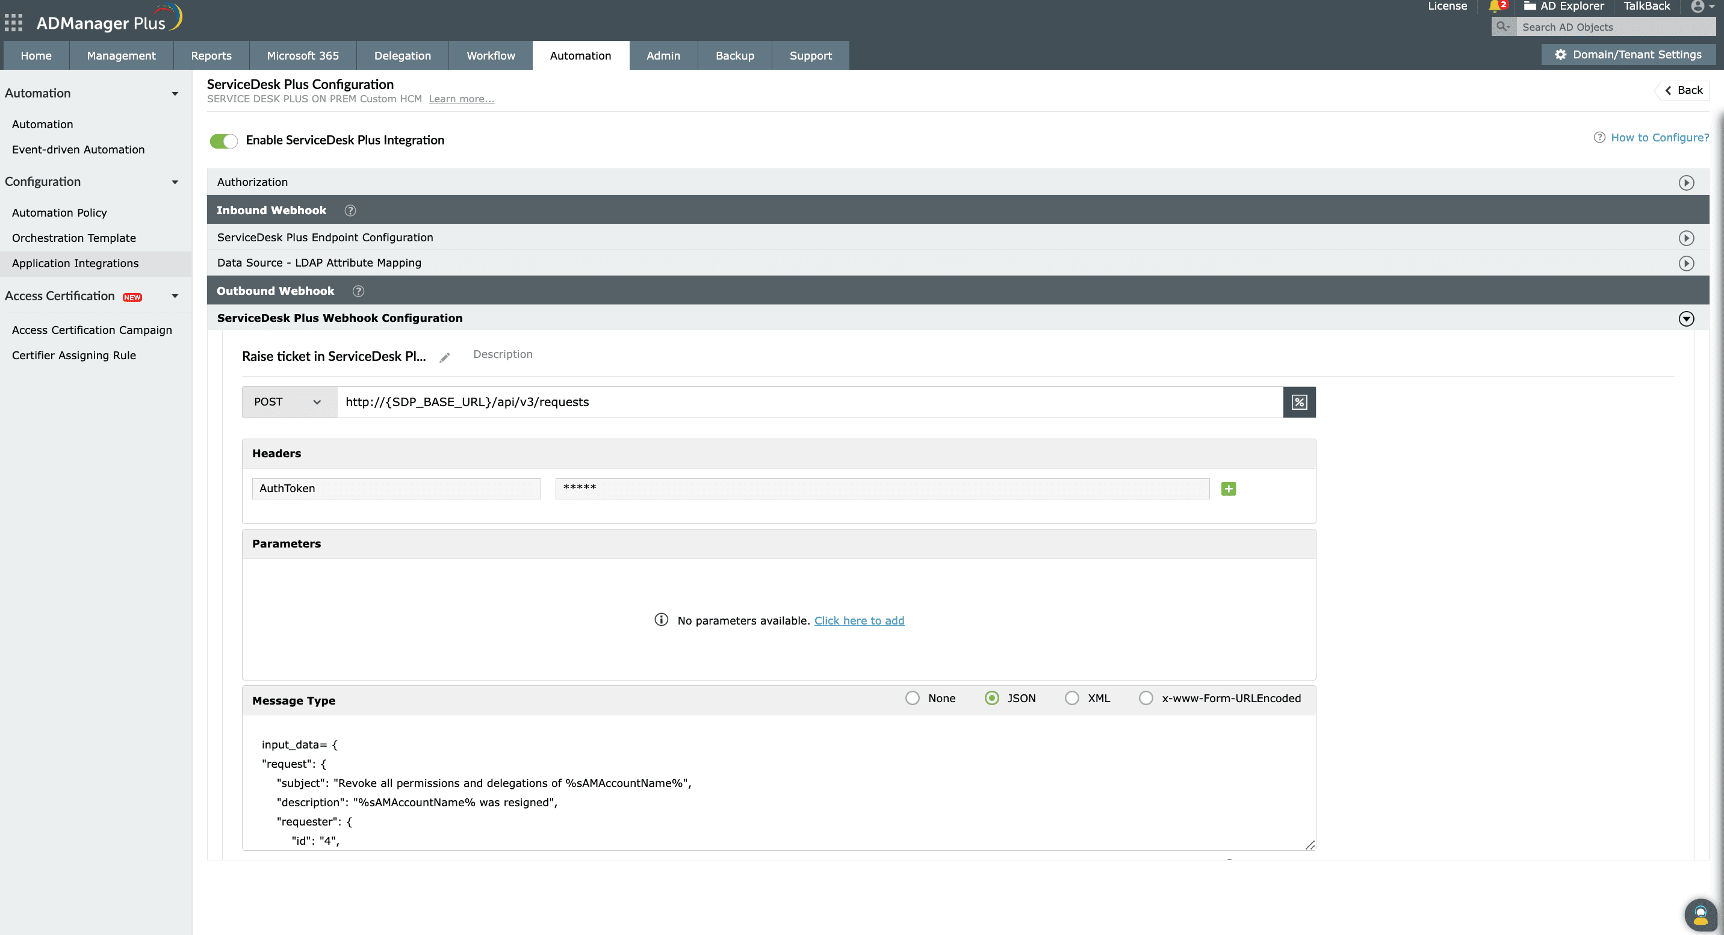
Webhooks
An outbound webhook to automatically raise requests in ManageEngine ServiceDesk Plus

Slide 11
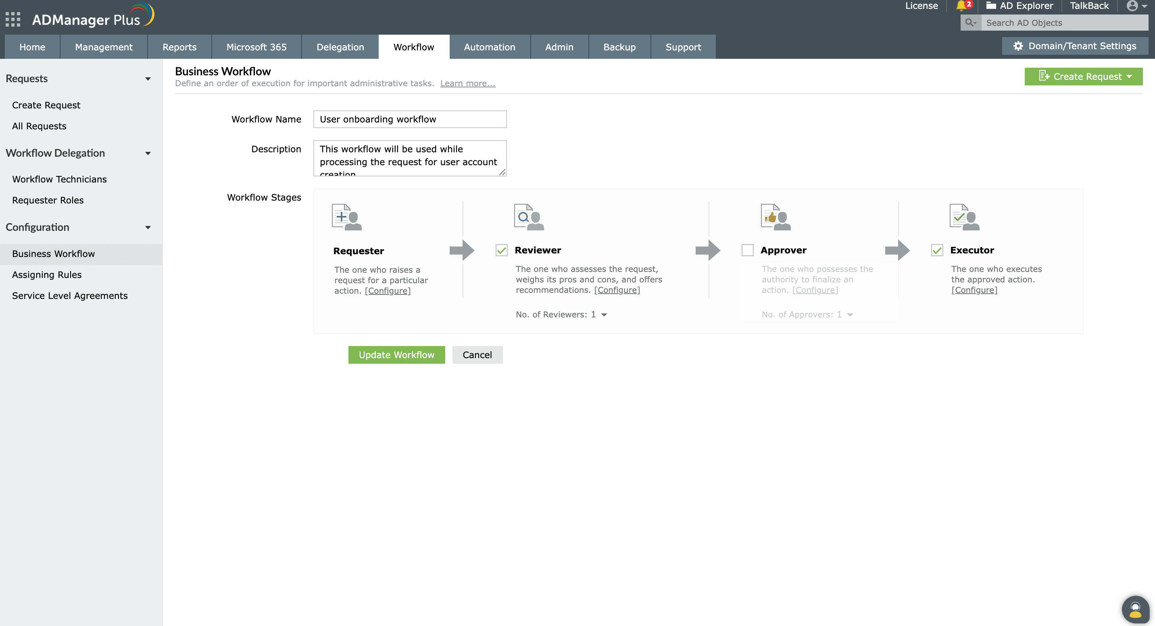
Multi-level workflows
A user onboarding workflow to oversee the user creation automation execution

Slide 12

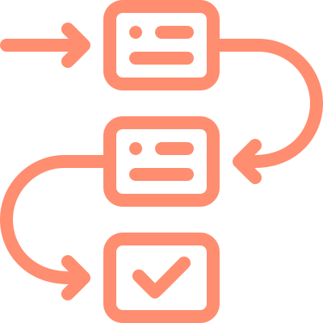

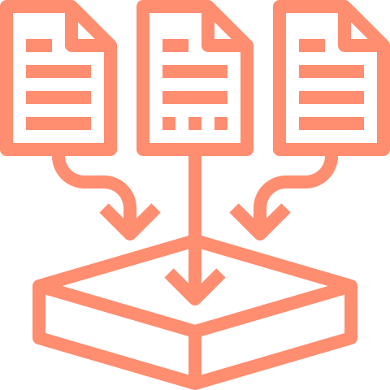
Scheduled automations
Automation policies
Configure policies with sequences of tasks to be executed at defined time intervals and use these policies to run scheduled automations
Business workflows
Associate business workflows with crucial tasks and ensure that tasks are supervised and executed promptly
Schedule and automatically execute tasks at defined times by fetching data from reports, applications, databases, and orchestration templates, then notify stakeholders in real time
Orchestration templates
Define sequential tasks using drag-and-drop actions and automate tasks across enterprise applications with webhooks
Multiple data sources
Automate tasks using CSV files, databases, integrated solutions such as HCM and ITSM tools, or ADManager Plus’ reports as data sources

Slide 13


01
Automation task configuration
Select the AD or Microsoft 365 management task, automation policy, or orchestration template that has to be automated
02
Data source configuration
Configure the objects on which the automation task has to be performed by selecting the desired data source; the data can be obtained from ADManager Plus' predefined reports, integrated applications or databases, or CSV files
How do
scheduled automations
work?
03
Workflow implementation
Associate multi-level business workflows based on the nature of the automation task
04
Execution schedule configuration
Configure the time and frequency at which the automation must be run
05
Notification configuration
Enable notifications about the automation status and customize the notification templates

Slide 14
Event-driven automations
Execute a sequence of identity management tasks across enterprise applications when a user or group management action is performed in ADManager Plus
Event-triggered execution
Condition-based execution
Template-based execution
Trigger a domino effect whenever a specific user or group management action is executed in ADManager Plus
+
Execute an orchestration template when certain conditions are satisfied
+
Construct an orchestration template with the sequence of tasks that must be triggered using webhooks, logic blocks, and more

Slide 15
01
Event configuration
Configure the user or group management action that will trigger the automation
How do
event-driven automations
work?
02
Criteria configuration
Configure conditions based on the domain, help desk technician, object, container, and management template related to the selected action
03
Orchestration template configuration
Select an orchestration template with the desired webhooks; AD, Google Workspace, and Microsoft 365 management tasks; notification templates; and more

Slide 16
Onboarding users from UKG Pro
Usecase
01
02
03
Integrate ADManager Plus with UKG Pro
Configure and run a user creation automation with UKG Pro as the data source
Sync users from UKG Pro to Active Directory every time the automation is run

Slide 17
User deprovisioning
Usecase
01
02
03
Construct an orchestration template with actions to deprovision users in Microsoft 365 and Google Workspace and to delete Exchange mailboxes
Configure an event-driven automation to execute the orchestration template when the delete users action is performed in ADManager Plus by the administrator
Delete AD users from ADManager Plus, trigger the event-driven automation, and deprovision users swiftly

Slide 18



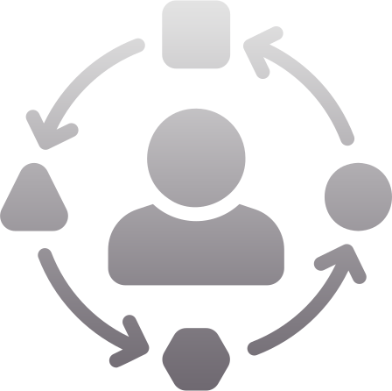


Benefits of automating identity management using ADManager Plus
Minimize data entry errors
Reduce administrative overhead
Orchestrate
sequential tasks
Streamline identity life cycle management
Demonstrate compliance with IT mandates
Alert stakeholders in real time

Slide 19

Thank you!
For more information, contact support@admanagerplus.com
Or
visit manageengine.com/products/ad-manager/

