Slide 1
ManageEngine® Applications Manager
Product Features

Slide 2
Applications Manager - The Solution
Monitors your entire IT infrastructure including applications, servers, databases, operating systems, network services, transactions and more - across physical, virtual and cloud environments.
Primary Positioning: Enterprises, IDCs
Direct Users: IT Administrator, Operators, Managers

Slide 3
Primary Functions
Monitoring
Alerting
Reporting
SLA Management

Slide 4
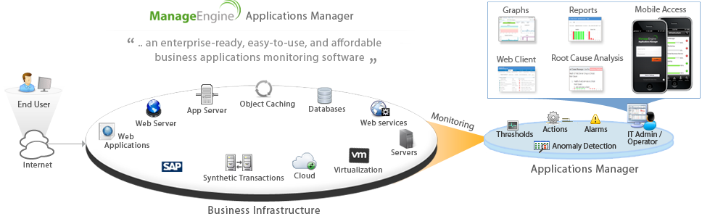
Agentless Monitoring of Heterogeneous Infrastructure

Slide 5
Primary Functions
Monitoring

Slide 6
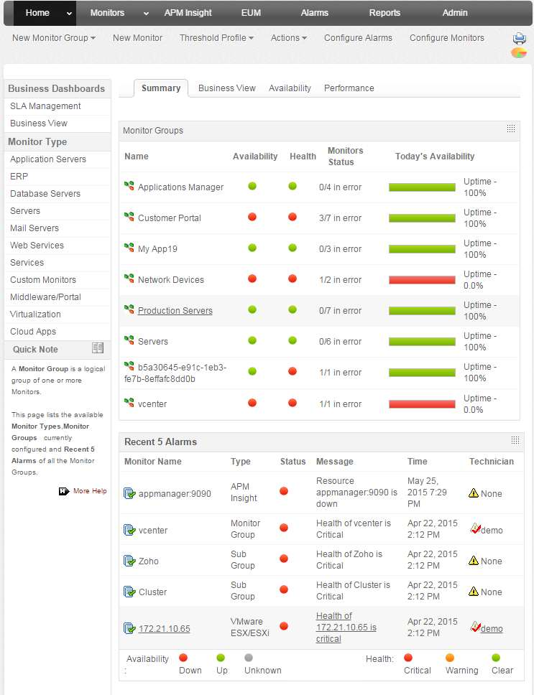
Primary Functions > Monitoring
Unified view of business infrastructure
Monitor diverse applications & servers
  Application Servers
  Servers
  Databases
  Systems & services
  ERP
  Middleware/portal
  Custom apps
  Websites, web services
  Web transactions
  Virtual resources
  Cloud apps

Slide 7
Primary Functions > Monitoring
Application Servers
Microsoft .NET
Oracle WebLogic
SliverStream
GlassFish
VMware vFabric tc Server
IBM WebSphere
JBoss
Tomcat
Oracle AS
WildFly (new)
Resin (new)

Slide 8
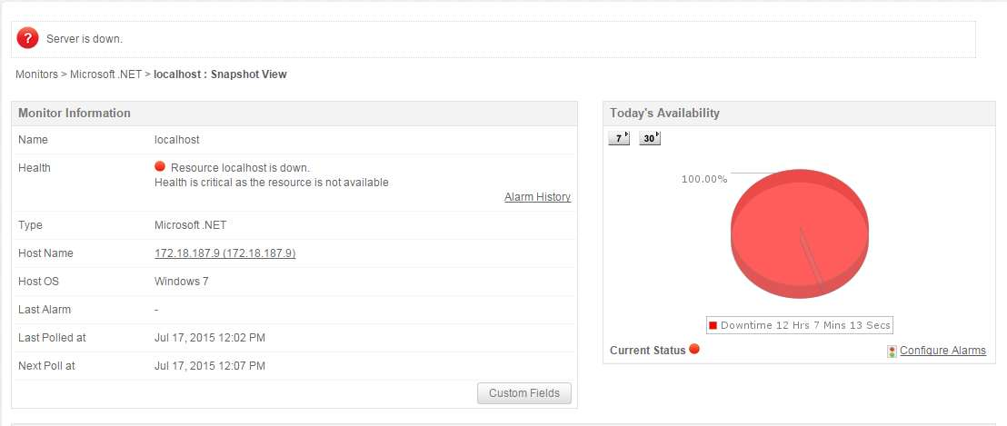
Primary Functions > Monitoring
Application Servers
Microsoft .NET
Health & Availability
User Requests, Active Sessions
Network Traffic
Abandoned, pending Transactions
Memory Usage : Heap
Thread Pools

Slide 9
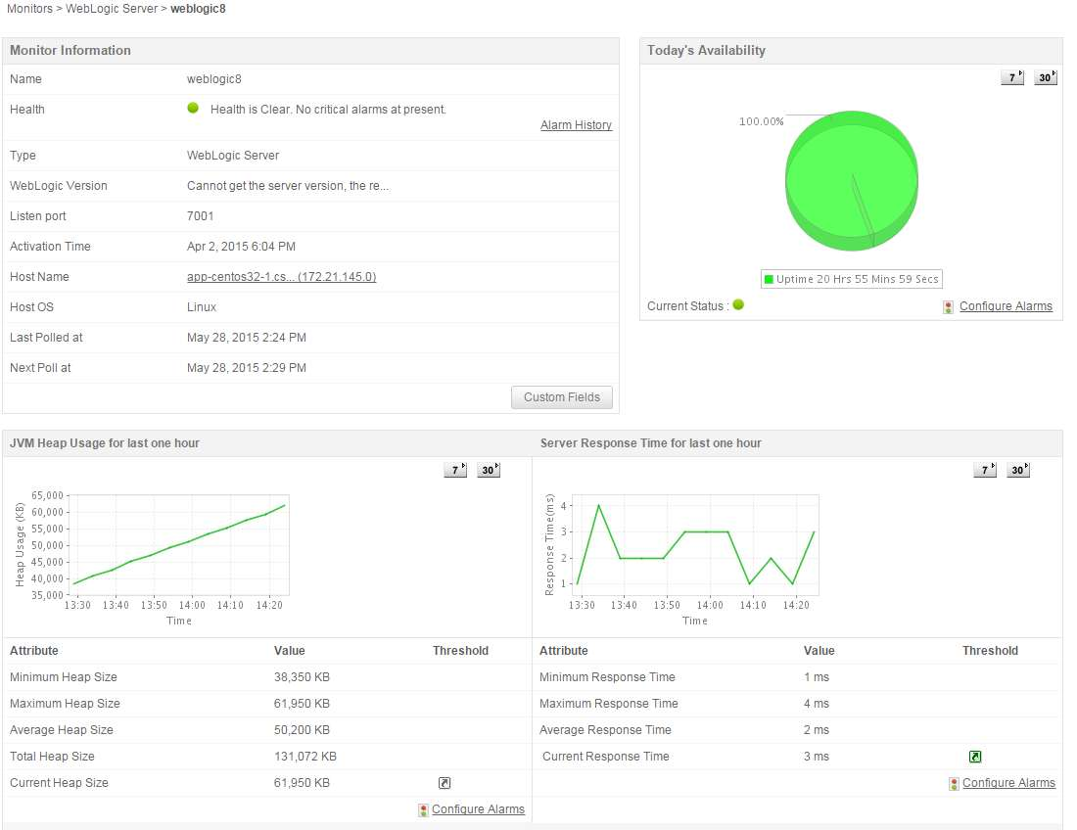
Primary Functions > Monitoring
Application Servers
Oracle WebLogic
Health & Availability
Gain visibility into Application Server
Performance
JVM Statistics
Web Applications Stats: Sessions
Execution count, time for EJBs, Servlets, JSPs
Thread Pools
Database Connection Pools: active, leaked

Slide 10
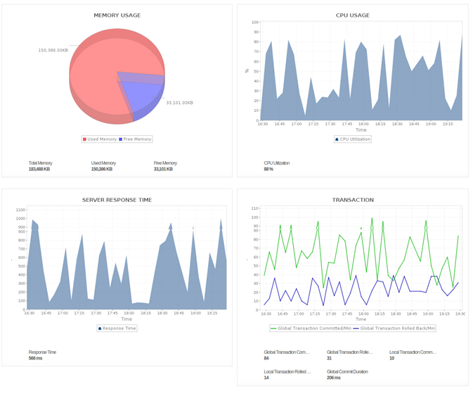
Primary Functions > Monitoring
Application Servers
IBM WebSphere
Health & Availability
Response Times
JVM memory, CPU
Web Applications: User Sessions
EJB Stats: activation, passivation times
Servlets, JSPs
Thread Pools & Database Connection Pools

Slide 11
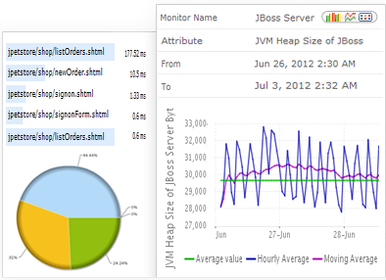
Primary Functions > Monitoring
Application Servers
JBoss Server
Response time
Health & Availability
JVM Statistics
Web Applications
EJBs, Servlets, JSPs
Thread Pools & Database Connection Pools

Slide 12
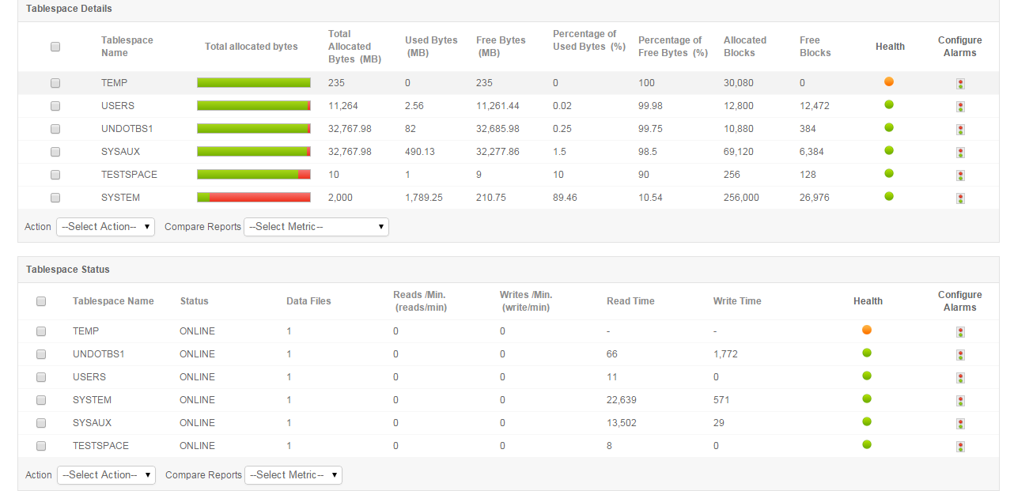
Primary Functions > Monitoring
Application Servers
Oracle Server
Oracle AS 10g
Response time ,Health & Availability
Table space
Rollback and Corrupted Blocks
OPMN Process Memory
JVM Statistics
Request Throughput
Web Applications: Sessions, Throughput
JMS: Message Queues etc

Slide 13
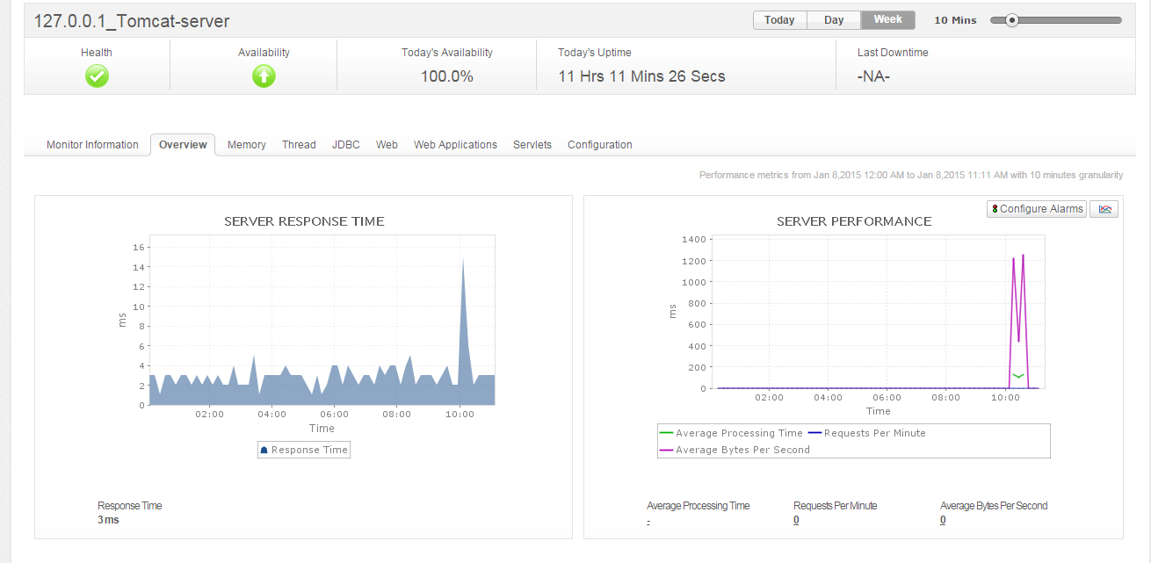
Primary Functions > Monitoring
Application Servers
Tomcat
Response time,
Health & Availability
JVM Statistics
JDBC pools
Web Applications: Sessions
Servlets, JSPs
Response Summary
Threads Availability

Slide 14
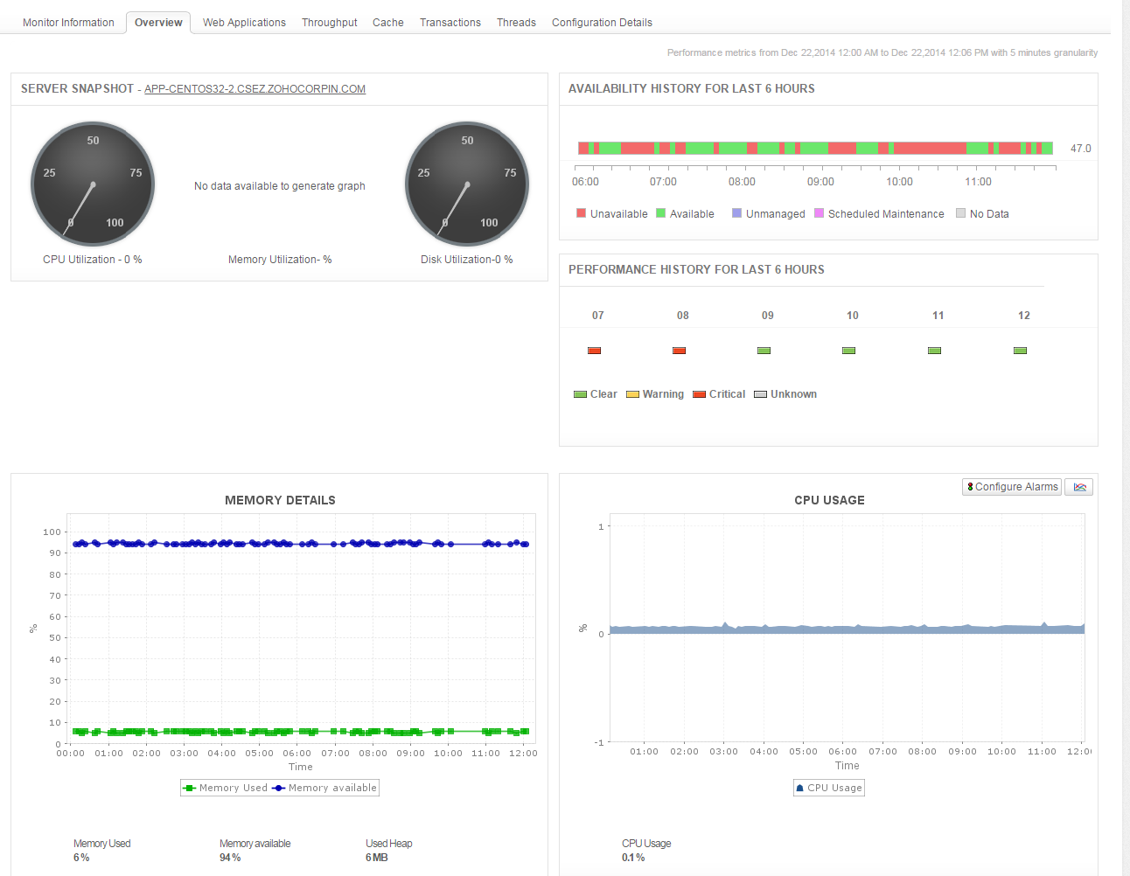
Primary Functions > Monitoring
Application Servers
VMware vFabric tc Server
Health, Availability & Performance
Memory Usage
Web Applications: Sessions
Request Processed: Throughput
Transaction Rate
Threads Availability
Cache Memory Usage

Slide 15
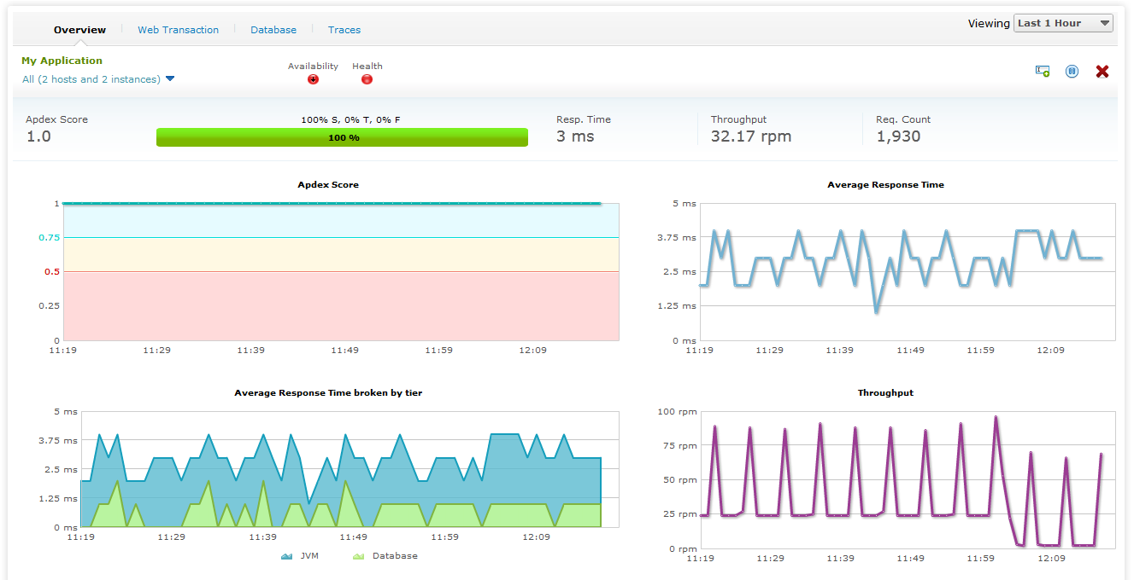
Primary Functions > Monitoring
Web Transactions
Java, Ruby on Rails, .Net

Slide 16
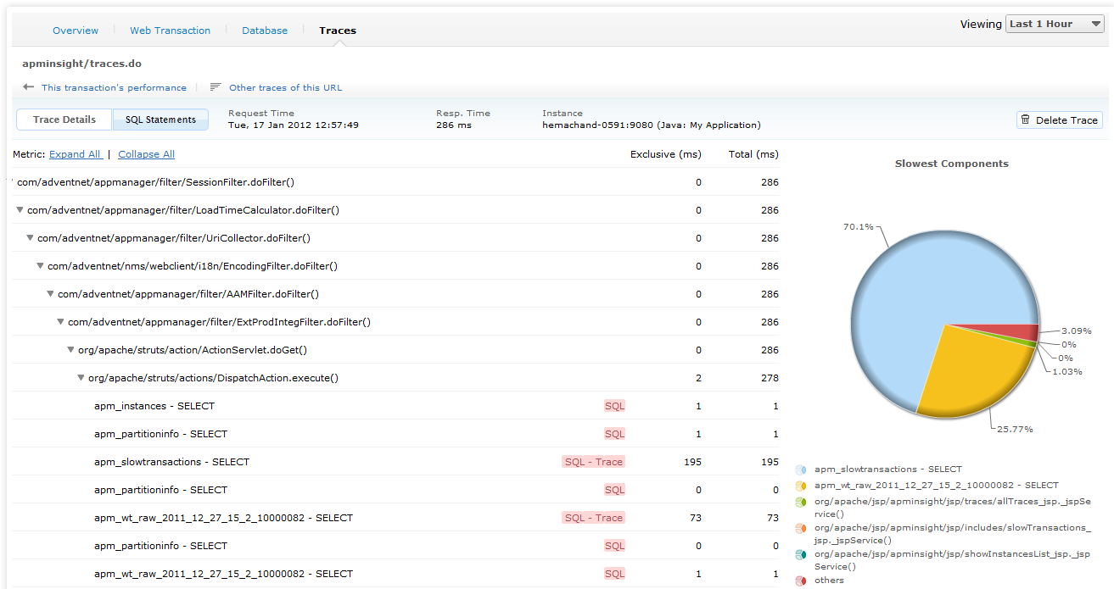
Primary Functions > Monitoring
Web Transactions
Java, Ruby on Rails, .Net
Apdex scores
Transaction tracing
Metrics from URL to SQL query
Database metrics
Slow transactions
Throughput

Slide 17
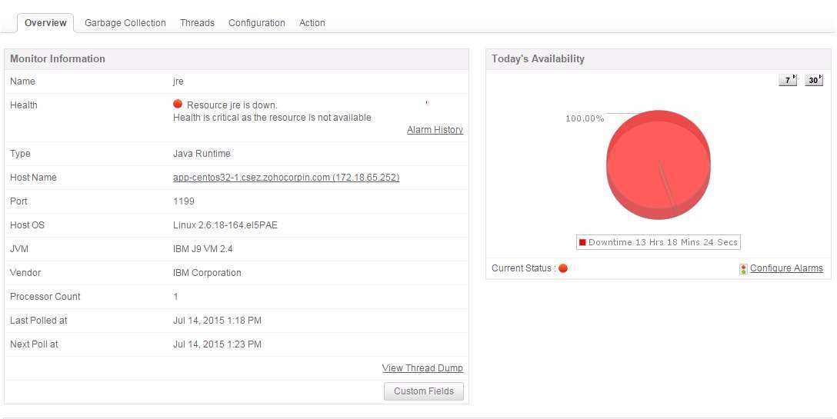
Primary Functions > Monitoring
Application Servers
Java Runtime Monitor
Out-of-the-box remote Monitoring & Mgmt on Java platform and of applications that run on it
Process Memory Parameters
Garbage collection
Thread Parameters
Virtual Memory Parameters

Slide 18
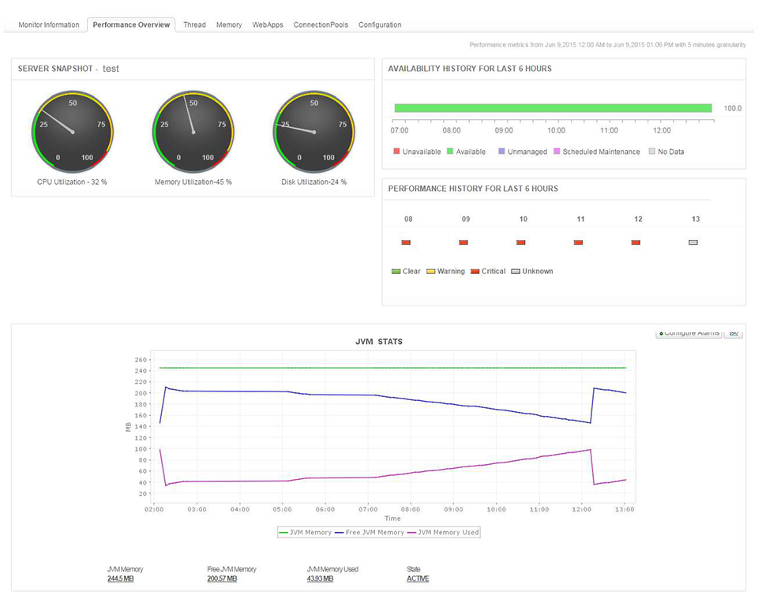
Primary Functions > Monitoring
Application Servers
Resin App Server
Monitors important parameters like CPU usage, JVM stats etc.
Tracks thread pool utilization to prevent deadlocks
Measures heap/non heap memory usage
Other parameters
Web Apps
Connection Pool details
End user experience

Slide 19
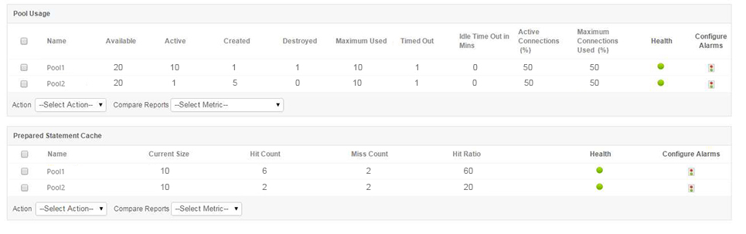
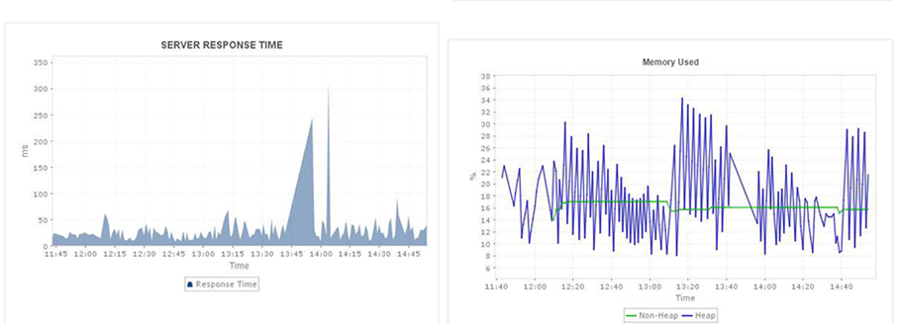
Primary Functions > Monitoring
Application Servers
WildFly Monitor
Monitors service response time, and performance of web applications
Tracks components such as Java virtual machine (JVM), Enterprise Java Beans(EJBs), Java database connection pools(JDBC) and servlets.
Process Memory Parameters
Garbage collection
Thread Parameters

Slide 20
Primary Functions > Monitoring
Databases
Oracle
MySQL
MS SQL Server
IBM DB2
Sybase
PostgreSQL
Memcached
Cassandra
MongoDB

Slide 21
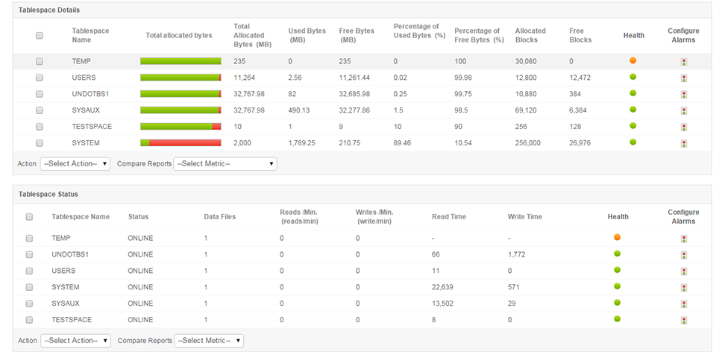
Primary Functions > Monitoring
Databases
Oracle
Oracle 8.x, 9i, 10g
Performance, health and availability
Table Space
SGA
Data file details
Uses JDBC calls to collect data

Slide 22
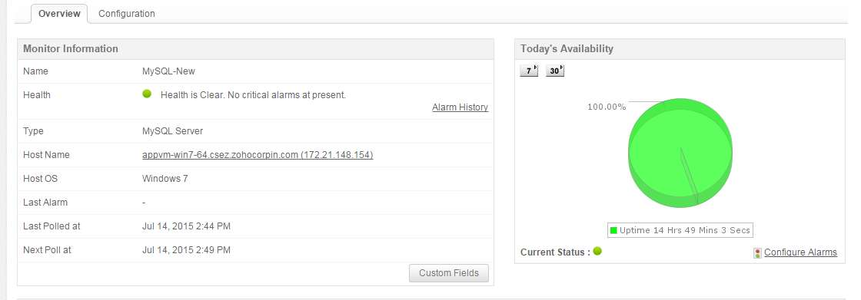
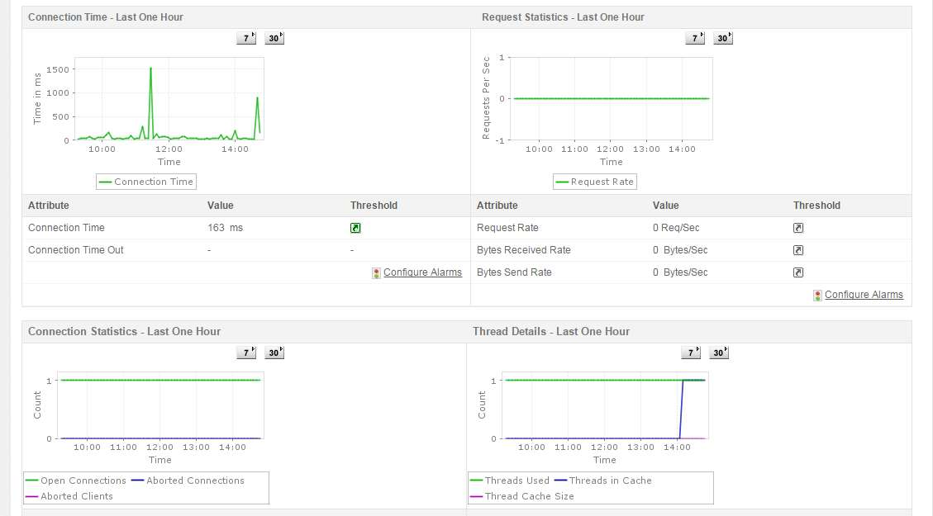
Primary Functions > Monitoring
Databases
MySQL
MySQL 3.x, 4.x, 5.x
Response time
Health
Availability
Request statistics
Server tuning metrics
Database tuning metrics
Notes:
Server Tuning metrics : connection statistics, thread details Database Tuning metrics : table lock stats, db details –no. of tables, db size etc

Slide 23
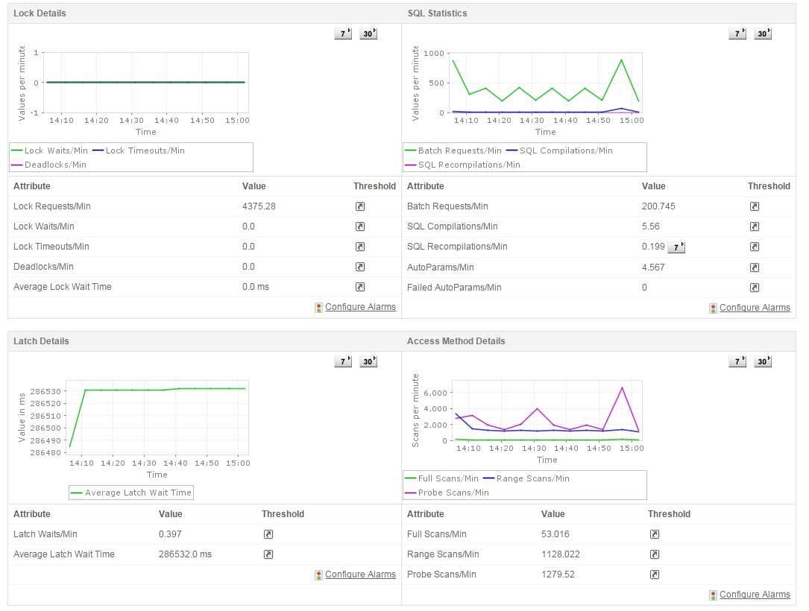
Primary Functions > Monitoring
Databases
MS SQL
MS SQL Server 2000, 2005, 2008
Response time
Health, availability
Request Statistics
Server Tuning metrics
Lock Details
Database Tuning metrics
Notes:
Server Tuning metrics : connection statistics, thread details Database Tuning metrics : table lock stats, db details –no. of tables, db size etc

Slide 24
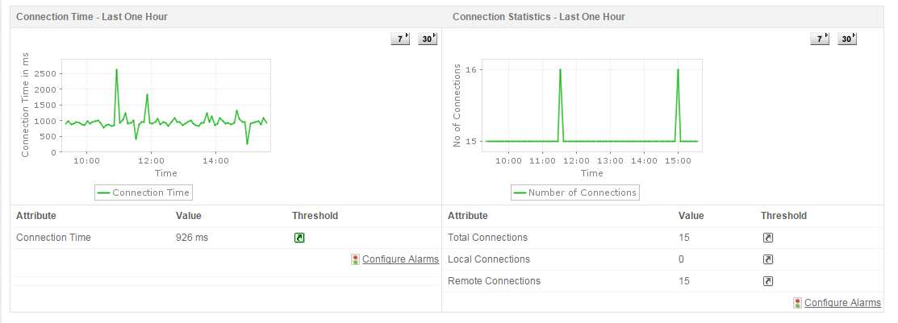
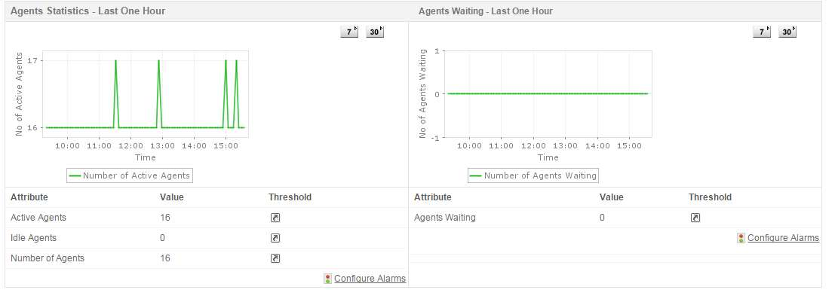
Primary Functions > Monitoring
Databases
IBM DB2
IBM DB2 8.x
Response time
Health, availability
Connection Statistics
Transaction Statistics
Agent statistics
Database Tuning metrics
Notes:
Server Tuning metrics : connection statistics, thread details Database Tuning metrics : table lock stats, db details –no. of tables, db size etc

Slide 25
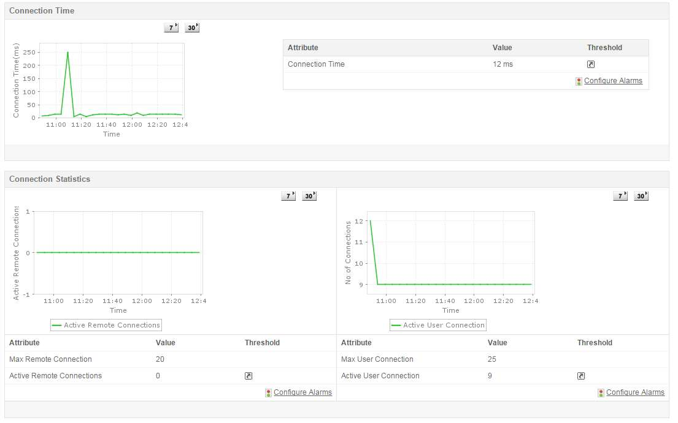
Primary Functions > Monitoring
Databases
Sybase
Response time
Health and availability
Current Process
Current Transactions
Connection Statistics
Notes:
Server Tuning metrics : connection statistics, thread details Database Tuning metrics : table lock stats, db details –no. of tables, db size etc

Slide 26
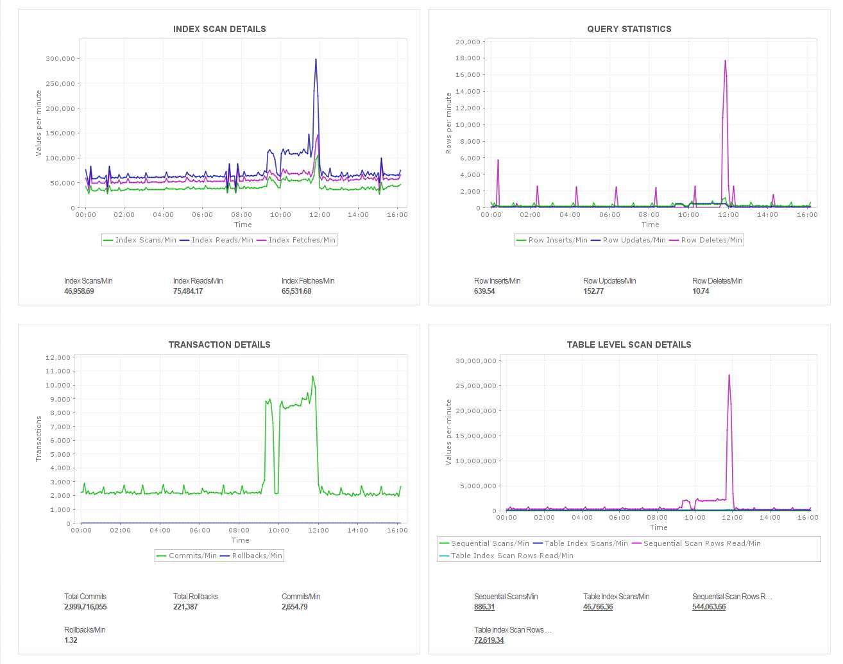
Primary Functions > Monitoring
Databases
PostgreSQL
Response time, health, and availability
Buffer, Connection, Query, Lock Stats
Transaction Details
Index Scan Details
Table level details
Notes:
Server Tuning metrics : connection statistics, thread details Database Tuning metrics : table lock stats, db details –no. of tables, db size etc

Slide 27
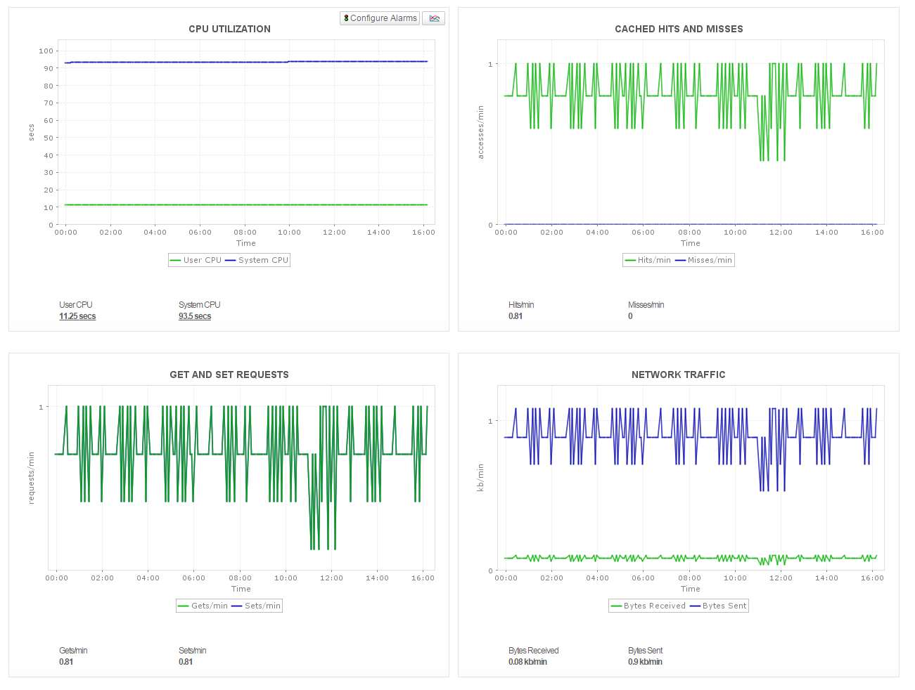
Primary Functions > Monitoring
Databases
Memcached
Availability, health, CPU
Cache hit ratio, memory usage, Transactions
Network Traffic
Connections
Cached items, request metrics, etc.
Notes:
Server Tuning metrics : connection statistics, thread details Database Tuning metrics : table lock stats, db details –no. of tables, db size etc

Slide 28
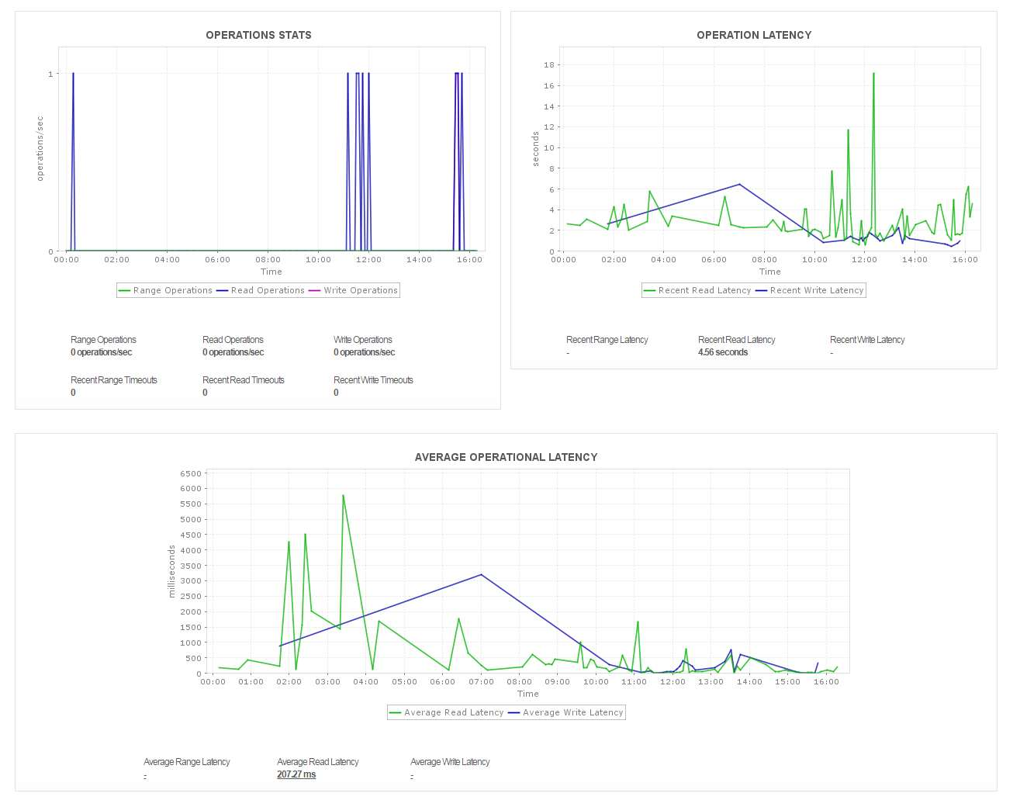
Primary Functions > Monitoring
Databases
Cassandra
Storage and Operation Stats, Operation Latency
Pending Tasks- Commitlog, Commands
Cluster and Cluster Node Details
Dropped message statistics
Thread pool statistics
Notes:
Server Tuning metrics : connection statistics, thread details Database Tuning metrics : table lock stats, db details –no. of tables, db size etc

Slide 29
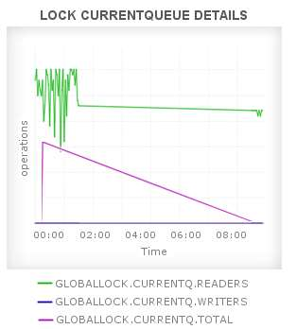
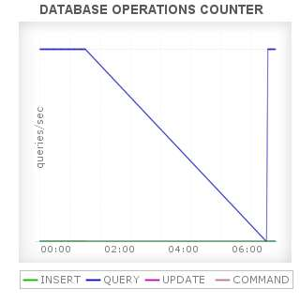
Primary Functions > Monitoring
Databases
MongoDB
Memory, CPU Usage, Current connection stats
Lock current queue details, lock active client details
Background flush statistics
Journaling statistics
Replica and sharding details for mongod and mongos device respectively.
Notes:
Server Tuning metrics : connection statistics, thread details Database Tuning metrics : table lock stats, db details –no. of tables, db size etc

Slide 30

Primary Functions > Monitoring
Server and Services
Windows, Linux, Solaris, IBM AIX, IBM AS400 / iSeries, HP Unix, Tru 64 Unix, FreeBSD, Mac OS, Novell
Exchange & other mail Servers
Web Servers – Apache, IIS
PHP Server
Any TCP Port
JMX – AdventNet & MX4J
SNMP-enabled Software
Ceph Storage (new)

Slide 31
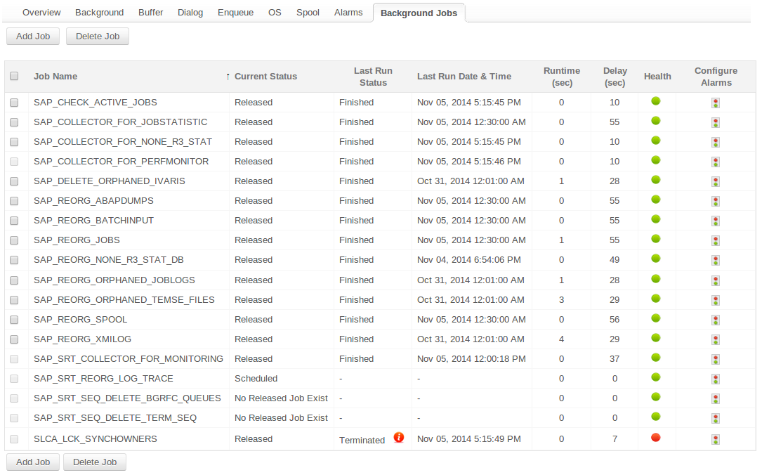
Primary Functions > Monitoring
ERP > SAP Server
Availability
Performance
Background jobs
Buffer
Dialog
Enqueue
Operating System
Spool

Slide 32
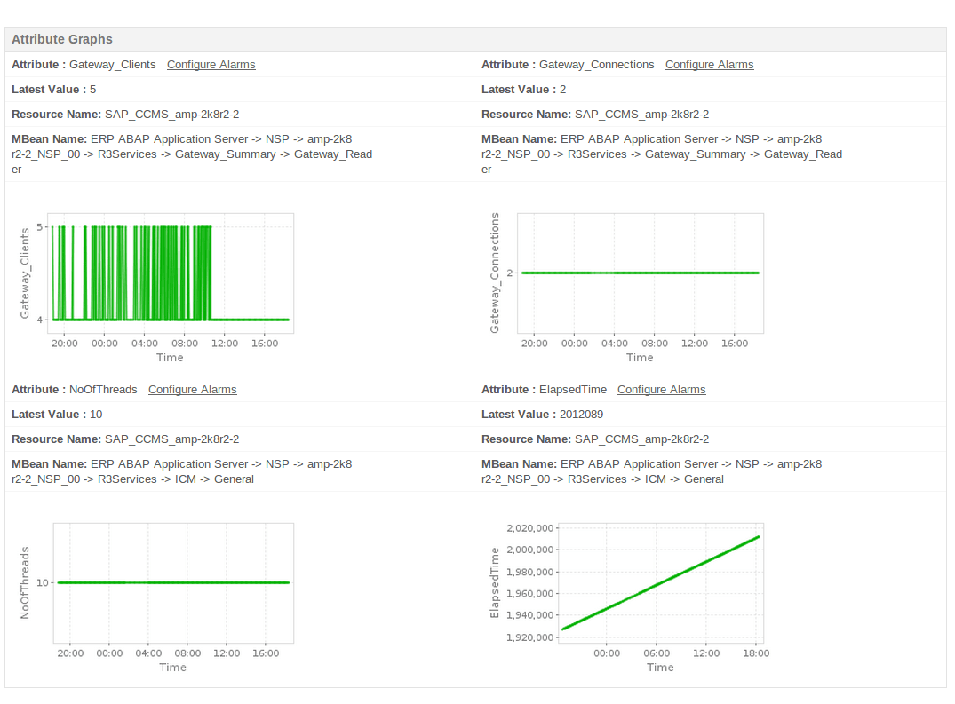
Primary Functions > Monitoring
ERP > SAP CCMS
Availability & Performance of SAP Business Components such as
Business Intelligence (BI)
Customer Relation Manager (CRM)
Supply Chain Management (SCM)
In addition you can also monitor,
Connection time
Performance attributes (all numeric attributes)
Status and Log attributes

Slide 33
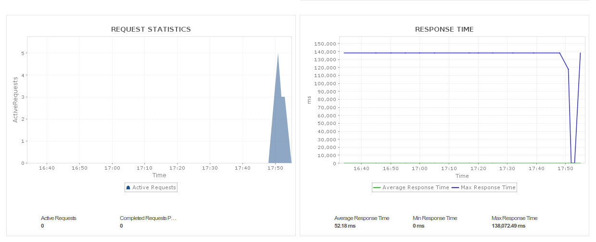
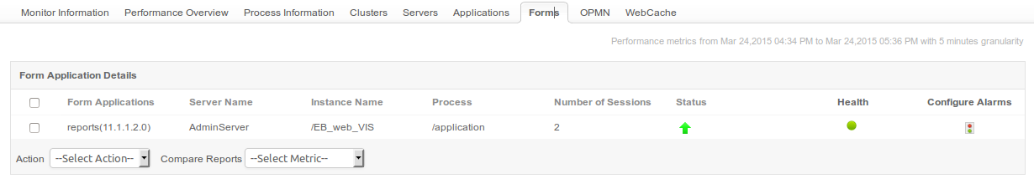
Primary Functions > Monitoring
ERP > Oracle E-Business Suite
Availability & Performance
Oracle E-Business Suite Setup
Performance Metrics like Request Stats, Response Time
Process Heap Size
Clusters
OPMN components
Web cache performance
Server status
Forms

Slide 34
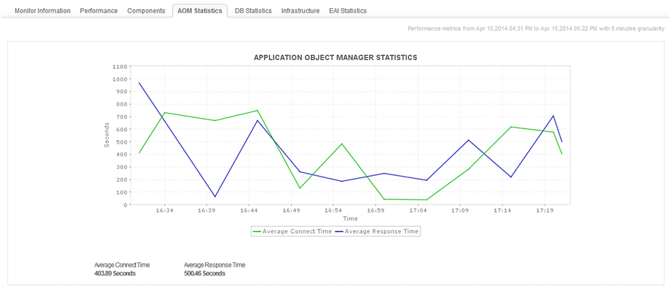
Primary Functions > Monitoring
ERP > Siebel CRM
Monitor Siebel CRM Enterprise server and child servers
Track KPIs of components, AOM statistics, EAI statistics, Infrastructure statistics and DB statistics.

Slide 35
Primary Functions > Monitoring
Middleware / Portal
MS SharePoint
IBM WebSphere MQ
BEA WebLogic Integration
Microsoft Message Queue (MSMQ)
VMware vFabric RabbitMQ

Slide 36
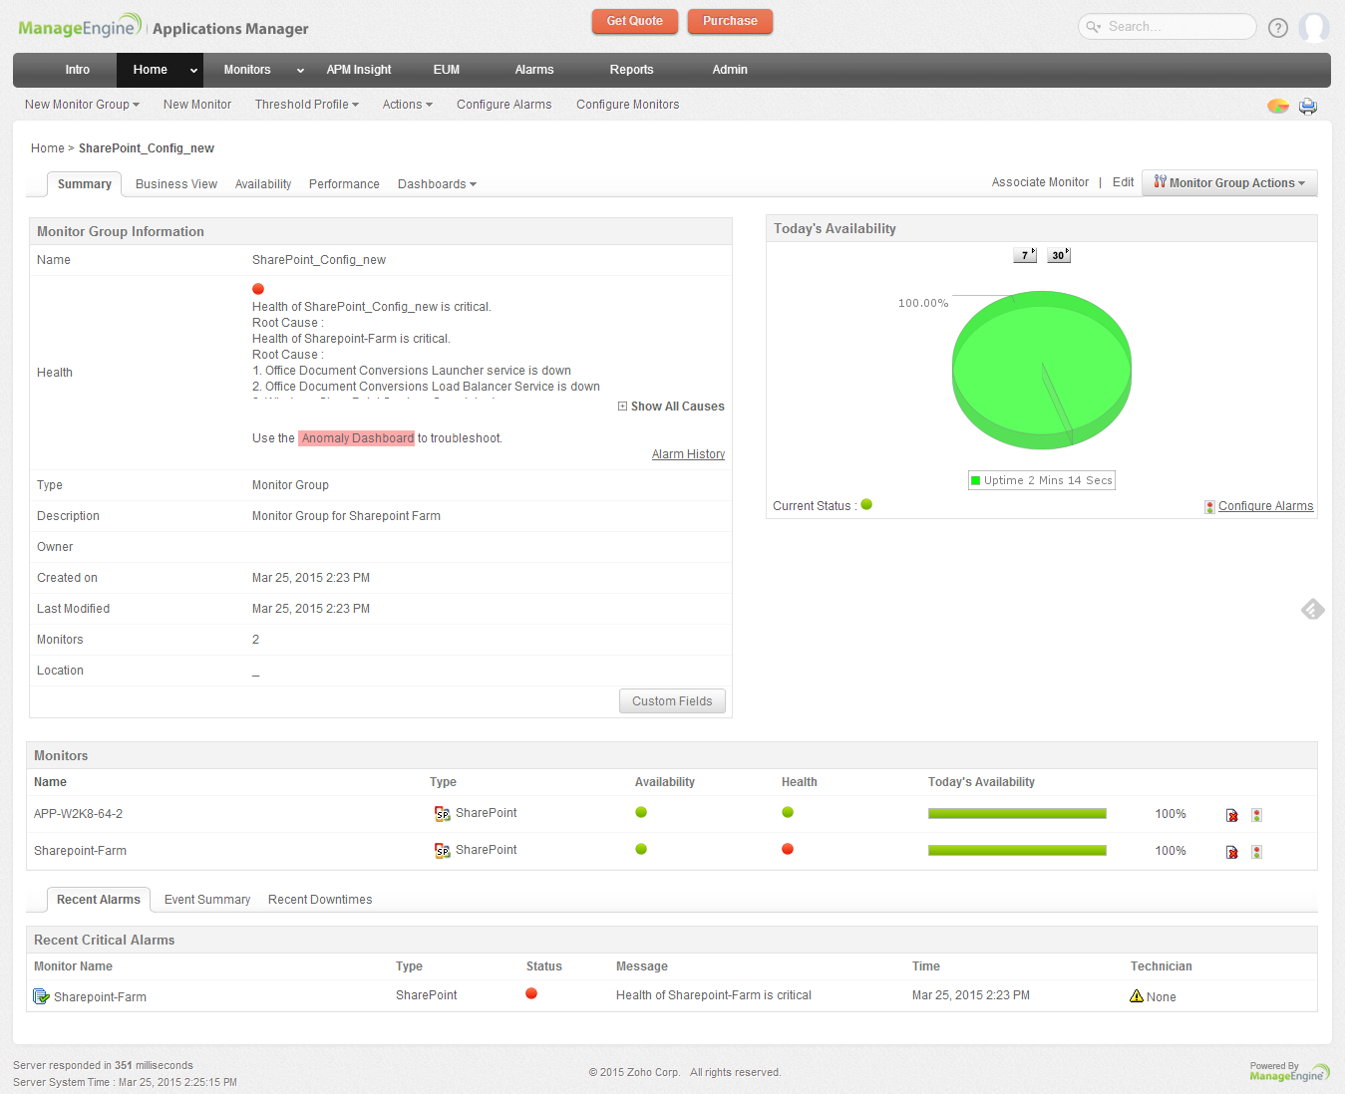
Primary Functions > Monitoring
Middleware / Portal
MS Office SharePoint
MS Sharepoint 2007, 2010 and 2013
Availability & Performance
Comprehensive Fault Management
Pro-active notifications
Active Server Pages
Memory Stats
Share Point Server Services
Sharepoint Farms

Slide 37
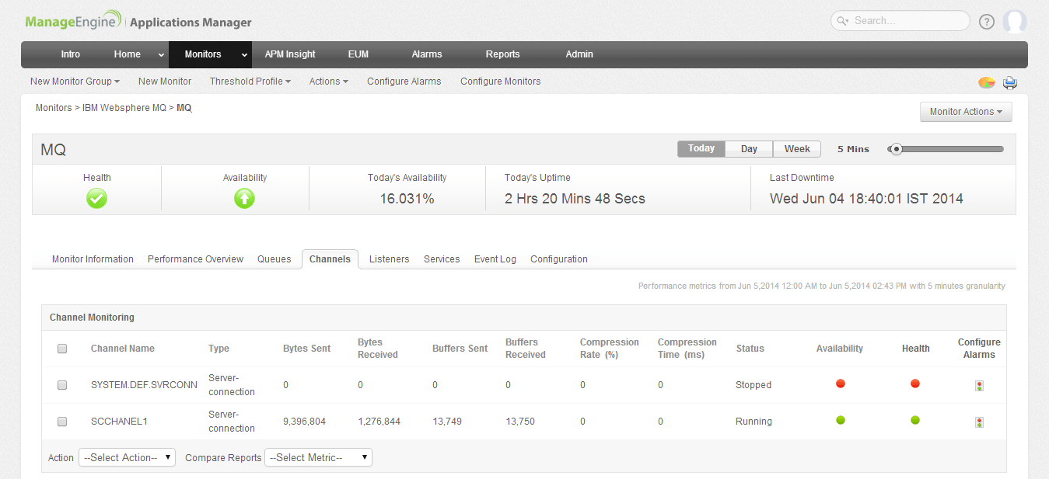
Primary Functions > Monitoring
Middleware / Portal
IBM WebSphere MQ
Health, Availability & Performance
Channel (Bytes-sent/Received, Buffers-sent/Received)‏
Listener Stats
Queue Stats

Slide 38
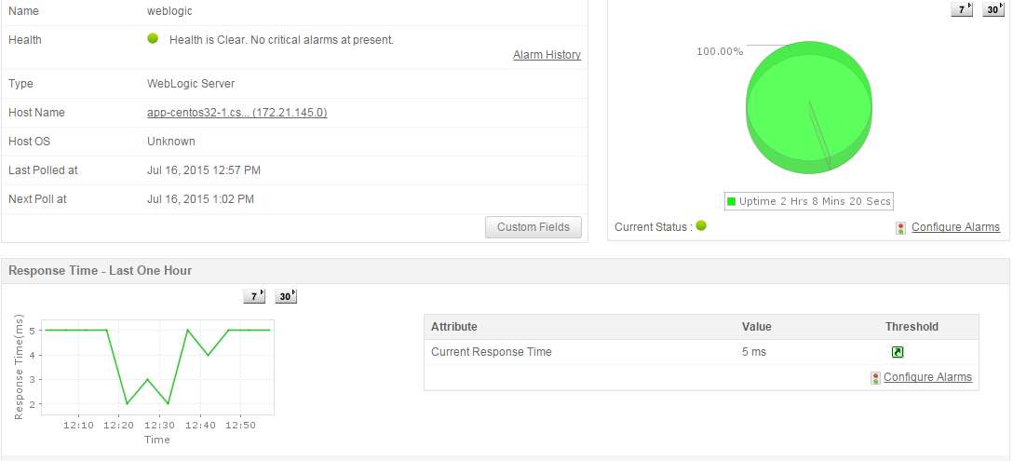
Primary Functions > Monitoring
Middleware / Portal
BEA WebLogic Integration
Health & Availability
Business Process Details
Application Integration Details
Track SLA
Service and Event Counts
Response Times
Message Broker Details

Slide 39
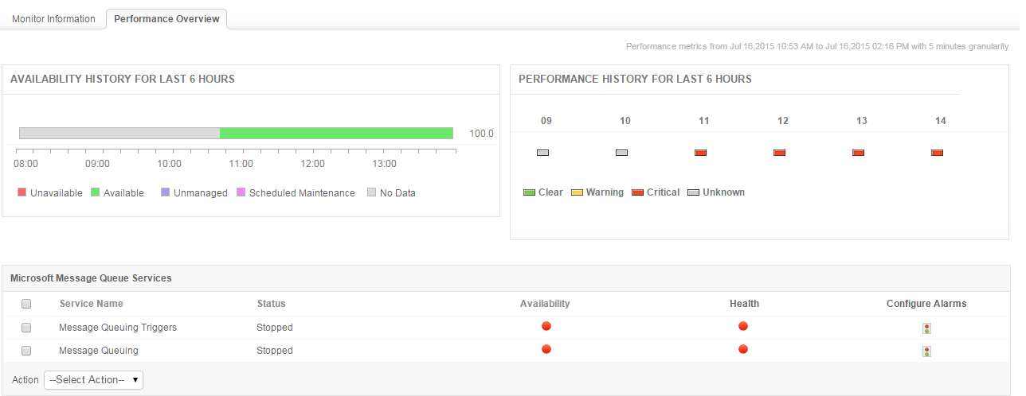
Primary Functions > Monitoring
Middleware / Portal
Microsoft Message Queue (MSMQ)
Health & Availability
Message Queue Services
Session Stats
Microsoft Message Queue
Stats

Slide 40
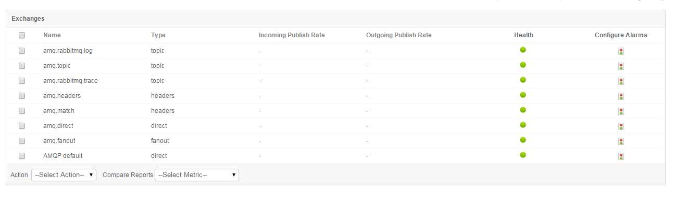
Primary Functions > Monitoring
Middleware / Portal
VMware vFabric RabbitMQ
Health, Availability & Performance
Queued Messages
Message Rates
Node Details
Connection Stats
Exchange Rates

Slide 41
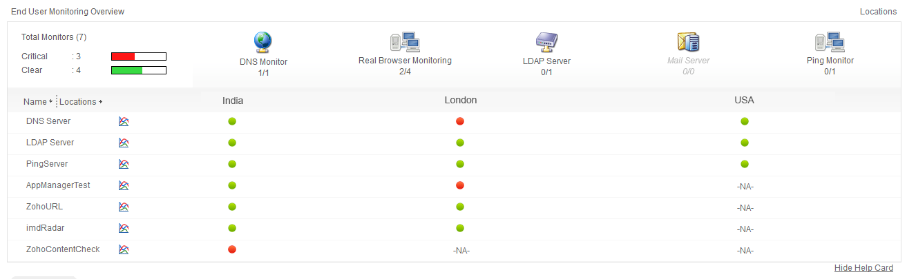
Primary Functions > Monitoring
End User Monitoring (EUM)
Value:
Measure end-user experience of network services & apps
Resolve problems before end users are affected
Easy troubleshooting

Slide 42
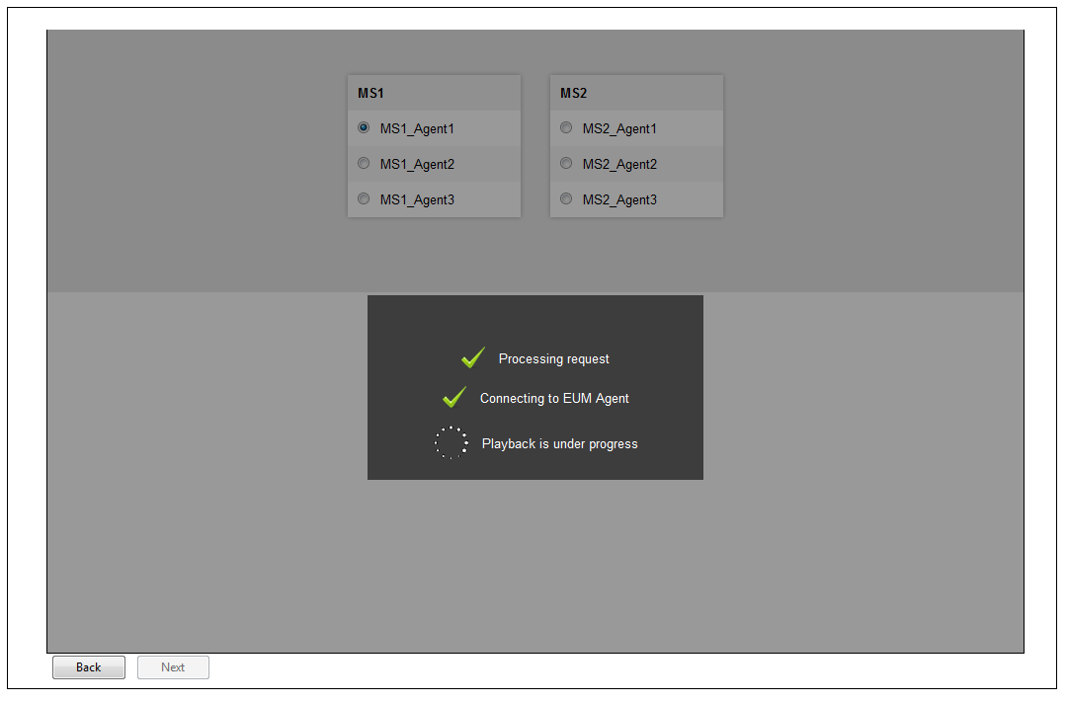
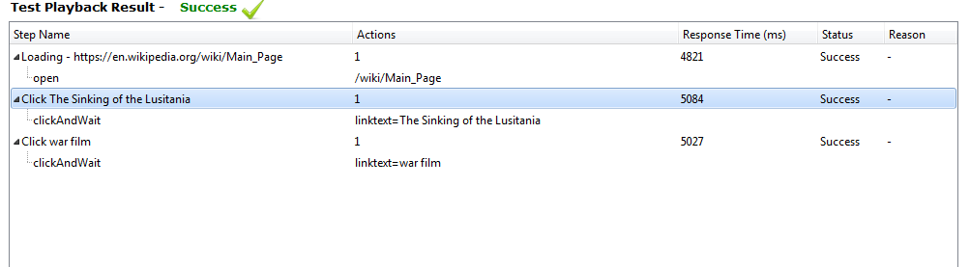
Primary Functions > Monitoring
Real Browser Monitor
Records transactions with Firefox toolbar
Stores user actions as web scripts
Play back web scripts from multiple locations
Value:
High visibility into Synthetic web transactions
Improves customer experience
Easy troubleshooting

Slide 43
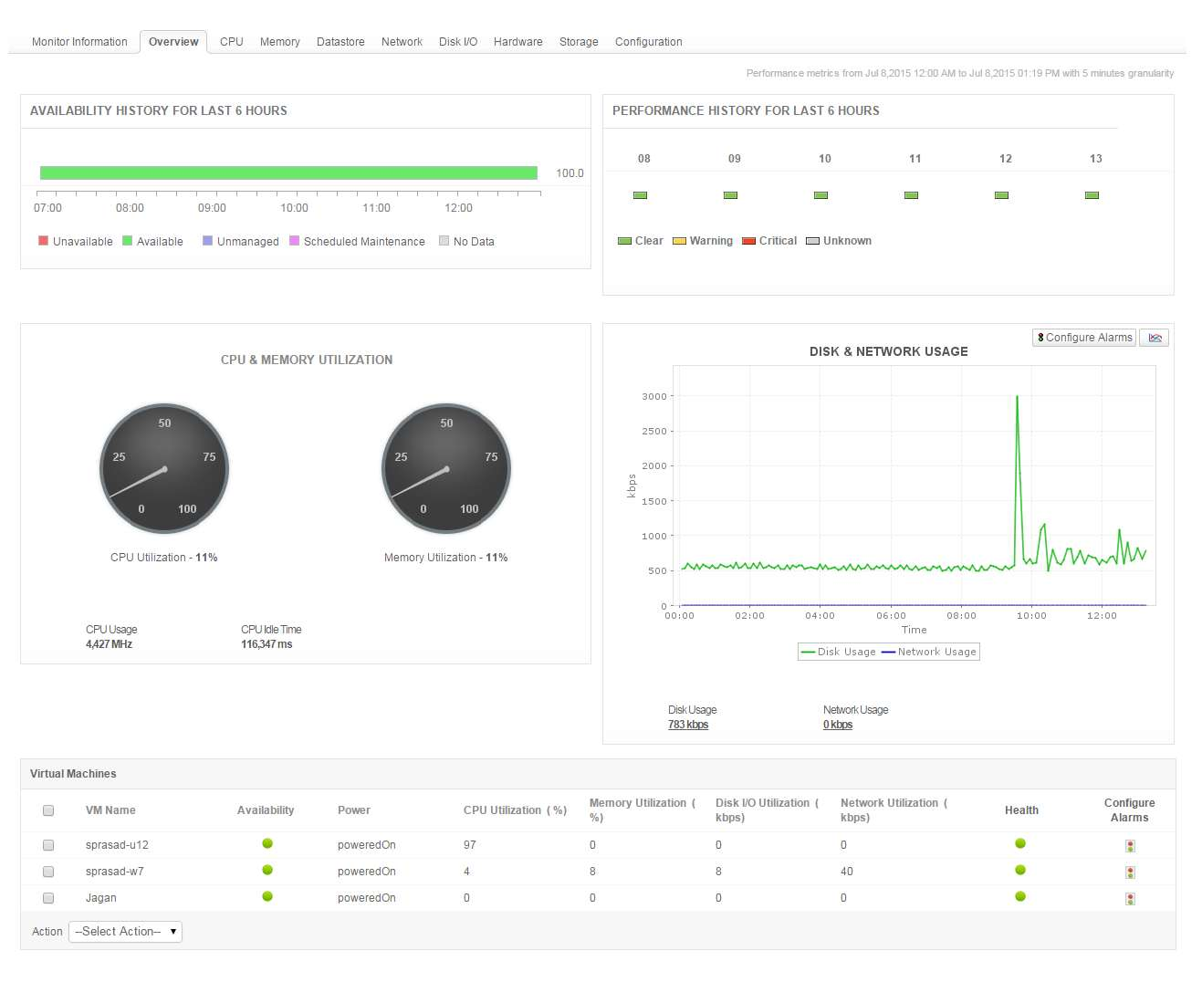
Primary Functions > Monitoring
VMware Monitoring
Monitor ESX/ESXi servers & guest VMs
In-depth performance metrics
Find out which VMs are consuming resources
Automatically start/stop/restart VMs
Value:
Gain insight into VMware performance
Manage physical and virtual infrastructure
Easy troubleshooting

Slide 44
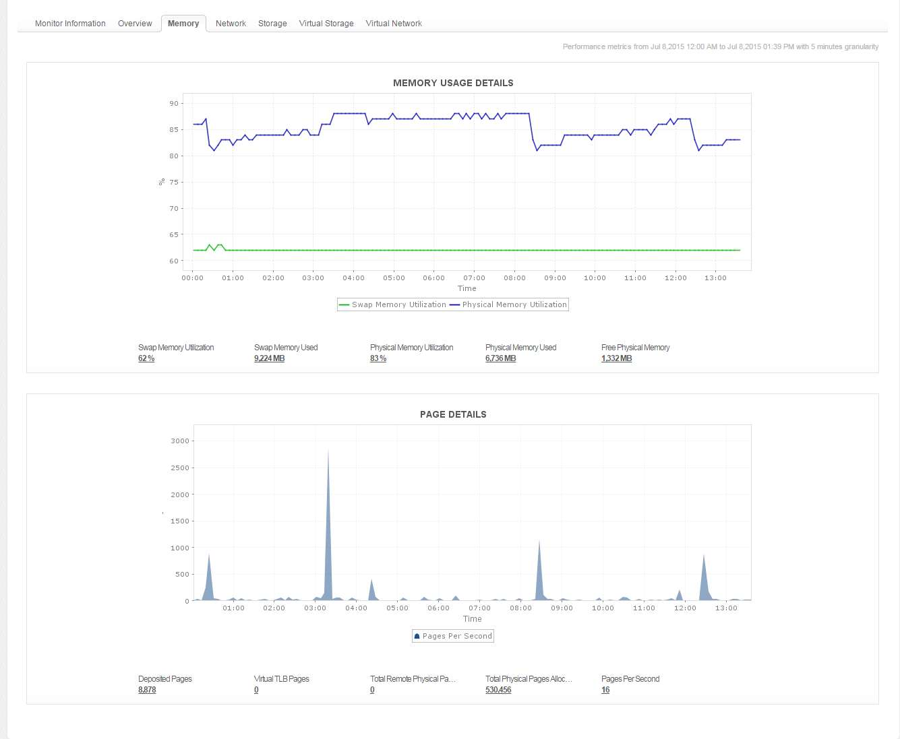
Primary Functions > Monitoring
Microsoft Hyper-V Monitoring
Monitor Hyper-V servers & guest VMs
In-depth performance metrics
Find out which VMs are consuming resources
Automatically start/stop/restart VMs
Value:
Gain insight into Hyper-V performance
Effective Capacity Planning
Easy troubleshooting

Slide 45
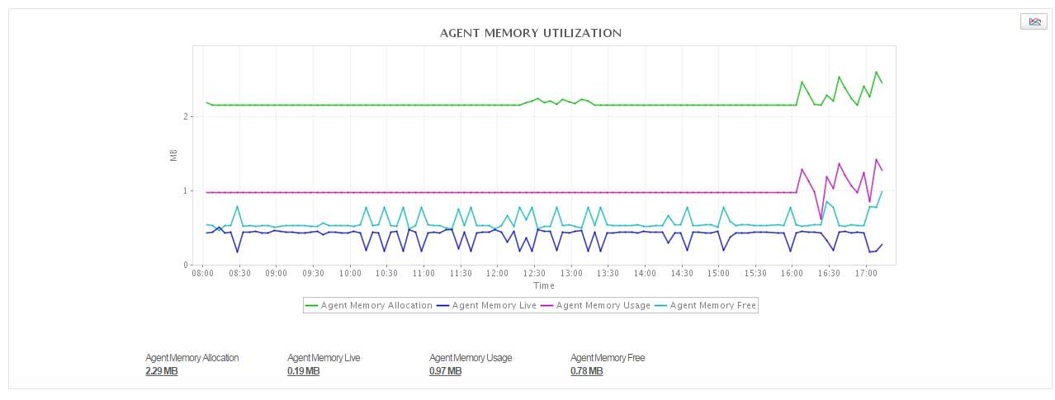
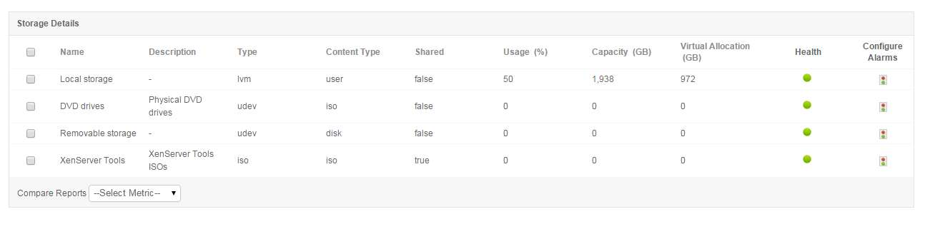
Primary Functions > Monitoring
XenServer Monitoring
Discover XenServer pools, hosts and their guest virtual machines.
Monitor CPU, Memory and Network Utilization
Track Storage Details, Usage and Capacity, VM Configuration and Capacity Details

Slide 46
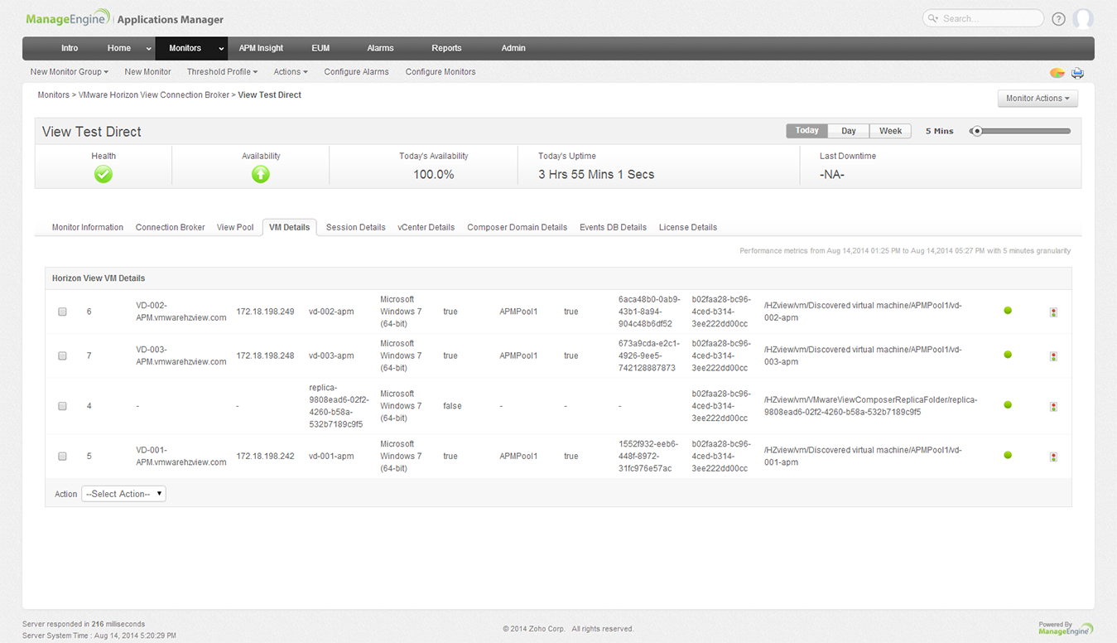
Primary Functions > Monitoring
VMware Horizon View
Gain insight into VMware Horizon View performance
Monitor key parameters like Connection Broker, Session Details, Database, pool details

Slide 47
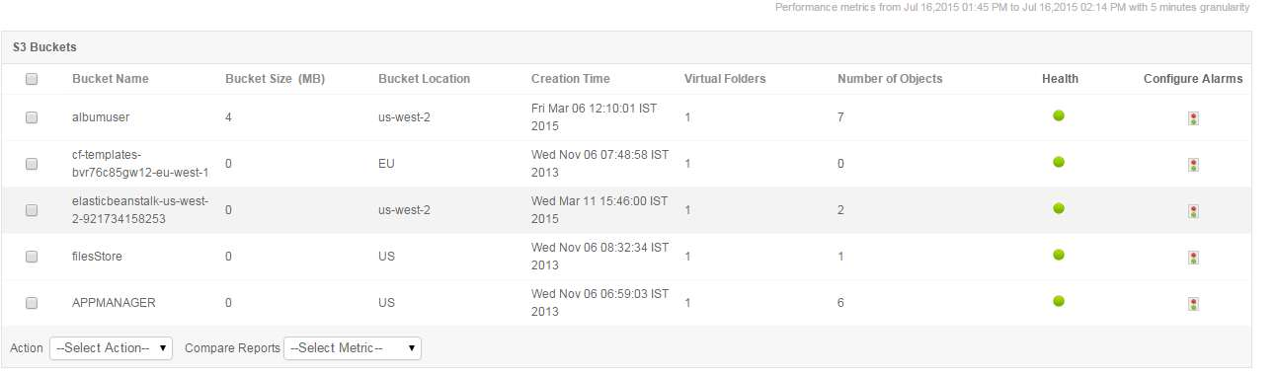
Primary Functions > Monitoring
Public Cloud–>Amazon AWS
Monitor Amazon EC2, RDS instances & attached EBS volumes
CPU Utilization
Network Traffic
Disk I/O
Volume Traffic, Latency
Bandwidth
Throughput
S3 Buckets
Value:
Gain insight into performance of Amazon AWS account and apps running on it.

Slide 48
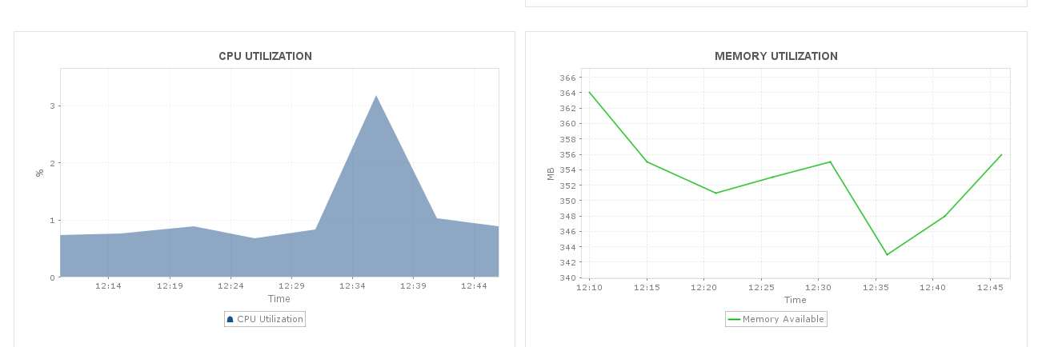
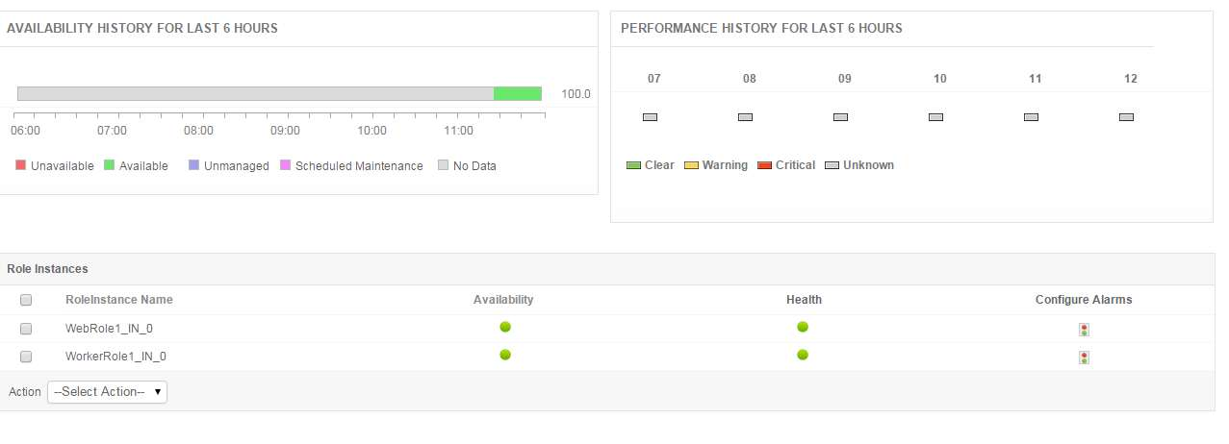
Primary Functions > Monitoring
Public Cloud –> Windows Azure
Monitor Web, Worker and VM roles
Request execution time
Requests rejected
Infrastructure logs
Trace & event logs
Network traffic
TCP connections
VMs in Azure roles

Slide 49
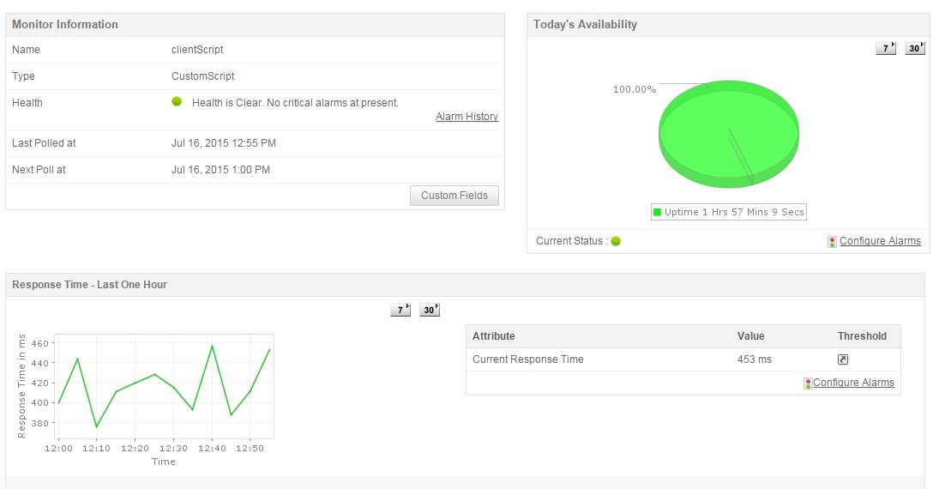
Primary Functions > Monitoring
Custom Application Management
Build Custom Screens for Management Bean (MBeans)‏
Monitor custom applications that provides management information via JMX 1.2 (JDK1.5 or MX4J) & SNMP
Consoles for JMX Agents
Monitor any SNMP Agent
Trap Listener

Slide 50
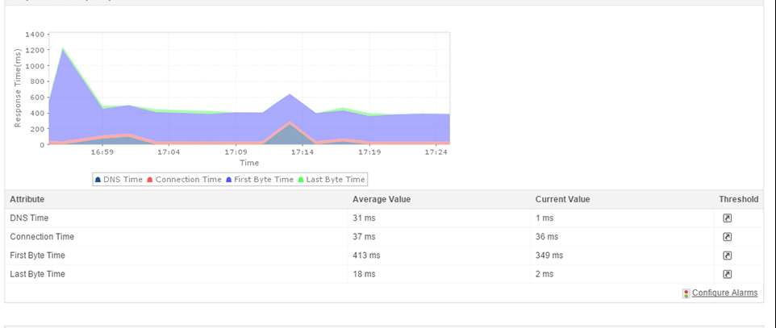
Primary Functions > Monitoring
Website/Web Application Monitoring
URL [HTML, PHP, JSP, ASP .NET Availability, Response time split up]
URL Sequence Monitor
URL Content Monitor

Slide 51


Primary Functions > Monitoring
Active Directory Monitoring
Monitors performance statistics such as availability and response time.
System and Performance Counter Monitor are also monitored in Active Directory monitor.
Active Directory monitor allows user to monitor NTLM authentications, and Replication Traffic In/Out in Bytes.

Slide 52

Primary Functions > Monitoring
DNS Monitoring
Monitors availability and performance monitoring of DNS (Domain Name System)
Monitors performance statistics such as response time. These performance statistics are available as performance graphs and reports which are available instantly.

Slide 53

Primary Functions > Monitoring
LDAP Monitoring
Monitors availability and performance of LDAP server
Notes:
Using LDAP monitor, you can monitor the amount of time taken for a user to log into to a domain. By monitoring these login time, response time and availability, it allows you to ensure whether the LDAP server is up and running. When a certain threshold is breached, you are informed quickly via email/SMS and thus helping you to troubleshoot issues quickly.

Slide 54

Primary Functions > Monitoring
FTP/sFTP Monitoring
Monitors performance statistics such as availability and response time.
Monitors key metrics like connection time, login time, file transfer speed and more

Slide 55

Primary Functions > Monitoring
Script Monitoring
Execute custom Windows/Linux scripts
Monitor the output of the scripts
Generate alerts and actions according
to thresholds configured

Slide 56

Primary Functions > Monitoring
Exchange Server Monitoring
Support for Powershell mode of monitoring
Get details about mailbox and database statistics and performance of the database availability groups.

Slide 57

Primary Functions > Monitoring
Database Query Monitoring
Monitors Business Metrics using custom SQL queries
Monitors additional performance metrics from time to time to ensure full time availability of a particular database
Monitors performance of SQL Query

Slide 58

Primary Functions > Monitoring
User Defined Monitor Types
Create your own monitor type
Script Monitor is the underlying Engine
Siebel Monitoring, Business Intelligence Dashboard

Slide 59

Primary Functions > CMDB Integration
CMDB Integration with Service Desk Plus
Detects applications in underlying IT environment, creates dependencies, populates in CMDB
Can easily drill down to the interdependencies in the environment and finds out the root cause quickly
Tickets can be raised from Applications Manager module, which will be reflected in SDP

Slide 60
Primary Functions
Alerting

Slide 61

Primary Functions > Alerting
Intelligent alarm correlation, colour coded alarms
Get notified through standard means (e-mail, SMS, Etc.,)‏
Automate Corrective Actions
In-depth root cause analysis of
critical alerts
Schedule Maintenance Window
Bulk alert configuration
Forward SNMP traps to third-party consoles such as HP OV and CA Unicenter

Slide 62


Primary Functions > Alerting
Alert View
Root Cause Analysis

Slide 63

Primary Functions > Alerting
Anomaly Detection
Anomaly profiles based on baseline value or custom expressions
Detect gradual performance degradation

Slide 64

Primary Functions
Reporting

Slide 65

Primary Functions > Reporting
In-built management reports
Out-of-the-box Current, Historical (weekly, monthly, early), and Custom reports
Graphs for trend analysis and planning Top ‘N’, Min, Max, Average
Grouping of reports
Scheduling of reports
Trend analysis and planning for long term infrastructure changes made easy

Slide 66

More Features ...
SLA Management
Integrated High-level view of Business Infrastructure
Support for ITIL Service Delivery processes
Define Business Services
Track Service Level Agreements (SLA’s)‏
Integrate Google Maps to empower business views

Slide 67


More Features ...
Multi-user Environment
User, Operator and Administrator access.
Web Client
Support for all popular browsers
Administrator and Operator activities
Client Personalization
Responsive GUI, Refresh mechanism for instant data
Native iPhone app and browser-based client for smartphones
Security
Passwords encrypted
Use authenticated mechanisms
Separate Admin and Operator/User roles
Reuse existing security mechanisms

Slide 68
What’s new
12.0 release
Enhancements to Microsoft Infrastructure Monitoring : Exchange Server, SharePoint
Help desk integration with CMDB
Enhancements to Oracle EBS, MS SharePoint, Exchange Server
groups
12.1 release
Support for Resin and WildFly Server Monitoring
Ceph storage monitoring supported
Enhancements to URL Monitoring

Slide 69

Contact: appmanager-support@manageengine.com
More Info
Live Demo: http://demo.appmanager.com/
Website: http://www.manageengine.com/apm
Forums: http://forums.manageengine.com/appmanager
Product Editions:
Free Edition: 5 applications or servers. Never expires
Cloud Starter Edition: Private/public clouds & open source apps
Professional Edition: All features of Cloud Starter + packaged apps.
Enterprise Edition: Distributed set up for scalability‏
Available in Chinese, Japanese, European Spanish, Korean, Hungarian, German, French & Vietnamese versions

