Slide 1

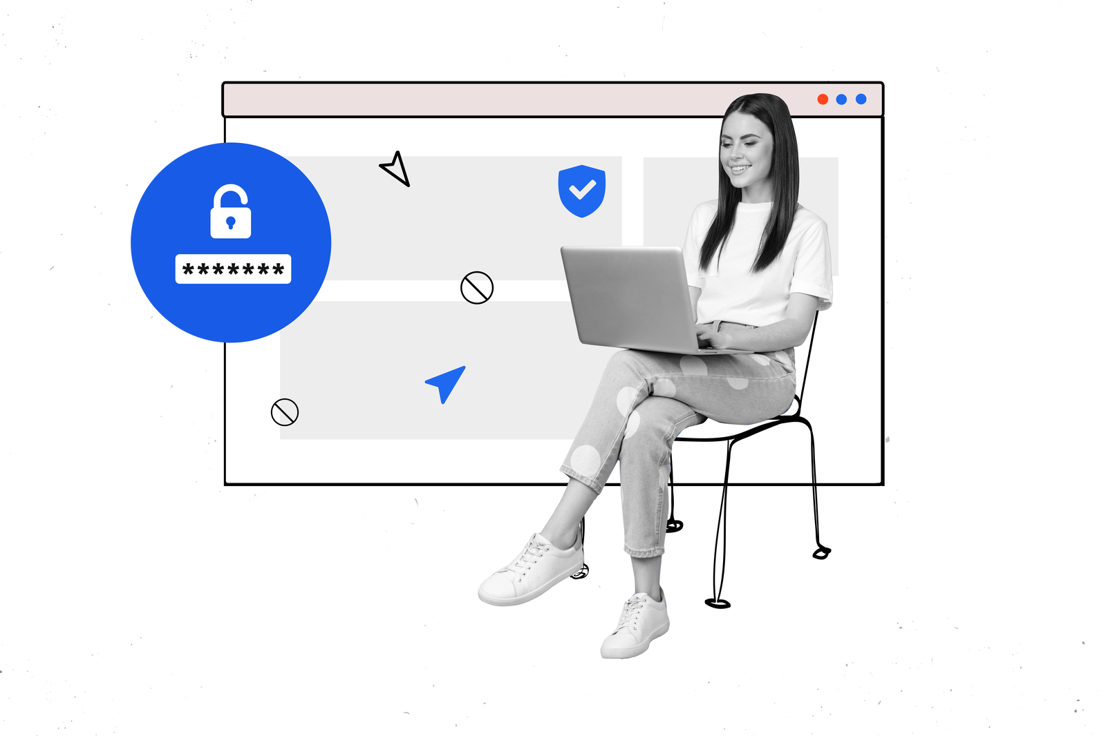
security posture with ADSelfService Plus'
MFA
Enhancing your

Slide 2


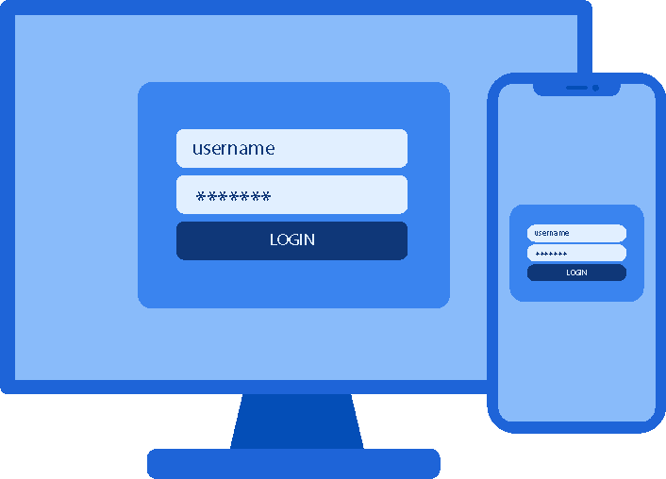
Multi-factor authentication (MFA) is the process of using multiple factors of authentication to verify a user's identity before giving them access to a particular resource
Along with entering a password, users are "asked to enter a code sent to their email, answer a secret question, or scan a fingerprint"
It plays an integral role in identity and access management, helping organizations get closer to creating a Zero Trust security framework
It strengthens account security and prevents fraudulent account access by providing more protection than single-factor authentication
1
What is
multi-factor authentication?

Slide 3
Cybercrime costs are predicted to rise 15% per year for the next five years, reaching $10.5 trillion in 2025
In today's digital age, passwords are not enough to protect sensitive information from cyberthreats
MFA blocks 99.9% of modern automated cyberattacks
2
Why is
MFA essential?

Slide 4
2. Why is MFA essential?
Cost savings for organizations
According to IBM's Cost of a Data Breach Report 2022, the average total cost of a data breach is $4.35 million
Implementing MFA can provide significant cost savings for organizations by decreasing the risk of data breaches and cyberattacks
Comply with IT regulations and avoid penalties
Regulations such as HIPAA, the PCI DSS, the GDPR, and more prioritize the protection of sensitive data
Implementing a stronger security posture will reduce the risk of data breaches and subsequent compliance fines. E.g., HIPAA's penalties for violations range from $100 to $50,000 per violation, going up to $1.5 million annually
Save money on insurance premiums
In the next 5-10 years, cyber insurance will grow from $12 billion in premiums today to $60 billion, according to the chief executive of Lloyd's
Many insurance agencies require organizations to have MFA to qualify for cyber insurance coverage
Some insurance companies offer discounts to organizations that implement MFA

Slide 5



MFA requires users to provide multiple authentication factors other than usernames and passwords
3
The knowledge factor
How does
MFA work?
Information that only the authorized user knows
Passwords, PINs, passphrases, security questions, etc.
The possession factor
Authentication is performed with something the user possesses
Smartphones, physical tokens, smart cards, etc.
The inheritance factor
Verifying identities with the help of inherited characteristics and biometrics
Fingerprint scans, facial scans, voice recognition, and retinal scans

Slide 6
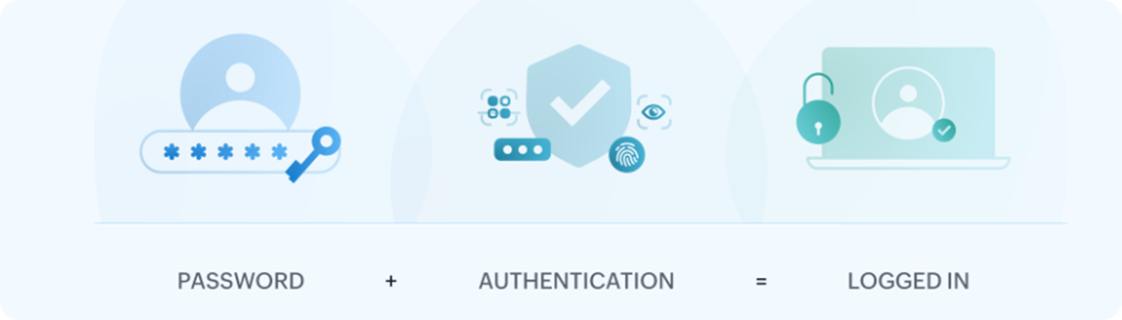
3. How does MFA work?
A user signs on with their username and password
The system prompts the user to provide a second method of identification
After authentication, the user gains access to the requested resource

Slide 7


4
ADSelfService Plus is an identity security solution with MFA, single sign-on (SSO), and self-service password management capabilities
It ensures seamless access to enterprise resources and establishes a Zero Trust environment
What is
ADSelfService Plus?

Slide 8
ADSelfService Plus supports MFA for the following:
Domain users logging in to machines (Windows, macOS, Linux, servers)
Local user and admin accounts login (workgroup and domain-joined Windows machines)
VPN logins (RADIUS- or IIS-based network endpoints)
OWA and Exchange admin center (EAC) logins
Application access (SAML-, OIDC-, and OAuth-enabled applications)
Self-service password reset and account unlock
Remote Desktop Protocol (RDP)
Windows User Account Control (UAC)
5
Secure your
organization with ADSelfService Plus'
MFA

Slide 9
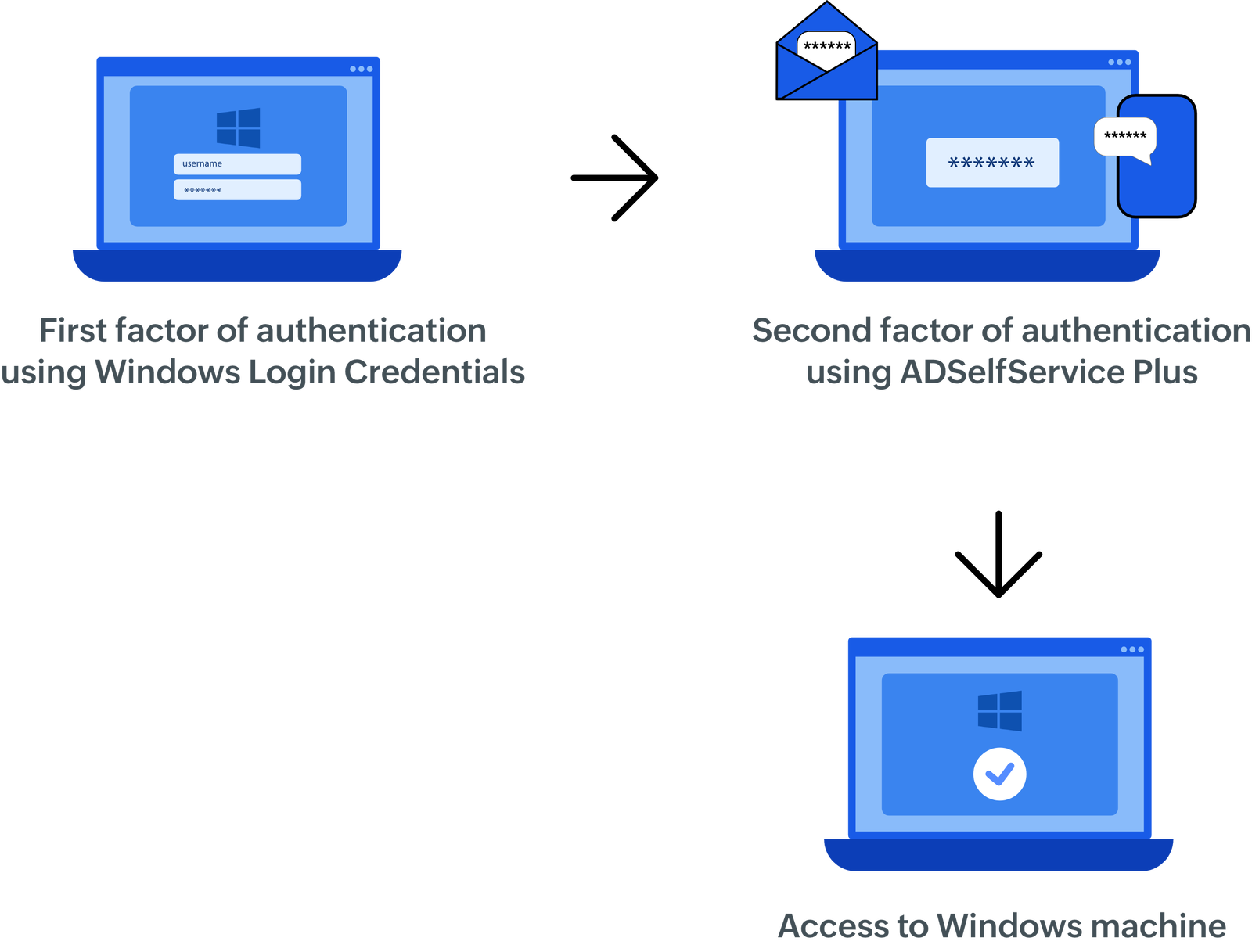
Machine logins
With ADSelfService Plus' endpoint MFA feature, users can authenticate their identities to access Windows, macOS, and Linux machines
The first factor is the user's domain credentials, while the second factor varies from biometrics to smart cards

Slide 10
Enable MFA for local user accounts on both domain-joined and workgroup Windows machines, even without internet connectivity.
Supports both policy-based (user-specific) and device-based MFA configurations.
Local user
MFA

Slide 11
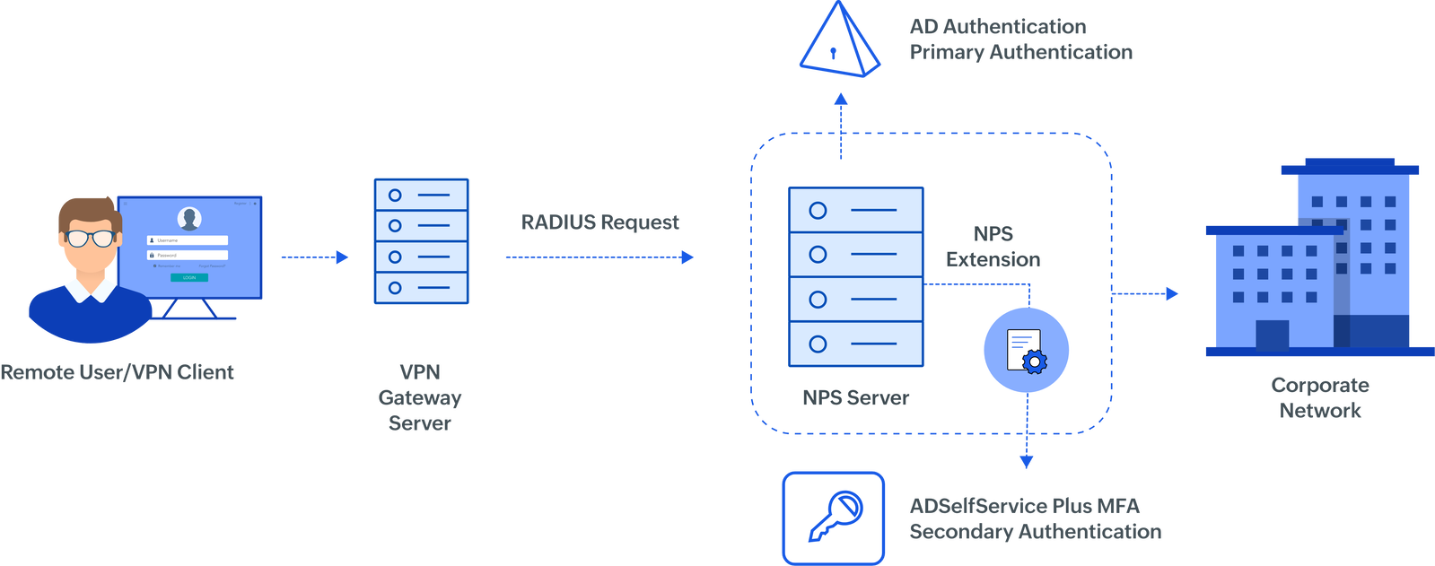
VPN logins
‌By using ADSelfService Plus' adaptive MFA, users can secure VPN connections to the organization's networks.
Admins can secure all RADIUS-based VPN providers, including Fortinet, Cisco AnyConnect, Windows, Juniper Networks, Palo Alto Networks, and SonicWall Global VPN Client.
MFA Modes for VPN Authentication:
VPN Client Verification: MFA prompts appear directly in the VPN client.
SecureLink Email Verification: Enables MFA via all ADSelfService Plus authenticators, with users authenticating via an email verification link.
This prevents unauthorized VPN access using exposed credentials.

Slide 12
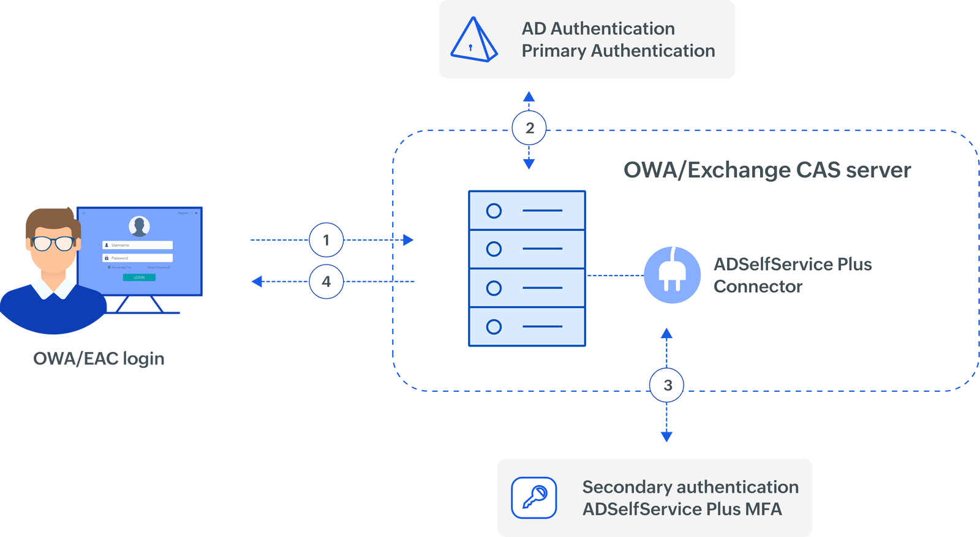
OWA logins
On the Exchange server, the ADSelfService Plus OWA Connector needs to be installed
ADSelfService Plus uses the Connector to enable MFA during OWA and EAC authentication

Slide 13
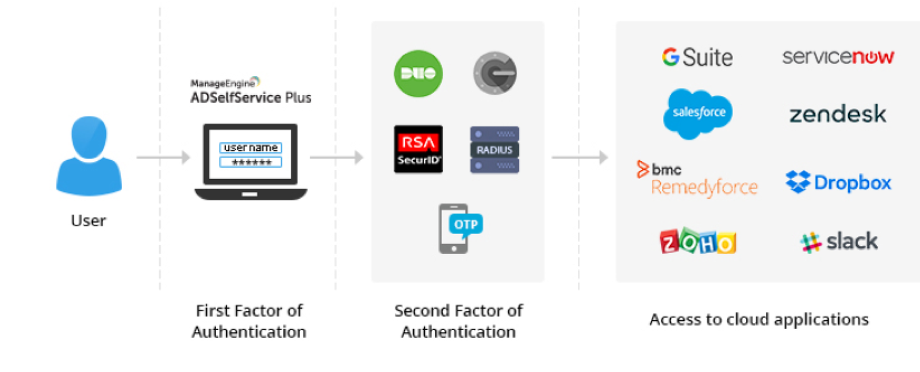
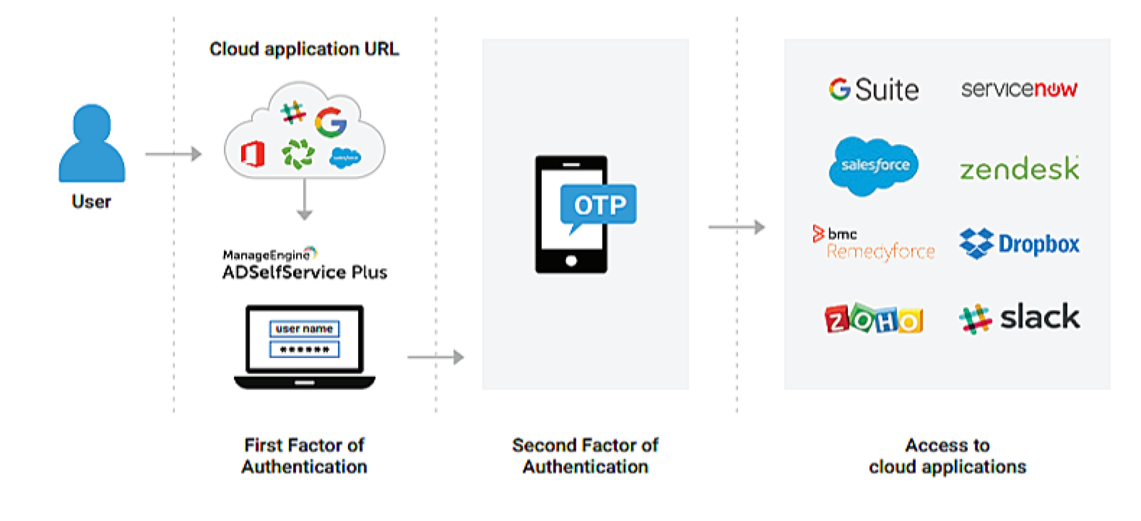
Enterprise applications
With ADSelfService Plus, users can add MFA for ADSelfService Plus, and SSO- enabled applications logins like Salesforce, Microsoft 365, Slack, and Dropbox
IdP-initiated SSO requires the user to log into the ADSelfService Plus portal first, whereas a SP-initiated SSO accesses the cloud application first, then the ADSelfService Plus login page
ADSelfService Plus prompts for an additional authentication factor. After successful authentication, users can access cloud applications
During IdP-initiated logins
During SP-initiated logins

Slide 14
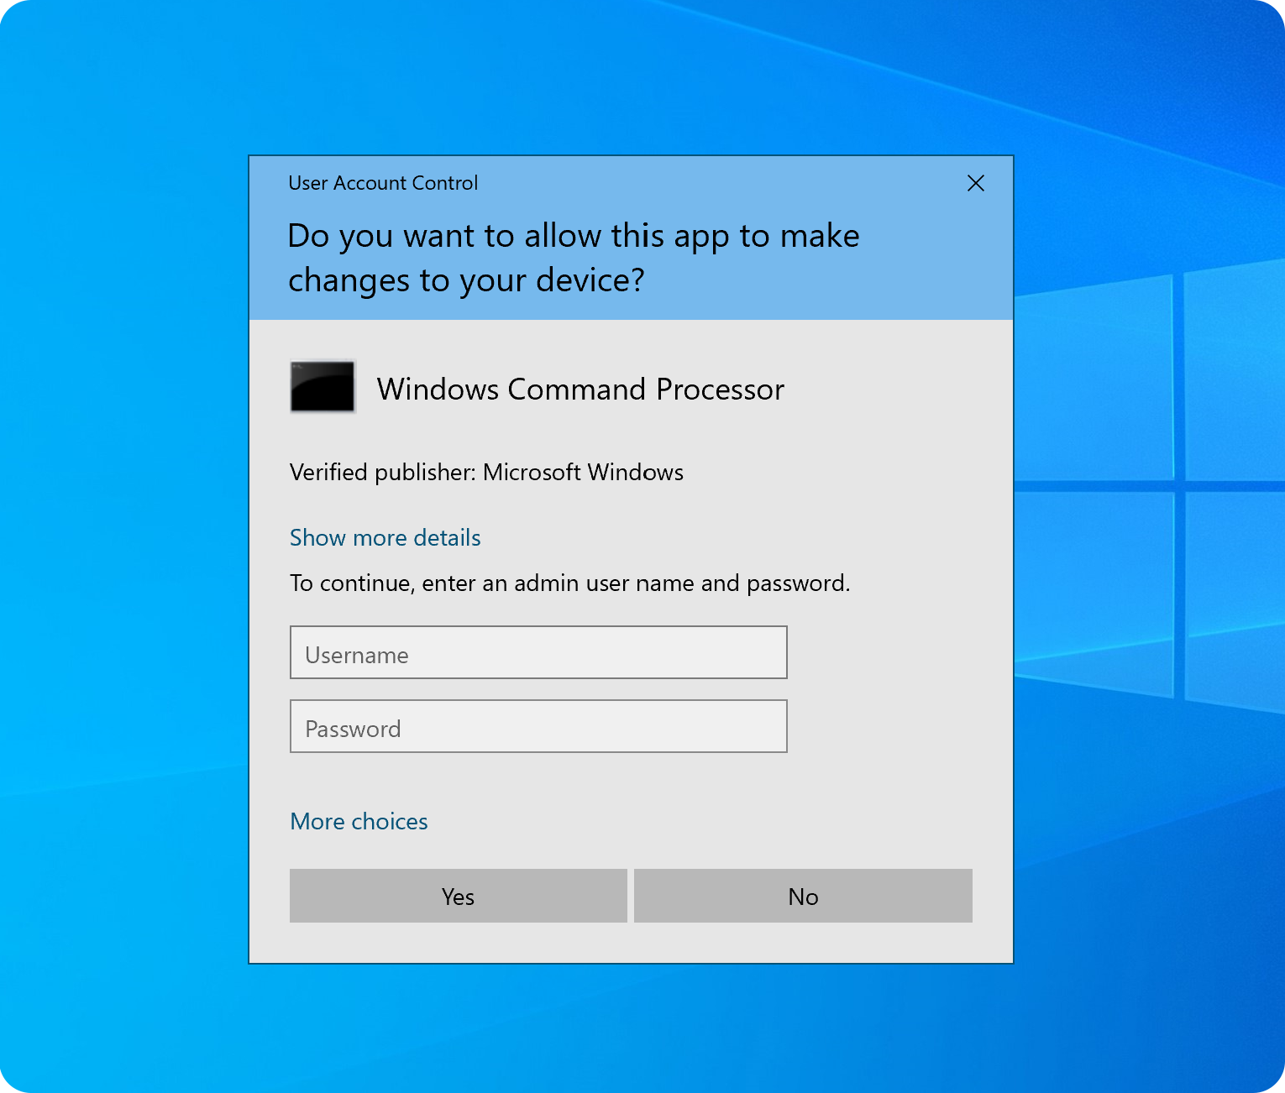
Windows UAC
Compatible with Windows 7+ and Windows Server 2008+

Slide 15
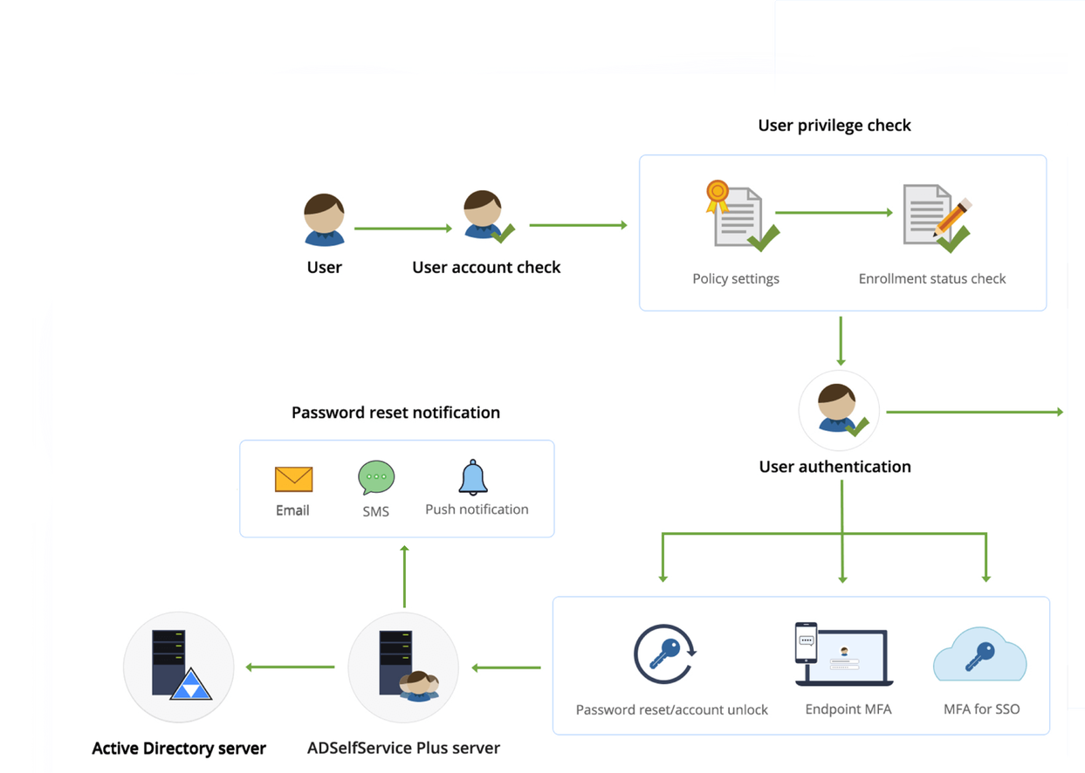
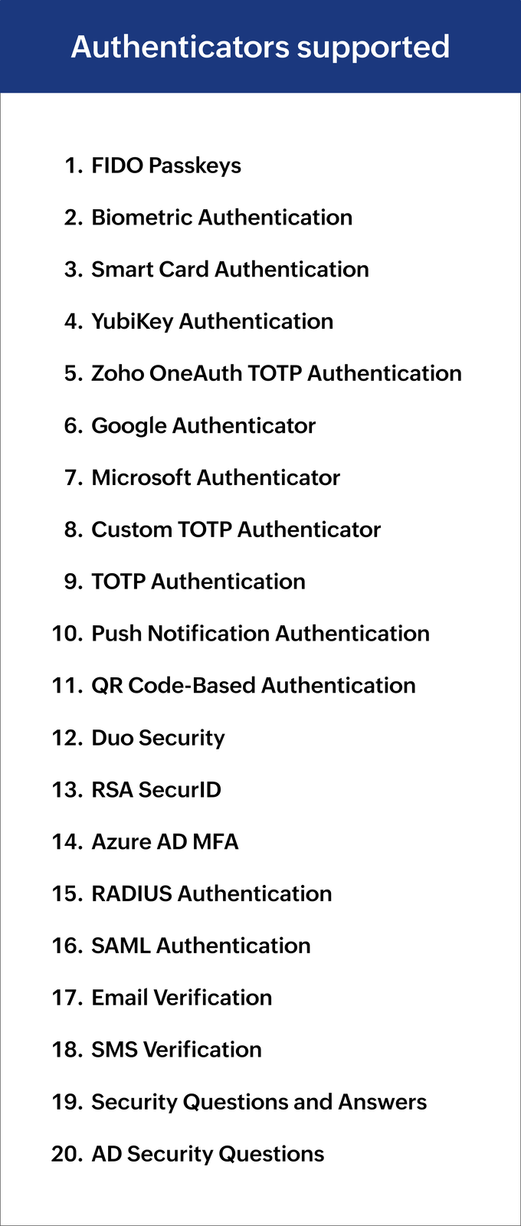
Self-service password reset and account unlock
Users can reset their passwords and unlock their accounts via self-service only after they prove their identities

Slide 16



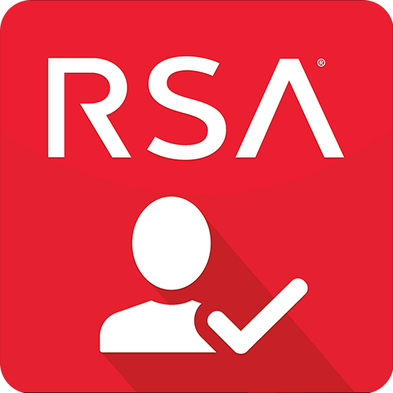


FIDO Passkeys
QR Code-Based Authentication
Biometric Authentication
Duo Security
Smart Card Authentication
RSA SecurID
6
Authenticators
supported by
ADSelfService Plus
YubiKey Authentication
Azure AD MFA
Zoho OneAuth TOTP Authentication
RADIUS Authentication
Google Authenticator
SAML Authentication
Microsoft Authenticator
Email Verification
Custom TOTP Authenticator
SMS Verification
TOTP Authentication
Security Questions and Answers
Push Notification Authentication
AD Security Questions

Slide 17
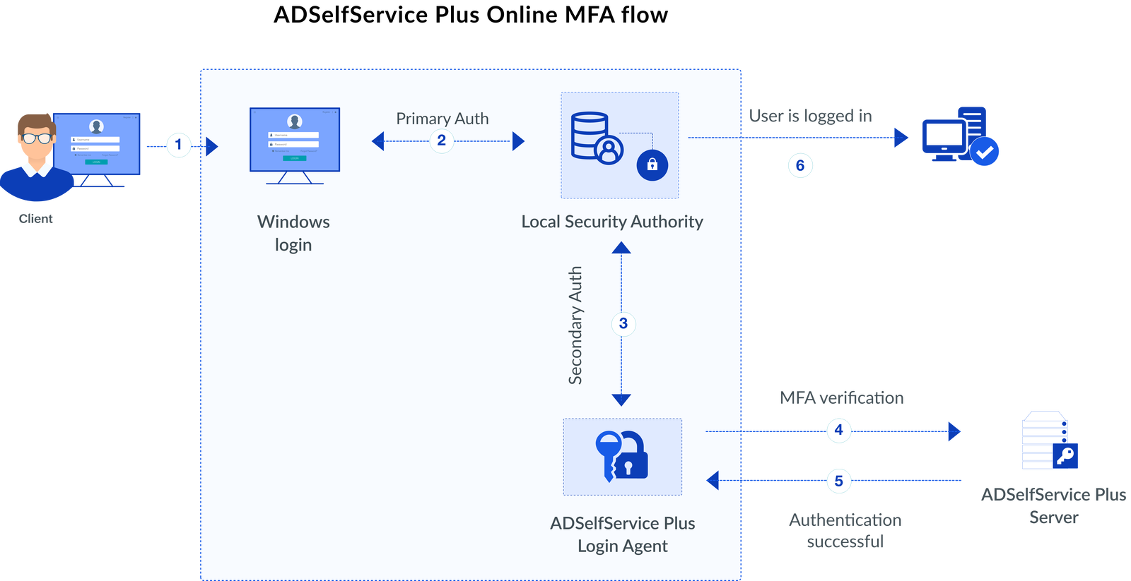
7
How does ADSelfService Plus' online MFA work?
A user logs in to their machine with their credentials as the primary authentication method
The initial credentials are verified by the local security authority
Once the initial credentials have been verified, ADSelfService Plus prompts the user for an additional authentication factor
ADSelfService Plus sends the relevant MFA factor request to the user's registered device, then the user authenticates themself by providing that factor
ADSelfService Plus validates the provided MFA factor against the user's registered information
If the factor is successfully validated, access is granted
Note: ADSelfService Plus supports online MFA for machine logins, VPN logins, OWA logins, UAC, cloud applications, and Microsoft 365

Slide 18
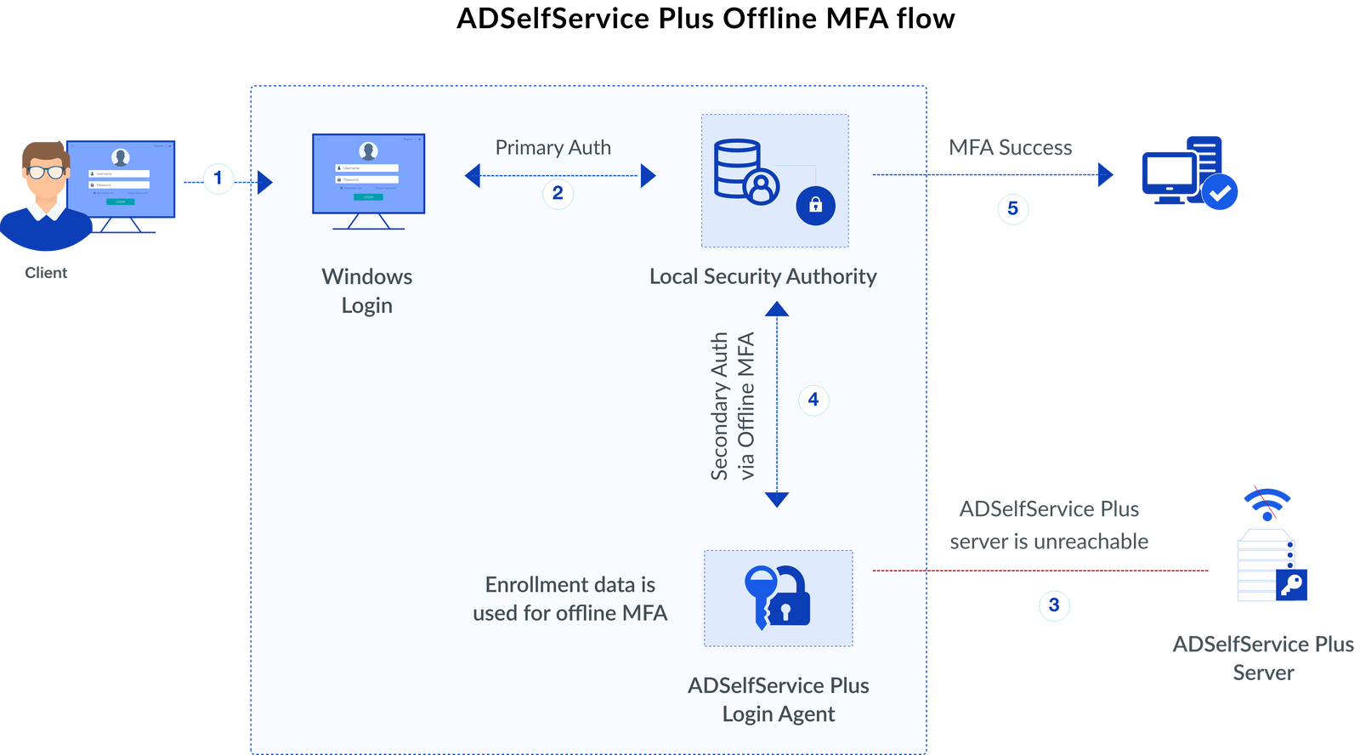
8
How does ADSelfService Plus' offline MFA work?
A user logs in to their machine with their credentials as the primary authentication method
Their credentials are verified by the local security authority
ADSelfService Plus attempts to prompt the user for an additional authentication factor, but fails due to connection issues
The login agent prompts the user for offline MFA, which supports Google Authenticator, Microsoft Authenticator, custom TOTP authenticators, and Zoho OneAuth TOTPs
Upon successful validation, access is granted
Note: ADSelfService Plus supports offline MFA for Windows, macOS, RDP, and UAC logons.

Slide 19
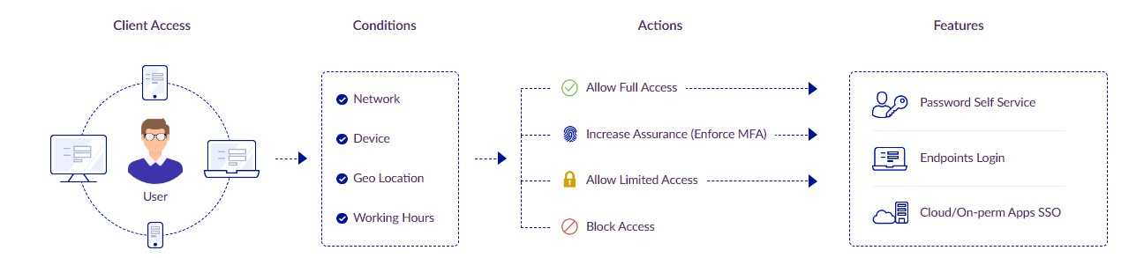
9
Enforce access control decisions
With ADSelfService Plus, admins can control which users can access workstations, applications, and various features (such as password changes and directory self-updates) based on factors like their IP address, time of access, device, and location
After analyzing these risk factors, ADSelfService Plus provides users with complete, unrestricted access; limited access; or no access to the resources
Admins can set specific rules for specific domains, OUs, and groups

Slide 20

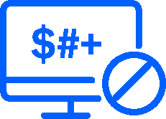

10
MFA use cases
Fortify endpoint access
Defend against credential-based attacks
Risk-based authentication
Using Endpoint MFA, users prove their identity during machine logins, VPN logins, OWA logins, UAC, cloud applications, Microsoft 365
When passwords are compromised due to inadequate password hygiene, Endpoint MFA mitigates the risk of exposing sensitive data
MFA defends against credential-based cyberattacks, such as brute-force attacks, password spray attacks, and dictionary attacks
Credential theft and compromise are reduced by requiring users to authenticate using multiple factors, such as a password, biometric scan, or smart card
Remote users are often more vulnerable to cyberattacks because they access corporate resources through public networks
With ADSelfService Plus, admins can set access policies based on the user's device type, time of access, IP address, or geolocation to keep IT resources secure
ADSelfService Plus prompts the user for MFA accordingly, enforcing additional measures for high-risk attempts and streamlining access for low-risk attempts

Slide 21


10
MFA use cases
MFA when not connected to the internet
Protect business data while complying with regulations
MFA insurance mandates
When employees travel frequently or work remotely without the internet, they can authenticate using MFA even if they aren't connected to the authentication server
Comply with industry regulations that recommend or mandate MFA, such as HIPAA, the PCI DSS, and the GDPR
E.g., the PCI DSS 8.3 requires MFA whenever a third party or portable computer accesses the network remotely
Marsh's Global Insurance Market Index reports that cyber insurance premiums rose 79% in 2022
Admin access and privileged accounts are required to implement MFA
Many insurance companies now require MFA before they can provide a quote for coverage

Slide 22
11
Conclusion
As organizations digitize, cybersecurity becomes increasingly important
MFA is the #1 way to prevent cybersecurity incidents
With ADSelfService Plus' MFA, protect your data against unauthorized access

Slide 23







Contact us
Contact Number
Support Email
+1-408-916-9890
support@adselfserviceplus.com
Live chat
Visit our website
For instant responses.
www.adselfserviceplus.com/
DOWNLOAD NOW

