Slide 1








Streamlining access and ensuring security for students and staff with ADSelfService Plus

Slide 2
Cyber security in the education sector
Microsoft says nearly 80% of enterprise malware encounters are in education
Educational institutions hold a vast amount of sensitive data, ranging from students' personal information to financial records
To protect sensitive data, educational institutions should implement robust security measures like enabling MFA, and enforcing strong passwords
Students often forget their passwords and get locked out of their accounts, resulting in the help desk getting backlogged and end users being unable to complete their tasks
By letting users reset their own passwords, admins can focus on critical tasks
In the education sector, students, teaching staff, management staff, parents, and alumni struggle to remember passwords for multiple applications, resulting in time-consuming repetitive logins
By implementing SSO, users can access applications with just one click, eliminating the need to enter multiple passwords

Slide 3

Cyber security in the education sector
In addition to protecting user data, educational institutions must comply with various regulations such as COPPA, FERPA, HIPAA, the GDPR, the PCI DSS, and more
This involves educational institutions to implement a comprehensive identity security solution to protect sensitive data, streamline user access, and maintain compliance with regulations

Slide 4
An all-encompassing identity security solution
ManageEngine ADSelfService Plus is an identity security solution with MFA, SSO, and self-service password management capabilities
ADSelfService Plus offers the following solutions
Self-service password management
Adaptive MFA
SSO for applications
Remote work enablement
Enterprise self-service

Slide 5
How ADSelfService Plus mitigates cybersecurity risks for education institutions

Slide 6
Self-Service capabilities
Before ADSelfService Plus
Students and staff often forget their login passwords. They approach admins to reset passwords or unlock accounts, which can disrupt their regular workflow and lead to high volumes of password reset requests
Users must send admins email requests about changes to their personal details or password modifications, resulting in delays or omissions in informing admins about these updates
Furthermore, administrative staff can make mistakes when updating school records due to human error

Slide 7
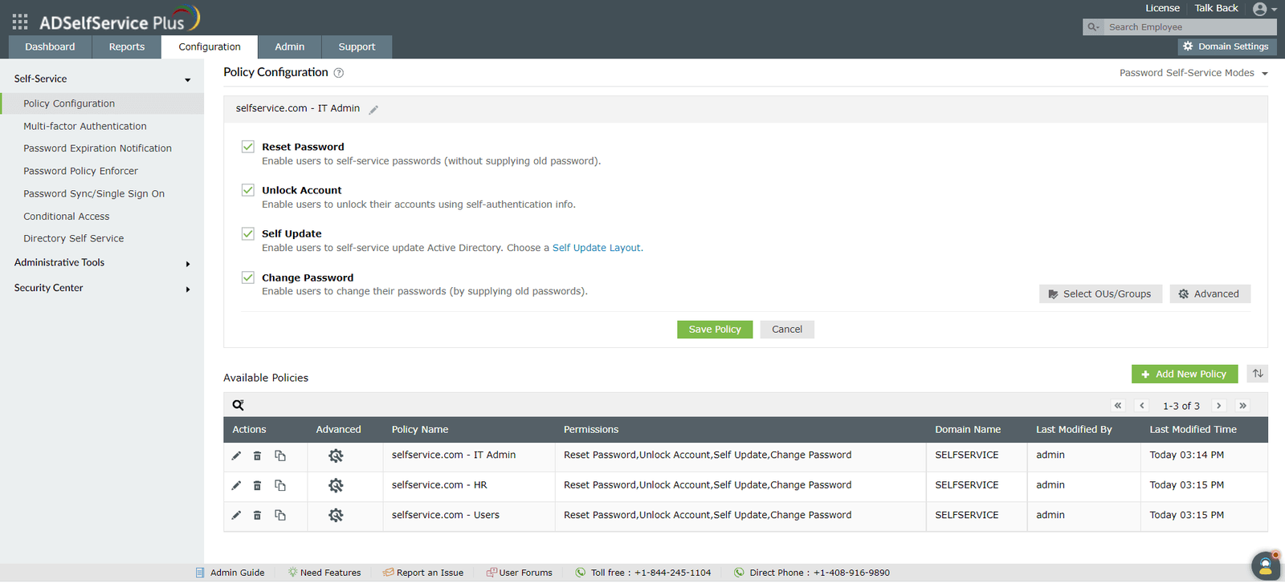
Self-Service capabilities
After ADSelfService Plus
Empower users to reset passwords, change passwords, and unlock their accounts themselves without IT assistance
Users can view and update their personal information in the organization's records
Admins can restrict what fields a user can self-update; they can also configure which fields a user can view

Slide 8
Password Policy Enforcer
Before ADSelfService Plus
Students tend to set weak, easily guessable passwords, increasing unauthorized access
The default password policy in AD may not enforce password complexity requirements, making it easier for attackers to crack passwords
Besides that, students reuse passwords across multiple platforms, which significantly amplifies the impact of a compromised password

Slide 9
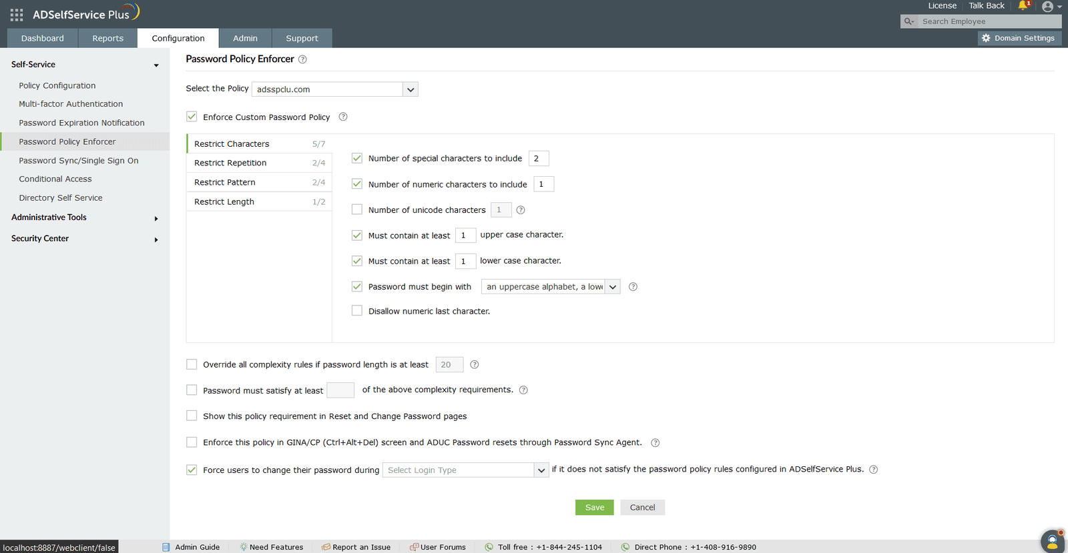
Password Policy Enforcer
After ADSelfService Plus
Admins can implement fine-grained password policies for users based on their OU, group, or domain membership
Admins can integrate with the Have I been Pwned? service, which can ban the use of passwords involved in previous hacks
NIST's SP 800-63B password best practices can be enforced with the Password Policy Enforcer

Slide 10
Password Policy Enforcer
After ADSelfService Plus
Policies can be used to set password controls that are not available in the native policies, like:
Unicode characters are mandatory
Restrictions on the repetition of characters in usernames and old passwords
Restrictions on the usage of weak passwords, dictionary words, and palindromes
Enforce passwords to match the regex pattern

Slide 11
Multifactor authentication
Before ADSelfService Plus
Weak and compromised passwords can, if breached, result in exposed personal information, including birthdates, full names, addresses, and payment information. This leaves students and staff vulnerable to identity theft and financial fraud
According to a recent report, educational institutions worldwide suffer more cyberattacks than any other sector
Furthermore, there is a misconception that MFA is too complex for K-12 students

Slide 12
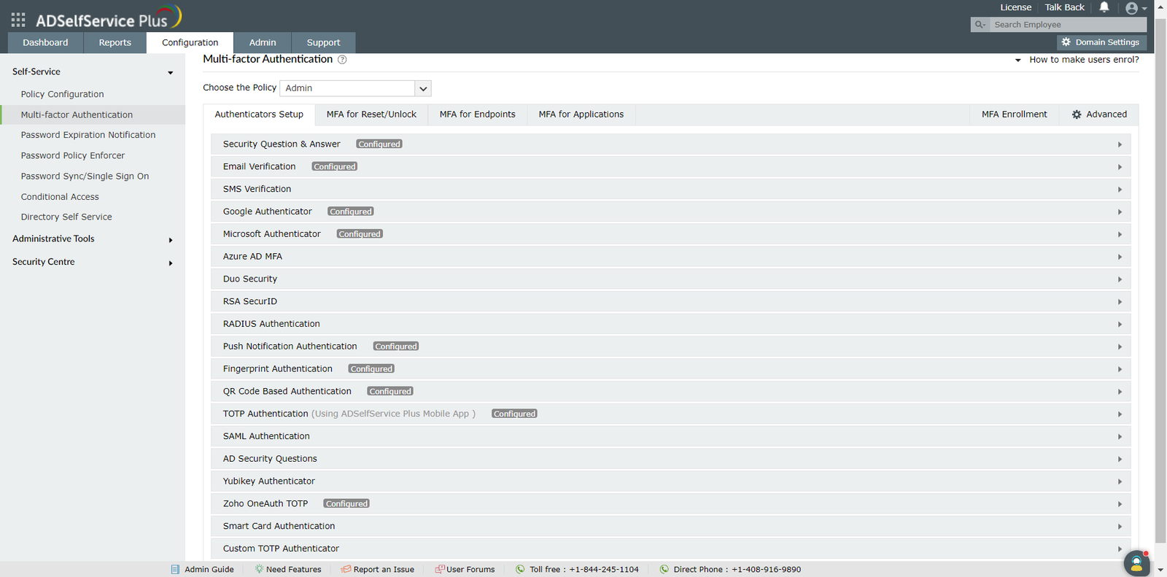
Multifactor authentication
After ADSelfService Plus
Admins can customize MFA by considering each user group's capabilities and responsibilities using 20 authentication methods, including SMS verification, email verification, push notifications, DUO security, Google Authenticator, and Microsoft Authenticator
Using MFA adheres to NIST's SP 800-63B and CISA recommendations to add an extra layer of security

Slide 13
Multifactor authentication
After ADSelfService Plus
Admins can configure MFA for:
Machine logins (Windows, macOS, and Linux, and servers)
VPN logins
OWA and EAC logins
Application access
Self-service password reset and account unlock
Remote Desktop Protocol (RDP)
Windows User Account Control (UAC)

Slide 14
Single sign-on
Before ADSelfService Plus
With the increasing number of online resources available, schools and colleges face the challenge of managing multiple login accounts for a large number of students
All applications and learning resources have unique login instructions. Some passwords require capital letters, some mandate special characters, and others require numbers. That means it'd be hard for students to remember several usernames and passwords
Teachers have to spend more time helping users log in to their applications, like EduBrite, Dropbox, and Tableau separately

Slide 15
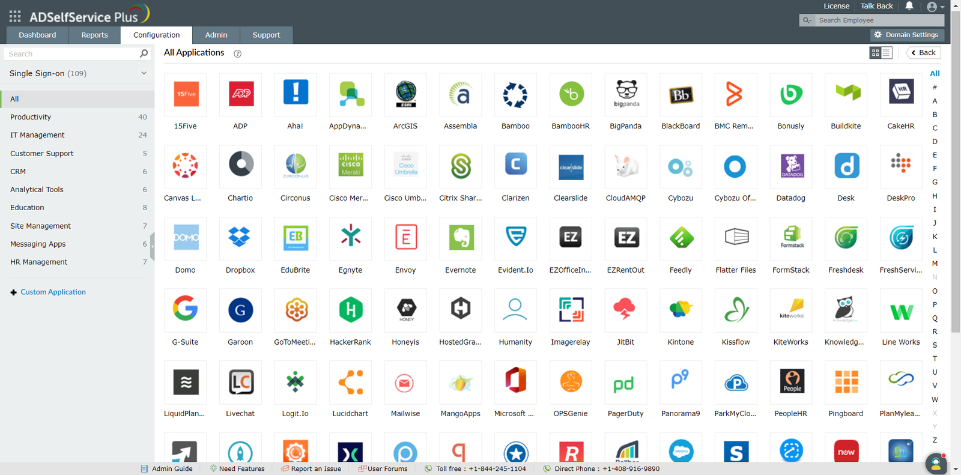
Single sign-on
After ADSelfService Plus
Users can seamless access all cloud applications with just one set of credentials
Our comprehensive SSO solution supports:
SAML-enabled applications like Google Workspace, Microsoft 365, and Salesforce
OAuth- and OIDC-enabled applications
Custom applications

Slide 16
Single sign-on
After ADSelfService Plus
Users can log in to an application or service using SSO in two ways:
Identity provider (IdP) initiated SSO (ADSelfService Plus)
Service provider (SP) initiated SSO (cloud application or service)
Bookmark functionality for seamless access to applications that do not support standard SSO protocols like SAML, OAuth, or OIDC.

Slide 17
Password expiration notification
Before ADSelfService Plus
Faculty and students are often unaware of when their passwords will expire, leading to sudden account lockouts and restricted access to essential resources, which disrupts academic activities
If passwords are not periodically changed, educational institutions may be unaware of compromised accounts, exposing sensitive information and resources
Consequently, other critical issues like resolving network issues and system outages get delayed due to an increase in help desk requests from users facing unexpected account lockouts

Slide 18
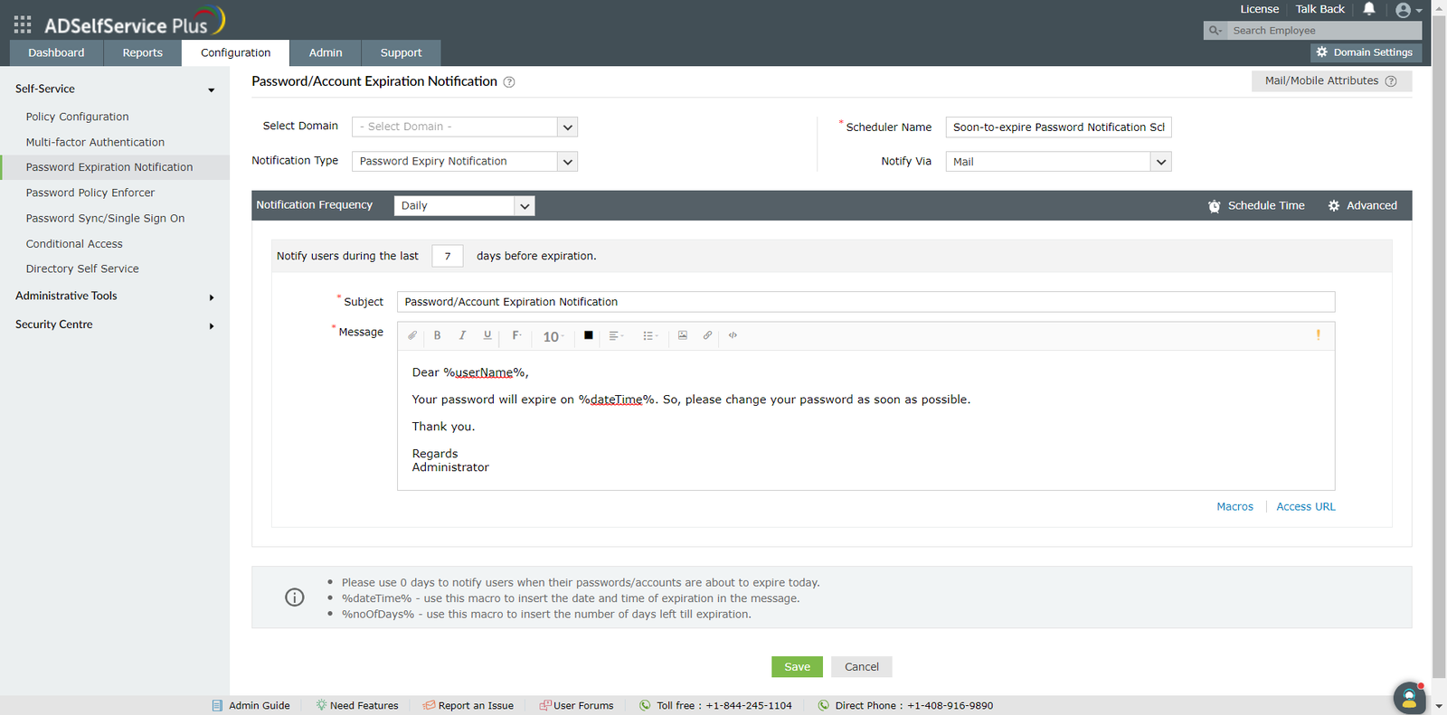
Password expiration notification
After ADSelfService Plus
Notifications can be set to notify users about soon-to-expire passwords and accounts via SMS, email, or push notifications
Admins can set the notification frequency and customize notification content with images and instructions
In addition, admins can create a schedule to automatically reset expired passwords and unlock locked-out accounts

Slide 19
Update cached credentials
Before ADSelfService Plus
When a user changes their password, the cached credentials on their device may not update automatically if the network connection is unstable. This can result in login failures or account lockouts when accessing resources with outdated credentials
Additionally, forgotten passwords or expired credentials often cause account lockouts, requiring assistance from the IT help desk
The frequent need to reenter credentials can disrupt the workflow of students and faculty, consuming valuable time

Slide 20
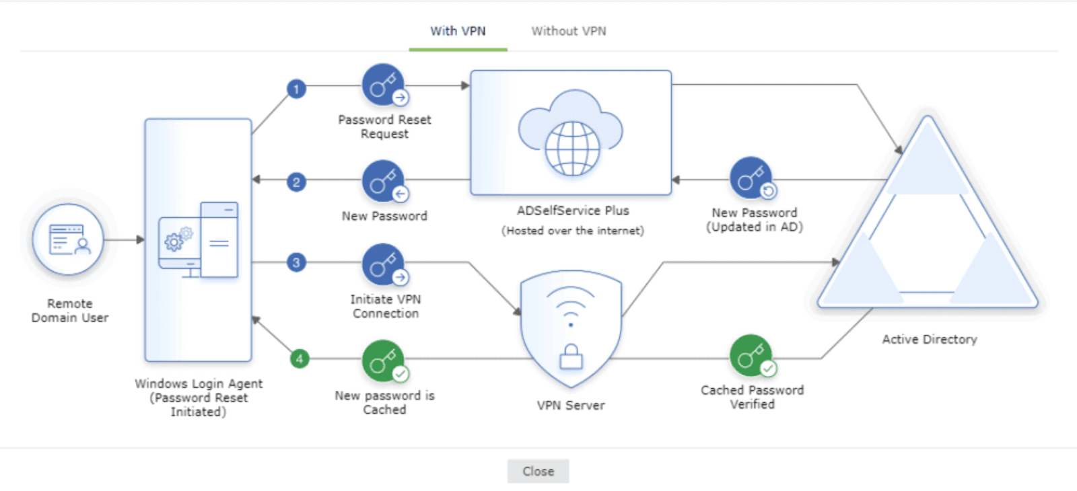
Update cached credentials through VPN
After ADSelfService Plus
Users can reset their domain passwords by installing the GINA/CP client, which places the Reset Password/Account Unlock link
With the logon agent, users can automatically update their credentials by connecting to AD through a VPN client
This way, users can access their accounts seamlessly without interruptions or login failures

Slide 21
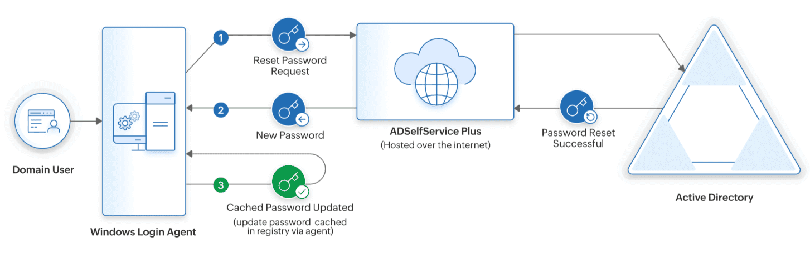
Update cached credentials without VPN
After ADSelfService Plus
Users’ identities are verified through MFA before the reset request is sent to ADSelfService Plus, which updates the new password in Active Directory.
Once updated in AD, the new password is automatically synced with the local cache on users’ machines.
This ensures users can log in without facing credential mismatches or login issues.

Slide 22
Conclusion
Schools, colleges, and universities are a significant target for malicious cyber activity
The standards for the educational sector are constantly changing, and hackers and malicious insiders may find new ways to compromise and steal data from these organizations
Using ADSelfService Plus, educational institutions can strengthen insider threat protection, secure users' data, and comply with regulations

Slide 23
Thank you

