Slide 1


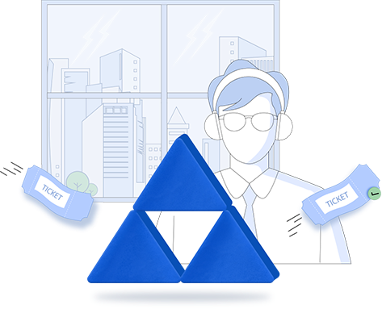

Enterprise self-service
with ADSelfService Plus
Decrease help desk workload with secure end-user self-service

Slide 2
IT admin, we hear you!
Are you swamped with trivial user requests that you often don't have time for other critical IT tasks?
Active Directory attribute updates, group membership requests, searching for employee information, and the list of trivial user requests goes on...
Did you know?
81% of all users attempt to take care of issues themselves before reaching out for help.
As an IT admin
don't you sometimes wish your users could manage some of their own tickets for a change?

Slide 3


Consider your wish, granted!
ADSelfService Plus, an identity security solution, provides secure end user self-service with features like self-update of AD attributes and self-service AD group subscription.

Slide 4
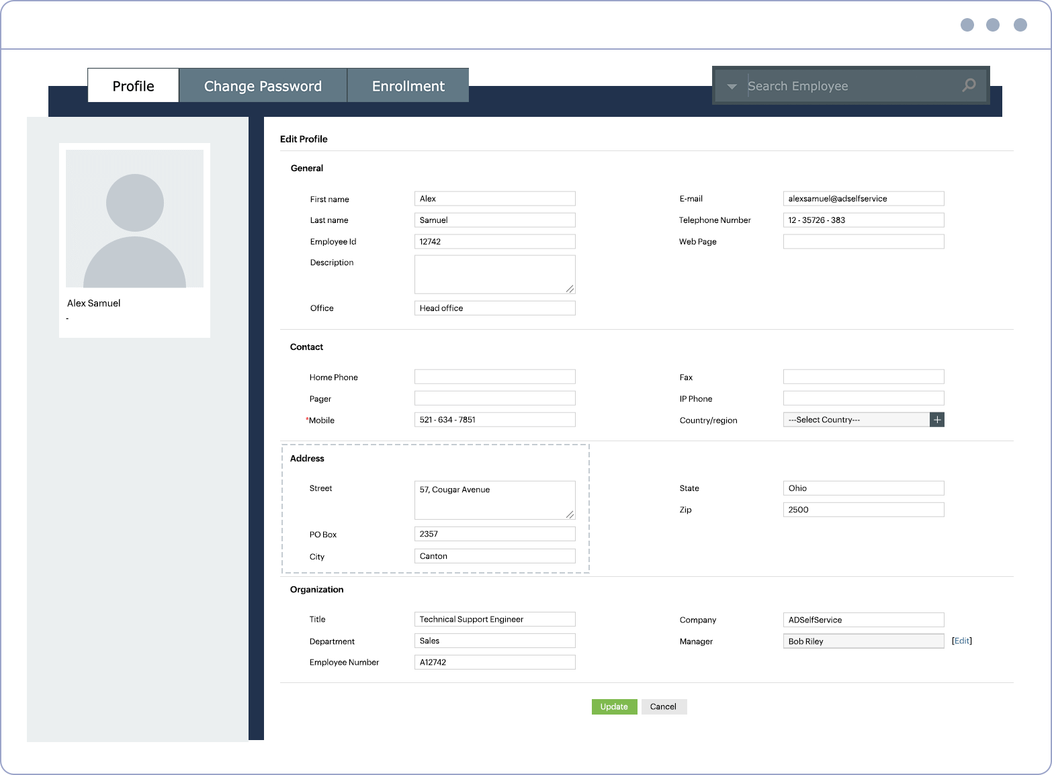
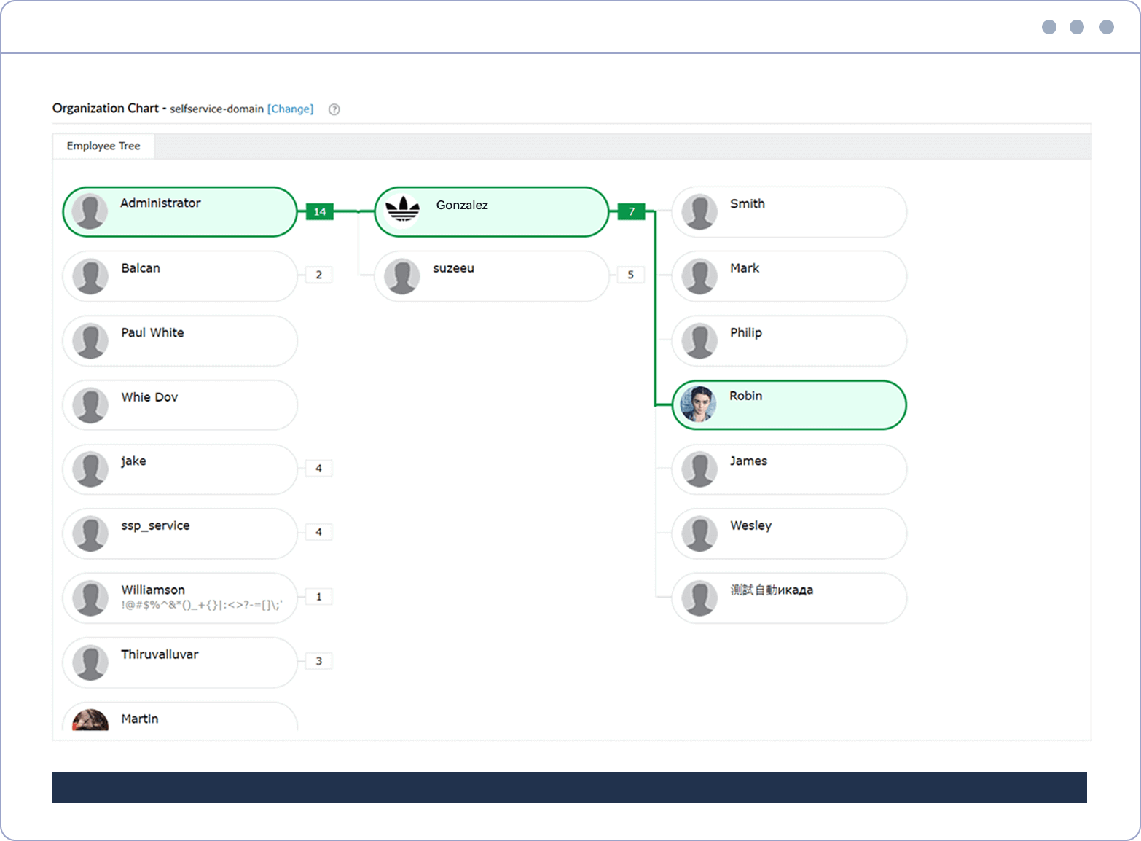
ADSelfService Plus provides approval-based self-service
for your users to
Update their Active Directory profile details
Opt in and out of selected distribution and security groups on their own
Search for users, contacts, and groups in your organization using advanced search filters
View their position in the organization's hierarchy using the organization chart
You can review, approve, and set approval workflow rules for users' self-service actions, which are raised as requests instead of direct updates to AD.

Slide 5



Switch to
ADSelfService Plus today
and enjoy enhanced identity security for your organization!
Guaranteed ROI
ADSelfService Plus gives you an immediate ROI by nearly eliminating password-related tickets.
Calculate ROI

Slide 6



For technical support:
Contact us
+1-408-916-9890
support@adselfserviceplus.com
www.adselfserviceplus.com
Chat live with our support team
Personalized web demo
Download ADSelfService Plus now

