Slide 1


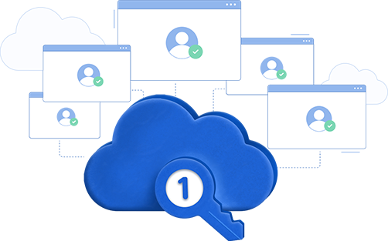

Enterprise single sign-on (SSO) with ADSelfService Plus
Secure and streamline enterprise application access

Slide 2
Life without SSO would be tiresome indeed!
Did you know?
Did you know that 69% of employees switch between ten apps every hour on average, and about 65% of employees use the same or a similar passwords on multiple apps!
your employees have diminished productivity and are more likely to forget passwords or set unsecure passwords.
Without SSO

Slide 3


ADSelfService Plus
to the rescue!
SSO with ADSelfService Plus:
Eliminates password fatigue
Adds security
Saves time and money

Slide 4
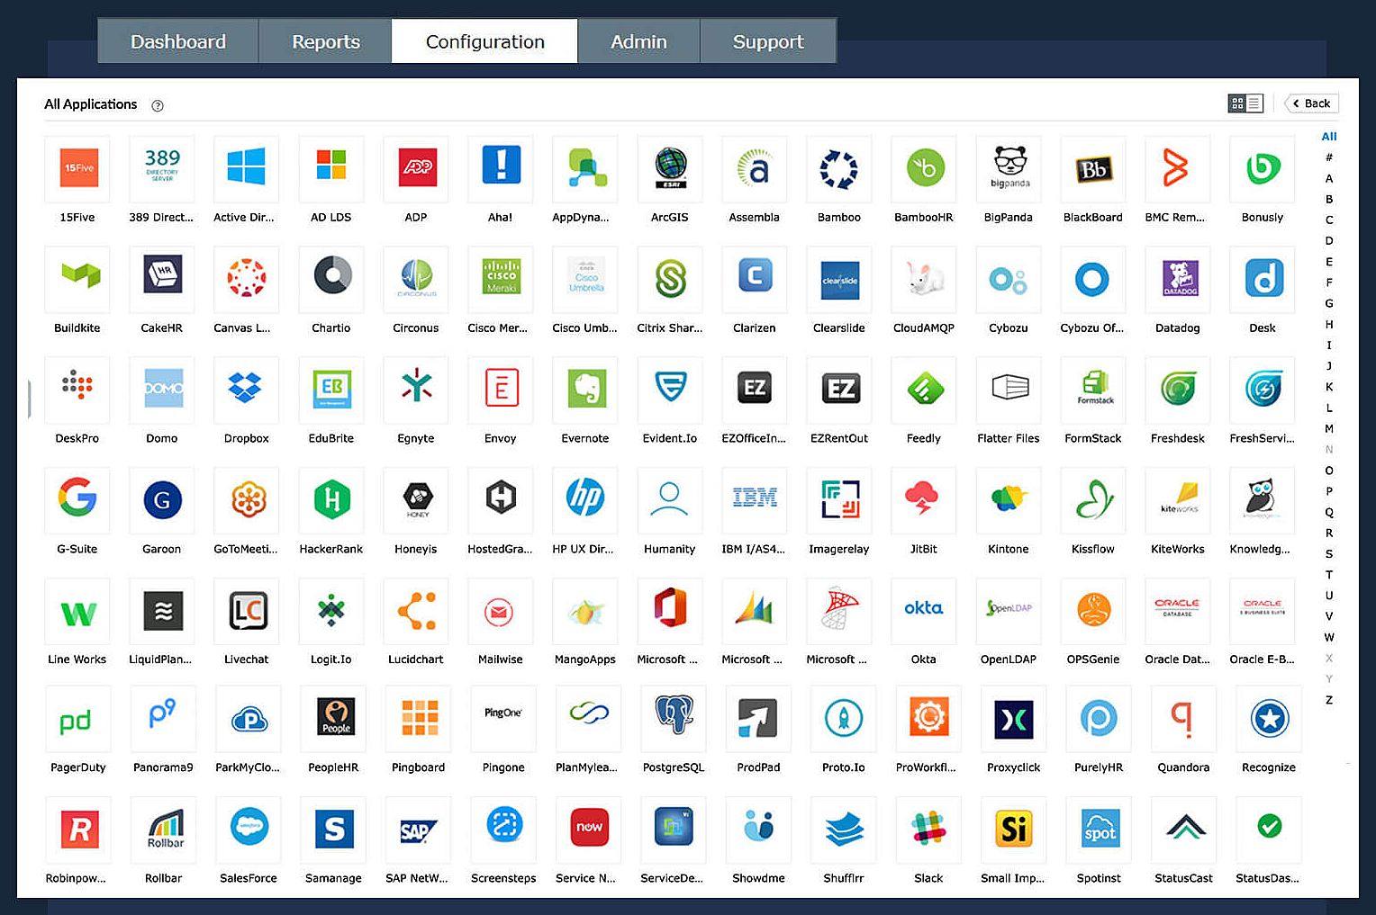
ADSelfService Plus' SSO includes Passwordless authentication
SSO for established cloud applications
SSO for custom enterprise applications
SAML- and OAuth/OpenID Connect-based applications
IdP- and SP-initiated SSO flows
Passwordless authentication
Bookmark functionality for seamless access to applications that do not support standard SSO protocols like SAML, OAuth, or OIDC.
ADSelfService Plus secures SSO with adaptive MFA that includes 20 different authenticators!

Slide 5
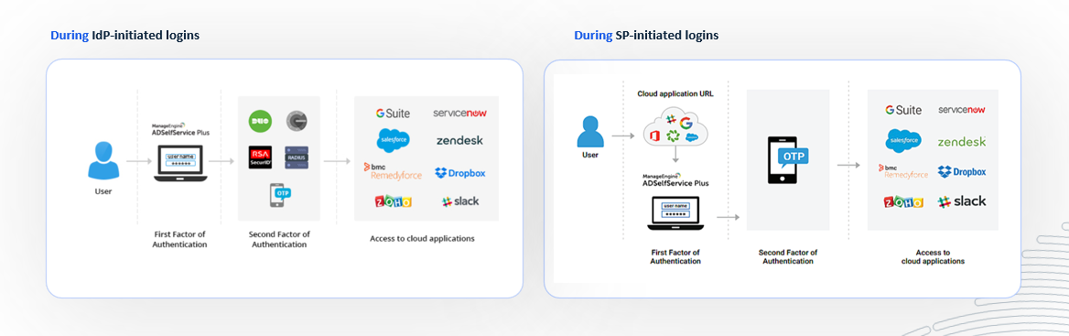
Here's how single sign-on works
in ADSelfService Plus

Slide 6



Switch to
ADSelfService Plus today
and enjoy enhanced identity security for your organization!
Guaranteed ROI
ADSelfService Plus gives you an immediate ROI by nearly eliminating password-related tickets.
Calculate ROI

Slide 7



For technical support:
Contact us
+1-408-916-9890
support@adselfserviceplus.com
www.adselfserviceplus.com
Chat live with our support team
Personalized web demo
Download ADSelfService Plus now

