Slide 1



ManageEngine SharePoint Manager Plus
The unified solution for your SharePoint organization

Slide 2
Outline
Challenges in enterprises
Why SharePoint Manager Plus?
Features offered by SharePoint Manager Plus
Benefits of SharePoint Manager Plus
Licensing and pricing
Contact us

Slide 3



Challenges
in enterprises
Lack of visibility
Inefficient management
Monitoring changes
Native reports provide limited information and require scripts to dig deeper. They lack a centralized viewpoint and aren't easily accessible.
Bigger organizations suffer from the lack of bulk controls, delegation, and scheduling features which can save time and effort.
Various changes going unnoticed, compliance requirements, and sites experiencing downtime—all require continuous monitoring and logging.

Slide 4



Why SharePoint Manager Plus?
Complete transparency
Efficient workflow
Activity tracking
Get comprehensive reports from site collections to lists. Obtain a complete overview on your SharePoint deployment to make data-driven decisions.
Speed up tasks with bulk operations and granular delegation features. Automate report generation and schedule migration tasks to function automatically.
Track and monitor changes with detailed audit reports and get notified instantly about critical events. Retain logs and back up your data to comply to regulations.

Slide 5






Features offered
by SharePoint Manager Plus
Reporting
Monitoring
Auditing
Management
Alerting
Delegation
Backup

Slide 6

Reporting
The need for a comprehensive reporting solution
To overcome the native tool's limitations:
PowerShell scripts are required to dig deeper and extract more data
Lack of report customization and filtering options makes comprehension harder

Slide 7
Infrastructure visibility
#1 Reporting
SharePoint Manager Plus provides more than 130 exhaustive reports to give you complete visibility on your environment.
Organizational structure
Granular content insights
Infrastructure visibility
Report on farms, site collections, and content databases. Get details on every site in your organization and the objects present inside them.
Go deeper with reports on granular objects like lists and list items. Get details on their modifications, inheritance, and storage information.
Use the Explorer tool to view the complete hierarchical architecture of your SharePoint deployment.

Slide 8


Security
and access reports
Permission governance
View all the user and group permissions on SharePoint objects. Also, view the inheritance broken items and group configurations.
#1 Reporting
Usage and analytics
Get site traffic and activity reports. View which pages are most viewed, which ones have unique visits, and which aren't accessible.
External and sharing access
View items that are shared externally and the users who have access to them. Also, get reports on sharing links that have expired.

Slide 9
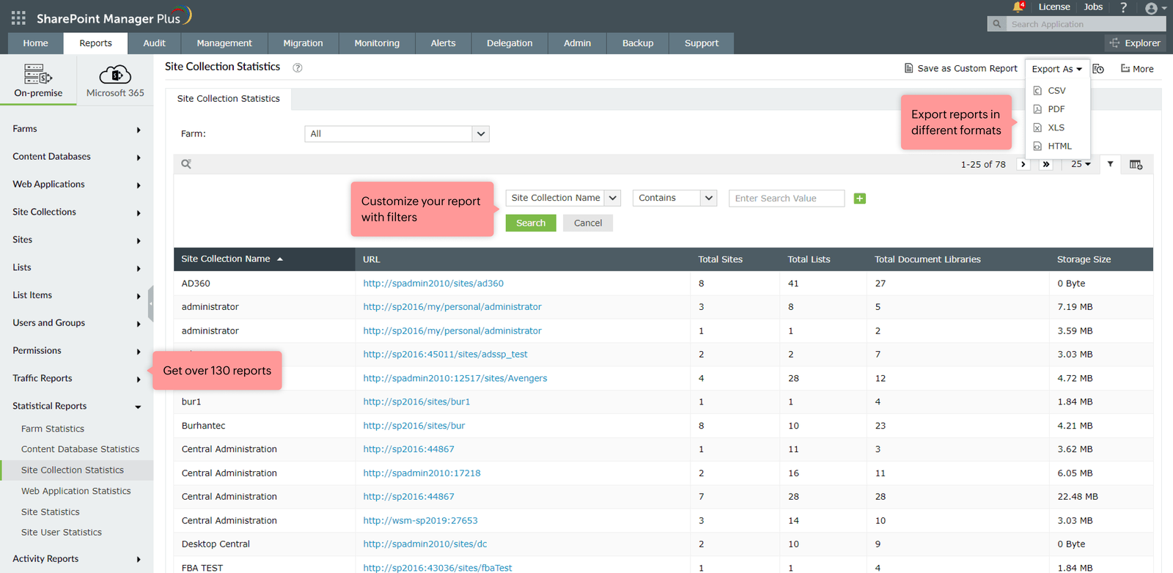
#1 Reporting

Slide 10
Use case
#1 Reporting
Manually generating reports
How SharePoint Manager Plus helps
Administrators, especially in large organizations, find it difficult to manage and report on the numerous aspects of their environment. Constantly generating reports and the complexity of data can become overwhelming.
Each report can be customized with filters and saved for quick access. Reports can also be scheduled to be automatically generated and delivered to email addresses of your choice. This simplifies the work of the administrator.

Slide 11

Auditing
The need for a critical change auditing tool
The native tool offers inadequate information on changes
To retain audit logs for a longer period to comply to regulations

Slide 12


Change auditing reports
#2 Auditing
Keep track of every change made in your environment with exhaustive reports.
Cumulative reports
Site change
File changes
View all the modification and deletion events across your entire farm and tenant from a single page with different filtering options.
Track changes made to sites and site collections like deletions, admin changes, and site visits.
See changes made to files, documents, and lists, such as creation, modification, and deletions.

Slide 13

Change auditing reports
Permission governance
Track all changes made to permissions, view unique permissions, inheritance, and modification.
#2 AUDITING
Group changes
Get group changes like creations and deletions. Also, get details on group membership and administrators.
Sharing and access changes
View access requests, removed links, and shared files to external users.

Slide 14
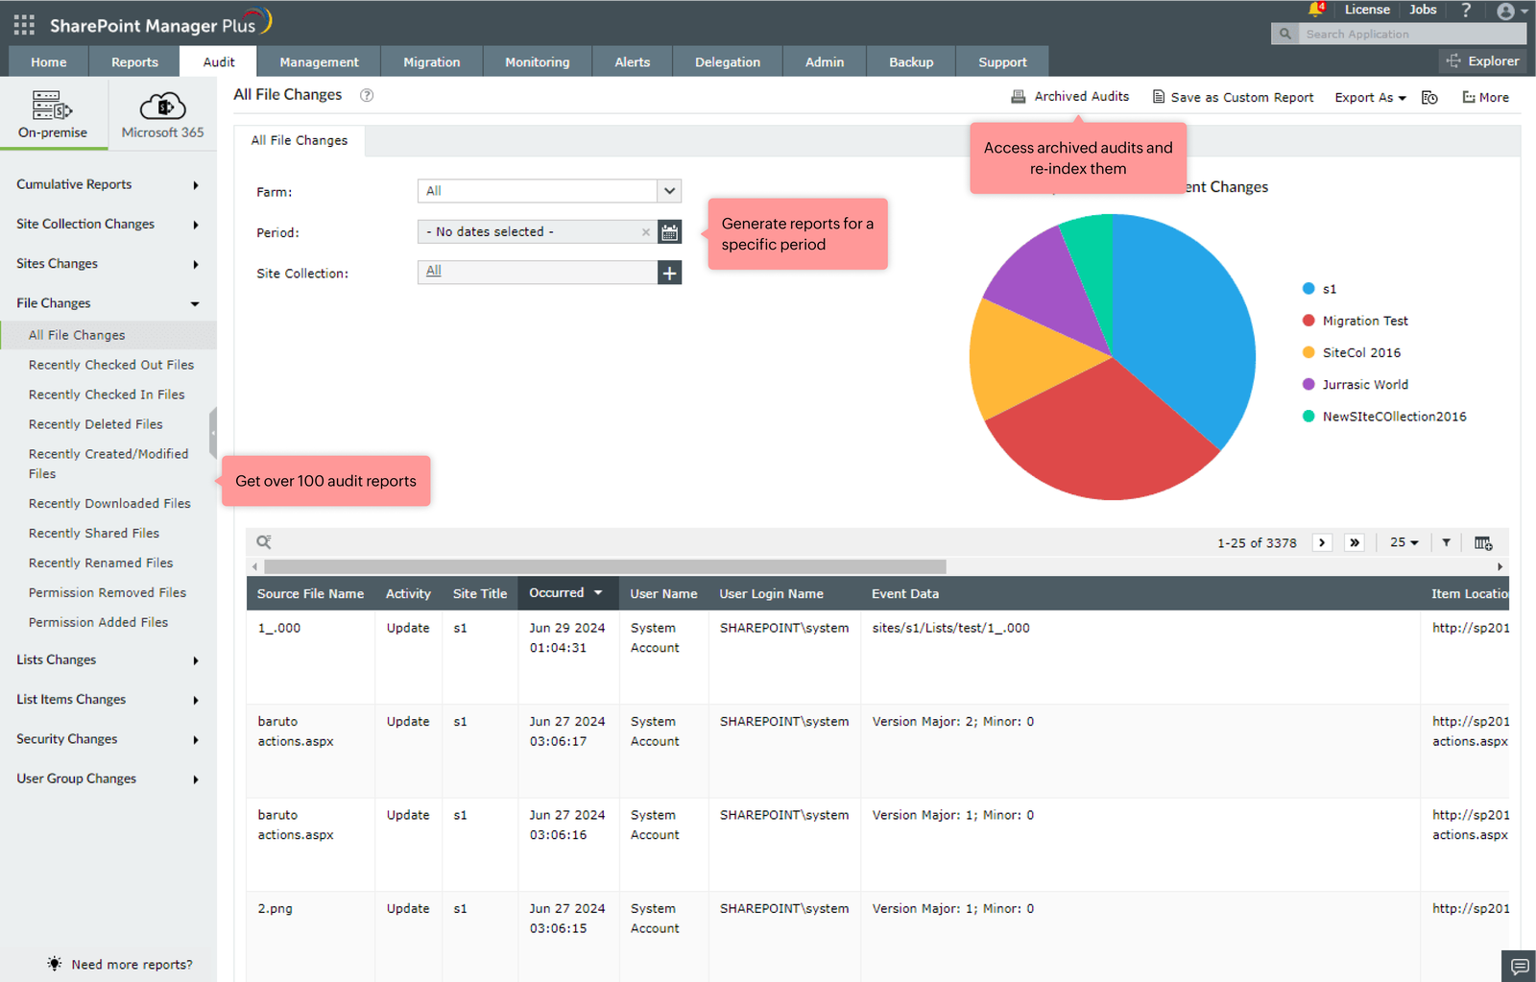
#2 AUDITING

Slide 15
Use case
#2 AUDITING
Demonstrating compliance
How SharePoint Manger Plus helps
No matter what industry you fall into, your organization will be required to comply with at least one mandate. To ensure proper security measures are in place, you need to regularly generate reports to meet the compliance requirements.
Automate report generation with powerful scheduling features to ensure adherence to compliance regulations
Archive audit logs in SharePoint Manager Plus' database with a flexible retention period to comply with regulations.

Slide 16

Management
The need for an efficient management solution
The native tool's lack of bulk operations leads to time-consuming and repetitive tasks
Ensuring that the right users have access to the right SharePoint data

Slide 17
Efficient SharePoint management
Manage permissions
#3 Management
Grant, remove, or copy permissions granularly or in bulk.
Manage groups
Create, delete, and perform group membership tasks.
Site collection
Add or remove site collection admins, control audit settings, and restore inheritance.

Slide 18
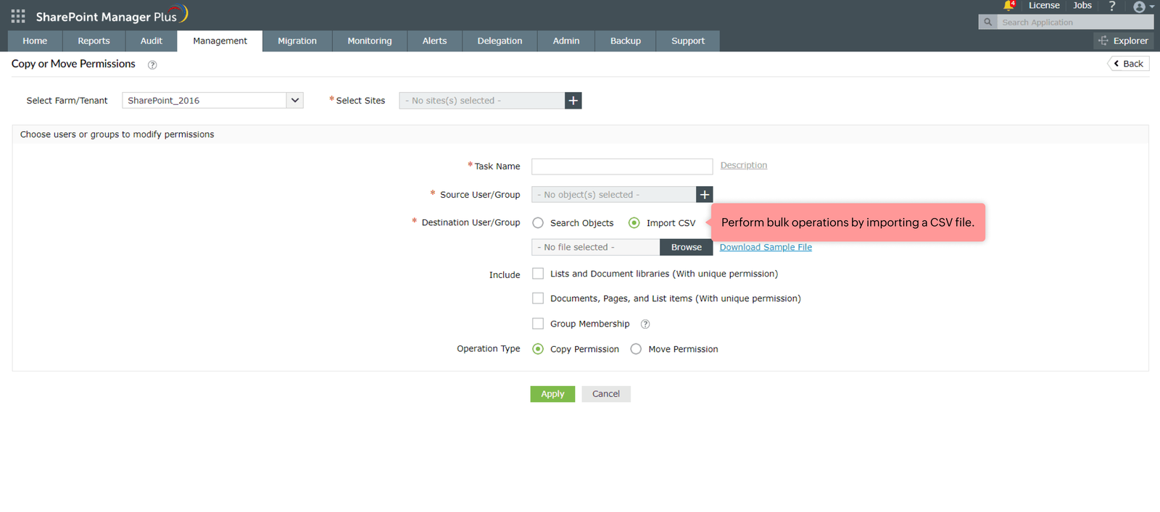
#3 MANAGEMENT

Slide 19
Use case
#3 Management
Speeding up repetitive tasks
How SharePoint Manager Plus helps
Controlling permissions for a large organization with as few as 20 groups is cumbersome since you need to modify each group separately. The task is repetitive, tedious, and prone to error.
Save time and effort by adding users to a CSV template and import it with a click of a button. This allows you to easily manage permissions and group memberships with bulk operations.

Slide 20

Alerting
The need for an instant alerting tool
Native tool's alerting feature offers limited customization options and isn't accessible
To notify you about various events happening in your SharePoint environment

Slide 21


Instant alerts on your environment
Alert profiles
#4 ALERTING
Create alerts for audited and monitored events.
Customization
Configure the severity and threshold of each alert profile.
Instant notifications
Get alerts sent to email addresses of your choice.

Slide 22
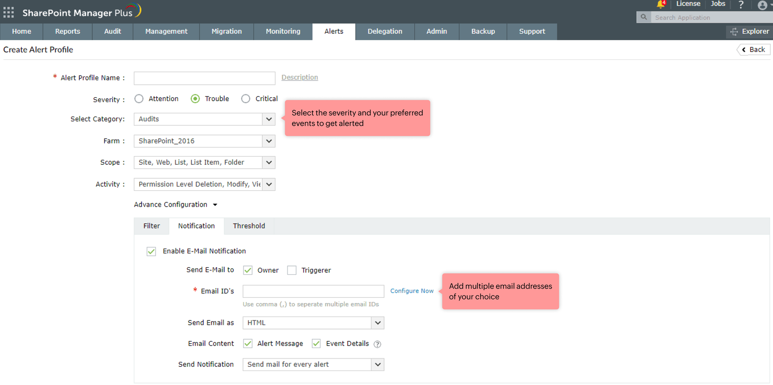
#4 Alerting

Slide 23
Use case
#4 Alerting
Staying informed on all events
How SharePoint Manager Plus helps
It is easy for administrators to get caught up with multiple tasks and require alerts to prompt them to take the necessary action. But the native tool requires you to enable alerts for each object separately, which is time-consuming.
Alert profiles can be configured to send alerts to email addresses for all the audited and monitored events in the product. You can also customize to only get alerts for the specific events you prefer.

Slide 24

Monitoring
The need for a comprehensive monitoring solution
To maintain a healthy SharePoint environment and prevent site downtime
To send alerts so the admin can perform the necessary actions before a disaster strikes

Slide 25

Monitor your tenant's health
Service health
Monitor various features of your tenant with detailed information on the degraded service.
#5 MONITORING
Site monitoring
Track site connection times and the storage quota.
Instant alerts
Get notified when any event exceeds a set threshold.

Slide 26
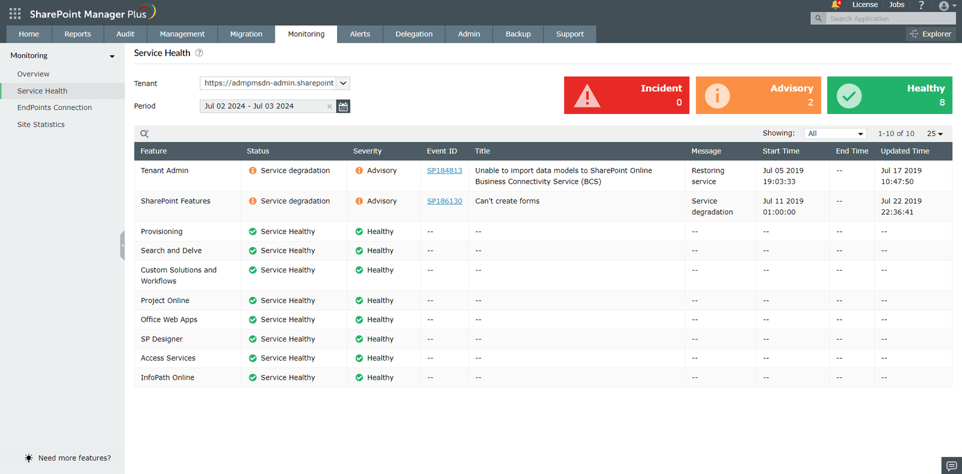
#5 MONITORING

Slide 27
Use case
#5 MONITORING
Proactive health monitoring
How SharePoint Manager Plus helps
Monitoring your SharePoint environment and staying alerted on any degraded service will help you take the necessary action quickly. However, if you're caught up with other tasks and rely on the native tool's limited reporting options, you won't be very efficient.
A graphical dashboard with categorized health statuses will provide an overall picture on your service health. Alerts can be configured with customizable threshold levels to notify when a specified limit is reached.

Slide 28

Migration
The need for a seamless migration solution
To ensure your SharePoint data is migrated to another version successfully without any hickups
To save time by automating the process and not causing any discruptions to an organization's workflow

Slide 29

Seamless migration
Migrate between versions
Perform migration between on-premises versions (2010, 2013, 2016, 2019, Subscription Edition) or to SharePoint Online.
#6 Migration
Granular flexibility
Select specific users, lists, and documents, or migrate entire sites depending on your needs
Import to your environment
Import files from local machines or shared network drives to your SharePoint environment.

Slide 30
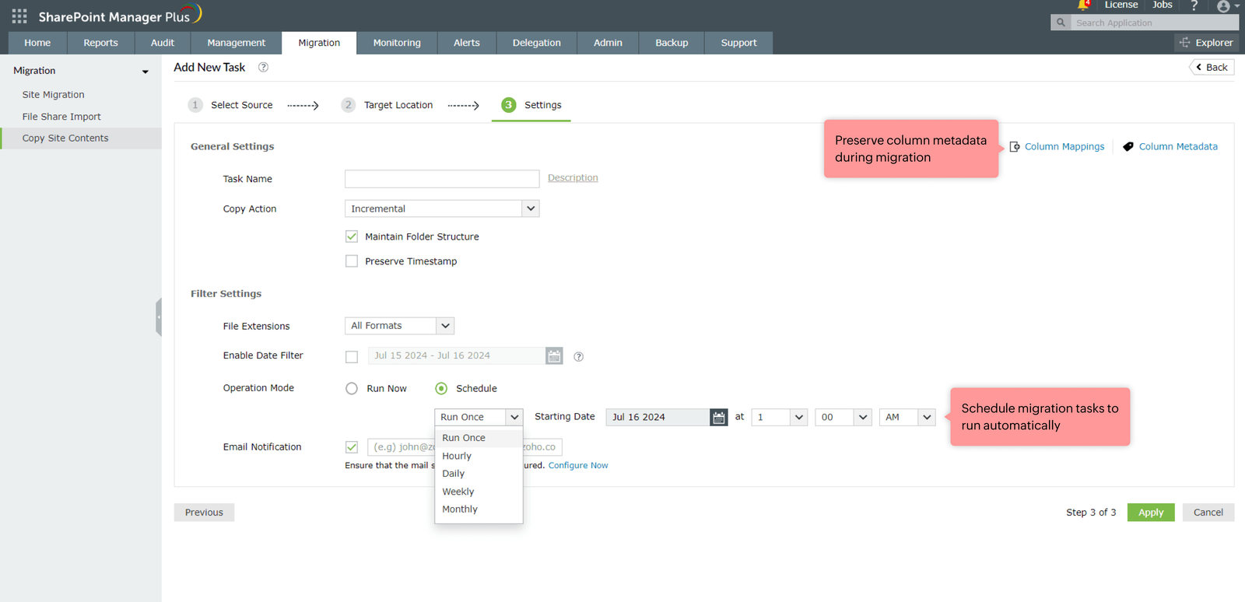
#6 MIGRATION

Slide 31
Use case
#6 MIGRATION
Speeding up repetitive tasks
How SharePoint Manager Plus helps
Importing multiple folders simultaneously to SharePoint isn't possible with the native tool. That process is time-consuming and repetitive. By speeding up the process, you can focus on other tasks at hand.
With the File Share Import feature, you can easily import multiple files from your local machine or a shared network drive to SharePoint. You can also schedule the process and configure it to upload files incrementally.

Slide 32

Backup
The need for a secure backup solution
The native tool lacks granular control to back up individual sites
Requires PowerShell scripts to manually backup data

Slide 33
Protect your SharePoint data
Granular flexibility
Perform granular backup by selecting specific sites or backup whole site collections in one go.
#6 Backup
Restoration
Access all your backups from a single console. Easily restore to an earlier version with a click of a button.
Scheduling
Configure the backup schedule to automatically back up your resources while you're away.

Slide 34
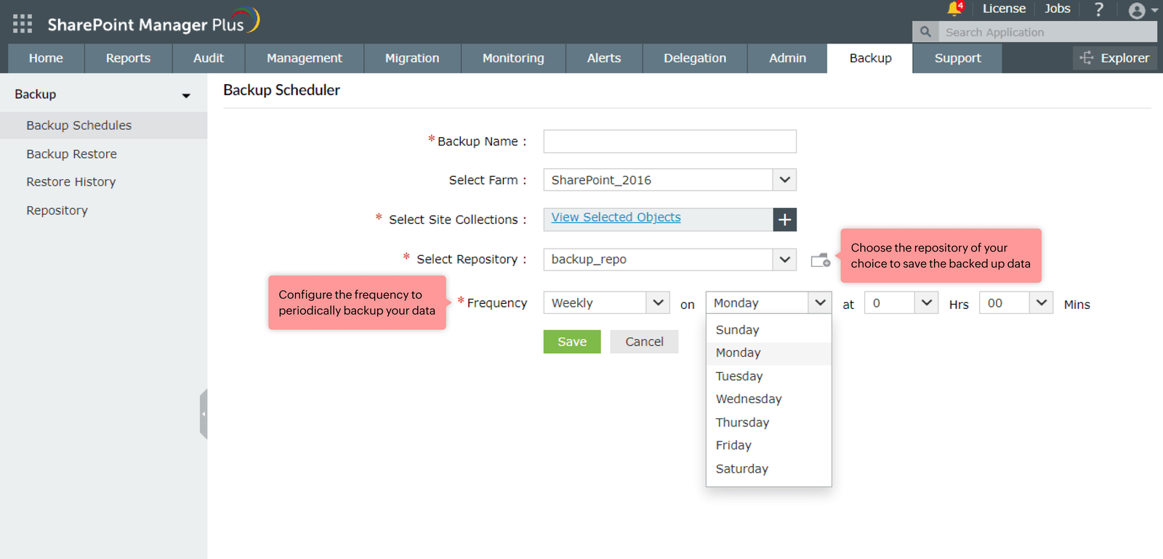
#6 BACKUP

Slide 35
Use case
#6 BACKUP
Hassle free backup experience
How SharePoint Manager Plus helps
An organization requires a backup tool not only for compliance, but also to secure resources and ensure procedural accountability. The tool should also help it recover from disasters through a script-free experience.
Easily perform script-free backups with a few clicks. Configure the schedule with different frequencies and restore backups anytime—all from the single console.

Slide 36

Delegation
The need for Role-Based Access Control (RBAC)
To ease the load on administrators by delegating tasks to the help desk users
To track the help desk users' actions with activity reports

Slide 37


Delegate roles to technicians
Help desk roles
Configure each role with granular control to allow only the necessary functionality.
#7 DELEGATION
Help desk technician
Ease the load by assigning roles to non-admin users (Technicians) without elevating their native privileges.
Audit reports
Keep track of technicians' actions and their activities with detailed reports.

Slide 38
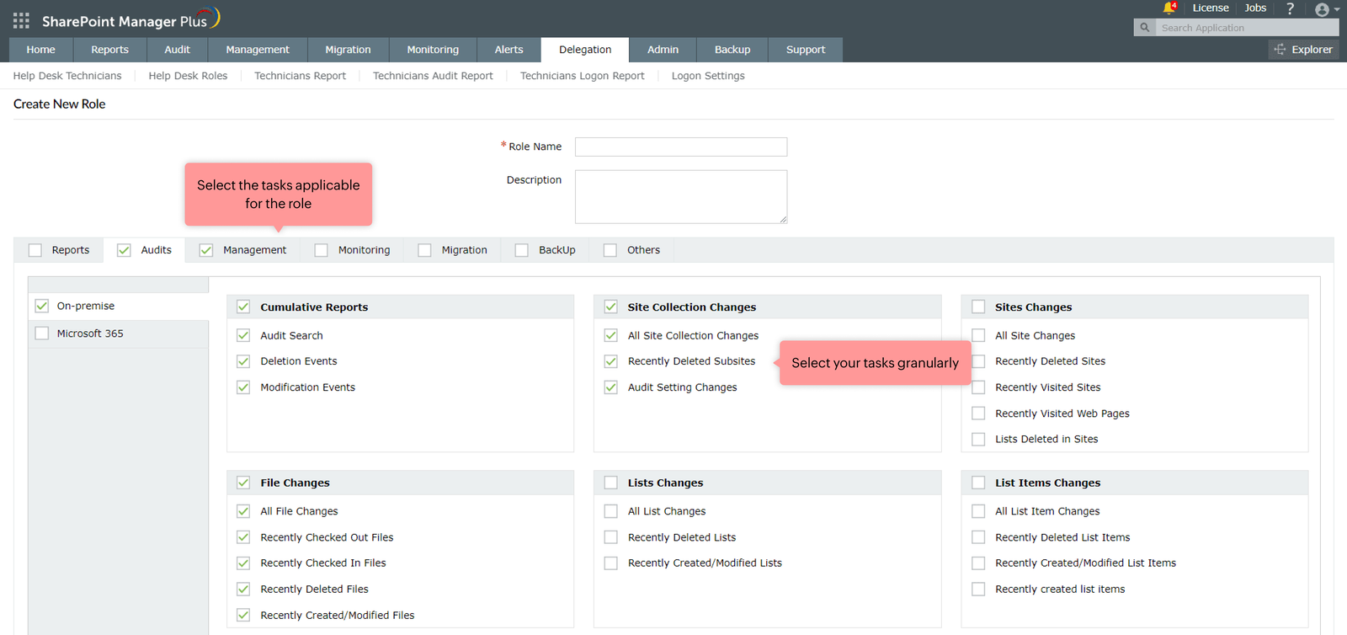
#7 Delegation

Slide 39
Use case
#7 DELEGATION
Administrative burden
How SharePoint Manager Plus helps
Handling multiple tasks in a large organization with numerous site collections can get cumbersome for the administrator.
By delegating specific SharePoint tasks to heads or team leaders, they can add or remove users, manage permissions, and perform more tasks, without the full administrative control.

Slide 40


Benefits of SharePoint Manager Plus
Hybrid support
for both on-premises (2010, 2013, 2016, 2019, Subscription Edition) and cloud (SharePoint Online) versions
Single platform
to administer every aspect of your SharePoint environment
Agent-less solution
that doesn't require server-side installation
Graphical dashboard
to understand what's happening in your environment

Slide 41
Licensing and pricing
SharePoint Manager Plus is licensed based on the number of Farms/Tenants and Help Desk Technicians.
It comes in two editions:
Standard Edition
Professional Edition
Pricing starts at
Pricing starts at
USD 945
USD 1,195

Slide 42



Contact us
Contact number: + 1-408-454-4213
Mail support@sharepointmanagerplus.com for assistance
Visit https://www.manageengine.com/sharepoint-management-reporting/ for more information.
Sign up for a live demo to explore how SharePoint Manager Plus works.
Live demo

