Slide 1


A 5-minute overview
of ADAudit Plus
Our integrated Active Directory, Azure AD, Windows Server, file server, and workstation auditing tool
Visit us at www.adauditplus.com

Slide 2

1. What is ADAudit Plus?
Our IT security and compliance solution
Offers real-time alerts and over 200 event-specific reports to provide information on:
Changes made to the content and configuration of Active Directory (AD), Azure AD, and Windows servers
Access to workstations and file servers (Windows, NetApp, and EMC)
24/7 surveillance for AD, Azure AD, Windows servers, file servers, and workstations
Visit us at www.adauditplus.com

Slide 3
2. Why you need ADAudit Plus?
The answer to what's going on in a Windows network lies deeply buried in event logs
Who logged in from where?
Who added an account to the admins group?
Etc.‌
Using native tools to analyze log data demands expertise and a lot of time
‌ADAudit Plus does this job for you!
Cut through all the noise and focus on the essentials with ADAudit Plus
Visit us at www.adauditplus.com

Slide 4

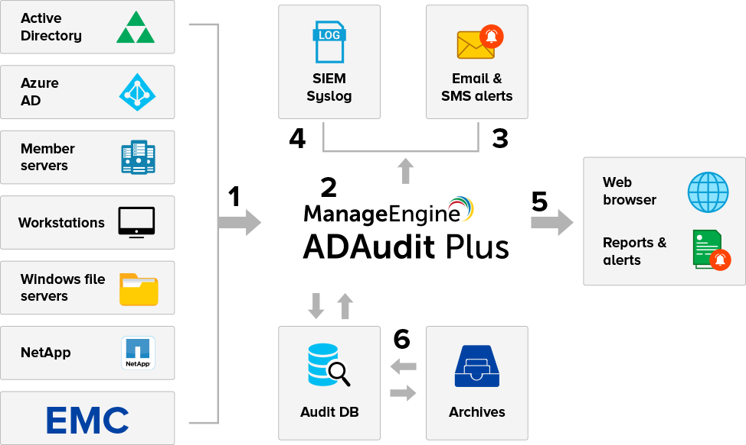
3. How ADAudit Plus works
Architecture diagram
Visit us at www.adauditplus.com

Slide 5
Refer to the architecture diagram
‌ADAudit Plus collects audit data from across your Windows network. Security log data is fetched using native Windows APIs, while directory data is fetched using LDAP.
The collected data goes through intelligent processing after which it is centrally stored in a database. Supported databases include Microsoft SQL Server (MS SQL), MySQL, and PostgreSQL.
ADAudit Plus allows you to select AD change events and configure them as real-time email or SMS alerts.
Visit us at www.adauditplus.com

Slide 6
Refer to the architecture diagram
The SIEM integration feature allows you to forward logs to any SIEM tool.
ADAudit Plus can be accessed through your web browser. The tool offers in-depth reports and real-time alerts, helping meet Windows server security and compliance needs. The tool also allows for fine-grained customization of all reports and alerts to meet specific needs.
The tool allows for long-term data retention through the process of data archiving; archived data can be restored at will.
Visit us at www.adauditplus.com

Slide 7



4. Top 5 features and benefits
Protect sensitive data: Track file access across Windows file servers, failover clusters, NetApp, and EMC
Monitor privileged users: Get a complete audit trail for administrator and other privileged user activities
Actively respond to threats: Leverage machine learning to detect anomalies instantly and configure the tool to act automatically in the event of an attack
Visit us at www.adauditplus.com

Slide 8


Trace user footsteps: Gain insight into user logon activity occurring across your Windows environment, spanning from logon failures to logon history
Troubleshoot account lockouts: Detect lockouts instantly with alerts and analyze the root cause for these lockouts with in-depth reports
Visit us at www.adauditplus.com

Slide 9
5. Other salient aspects
‌User behavior analytics
AD FS, AD LDS, and LAPS auditing
Employee productivity tracking
File integrity monitoring
Printer and removable storage auditing
Visit us at www.adauditplus.com

Slide 10
Data archiving and retrieval
Log forwarding to SIEM tools
Advanced search to track down specifics quickly
Before and after picture for changes
IT compliance reports for SOX, HIPAA, PCI, FISMA, and GLBA
Visit us at www.adauditplus.com

Slide 11
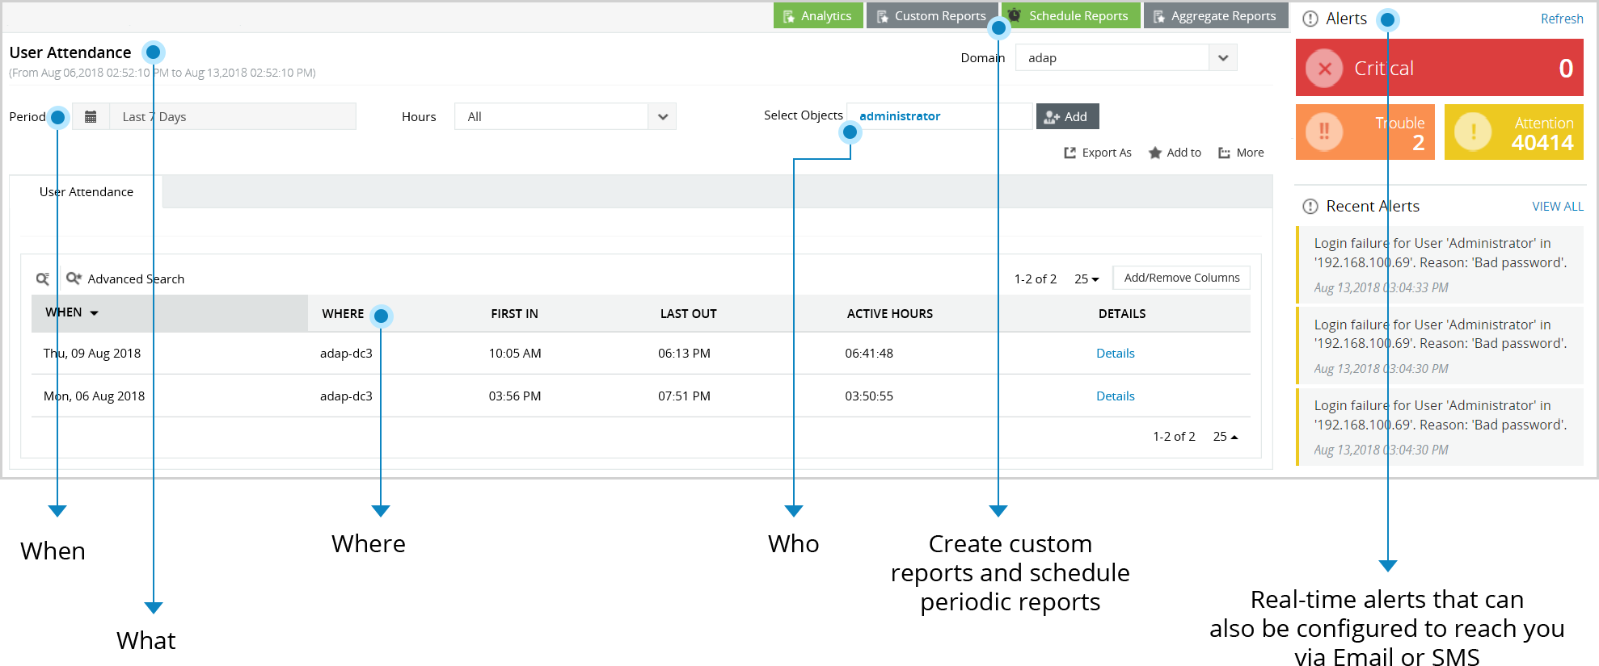
6. Bird’s-eye view of ADAudit Plus
Visit us at www.adauditplus.com

Slide 12
7. Evaluation & purchase
To help you evaluate the product thoroughly, we offer:
A fully functional 30-day free trial version: Download now
A personalized free guided tour of the product: Schedule now
Licensing is based on the number of domain controllers, file servers, member servers, and workstations. Pricing starts at $595.
ADAudit Plus is available in 2 different editions: Compare editions
Every user gets free 24/5 technical support: Contact us
Visit us at www.adauditplus.com

Slide 13

8. Companies that trust ADAudit Plus
ADAudit Plus is listed in Gartner's Magic Quadrant under the product suite Log360
Visit us at www.adauditplus.com

Slide 14
Learn about the latest trend creating ripples in the IT security industry:
user behavior analytics (UBA)
Visit us at www.adauditplus.com

