Slide 1


IT Management, Simplified
Real time IT management solutions for the new speed of business

Slide 2
Desktop Central
In IT administrators' perspective

Slide 3

Agenda
About ManageEngine
About Desktop Central
Product overview

Slide 4



ManageEngine - the Enterprise IT Management division of ZOHO Corporation
Privately held, profitable since inception
(Est. 1996)
(Est. 2002)
(Est. 2005)
(Est. 1996)
Applications for
Business, Collaboration,
and Productivity
Enterprise IT
Management
Solutions
Network
Management
Framework

Slide 5







Some of our other solutions
Active Directory Management
Active Directory
Exchange Server
Self-Service Portal
Recovery and Backup
IT Security
Log Management
Firewall Analysis
Vulnerability Analysis
Privileged Password
Network Anomaly Detection
IT Service Management
Help Desk
Asset Lifecycle
CMDB and ITIL
Customer Support
End Point Management
Desktops Management
MDM and BYOD Policies
OS Deployments
IT Operations
Management
Network Performance
Application Performance
End user Experience
Network Change and Configuration
Converged Infrastructure
Storage Infrastructure
Bandwidth and Traffic
SQL Server Monitoring
On Demand Solutions
Application Performance
Helpdesk Software
Active Directory Recovery and Backup
Mobile Device Management

Slide 6







2 Million Users
3 of every 5 Fortune 500 companies are ManageEngine
customers

Slide 7


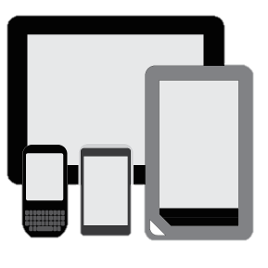
Unified Endpoint Security and Management
Product Overview

Slide 8
Desktop Central is a unified endpoint management solution that helps in managing servers, laptops, desktops, smartphones, and tablets from a central location.
Patch management
Software deployment
Asset management
Configurations & Tools
Imaging & OS Deployment
Remote control
Audits & Reports
Mobile Device Management
Security
Management

Slide 9
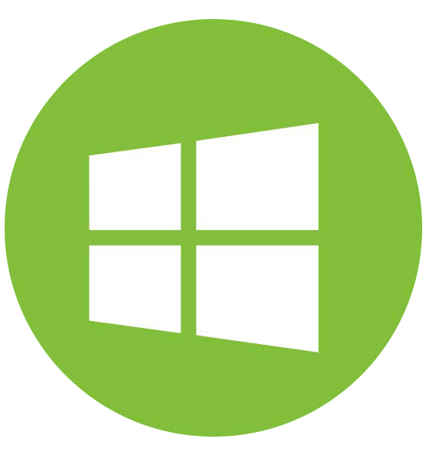



Supported OS
Desktops & Laptops
Mobile devices

Slide 10
Feature Highlights
Patch Management: Automate patching Windows, Mac, Linux & 3rd party applications
Software Deployment: Remotely install/uninstall free & commercial software to users & computers
Remote Control: HIPAA compliant, advanced remote control with video recording, file transfer etc.
Imaging & OS Deployment: Customized Templates, Deploy drivers, Post-deployment configurations
Tools: System tools, announcement, chat & system manager
Configurations: 30+ configurations for Windows, Mac & Linux
Asset Management: Real-time hardware and software inventory
Security Management: Secure USB, Prohibit Software, Block Exe, Configure Firewall & Ports.
Reports: Out of the box pre-defined & custom reports which can be scheduled
Mobile Device Management:Manage iOS, Android & Windows devices.

Slide 11

Patch Management
850+ supported applications
Automate Windows, Mac, Linux and 250+ 3rd party apps patch management
Enhanced patch deployment
Test & approve / decline patches
Definition updates, Rollups & Preview Rollups
System vulnerability report & health policy

Slide 12

Software Deployment
Over 1100 ready-to-use software templates
Install and uninstall software silently
Self-service portal
Approval based installation
Pre & Post-deployment activities

Slide 13

Remote Control
File transfer
Voice and video call support
Record sessions for auditing purposes
Shadow remote user
Multi monitor support
Integrated chat
Remote system management
Remotely troubleshoot mobile devices

Slide 14


Asset Management
For Desktops:
Tracking of hardware and software inventory
10,000+ software catalogue
Block / auto-uninstall blacklisted software
Alert, audit, 20+ predefined reports
Software metering
License & warranty management
File Type Scan
Reports - Bit locker Encryption, Antivirus, Firewall
For Mobiles:
Geo tracking
Device details
Network details
Installed apps
Installed certificates
Device and app restrictions

Slide 15
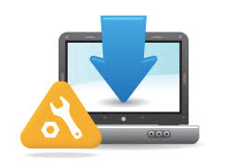
Imaging and OS Deployment
Modern imaging techniques
Customized deployment templates
Hardware Independent deployment
Advanced & unique deployment methods
Post-deployment configuration

Slide 16
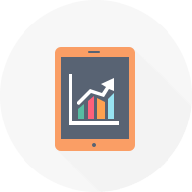
Reports
User Reports
Computer Reports
GPO Reports
Power Management Reports
User logon Reports
Patch Reports
Inventory Reports
AD Reports
MDM Reports

Slide 17
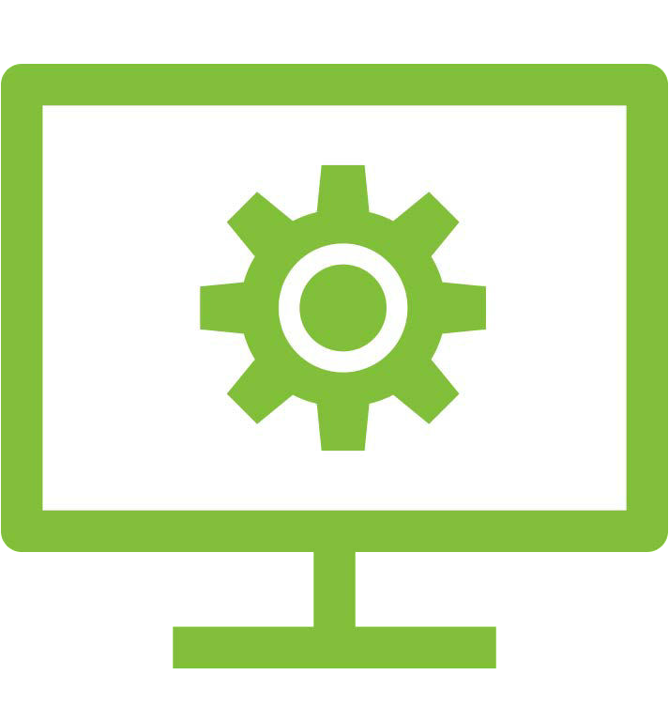
Configurations
40+ predefined configurations
50+ templates
100+ custom scripts
USB management, firewall, browser, Certificate distribution, WiFi, etc
Exclusive for applications, systems & users
User-defined Templates
Linux Custom Script Configuration

Slide 18
Mobile Device Management
App Management
Profiles & Restrictions
Content Management
Security Management
Location Tracking

Slide 19
Integrations
Help desk software
ServiceDesk Plus
Zendesk
Jira
Asset Explorer
Available on Amazon & Azure

Slide 20
General
Role Based Administration
Secure Gateway – to manage roaming users & work from home users
Failover Server
Available as mobile app – for iOS and Android devices

Slide 21
Pricing
Desktop Central is available as :
Free edition
Professional Edition
Enterprise edition
UEM Edition
Pricing details can be seen here:
https://store.manageengine.com/desktop-central/

Slide 22











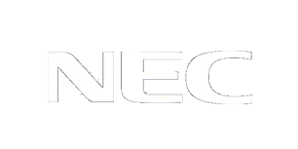


Some of our clients

