Slide 1




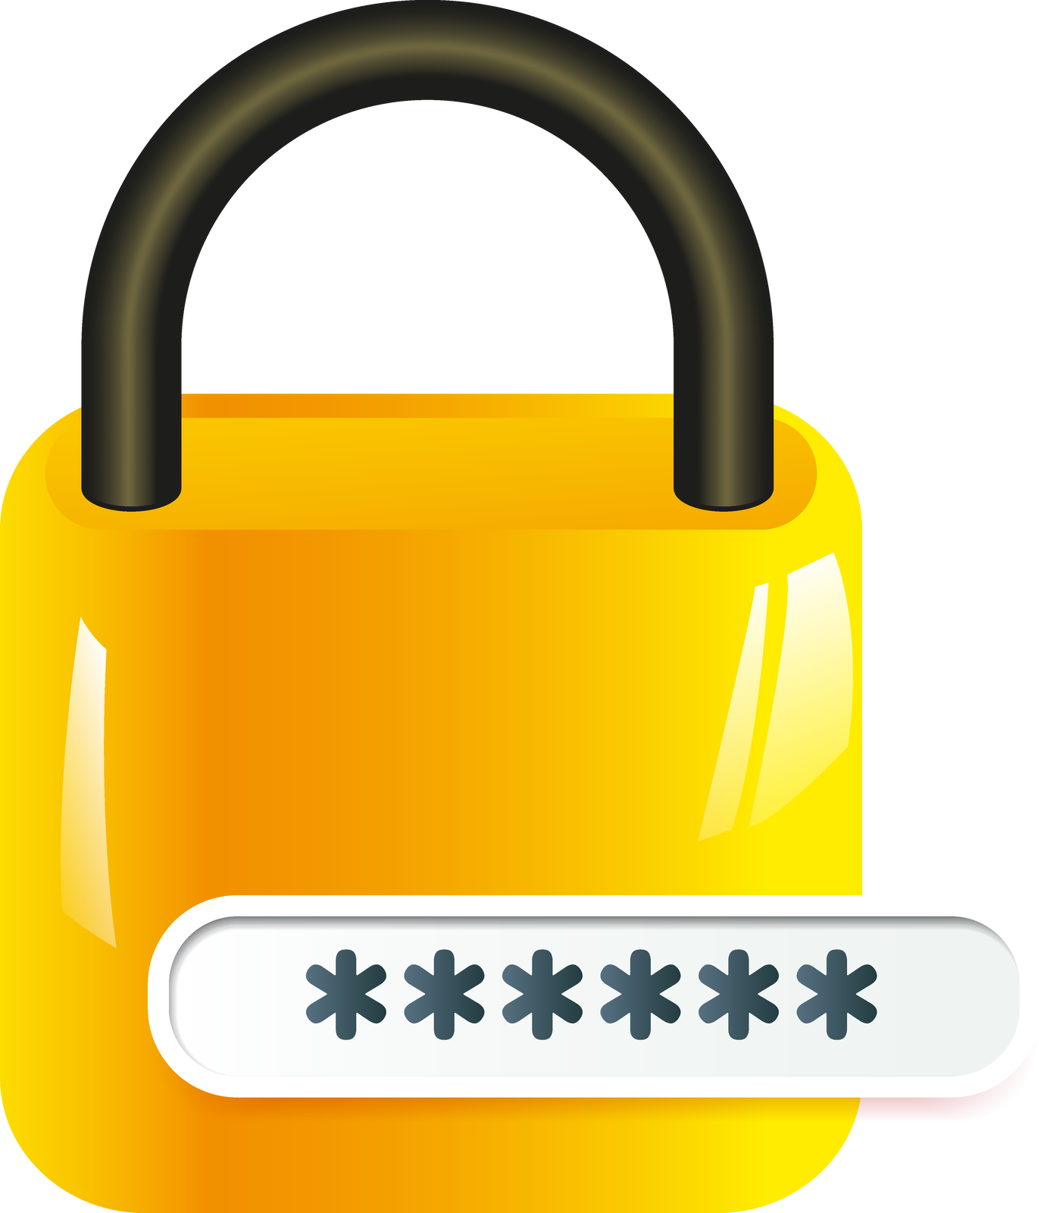
Enhancing cyber hygiene in healthcare
Protecting identities with ADSelfService Plus

Slide 2

Between 2009 and 2022, there were 5,150 healthcare data breaches reported to HHS' Office for Civil Rights
Healthcare organizations store a vast amount of sensitive data—including patient information, hospital records, insurance details, biomedical research findings, and medical test results—which attracts cybercriminals who profit by stealing it and selling it on the dark web
Security measures like MFA and strong passwords will help healthcare organizations protect sensitive data
Cyber security in the healthcare sector
When patients forget their passwords, their accounts get locked out, resulting in a backlog on the help desk and users unable to complete their tasks
By enabling users to reset their own passwords, users can regain access to their accounts promptly, allowing admins to focus on system-critical tasks

Slide 3
Doctors, clinical staff, IT staff, researchers, and patients struggle to remember passwords for multiple applications, resulting in repetitive time-consuming logins
By implementing SSO, users can access applications with just one click, eliminating the need to enter multiple passwords
Cyber security in the healthcare sector
Additionally, healthcare organizations must comply with various regulations, including HIPAA, HITECH, GDPR, and PCI DSS
In order to protect sensitive data, streamline user access, and maintain regulatory compliance, healthcare organizations implement comprehensive identity security solutions

Slide 4
ManageEngine ADSelfService Plus is an identity security solution with MFA, SSO, and self-service password management capabilities
ADSelfService Plus offers the following solutions:
An all-encompassing identity security solution
Self-service password management
Adaptive MFA
SSO for applications
Remote work enablement
Enterprise self-service

Slide 5
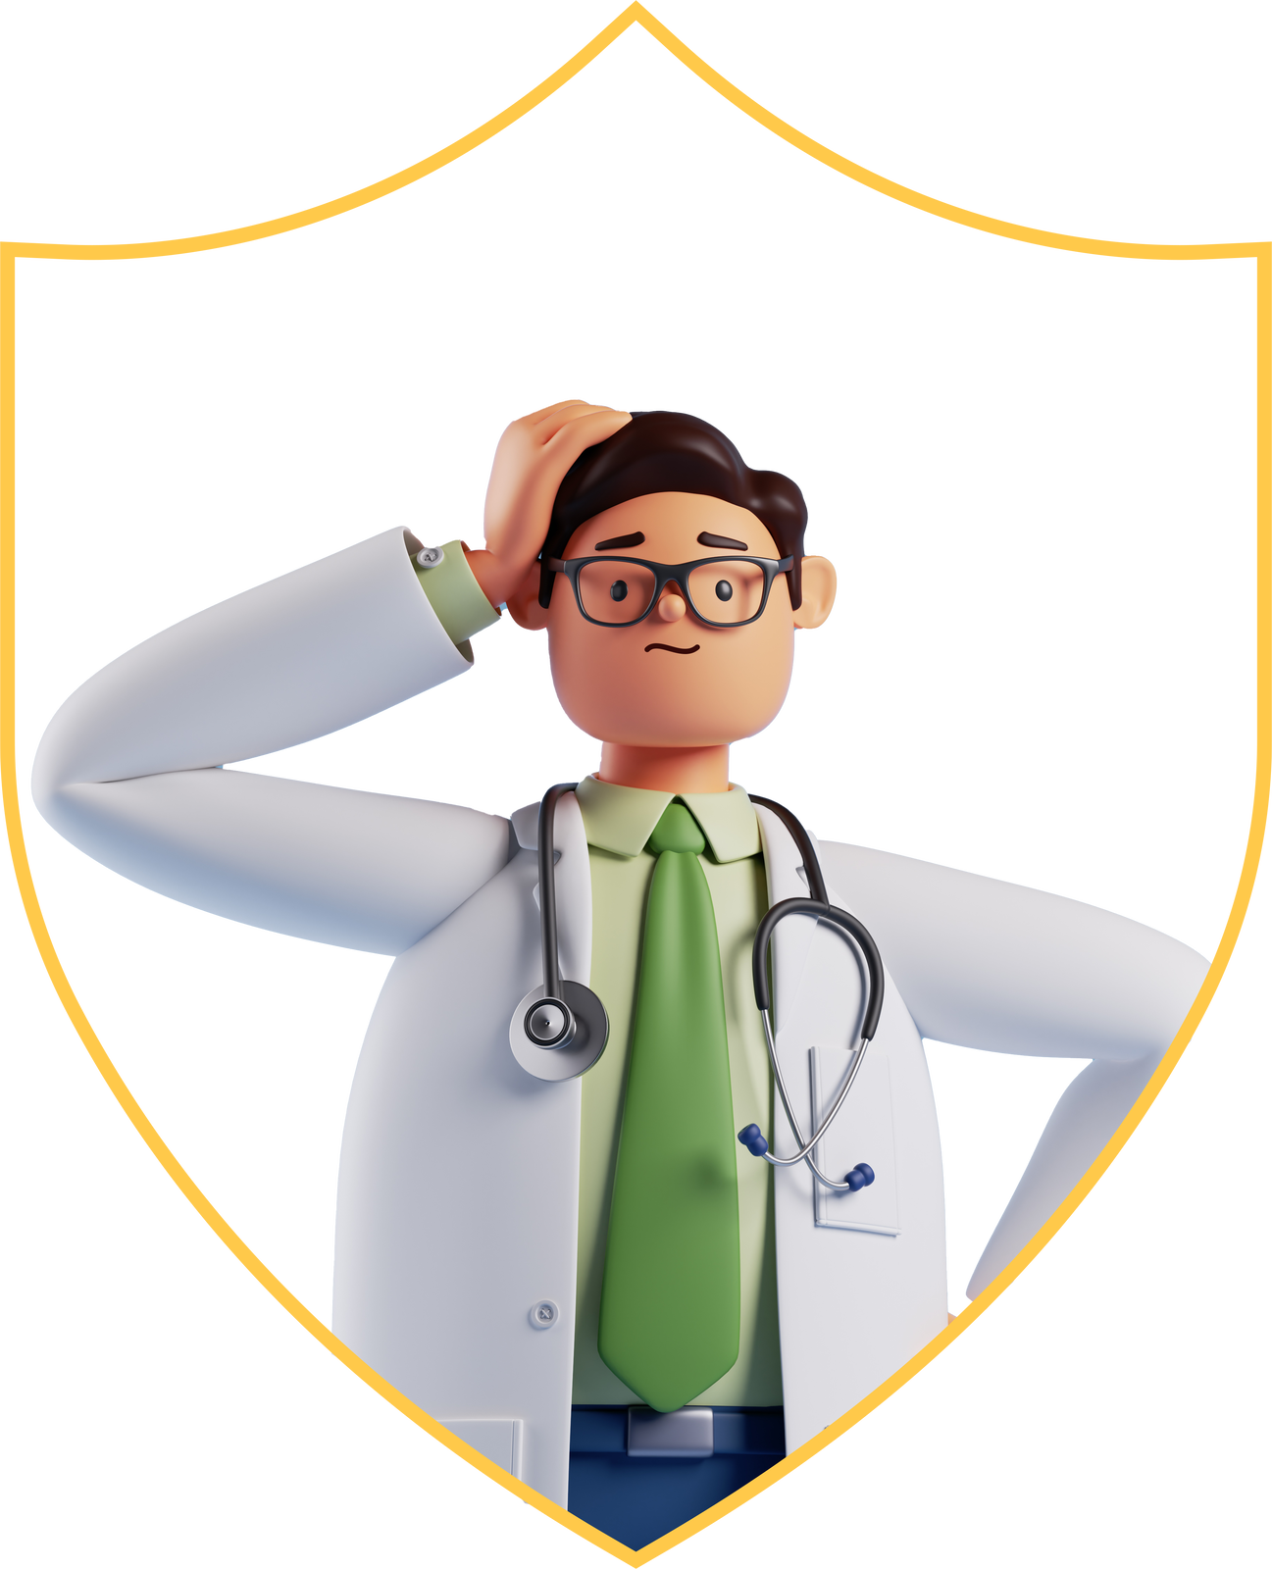



How
ADSelfService Plus
mitigates cybersecurity risks for healthcare organizations

Slide 6


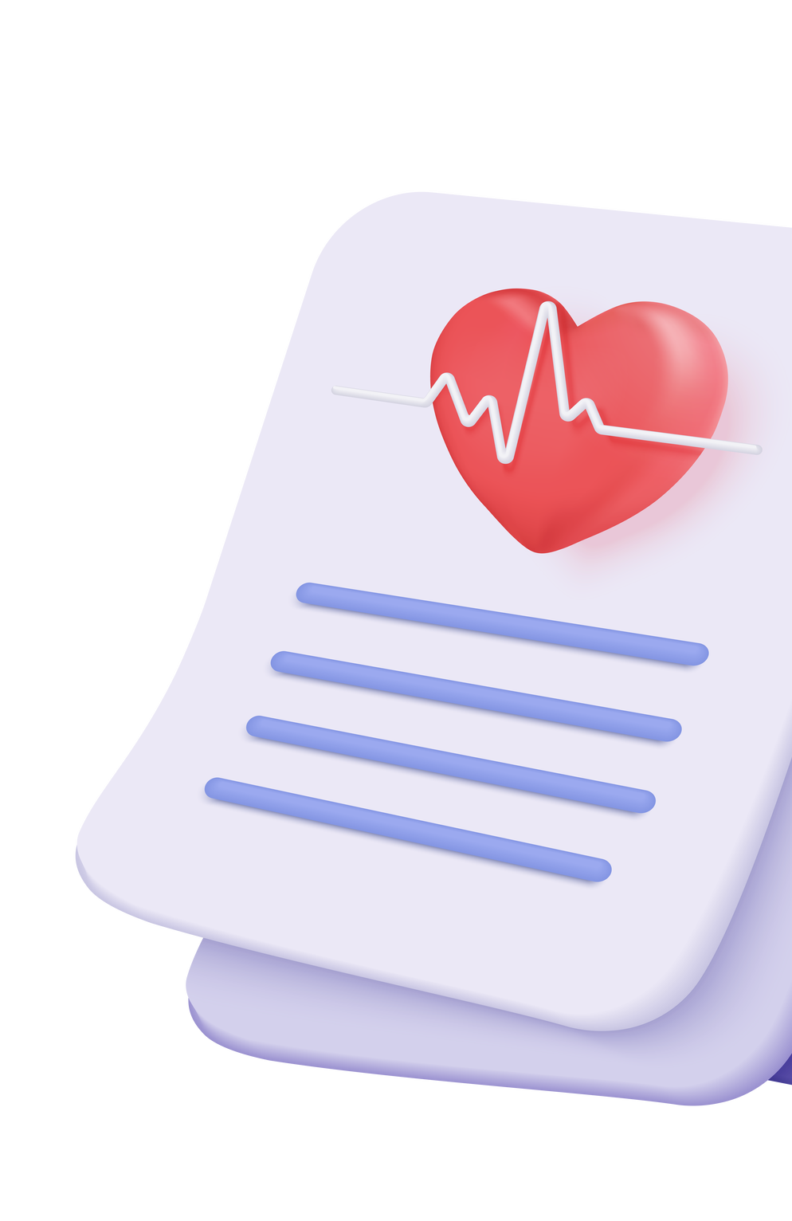
Self-service capabilities
Before ADSelfService Plus
When patients and healthcare professionals send emails for password resets and account changes, admins forget to resolve the tickets or take longer to respond
Gartner analysts say 40% of help desk calls are related to password resets. Due to this, critical tasks—such as providing network infrastructure, maintaining servers, or deploying software—are delayed
When hospital staff and IT admins create and update user records, they can encounter delays or make errors, which leads to longer patient wait times, unsatisfied staff, and low productivity

Slide 7
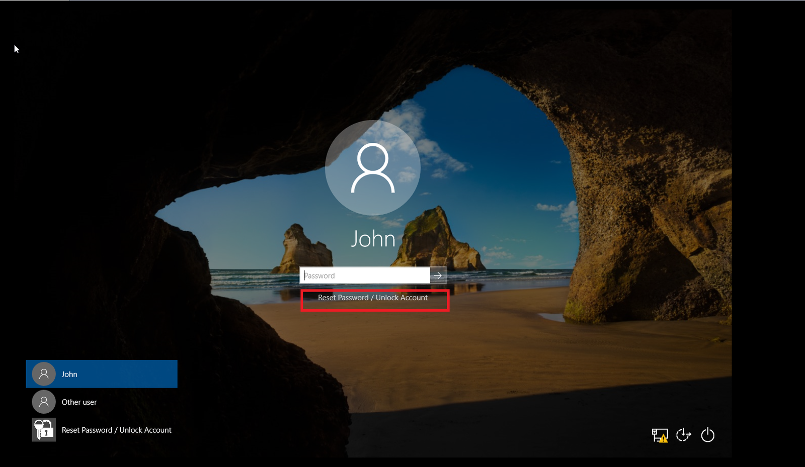
Self-service capabilities
After ADSelfService Plus
Users can reset their passwords, change passwords, unlock their accounts, and self-update personal information—all without help from the IT team
By clicking the Reset Password/Account Unlock option in the GINA/CP client, users can reset their passwords and unlock their accounts themselves
Admins can restrict what fields users can self-update, and also what fields they can view

Slide 8
Password policy enforcer
Before ADSelfService Plus
While creating passwords, clinical staff and patients often choose easy-to-type passwords that include simple patterns, hospital names, or common dictionary words
Moreover, the default password policy in AD may not support password complexity requirements like unicode characters. Attackers can exploit this weakness by targeting passwords, making them easier to crack

Slide 9
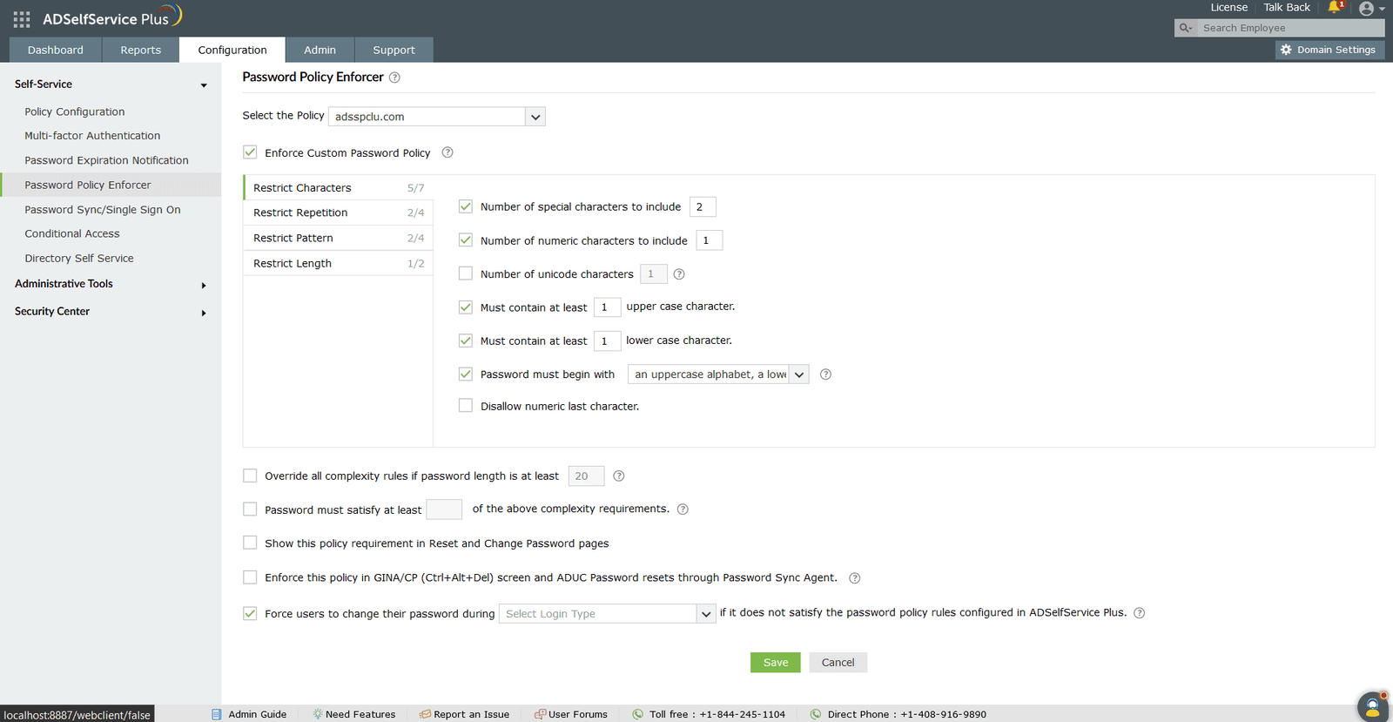
Password policy enforcer
After ADSelfService Plus
By implementing fine-grained password policies, admins can protect users based on their membership in an OU, group, or domain
It is possible to set password controls not available in native policies, including:
Mandatory use of Unicode characters
Restrictions against character repetition in usernames and reusing old passwords
Limitations on weak passwords, dictionary words, and palindromes
Enforce passwords to match the regex pattern

Slide 10
Password policy enforcer
After ADSelfService Plus
By integrating with the "Have I been Pwned?" service, users are prevented from using passwords involved in previous hacking incidents
Moreover, the password policy enforcer aligns with the password best practices outlined in NIST SP 800-63B

Slide 11
Multi-factor authentication
Before ADSelfService Plus
Shared devices in healthcare settings, like those found in emergency rooms and laboratories, create additional security vulnerabilities, especially when password sharing is involved
This behavior allows a malicious employee to exploit shared passwords, potentially gaining unauthorized access to sensitive information
Moreover, if there is limited network access, traditional authentication methods that rely on internet connectivity may result in delayed verification

Slide 12
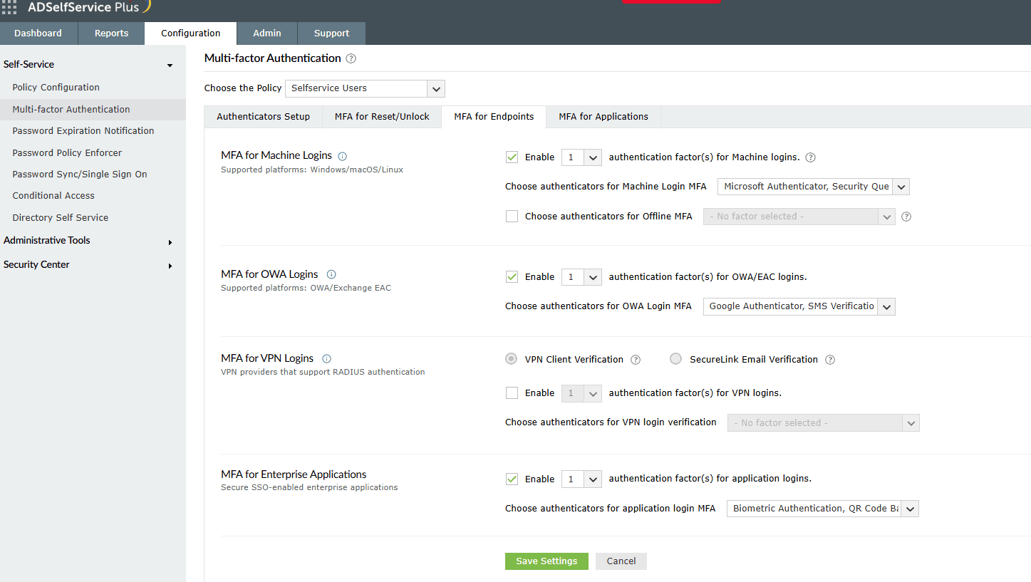
Multi-factor authentication
After ADSelfService Plus
Enables customized MFA by considering each user group's capabilities and responsibilities using 20 authentication methods
Also, offline MFA is supported for Windows, macOS,RDP, and UAC logons
Adding MFA complies with NIST's SP 800-63B and CISA's recommendations to add an extra layer of security

Slide 13
Multi-factor authentication
After ADSelfService Plus
Admins can configure MFA for:
Machine logins (Windows, macOS, Linux, servers)
VPN logins
OWA and EAC logins
Application access
Self-service password reset and account unlock
Remote Desktop Protocol (RDP)
Windows User Account Control (UAC)

Slide 14
Single sign-on
Before ADSelfService Plus
Healthcare companies require employees and patients to use long and complicated passwords, and they need to remember multiple passwords
Staff members use multiple applications such as EHR systems, patient management software, and others across various devices
However, repetitive logins and complex passwords reduce productivity and consume valuable time

Slide 15
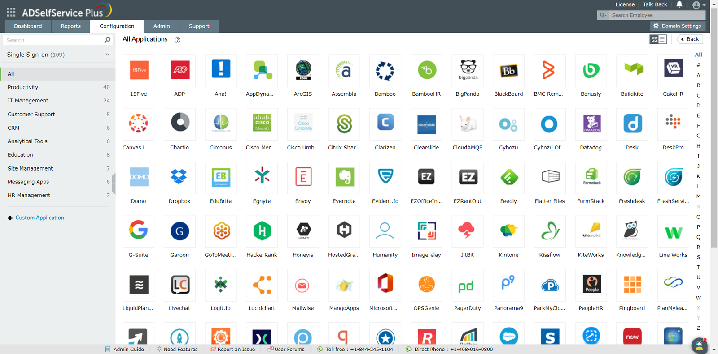
Single sign-on
After ADSelfService Plus
Users can access all cloud applications with just one set of credentials
Our comprehensive SSO solution supports:
SAML-enabled applications like Google Workspace, Microsoft 365, and Salesforce
OAuth- and OIDC-enabled applications
Custom applications

Slide 16
Single sign-on
After ADSelfService Plus
SSO allows users to log in using two methods:
Identity provider (IdP) initiated SSO (ADSelfService Plus)
Service provider (SP) initiated SSO (cloud application or service)
Bookmark functionality for seamless access to applications that do not support standard SSO protocols like SAML, OAuth, or OIDC.

Slide 17
Conditional access policy
Before ADSelfService Plus
Physicians accessing the hospital's electronic medical records system via personal smartphones outside the premises face an increased risk of device hacking when connected to public networks
These networks lack security measures, leaving them vulnerable to hackers. Personal smartphones may also lack hospital-owned security, risking sensitive patient information exposure

Slide 18
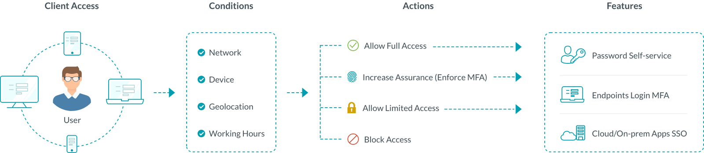
Conditional access policy
After ADSelfService Plus
Enabling conditional access automatically assigns access policies to determine whether to enable MFA based on users' parameters such as IP address, device, time of access, and geolocation
This allows admins to effectively manage access by granting complete access, limited access, or denying access to resources
Based on the risk level, users are prompted to provide additional authentication factors. This enhances security by protecting endpoints against unauthorized access attempts

Slide 19
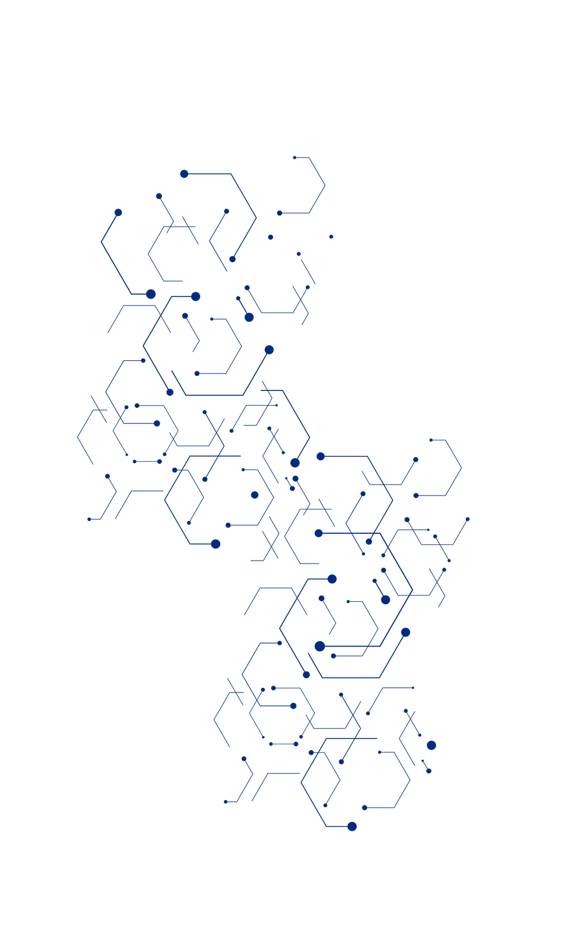

Conclusion
The healthcare sector faces challenges in managing identities due to its ongoing digital transformation and expansive attack surface
Prioritizing cyber hygiene has become crucial as healthcare organizations are lucrative targets for cybercriminals seeking financial gains
With ADSelfService Plus, healthcare organizations can enhance their cybersecurity posture and mitigate identity management risks

Slide 20





Contact us
Contact Number
Support Email
+1-408-916-9890
support@adselfserviceplus.com
Live chat
Visit our website
For instant responses.
www.adselfserviceplus.com/
DOWNLOAD NOW

