Slide 1
IT management, simplified.
Real-time IT management solutions for the new speed of business

Slide 2
Underpinning of a successful IT help desk
Service catalog in ServiceDesk Plus

Slide 3
Say hello to Zylker
BUSINESS USERS
IT FOLKS
SCOTT
IT TECHNICIAN
DAVE
HIRING MANAGER
JASON
IT TECHNICIAN
CIO
MARCUS
CATRIN
IT SERVICE MANAGER
ADAM
IT TECHNICIAN
WENDY
HR
JOHN
END USER

Slide 4
Story time:
Phone ordering process at Zylker

Slide 5
John requests a phone
How John expects it to work
JOHN
END USER
SCOTT
IT TECHNICIAN

Slide 6
John requests a phone
John mails Scott requesting a phone.
How it actually works!
Emails pile up. Scott is unable to track the mails.
Scott mails him to choose the model.
John replies with the specifications.
John sends back a mail asking for an iPhone.
Scott mails him for further specifications such as color, size…

Slide 7
The chaos continues

Slide 8
After a few days…
Get me a report of all phone requests this quarter
A frustrated John walks into IT
Meanwhile in IT
Any updates?
You guys have no clue.
Marcus, CIO
Now what? Status please?
I’ll check
John, end user
Catrin, IT service desk manager
I’ve raised a PO. It will take a few weeks
Scott, IT technician

Slide 9
What does this mean for Zylker?
4 unhappy people and no phone yet!

Slide 10
Phone ordering with ServiceDesk Plus
Zylker gets smart and handles service requests the ServiceDesk Plus way!

Slide 11
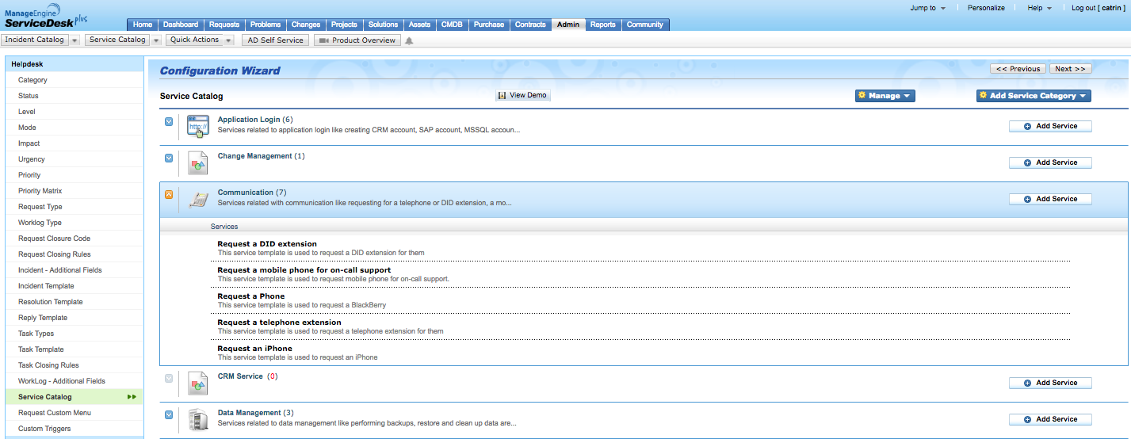
As the IT service desk manager and admin, Catrin uses the service catalog in ServiceDesk Plus to create service categories and lists the services that Zylker IT offers.
Catrin creates service categories in ServiceDesk Plus
And defines the services

Slide 12
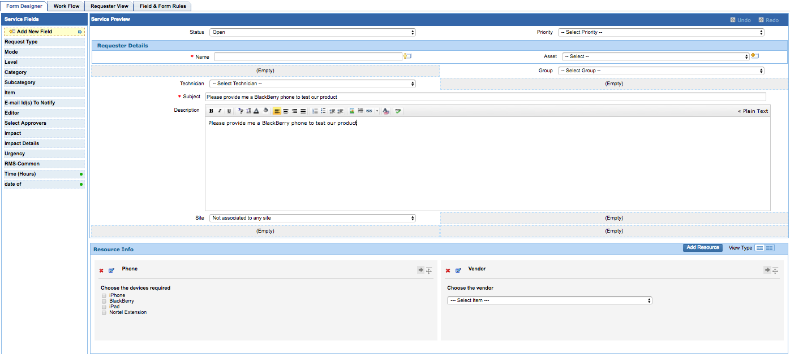
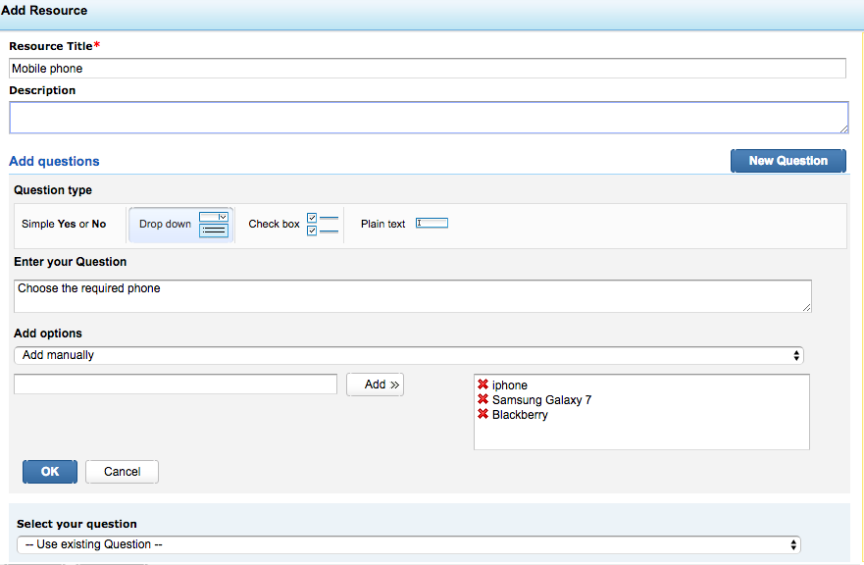
Next, she configures workflows to trigger approvals, sets up SLAs, auto assigns the service request to a technician, and assigns the task to the PO team.
Catrin defines the questions
Adds the resources.

Slide 13
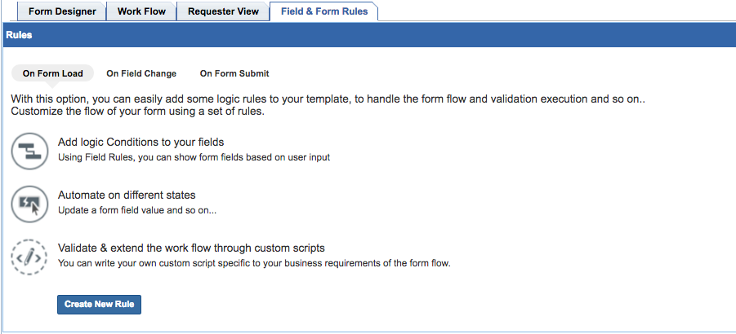
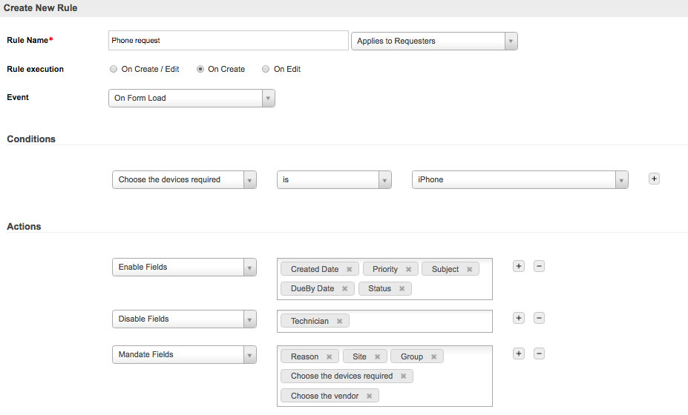
Catrin uses the field and form rules so that the end user sees only those fields relevant to the model he/she has chosen. For example, if the end user chooses iPhone, only those fields relevant to iPhone will be shown.
Catrin defines the fields that have to be enabled, disabled, and made mandatory

Slide 14
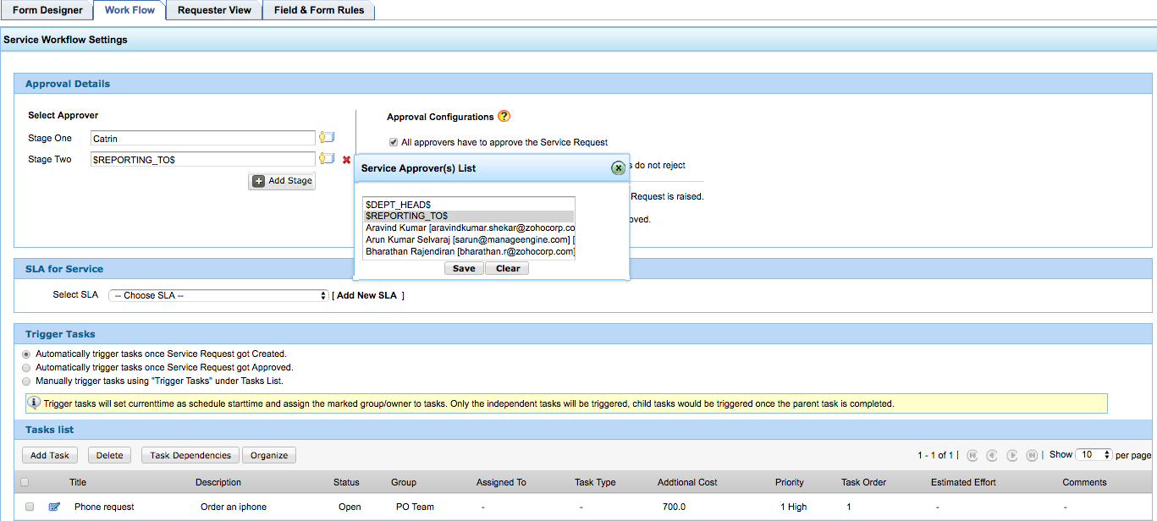
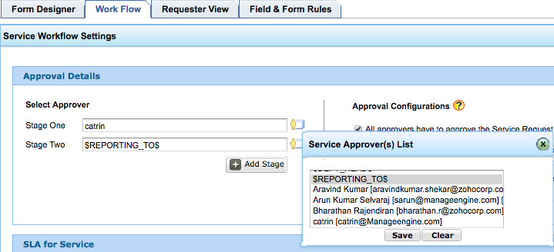
ServiceDesk Plus allows Catrin to add up to 5 stages of approvals with each stage having multiple approvers.
5-stage approval mechanism
The list of approvers is pulled from the Active Directory.

Slide 15
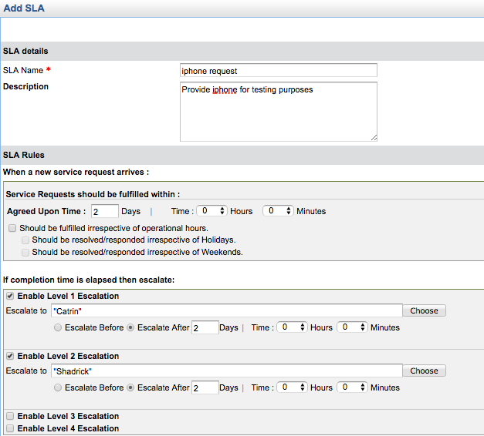
Catrin configures the agreed upon time using SLAs and enables escalation in case the resolution time is violated.
Up to 4 levels of escalation.

Slide 16
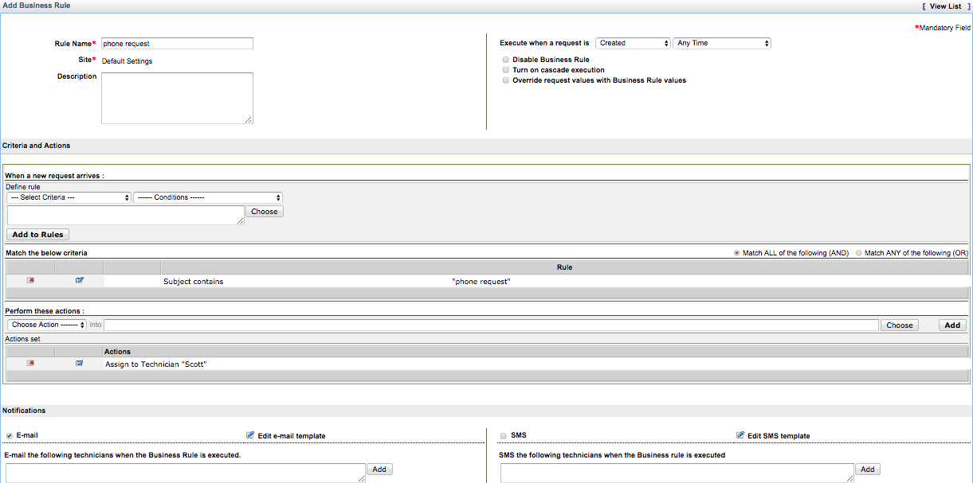
Catrin configures business rules to auto assign the service request to Scott, the IT technician.
Service request is assigned to Scott, the IT technician who becomes the service request owner.

Slide 17
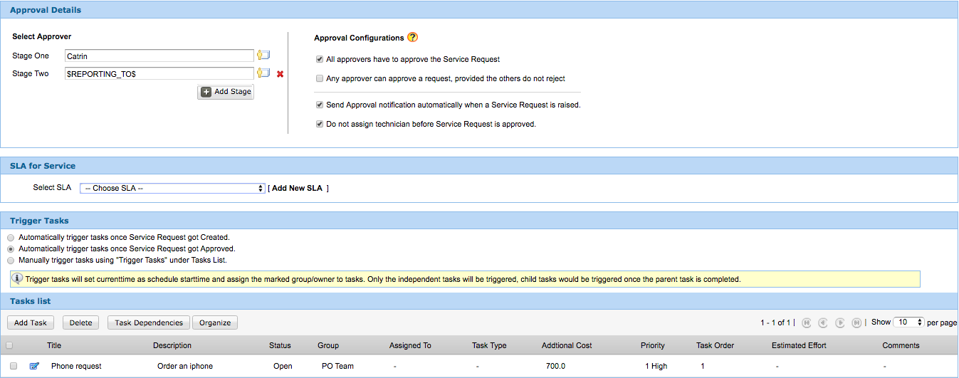
Catrin configures the workflow such that the service requests get assigned automatically to the IT team on approval and the task is triggered to the PO team. Further, Catrin also configures the additional costs for the mobile phone.
Task is auto triggered to the PO team on approval.

Slide 18
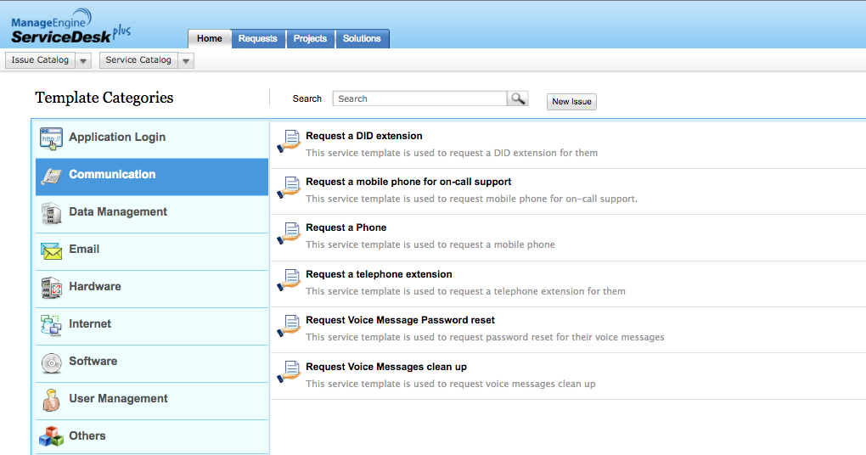
John, the end user, uses the service templates in the self-service portal to raise a service request.

Slide 19
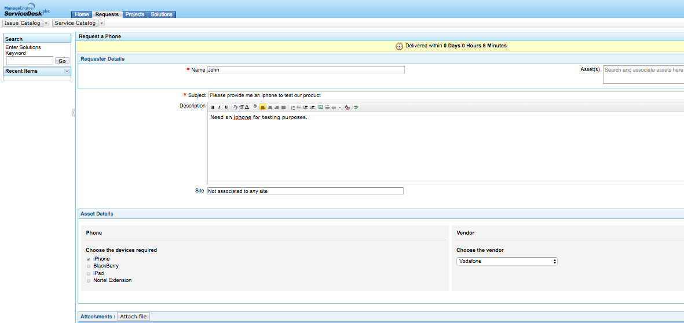
In the request form, John enters the necessary details such as the reason, device name, and the vendor details and quickly submits the service request.
End user enters the reason, asset, and vendor details.

Slide 20
Zylker IT transforms with
ServiceDesk Plus
Catrin configures the workflows, approval mechanism, and SLAs
John receives the phone and becomes a happy end user!
John raises a service request
John is notified at every step and views the status of the request through self service portal.
The request gets auto assigned to Scott
A task is triggered to the PO team. Scott follows up with the PO team and procures the phone.
Catrin and the end, user John’s, reporting manager approve the request. SLAs are applied.
Scott and John await approval.

Slide 21
Service catalog best practice checklist in ServiceDesk Plus
Provide a simple, business-facing description of the service (description)
Identify a service owner (technician, groups)
Service availability (publish to relevant user groups)
Mention service level targets (SLAs)
Define authorization, escalation, and notification policies (Approval details, notification rules)
Specify costs (additional fields)

Slide 22
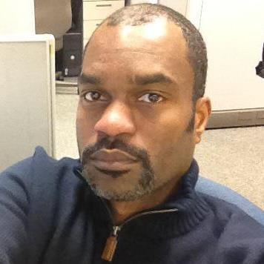
What customers say
ServiceDesk Plus has been a great decision both functionally and financially
James Arnold
Service desk manager
Manhattan Associates

Slide 23
100,000+
IT service desks
700,000
IT technicians
185
Countries worldwide

Slide 24
Get ServiceDesk Plus
Join the 100,000+ IT help desks worldwide.
Sign up for a 30-day free trial.
Have questions? Drop us a line at hello@servicedeskplus.com

