Slide 1
The CMDB in 2012: A Tale of Two Extremes
Dennis Drogseth
Vice President
Enterprise Management Associates

Slide 2
Agenda
What is a CMDB/CMS?
The good, the bad, and the ugly
Selecting and Deploying your CMDB
Two Primary Use Cases
Asset Management and Financial Optimization
Change Management and Change Impact Analysis
Case Study and Conclusions

Slide 3

CMDB/CMS Perceptions are More than Ever Akin to the Blind Men and the Elephant

Slide 4
Is the CMDB Dead or Just in a State of Transformation?
Is the CMDB Relevant to a Virtual Cloud-based World?
The CMDB is Dead – Long Live the CMDB
Reinvent the Obsolete but Necessary CMDB
CMDB 3.0
CMDB = IT Bill of Materials, Resources?
Configuration Management Database – the New Kid on the ITIL Block
You Don’t Want a CMDB- -You want a CMS

Slide 5

Past Failures
In the past, most enterprise CMDB deployments required 2-3 full-time professionals for technical and administrative support.
CMDB data was on average no better than 75% accurate
Data remained spread out across many sources without reconciliation into the CMDB

Slide 6

Things really ARE Getting Better
Improvements in deployment, administration and ease-of-use are real and significant – although there’s still a long way to go in most cases.
CMDBs are being used more and more effectively not just as a single state – view of “what’s true,” but as a platform for analysis and decision support.
CMDB integrations with other capabilities such as asset management, incident management and problem management are becoming more and more out of the box.

Slide 7
And Even in the Past, CMDB Benefits Could be Very Real!
Sample Size = 162, Valid Cases = 162

Slide 8

CMDB Adoption also Helps to Accelerate the Benefits of Cloud
When CMDB deployments were available to internal and external cloud initiatives, respondents saw the following:
1.4 times more likely to reduce complexity of management via cloud
1.4 times more likely to improve service resilience via cloud
1.6 times more likely to accelerate deployment of existing services via cloud
1.6 times more likely to accelerate the creation of new services via cloud
1.5 times more likely to increase infrastructure flexibility via cloud
1.7 times more likely to expand revenue channels via cloud

Slide 9
Selecting and Deploying your CMDB

Slide 10

Deployment and Administration Criteria
ROI and POC
Average time to deploy in a mid-tier enterprise
Administrative overhead—FTEs required
Automation to support deployments
Ease of initial CMDB/CMS population
Flexibility and ease of setting policies
Ease of customizing models
Ease of maintaining, updating modeled groups against discovery
Reports to support maintenance and administration
Ease of entering “domain expertise”
Professional services

Slide 11
Organizational Ownership of the CMDB can Vary
Sample Size = 162

Slide 12
Managing Deployments
One thing I’d like to see in the industry is dumbing down the CMDB so the average person can use it.
From our perspective—we have been very opportunistic—in rolling out the CMDB. We look to address known problems already underway.
Right now the full resources specific to administration of the CMDB is about one half of one FTE—that’s me. Fifty percent of my job is CMDB administration along with being the configuration and ITIL lead for our IT organization of 300.
The challenge is still making the organization use it – today we still have some teams that use EXCEL CMDBs and don’t want to use a discovery tool because they don’t trust it.
I would say that two-thirds of our 300-person IT organization are currently stakeholders of the larger CMDB/CMS system either directly or indirectly. And interest continues to grow.

Slide 13
Real Roles in CMDB Deployments Cluster Around Managerial, Technical, Process and Stakeholders
Sample Size = 162, Valid Cases = 162

Slide 14
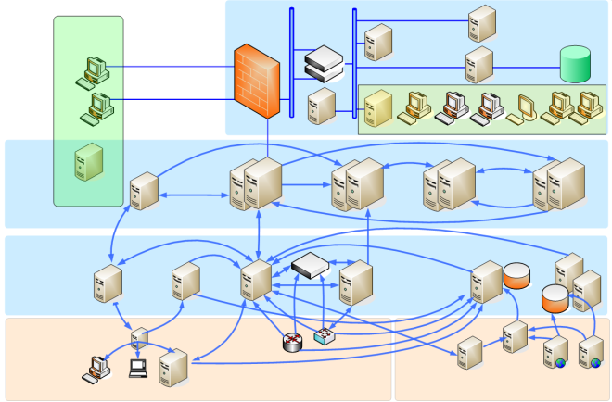
Architecture and Integration Criteria
Scalability
Range of discovery
Reconciliation and normalization
Integration:
Types of MDRs (asset, financial planning, change, performance monitoring, business impact, etc.)
Types of environments:
Standards overall, Web Services, APIs, adapters/connectors,
Policies for scheduled, and dynamic (real-time) access

Slide 15
For Most Respondents, CI Update Intervals Should be Differentiated
Sample Size = 162

Slide 16
Choice of Right Suite, Process Automation, and Reporting /Visualization Lead in Design Values
Sample Size = 162, Valid Cases = 162, Total Mentions = 324

Slide 17
Two Primary Use Cases: Asset and Change Management

Slide 18
Asset Management is Probably the Single Most Popular Use Case for First Phase CMDBs
Sample Size = 40

Slide 19
CMDB Links To Asset Favor Mapping To Owners, Inventory, Retirement, And Lifecycle
Sample Size = 80

Slide 20

Change and Asset Management Benefits
Our CMDB is doing a good job of supporting our migration towards a more fully virtualized infrastructure. It’s also helping us to cut down on the number of management tools we need.
We’re using the CMDB as the system of record for all of our PCs and their owners and where they are located and what applications run on them, in addition to our data center assets. It has become our authorized system of record.
We use it every time we plan a big change, or when there’s a critical change to plan. Instead of taking one week or more, it takes five minutes in the CMDB.
Generating compliance reports is also a core value. We’re audited twice a year and need to generate detailed configuration histories to comply with government regulatory requirements.

Slide 21
Change Management and Change Impact Analysis - A Look into the Future
IT & Customer
Owners
Application
Development
Systems
Performance
Events
Service
Impact
Analysis
DML
“Process-Centric” CMDB
Change Impact Management
Real-Time Service Model
Service Impact Management
CAB
Automation
CMS
Modeling
App
Dependency
Mapping
Configuration
Asset
Capacity
Infrastructure
Utilization
Infra.
Topology
UEM
Flow
Consumption
Change Management & Change Impact Analysis

Slide 22
Case Study and Conclusions

Slide 23
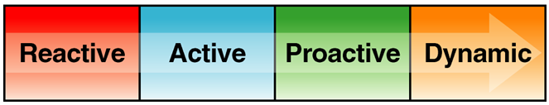
Case Study: Company X
COMPANY X is in the Early Active Stage
Focus is on daily issues
Change is a challenge – despite tracked metrics
Little consideration for integration when getting new tools
Scattered automation
No integrated resource for asset management
Executive sponsorship is a game of Hot Potato

Slide 24
Service-centric Asset Management Initiative: Gating Factors for Company X
Sustained executive management support (11)
Setting initial expectations (8)
Implementation of solid process (8)
Getting funding (7)
Getting buy-in (6)
Getting the right level of requirements to understand the value (5)
Resistance to change (5)
Identifying and maintaining application information (3)
Dedication of key SME’s (3)
Collecting too much data (1).

Slide 25
… and BTW, It’s More Than Worth the Effort
I don’t think there are bad motivators for CMDB/ CMS deployments. People have to move to a centralized information model and singular process sets to support IT operations. That’s what CMDBS initiatives are trying to do.
We wanted a system that would tell his what we had, how it was configured, what applications we were using, who was responsible for it, what were the historical trends in usage, and from that we could better determine if it was a candidate for virtualization or stacking. (It was our golden ladder to infrastructure optimization.)
My advice to others is to DO IT! Don’t be scared. But don’t listen to consultants who tell you they can do everything for you, either. And don’t listen to those who insist that you have to start at the business process level and work down.

Slide 26
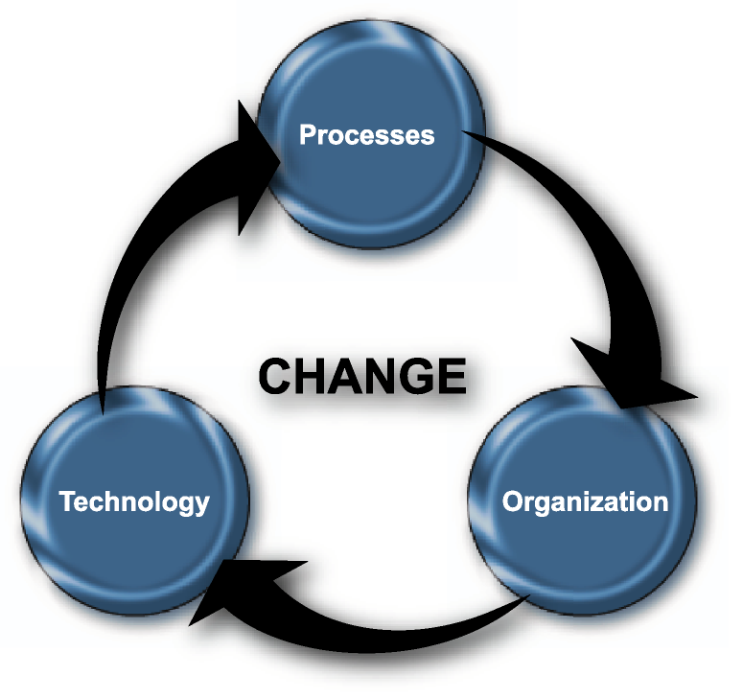
Conclusion: Process, Technology and Organization are Simultaneous Points of Optimization

