Slide 1
A unified data visibility and security platform
File Audit
File Analysis
Data Risk Assessment
Data Leak Prevention
Cloud Protection

Slide 2
Agenda
About DataSecurity Plus
Solutions offered
Highlights and capabilities
License model
Supported platforms
Evaluation assistance
Our customers
Contact us

Slide 3
About DataSecurity Plus
ManageEngine DataSecurity Plus is a unified data visibility and security platform. It provides the below capabilities:
File server auditing
File integrity monitoring
Ransomware detection and response
Security incident response
File and security permission analysis
Data discovery and classification
File copy protection
Endpoint data leak prevention
Cloud application protection, and more.

Slide 4
Solutions offered
DataSecurity Plus comprises of the below modules:
File Audit
Report, analyze, and alert on file accesses and modifications in real time
File Analysis
Analyze file storage, monitor disk space usage, and examine security permissions to locate junk data and security vulnerabilities
Data Risk Assessment
Discover and classify files containing sensitive data (PII, PCI, and ePHI)

Slide 5
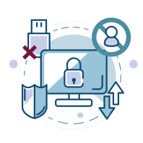
Data Leak Prevention
Detect and disrupt sensitive data leaks via endpoints (USBs, email, etc.)
Cloud Protection
Audit your organization's web traffic to track and control the use of high-risk web applications

Slide 6
Highlights of
File Audit

Slide 7
Highlights of File Audit
Audit file and folder access: Track file read, create, modify, move, delete, copy, paste, etc. to learn who did what, when, and from where
Monitor file integrity: Detect critical events like file changes after business hours, user activity in sensitive files, and multiple failed access attempts
Receive real-time change alerts: Alert admins to unauthorized or unusual file changes, and automatically execute custom scripts to shut down attacks
Shut down ransomware attacks: Detect and respond to ransomware attacks with an automated threat response mechanism
Comply with regulatory mandates: Meet the requirements of multiple IT regulations like PCI DSS, HIPAA, GDPR, FISMA, GLBA, and more

Slide 8
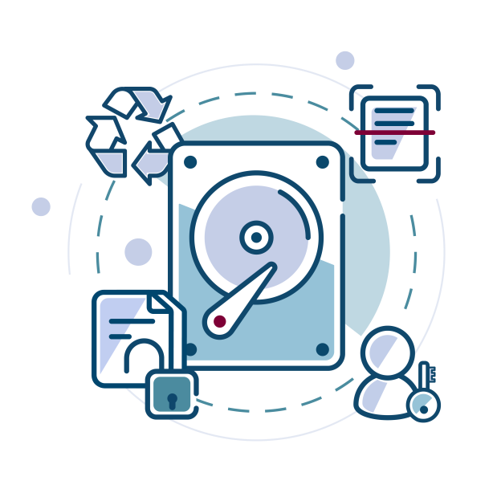
Highlights of
File Analysis

Slide 9
Highlights of File Analysis
Manage ROT data: Find and delete redundant, obsolete, and trivial files to reduce expenditure on storage
Delete duplicate files: Locate duplicate files by comparing file names, sizes, and last modification times, and delete the unnecessary copies to free up primary storage
Analyze disk space usage: Track disk space consumption, and receive alerts on critically low disk space to ensure business continuity
Examine file permissions: Analyze NTFS permissions and detect security vulnerabilities like broken inheritances and files owned by dormant users
Detect overexposed files: Detect files with excessive permissions such as those accessible by every user or allow unrestricted access

Slide 10
Highlights of
Data Risk Assessment

Slide 11
Highlights of Data Risk Assessment
Discover sensitive data: Scan enterprise storage for passport numbers, email addresses, credit card numbers, and over fifty other types of personal data
Analyze trends in PII storage: Receive reports on the volume, type, and trends in the storage of sensitive data
Detect storage policy violations: Instantly detect data that violates enterprise storage policies and respond by executing custom script
Analyze file sensitivity and vulnerability: Analyze the risk associated with files by viewing details on the amount and type of personal data they contain and who can access them
Classify sensitive files: Classify files containing PII, PCI, or ePHI to better understand which files need elevated data security measures

Slide 12
Avoid non-compliance: Avoid the risk of non-compliance penalties by generating periodic reports on the location and amount of sensitive data stored in your environment
Leverage incremental scanning: Scan only new and recently modified files to reduce data discovery scan times
Examine file security: Identify employees who can access files containing personal information
Analyze risk scores: Assess the vulnerability of personal data with an evolving risk score, assigned based on its content, ownership, and more

Slide 13
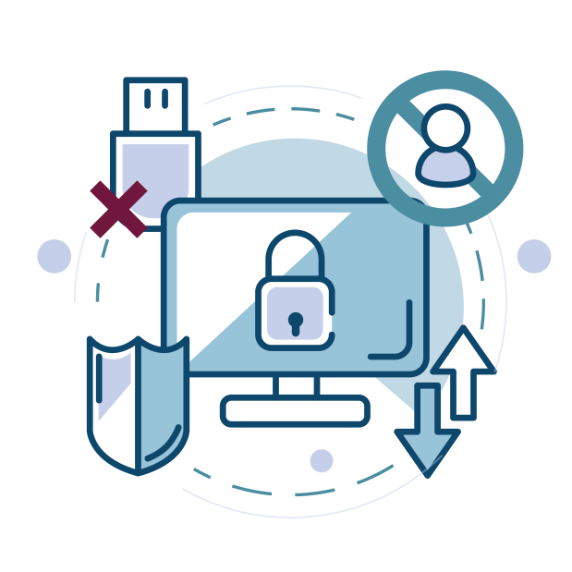
Highlights of
Data Leak Prevention

Slide 14
Highlights of Data Leak Prevention
Audit file activity in endpoints: Audit file accesses across your Windows workstations in real time
Classify endpoint data: Classify files based on their sensitivity as Public, Internal, Confidential, or Restricted
Enable content-aware protection: Closely monitor who owns and accesses sensitive data. Execute instant responses when threats to this data are detected
Monitor removable devices: Audit and control the use of removable storage media and all sensitive data transfer activities to them
Prevent data leaks via USBs: Lock down peripheral ports in response to malicious user behavior to prevent potential data leaks

Slide 15
Block data exfiltration via email: Block files with highly sensitive data—such as PII or ePHI—from being moved via email (Outlook)
Automate incident response: Delete or quarantine files, block USB ports, or choose from other predefined remediation options to prevent data leaks
Audit printer usage: Track and analyze who printed what files and when
Control the use of applications: Create allow and block lists to exercise granular control over which applications can be used by employees.
Prevent file copy actions: Track attempts to copy critical files across local and network shares and block unwarranted file transfers.

Slide 16
Highlights of
Cloud Protection

Slide 17
Highlights of Cloud Protection
Track cloud application usage: Monitor your organization's web traffic to analyze the use of sanctioned or unsanctioned apps
Assess the threat of shadow IT: Spot employees who are putting your organization at risk with their use of shadow cloud applications
Monitor web requests: Capture all HTTP requests along with details on when a cloud application was accessed, by whom, the app's reputation details, and more
Block unsanctioned applications: Prevent your employees from accessing or uploading corporate data via high-risk applications by blocking their actions in real time

Slide 18
Licensing details
File Audit
Licensed based on the number of file servers. Users also get 1TB free File Analysis capabilities for every licensed server.
File Analysis
Licensed based on data size in Terabytes.
Data Risk Assessment
Licensed based on data size in Terabytes.

Slide 19
Data Leak Prevention
Licensed based on the number of endpoints.
Cloud Protection
Free add-on of the Data Leak Prevention module.

Slide 20
Supported platforms
File Audit
Windows File Server 2003 R2 and above
File Analysis
Windows File Server 2003 R2 and above
Data Risk Assessment
Windows File Server 2003 and above

Slide 21
Data Leak Prevention
Windows Vista and above
Cloud Protection
Windows XP and above, Windows Server 2003 and above,
Linux, and Mac

Slide 22
How we aid your evaluation
A fully functional 30-day, free trial
Extension of evaluation license, if needed
24x5 technical support
An online demo hosted at demo.datasecurityplus.com
An extensive knowledge base

Slide 23
Our customers
‌“DataSecurity Plus is a high valued solution that ensures file system integrity and
data loss prevention, and it helps us comply with regulatory standards.”
-Phurich Leemakanot, Mubadala Petroleum

Slide 24
Contact us
Telephone: +1.925.924.9500
Live chat: For instant responses
Email the support team: support@datasecurityplus.com
Visit our website: www.datasecurityplus.com
Mailing address:
ZOHO Corporation,
4141 Hacienda Drive,
Pleasanton, CA 94588, USA

