Slide 1



Analytics Plus for ServiceNow
Product overview

Slide 2

What is Analytics Plus for ServiceNow?
02
Plug-and-play IT analytics solution tailored for ServiceNow users
Offers out-of-the-box IT analytics with over 150 prebuilt reports and dashboards
Features an AI-powered analytics assistant
Provides users with predictive analytical insights
Delivers real-time data alerts via in-app and email notifications
Enables real-time sharing and collaboration

Slide 3
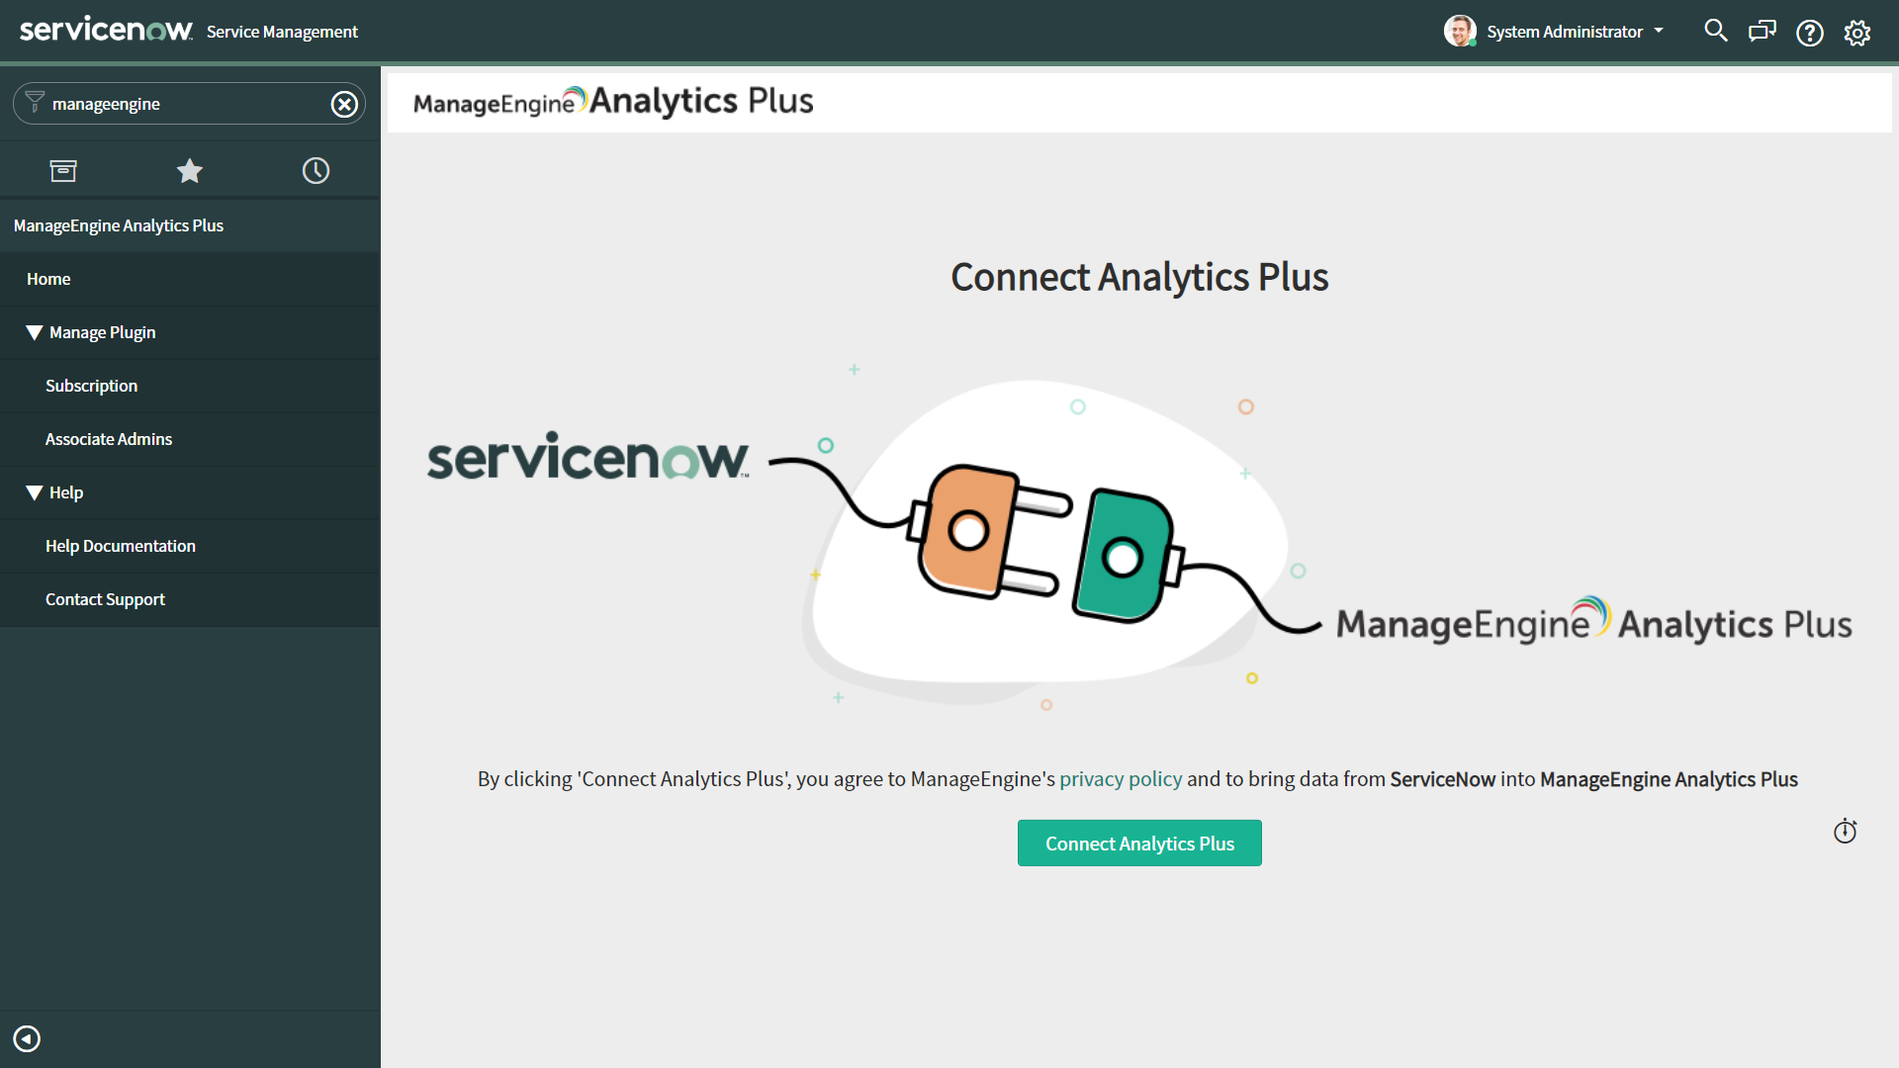
Instantly connect to ServiceNow
03
Installs in minutes enabling you to create ServiceNow reports in seconds

Slide 4
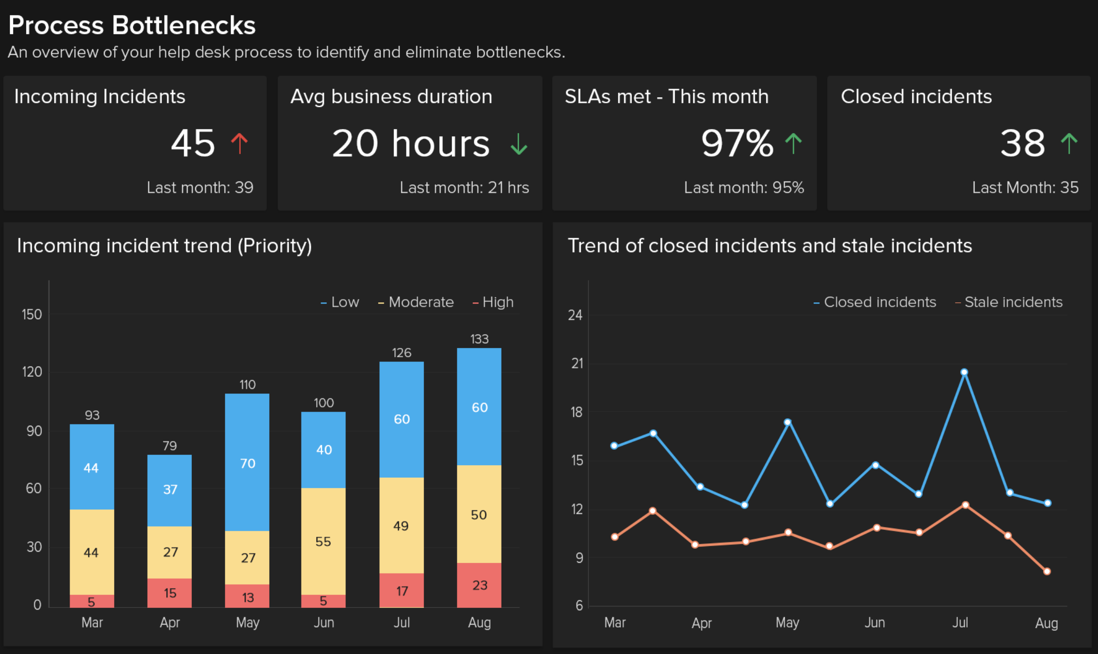
Get out-of-the-box IT analytics
04
Unlock instant value with over 150 prebuilt reports and dashboards

Slide 5
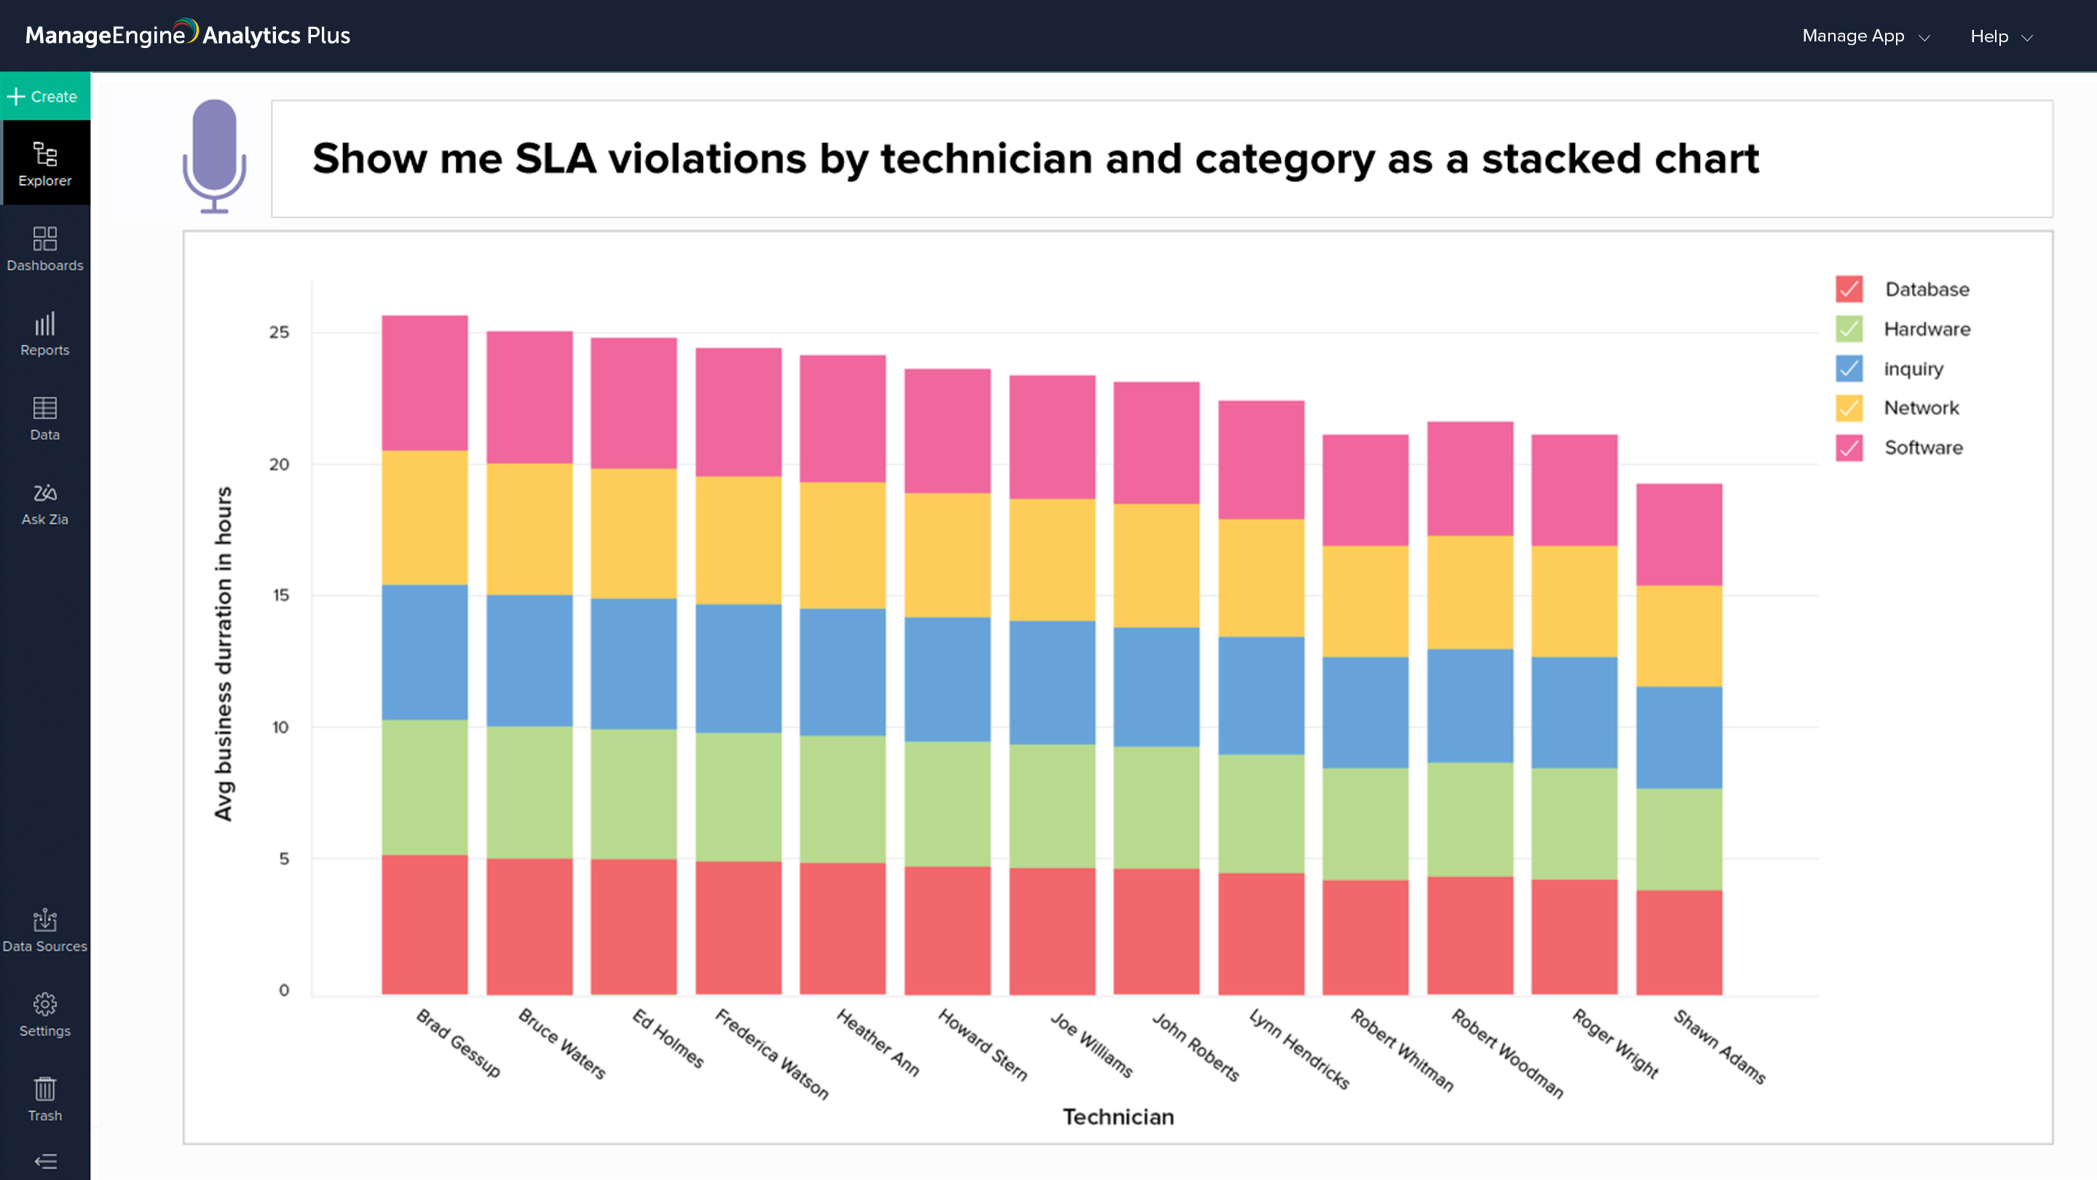
Explore ServiceNow data with AI
05
Uncover hidden insights in your ServiceNow data with Zia, an AI-powered analytics assistant

Slide 6
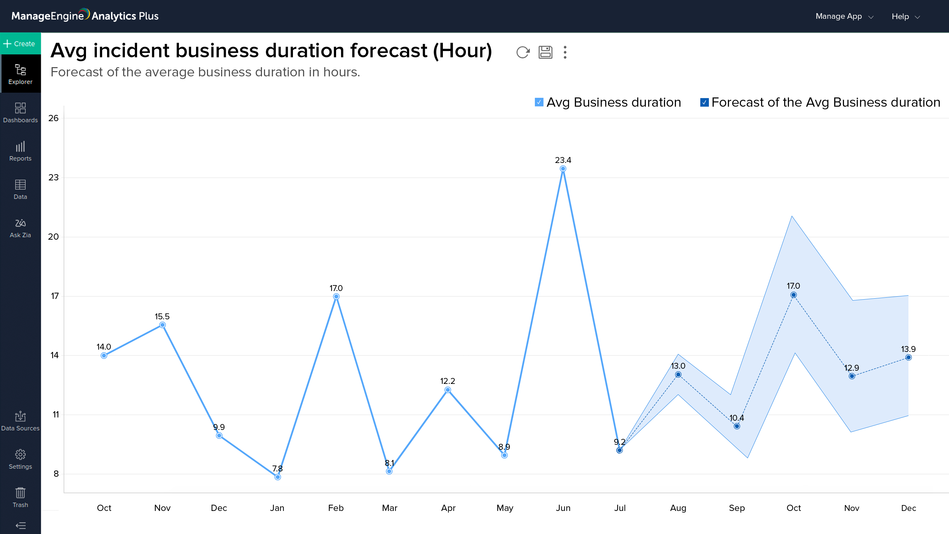
Gain predictive insight into processes
06
Leverage past and current data to accurately forecast the future and prepare for problems beforehand

Slide 7
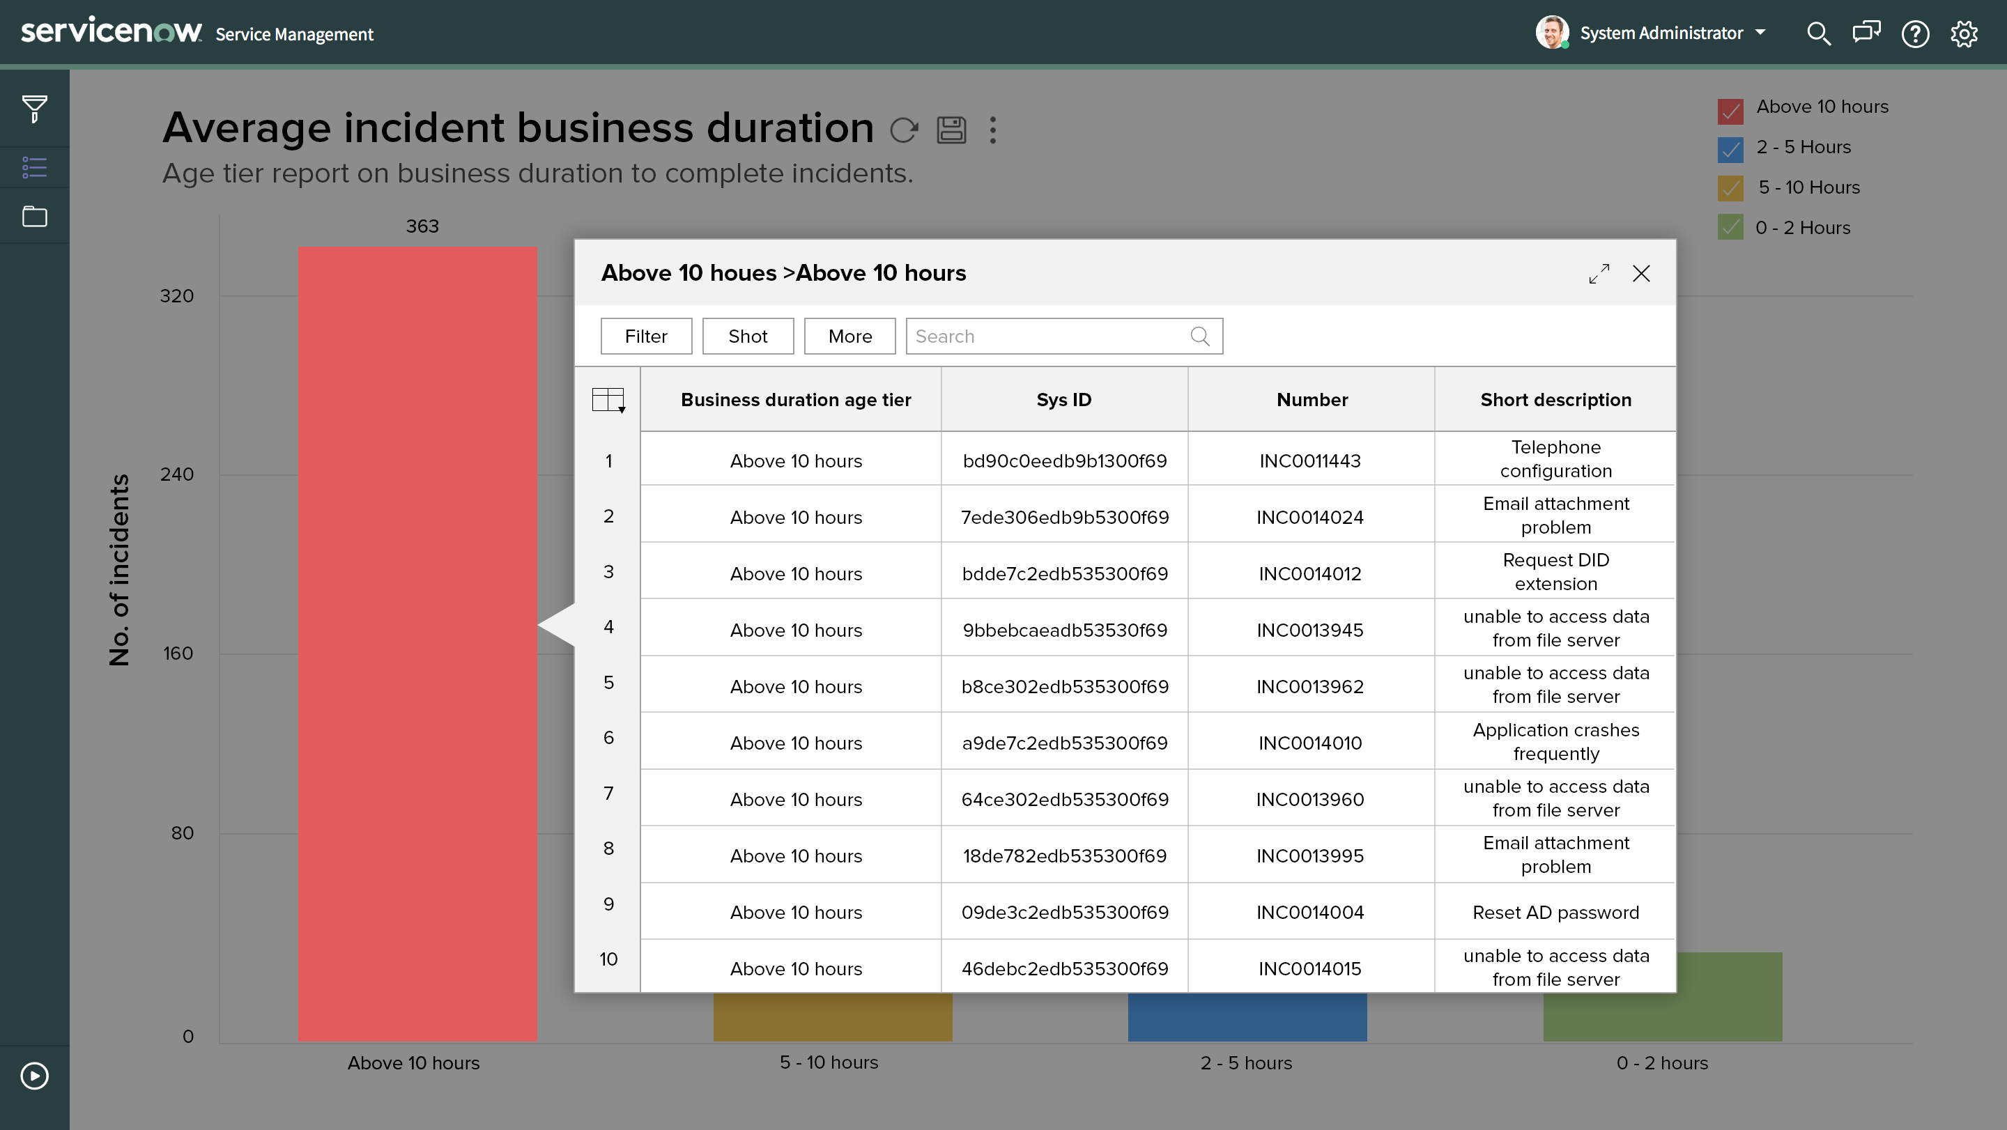
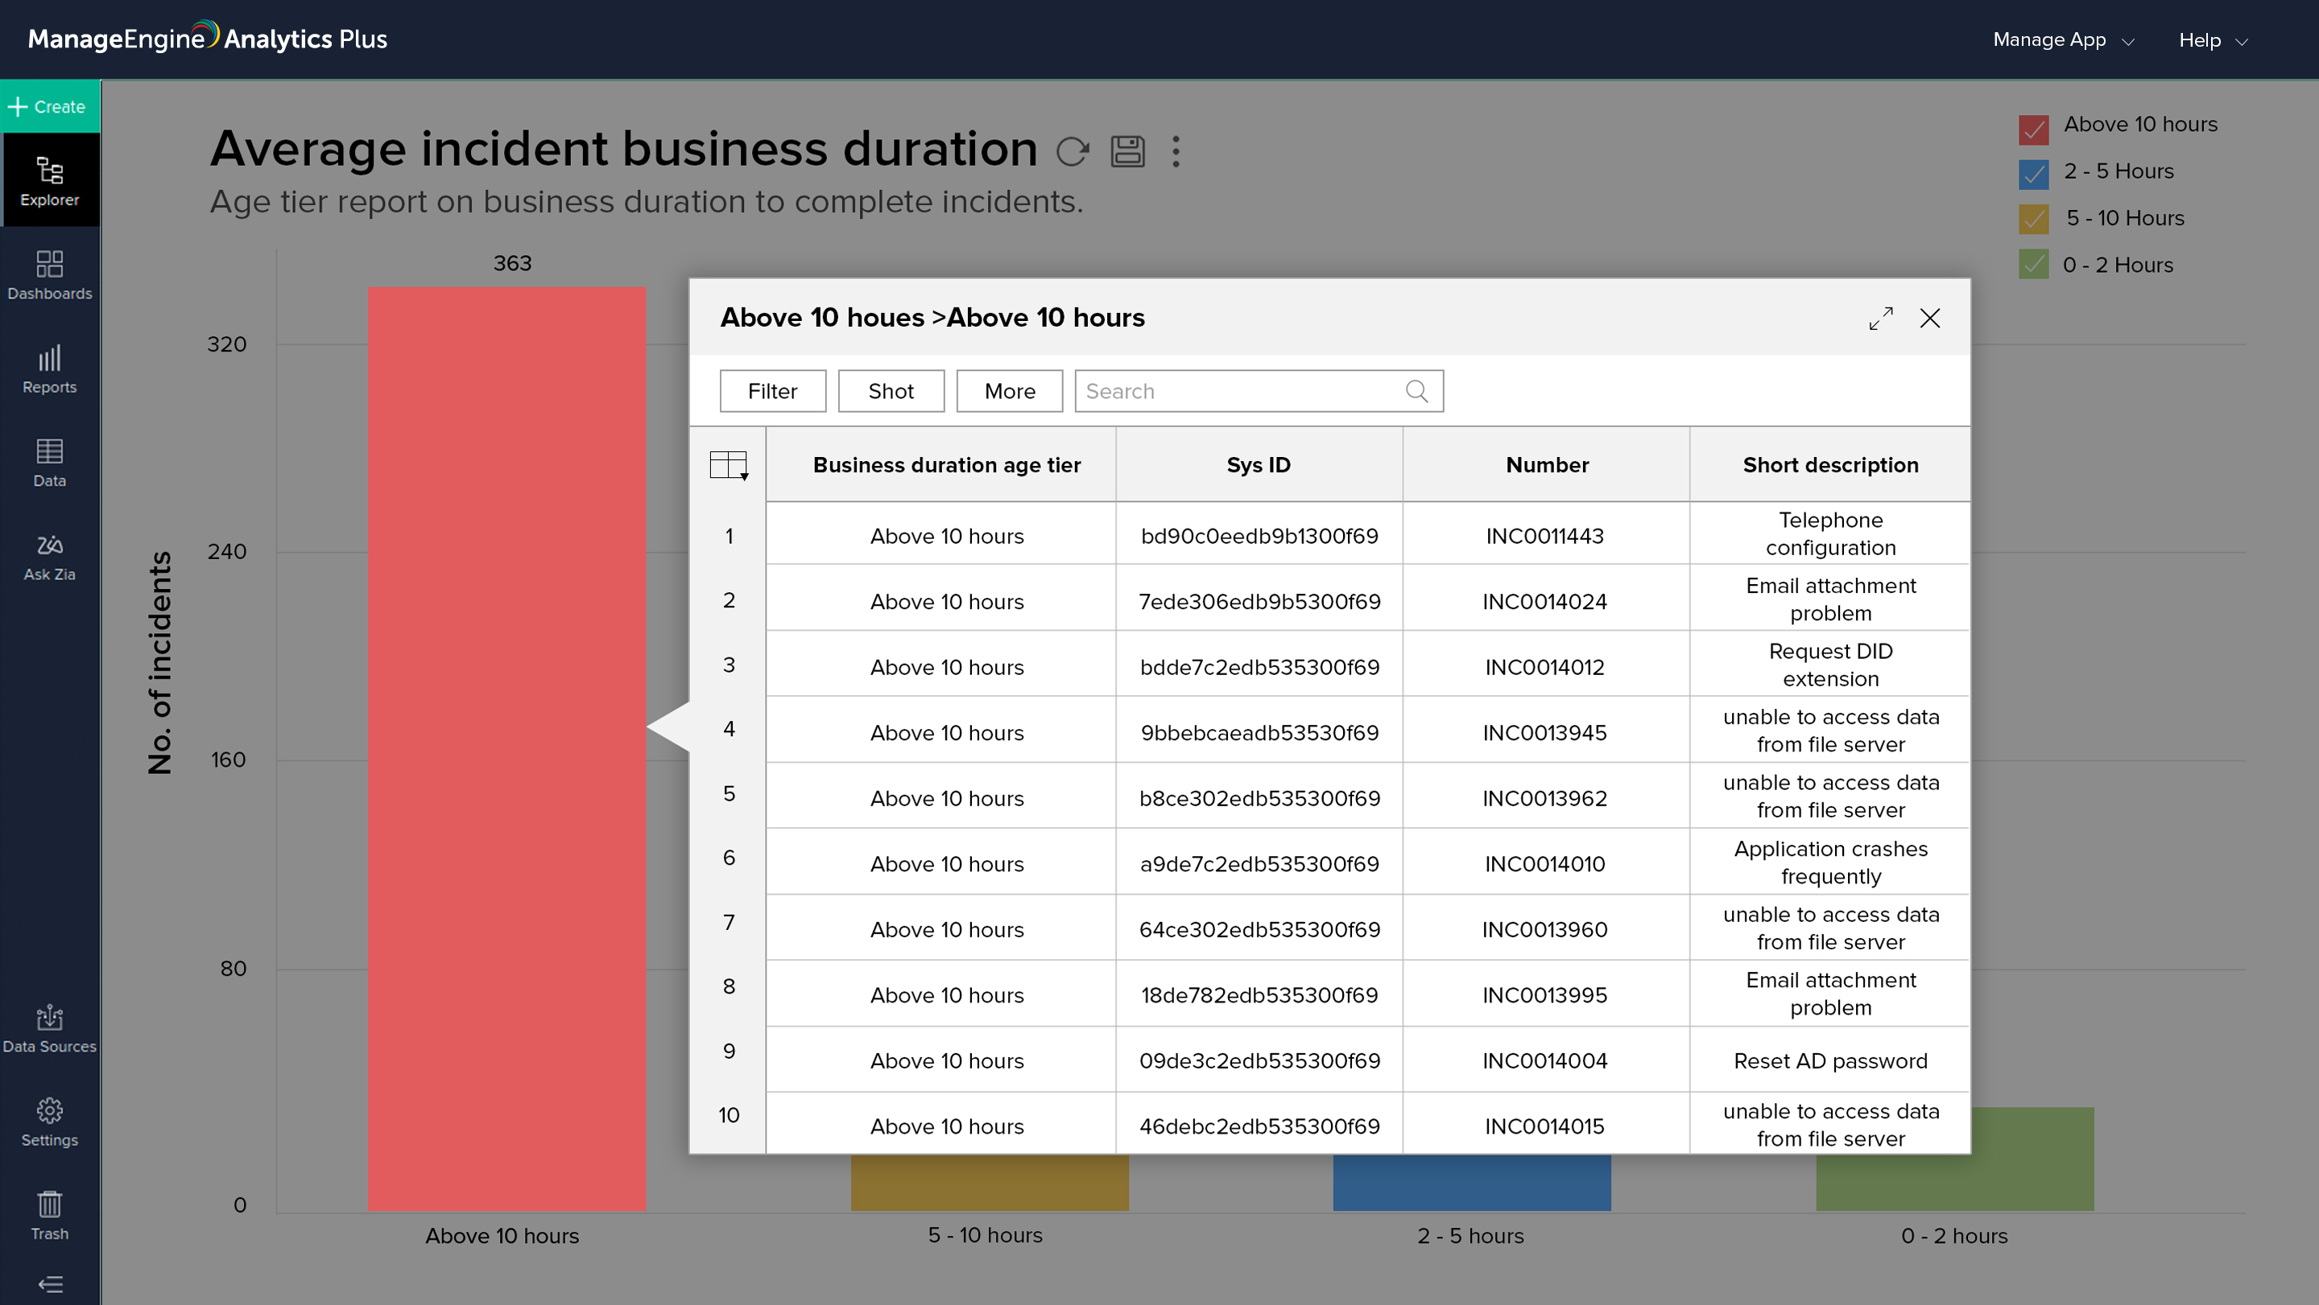
Perform faster root cause analysis
07
Drill down to get a granular view of ServiceNow data and analyze sections of your report that show
an anomaly

Slide 8
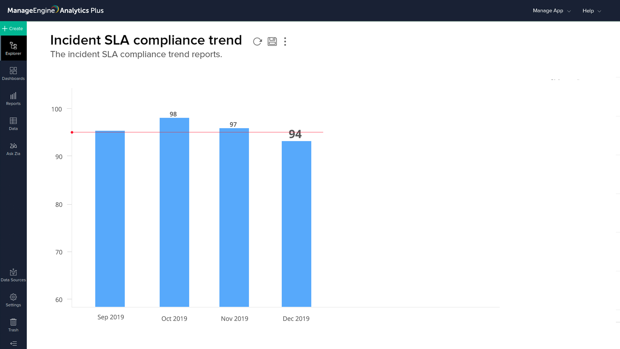


Get notified about threshold violations
08
Stay on top of threshold violations with data alerts sent via in-app and email notifications
SLA compliance is below 95%
The percentage of incidents resolved within SLA is below 95%.
Today at 10:30 am

Slide 9
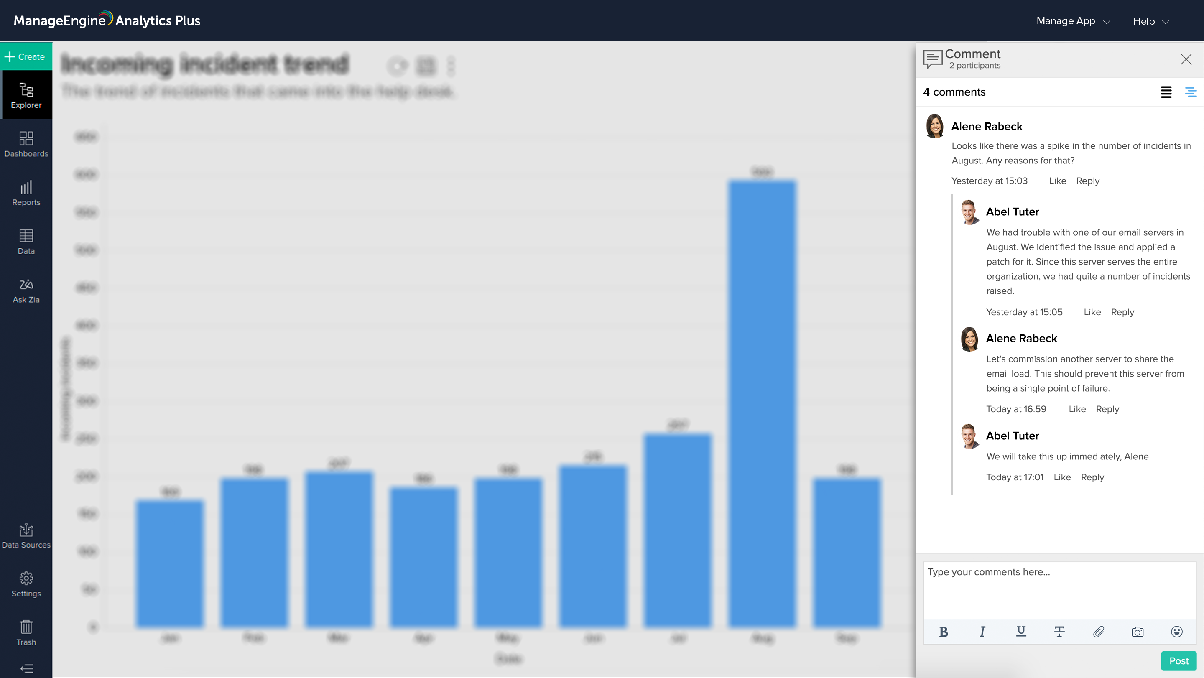
Share and collaborate in real time
09
Export, email, and publish reports, or engage with users in real time with report comments

Slide 10


For more information
10
Check out our website
Contact support at
https://zurl.co/X5ZB
Email :
analyticsplus-support@manageengine.com
Phone:
+1-888-720-9500

