Slide 1
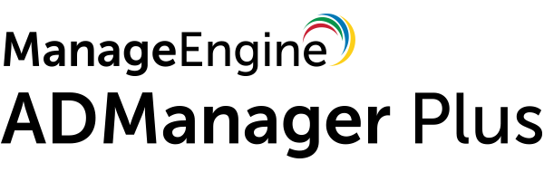
ManageEngine ADManager Plus

Slide 2
Introduction
ADManager Plus is a web-based Active Directory (AD), Microsoft 365 and Microsoft Exchange management solution that offers:
360-degree provisioning
Bulk management of AD objects
200+ pre-packaged reports complete with on-the-fly management actions
NTFS and Share permissions management, group membership management and more
Automate crucial AD routines
Secure and granular delegation of tasks

Slide 3
Why ADManager Plus?
A dashboard that can be customized to view the most essential information of your domain.
Predefined purpose-based management actions that reduce the time and effort required for object management.
Gain essential insights about your AD, Microsoft 365 and Exchange objects, without using complex scripts.

Slide 4
Why ADManager Plus?
Point-and-click operations that empower technicians without any AD expertise to perform successful AD management and reporting.
Notify admins via SMS or email alerts whenever a task is performed.
Since ADManager Plus is a web-based solution, you can perform AD management securely, without accessing your domain controllers directly.

Slide 5

Management

Slide 6
Management
Provision user accounts across multiple platforms such as Active Directory (AD), Microsoft Exchange, Microsoft 365, MS Teams, and Google Workspace, simultaneously from a single console.
Streamline the management of AD objects like users, computers,groups, contacts, OUs and GPOs using customizable templates.
Perform bulk AD object management via CSV import.
Perform AD tasks such as password reset, account unlocks, and more.
Manage permissions of Windows file servers, Netapp and EMC Isilon servers.
Customize naming formats to meet the needs of your organization.
Get real-time notifications whenever a management operation is performed.
Migrate user accounts with all the corresponding attributes across domains, all within the same forest.

Slide 7

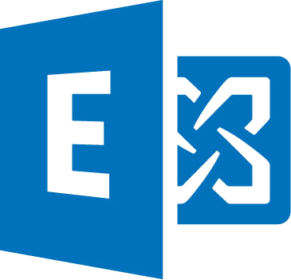


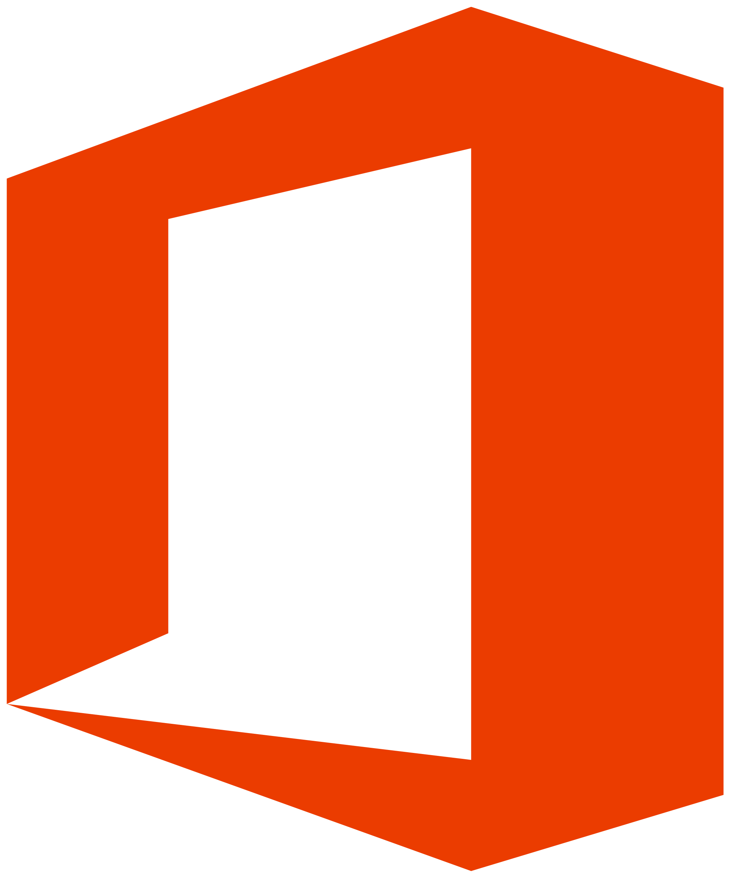


360 Degree Provisioning
Provision accounts across the following platforms from a single console:
Google Workspace
Active Directory
Microsoft Exchange
Microsoft 365
MS Teams

Slide 8

Management:
Customizable
Templates

Slide 9
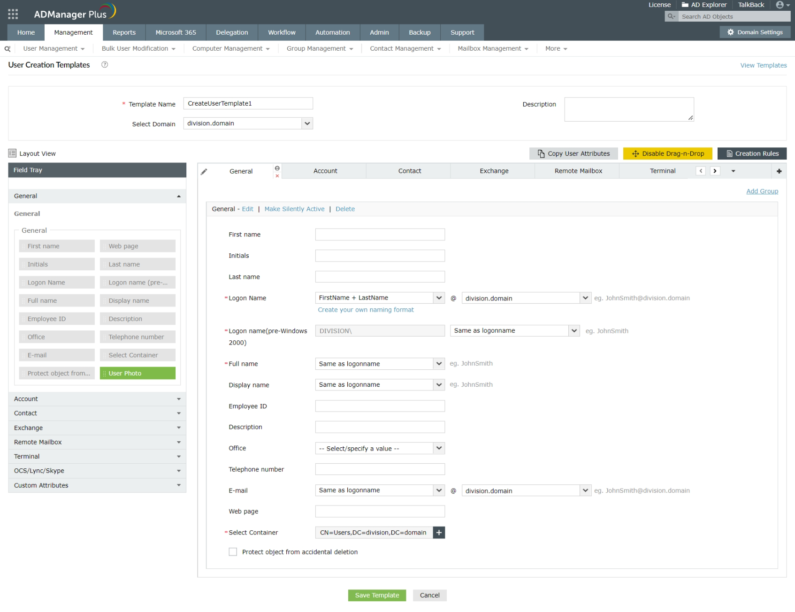
Customizable Templates

Slide 10



Auto - configure attributes
based on conditions
User 1
Dept:
Templates
Dept:
User 2
User 3
100%
Dept:
Dept:
In a template, pre-configure access permissions/entitlements for users based on their positions or departments.
Set rules to populate attributes automatically.

Slide 11


Avoid Duplication
Use templates to proactively identify and handle duplicates at the forest or domain level. Decide what action has to be taken in case duplication occurs.

Slide 12

Management:
Bulk
Management

Slide 13
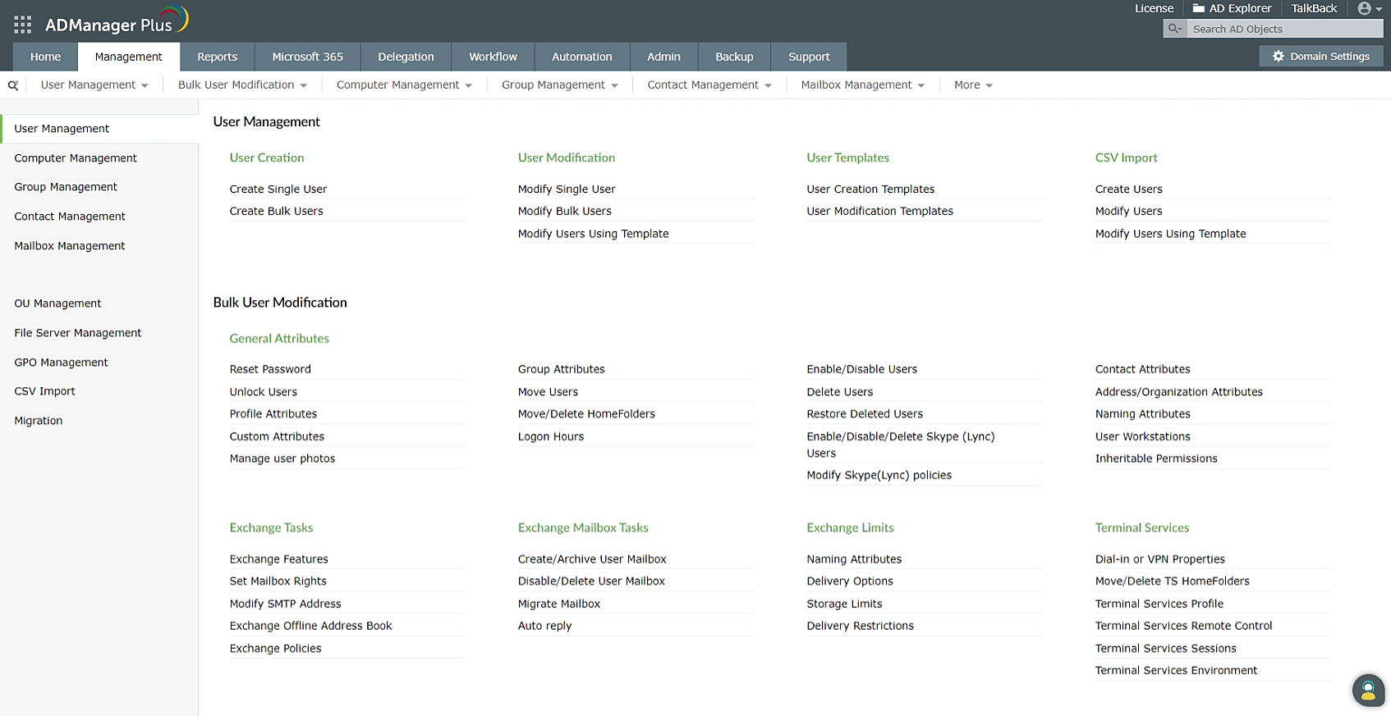
Bulk Management

Slide 14
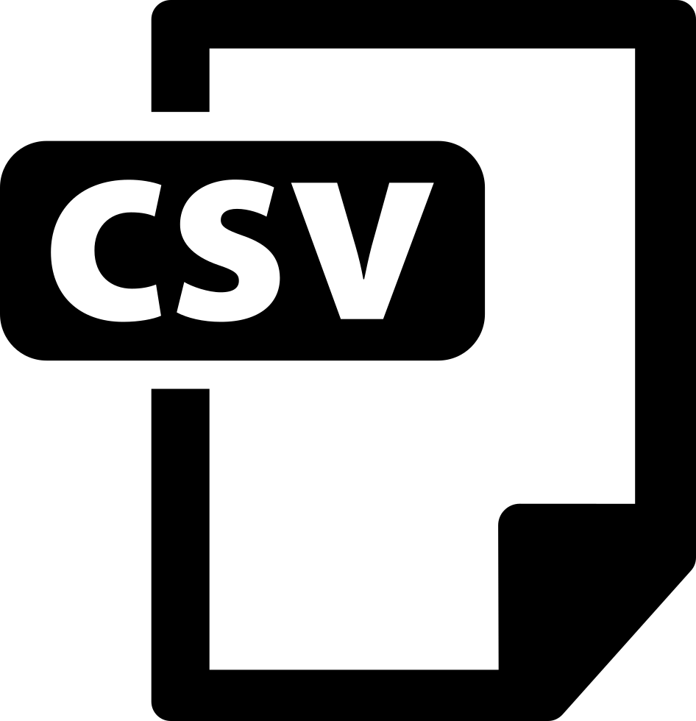

Bulk Object Creation
Create multiple objects (say users) at one go by importing a CSV file containing user data (without using any script).
Importing user details from a CSV
Create Users

Slide 15
Bulk Management of Objects
Use built-in features to perform operations like reset password, unlock accounts, or modify multiple attributes like Profile attributes, Contact attributes, and more.
Perform management operations on multiple objects at one go.

Slide 16



Delete/Disable Policy
Automatically perform the following whenever a user account is deleted, or disabled:
Delete, or disable the:
  Home folders
  Roaming profiles
  Microsoft 365, Google Workspace accounts, and more.
Export Exchange mailboxes as a PST file

Slide 17
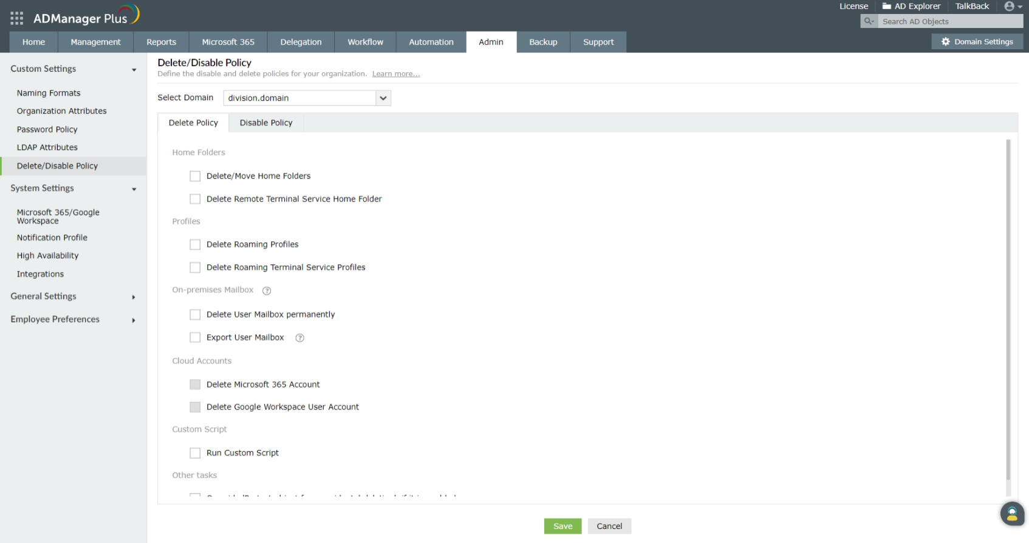
Delete/
Disable
Policy

Slide 18
Customize Naming Formats
Create custom naming formats according to the needs of your organization.
Create multiple naming formats, and configure the option of trying out other formats to handle exceptions.

Slide 19
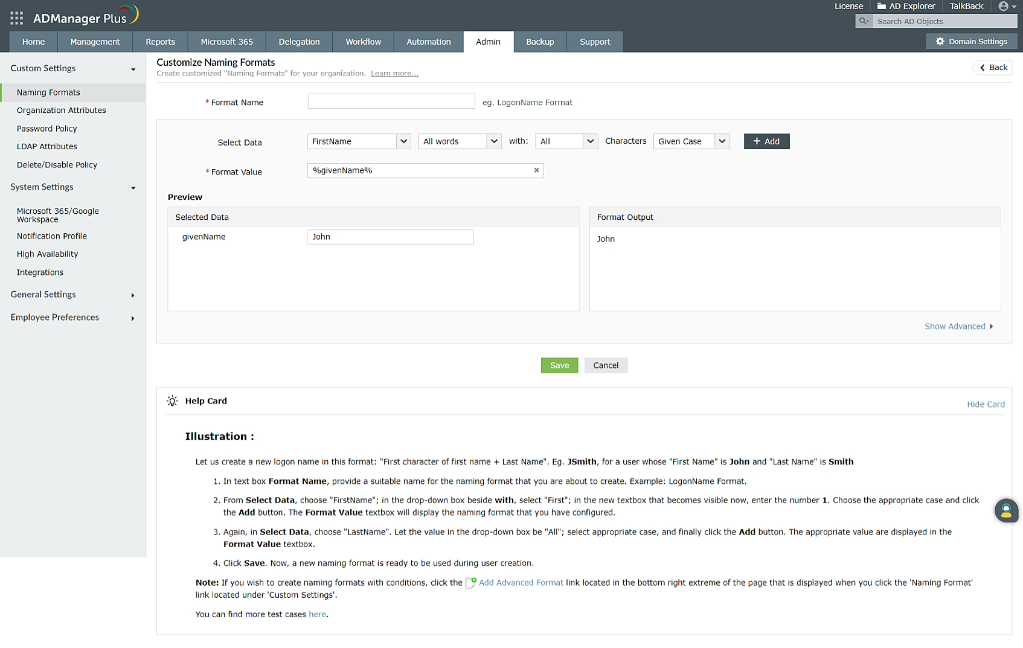
Custom Naming Formats

Slide 20

Real-time notifications
Notify administrators or technicians about any change made in AD through ADManager Plus via:
  SMS
  Email
Create notification templates to configure the recipient, and the message that has to be sent.
Create notification profiles to send custom notification messages.

Slide 21

Reporting

Slide 22
Reporting
Script-free reporting.
200+ pre-packaged reports that cover essential information about AD, Exchange, Microsoft 365, Google Workspace, and more.
Perform on-the-fly management tasks directly from these reports.
Create custom reports as per the needs of your organization.
Automatically generate reports using the report scheduler.
Meet compliance needs with reports for regulations like SOX, GLBA, HIPAA, PCI, GDPR and FISMA.

Slide 23
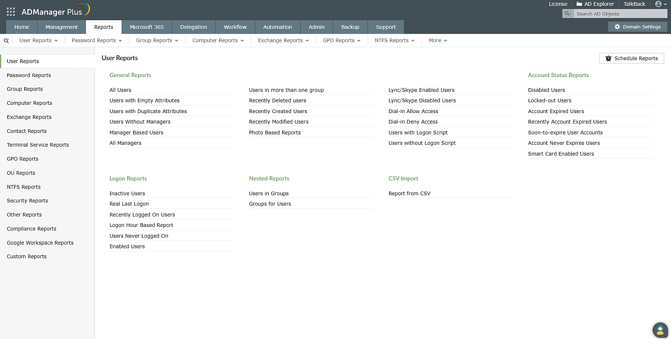
200+
Pre-packaged Reports
Generate reports such as Inactive Users report, Password Unchanged Users report, Disabled Users report, and more.

Slide 24
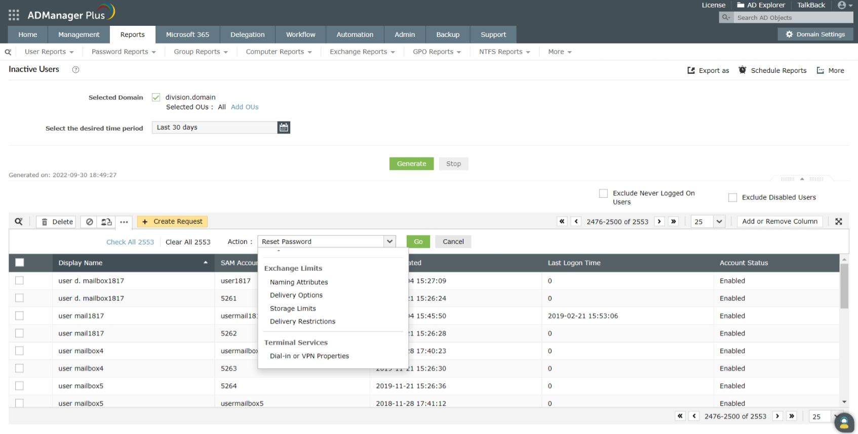
On-the-fly Management
Perform management operations from within the reports.

Slide 25

Built-in Report Scheduler
Schedule reports to be generated at a specified time.
Email the required reports to administrator/technicians automatically.
Set a location at which these reports must be stored.

Slide 26
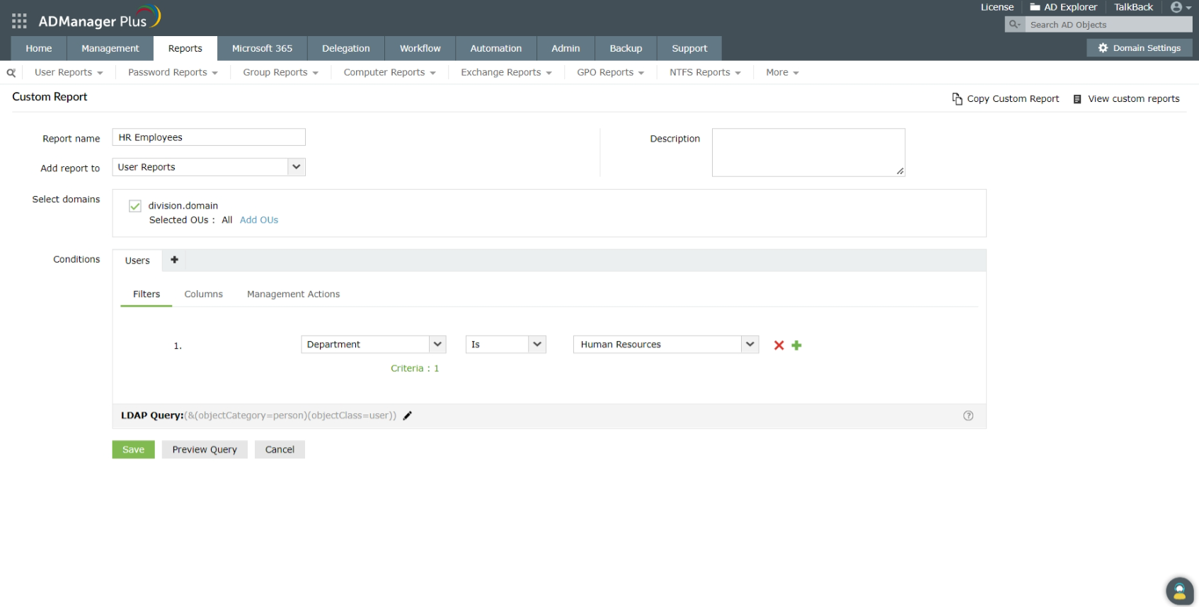
Custom Reports
Apart from 200+ built-in reports, you can also create your own report that includes only the required attributes, and best suits the needs of your organization.

Slide 27
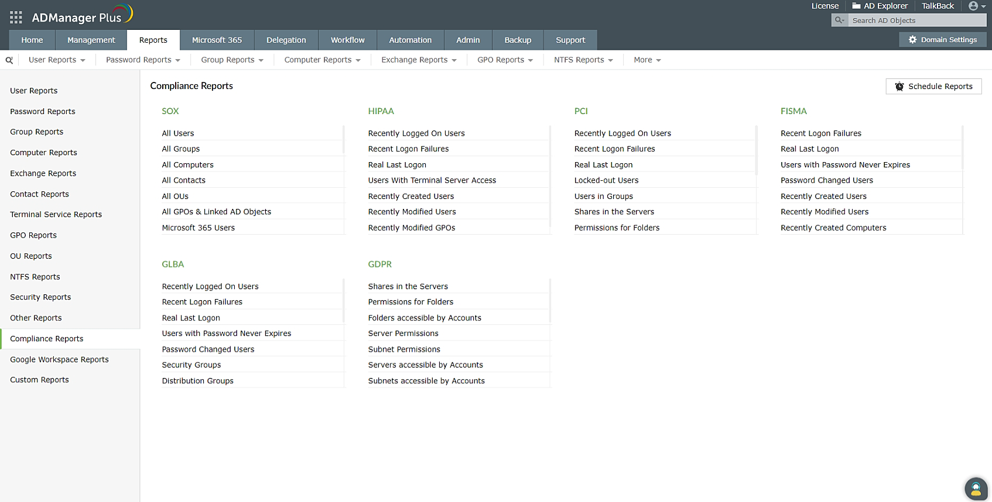
Compliance Reports
Verify your compliance position with the help of predefined reports.
If needed, take remedial actions within these reports to ensure your organization complies with PCI, HIPAA, SOX, the GDPR, and more.

Slide 28

Delegation

Slide 29
Delegation
Non-invasive delegation: Actual Active Directory permissions remain untouched.
The technician role is defined only in the tool.
OU-based delegation: Fine-tune delegation of Active Directory tasks by restricting delegation rights of technicians to specific OUs.
Role-based access: A technician will not be able to perform any other task apart from the ones delegated to him.
Audit reports: Track the activities of the help desk technicians and administrators, and identify any deviations from established standards.

Slide 30
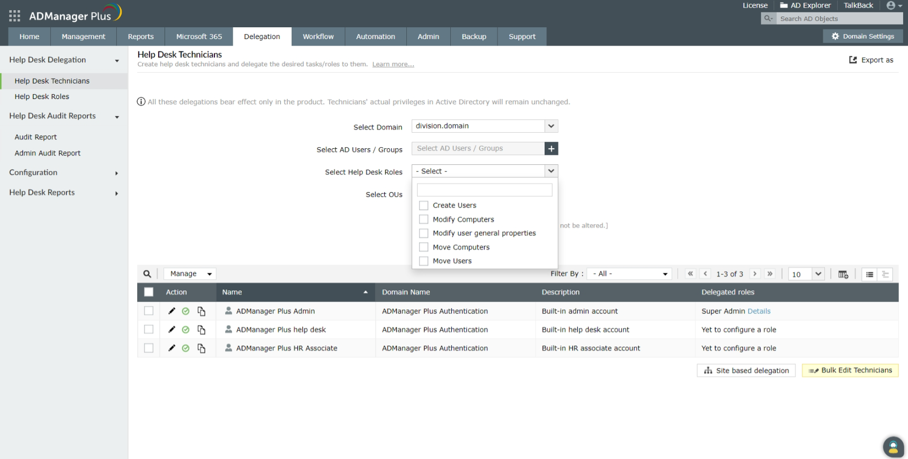
Delegation

Slide 31



Non-invasive Delegation
The permissions delegated using ADManager Plus do not affect the actual AD permissions of the user.
Role-based Access
Create roles to granularly delegate management and reporting actions to technicians.
Audit Reports
Keep track of the activities performed by all the technicians and detect anomalies in your AD environment.

Slide 32

Backup and recovery

Slide 33

Active Directory backup and restoration
Back up and restore important AD objects, such as users, computers, contacts, groups, OUs, and GPOs, without directly accessing the DC.
Back up and restore your domain's DNS zones and nodes. You can also keep backups of DNS configuration changes for easy restoration after accidental changes.
Compare different backup versions to view what has changed, and undo even the smallest of accidental changes.
Empower your help desk by delegating AD backup and recovery rights to specific OUs. Keep track of backup and restore activities with the help of audit reports.

Slide 34
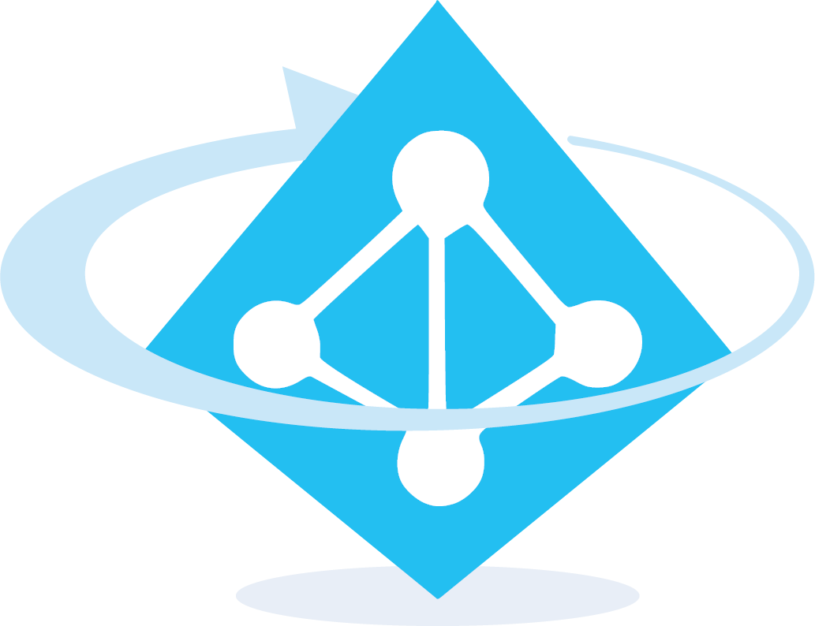
Azure Active Directory backup and recovery
Backup and restore all objects in your Azure Active Directory environment.
Restore entire objects or just specific attributes to their backed up state.

Slide 35
Google Workspace backup and restoration
Explore all the available backups and perform restorations of Google Workspace mailboxes, contacts, user drives, and calendar items
Choose Google Workspace accounts that you wish to back up to save on licensing costs
Compare various backup versions and undo even minor, unintentional changes
Distribute the workload among your help desk technicians by delegating backup and recovery permissions

Slide 36
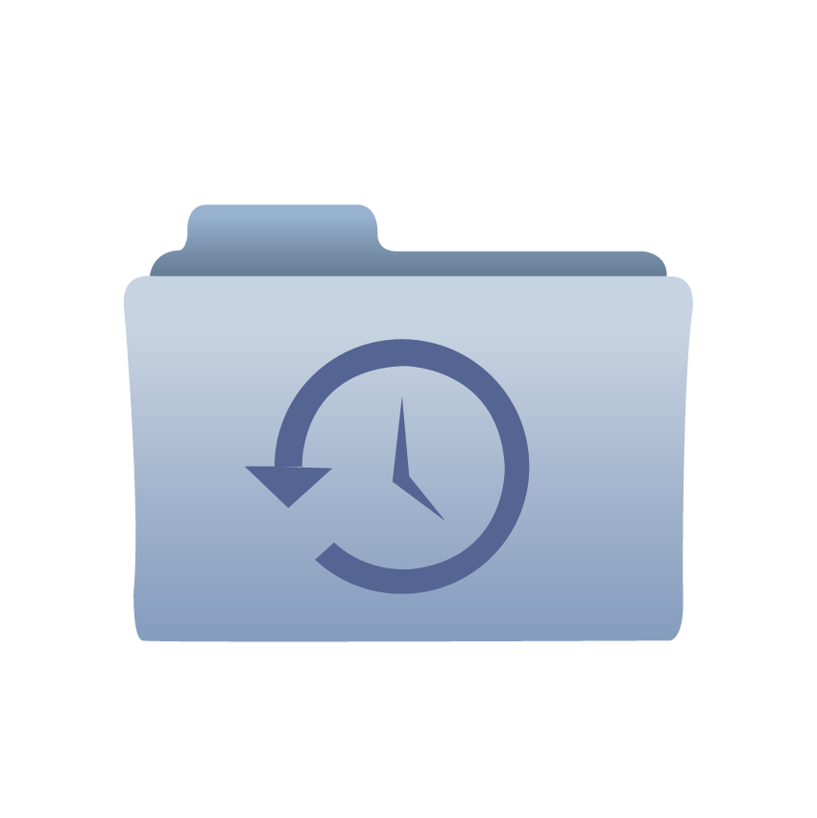
Backup
Incremental backup: Expedite the backup process and minimize the utilization of storage space by only backing up the changes made since the last backup. Subsequent backups are stored as versions.
Full backup: Regularly perform complete backups of all the objects present in your domain.
Scheduled backup: Schedule backups for a specific date, day, and time

Slide 37
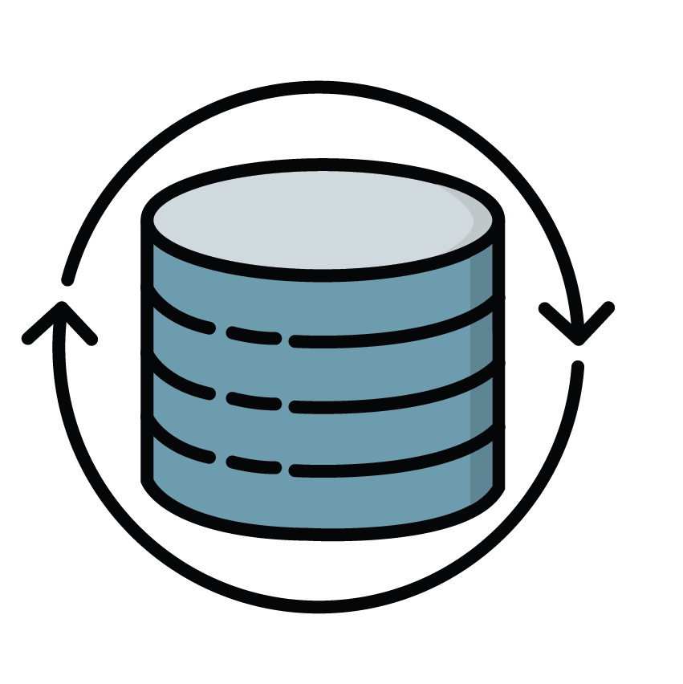
Recovery
Object and attribute-level restoration: Restore only the required objects or individual attributes of particular objects.
Restart-free recovery: Recover objects completely or granularly without having to restart your DCs.

Slide 38

Workflow

Slide 39
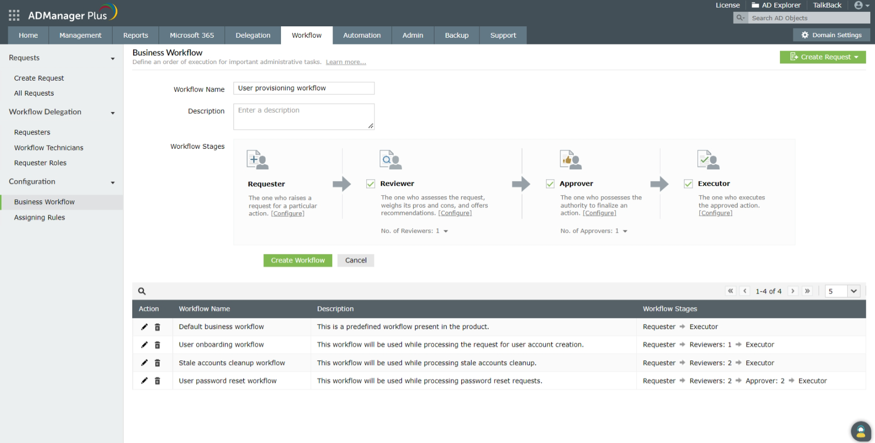
Workflow
Multilevel workflow that helps assign and prioritize tasks.
Manager-based workflow that grants managers granular control over the properties of their team's objects.
Track the status of delegated tasks. Monitor and review tasks including automated tasks.
Define SLA to help users take actions on time-sensitive requests.

Slide 40

Automation

Slide 41


Automation
Script-free automation
Enforce workflow for controlled automation
Automated AD object management with the help of pre-built actions
Automate tasks
Easily automate crucial standalone tasks such as user creation, password resets, moving computers, and more.
Set the time constraints and intervals after which the automation is to be repeated.
Option of importing user details from a CSV, or external databases or HRMS, for creating AD users automatically.
Option to use any of the relevant reports as inputs for automating tasks.

Slide 42
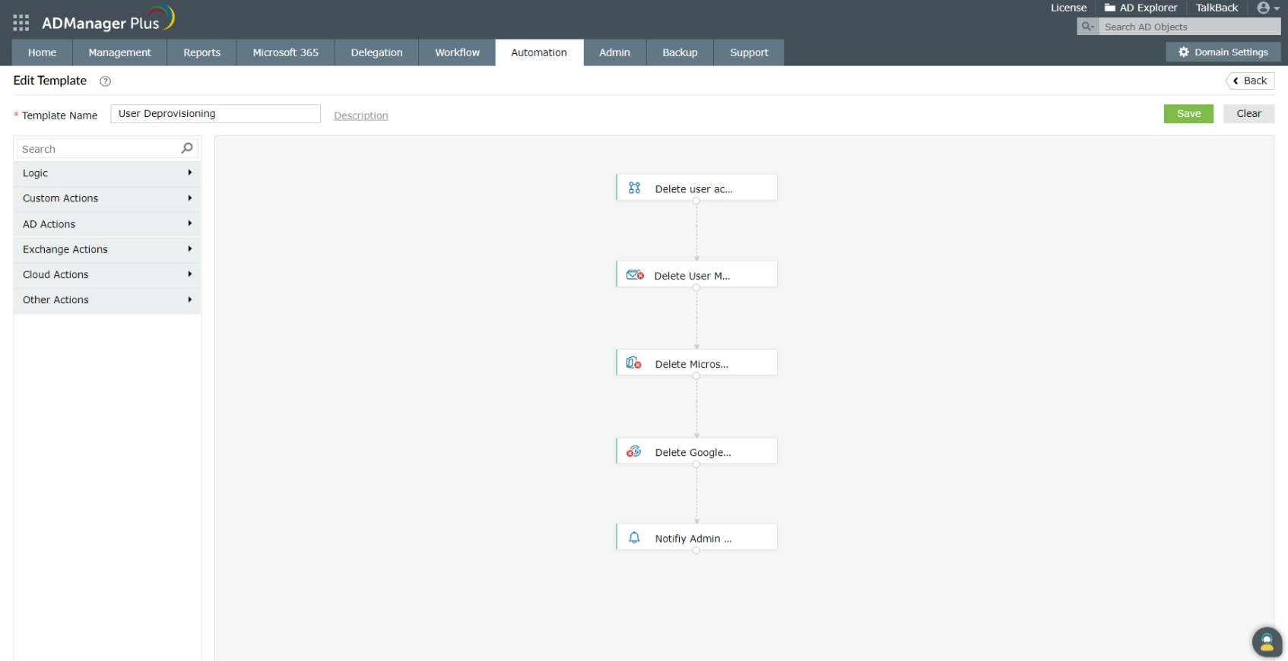
Orchestration

Slide 43
Orchestration
Automate a series of user provisioning and deprovisioning tasks in succession at defined time intervals whenever a user or group management task is carried out in ADManager Plus
Create, update, and delete users, groups, and their attributes in external applications using webhook templates
Build templates easily with drag-and-drop actions
What makes up orchestration?
  Webhook templates
  Logic blocks
  Custom scripts
  Predefined AD, Exchange, Microsoft 365, and Google Workspace actions
  Orchestration profile

Slide 44
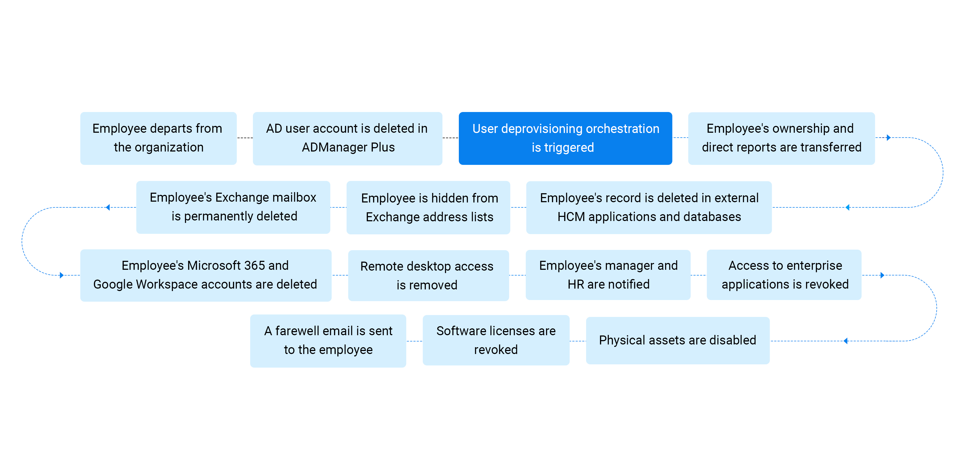
User deprovisioning using orchestration

Slide 45
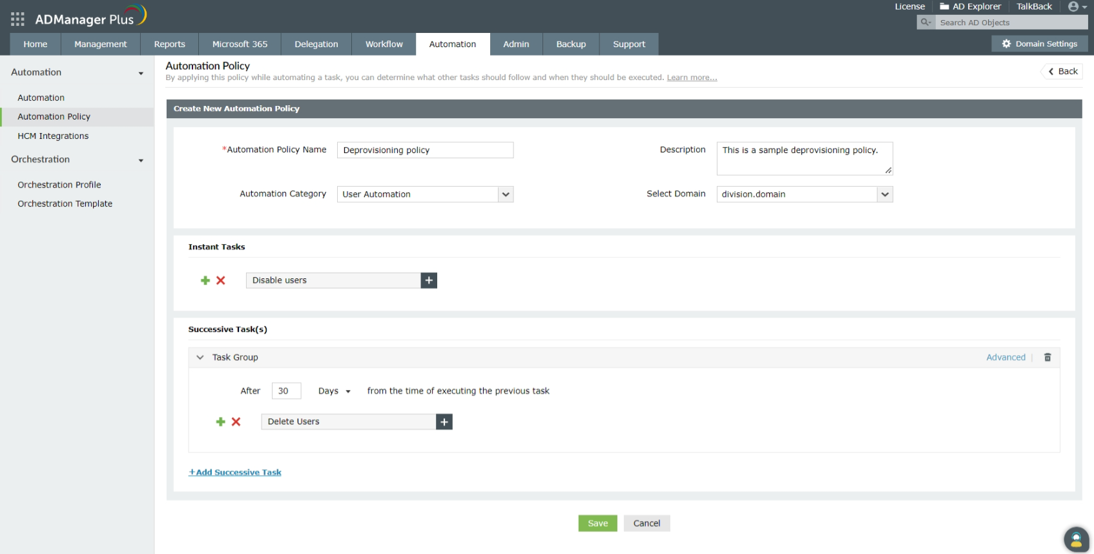
Automation Policy

Slide 46


Automation Policies
Automate a series of tasks that help you automate complete routines.
For instance, AD cleanup will require the following tasks to be automated:
  Disable the required users
  After 30 days from disabling the users, strip off all the group memberships.
  After another 30 days, delete the users.

Slide 47
Microsoft 365 Management and Reporting
Flexibility to manage and report on Active Directory and Microsoft 365 from a single window.
Create Microsoft 365 groups, Distribution/Security Mail enabled groups and Dynamic distribution groups in single and bulk using group creation templates.
Built-in management tasks.
Get Microsoft 365 License and Group reports in an instant without PowerShell scripting.

Slide 48
Microsoft Exchange Management and Reporting
Bulk mailbox creation: Create bulk user mailboxes in a single click by just importing a CSV file.
Set mailbox properties while creating mailbox – all in one action.
Delegate to help desks the rights of creating and setting mailbox properties.

Slide 49
Mobile AD user management
ADManager Plus mobile apps for iOS and Android offers the following operations:
Reset password, unlock, enable/disable, and delete users
Manage group memberships
View, manage, and execute AD task requests
Get reports about locked out, disabled, password expired, and inactive users

Slide 50



Integrations
ADManager Plus supports integrations with:
External
databases
HR management systems
Help desk
software

Slide 51
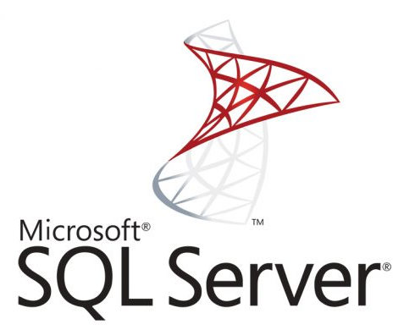
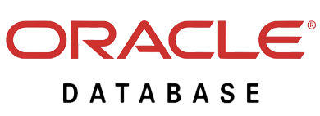
Integration with external databases
Administrators can now import user records directly from external databases to automate user creation, modification and deletion.
The external databases that can be integrated with ADManager Plus include:

Slide 52
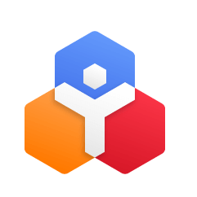

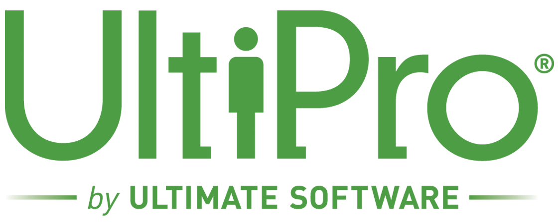
Integration with HR Management Software
Administrators can now integrate ADManager Plus with a HR Management system and directly import the user details from the HRMS to create AD user accounts automatically.
ADManager Plus currently supports integrations with custom HRMS platforms and HR management systems like,
  Zoho People
  UltiPro
  bambooHR

Slide 53
Integration with help desk software
By integrating ADManager Plus with your help desk console such as ServiceDesk Plus (on-prem and cloud), Jira, ServiceNow and Zendesk, you can:
Execute AD tasks directly from your help desk console
Delegate simple AD tasks to technicians/HR associates having little to no AD expertise since AD management via ADManager Plus is a point and click activity
Create users across multiple platforms like AD, MS Exchange, Microsoft 365, MS Teams, and Google workspace without toggling between multiple windows

Slide 54
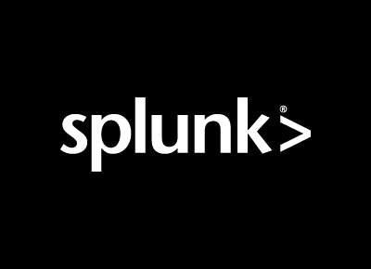
Log forwarding
Administrators can now send the logs of Active Directory management operations performed using ADManager Plus to Syslog servers and SIEM tools such as Splunk for detailed auditing.
  Syslog

Slide 55


Thank you!
For more details mail us at:
support@admanagerplus.com

