Slide 1

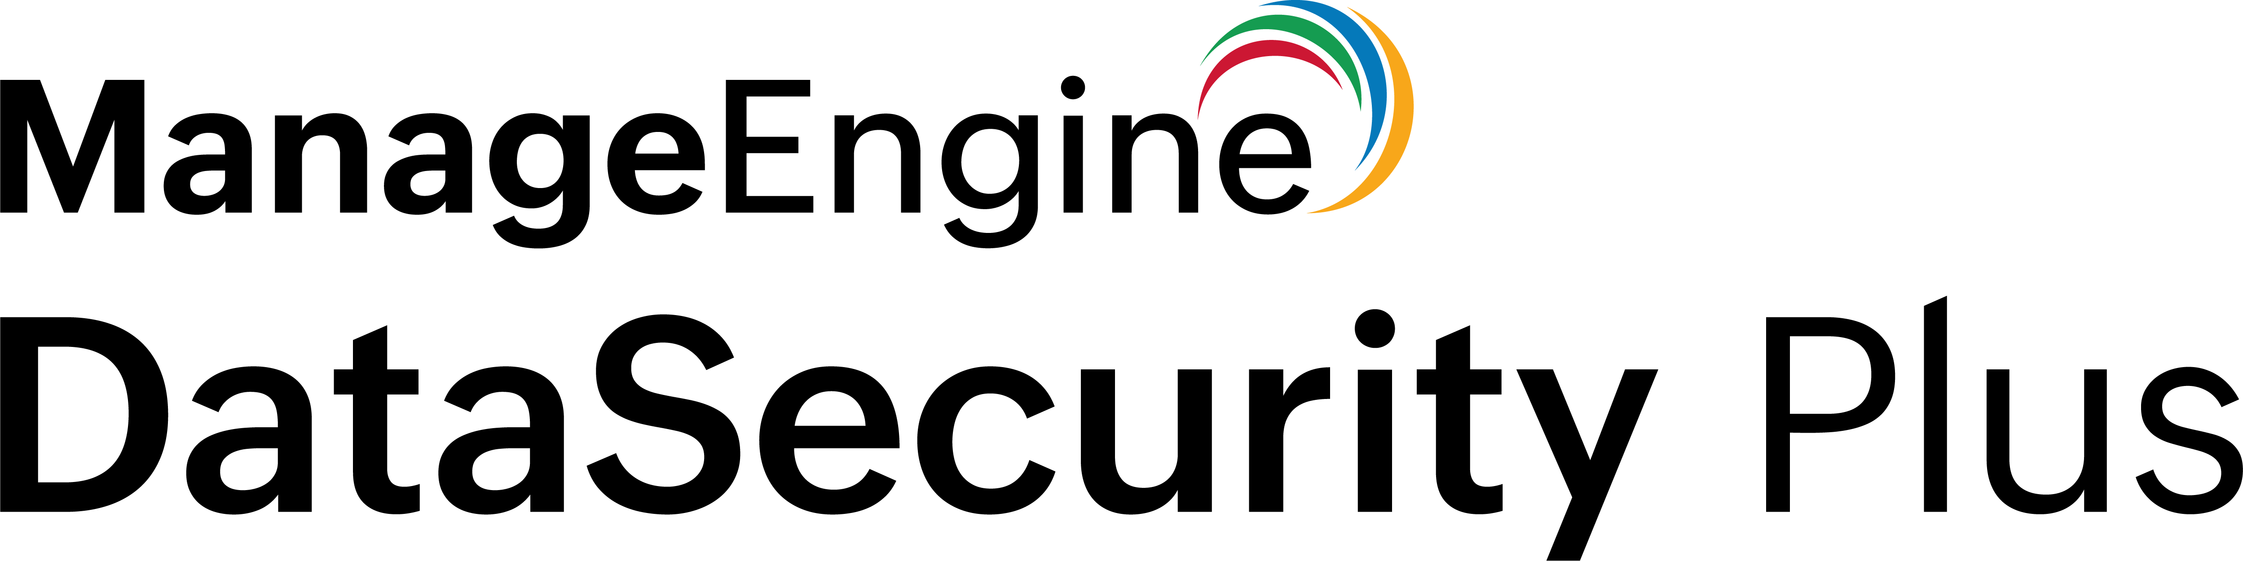
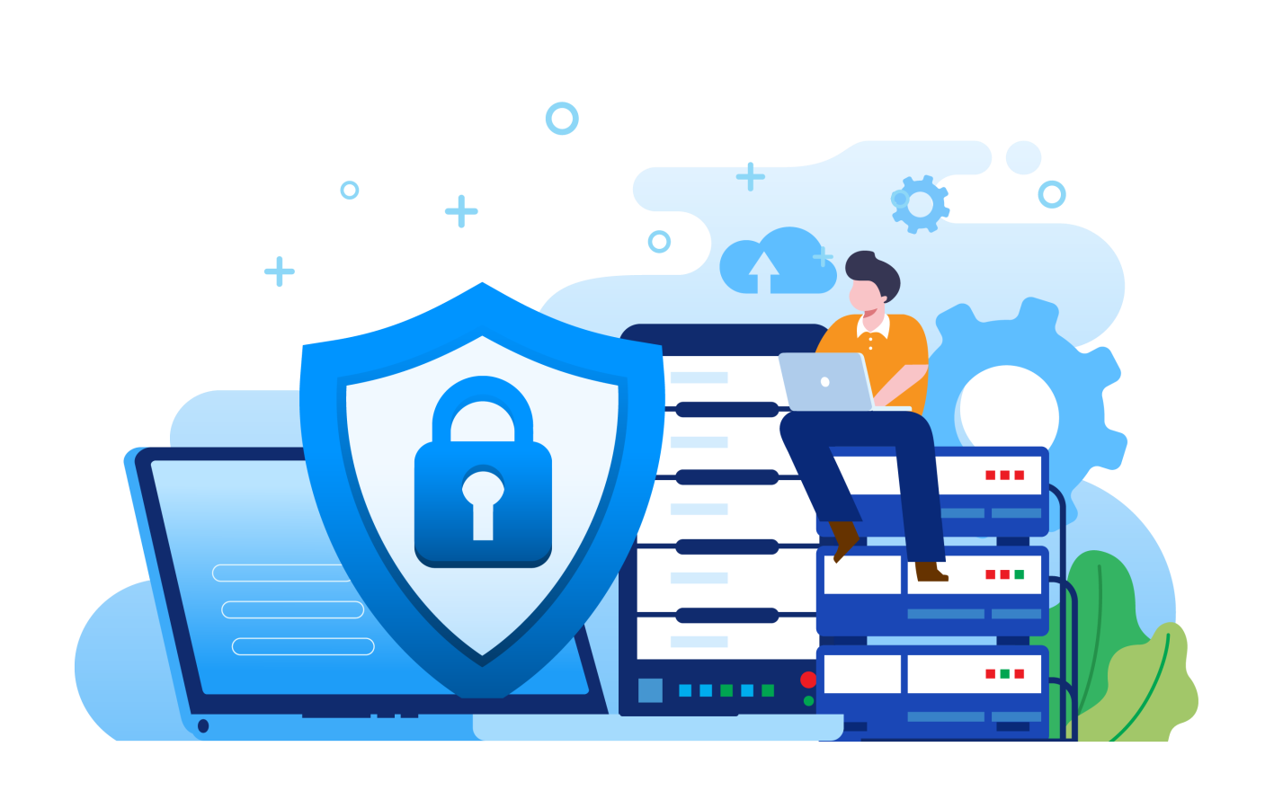
A unified data security posture management platform
File Audit
File Analysis
Data Risk Assessment
Data Leak Prevention
Cloud Protection

Slide 2
Agenda
Data security: Need of the hour -------------------------------------- 3
About DataSecurity Plus ----------------------------------------------- 4
Solutions offered --------------------------------------------------------- 5
Highlights and capabilities -------------------------------------------- 8
How DataSecurity Plus stands out ---------------------------------- 20
License model ------------------------------------------------------------ 21
Supported platforms --------------------------------------------------- 23
Evaluation assistance -------------------------------------------------- 26
Our customers ----------------------------------------------------------- 27
Contact us ---------------------------------------------------------------- 28

Slide 3
Data security: Need of the hour
‌Exponential data growth: Control over data usage and proactive data management is essential to reduce expenses and optimize storage efficiency
Advanced threats to sensitive data: Increasing data breach incidents necessitate a content-aware data loss prevention measure that can locate and protect vulnerable, sensitive files
Complying with regulations: An automated data-centric audit and protection approach can help organizations meet compliance requirements

Slide 4
About DataSecurity Plus
ManageEngine DataSecurity Plus is a unified data security posture management platform. It provides a host of capabilities, including:
File server auditing and file integrity management
Ransomware detection and response
Security incident response
File and security permission analysis
Data discovery and classification
File copy protection
Endpoint and cloud data leak prevention
Cloud application protection

Slide 5

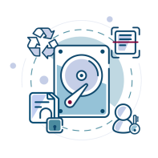

Solutions offered
DataSecurity Plus comprises of the below modules:
File Audit
Report, analyze, and alert on file accesses and modifications in real time
File Analysis
Analyze file storage, monitor disk space usage, and examine security permissions to locate junk data and security vulnerabilities
Data Risk Assessment
Discover and classify files containing sensitive data (PII, PCI, and ePHI)

Slide 6
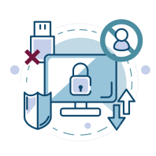

Solutions offered
Data Leak Prevention
Detect and disrupt sensitive data leaks via endpoints (USBs, email, etc.)
Cloud Protection
Audit your organization's web traffic to track and control the use of high-risk web applications

Slide 7

Highlights of
File Audit

Slide 8
Highlights of File Audit
Audit file and folder access: Track file read, create, modify, move, delete, copy, paste, etc. to learn who did what, when, and from where
Monitor file integrity: Detect critical events like file changes after business hours, user activity in sensitive files, and multiple failed access attempts
Receive real-time change alerts: Alert admins to unauthorized or unusual file changes, and automatically execute custom scripts to shut down attacks
Shut down ransomware attacks: Detect and respond to ransomware attacks with an automated threat response mechanism
Comply with regulatory mandates: Meet the requirements of multiple IT regulations like PCI DSS, HIPAA, GDPR, FISMA, GLBA, and more

Slide 9
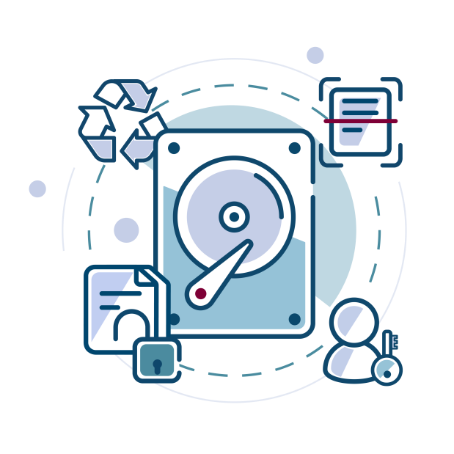
Highlights of
File Analysis

Slide 10
Highlights of File Analysis
Manage ROT data: Find and delete redundant, obsolete, and trivial files to reduce expenditure on storage
Delete duplicate files: Locate duplicate files by comparing file names, sizes, and last modification times, and delete the unnecessary copies to free up primary storage
Analyze disk space usage: Track disk space consumption, and receive alerts on critically low disk space to ensure business continuity
Examine file permissions: Analyze NTFS permissions and detect security vulnerabilities like broken inheritances and files owned by dormant users
Detect overexposed files: Detect files with excessive permissions such as those accessible by every user or allow unrestricted access

Slide 11

Highlights of
Data Risk Assessment

Slide 12
Highlights of Data Risk Assessment
Discover sensitive data: Scan enterprise storage for passport numbers, email addresses, credit card numbers, and over fifty other types of personal data
Analyze trends in PII storage: Receive reports on the volume, type, and trends in the storage of sensitive data
Detect storage policy violations: Instantly detect data that violates enterprise storage policies and respond by executing custom script
Analyze file sensitivity and vulnerability: Analyze the risk associated with files by viewing details on the amount and type of personal data they contain and who can access them
Classify sensitive files: Classify files containing PII, PCI, or ePHI to better understand which files need elevated data security measures

Slide 13
Highlights of Data Risk Assessment
Avoid non-compliance: Avoid the risk of non-compliance penalties by generating periodic reports on the location and amount of sensitive data stored in your environment
Leverage incremental scanning: Scan only new and recently modified files to reduce data discovery scan times
Examine file security: Identify employees who can access files containing personal information
Analyze risk scores: Assess the vulnerability of personal data with an evolving risk score, assigned based on its content, ownership, and more

Slide 14
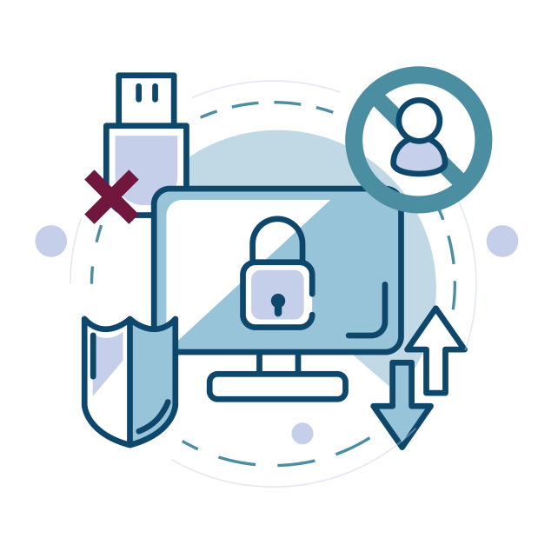
Highlights of
Data Leak Prevention

Slide 15
Highlights of Data Leak Prevention
Audit file activity in endpoints: Audit file accesses across your Windows workstations in real time
Classify endpoint data: Classify files based on their sensitivity as Public, Internal, Confidential, or Restricted
Enable content-aware protection: Closely monitor who owns and accesses sensitive data. Execute instant responses when threats to this data are detected
Monitor removable devices: Audit and control the use of removable storage media and all sensitive data transfer activities to them
Prevent data leaks via USBs: Lock down peripheral ports in response to malicious user behavior to prevent potential data leaks

Slide 16
Highlights of Data Leak Prevention
Block data exfiltration via email: Block files with highly sensitive data—such as PII or ePHI—from being moved via email (Outlook)
Automate incident response: Delete or quarantine files, block USB ports, or choose from other predefined remediation options to prevent data leaks
Audit printer usage: Track and analyze who printed what files and when
Control the use of applications: Create allow and block lists to exercise granular control over which applications can be used by employees.
Prevent file copy actions: Track attempts to copy critical files across local and network shares and block unwarranted file transfers.

Slide 17
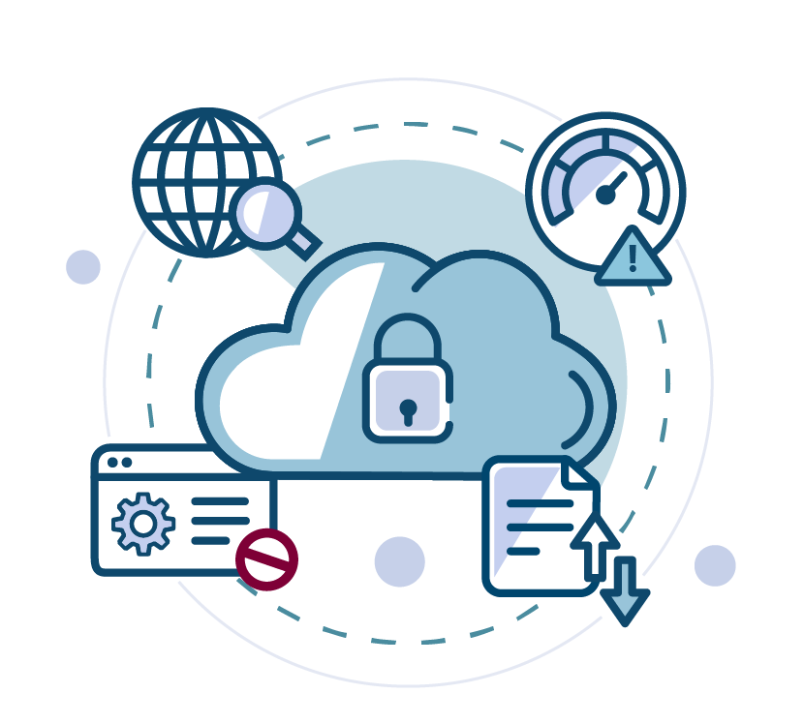
Highlights of
Cloud Protection

Slide 18
Highlights of Cloud Protection
Track cloud application usage: Monitor your organization's web traffic to analyze which websites were accessed, when, from where, and by whom
URL filtering: Prevent your employees from accessing unproductive, risky, or unnecessary cloud applications
Assess the threat of shadow IT: Spot employees who are putting your organization at risk with their use of shadow cloud applications
Audit file uploads: Monitor file uploads made to various storage applications, including Microsoft 365, Google Workspace, and DropBox

Slide 19
Highlights of Cloud Protection
Deploy Cloud DLP policies: Granularly block risky file uploads based on domains, URLs, application suites, and other parameters.
Assess domain reputation scores: Use real-time data from integrated threat analytics to ensure that only business-critical applications are sanctioned for use.

Slide 20
How DataSecurity Plus stands out
One-stop solution: It is an integrated, all-in-one software for sensitive data visibility and security for data at rest, in use, and in motion.
Enhanced data protection: It includes a vast array of user activity monitoring and data loss prevention capabilities to protect your data from insider threats, ransomware, theft, exfiltration via endpoints, and more
Compliance reporting: It can generate comprehensive reports using predefined templates to demonstrate compliance with the GDPR, HIPAA, the PCI DSS, and more
Meet organizational needs: It offers an intuitive dashboard and quick deployment, and it is scalable and customizable

Slide 21
Licensing details
File Audit
Licensed based on the number of file servers. Users also get 1TB free File Analysis capabilities for every licensed server.
File Analysis
Licensed based on data size in Terabytes.
Data Risk Assessment
Licensed based on data size in Terabytes.

Slide 22
Licensing details
Data Leak Prevention
Licensed based on the number of endpoints.
Cloud Protection
Free add-on of the Data Leak Prevention module.

Slide 23

Supported environments
File Audit
Windows file servers, failover clusters, workgroups, and NetApp CIFS servers
File Analysis
Windows file servers, failover clusters, and workgroups
Data Risk Assessment
SMB-based shares and Microsoft SQL servers

Slide 24
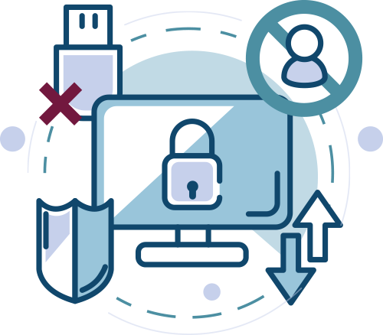
Supported environments
Data Leak Prevention
Endpoints: Windows client OS
Application: Outlook
Browsers: Chrome, Firefox, and Microsoft Edge
Removable storage auditing and blocking: USBs
Virtual desktops: Citrix and VMware (provided the OS installed is Windows 7 or above)
Distributed machines: Laptops and desktops
Others: Internal drives, printers, clipboards, network shares, Wi-Fi, and Bluetooth adapters

Slide 25

Supported environments
Cloud Protection
Cloud applications: Box, Dropbox, Microsoft 365 (OneDrive, Sharepoint, and Exchange Online), and more
Network protocols: HTTP and HTTPS
Browsers: Chrome, Firefox, and Microsoft Edge

Slide 26
How we aid your evaluation
A fully functional 30-day, free trial
Extension of evaluation license, if needed
24x5 technical support
An online demo hosted at demo.datasecurityplus.com
An extensive knowledge base

Slide 27

Our customers
"DataSecurity Plus provides insight into the types of data being stored on our servers so we can better protect it"
Rosemarie Deronne,
Systems engineer, Eastern Virginia Medical School
"DataSecurity Plus is a high-valued solution that ensures file system integrity and data loss prevention, and it helps us comply with regulatory standards"
Phurich Leemakanot,
Mubadala Petroleum

Slide 28





Contact us
Telephone:
+1.925.924.9500
Live chat:
For instant responses
Email the support team:
support@datasecurityplus.com
Visit our website:
www.datasecurityplus.com
Email the support team:
ZOHO Corporation,
4141 Hacienda Drive,
Pleasanton, CA 94588, USA
Download now

