Slide 1



Boost your organization's security and centralize management
with Identity360
A cloud-native identity platform for workforce IAM

Slide 2


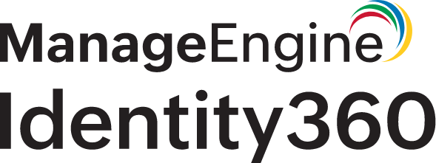
Outline
Identity360's vision
Critical IAM challenges for enterprises
Identity360 solutions
Universal Directory
Integrations
Life cycle management
Single sign-on (SSO)
Multi-factor authentication (MFA)
Access management
Delegation
Reports and identity analytics
Identity360 architecture
Identity360 licensing

Slide 3

Identity360's vision
Unify identity silos, streamline identity management, and secure resources with centralized access management

Slide 4



Critical IAM challenges for enterprises
Identity
fragmentation
Complex identity life cycle management
Increased
IT costs
Enterprises often struggle with managing multiple user identities across various platforms, leading to inefficiencies and security risks
Managing the entire identity life cycle, from onboarding to offboarding, can be challenging and error-prone for enterprises.
The lack of scalability and flexibility in managing access requirements can result in higher infrastructure costs as organizations struggle to adapt to changing business needs

Slide 5







Universal Directory
Life cycle management
Single sign-on (SSO)
Identity360
solutions
Multi-factor authentication (MFA)
Access management
Delegation
Reports and identity analytics

Slide 6
Consolidate identity silos into a single source of truth and enable centralized identity management with our cloud directory
Identity360 solutions
Universal Directory

Slide 7
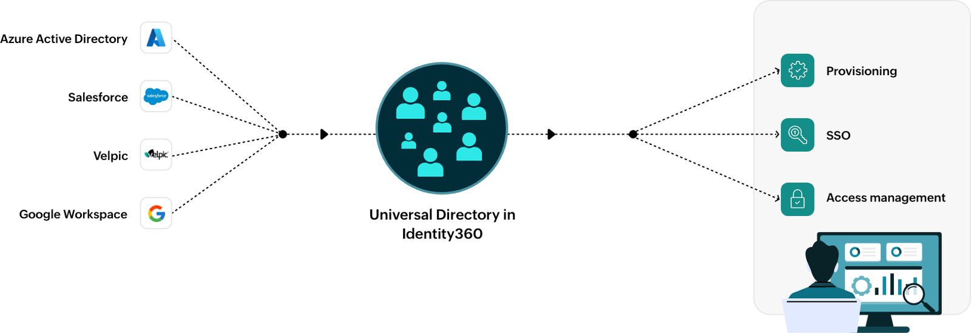
Identity360 solutions
www.manageengine.com/identity-360
How does Universal Directory work?

Slide 8



Unified solution
Leverage Universal Directory to consolidate identities from multiple platforms
Unlock efficient directory services with Universal Directory
Cost saving
Centralize identity management and streamline access control to achieve significant cost savings by reducing manual processes and errors
Efficiency gains
Effortlessly gather precise information from all your integrated directories with preconfigured reports

Slide 9
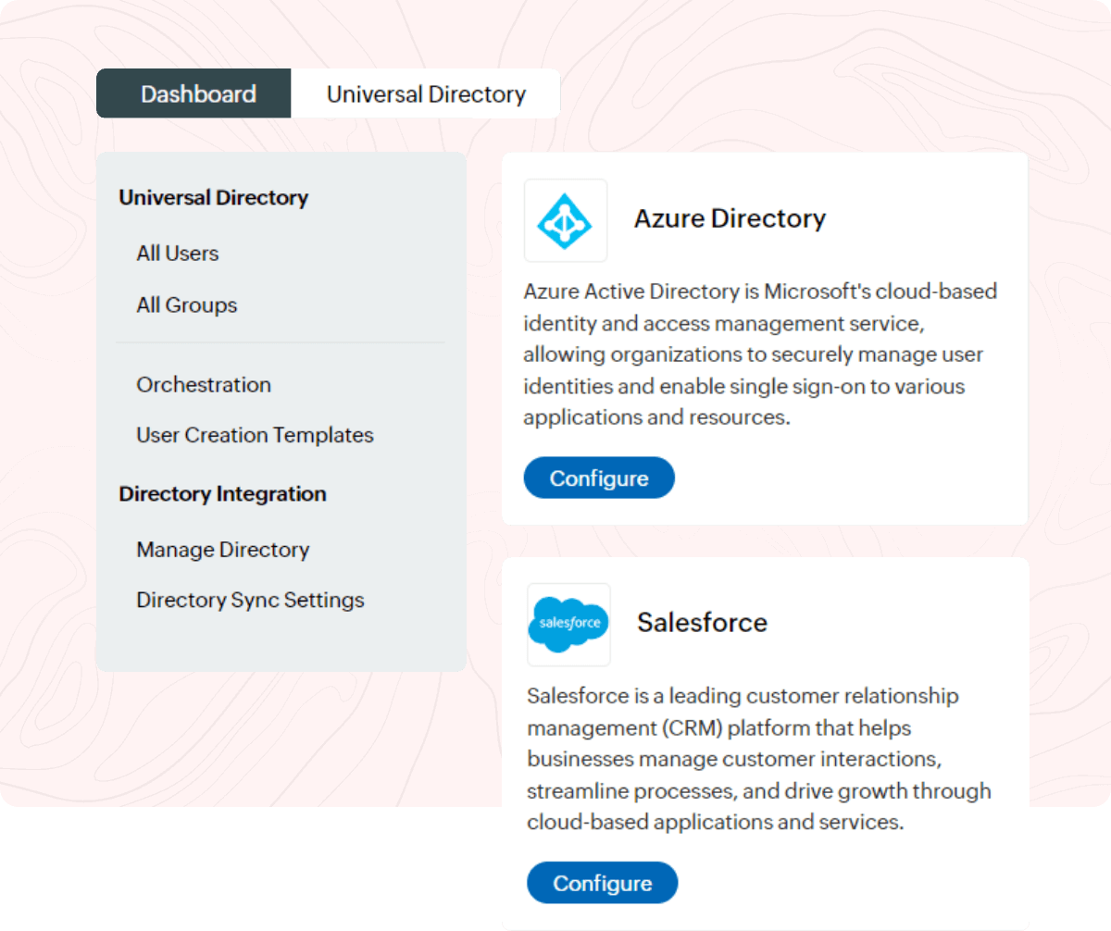
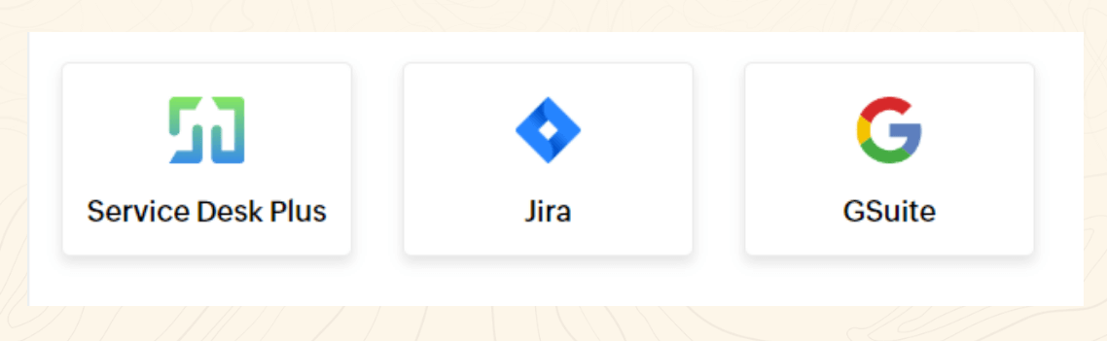
Identity360 solutions
www.manageengine.com/identity-360
Unify users from multiple directories and applications, providing a single point of access management
Integrate with our roster of applications including Slack, Zendesk, Google Workspace, Jira, Zoho People, and more

Slide 10

Universal Directory use case
Problem
Organization faces identity management challenges due to fragmented sources across directories and applications, causing operational inefficiencies.
Solution
Implement Universal Directory to centralize identity management and consolidate sources into a single, cloud-based directory. Gain a unified view of identities for streamlined access control.

Slide 11
Enhance workforce productivity by seamlessly managing the complete life cycle of digital identities
Identity360 solutions
Life cycle management

Slide 12
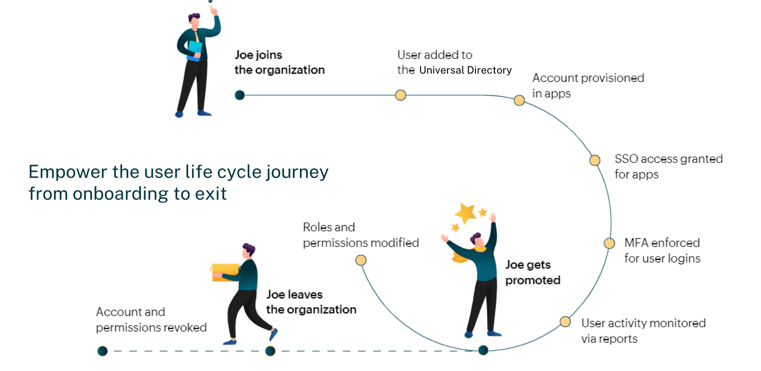
Identity life cycle management breakdown

Slide 13
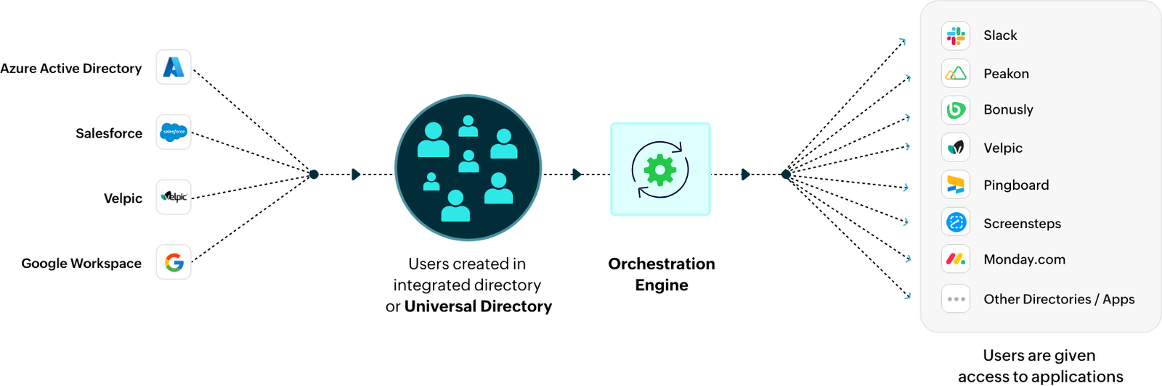
Orchestration
Streamline IAM processes with centralized cloud orchestration

Slide 14
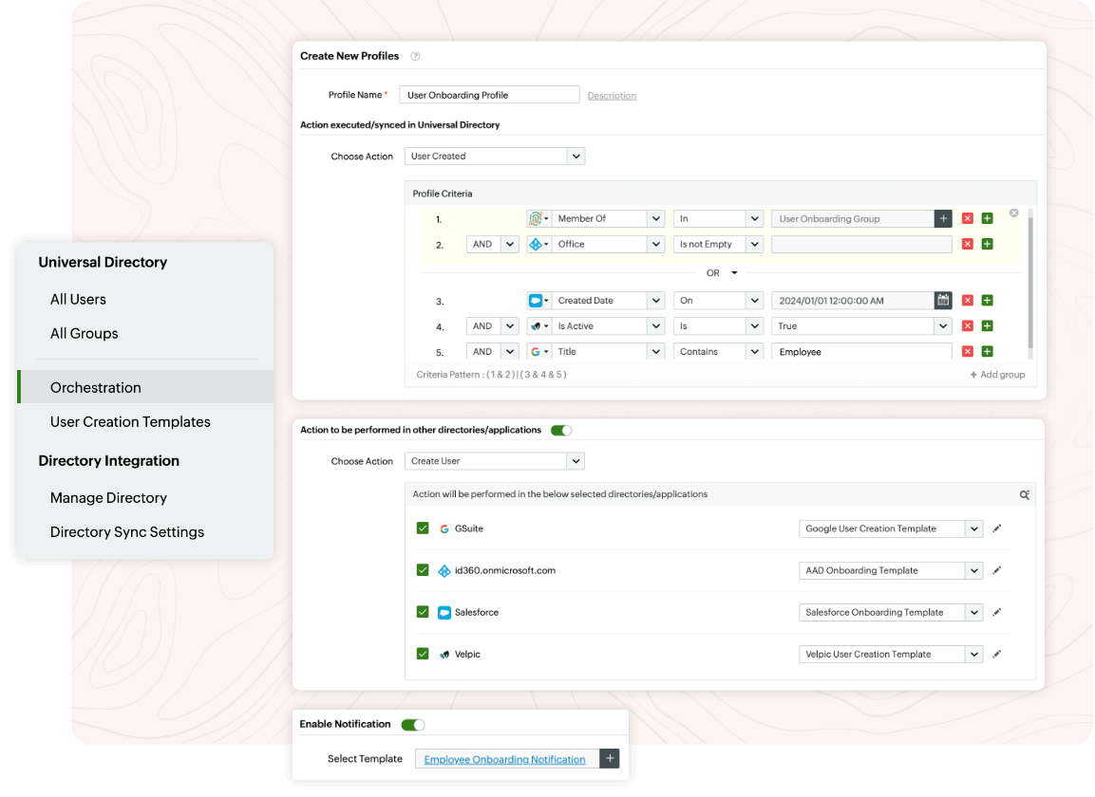
Add conditions based on which tasks should be executed
Orchestrate events across external applications from a single interface
Receive notifications when the orchestration occurs

Slide 15
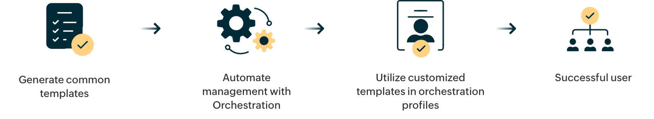
Smart templates
Speed up your onboarding process with smart templates

Slide 16
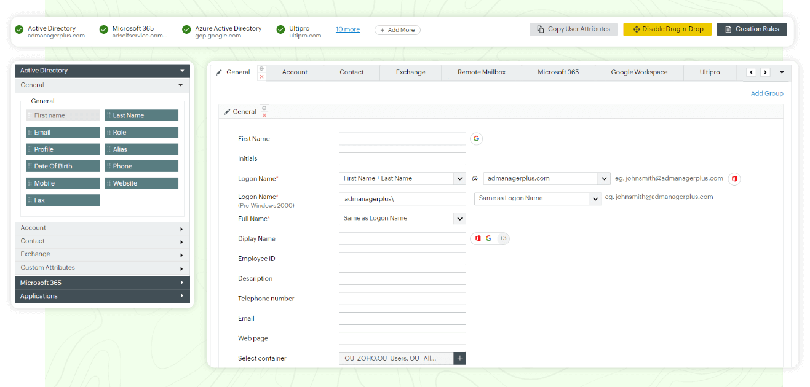
Set up rules that assign values to fields when they match a specified criteria
Effortlessly craft customizable templates tailored to various departments using the drag-and-drop interface

Slide 17



Operational efficiency
Automate the entire identity life cycle process by streamlining administrative tasks, thereby reducing the burden on IT administrators, minimizing the risk of errors, and improving overall operational efficiency
Reap the benefits
of managing your identities throughout their entire life
cycle with life cycle management
Reduced risk of errors
Reduce the likelihood of manual errors that can occur during user onboarding, offboarding, and role changes, ensuring data accuracy and consistency across all integrated platforms.
Customizable templates
Utilize predefined templates with intuitive creation rules for quick and easy user onboarding

Slide 18

Life cycle management use case
Problem
An organization is managing the identity life cycle for a diverse workforce. Traditional processes don't keep up with employee turnover and profile changes. These challenges result in time-consuming, error-prone onboarding and offboarding, leading to security gaps and compliance concerns
Solution
Implementing identity life cycle management enhances agility and security, ensuring regulatory compliance and aligning employee engagements with legal standards. This fosters sustainable growth in today's dynamic business landscape

Slide 19
Streamline access to enterprise resources with secure SSO
Identity360 solutions
Single sign-on (SSO)

Slide 20
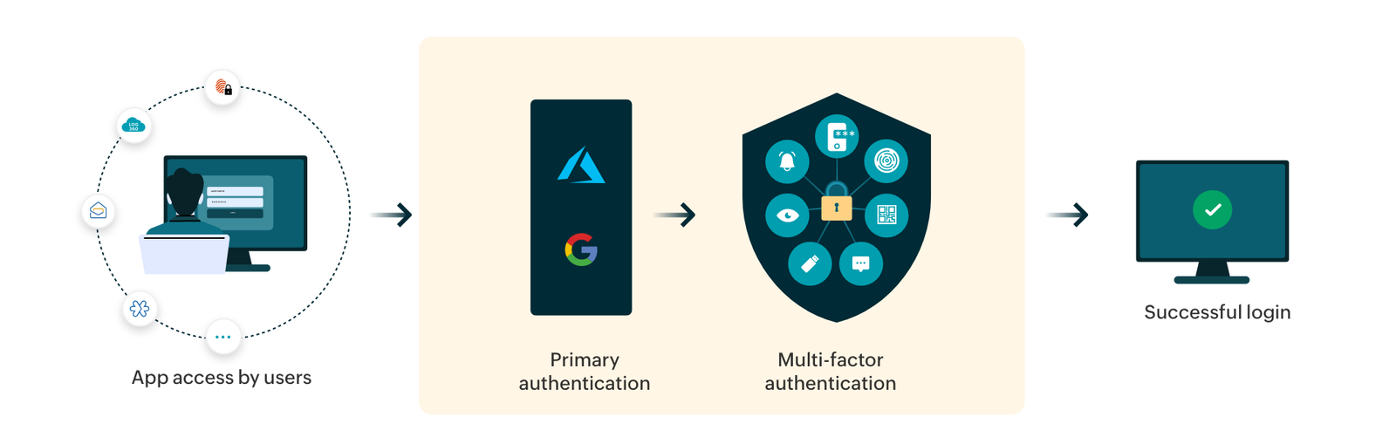
Identity360 solutions
www.manageengine.com/identity-360
How does SSO work?

Slide 21


Increase employee productivity
Provide one-click access to enterprise apps and reduce password fatigue by eliminating traditional passwords and time-consuming login processes.
Elevate user experience with secure passwordless login and seamless SSO
Broad spectrum of supported apps
Enable SSO to over 450 pre-integrated enterprise applications, or any custom application that supports federation standards, in a few steps
Secure user access
Mitigate security threats by empowering IT teams to promptly disable access to accounts in the event of theft or unauthorized access

Slide 22
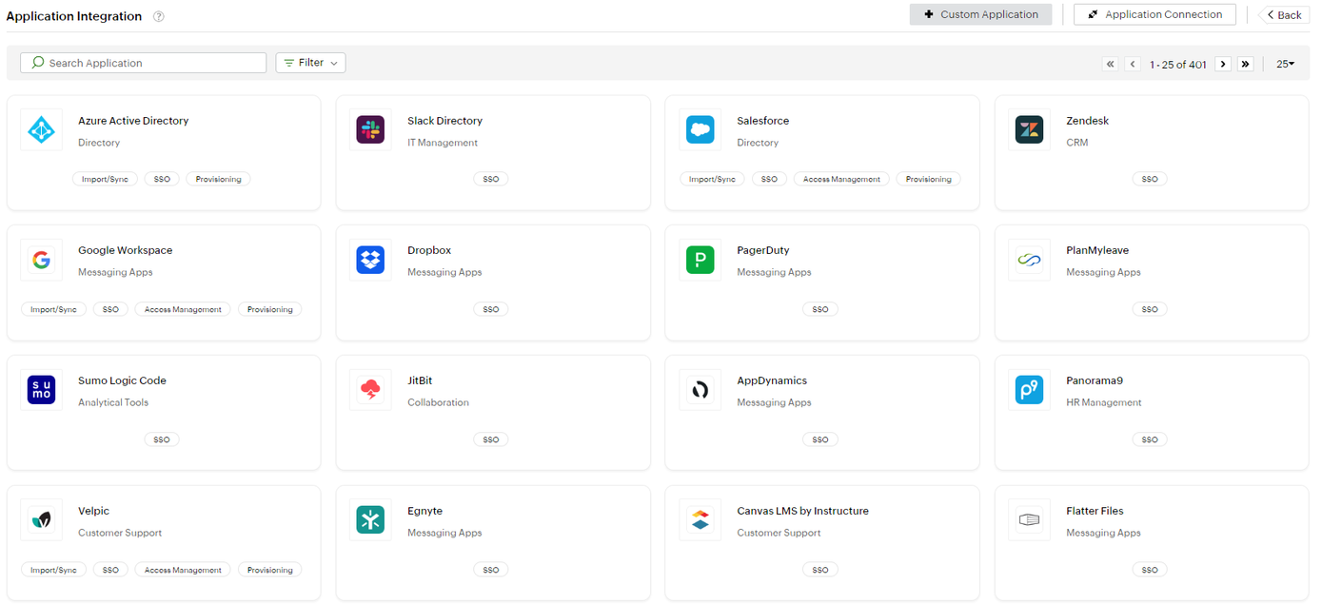
Identity360 solutions
www.manageengine.com/identity-360
SSO can be enabled easily for
a myriad of pre-integrated applications
Easily integrate your own custom applications for end-user SSO

Slide 23
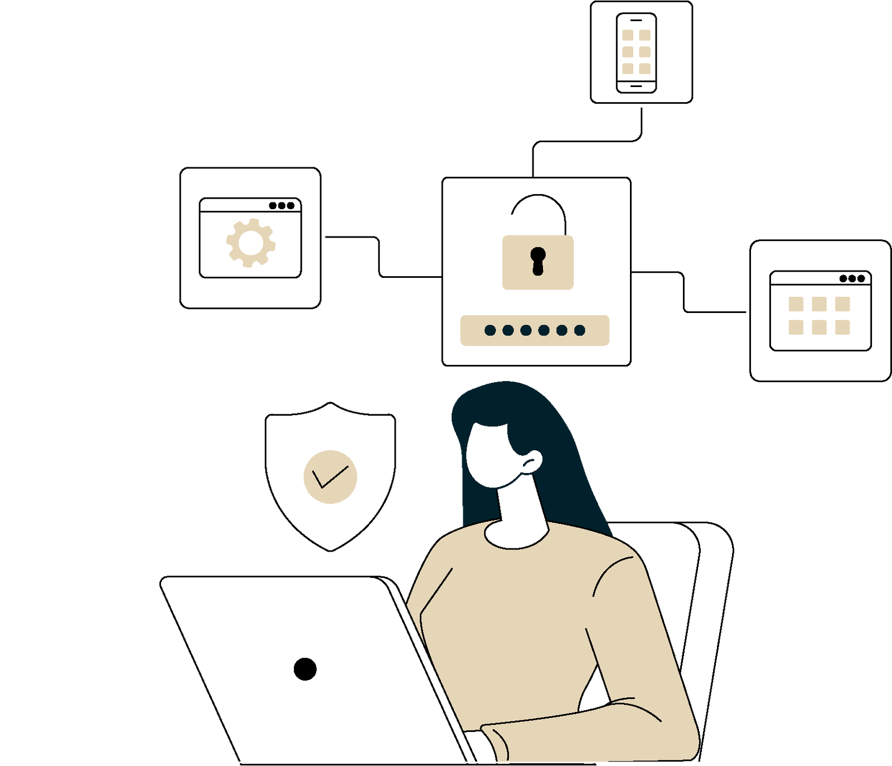
SSO use case
Problem
A large enterprise faces challenges managing access to numerous applications. Employees waste time navigating multiple login screens, causing inefficiencies and frustration
Solution
Implementing SSO improves efficiency, granting employees one-click entry to multiple enterprise apps, cutting login friction, and enhancing productivity

Slide 24
Secures access to enterprise applications with MFA
Identity360 solutions
Multi-factor authentication

Slide 25
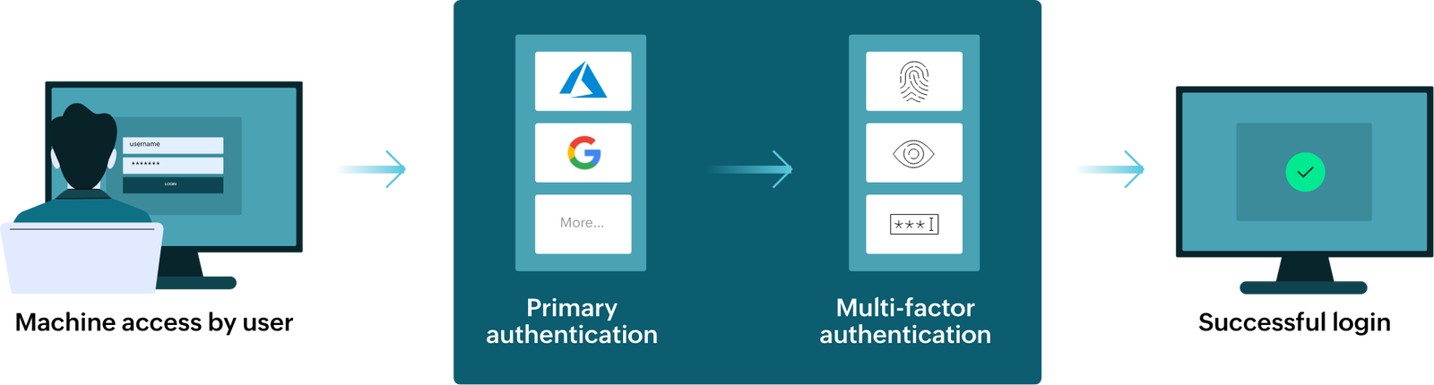
Identity360 solutions
www.manageengine.com/identity-360
How MFA works
App access by user

Slide 26
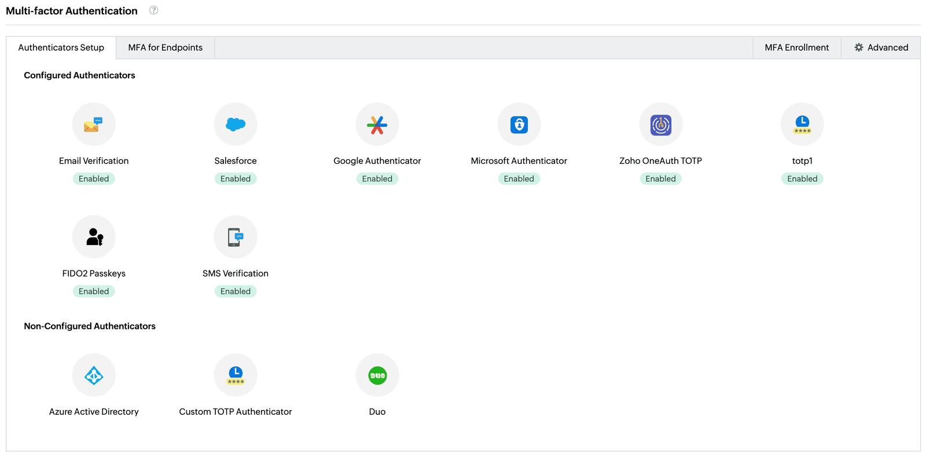
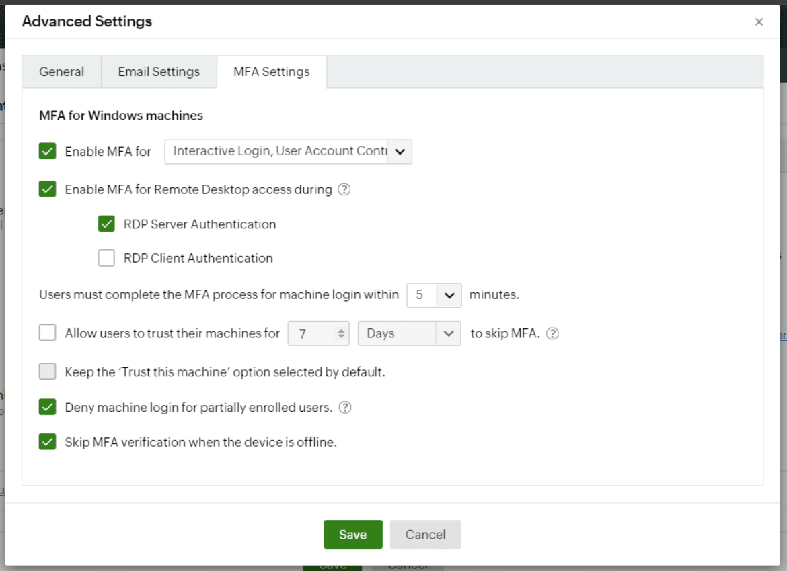
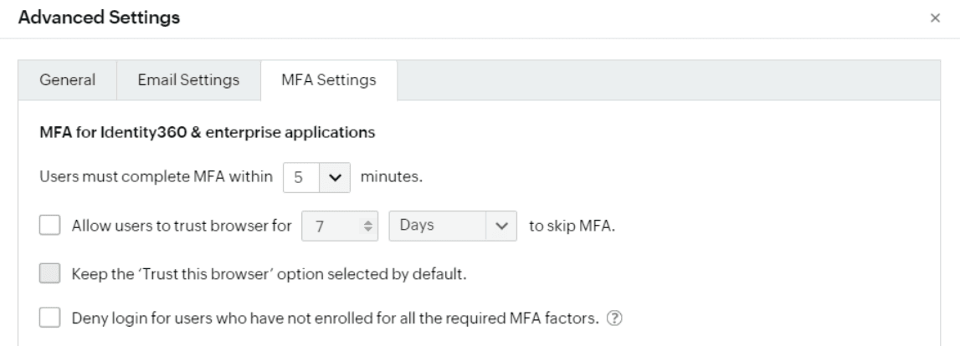
Customize MFA for your organization with fine-grained controls
Choose from a variety of MFA authenticators to verify users' identities

Slide 27


Compatible with multiple directories
Choose your preferred directory for primary authentication—like Azure AD, Google, and Salesforce—which your users may already be a part of
Secure identities
with multi-factor authentication
An interactive, user-friendly UI
Makes MFA configuration and enrollment easy for admins and end users respectively, with a simple and easy-to-understand UI
Security against cyberthreats
Defend against various credential-based attacks, including those targeting UAC, Windows login, RDP, VPN and RADIUS-supporting endpoints while ensuring seamless application access to employees

Slide 28
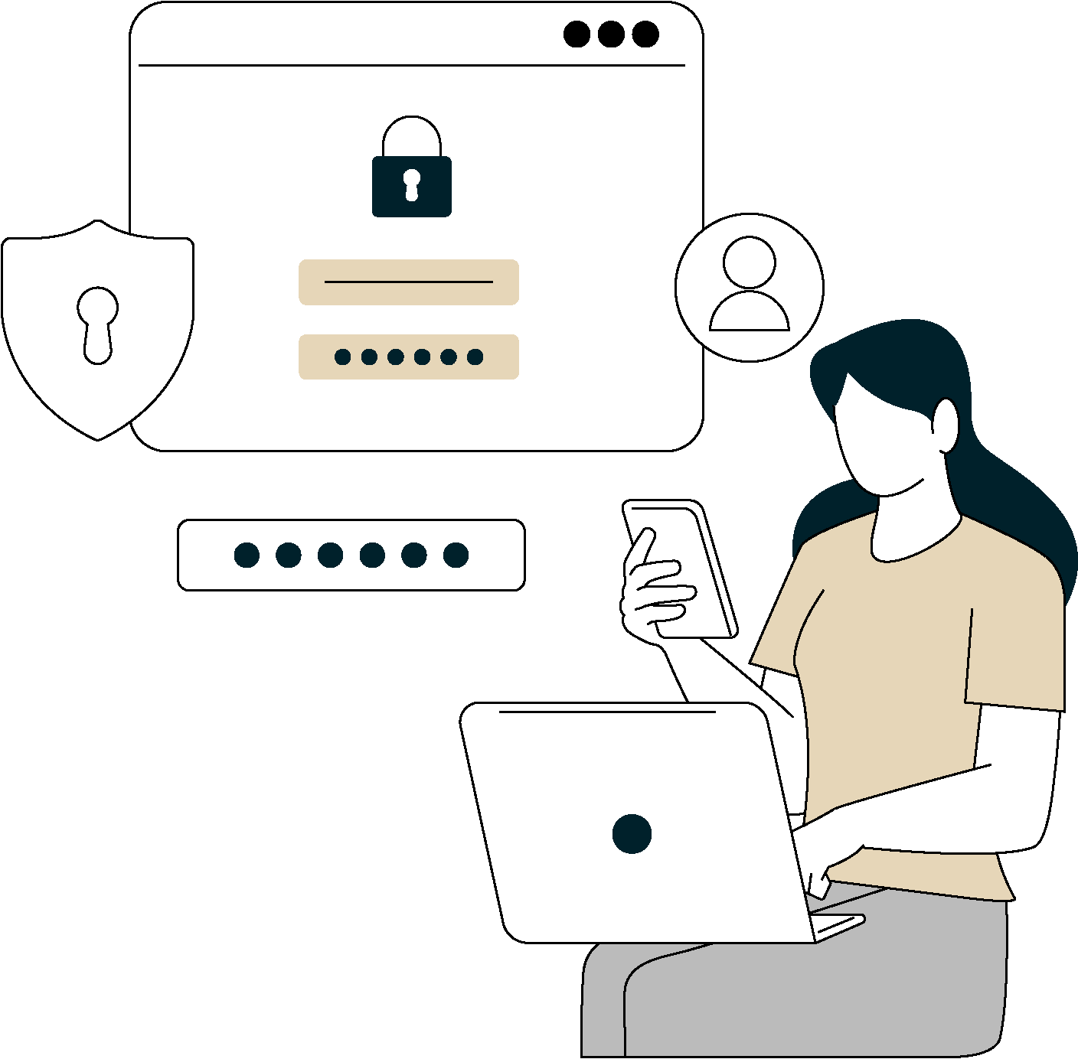
MFA use case
Problem
A corporation in diverse sectors faces growing cybersecurity threats to sensitive data. Traditional password-based authentication methods used for Windows login are vulnerable to phishing and breaches, posing significant security risks
Solution
Implementing MFA for Windows login strengthens the organization's security by enhancing security during logins to Windows machines, RDP sessions, and UAC prompts. This multi-layered authentication adds robust protection against unauthorized access

Slide 29
Secure and ensure that the right users have the right access consistently across resources
Identity360 solutions
Access management

Slide 30
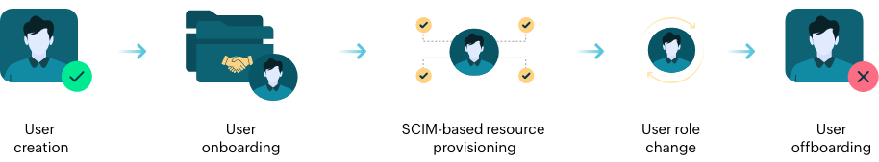
Identity360 solutions
www.manageengine.com/identity-360
How does access management work?

Slide 31

Improved compliance
Ensure compliance with regulatory requirements and industry standards related to data protection and privacy
Cross-platform access management capabilities
Enhanced user experience
Users experience seamless and convenient access to the resources they need, leading to higher satisfaction and improved user experience
Security against cyberthreats
Safeguard against unauthorized access attempts and mitigate the risk of various cyberthreats, while also providing easy application access to employees

Slide 32
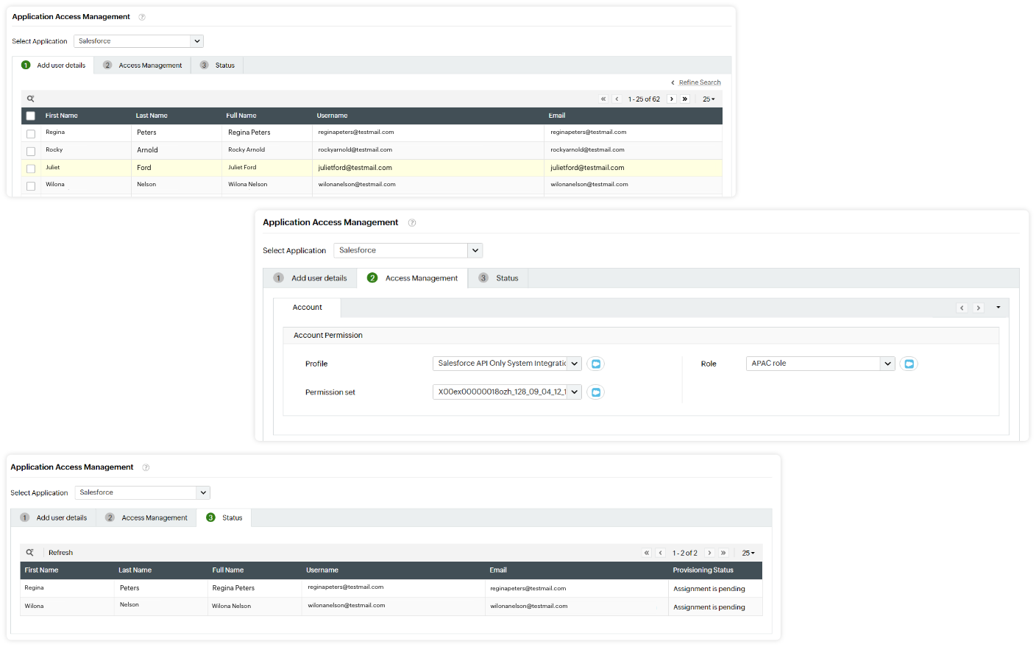
Within each app, you can fine-tune users' access rights by assigning them relevant roles and permissions in bulk
Provides enhanced tracking capabilities for admins using consolidated tables showing users' access assignment statuses for each application

Slide 33
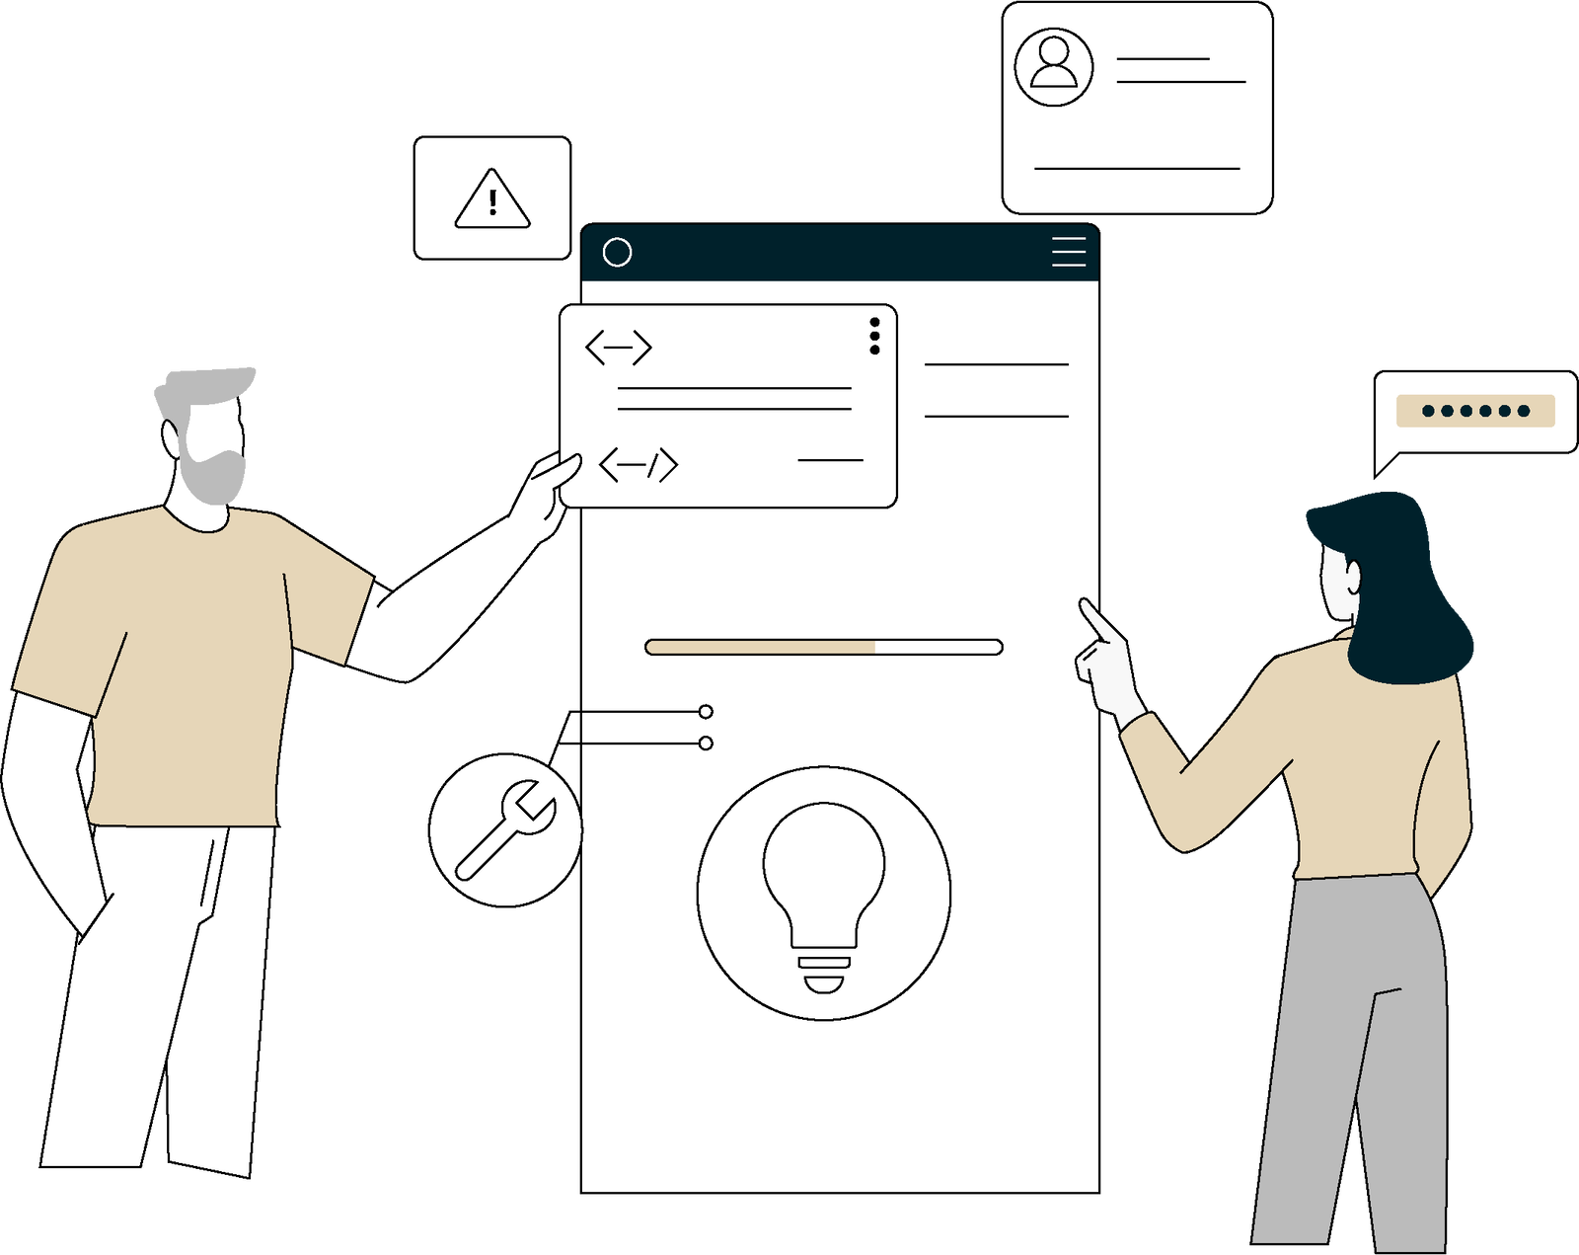
Access management use case
Problem
An organization handles extensive customer data, including personal information and payment details. With rising cyberthreats, securing access to this sensitive data is vital to preserving customer privacy and trust in the brand
Solution
Implementing access management provides robust control over data access while adhering to regulatory requirements such as the GDPR and the PCI DSS. This is achieved through tailored access controls that align with the organization's structure and operational needs

Slide 34
Entrust routine tasks to non-admin users without altering their inherit permissions, allowing admins to focus on critical tasks
Identity360 solutions
Delegation

Slide 35
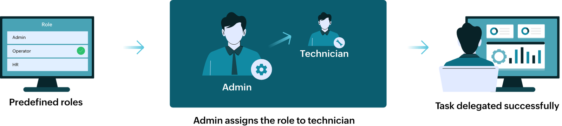
Identity360 solutions
www.manageengine.com/identity-360
How does help desk delegation work?
Predefined and custom roles

Slide 36

Reduced workload
Decrease the workload for IT admins by delegating management tasks to technicians, mitigating burnout and boosting job satisfaction
Adopt delegation to transform your IT support environment
Improved responsiveness
Enable quicker response times to user inquiries and technical issues by assigning specific tasks to designated team members
Scalability and flexibility
Adapt to changing workload demands and scale operations as needed, ensuring continued efficiency and effectiveness in providing support services

Slide 37
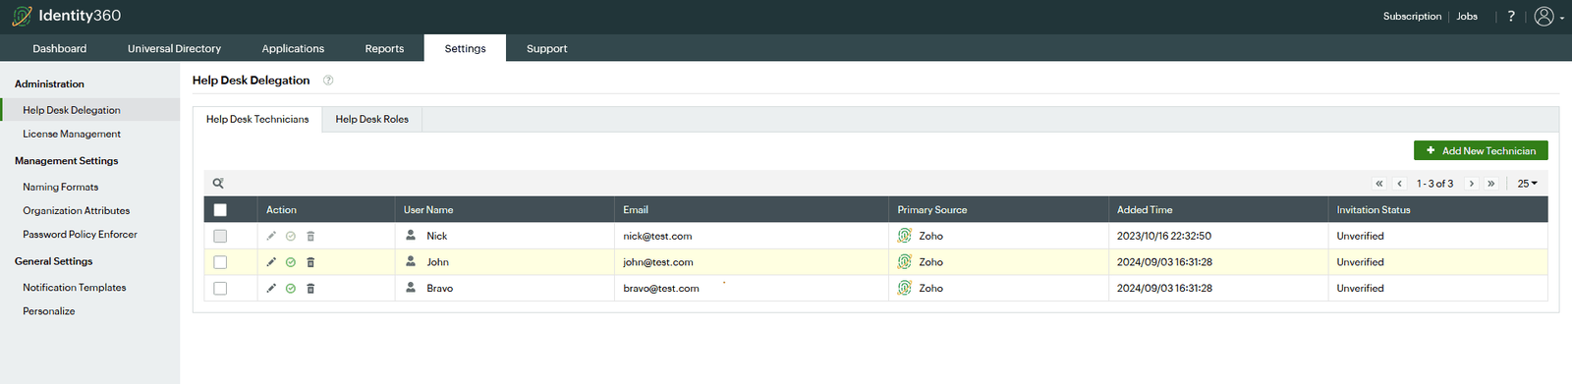
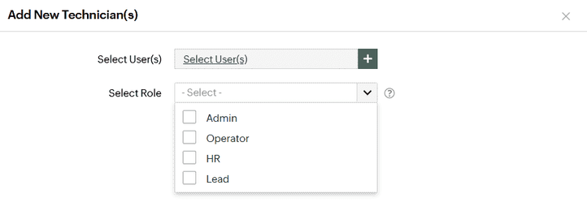
Enable or disable technicians and modify the delegated roles from the central console
Choose predefined technician roles like the Admin or Operator, or create custom roles to be assigned to non-admin users

Slide 38
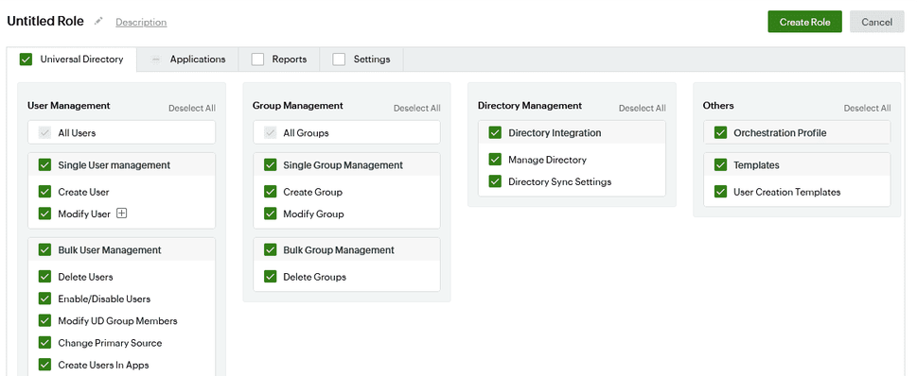
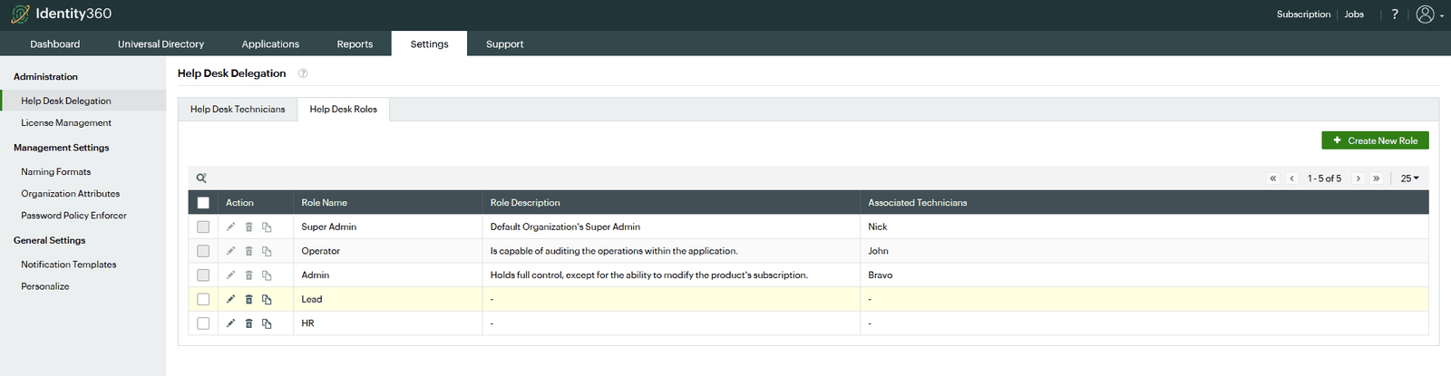
Create custom technician roles to suit your organization's needs and manage the permissions required to carry out specific tasks

Slide 39

Help desk delegation use case
Problem
A large corporation heavily relies on its IT support team for user inquiries, technical issues, and service requests. However, a surge in support tickets and limited resources strain the IT department's efficiency and responsiveness
Solution
Implementing a help desk delegation system streamlines operations and boosts service delivery. Technicians are assigned specific tasks, with access easily managed and revocable ensuring efficient handling for timely issue resolution

Slide 40
Gain insights into application access, user activities, account status, and more to make informed decisions
Identity360 solutions
Reports and identity analytics

Slide 41
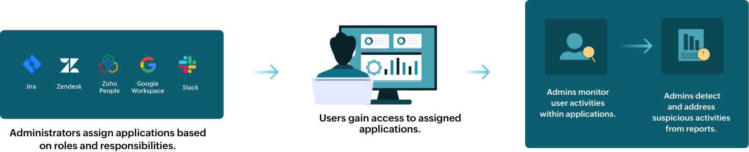
Identity360 solutions
www.manageengine.com/identity-360
How do reports and identity analytics work?
Administrators assign specific applications to user based on their roles and responsibilities within the organization

Slide 42



Enhanced visibility
Gain enhanced visibility into user activities and behaviors through comprehensive reports
Unlock superior access insights to boost your organization's
security and efficiency
Informed decisions
Enable admins to make informed decisions based on real-time data and user interactions
Prebuilt reports
Access prebuilt reports to help admins identify security risks and understand end-user application and service consumption patterns

Slide 43
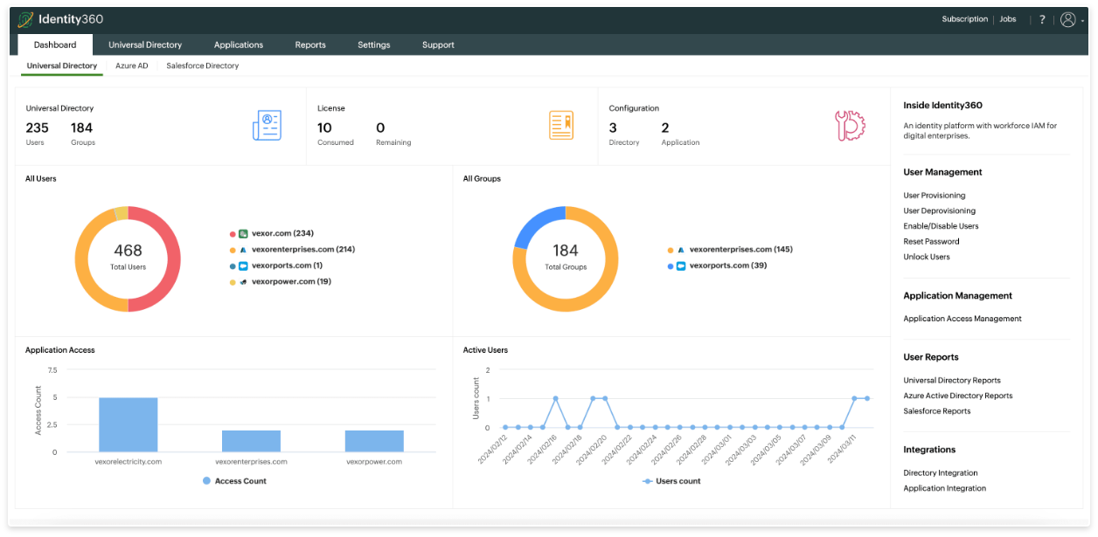
Gain insights into various aspects, such as user activities and access patterns, from a single console of various directories and applications

Slide 44
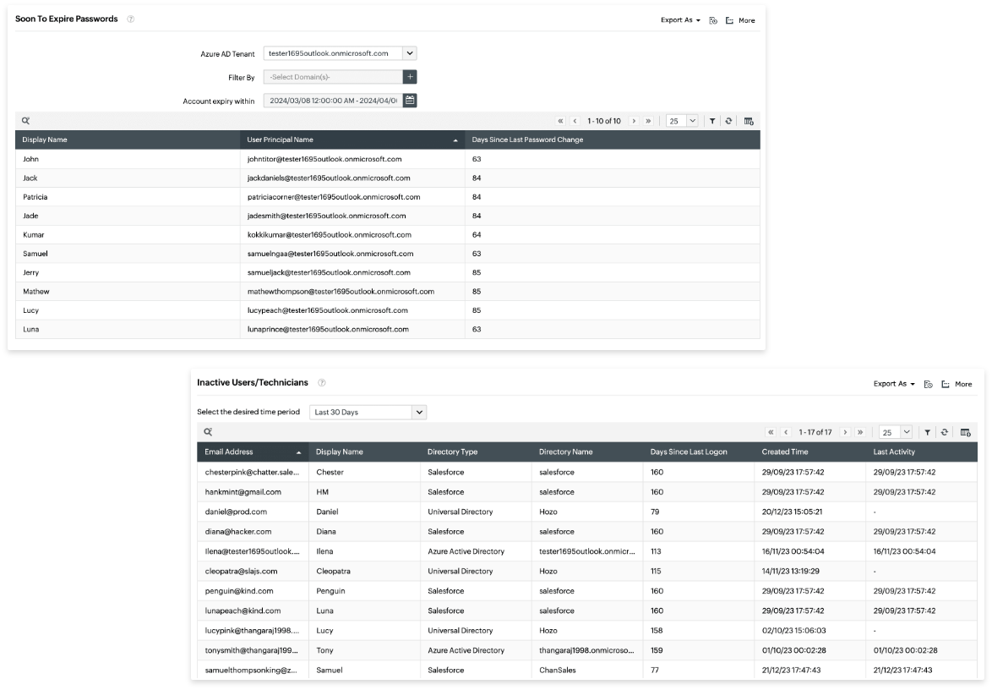
Explore various export options for your reports to further analyze identity data and gain insights
Explore built-in reports that offer insights into user-related data across various directories like Universal Directory, Azure AD, and Salesforce

Slide 45

Reports and identity
analytics use case
Problem
In an organization with a diverse workforce and extensive system access, ensuring security and compliance is paramount. With rising cybersecurity threats and regulatory standards like the GDPR and SOC 2, the challenge lies in effectively monitoring and managing user identities and access
Solution
Identity360 enables the organization to extract actionable insights from user access patterns and behavior, swiftly identifying anomalies, unauthorized access, and compliance issues

Slide 46
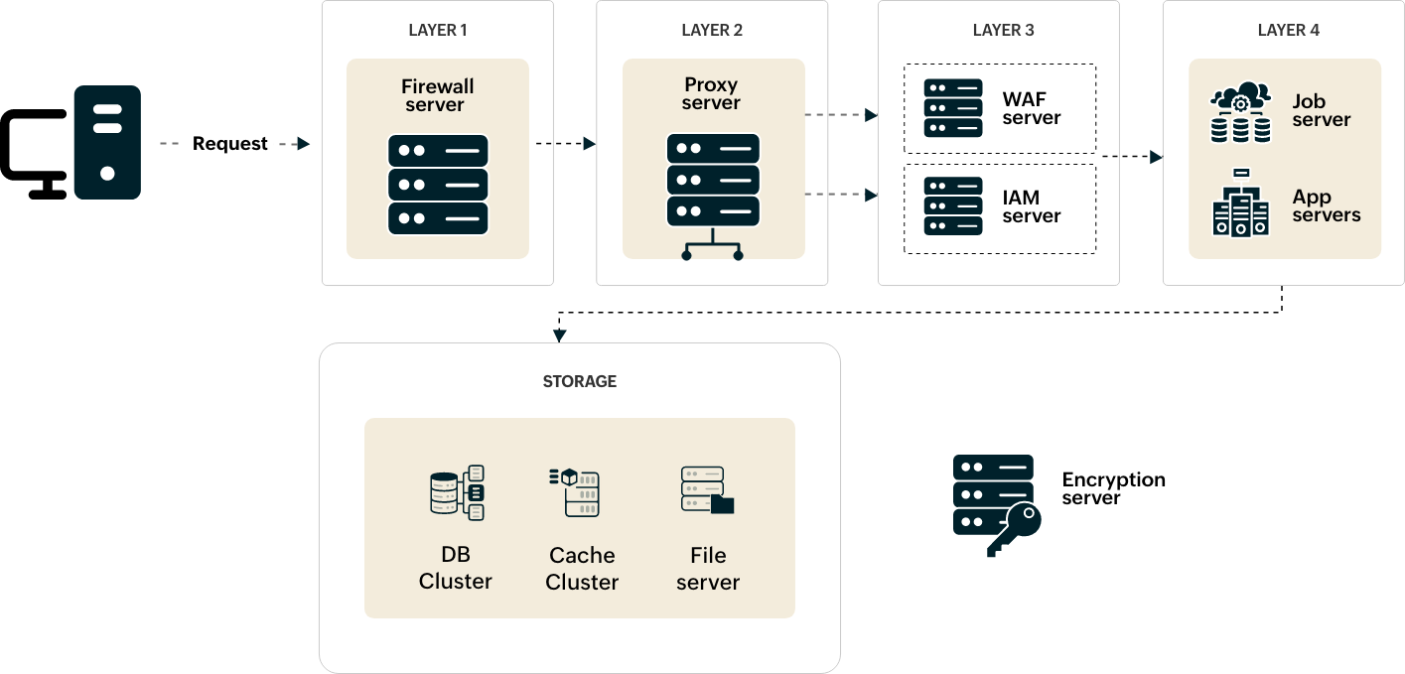

Slide 47
ISO/IEC 27001
ISO/IEC 27701
ISO/IEC 27017
ISO/IEC 27018
SOC 2 Type II
Cyber Essentials
ESQUEMA NACIONAL DE SEGURIDAD (ENS) - Spain
CSA STAR Self-Assessment
GDPR
CCPA
Signal spam
Security and compliance
Identity360 showcases its dedication to maintaining a secure and compliant environment by adhering to various industry-standard certifications:

Slide 48
Identity360 licensing
All inclusive (life cycle management with
MFA and SSO)
Life cycle
management
MFA and SSO
Starts at $295 per
100 users,
per year
Starts at $195 per
100 users,
per year
Starts at $415 per
100 users,
per year

Slide 49

Thank you!
www.manageengine.com/identity-360
identity360-support@manageengine.com
START FREE TRIAL

