Slide 1

IT Management, Simplified
Real-time IT management solutions for the new speed of business

Slide 2
Envisioning the service desk as
the control center of IT
Generating insightful reports and dashboards

Slide 3






Functions of a centralized IT service desk
Device
management
IT operations
management
IT security
IT service
management
Active Directory management
IT analytics
The problem: They all work in silos
Notes:
2 way representation-with out details

Slide 4
The implications
No proper streamlined IT service desk processes, and reduced productivity.
Lack of control and visibility over the IT environment.
Inability to gain insights from the help desk data to support decisions.
Notes:
2 way representation-with out details

Slide 5
How centralized IT service desks should work
IT analytics
Active Directory management
IT security
IT service
management
Device
management
IT operations
management
Notes:
2 way representation-with out details

Slide 6
Story time
The tale of Zylker and its IT team.

Slide 7





Say hello to Zylker
Business users
IT folks
MARCUS
CIO
WENDY
HR
CATRIN
IT SERVICE DESK MANAGER
DAVE
HIRING MANAGER
JOHN
END USER
JASON
IT TECHNICIAN
SCOTT
IT TECHNICIAN
ADAM
IT TECHNICIAN

Slide 8
Zylker IT needs more hands.
IT challenge: Establishing the value of IT to the top level management through insightful reports.

Slide 9






We need help!
More assets, more users, and more tickets. Everything is MORE! So yes, we need more hands. . .
JASON
SCOTT
ADAM

Slide 10


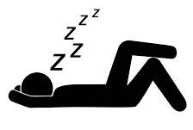
Meanwhile, it's the weekend
JASON
SCOTT
ADAM

Slide 11

The classic Dilbert request. . .
Hey Marcus,
we need more people.
What’s that gibberish?!
More people for what? Don't tell me you are all overworked.

Slide 12
. . .that evokes the classic response
Well, we already are! My technicians are working weekends to clear the backlog.
Get me information. What’s the ticket load your team is handling, the backlog levels, end-user satisfaction levels? Then, we’ll talk!

Slide 13

And poor Catrin. . .
I need to do more with
less or come up with the reports. I'm joining you this weekend!

Slide 14
Business intelligence and advanced analytics
With
ServiceDesk Plus

Slide 15
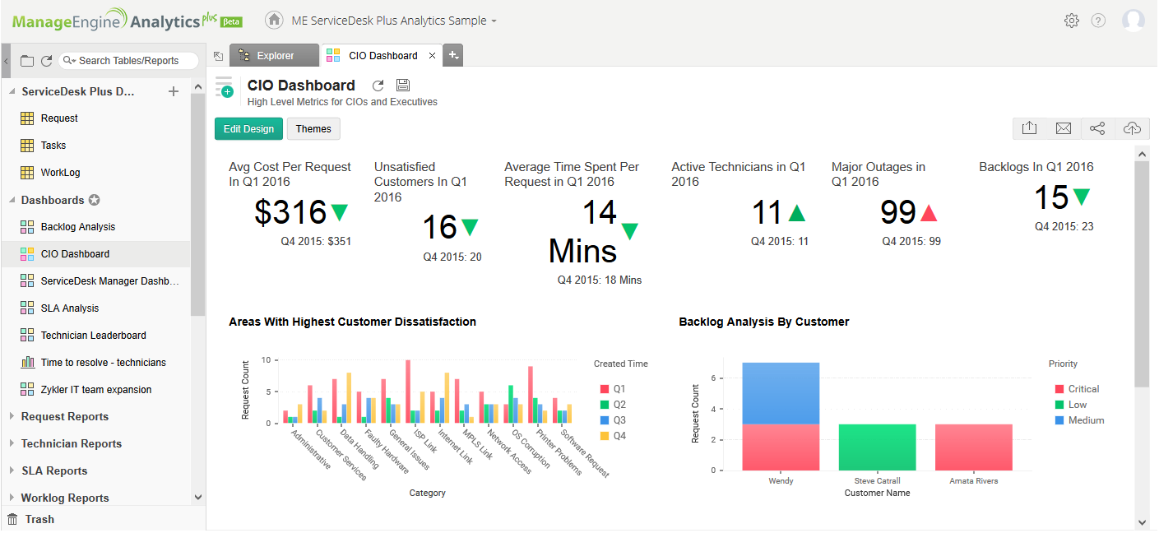
Catrin integrates ServiceDesk Plus with Analytics Plus, the advanced analytics and business intelligence software from ManageEngine.

Slide 16
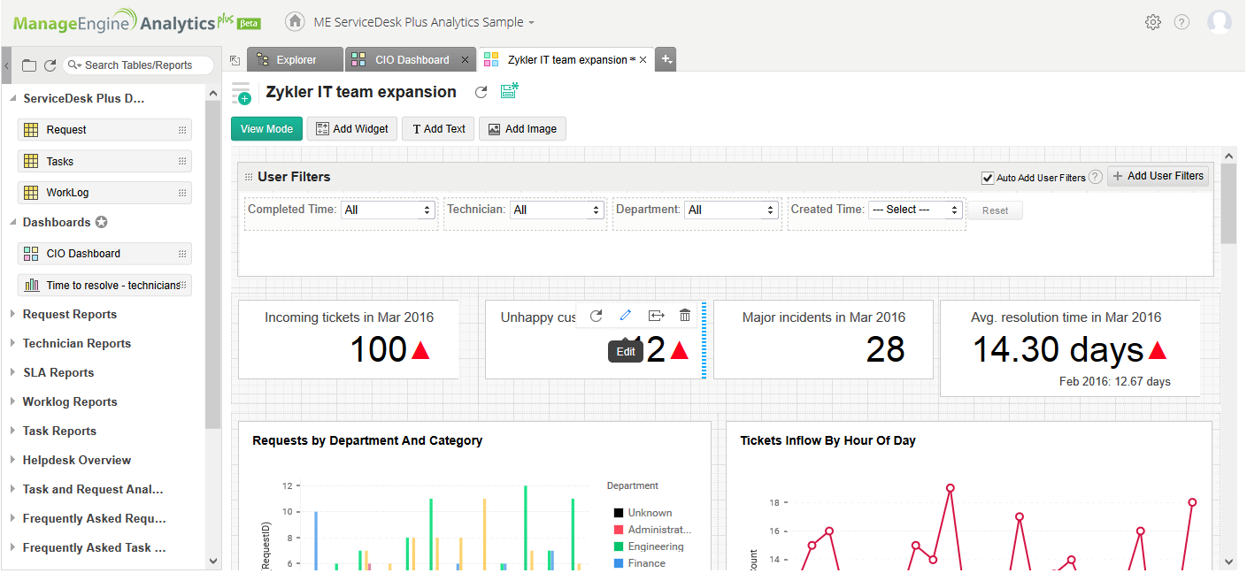
She generates and assembles all the right information on a custom dashboard over a drag-and-drop interface and shares it with the CIO within an hour.

Slide 17
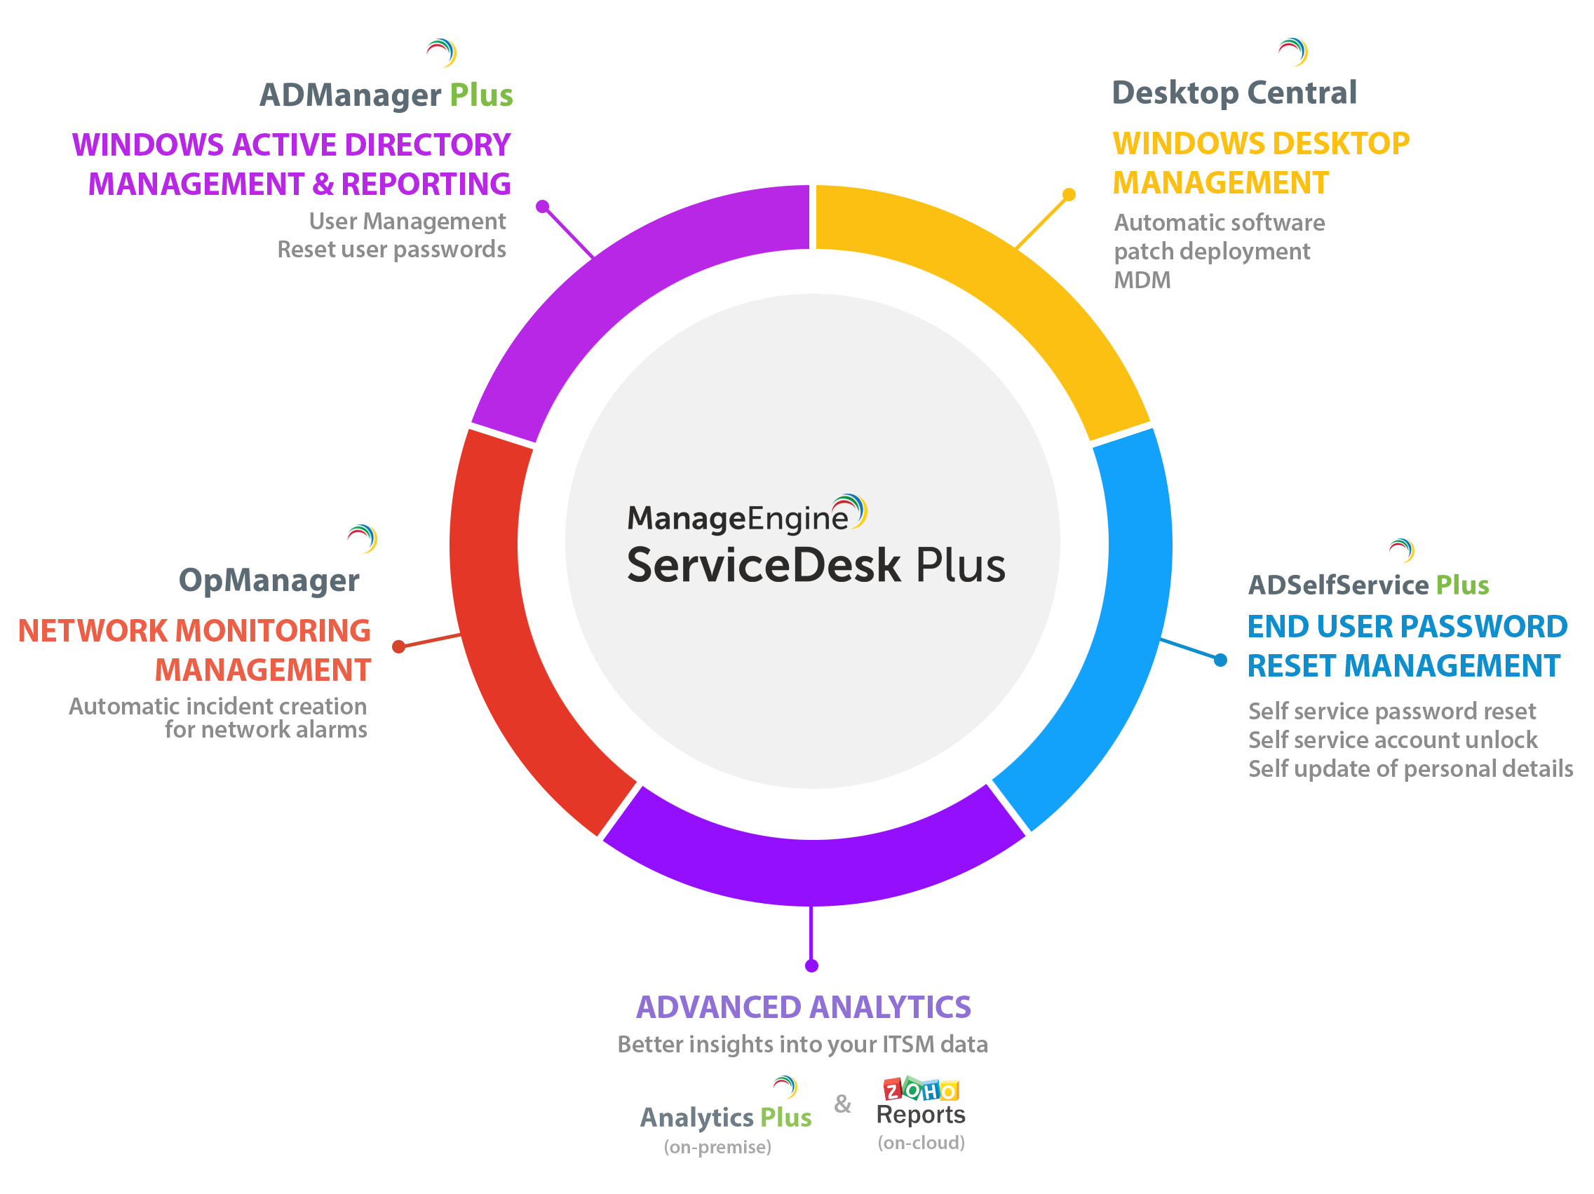
Building a
centralized
IT service desk
with
ServiceDesk Plus

Slide 18
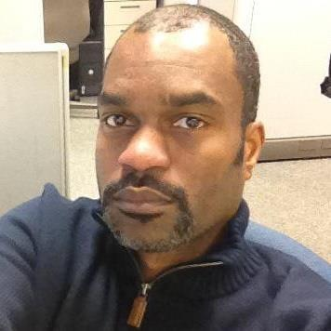

“ ”
ServiceDesk Plus has been a great decision both functionally and financially.
James Arnold service desk manager Manhattan Associates
Join the
100,000+
happy service desks worldwide
Sign up for a 30-day free trial now.

Slide 19

Thank you!
hello@servicedeskplus.com

